Slide 1
Introduction to Java
James Brucker

Slide 2
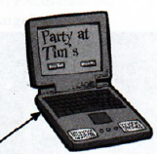
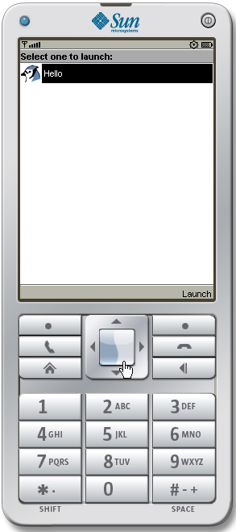

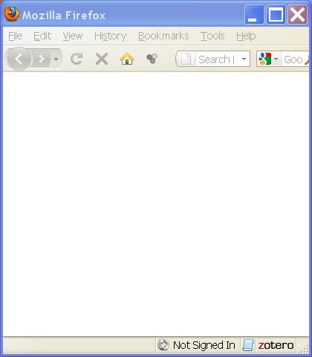
What is Java?
Java is a language for writing computer programs.
it runs on almost any "computer".
  desktop
  mobile phones
  game box
  web server
  embedded device

Slide 3
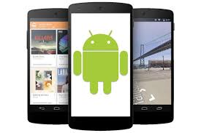
Why is popular?
Can create many kinds of software...
  mobile apps (Android)
  games
  desktop programs
  web apps & web services
Lots of info, tools, and software
Runs (almost) anywhere

Slide 4
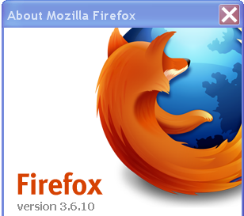

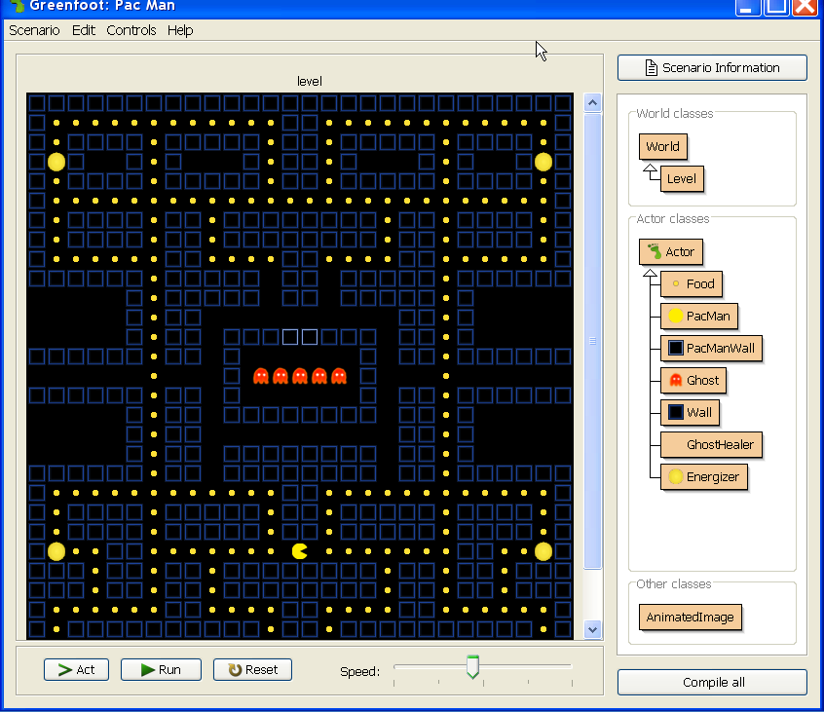
What Uses Java?
OpenOffice (like Microsoft Office)
Firefox
Google App Engine
Android
Minecraft
Greenfoot

Slide 5
How Java Works: Compiling
1. You (programmer) write source code in Java.
2. A compiler checks the code and translates it into "byte code" for a "virtual machine".
Java source code
Java
byte code
Hello.java
javac
Hello.class
compiler
public class Hello {
public static void main( String [ ] args ) {
System.out.println( "I LOVE programming" );
}
}
public Hello();
aload_0
invokespecial #1; //Method java/lang/Object."<init>":()V
return
main(java.lang.String[]);
getstatic #2; //Field ...

Slide 6
How Java Works: Run the Bytecode
3. Run the byte code on a Java Virtual Machine (JVM).
4. The JVM interprets the byte code
and also loads other code from libraries (as needed).
Java byte code
java
I LOVE programming
Hello.class
java virtual machine
public Hello();
aload_0
invokespecial #1; //Method java/lang/Object."<init>":()V
return
main(java.lang.String[]);
getstatic #2; //Field ...
Other java classes, saved in libraries.

Slide 7
Summary: How Java Works
You (programmer) write source code in Java.
A Java compiler checks the code and translates it into "byte code".
A Java virtual machine (JVM)
runs the byte code.
Libraries
Hello, World!
Hello.java
javac
Hello.class
java
Java source program
compiler
byte code
Java VM
- runs your program
Program execution
Java Runtime Environment (JRE)

Slide 8
How to Write Source Code?
You can use any editor to write the Java code.
- or -
Integrated Development Environment (IDE) such as BlueJ, Eclipse, and Netbeans.
An IDE makes you much more productive, but they take some practice...

Slide 9
What you Need
1. install the Java Development Kit (JDK).
2. It is helpful to install the Java documentation.
3. Integrated Development Environment (IDE) or an editor
  an IDE makes programming much faster
  BlueJ, Eclipse, Netbeans, IntelliJ
There are several implementations of Java (like OpenJDK) but we will use Oracle's Java, from:
http://java.oracle.com

Slide 10
Important: BlueJ includes JDK
BlueJ v. 4 for Windows and Mac OSX includes Java JDK
So... if you use BlueJ you do not need to download JDK.
Linux: you do need to install JDK separately.
If you use Eclipse, NetBeans, or IntelliJ:
install JDK separately.

Slide 11
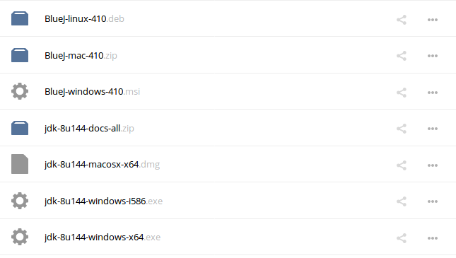
Download Files at KU
At KU, download everything from cloubbox:
https://goo.gl/Ct7nuU

Slide 12
Install Java Development Kit (JDK)
Download "Java SE Development Kit" (JDK) at...
http://java.oracle.com
Direct Link: http://www.oracle.com/technetwork/java/javase/downloads
Windows
1. double-click jdk-8u144-windows-x64.exe
2. Install in C:\java\jdk1.8.0_144
(not C:\Program Files)
Ubuntu Linux
1. download debian
2. Install in C:\java\jdk1.8.0_144
(not C:\Program Files)

Slide 13
BlueJ IDE
BlueJ is a simple IDE, but useful for learning Java.
https://bluej.org
Note:
BlueJ v.4 for Windows and Mac OSX includes Java JDK.
So... if you use BlueJ you do not need to download JDK.

Slide 14
Installation Notes
There are some suggestions at the end of these slides
You can also find videos on YouTube for help installing Java and writing your first program.

Slide 15
What Are We Going to Write?
First version: program will print
Hello, human.
Second version: program will ask for your name, save it as a String, and print a personal greeting. Example:
What is your name? Cat
Hello, Cat.
Third version: we will also get the current time and print it along with greeting like in second version.

Slide 16
Write this Program
1. Use a text editor (WordPad, EditPlus, not MS Word).
2. Save this code as Hello.java
Name of the class must be same as name of file
public class Hello {
public static void main( String [ ] args ) {
System.out.println( "Hello, human" );
}
}

Slide 17
Compile and Run the Program
3. Compile the program using "javac". This translates the source code into byte code.
4. Run it. "java" runs the virtual machine.
C:> javac Hello.java
C:> java Hello
Hello, human.

Slide 18
Errors?
javac: Command not found.
This means Java isn't on your PATH environment variable. Fix it. :-)
Hello.java:1 public Class Hello {
^class, interface, or enum expected
Message like this are syntax errors.
Check spelling. Java is case-sensitive.
For example, "main" is not "Main"
In the above error, the source contains "Class" instead of "class".

Slide 19
2nd Version: input
In this version we'll see how to read input and how to use a local variable to store the person's name.
The easiest way to read input in Java is with a Scanner object. A Scanner parses input into strings, numbers, etc
import tells the compiler where to find the Scanner class
import java.util.Scanner;
public class Hello {
public static void main(String [] args) {
Scanner console = new Scanner( System.in );
this declares a variable named "console" of type Scanner

Slide 20
What is System.in ?
System is a class. It provides access to resources of the operating system.
System.in is an input stream for reading from the console. But it only reads 1 byte at a time.
Scanner is a class. It reads an input and converts the input to numbers, Strings, and more.
// create a Scanner object (named console)
Scanner console = new Scanner( System.in );
// read one line of input and save as String
String who = console.nextLine( );

Slide 21
2nd Version: main method
Scanner has a method named nextLine( ). It reads the rest of the input line and converts it to a String.
System.out.print("string") does not print a newline after the output.
public static void main(String [] args) {
System.out.print("What is your name? ");
String who = console.nextLine( );
System.out.println("Hello, " + who );
}
}
+ joins two strings together.

Slide 22
Scanner
Scanner methods:
next( ) - read one "word" as a String from console
nextLine( ) - read entire line from console
nextInt( ) - read a number (int) from console

Slide 23
dot notation for object methods
To invoke an object's method, you write the object reference (variable) + "." + the method name:
"hello world".length( ) // length of string (11)
// read one line from console (Scanner object)
String s = console.nextLine( ) ;
// read an integer number from console
int n = console.nextInt( );

Slide 24
dot notation for object methods
console is the name of a variable (an object reference) that refers to a Scanner object.
To invoke an object's method, you write the object reference (variable) + "." + the method name:
String who = console.nextLine( );
nextLine method of console object

Slide 25
Compile and Run 2nd Version
Compile (javac) and run (java) the 2nd version:
C:> javac Hello.java
C:> java Hello
What is your name? Nerd
Hello, Nerd.

Slide 26
3nd Version: decisions
Most programs contain logic for decision making.
We'll write a program that greets and show the time.
The logic is:
get the current time
if time is before 12:00
print "Good Morning, " + user's name
else
print "Good Afternoon, " + user's name
print "It is now hh:mm:ss" (say the actual time)

Slide 27
Creating a Date Object
Java has a Date class located in java.util package.
Date has lots of methods. getHours( ) returns the hour.
To create a Date object with the current date and time, use:
Date now = new Date( );
To create an object from a class, write:
new ClassName( );
Some classes allow parameters when creating a new object, for example:
new Double( 0.5 ); // double with value 0.5

Slide 28
3rd version: using a method
import java.util.Date;
import java.util.Scanner;
/** Greeting with time of day. */
public class Hello {
private static Scanner console = ...;
public static void main( String[] args ) {
// ask user his name and call greet
System.out.print("What is your name? ");
String who = console.nextLine( );
greet( who );
}
}
we will add greet method here

Slide 29
greet method
This declares a method named greet that doesn't return anything (void) and has one parameter (name)
public static void greet( String name ) {
Date now = new Date( );
if ( now.getHours() < 12 )
Sytem.out.println("Good morning, "+name);
else
System.out.println("Good afternoon, "+name);
System.out.println("The time is "+now);
}

Slide 30
Compile and Run
Compile (javac) and run (java) the 3rd Hello program.

Slide 31
That's It!
This program was a quick overview of how to program in Java.
After this, we'll write code in BlueJ. BlueJ makes it much easier to edit, compile, and run your code.
In BlueJ, you can also run Java commands interactively, without creating a program.

Slide 32
What do you need to use Java?
Programmer needs the JDK to compile Java code.
JDK contains many useful tools + JRE
but its very big (150MB).
To run a Java program you need only:
"Java Runtime Environment" (JRE) - about 10MB
contains Java Virtual Machine (JVM) and libraries

Slide 33
Layout of the JDK
C:/java /jdk1.8.0_111 /bin /demo /include /jre /lib /sample src.zip | Base directory for java stuff JDK 8u111 programs ("binaries") demo apps with source interface to C language code Java Runtime for JDK libraries used by JDK samples with source source code for JRE classes

Slide 34
Executable are in /bin
C:/java /jdk1.8.0_26 /bin java javac javadoc javaw jar jvisualvm | Java Virtual Machine (JVM) compiler create Javadoc (HTML) JVM for GUI applications manage Java Archive (jar) files monitor the Java VM

Slide 35
Demo applications
C:/java /jdk1.8.0_26 /demo /jfc/ /applets/ /plugins/ /netbeans/ | "Demo" is optional. You might not have it. Demos for Java core classes Java applets (run in browser) Java plugins jfc and applets as Netbeans projects

Slide 36
Java Runtime for JDK
/java/jdk1.8.0_26 /jre /bin/ /lib/ classlist rt.jar plugin.jar /ext | Java Runtime Environment Executables and C-libraries needed by JRE Java classes and utilities list of all classes Archive of runtime classes Plugin for web browser Java extensions (automatically added to CLASSPATH)

Slide 37
Java Archive (JAR)
A JAR file (*.jar) is a ZIP file with special directory structure.
* Used to contain Java class files.
* May also contain other kinds of files (images).
* You can run JAR files! (if they designate a "main" method).

Slide 38
Organize Your Software
You may have many JDK and JRE.
Organize them so you can find them.
C:/java /jdk1.8.0_26 /docs /jre1.8.0 /jdk1.7.0_xx /tutorial /... | Location for java (your choice) JDK 8u26 (you can have many) Documentation for JDK 8 JRE for Java 8 Old Java for a client (example) Java tutorial More Java tools

Slide 39
Java on your PATH
JAVA_HOME=C:\java\jdk1.8.0_26
PATH=...;%JAVA_HOME%\bin;...
Java should be on your search PATH in order to be able to use Java at the command prompt.
May also affect double-click on executable JAR files.

Slide 40
Can't find javac or java ?
C:> javac -version
"javac" not found.
If "Not Found" then add Java's "bin" dir to your PATH.
1) Right-click "My Computer" → choose "Properties"
2) Select "Advanced" tab
3) Click "Environment Variables"
4) Select PATH and click "Edit"
5) Add this to PATH:
...;C:\java\jdk1.6.0_26\bin
MS Windows

Slide 41
Env Variables used by Java
These are not required, but used by many Java tools to find Java. On Windows they are usually set by the setup program, but you might want to check it.
How? open a cmd window and type "set" or "env".
JAVA_HOME=C:\java\jdk1.6.0_26
JAVA_HOME=C:\java\jre1.6.0
CLASSPATH is another variable used by Java. CLASSPATH tells Java where to look for class files.

Slide 42
Know Your Tools
Craftman, Farmers, Engineers, Scientists, ...
Know Their Tools

Slide 43
Programming Problems
1. LocalTime - Java 8 has a better class for time. It is named LocalTime in package java.time. Use LocalTime instead of Date.
What you need:
import java.time.LocalTime;
// get the current time:
LocalTime now = LocalTime.now( );
// get the current hour ("getHour" instead of "getHours")
if ( now.getHour( ) < 12 ) ...

Slide 44
Programming Problems
2. Modify the greet method:
if (hour < 12)
print "Good morning, [name]"
else if (hour < 18)
print "Good afternoon, [name]"
else
print "Good evening, [name]"

