Slide 1
Guides for Writing Better Code
Common guideliines for writing better code.

Slide 2
Guidelines
1. Code should be easy to read.
2. Be consistent in naming and formatting.
3. Use comments where helpful. Explain & document code. Write Javadoc.
4. Write (simple) methods that do just one thing.
5. Avoid duplicate logic and duplicate code (DRY).
6. Localize variables.
7. No magic numbers.
8. Treat warnings like errors.

Slide 3
Why?
1. Help write correct code.
Easy to Read -> fewer bugs
Simple methods -> verify by testing & code review
No duplicate code -> no inconsistencies
2. Easy to modify or update.
3. Code that others can understand.
  If they don't understand it, they won't use it.
4. Reusable.

Slide 4
Code should be easy to read
1. Use a coding standard (names and formatting).
2. Use space to separate blocks of code.
3. Use space around operators, (...), and {...}
Bad: if(x<0||x>=board.width)return false;
Good: if (x < 0 || x >= board.width) return
4. Use descriptive variable & method names:
Good: gameBoard, player, piece, moveTo( Piece, x, y)
Bad: b, play, pc, mv( Piece, x, y)
5. Use simple expressions instead of complex ones.

Slide 5
Java Naming Convention
public class BankAccount {
private String accountId;
private Person owner;
public double getBalance() {
...
}
public void deposit(
Money amount) {...
}
class name is TitleCase. Usually a noun.
variable names are camelCase. Don't use abbreviations.
methods names are camelCase. Usually a verb phrase. Don't use abbreviations.

Slide 6
Class Names
Good Class Names
Bad Class Names
BankAccount
Person
Menu
MenuItem
OrderTaker
Inventory
RestaurantUI
bankaccount
BankAcct (no abbrev.)
main
TEST
Program
assignment02
OrderSystem
Class (Java has a core class named "Class")
avoid "___System", it is vague and overused.

Slide 7
Variable & Method Names
Good Names
Bad Names
bankAccount
quantity
totalPrice
# methods are behavior
# names should be verbs
printMenu()
getBalance()
addToOrder(item)
computeTotal()
bankacct
qnty
q1, q2, sum1, sum2
check (*)
menu()
bal()
order(item)
(*) In OOP2, points deducted for a variable named "check". Its usually a sign of BAD LOGIC.

Slide 8
Order of code in a class
1. constants
public class BankAccount {
private static final String CURRENCY = "Baht";
private static long nextAccountId;
private String accountId;
private Person owner;
/** Constructor initializes a new object. */
public BankAccount() {
...
}
public double getBalance() {
...
}
2. static variables
3. attributes of objects
4. constructor(s)
5. methods

Slide 9
What comes BEFORE a class?
package ske.food;
import java.util.Scanner;
/**
* Console application to display
* menu and record a food order.
* @author Fatalai Jon
*/
public class OrderTaker
package (optional) - lowercase
imports
Class Javadoc comment - describe the class.
Valid tags:
@author Your Name
@version 2017.09.26
@see URL
(you can repeat a tag)

Slide 10
Variable & Method Names
Good Names
Bad Names
bankAccount
quantity
totalPrice
# methods are behavior
# names should be verbs
printMenu()
getBalance()
addToOrder(item)
computeTotal()
bankacct
qnty
q1, q2, sum1, sum2
check (*)
menu()
bal()
order(item)
(*) In OOP2, points deducted for variable named "check". Its usually a sign of BAD LOGIC.

Slide 11
Use Comments to Explain "why"
Good comments help reader understand the code
public void paint(Graphic g) {
// create a copy of g so we can modify it
// this is recommended by Swing
g = g.create();
Bad comments just state the obvious
// if the piece is null then return
if (piece == null) return;
// add all the scores in list
int total = scores.stream( ).sum( );

Slide 12
Leave Vertical Space (blank lines)
Blank lines help you divide a long code into components. Compare this code with the next slide.
class Banknote {
private double value;
private String currency;
public Banknote(double value, String currency) {
this.value = value;
this.currency = currency;
}
public int compareTo(Banknote other) {
if ( !other.currency.equals(this.currency))
return currency.compareTo(other.currency);
return Double.compare(this.value,other.value);
}
public String toString() {
return String.format("%f %s note",value,currency);
}
...

Slide 13
Code with Vertical Space
Which version is easier to understand?
class Banknote {
private double value;
private String currency;
public Banknote(double value, String currency) {
this.value = value;
this.currency = currency;
}
public int compareTo(Banknote other) {
if ( !other.currency.equals(this.currency) )
return currency.compareTo(other.currency);
return Double.compare(this.value,other.value);
}
public String toString() {
return String.format("%f %s note",value,currency);

Slide 14
Indent Your Code using TAB
Use TAB, not spaces. Set 1 TAB = 4 spaces (for Java).
TAB
TAB
TAB
class Greeter {
private static Scanner console;
public void greet(String name)
{
LocalTime now = LocalTime.now();
if (now.getHour() < 12) {
System.out.println("Good morning, "+name);
}
else {
System.out.println("Good afternoon, "+name);
}
}

Slide 15
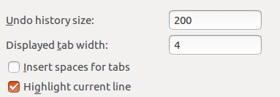
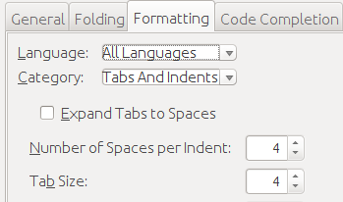
Check your IDE Settings
Eclipse: default settings are OK
Window -> Preferences -> General -> Text Editors
Netbeans: inserts spaces by default. Change it.
Tools -> Options -> Editor -> "Formatting" tab

Slide 16
Methods
1. Method should do just one thing
2. Strive for simple methods
    usually < 20 lines of code
3. Create a method for repeated task
4. Create a method to break up bigger tasks

Slide 17
Look for repeated tasks
Do you see any duplicate code? Can you use a method?
/** SKE Restaurant partial code */
public static void main(String[] args) {
Scanner console = new Scanner(System.in);
System.out.print("Enter choice (1-4): ");
int choice = console.nextInt();
if (choice>= 1 && choice<=3) {
System.out.print("Enter quantity: ");
int quantity = console.nextInt( );
}
...

Slide 18
Method for a repeated task
// Scanner is static attribute so methods can use it
private static Scanner console = new Scanner(System.in);
public static int getIntReply(String prompt) {
System.out.print(prompt);
int reply = console.nextInt();
return reply;
}
public static void main(String[] args) {
int choice = getIntReply("Enter choice (1-4): ");
if (choice>= 1 && choice<=3) {
int quantity = getIntReply("Enter quantity: ");
}
...

Slide 19
Helpful code with Javadoc
/**
* Print a prompt message and read user's input.
* @param prompt a prompt message to display
* @return the user's reply, as an int value
*/
public static int getIntReply(String prompt) {
System.out.print(prompt);
// prompt should end with space for readability
if (!prompt.endsWith(" ")) System.out.print(" ");
int reply = console.nextInt();
return reply;
}

Slide 20
Write Methods that do just one thing
I need an example...

Slide 21
duplicate code that's hard to read
/** Read words from inputStream. Count by first letter. */
Map<Character,Integer> map =
new HashMap<Character,Integer>();
Scanner in = new Scanner(inputStream);
while(in.hasNext()){
String word = in.nextLine();
if(map.containsKey(word.charAt(0))){
map.put(word.charAt(0),map.get(word.charAt(0))+1);
}
else{
map.put(word.charAt(0),1);
}
}
What is duplicate (used many times) in this code?

Slide 22
use a variable to avoid redundant method call
/** Read words from inputStream. Count by first letter. */
Map<Character,Integer> map =
new HashMap<Character,Integer>();
Scanner in = new Scanner(inputStream);
while (in.hasNext()) {
String word = in.nextLine();
char firstChar = word.charAt(0);
if ( map.containsKey(firstChar) ) {
map.put(firstChar, map.get(firstChar)+1);
}
else {
map.put(firstChar, 1);
}
}
and add space for readability!

Slide 23
add explanatory variable (count)
/** Read words from inputStream. Count by first letter. */
Map<Character,Integer> map =
new HashMap<Character,Integer>();
Scanner in = new Scanner(inputStream);
while (in.hasNext()) {
String word = in.nextLine();
char firstChar = word.charAt(0);
int count = 0; // number of times this char was seen
if ( map.containsKey(firstChar) ) {
count = map.get(firstChar);
}
map.put(firstChar, count+1);
}

Slide 24
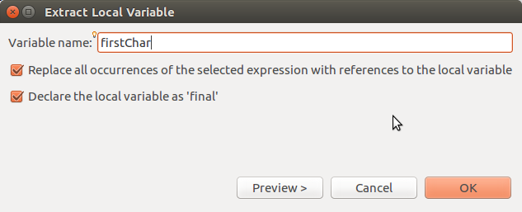
Let Eclipse do it for you
"Define a variable" is an example of refactoring.
1) select expression you want to define as variable:
word.charAt(0)
2) From menubar (or right-click):
Refactor -> Extract Local Variable...

Slide 25
Anticipate and avoid errors
System.out.print("Input item number: ");
int item = scanner.nextInt();
What could go wrong?
Input item number: one
java.util.InputMismatchException
int item = Integer.MIN_VALUE;
do {
System.out.print("Input item number: ");
if (scanner.hasNextInt()) item = scanner.nextInt();
else {
scanner.nextLine(); // discard the input line
System.out.println("Sorry. Please input an int.");
}
} while (item == Integer.MIN_VALUE);

Slide 26
Be careful of Strings
System.out.print("Are you awake? ");
String awake = scanner.next();
if (awake.equals("yes")) ...
else System.out.println("Then wake up!!");
What could go wrong?
Are you awake? Yes
Then wake up!!
// case insensitive comparison
if ( awake.equalsIgnoreCase("yes") ) ...
// convert string to lowercase (or uppercase)
awake = awake.toLowerCase();

Slide 27
Avoid Duplicate Logic
/** Insert money if the purse is not full. */
public boolean insert(Valuable obj) {
if (money.size() == capacity) return false;
return money.add(obj);
}
Avoid duplicate logic and make the intention clear:
public boolean insert(Valuable obj) {
if ( isFull() ) return false;
return money.add(obj);
}

Slide 28
Localize variables
Use the smallest possible scope
attributes only for things that object/class must remember
minimize sharing of information between methods
public class Factor {
static int sumFactors;
public static int findFactors(int n) {
sumFactors = 0;
for(int factor=2; factor<=n; factor++) {
if (n%factor == 0) sumFactors += factor;
}
return sumFactors;
}

Slide 29
Avoid Magic Numbers
SKE Restaurant code:
public static void printMenu() {
System.out.println("1) Pizza \t250 Baht");
System.out.println("2) Chicken \t120 Baht");
... // more menu choices
}
public static double getTotal(int numPizza,
int numChicken, ...) {
double total = 250.0*numPizza + 120*numChicken
+ ... ;
return total;
}

Slide 30
Requirements Change:
Pizza only 199 Baht!
(this week only)
How are you going to fix the code?

Slide 31
Use Named Constants
final declares a variable that cannot be changed (constant)
static final double PIZZA_PRICE = 250.0;
static final double CHICKEN_PRICE = 120.0;
public static void printMenu() {
System.out.printf("1) %-20s %6.2f Baht%n",
"Pizza", PIZZA_PRICE );
System.out.printf("2) %-20s %6.2f Baht%n",
"Chicken", CHICKEN_PRICE);
}
public static double getTotal(int numPizza,
int numChicken, ...) {
double total = PIZZA_PRICE*numPizza
+ CHICKEN_PRICE*numChicken + ... ;
return total;
}

Slide 32
Constant for Duplicate Format String
final declares a variable that cannot be changed (constant)
static final double PIZZA_PRICE = 250.0;
static final double CHICKEN_PRICE = 120.0;
public static void printMenu() {
final String FORMAT = "%d) %-20.20s %6.2f Baht%n";
System.out.printf(FORMAT, 1,"Pizza", PIZZA_PRICE );
System.out.printf(FORMAT, 2,"Chicken",CHICKEN_PRICE);
...
}
public static double getTotal(int numPizza,
int numChicken, ...) {
double total = PIZZA_PRICE*numPizza
+ CHICKEN_PRICE*numChicken + ... ;
return total;
}

Slide 33
Avoid Magic Strings, too
public class Coin {
public Coin(double value) {
this.valiue = value;
this.currency = "Baht"; //BAD
}
public class Coin {
public static final String
DEFAULT_CURRENCY = "Baht"; //GOOD
public Coin(double value) {
this.valiue = value;
this.currency = DEFAULT_CURRENCY;
}

Slide 34
Named Constant Explains a Number
This is code from a StopWatch. Times are in nanoseconds.
public double getElapsedTime() {
return (stopTime - startTime) * 1.0E-9; // Bad
}
/** conversion from nanoseconds to seconds */
static final double NANOSECONDS = 1.0E-9; // Good
public double getElapsedTime() {
return (stopTime - startTime) * NANOSECONDS;
}

Slide 35
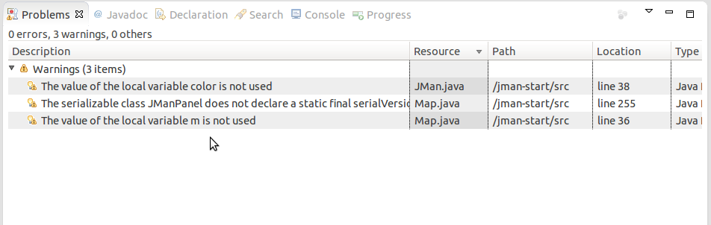
Treat Warnings Like Errors
Try to eliminate all the warnings in Eclipse or IntelliJ or ...
Eclipse: Close unrelated projects so you only see problems for this project.

Slide 36
Example
Let's review a student code for SKE Restaurant,
and look for improvements.
Example: 6010545765/day6.java

Slide 37
References
Steve McConnell, Code Complete, 2nd Edition.
Robert Martin, Clean Code.
http://www.unclebob.com - Robert Martin's blog

