Slide 1

Short research talk · synthetic teaching example
Recording brief changes
in classroom air
Alex Morgan · Fictional methods laboratory
Fictional study · synthetic data · concept images
1
Notes:
All study data and the presenter are fictional. Images are generated concepts, not working devices.

Slide 2
Contents
Recording brief changes
Contents
01 Question and alternatives
3–4
What a sparse log can miss
02 Proposed workflow
5–7
Concept device, interface and selection
03 Synthetic evidence and next study
8–9
One trace, followed by a planned test
2

Slide 3
Question and alternatives
Recording brief changes
A short change can fall between samples
Fewer stored readings reduce the size of a log.
Which brief changes remain
when we keep fewer readings?
[1] Synthetic classroom trace, supplied teaching input (2026).
3
Notes:
This question does not assert an effect on health or battery life.
[1] Synthetic classroom trace, supplied teaching input (2026).

Slide 4
Question and alternatives
Recording brief changes
Choose what the recording rule preserves
Rule | Keeps | May omit | Evidence needed
Fixed interval | Regular samples | Changes between samples | Duration and phase
Threshold crossing | A crossing event | Context below threshold | Noise sensitivity
Change-triggered | Large differences | Slow changes | Choice of threshold
Combined rule | Events and context | Unobserved detail | Storage and fidelity
[1] Synthetic teaching specification; alternatives are design options.
4
Notes:
Candidate rules, not results of a comparative trial.
[1] Synthetic teaching specification; alternatives are design options.

Slide 5
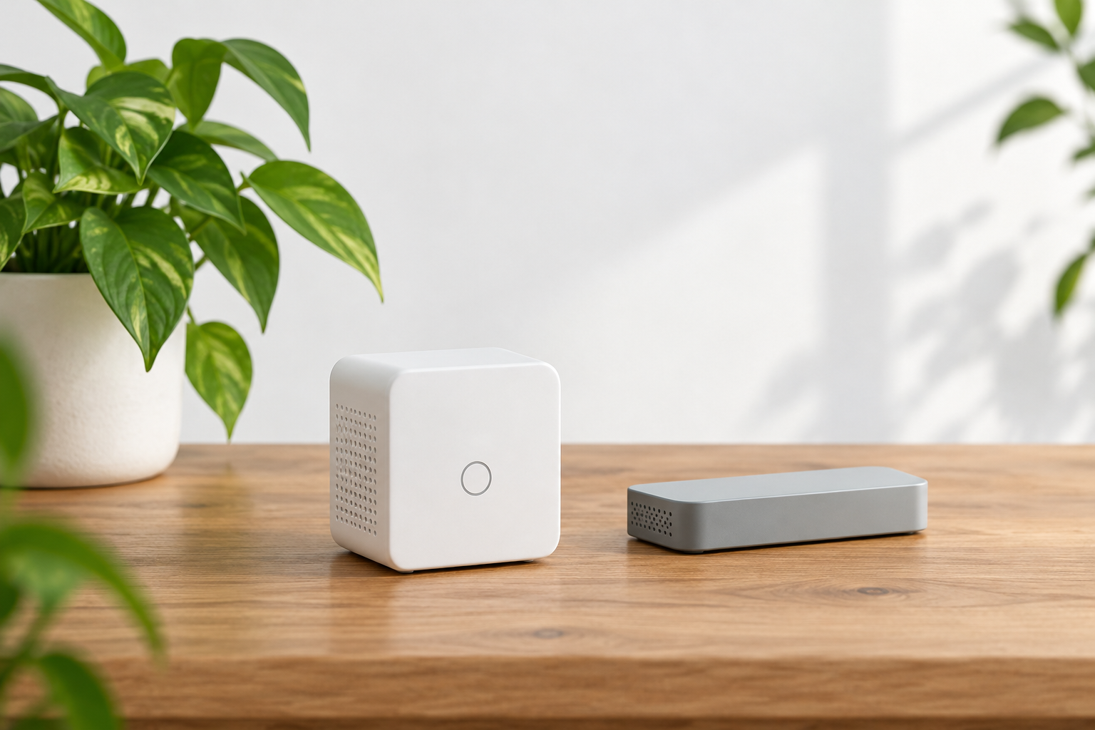
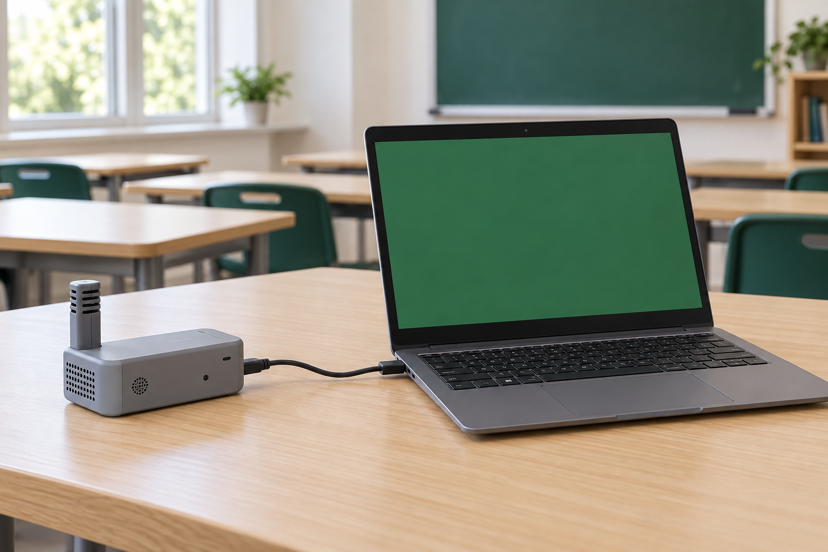
Proposed workflow
Recording brief changes
Two concept components
Generated concepts illustrate roles; neither is a tested prototype.
Sense the room
Review the log
Collect a time series.
Inspect what was retained.
5
Notes:
Both images were created with ImageGen for this fictional example.

Slide 6
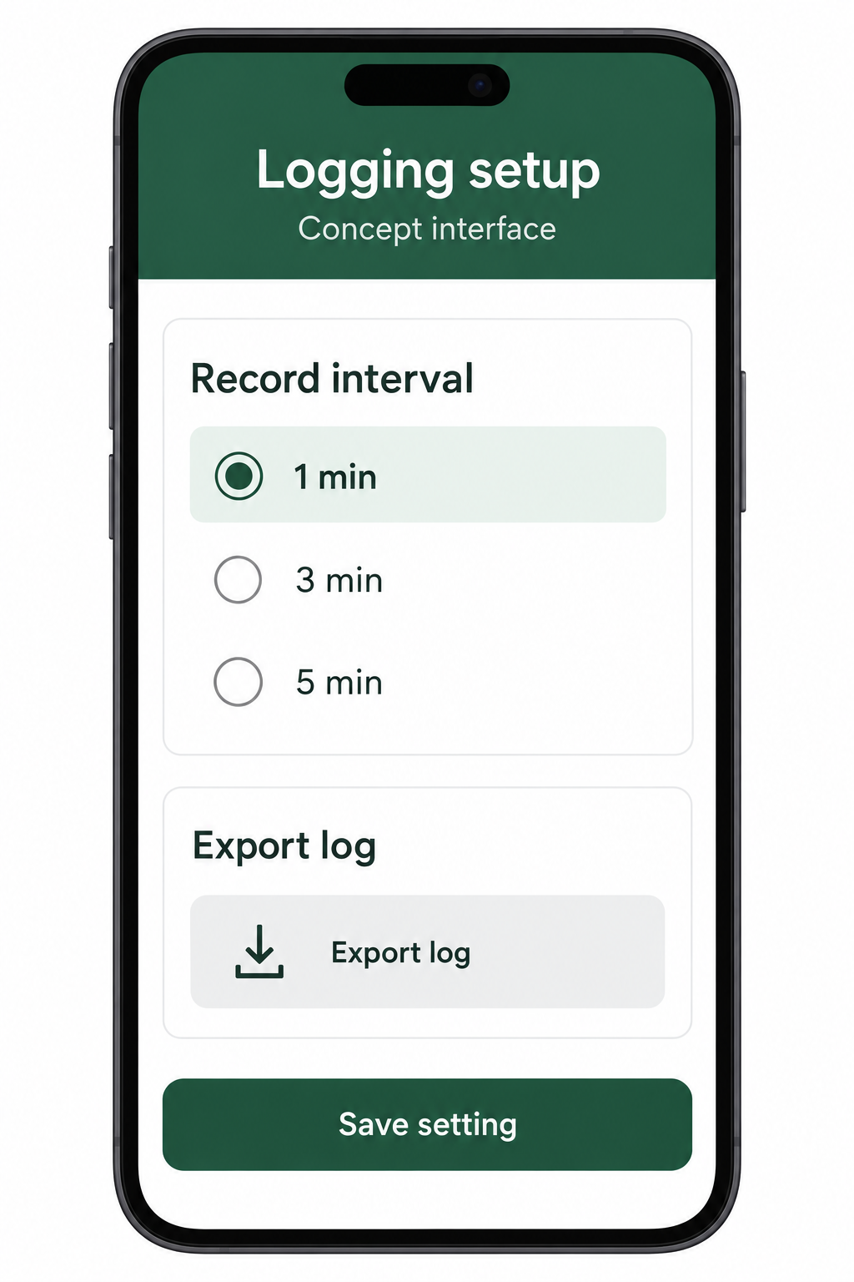
Proposed workflow
Recording brief changes
Choose the recording interval
Concept interface; no working application is claimed.
Select an interval before recording.
Export the retained log for inspection.
Keep the interval with the data so comparisons use the same conditions.
6
Notes:
The screen is illustrative. Its key labels are repeated in editable text outside the image.

Slide 7
Proposed workflow
Recording brief changes
Select a rule before retaining data
Regular samples
Input trace
Choose rule
Event samples
Arrows show processing choices, not a causal effect.
7
Notes:
The paths are operator-selected alternatives, not randomised experimental arms.

Slide 8
Synthetic evidence and next study
Recording brief changes
Sparse samples miss one peak in this trace
One synthetic trace · last retained value at each time · ppm
The retained representation never reaches the synthetic peak of 1140 ppm.
[1] Synthetic values in input.json; retained values use the last recorded sample.
8
Notes:
The retained representation repeats the last retained reading for display; these repeats are not additional measurements. The synthetic peak is not a safety threshold. No real-world detection claim.
[1] Synthetic values in input.json; retained values use the last recorded sample.

Slide 9
Synthetic evidence and next study
Recording brief changes
Planned comparison across varied traces
Planned evaluation; no results are available.
Fixed intervals
Change-triggered retention
Apply the same intervals to each trace.
Record storage size and omitted peaks.
Apply a predefined difference threshold.
Use the same traces and measures.
9
Notes:
Planned study. Trace selection and thresholds must be fixed before evaluation.

Slide 10
Summary
Recording brief changes
A recording rule determines what can be seen
Recording brief changes
in classroom air
Alex Morgan · Fictional methods laboratory
Question: which short changes survive sparse recording?
Synthetic example: one peak is absent from the retained representation.
Next: compare rules across traces before building a prototype.
alex.morgan@example.org
[1] Synthetic teaching input; no empirical effectiveness claim.
10
Notes:
No hardware, application or energy saving has been validated. Contact details are fictional.
[1] Synthetic teaching input; no empirical effectiveness claim.

