Slide 1
Chickenizer
Package for all things Chicken
CSC 343
Spring 2026
Greyson H.
Will Z.

Slide 2
What is “Chicken”?
Objective:
maximize your reputation
“Stay”
“Swerve”
Player 1
Player 2
Actions

Slide 3
🤕
🤕
😃
😐
Scenario 1: Crash
Scenario 2: Stay/Swerve
😐
😃
😐
😐
Scenario 3: Swerve/Stay
Scenario 4: Wash
Notes:
relatively speaking, crash and wash are the same.

Slide 4

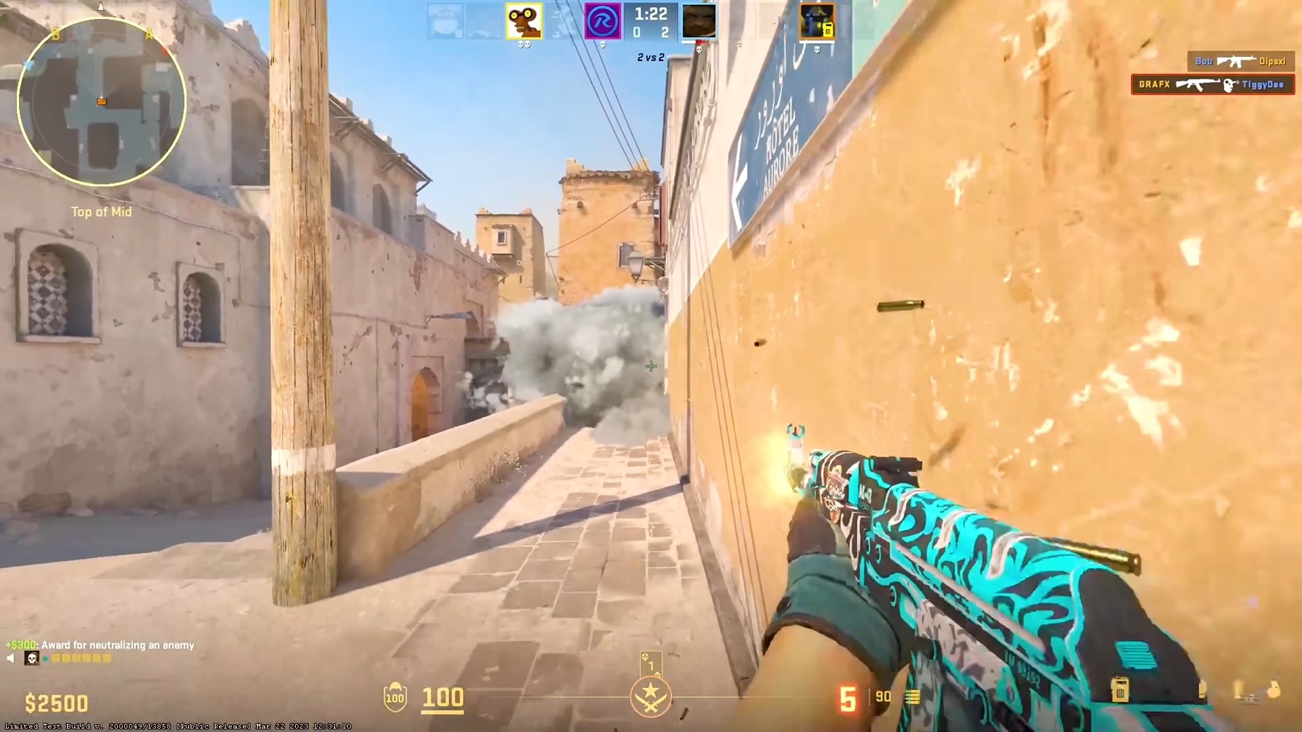

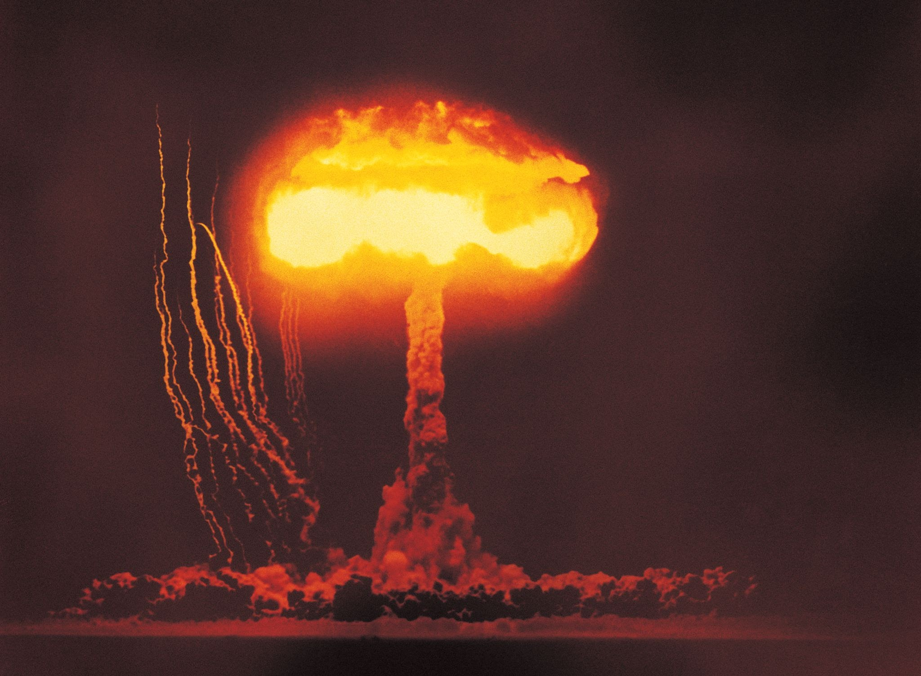
WHY Chicken?
*meaning a risky, 2-player competition.
Players could be people, teams, narratives… “risky” implies there are ways to act that could leave you worse off than before.
Other, better games* abstract to it! They’re chicken-ish.
So it seems reasonable that we could use chicken to represent them and explore them agentically.
OK… but there are serious limitations to chicken in its naïve form
Oversimple: 1 round, 2 players, 2 actions @ same time
Solved (i.e., we already know the conditions for Nash equilibrium)
…we need to make some changes to the game engine to handle complexity.
Notes:
nations posturing & deploying nuclear weapons; a trader holding a volatile asset, trying to sell at the optimal time; a driver chooses what to do at a yellow light; a CS team decides whether to challenge better-equipped enemies

Slide 5
OBJECTIVES
Increase chicken’s complexity to handle bigger games
Impose (models of) real games onto chicken
Agentically explore optimal strategies in some of these scenarios

Slide 6
Demo

Slide 7
Module 5 - UI | Visual display + animations Custom strategies Live training
Module 4 - Reinforcement Learning | Q-learning strategy Performance analysis
Module 3 - Strategies & Nash Equilibria | Strategy objects Basic strategy suite Hypothesis vs final NEs
Module 2 - Engine | Gamestate generation “Caring” Resilience scoring
Module 1 - Knowledge Base | Basic logic, rules Action validation

Slide 8
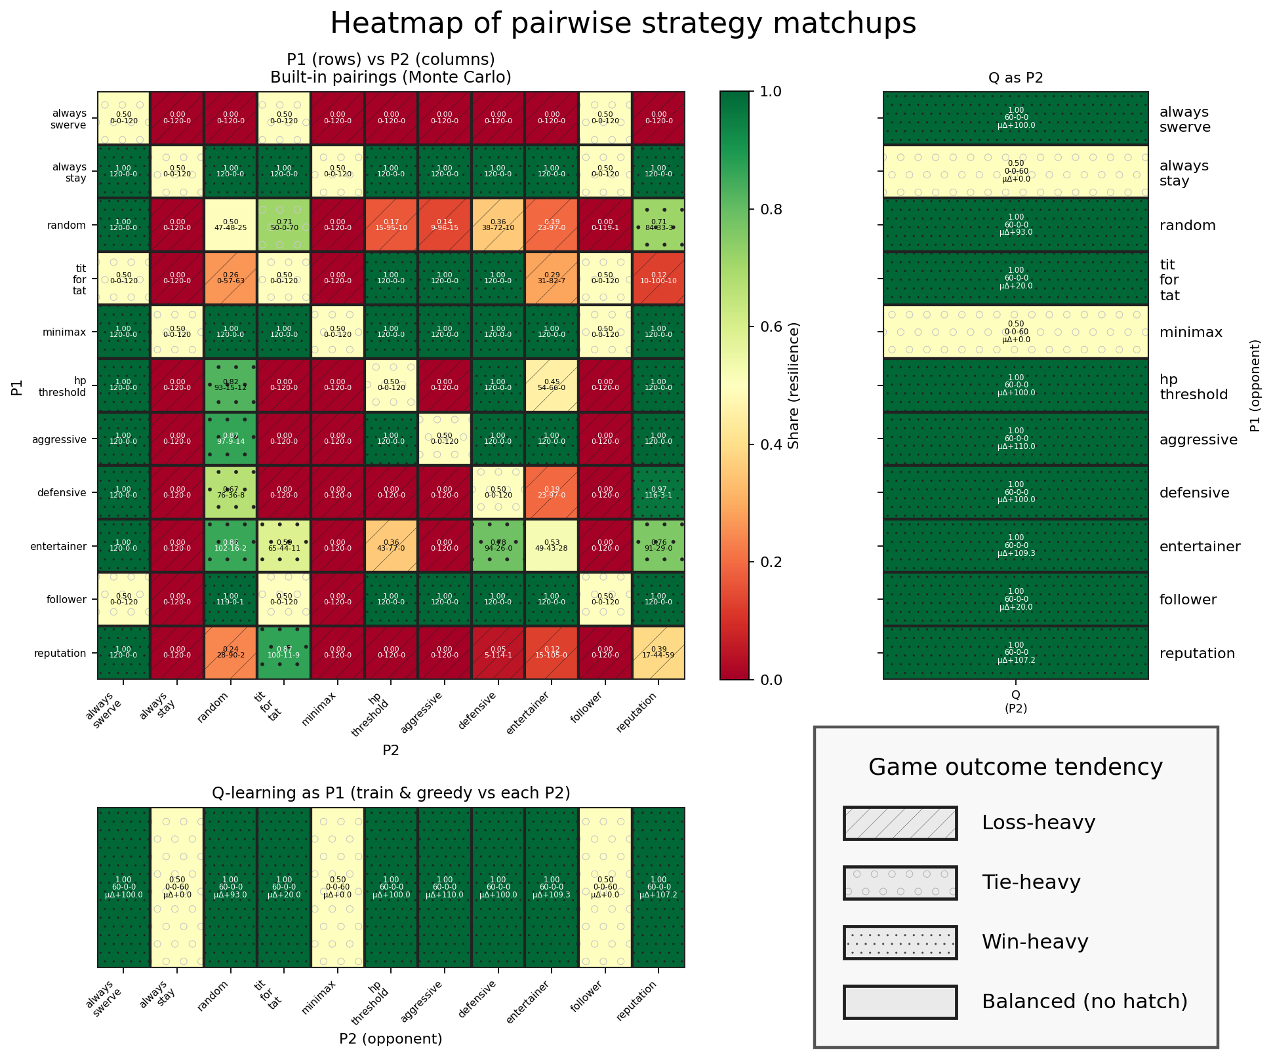
Q-learning outcomes
The Q-learning agent performed as well as possible in every matchup.
GIVEN…
Default “cares”
No custom strategies
120 rounds of exploration each
Consider:
is this realistic?

Slide 9
Thanks!

