Slide 1
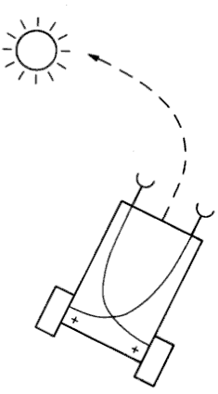
Aggression Simulation
Steven Hooke
12433789

Slide 2
The Task
Simulate aggression in a Turtlebot robot and in an Rviz simulation.
The robot would identify any green targets in its vision.
Upon identifying a target, the robot would move towards the target until the target left the robots vision.
Written in Python.
Based on Braitenberg’s emotionally-responsive vehicles.
Movement will be based around Twist library.
Imagery will be handled by OpenCV.
Colour detection identified using HSV model.

Slide 3
Results
Robot – https://www.youtube.com/watch?v=jvSJGsLd2Iw
Robot identifies green object.
Moves towards the object.
Rviz simulation – https://www.youtube.com/watch?v=l3RzWupazB8
Simulation identifies green object.
Moves towards the object.
Continues until it can no longer see the green object.

