Slide 1
L41: Advanced Operating Systems Through tracing, analysis, and experimentation
L41 Lecture 1
Dr Robert N. M. Watson
25 October 2016

Slide 2
Getting started
What is an operating system?
Systems research
About the module
Lab reports
Readings for next time

Slide 3
What is an operating system?
(Whiteboarding exercise)

Slide 4
What is an operating system?
[An OS is] low-level software that supports a computer’s basic functions, such as scheduling tasks and controlling peripherals.
- Google hive mind

Slide 5
General-purpose operating systems
… are for general-purpose computers
Servers, workstations, mobile devices
Run ‘applications’ – i.e., software unknown at design time
Abstract the hardware, provide ‘class libraries’
E.g., Windows, Mac OS X, Android, iOS, Linux, FreeBSD, …
Userspace | Local and remote shells, management tools, daemons Run-time linker, system libraries, tracing facilities
– system-call layer –
Kernel | System calls, hypercalls, remote procedure call (RPC)* Processes, filesystems, IPC, sockets, management Drivers, packets/blocks, protocols, tracing, virtualisation VM, malloc, linker, scheduler, threads, timers, tasks, locks
* Continuing disagreement on whether distributed-filesystem servers and window systems ‘belong’ in userspace or the kernel

Slide 6
Other kinds of operating systems
Specialise the OS for a specific application or environment:
Embedded operating systems
Serve a single application in a specific context
Wireless access points, medical devices, washing machines, cars
Small code footprint, real-time scheduling
Might have virtual memory / process model
Microkernels or single-address space: VxWorks, RTEMS, L4
Now also: Linux, BSD over a real-time kernel
Appliance operating systems
Apply embedded model to higher-level devices/applications
File storage appliances, routers, firewalls, ...
E.g., Juniper JunOS, Cisco IOS, NetApp OnTap, EMC/Isilon
Under the hood, almost always Linux, BSD, etc.
Key concept: Operating system as a reusable library

Slide 7
Other kinds of operating systems?
What if we rearrange the boxes?
Microkernels, library operating systems, unikernels
Shift code out of the kernel into userspace to reduce TCB; improve robustness/flexibility; ‘bare-metal’ apps
Early 1990s: Microkernels are king!
Late 1990s: Microkernels are too slow!
2000s/2010s: Microkernels are back! But now ‘hypervisors’
Sometimes: alternative linkage (e.g., programming-language)
Hypervisors
Kernels host applications; hypervisors host virtual machines
Virtualised hardware interface rather than POSIX
Paravirtualisation reintroduces OS-like interfaces for performance
A lot of microkernel ideas have found a home here
E.g., System/370, VMware, Xen, KVM, VirtualBox, bhyve, ...

Slide 8
What does an operating system do?
Key hardware-software surface
System management: bootstrap, shutdown, watchdogs
Low-level abstractions and services
Programming: processes, threads, IPC, program model
Resource sharing: scheduling, multiplexing, virtualisation
I/O: device drivers, local/distributed filesystems, network stack
Security: authentication, encryption, permissions, labels, audit
Local or remote access: console, window system, SSH
Libraries: math, protocols, RPC, crypto, UI, multimedia
Other stuff: system log, debugging, profiling, tracing
Compiler? Text editor? E-mail package? Web browser? Can an operating system be “distributed”?

Slide 9
Why study operating systems?
The OS plays a central role in whole-system design when building efficient, effective, and secure systems:
Strong influence on whole-system performance
Critical foundation for computer security
Exciting programming techniques, algorithms, problems
Virtual memory; network stack; filesystem; run-time linker; …
Co-evolves with platforms, applications, users
Multiple active research communities
Reusable techniques for building complex systems
Boatloads of fun (best text adventure ever)

Slide 10
Where is the OS research?
A sub-genre of systems research:
Evolving hardware-software interfaces
New computation models / architectures
New kinds of peripheral devices
Integration with programming languages and runtimes
Concurrent/parallel programming models; scheduling
Security and virtualisation
Networking, storage, and distributed systems
Tracing and debugging techniques
As a platform for other research – e.g., mobile systems
Venues: SOSP, OSDI; USENIX ATC; EuroSys; HotOS; FAST; NSDI; HotNets; ASPLOS; USENIX Security; ACM CCS; IEEE S&P; …

Slide 11
What are the research questions?
Just a few examples: By changing the OS, can I…
create new abstractions for new hardware?
make my application run faster by…
better masking latency?
using parallelism more effectively?
exploiting new storage mediums?
adopting distributed-system ideas in local systems?
make my application more {reliable, power efficient}
limit the {security, privacy} implications of exploited programs?
use new language/analysis techniques in new ways?
Systems research focuses on evaluation with respect to applications or workloads: How can we measure whether it is {faster, better, ...}?

Slide 12
Teaching operating systems
Two common teaching tropes:
Trial by fire: in micro, recreate classic elements of operating systems: microkernels with processes, filesystems, etc.
Research readings course: read, present, discuss, and write about classic works in systems research
This module adopts elements of both approaches while:
mitigating the risk of OS kernel hacking in a short course
working on real-world systems rather than toys; and
targeting research skills not just operating-system design
Trace and analyse real systems driven by benchmarks
Possibly only because of recent developments in tracing

Slide 13
Aims of the module
Teaching methodology, skills, and knowledge required to understand and perform research on contemporary operating systems by…
Employing systems methodology and practice
Exploring real-world systems artefacts
Developing scientific writing skills
Reading selected original systems research papers

Slide 14
Prerequisites
We will take for granted:
High-level knowledge of operating systems gained in an undergraduate course (or equivalent); e.g.:
What schedulers do
What processes are … and how they differ from threads
What Interprocess Communication (IPC) does
How might a simple filesystem might work
Reasonable fluency in reading/producing multithreaded C
Comfort with the UNIX command-line environment
Undergraduate skills with statistics (mean/median/mode/stddev/t-tests/linear regression/boxplots/scatterplots ... )
You can pick up some of this as you go (e.g., IPC, t-tests), but will struggle if you are missing most of these

Slide 15
Module structure
One-hour lectures in FS-07 (x6)
Theory, methodology, architecture, and practice
Two-hour labs in SW-02 (x5)
10-20-minute lecturelets on artefacts and practical skills
Remainder on hands-on measurement and experimentation
Optional exploratory questions vs. experimental goals
Assigned readings
Selected portions of module texts
Historic and contemporary research papers
Assessed lab reports
Based on experiments done in (and out) of labs
Refine scientific writing style suitable for systems research
One ‘practice run’ marked but not assessed
Two assessed; 50% of final mark each

Slide 16
Rough module schedule and decomposition
Submodule 1: Introduction to kernels and tracing/analysis
2 lectures, 1 lab (I/O)
Introduction: OSes, Systems Research, and L41
The Kernel: Kernel and Tracing
First lab report due
Submodule 2: The Process Model
2 lectures, 2 labs (IPC, PMC)
The Process Model (1) – Binaries and Processes
The Process Model (2) –Traps, System Calls, and Virtual Memory
Second lab report due
Submodule 3: TCP/IP
2 lectures, 2 labs (TCP state machine, congestion control)
The Network Stack (1) – Sockets, NICs, and Work Distribution
The Network Stack (2) – TCP protocol
Final lab report due

Slide 17
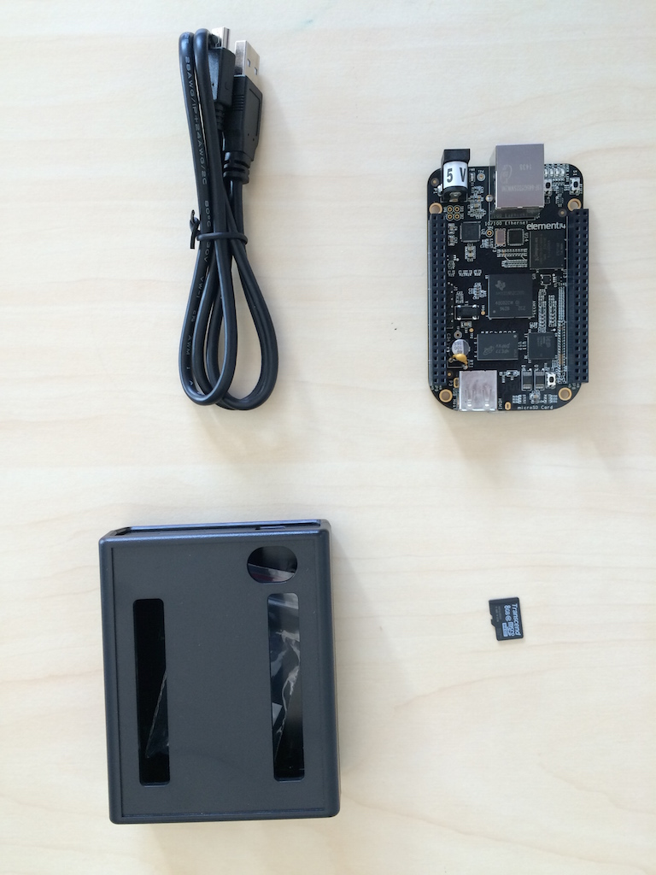
The platform
BeagleBone Black
1GHz ARM Cortex A-8 32-bit CPU
Superscalar pipeline, MMU, L1/L2 caches
FreeBSD operating system + DTrace
“potted benchmarks”

Slide 18
Labs and lab reports
Lab reports document an experiment and analyse its results – typically in the context of a hypothesis that will be tested.
Our lab reports will contain the following sections:
1. Title + abstract | 5. Conclusion
2. Introduction | 6. References
3. Experimental setup and methodology | 7. Appendices
4. Results and discussion
Some formats break out (e.g.) experimental setup vs. methodology, and results vs. discussion. The combined format seems to work better for systems experimentation as compared to (e.g.) biology. See lab-report notes on the website.

Slide 19
Module texts – core material
You will need to make frequent reference to these books both in the labs and outside of the classroom:
Operating systems: Marshall Kirk McKusick, George V. Neville-Neil, and Robert N. M. Watson, The Design and Implementation of the FreeBSD Operating System, 2nd Edition, Pearson Education, Boston, MA, USA, September 2014.
Performance measurement: Raj Jain, The Art of Computer Systems Performance Analysis: Techniques for Experimental Design, Measurement, Simulation, and Modeling, Wiley - Interscience, New York, NY, USA, April 1991.
Tracing and profiling: Brendan Gregg and Jim Mauro, DTrace: Dynamic Tracing in Oracle Solaris, Mac OS X and FreeBSD, Prentice Hall Press, Upper Saddle River, NJ, USA, April 2011.

Slide 20
Module texts – supplemental material
If your OS recollections feel a bit hazy:
Operating systems: Abraham Silberschatz, Peter Baer Galvin, and Greg Gagne, Operating System Concepts, Eighth Edition, John Wiley & Sons, Inc., New York, NY, USA, July 2008.
If you want to learn a bit more about architecture and measurement:
Performance measurement and diagnosis: Brendan Gregg, Systems Performance: Enterprise and the Cloud, Prentice Hall Press, Upper Saddle River, NJ, USA, October 2013.

Slide 21
For next time
McKusick, et al. – Chapter 3
Cantrill, et al. 2004 – full article

