Slide 1
The Network Stack (2)
L41 Lecture 6
Dr Robert N. M. Watson
27 January 2017

Slide 2
Reminder: Last time
Rapid tour across hardware and software:
Networking and the sockets API
Network-stack design principles: 1980s and today
Memory flow across hardware and software
Network-stack construction and work flows
Recent network-stack research

Slide 3
This time: The Network Stack (2)
The Transmission Control Protocol (TCP)
The TCP state machine
TCP congestion control
TCP implementations and performance
The evolving TCP stack
Labs 4 + 5 on TCP
Wrapping up the L41 lecture series

Slide 4
The Transmission Control Protocl (TCP)
September 1981 Transmission Control Protocol
Functional Specification
+---------+ ---------\ active OPEN
| CLOSED | \ -----------
+---------+<---------\ \ create TCB
| ^ \ \ snd SYN
passive OPEN | | CLOSE \ \
------------ | | ---------- \ \
create TCB | | delete TCB \ \
V | \ \
+---------+ CLOSE | \
| LISTEN | ---------- | |
+---------+ delete TCB | |
rcv SYN | | SEND | |
----------- | | ------- | V
+---------+ snd SYN,ACK / \ snd SYN +---------+
| |<----------------- ------------------>| |
| SYN | rcv SYN | SYN |
| RCVD |<-----------------------------------------------| SENT |
| | snd ACK | |
| |------------------ -------------------| |
+---------+ rcv ACK of SYN \ / rcv SYN,ACK +---------+
| -------------- | | -----------
| x | | snd ACK
| V V
| CLOSE +---------+
| ------- | ESTAB |
| snd FIN +---------+
| CLOSE | | rcv FIN
V ------- | | -------
+---------+ snd FIN / \ snd ACK +---------+
| FIN |<----------------- ------------------>| CLOSE |
| WAIT-1 |------------------ | WAIT |
+---------+ rcv FIN \ +---------+
| rcv ACK of FIN ------- | CLOSE |
| -------------- snd ACK | ------- |
V x V snd FIN V
+---------+ +---------+ +---------+
|FINWAIT-2| | CLOSING | | LAST-ACK|
+---------+ +---------+ +---------+
| rcv ACK of FIN | rcv ACK of FIN |
| rcv FIN -------------- | Timeout=2MSL -------------- |
| ------- x V ------------ x V
\ snd ACK +---------+delete TCB +---------+
------------------------>|TIME WAIT|------------------>| CLOSED |
+---------+ +---------+
TCP Connection State Diagram
Figure 6.
V. Cerf, K. Dalal, and C. Sunshine, Transmission Control Protocol (version 1), INWG General Note #72, December 1974.
In practice: J. Postel, Ed., Transmission Control Protocol: Protocol Specification, RFC 793, September, 1981.

Slide 5
TCP principles and properties
Network may delay, (reorder), drop, corrupt packets
TCP: Reliable, ordered, stream transport protocol over IP
Three-way handshake: SYN / SYN-ACK / ACK (mostly!)
Sequence numbers ACK’d
Round-Trip Time (RTT) measured to time out loss
Data retransmitted on loss
Flow control via advertised window size in ACKs
Congestion control (‘fairness’) detects congestion via loss

Slide 6
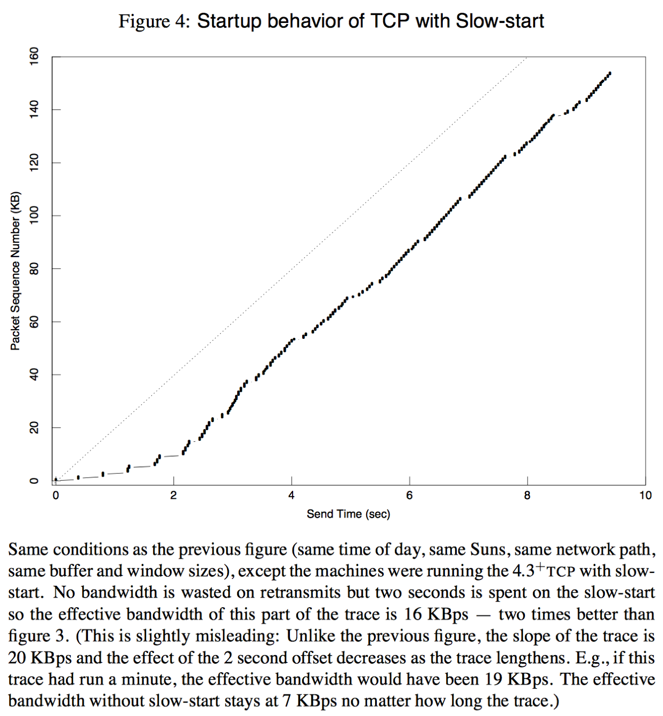
TCP congestion control and avoidance
1986 Internet CC collapse
32Kbps → 40bps
Van Jacobson, SIGCOMM 1988
Don’t send more data than the network can handle!
Conservation of packets via ACK clocking
Exponential retransmit timer, slow start, aggressive receiver ACK, and dynamic window sizing on congestion
ECN (RFC 3168), ABC (RFC 3465), Compound (Tan, et al, INFOCOM 2006), Cubic (Rhee and Xu, ACM OSR 2008)

Slide 7
TCP time/sequence graphs
Extracted from TCP packet traces (e.g., via tcpdump)
Visualize windows, congestion response, buffering, RTT, etc:
X: Time
Y: Sequence number
We can extract this data from the network stack directly using Dtrace
Allows correlation/plotting with respect to other variables / events

Slide 8
Evolving BSD/FreeBSD TCP implementation
Year | Version | Feature
1983 | 4.2BSD | BSD sockets, TCP/IP implementation
1986 | 4.3BSD | VJ/Karels congestion control
1999 | FreeBSD 3.1 | sendfile(2)
2000 | FreeBSD 4.2 | TCP accept filters
2001 | FreeBSD 4.4 | TCP ISN randomisation
2002 | FreeBSD 4.5 | TCP SYN cache/cookies
2003 | FreeBSD 5.0-5.1 | IPv6, TCP TIMEWAIT state reduction
2004 | FreeBSD 5.2-5.3 | TCP host cache, SACK, fine-grained locking
2008 | FreeBSD 6.3 | TCP LRO, TSO
2008 | FreeBSD 7.0 | T/TCP removed, socket-buffer autosizing
2009 | FreeBSD 7.1 | Read-write locking, full TCP offload (TOE)
2009 | FreeBSD 8.0 | TCP ECN
2012 | FreeBSD 9.0 | Pluggable TCP congestion control, connection groups
Which changes have protocol-visible effects vs. only code?

Slide 9
Lect. 5 - Send/receive paths in the network stack

Slide 10
Data structures – sockets, control blocks

Slide 11
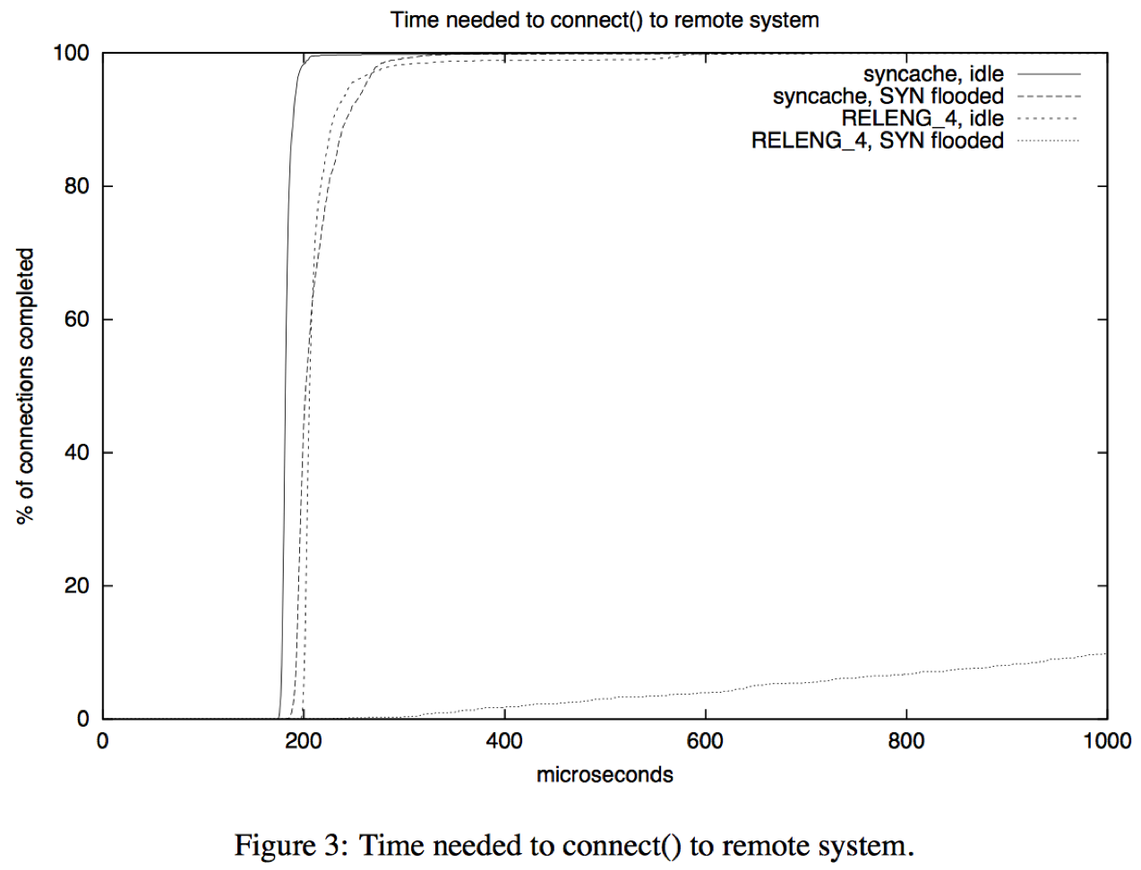
Denial of Service (DoS) – state minimisation
Yahoo!, Amazon, CNN taken down by SYN floods in February 2000
D. Borman: TCP SYN cache – minimise state for new connections
D. Bernstein: SYN cookies – eliminate state entirely – at a cost
J. Lemon: TCP TIMEWAIT reduction – minimise state during close
J. Lemon: TCP TIMEWAIT recycle – release state early under load

Slide 12
TCP connection lookup tables
Global list of connections for monitoring (e.g., netstat)
Connections are installed in a global hash table for lookup
Separate (similar) hash table for port-number allocations
Tables protected by global read-write lock as reads dominate
New packets are more frequent than new connections

Slide 13
Lect. 5 - Work dispatch: input path
Deferred dispatch: ithread → netisr thread → user thread
Direct dispatch: ithread → user thread
Pros: reduced latency, better cache locality, drop early on overload
Cons: reduced parallelism and work placement opportunities

Slide 14
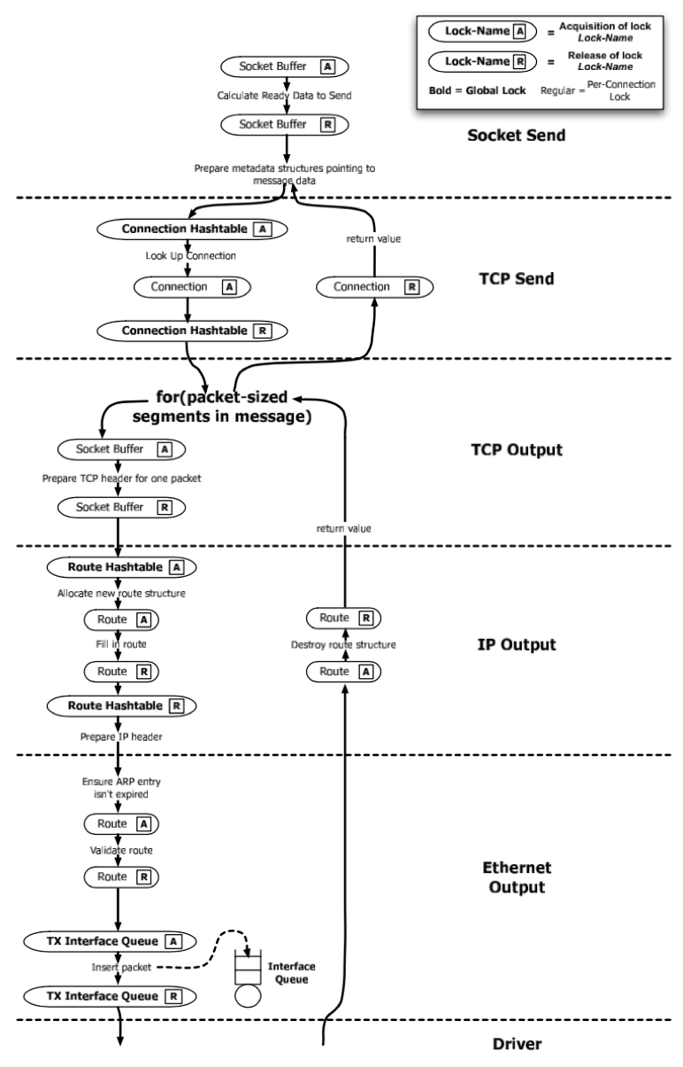
An Evaluation of Network Stack Parallelization Strategies in Modern Operating Systems Paul Willmann, Scott Rixner, and Alan L. Cox, USENIX ATC, 2006
Network bandwidth growth > CPU frequency growth
Locking overhead (space, contention) substantial
Getting ‘speedup’ is hard!
Evaluate different strategies for TCP processing parallelisation
Message-based parallelism
Connection-based parallelism (threads)
Connection-based parallelism (locks)
Coalescing locks over connections:
reduces overhead
increases parallelism

Slide 15
FreeBSD connection groups, RSS
Connection groups blend MsgP and ConnP-L models
PCBs assigned to group based on 4-tuple hash
Lookup requires group lock, not global lock
Global lock retained for 4–tuple reservation (e.g., setup, teardown)
Problem: have to look at TCP headers (cache lines) to place work!
Microsoft: NIC Receive-Side Scaling (RSS)
Multi-queue NICs deliver packets to queues using hash of 4-tuple
Align connection groups with RSS buckets / interrupt routing

Slide 16
Performance: dispatch model and locking
2010 8-core x86 multicore server
TCP LRO disabled (maximise PPS)
Configurations:
1 queue (no dispatch), 1 thread on 1 core
1 queue (SW dispatch), 8 threads on 8 cores
8 queues (HW dispatch), 8 threads on 8 cores
Userspace processes receiving bulk TCP
8 7 6 5 4 3 2 1 8 7 6 5 4 3 2 1 8 7 6 5 4 3 2 1

Slide 17
Architectural → micro-architectural + I/O optimisation
Hardware, software, protocol co-design causes change to optimisation approach over time:
Counting instructions → counting cache misses
Reducing lock contention → cache-line contention
Adding locking → identifying new parallelism
Work ordering, classification, and distribution
Vertically integrated distribution and affinity
NIC offload of further protocol layers, crypto
DMA/cache interactions
Convergence of networking and storage technologies?

Slide 18
Labs 4 + 5: TCP
From abstract to concrete understanding of TCP
Use tools such as tcpdump and DUMMYNET
Explore effects of latency on TCP performance
Lab 4 – TCP state machine and latency
Measure the TCP state machine in practice
Start looking at TCP latency vs. bandwidth (DUMMYNET)
At what transfer sizes are different latencies masked?
Lab 5 – TCP congestion control
Draw time-sequence-number diagrams
Explore OS buffering strategies
Explore slow-start vs. steady state as latency changes
Explore OS and microarchitectural performance interactions

Slide 19
L41 lecture wrap-up
Goal: Deeper understanding of OS design and implementation
Evolving architectural and microarchitectural foundations
Evolving OS design principles
Evolving tradeoffs in OS design
Case study: The process model
Case study: Network-stack abstractions
Quick explorations of past and current research
Goal: Gain practical experience analysing OS behaviour
Goal: Develop scientific analysis and writing skills
Feel free to get in touch to learn more!

