Slide 1
Investigating the role of fires on GDP

Slide 2
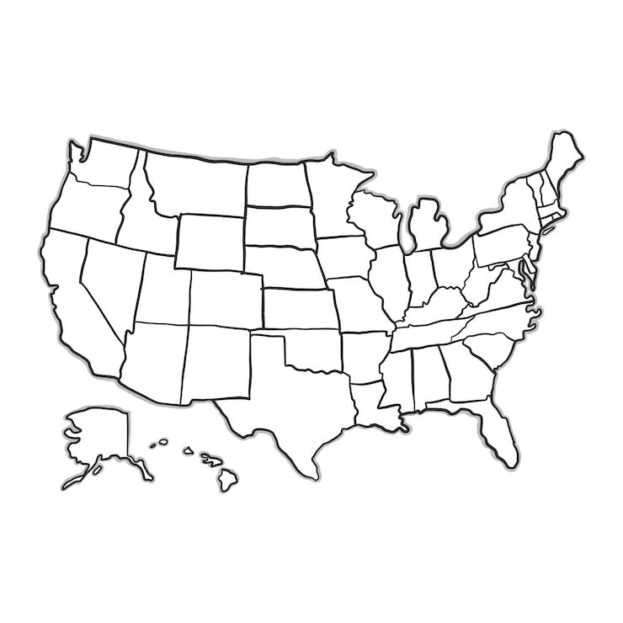
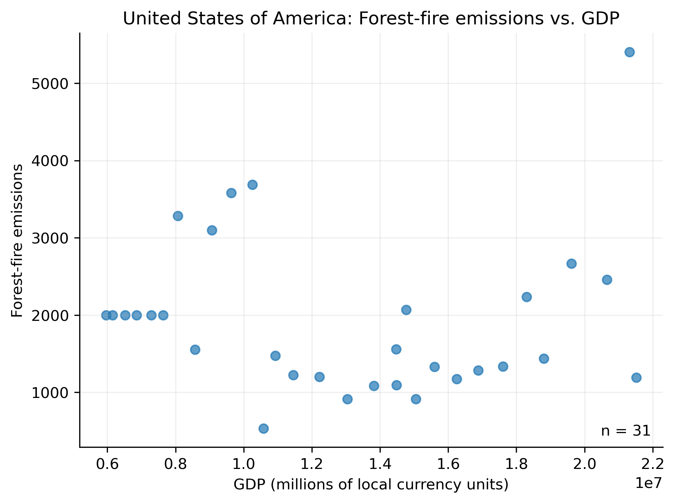
Introduction: How do number of fires scale with a country’s GDP?
Fire-related emissions by country are compared to GDP by year

Slide 3
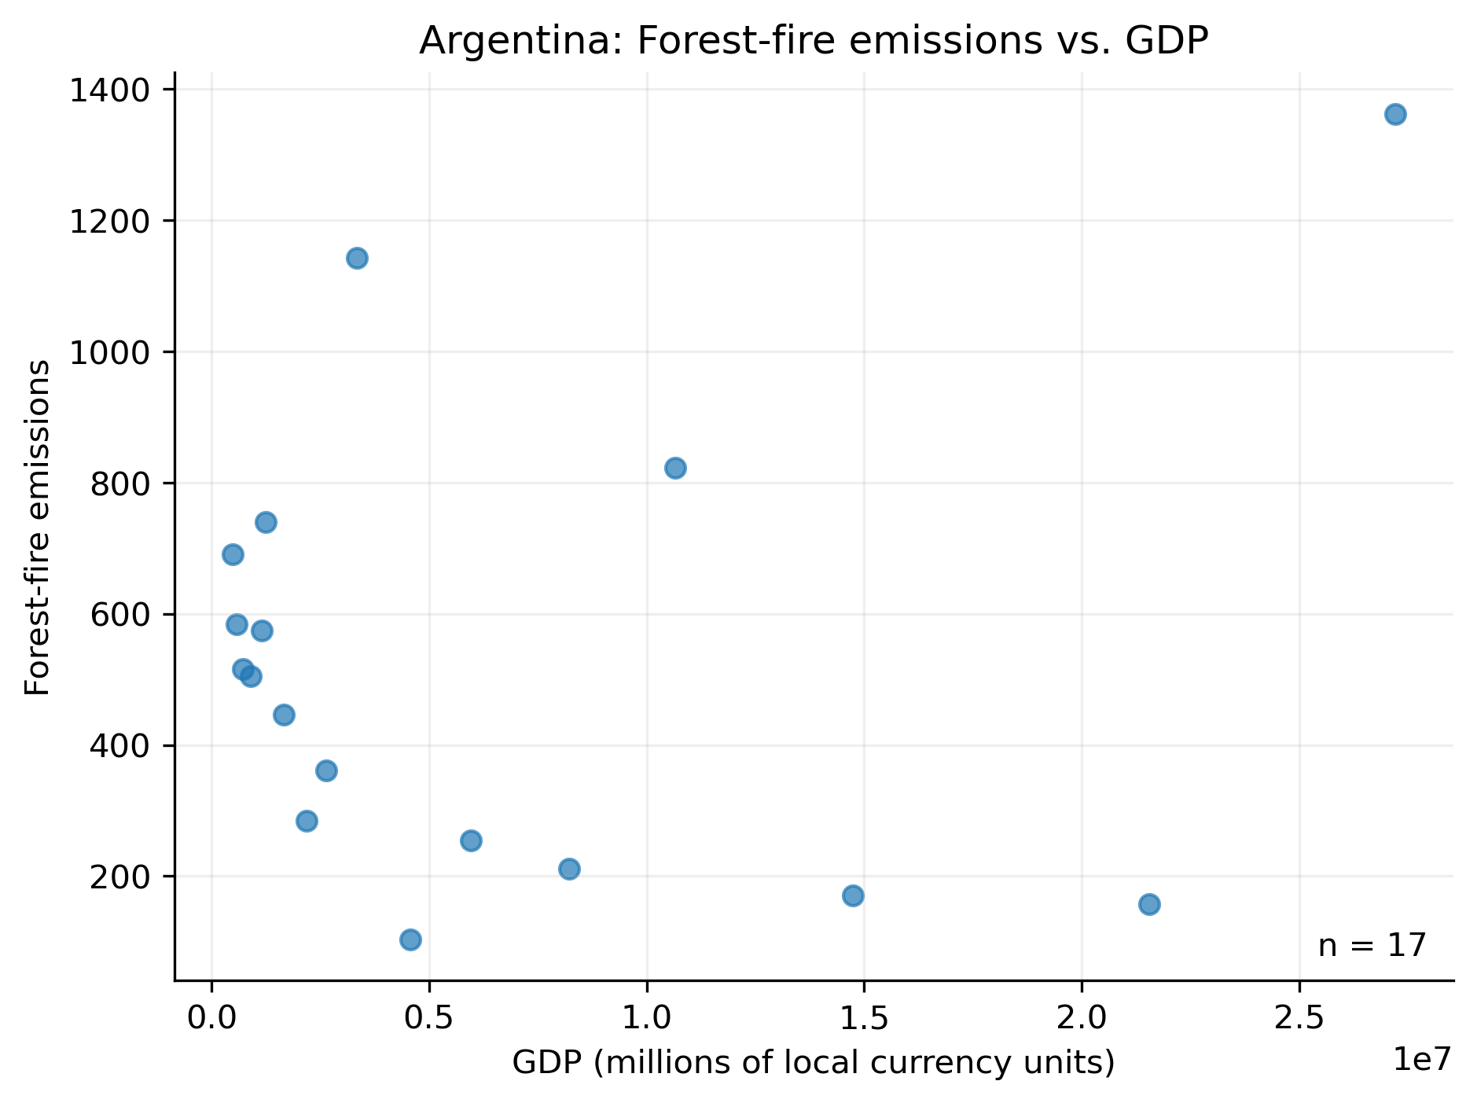
Results: A case study of Argentina
Aside from a few outliers, it seems like there is an exponentially decreasing trend in forest-fire emissions with GDP.
Predicted outliers

Slide 4
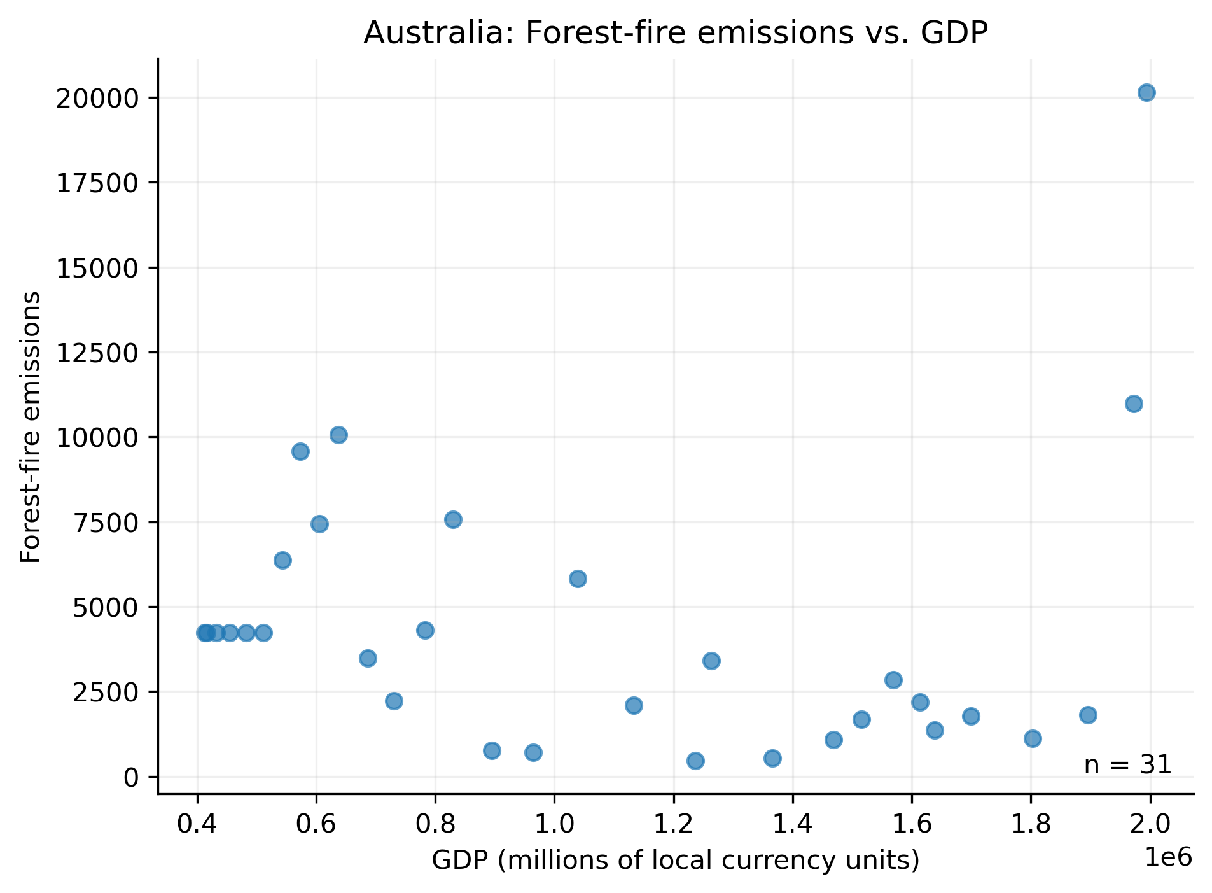
Results: A case study of Australia
Predicted outliers
Aside from a few outliers, it seems like there is an exponentially decreasing trend in forest-fire emissions with GDP.

Slide 5
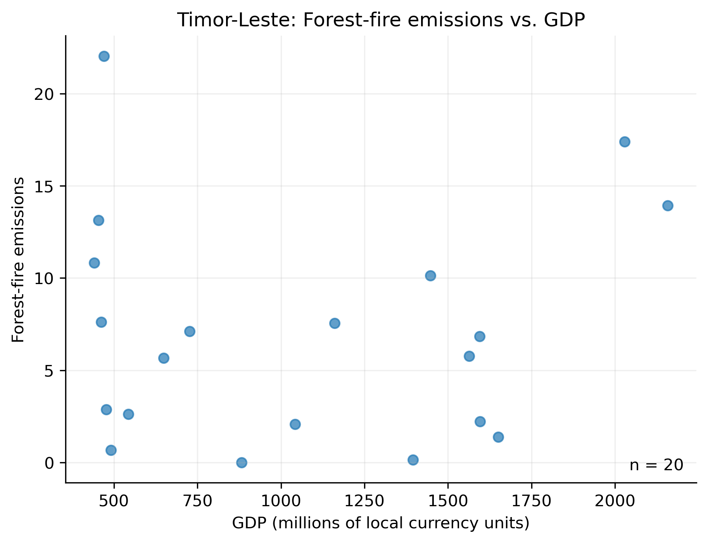
Results: A case study of Timor-Leste
In some countries, the extent of forest fire emissions are independent of GDP

Slide 6
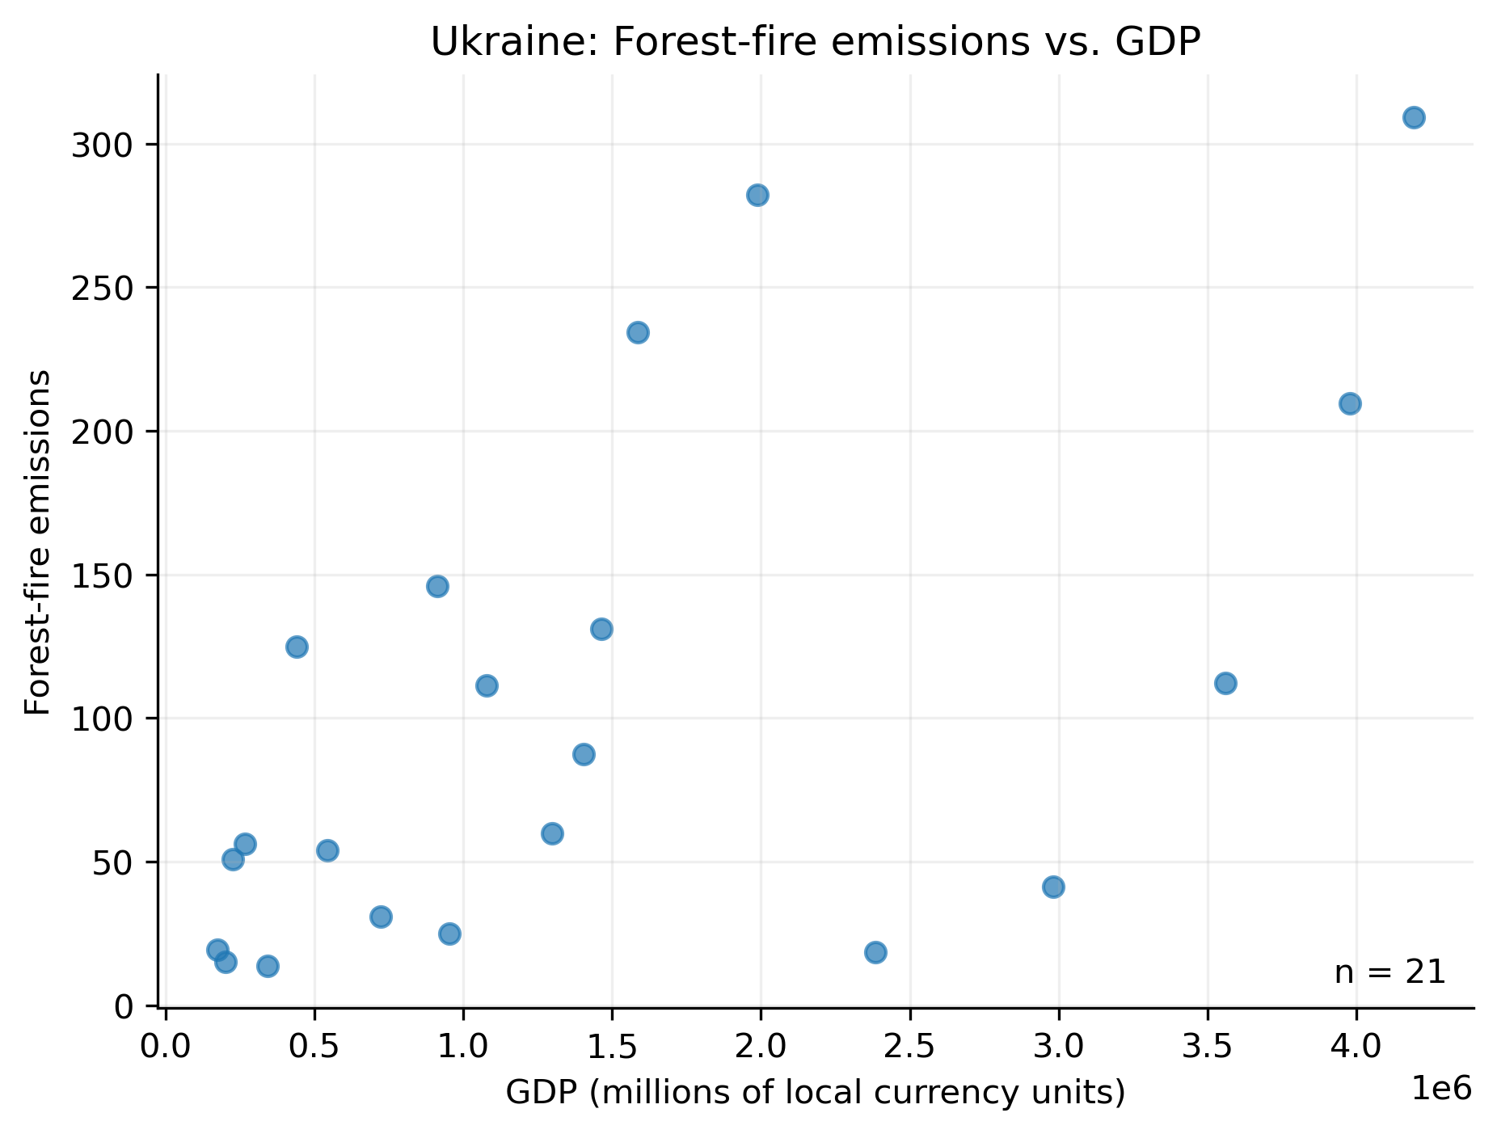
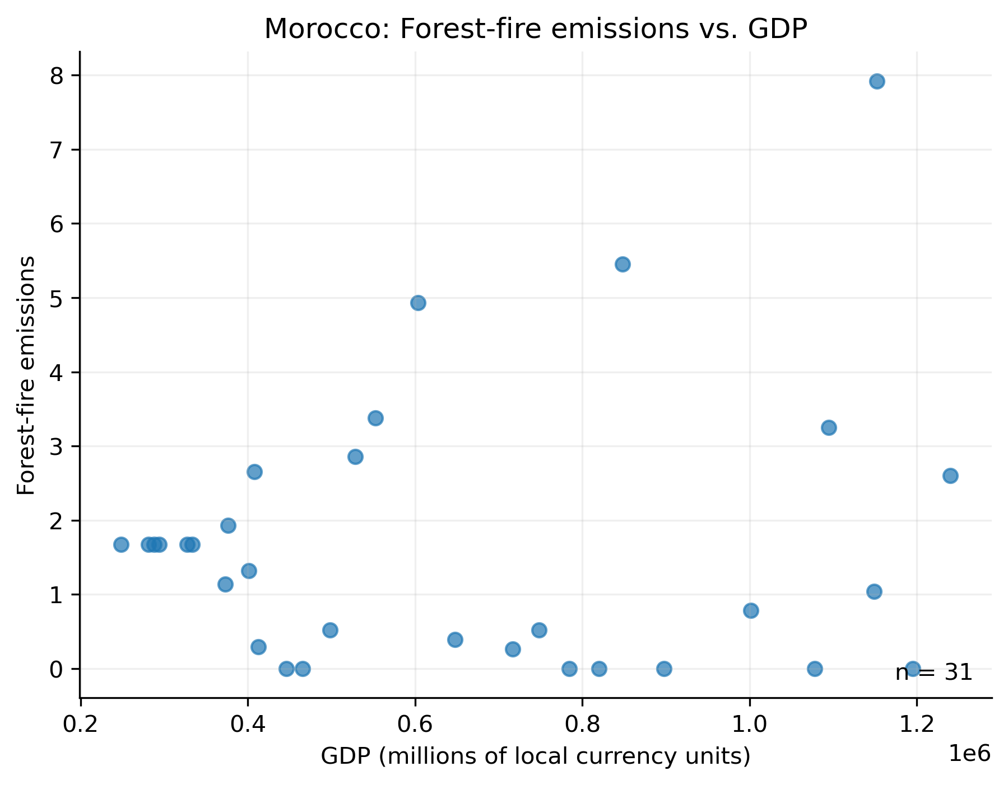
Results: Most recent timepoints have higher emissions

Slide 7
Methods: Creating one figure from scatter.py
Example: Denmark
emission file location
GDP file input parameter
scatter.py file location
emission file input parameter
GDP file location
python src/scatter.py --co2_file test/data/test_co2.csv --gdp_file test/data/test_gdp.csv --country "Denmark" --output figures/denmark.png
Country name
Image output location and format
Country name input parameter
image name input parameter

Slide 8
Methods: Figures for every country generated via batch command
for /f "delims=" %C in ('python -c "import csv; print('\n'.join(sorted({r['Area'] for r in csv.DictReader(open('data/Agrofood_co2_emission.csv', encoding='utf-8-sig'))})))"') do @python src/scatter.py --co2_file data/Agrofood_co2_emission.csv --gdp_file data/IMF_GDP.csv --country "%C" --output "figures/%C.png"

