Slide 1
Scheduling
9562822 曾令驊
9662809 薛琮樺
9662812 林餘德
Notes:
<number>

Slide 2
Outline
Introduction
Schedule algorithm
Schedule structure
Init scheduler
Every schedule tick
Schedule detail
Completely Fair Scheduler
Notes:
<number>

Slide 3
Introduction
The scheduler makes it possible to execute multiple programs at the same time, thus sharing the CPU with users of varying needs.
minimizing response time
maximizing overall CPU utilization
Notes:
An operating system, in a general sense, mediates between applications and available resources. Some typical resources are memory and physical devices. But a CPU can also be considered a resource to which a scheduler can temporarily allocate a task (in quantities called slices of time). The scheduler makes it possible to execute multiple programs at the same time, thus sharing the CPU with users of varying needs.
<number>

Slide 4
Schedule algorithm
Real-time scheduling
Priority 1~99
complete fair scheduling (cfs)
Priority 100~139
Notes:
<number>

Slide 5
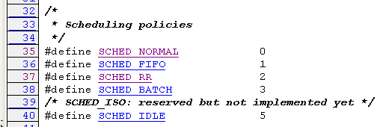
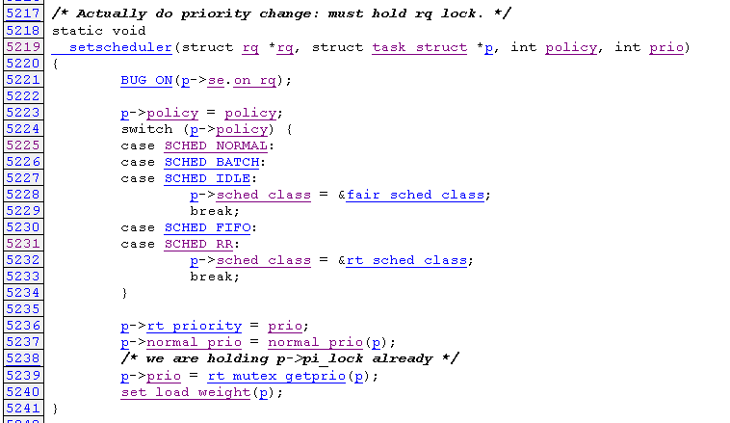
Scheduling policy
Include/linux/sched.h
Include/linux/sched.h
Notes:
經驗法則 or user決定
I/O bound vs CPU bound
<number>

Slide 6
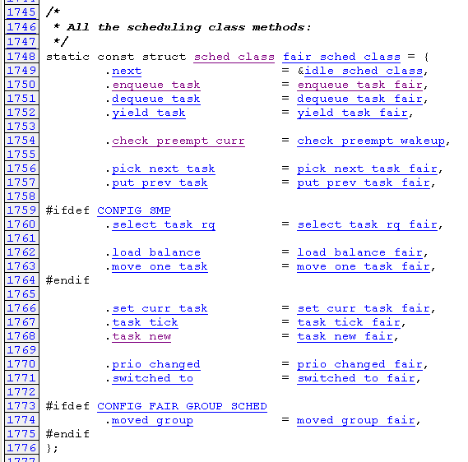
kernel/sched_fair.c
Notes:
<number>

Slide 7
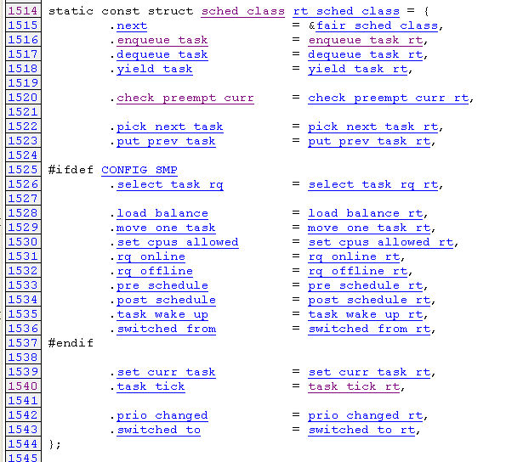
kernel/sched_rt.c
Notes:
<number>

Slide 8
Scheduling structure
task_struct
record all status about task, like policy, state …
sched_entity
cfs scheduling node
sched_rt_entity
Real-time scheduling node
rq
per-CPU runqueue data structure
cfs_rq
CFS-related fields in a runqueue
rt_rq
Real-Time classes‘ related field in a runqueue
Notes:
<number>

Slide 9
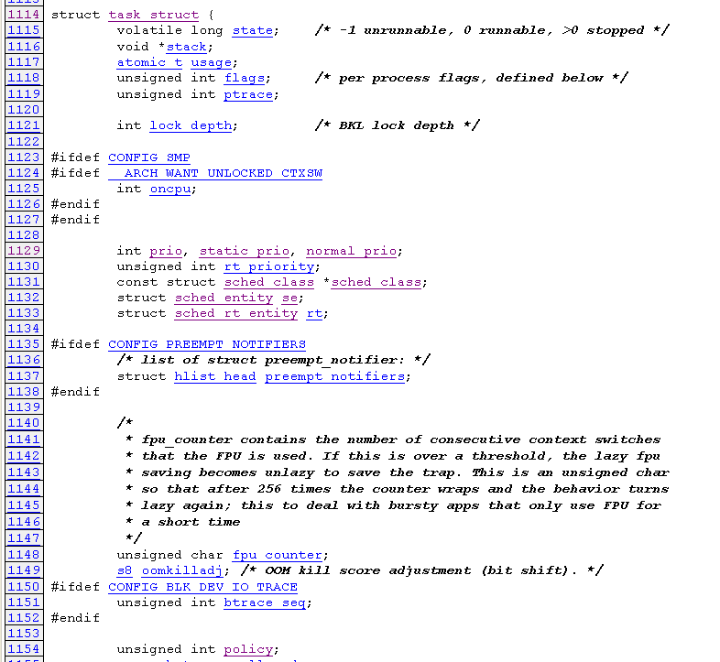
include/linux/sched.h
Notes:
<number>

Slide 10
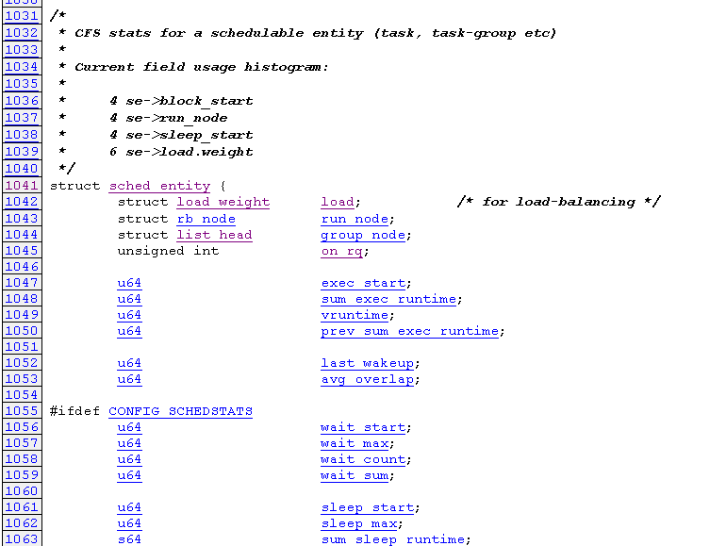
sched_entity
include/linux/sched.h
Notes:
<number>

Slide 11
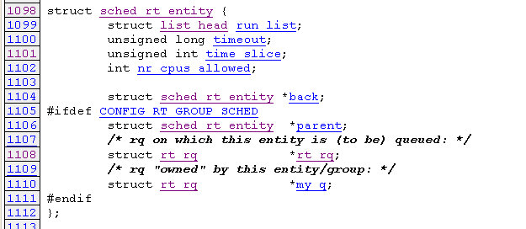
sched_rt_entity
include/linux/sched.h
Notes:
<number>

Slide 12
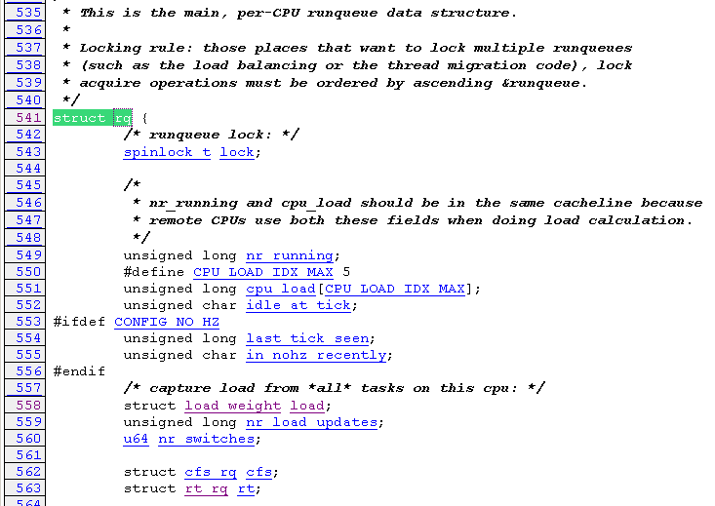
rq
kernel/sched.c
Notes:
<number>

Slide 13
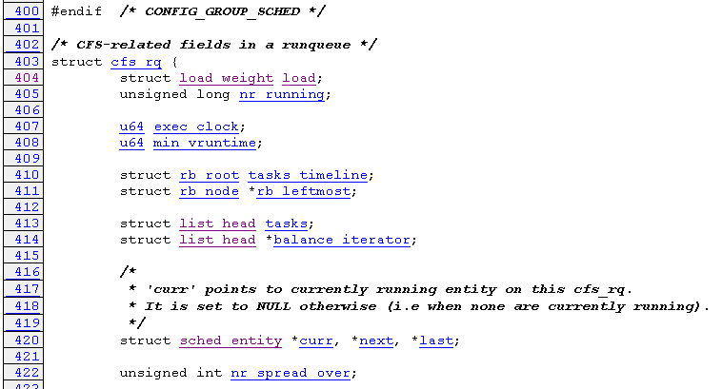
cfs_rq
kernel/sched.c
Notes:
<number>

Slide 14
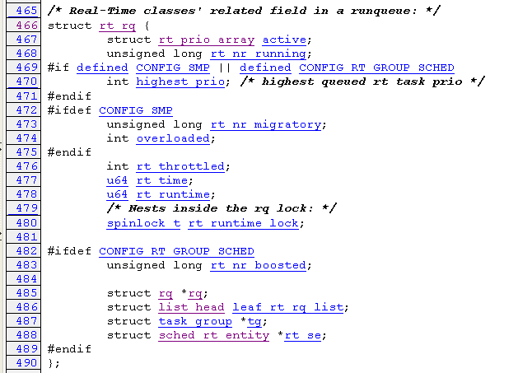
rt_rq
kernel/sched.c
Notes:
<number>

Slide 15
Initial scheduler
4
sched_init()
kernel_init()
sched_init_smp()
1
3
0
2
start_kernel()
rest_init()
do_fork()
wake_up_new_task
timer_interrupt
check_preempt_curr
do_exit
do_wait
Schedule()
sys_sigsuspend
sys_sched_yield
RT task
Non-RT task
cpu_idle()
Notes:
<number>

Slide 16
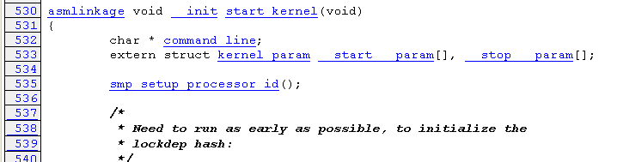
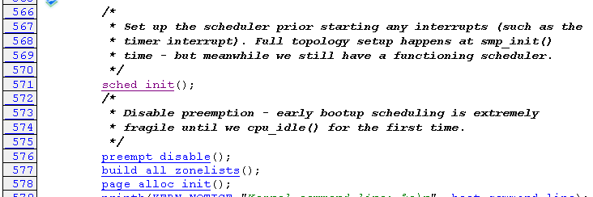



Initial scheduler
init/main.c
0
1
2
3
4
Notes:
<number>

Slide 17
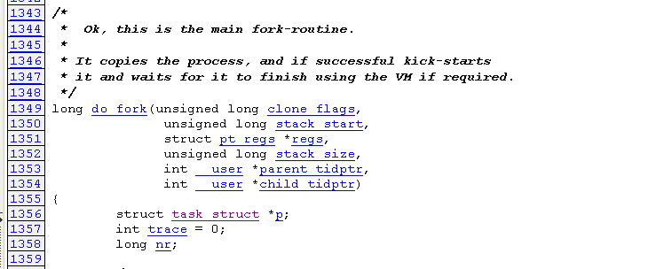
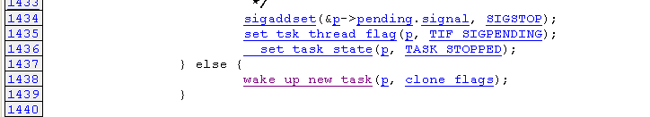
fork
kernel/fork.c
Notes:
<number>

Slide 18
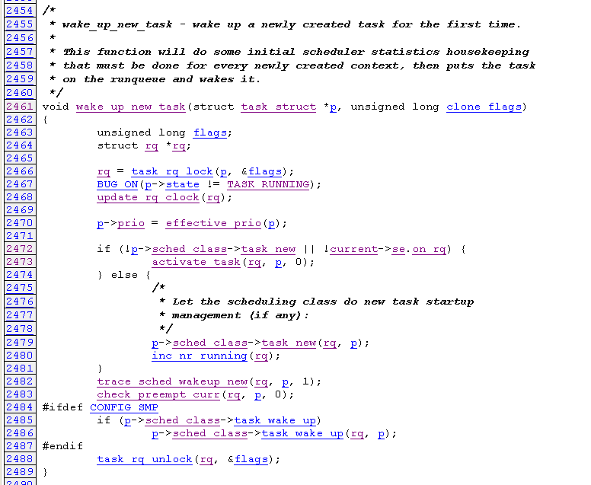
kernel/sched.c
Notes:
<number>

Slide 19
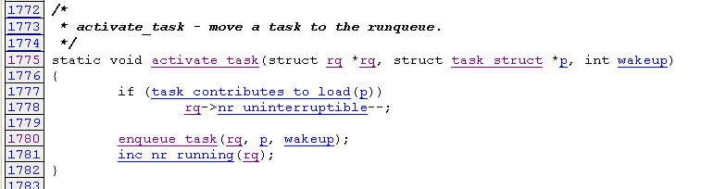
task_new
kernel/sched.c
Notes:
<number>

Slide 20
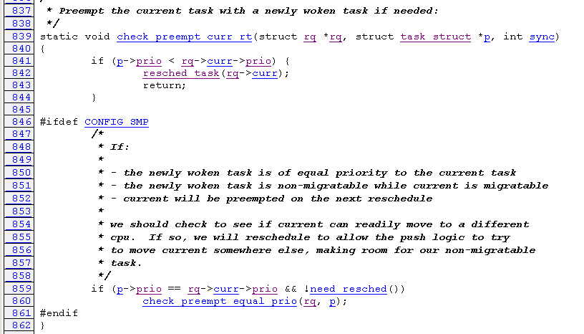
Check preempt curr
Real-time scheduling
kernel/sched.c
Notes:
<number>

Slide 21
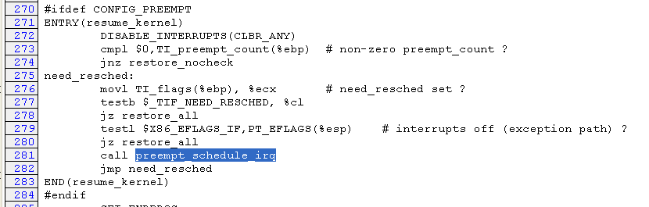
Timer interrupt
arch/x86/kernel/entry_32.S
Notes:
<number>

Slide 22
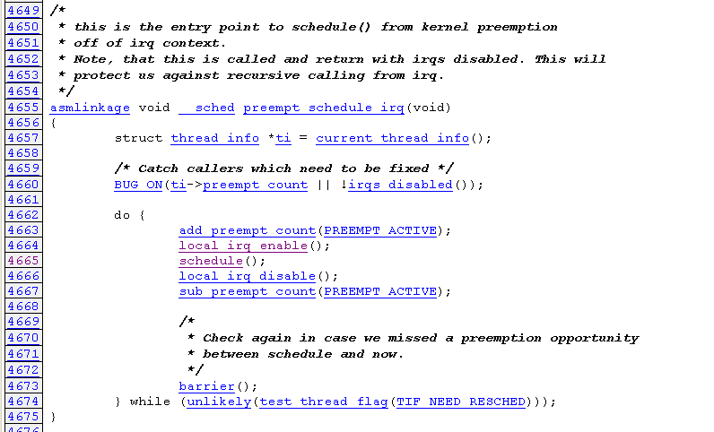
kernel/sched.c
Notes:
<number>

Slide 23
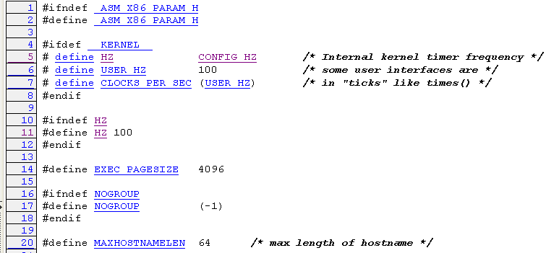
Flow or word about schedule tick
Tick is inverse of HZ
Notes:
<number>

Slide 24
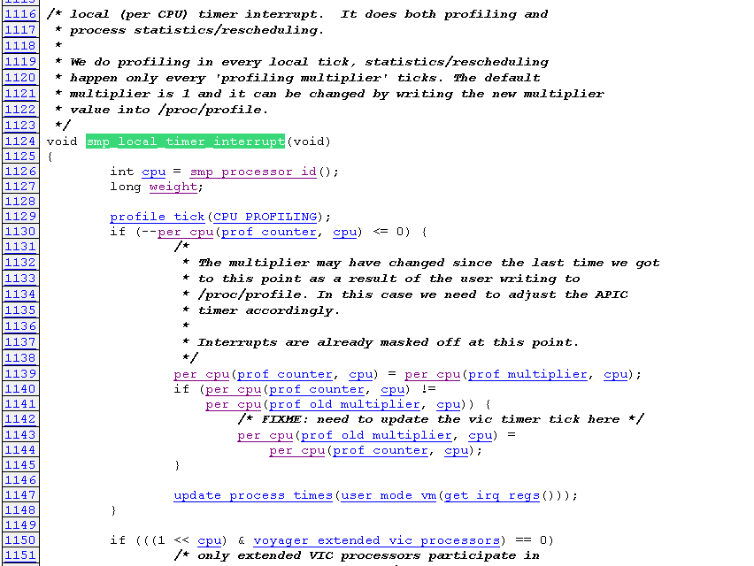
arch/x86/mach-voyager/voyager_smp.c
Notes:
<number>

Slide 25
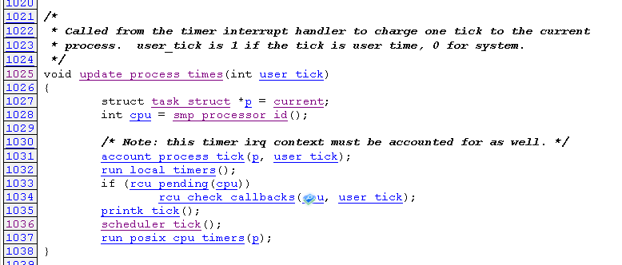
kernel/timer.c
Notes:
<number>

Slide 26
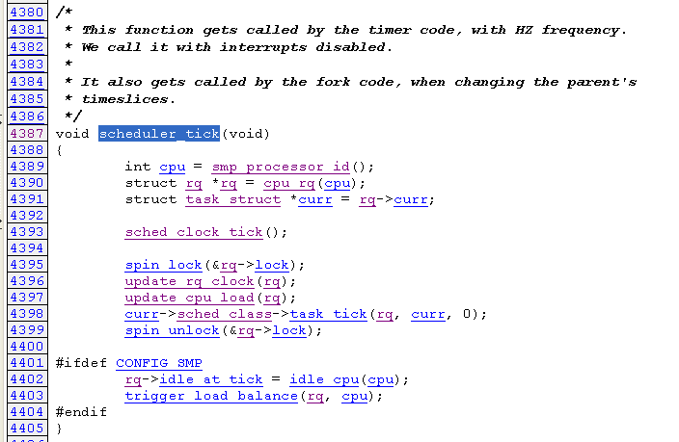
kernel/sched.c
Notes:
<number>

Slide 27
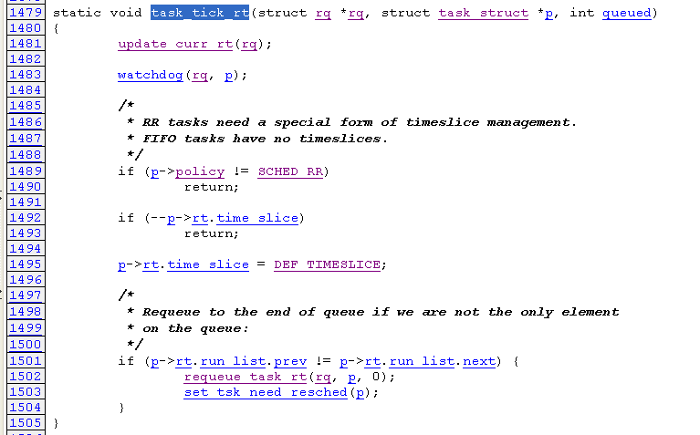
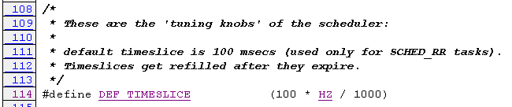
Real-time scheduling
kernel/sched_rt.c
kernel/sched.c
Notes:
<number>

Slide 28
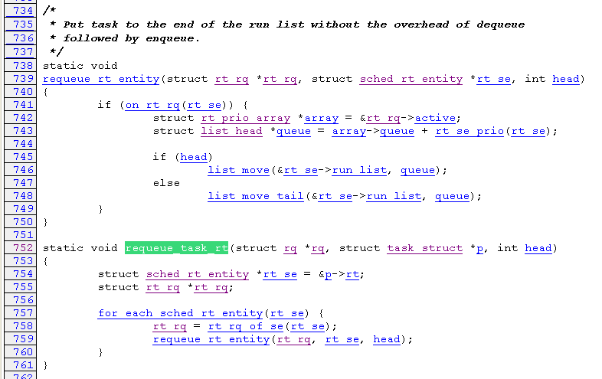
kernel/sched_rt.c
Notes:
<number>

Slide 29
Scheduling Flow
Schedule()
preempt_disable
Take rq and task
clear_tsk_need_resched
pick_next_task
put_prev_task
Check task state
deactivate_task
Check task same
preempt_disable
context_switch
Notes:
<number>

Slide 30
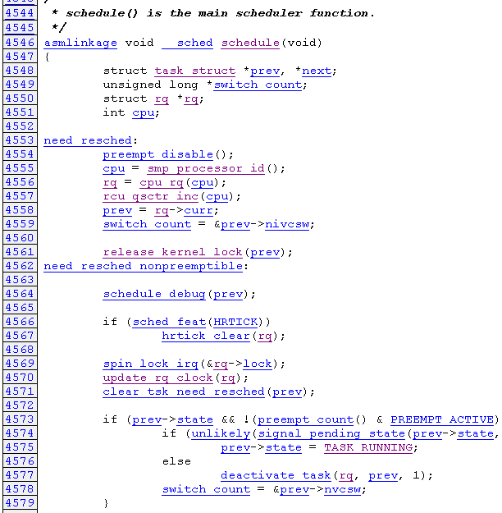
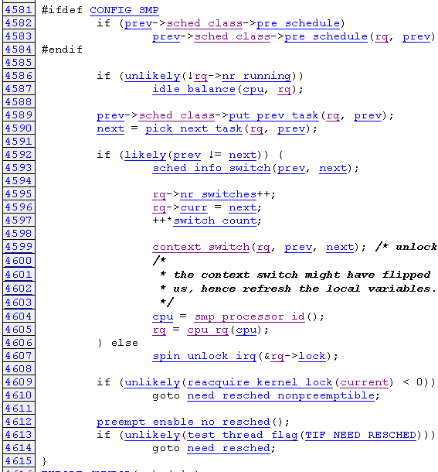
Schedule main function
kernel/sched.c
Notes:
<number>

Slide 31
Scheduling Flow
Schedule()
preempt_disable
Take rq and task
clear_tsk_need_resched
pick_next_task
put_prev_task
Check task state
deactivate_task
Check task same
preempt_disable
context_switch
Notes:
<number>

Slide 32



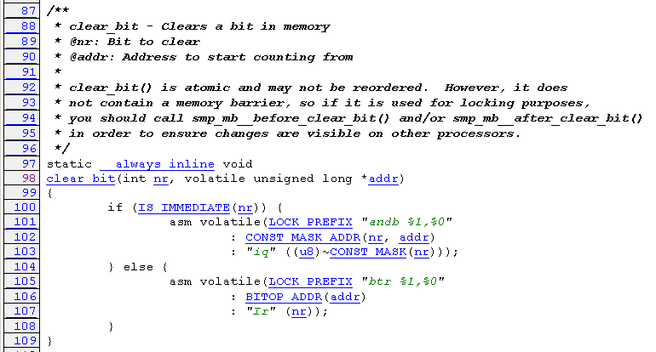
clear_tsk_need_resched
include/linux/sched.h
include/linux/thread_info.h
arch/x86/include/asm/bitops.h
Notes:
<number>

Slide 33
Scheduling Flow
Schedule()
preempt_disable
Take rq and task
clear_tsk_need_resched
pick_next_task
put_prev_task
Check task state
deactivate_task
Check task same
preempt_disable
context_switch
Notes:
<number>

Slide 34
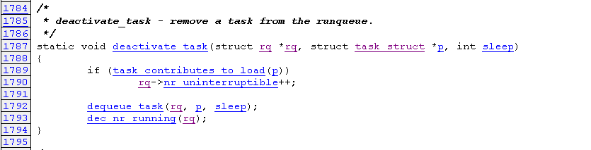
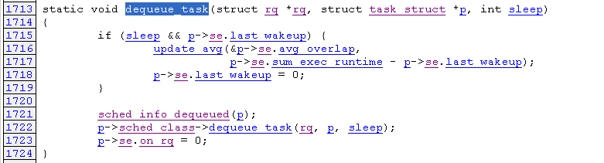
deactivate_task
kernel/sched.c
Notes:
<number>

Slide 35
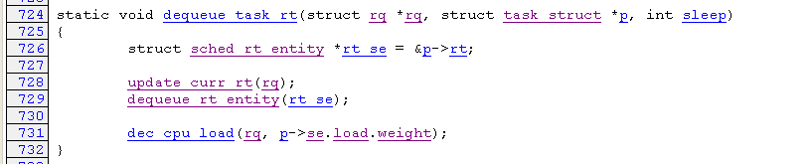
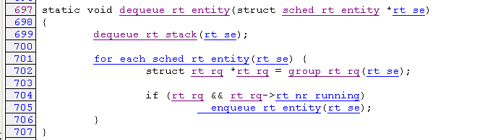
Real-time scheduling
kernel/sched_rt.c
Notes:
<number>

Slide 36
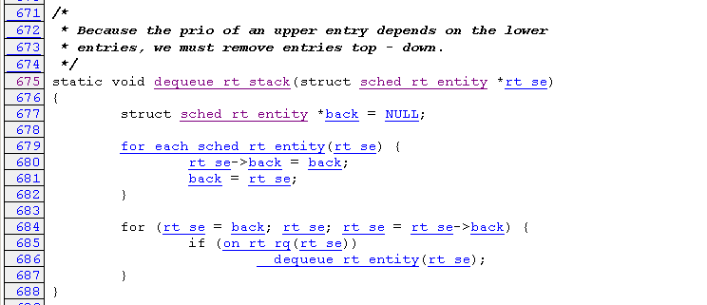
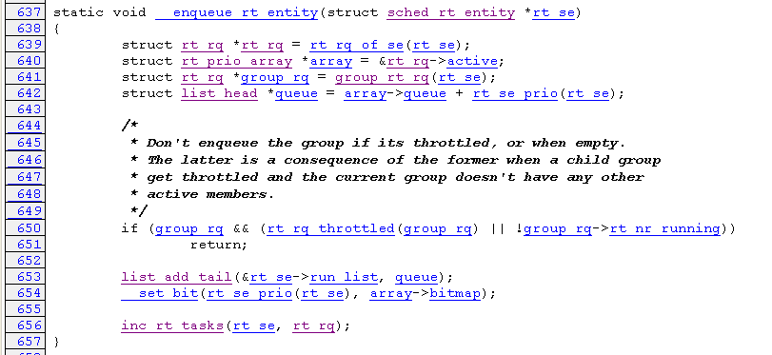
kernel/sched_rt.c
Notes:
<number>

Slide 37
Scheduling Flow
Schedule()
preempt_disable
Take rq and task
clear_tsk_need_resched
pick_next_task
put_prev_task
Check task state
deactivate_task
Check task same
preempt_disable
context_switch
Notes:
<number>

Slide 38

put_prev_task
Real-time scheduling
kernel/sched_rt.c
Notes:
<number>

Slide 39
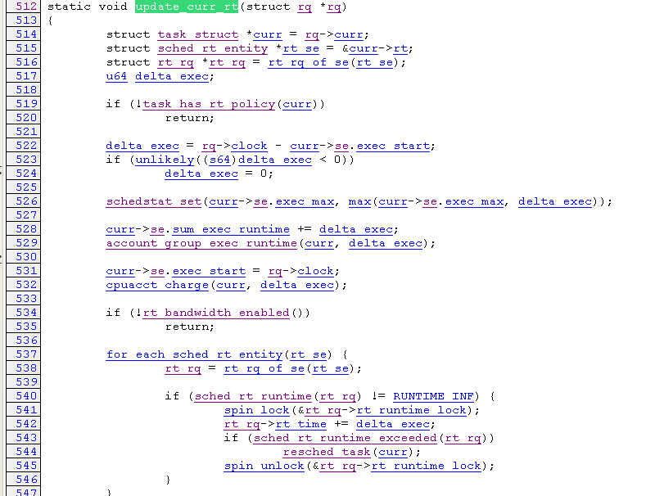
kernel/sched_rt.c
Notes:
<number>

Slide 40
Scheduling Flow
Schedule()
preempt_disable
Take rq and task
clear_tsk_need_resched
pick_next_task
put_prev_task
Check task state
deactivate_task
Check task same
preempt_disable
context_switch
Notes:
<number>

Slide 41
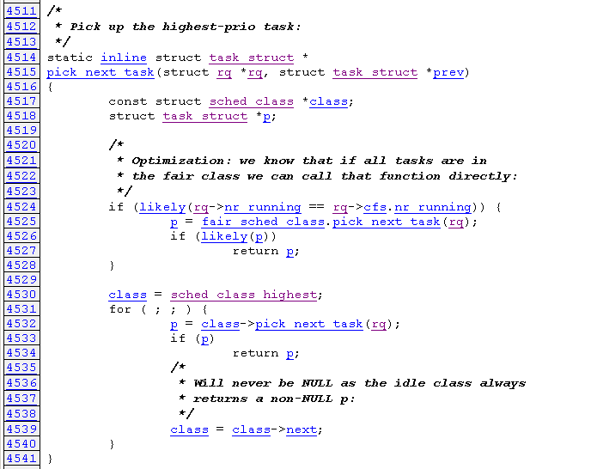
pick_next_task
kernel/sched.c
Notes:
<number>

Slide 42
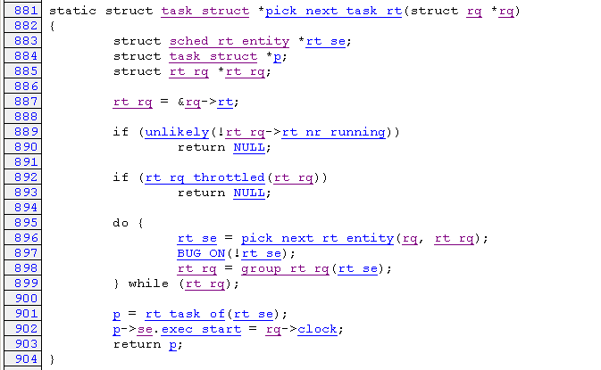
Real-time scheduling
kernel/sched_rt.c
Notes:
<number>

Slide 43
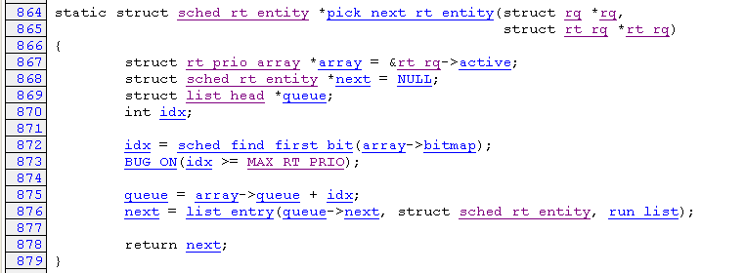
kernel/sched_rt.c
Notes:
<number>

Slide 44
rt_prio_array
bitmap
queue
1
0
0
1
0
2
1
3
0
4
…
0
…
5
0
94
0
95
1
96
0
97
1
98
0
99
Notes:
<number>

Slide 45
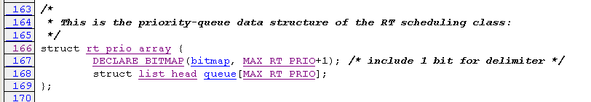
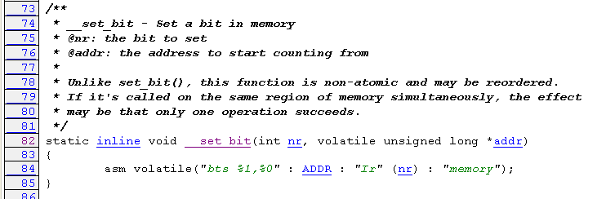
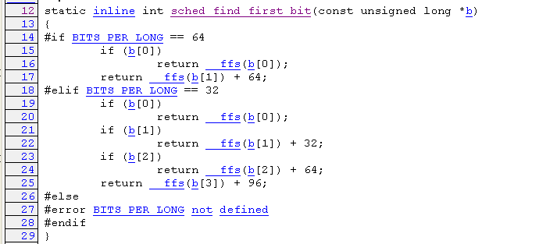
kernel/sched.c
arch/x86/include/asm/bitops.h
include/asm-generic/bitops/sched.h
Notes:
<number>

Slide 46
Scheduling Flow
Schedule()
preempt_disable
Take rq and task
clear_tsk_need_resched
pick_next_task
put_prev_task
Check task state
deactivate_task
Check task same
preempt_disable
context_switch
Notes:
<number>

Slide 47
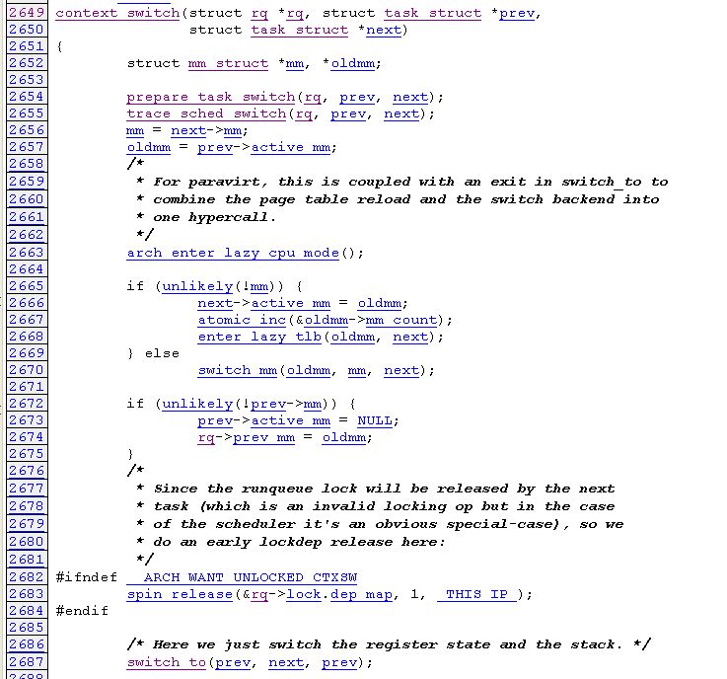
Context switch
kernel/sched.c
Notes:
<number>

Slide 48
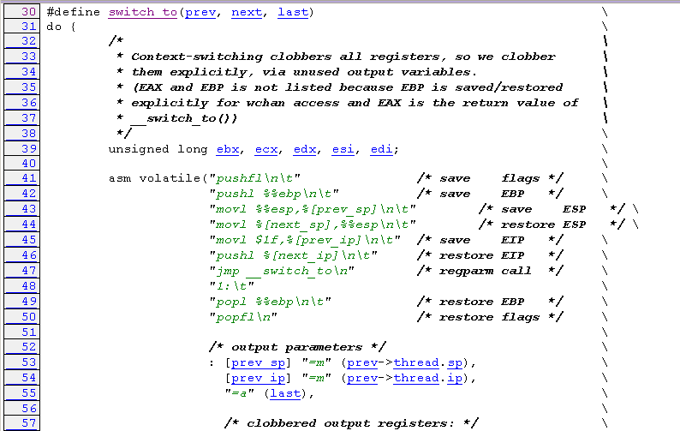
arch/x86/include/asm/system.h
Notes:
<number>

Slide 49
CFS
CFS stands for "Completely Fair Scheduler," and is implemented by Ingo Molnar and merged in Linux 2.6.23.
CFS basically models an "ideal, precise multi-tasking CPU" on real hardware.
Ideal multi-tasking CPU is non-existent since we can run only a single task at once.

Slide 50
CFS
CFS uses a time-ordered red-black tree for each CPU.
The feature of RB-tree approach:
The red-black tree is always balanced.
The time complexities of lookup operations are logarithmic. However, non-left-most lookup is hardly ever done and the left-most node pointer is always cached.
The red-black tree is O(log n) in time for most operations. (The previous scheduler employed O(1) )

Slide 51
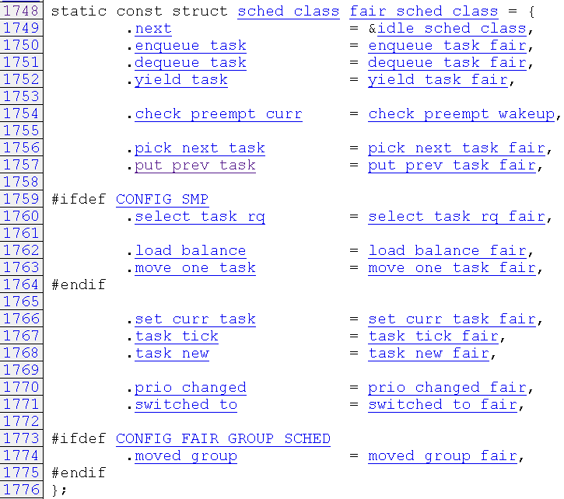
linux-2.6.29.2/kernel/sched_fair.c

Slide 52
DFS Traverse
scheduler_tick()
task_tick_fair( )
entity_tick( )
update_curr( )
check_preempt_tick( )
__update_curr( )
sched_slice( )
calc_delta_fair( )
__sched_period( )
calc_delta_mime( )
calc_delta_mime( )

Slide 53
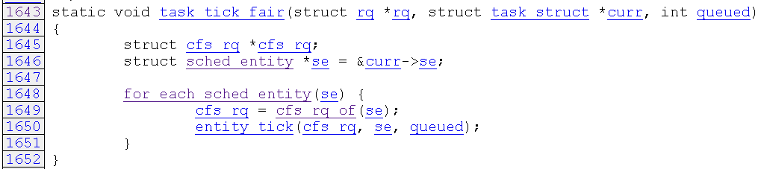
linux-2.6.29.2/kernel/sched_fair.c
#ifndef CONFIG_FAIR_GROUP_SCHED
for (; se; se = NULL)

Slide 54
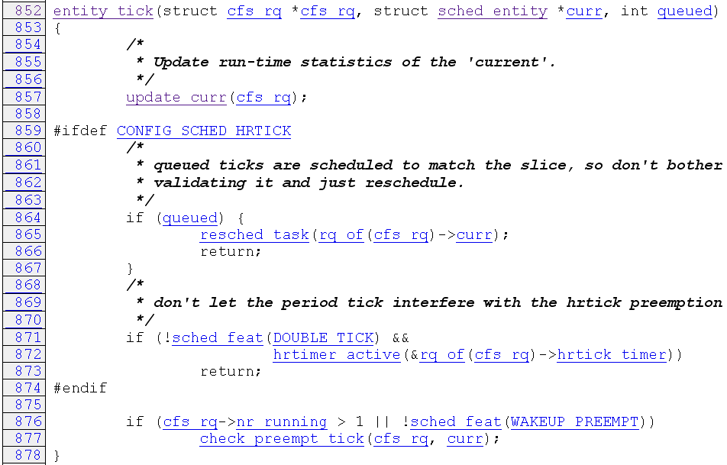
linux-2.6.29.2/kernel/sched_fair.c

Slide 55
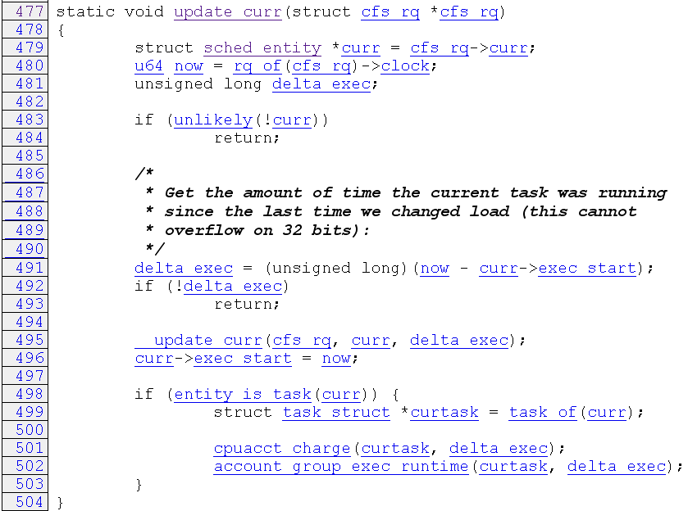
linux-2.6.29.2/kernel/sched_fair.c
Get the rq of cfs_rq
The time passed from last tick interrupt
Update the timestamp of current sched_entity

Slide 56
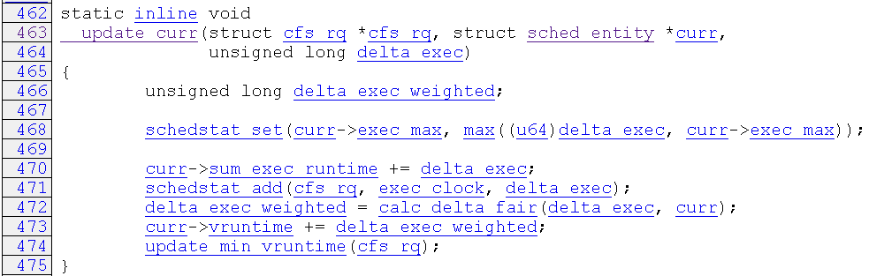
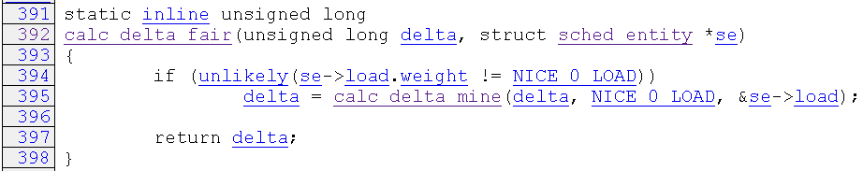
linux-2.6.29.2/kernel/sched_fair.c
Total execution time
Calculate weight
Nice ↑weight↓
Update min vruntime of cfs_rq ≈ vruntime of left most rb_tree
delta * NICE_O_LOAD / se->load->weight

Slide 57

linux-2.6.29.2/kernel/sched.c

Slide 58
DFS Traverse
scheduler_tick()
task_tick_fair( )
entity_tick( )
present position
update_curr( )
check_preempt_tick( )
__update_curr( )
sched_slice( )
calc_delta_fair( )
__sched_period( )
calc_delta_mime( )
calc_delta_mime( )

Slide 59

linux-2.6.29.2/kernel/sched_fair.c
Set TIF_NEED_RESCHED flag

Slide 60

linux-2.6.29.2/kernel/sched_fair.c

Slide 61

linux-2.6.29.2/kernel/sched_fair.c
20ms
5
4ms

Slide 62
DFS Traverse
scheduler_tick()
task_tick_fair( )
entity_tick( )
update_curr( )
check_preempt_tick( )
__update_curr( )
sched_slice( )
present position
calc_delta_fair( )
__sched_period( )
calc_delta_mime( )
calc_delta_mime( )

Slide 63
DFS Traverse
schedule()
put_prev_task_fair( )
pick_next_task_fair( )
put_prev_entity( )
pick_next_entity( )
set_next_entity( )
update_curr( )
__enqueue_entity( )
__pick_next_entity( )
__update_curr( )
wakeup_preempt_entity( )
calc_delta_fair( )
calc_delta_mime( )

Slide 64

linux-2.6.29.2/kernel/sched.c

Slide 65

linux-2.6.29.2/kernel/sched.c

Slide 66

linux-2.6.29.2/kernel/sched_fair.c

Slide 67

linux-2.6.29.2/kernel/sched_fair.c
If prev is on runqueue
Put prev back into RB-tree

Slide 68

linux-2.6.29.2/kernel/sched_fair.c
se->vruntime –
cfs_rq->min_vruntime
Move left
Move right

Slide 69

linux-2.6.29.2/kernel/sched_fair.c
Insert to RB-tree and set its color

Slide 70
DFS Traverse
schedule()
present position
put_prev_task_fair( )
pick_next_task_fair( )
put_prev_entity( )
pick_next_entity( )
set_next_entity( )
update_curr( )
__enqueue_entity( )
__pick_next_entity( )
__update_curr( )
wakeup_preempt_entity( )
calc_delta_fair( )
calc_delta_mime( )

Slide 71

linux-2.6.29.2/kernel/sched_fair.c
It will return NULL if CONFIG_FAIR_GROUP_SCHED

Slide 72


linux-2.6.29.2/kernel/sched_fair.c
cfs_rq->next will preempt se ?
cfs_rq->last will preempt se ?
Return leftmost node of RB-tree

Slide 73

linux-2.6.29.2/kernel/sched_fair.c
If se->vruntime >= curr->vruntime, can not preempt
If less than 1, se can not preempt curr
If vdiff greater than curr’s granularity, can preempt
If vdiff less than curr’s granularity, can not preempt

Slide 74
DFS Traverse
schedule()
put_prev_task_fair( )
pick_next_task_fair( )
present position
put_prev_entity( )
pick_next_entity( )
set_next_entity( )
update_curr( )
__enqueue_entity( )
__pick_next_entity( )
__update_curr( )
wakeup_preempt_entity( )
calc_delta_fair( )
calc_delta_mime( )

Slide 75

linux-2.6.29.2/kernel/sched_fair.c
If se is on run queue
remove se from RB-tree
Update start execution time of se

Slide 76
DFS Traverse
do_fork()
wake_up_new_task( )
task_new_fair( )
check_preempt_curr( )
place_entity( )
enqueue_task_fair( )
enqueue_entity( )
account_entity_enqueue( )

Slide 77

linux-2.6.29.2/kernel/sched_fair.c
Adjust vruntime of new se
If child’s vruntime greater then parent’s, swap

Slide 78

linux-2.6.29.2/kernel/sched_fair.c
for new task
Convert schedule slice to virtual run time
for wake up task
For task slept for a long time, its vruntime might be far less than min_vruntime. It will hold entire CPU if without adjusting.
New vruntime can not be less than old vruntime

Slide 79
DFS Traverse
do_fork()
wake_up_new_task( )
task_new_fair( )
present position
check_preempt_wakeup( )
place_entity( )
enqueue_task_fair( )
enqueue_entity( )
account_entity_enqueue( )

Slide 80

linux-2.6.29.2/kernel/sched_fair.c
Specify it is call by wakeup or fork

Slide 81


linux-2.6.29.2/kernel/sched_fair.c
Calculate load and nr_running of cfs_rq. Set se->on_rq to 1
If come from wakeup, call place_entity to adjust vruntime
If se is not the current task, add se to RB_tree
Increase the load of cfs_rq
Increase the load of run queue
Increase the number of running task

Slide 82
DFS Traverse
do_fork()
wake_up_new_task( )
present position
task_new_fair( )
check_preempt_wakeup( )
place_entity( )
enqueue_task_fair( )
enqueue_entity( )
account_entity_enqueue( )

Slide 83

linux-2.6.29.2/kernel/sched_fair.c
For rt task
If not CFS
If the wakeuped task is the same as current task

Slide 84

linux-2.6.29.2/kernel/sched_fair.c
If not allow preemption while wakeup
Check to see if the wakeuped task can preempt current task

Slide 85

linux-2.6.29.2/kernel/sched_fair.c

