Slide 1
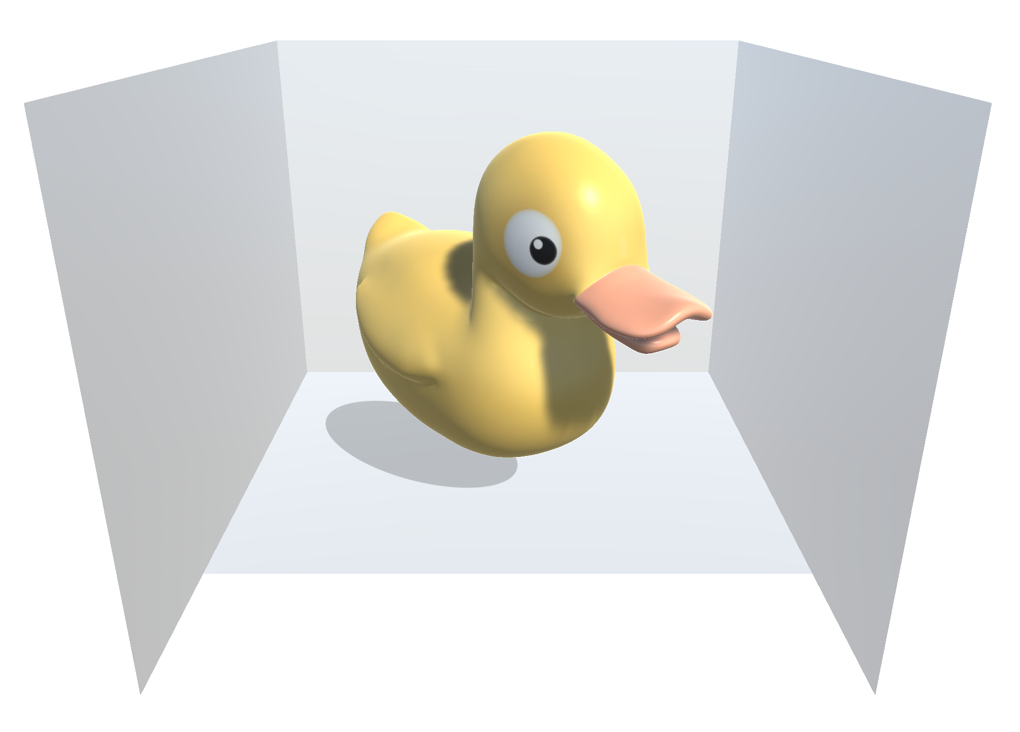
Unity 3D Server for CAVE Rendering
Bachelorthesis

