Slide 1
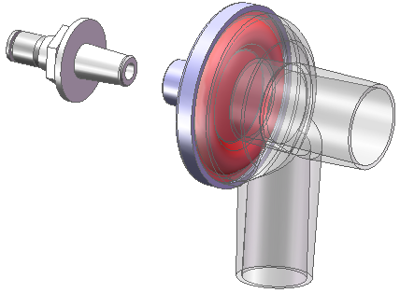
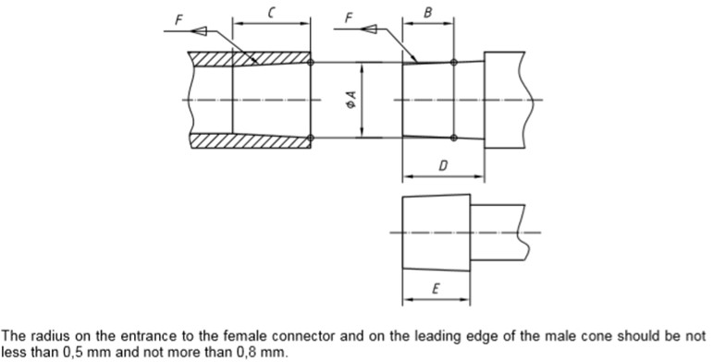
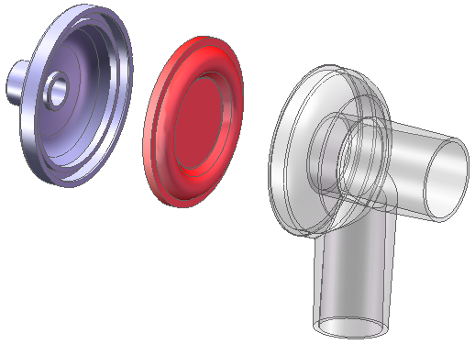
Steel spigot for push fit
22M female
EN ISO5356-1:2004 on Anaesthetic and respiratory equipment – Conical connectors – Part 1: Cones and sockets
22mm conical connector for ventilators
# | Description | Dimension
A | Diameter at point of engagement | 22.39 +/-0.04
B | Depth of point of engagement, for male part | 15mm
C | Taper length, female part | 21
D | Clearance to shoulder | 25.5mm
E | Taper length, male part | 19.5mm
F | Taper ratio | 1:40 (=1.49 degree)
22M male
ABS
Elastomeric or silicon rubber
3 component parts
ABS
Snap fit together (consider ultrasonic welding for mass-production)

