Slide 1
Trends in Data Science (2017-2021)
Presented by: William Ming

Slide 2
Objectives
Understand the changes in the demographics of Data Science professionals
Understand the technical skills and tools used by Data Science professionals in practice

Slide 3
Dataset
Annual online survey conducted by Kaggle – a platform for data science enthusiasts
Respondents can include those who are not working in data science, e.g. students, software engineers. Hence, analysis was narrowed to respondents with any of the following job titles:
Data Scientist
Data Analyst
Data Miner
Data Journalist

Slide 4
Demographics
Gender
Age
Educational Qualifications

Slide 5
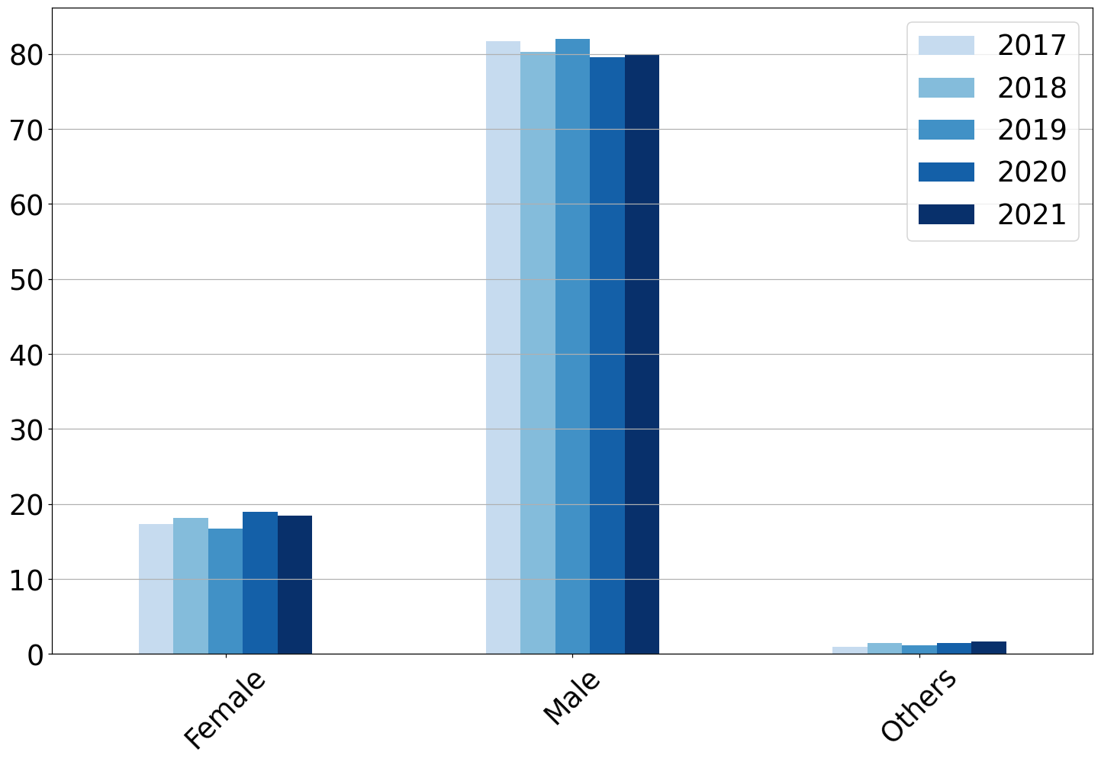
Gender
Gender Distribution (2017-2021)
No significant changes in gender distribution throughout the years
Male-dominated field: Males consistently represented ~80% of the data science professionals surveyed
Percentage of Respondents
Gender

Slide 6
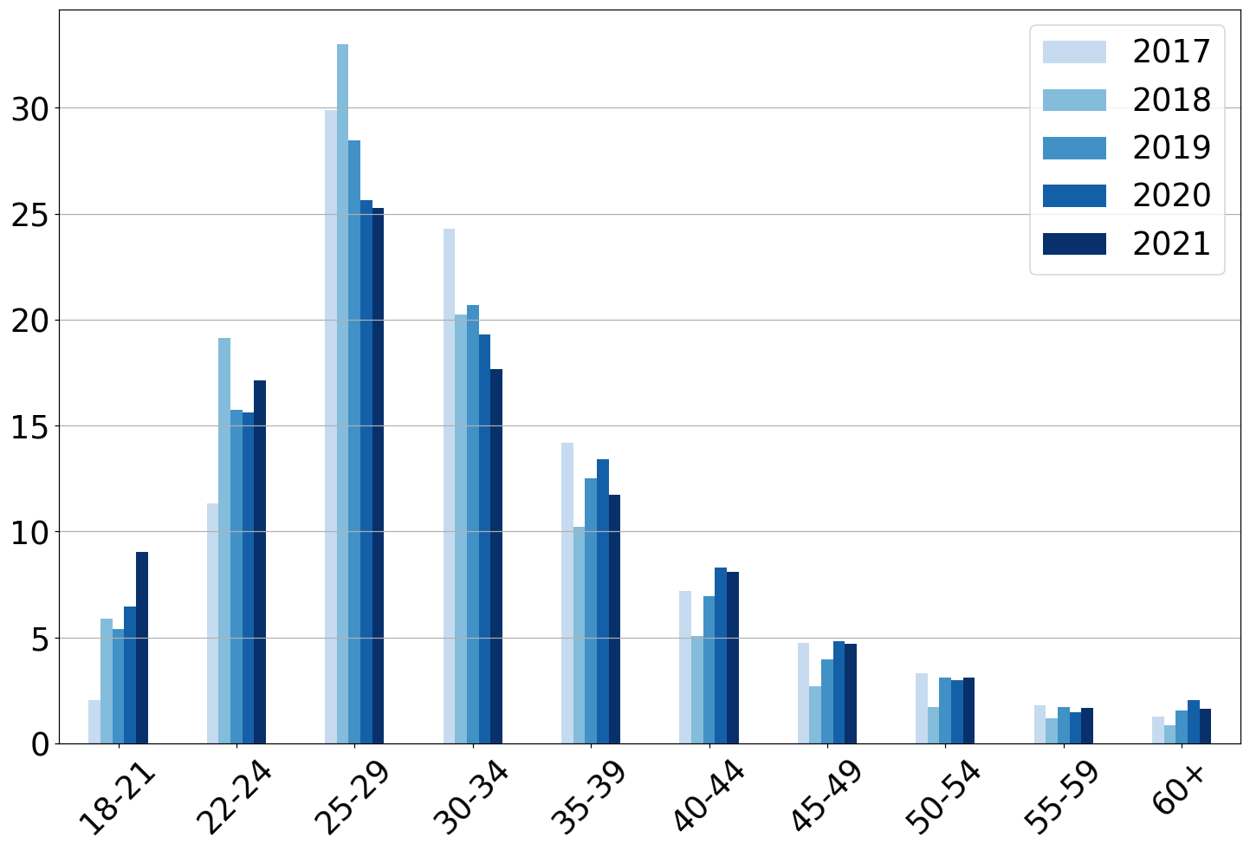
Age Distribution
Age Distribution (2017-2021)
Majority of data science professionals are 22-34 years old across all years
25-29 remains the largest group, albeit forming a smaller percentage in recent years
Fastest-growing age group: 18-21
Percentage of Respondents
Age Group

Slide 7
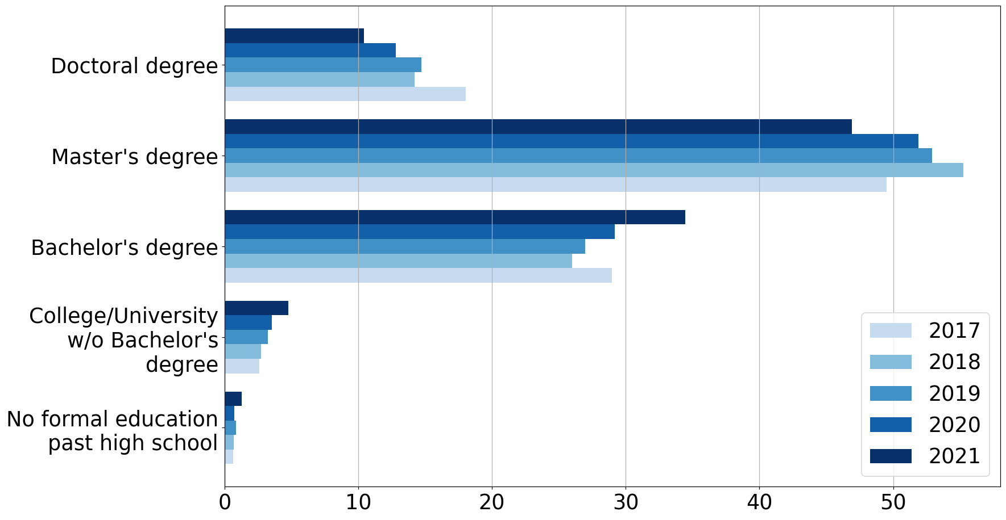
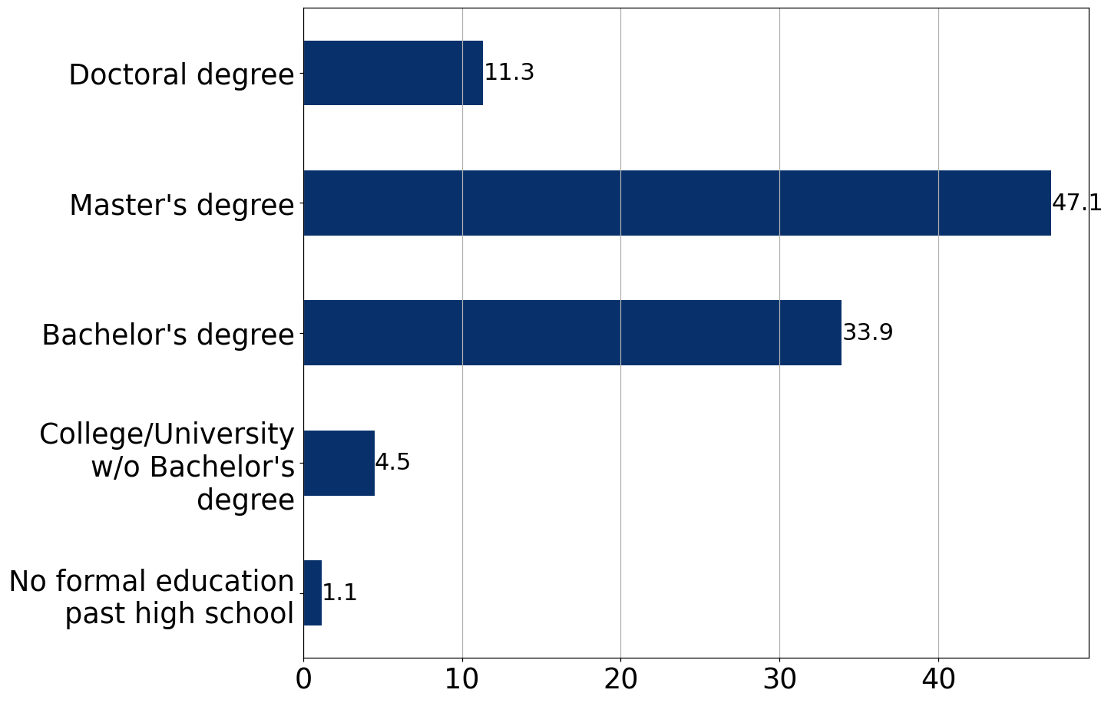
Education
Highest level of formal education (2017-2021)
Highest level of formal education (2021)
Preference for advanced degrees: Majority of respondents (>58%) have a Master’s degree or higher in 2021
Data Science without an advanced degree has become more common
Bachelor’s degree: 28.2% → 33.9%
Below bachelor’s degree: 3.2% → 5.6%
Percentage of respondents

Slide 8
Technical Skills
Programming Languages
Machine Learning Frameworks

Slide 9
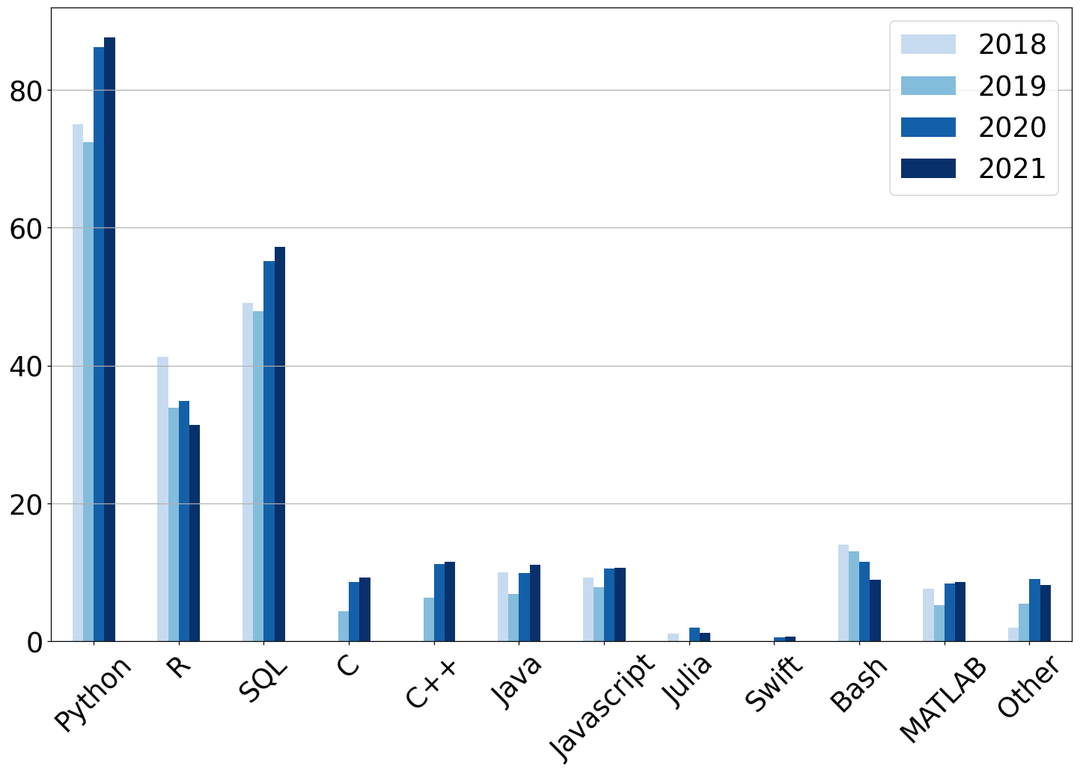
Programming Languages
Regularly used programming languages (2018-2021)
Consistently highest usage: Python & SQL, with both usage rates increasing
Significant but decreasing popularity of R: The 3rd most popular language is seeing decreasing usage
Increase in usage of C and C++: Possibly indicating higher need for low-level memory management and high-speed ML
Percentage of respondents
Programming Language

Slide 10
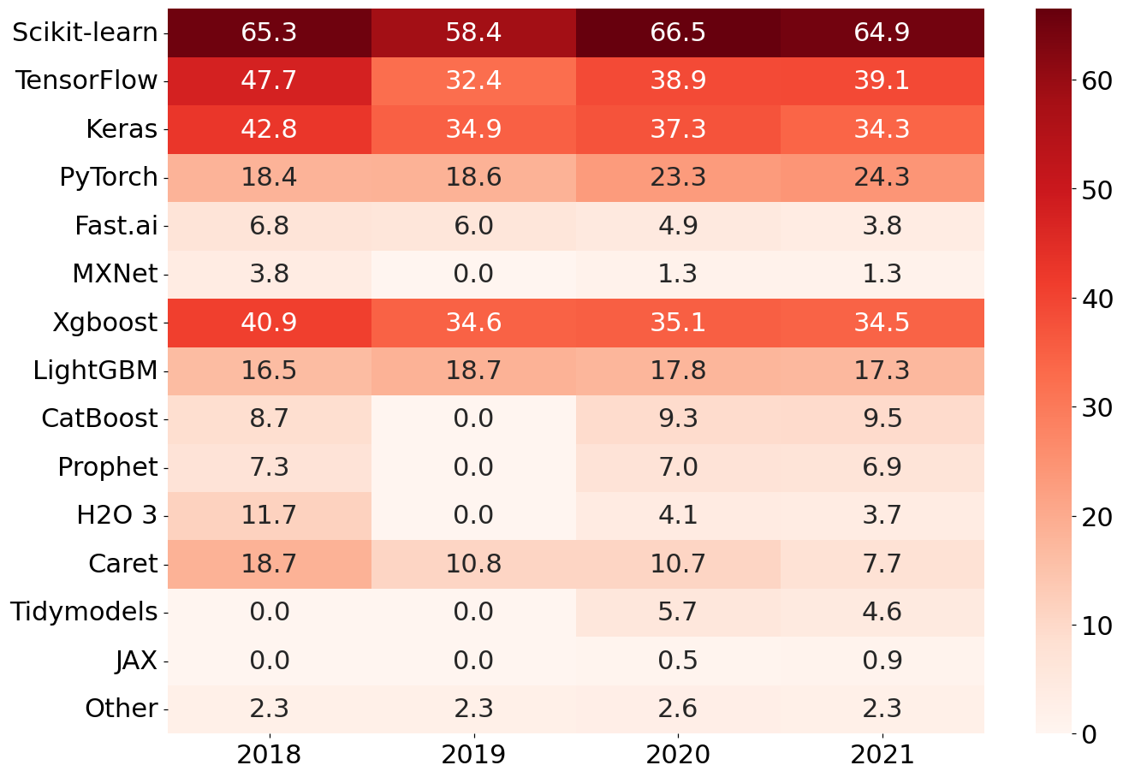
Machine Learning Frameworks
Adoption of Machine Learning Tools (2018 – 2021)
Traditional ML dominates: Scikit-learn consistently has the highest adoption rate
Shifts in Deep Learning tools: PyTorch has gained traction, while TensorFlow & Keras have declined
Low adoption of R-based tools (Caret & Tidymodels), with Caret declining each year
Percentage of respondents
Year

Slide 11
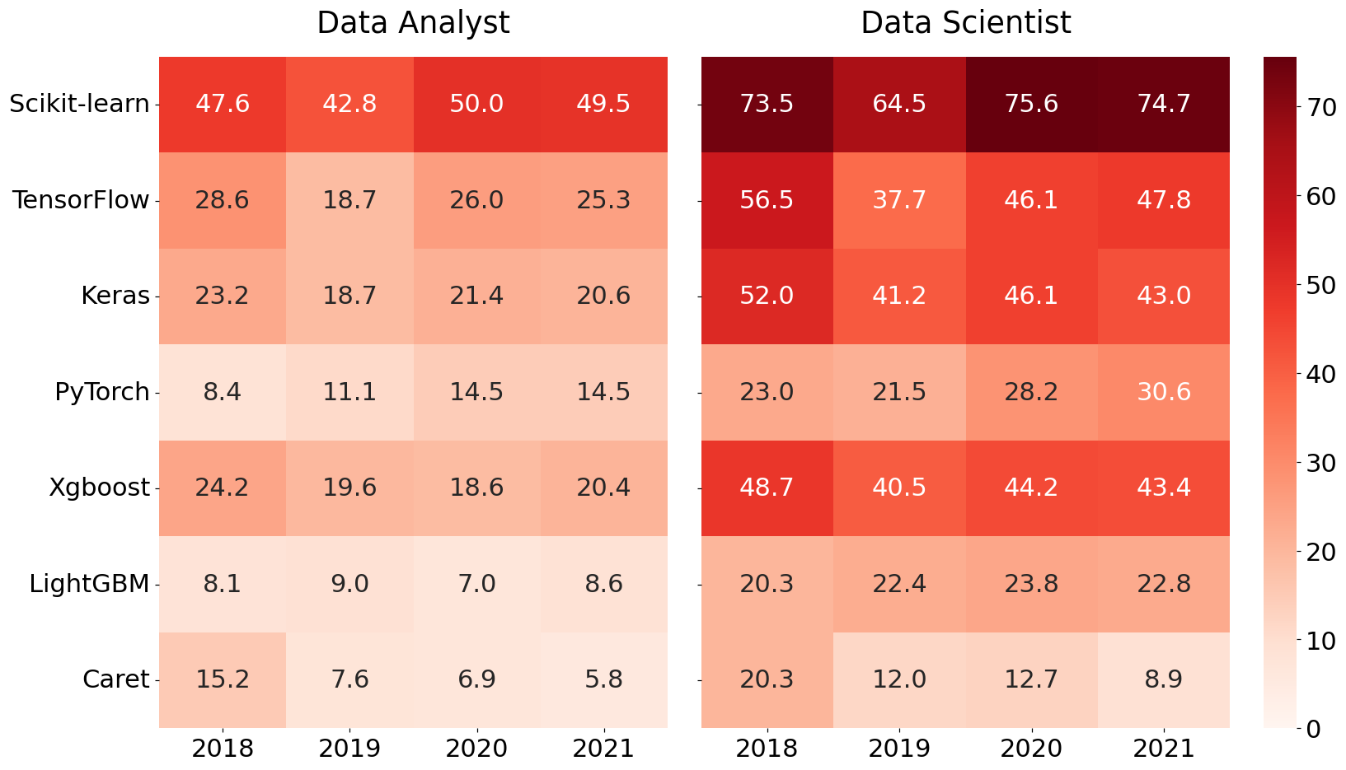
Machine Learning Frameworks
Comparison of ML Tool Adoption Rates between
Data Analysts & Data Scientists (2018-2021)
Higher ML adoption rates among data scientists
High usage of Scikit-learn in both roles
Adoption of deep learning tools among data analysts: ~35% of DAs surveyed each year used at least one of TensorFlow, Keras and PyTorch
Percentage of respondents within job title
Year

Slide 12
Summary
Demographics
Male-dominated
Increasingly younger
Advanced degrees becoming less common, but still dominates
Technical Skills
Python & SQL remain dominant in data science
Scikit-learn sees high usage as a foundational ML library
Deep Learning tools see usage by both data analysts and scientists

