Slide 1
Chronic Disease Surveillance Demo II
August 12, 2021

Slide 2
Agenda
Review of project goals
Overview of demo scenario / environment
End-to-end demo w/ Analytics UI

Slide 3
Project Goals
Demonstrate the usage of HL7 FHIR standards and existing infrastructure to enable chronic disease surveillance use cases
Core surveillance activities:
Distribute reporting specifications to sites
Data submission from sites
Initial reporting scenarios:
Blood Pressure Control
Diabetes A1C Control
Proof of Concept Analytics UI

Slide 4
Reporting Specification
Related to various existing specifications
Clinical Quality Measures - http://hl7.org/fhir/us/cqfmeasures/
Electronic Case Reporting (eCR) - http://build.fhir.org/ig/HL7/case-reporting/
MedMorph - https://build.fhir.org/ig/HL7/fhir-medmorph/
Other supporting IGs
Reporting Program Specification
Shipped to sites, specifies indicators and reporting workflow
https://github.com/DBCG/aphl-chronic-disease-surveillance-ig
eRSD: http://build.fhir.org/ig/HL7/case-reporting/electronic_reporting_and_surveillance_distribution_ersd_transaction_and_profiles.html

Slide 5
Data Submission
Also related to various existing specifications
Clinical Quality Measures - http://hl7.org/fhir/us/cqfmeasures/
Electronic Case Reporting (eCR) - http://build.fhir.org/ig/HL7/case-reporting/
Other supporting IGs
Submitted data can include:
Reports on the measure(s)
Line-list data about patients

Slide 6
Existing Infrastructure
eCR Now App
Adds eCR capabilities to existing EHRs
Deployed to major EHRs
Enhanced to support the chronic surveillance reporting specification, in particular Measure reporting
Executes workflow and submits data

Slide 7
What’s New?
Added support for the “Seen Patients” Cohort Measure
Measure data and line-list data is linked now (wasn’t previously)
Calculating aggregate data based on the individual submissions
Added stratifier calculations (didn’t previously calculate)
UI is wired up to the PHA Surveillance Repository, instead of running on mock data
Notes:
JP

Slide 8






Surveillance Reporting Process (122 & 165)
Numerator
Denominator
Sent to PHA
Initial population
Considered for reporting
Triggered patients
Seen patients
General population
Notes:
Bryn

Slide 9
Surveillance Reporting Process (seen patients)
Numerator
Denominator
Proportion
Sent to PHA
Initial population
Cohort
Considered for reporting
Triggered patients
Seen patients
General population
Notes:
Bryn

Slide 10
Demo Scenario
Simulates Patient visiting site, triggering reporting workflow
eCR Now App uses measures to produce measure reports and submits line-list data as appropriate
A bit technical since this is all “backend” stuff
Will show before and after of PHA
Notes:
JP

Slide 11
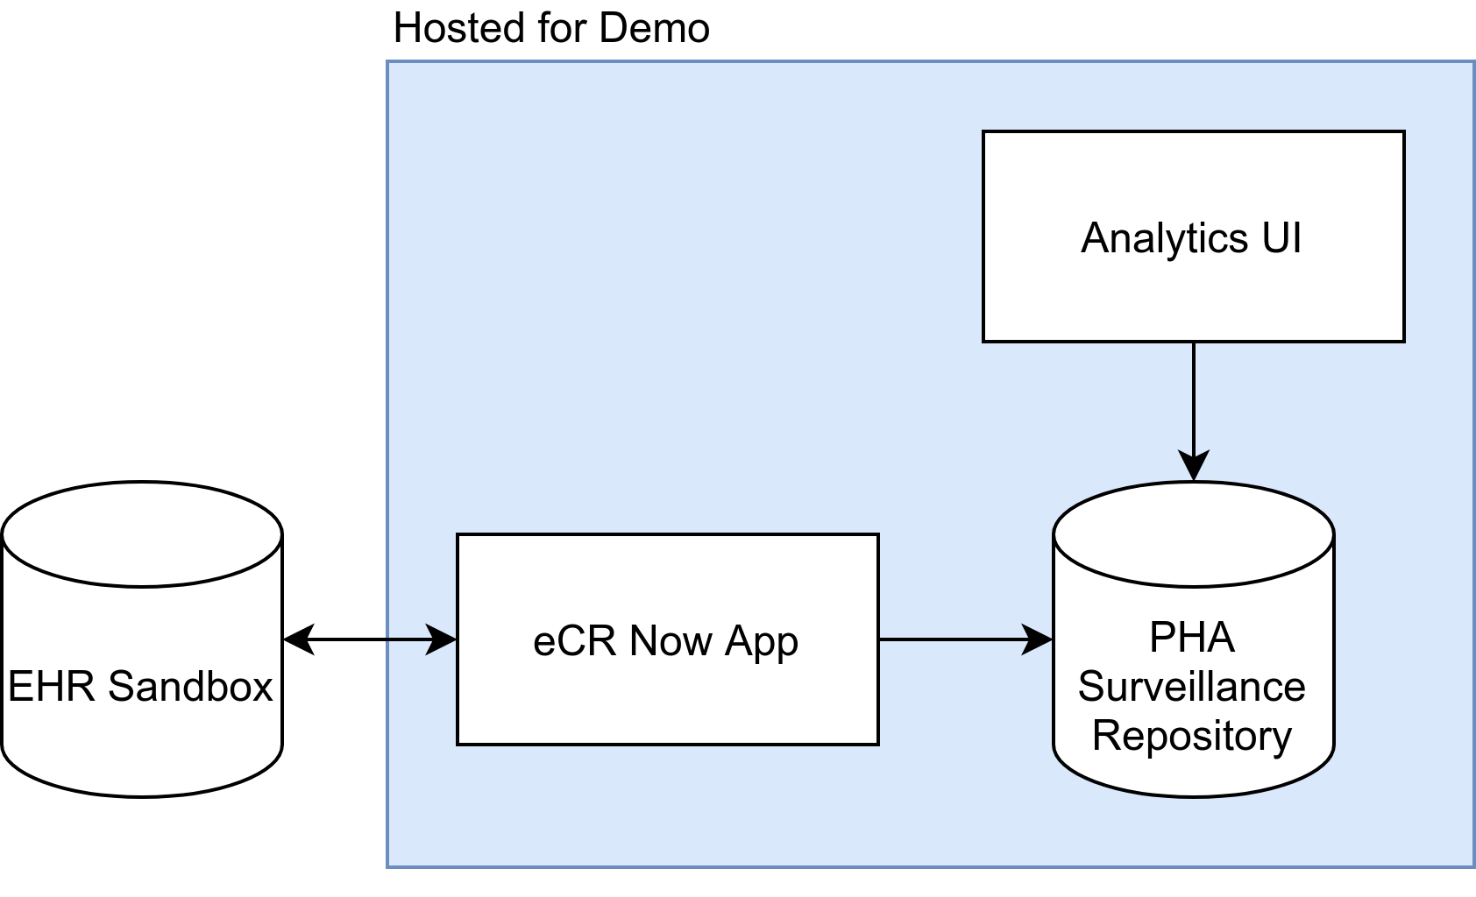
Demo Environment

Slide 12
Demo Discussion / Q&A
This portion of the demo showed collection and submission of the relevant data, which is the core functionality the project hoped to achieve

Slide 13
Analytics UI Demo
This analytics UI demonstrates some of the possible ways in which the data collected could be used and visualized
Stratifications shown are Gender, Age, Race, and Ethnicity
Shows line-list data per subject (not for “seen patients”)
Same demonstration as last time, but connected to PHA Surveillance repository
PHA Repository has “Seen Patients” data now
Notes:
Patrick

Slide 14
Discussion

Slide 15
Continued Testing
Developed a test plan to ensure correct functionality using the demonstration use cases
Will make these test cases part of the testing suite
We would like to test a scenario around this in the eCR/MedMorph track at FHIR Connectathon 28 in September
Notes:
Patrick

