Slide 1

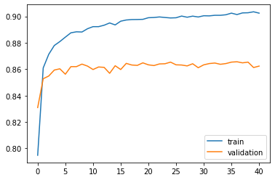
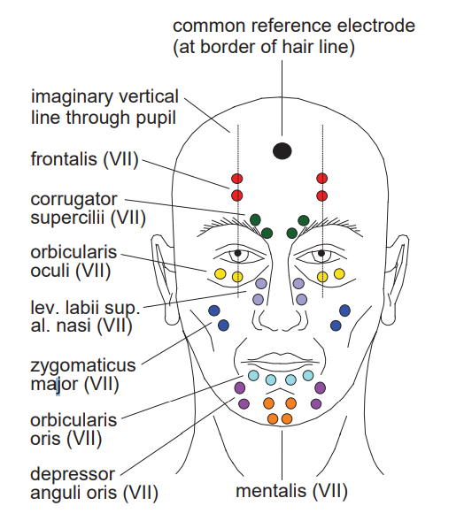
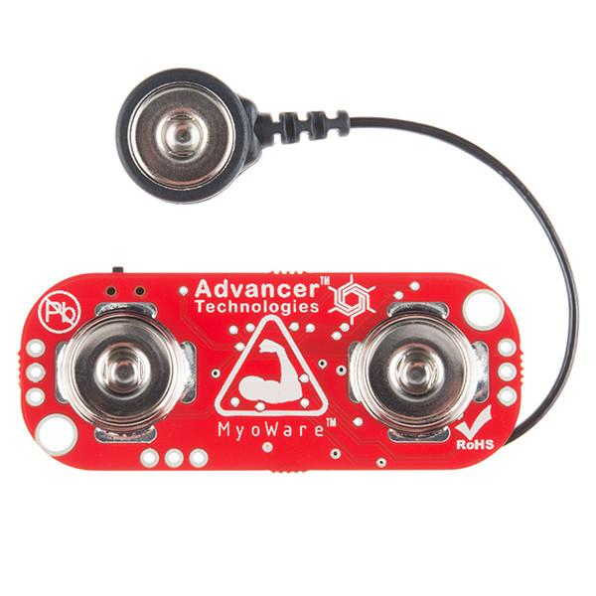
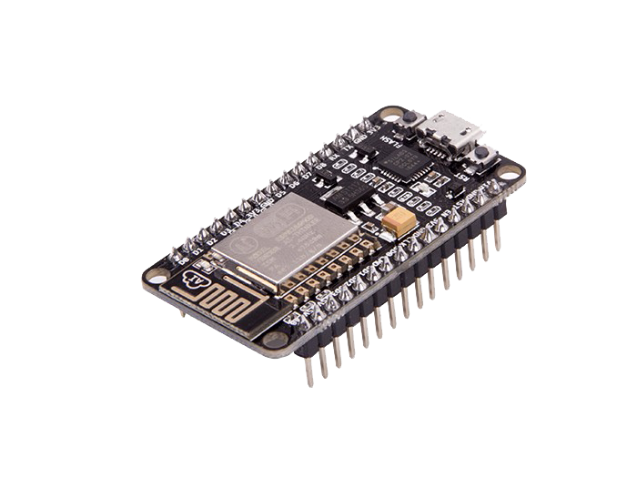



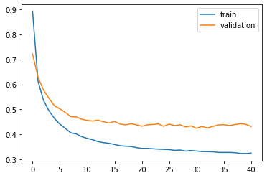
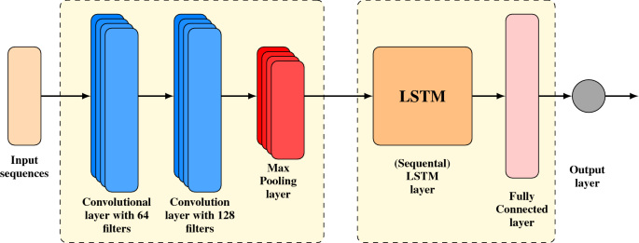
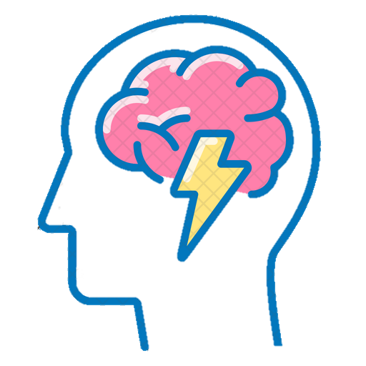
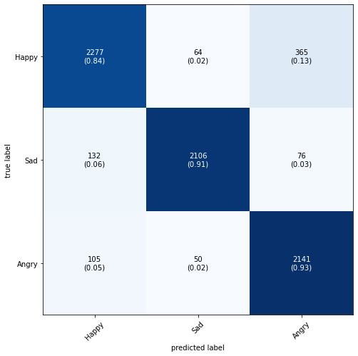
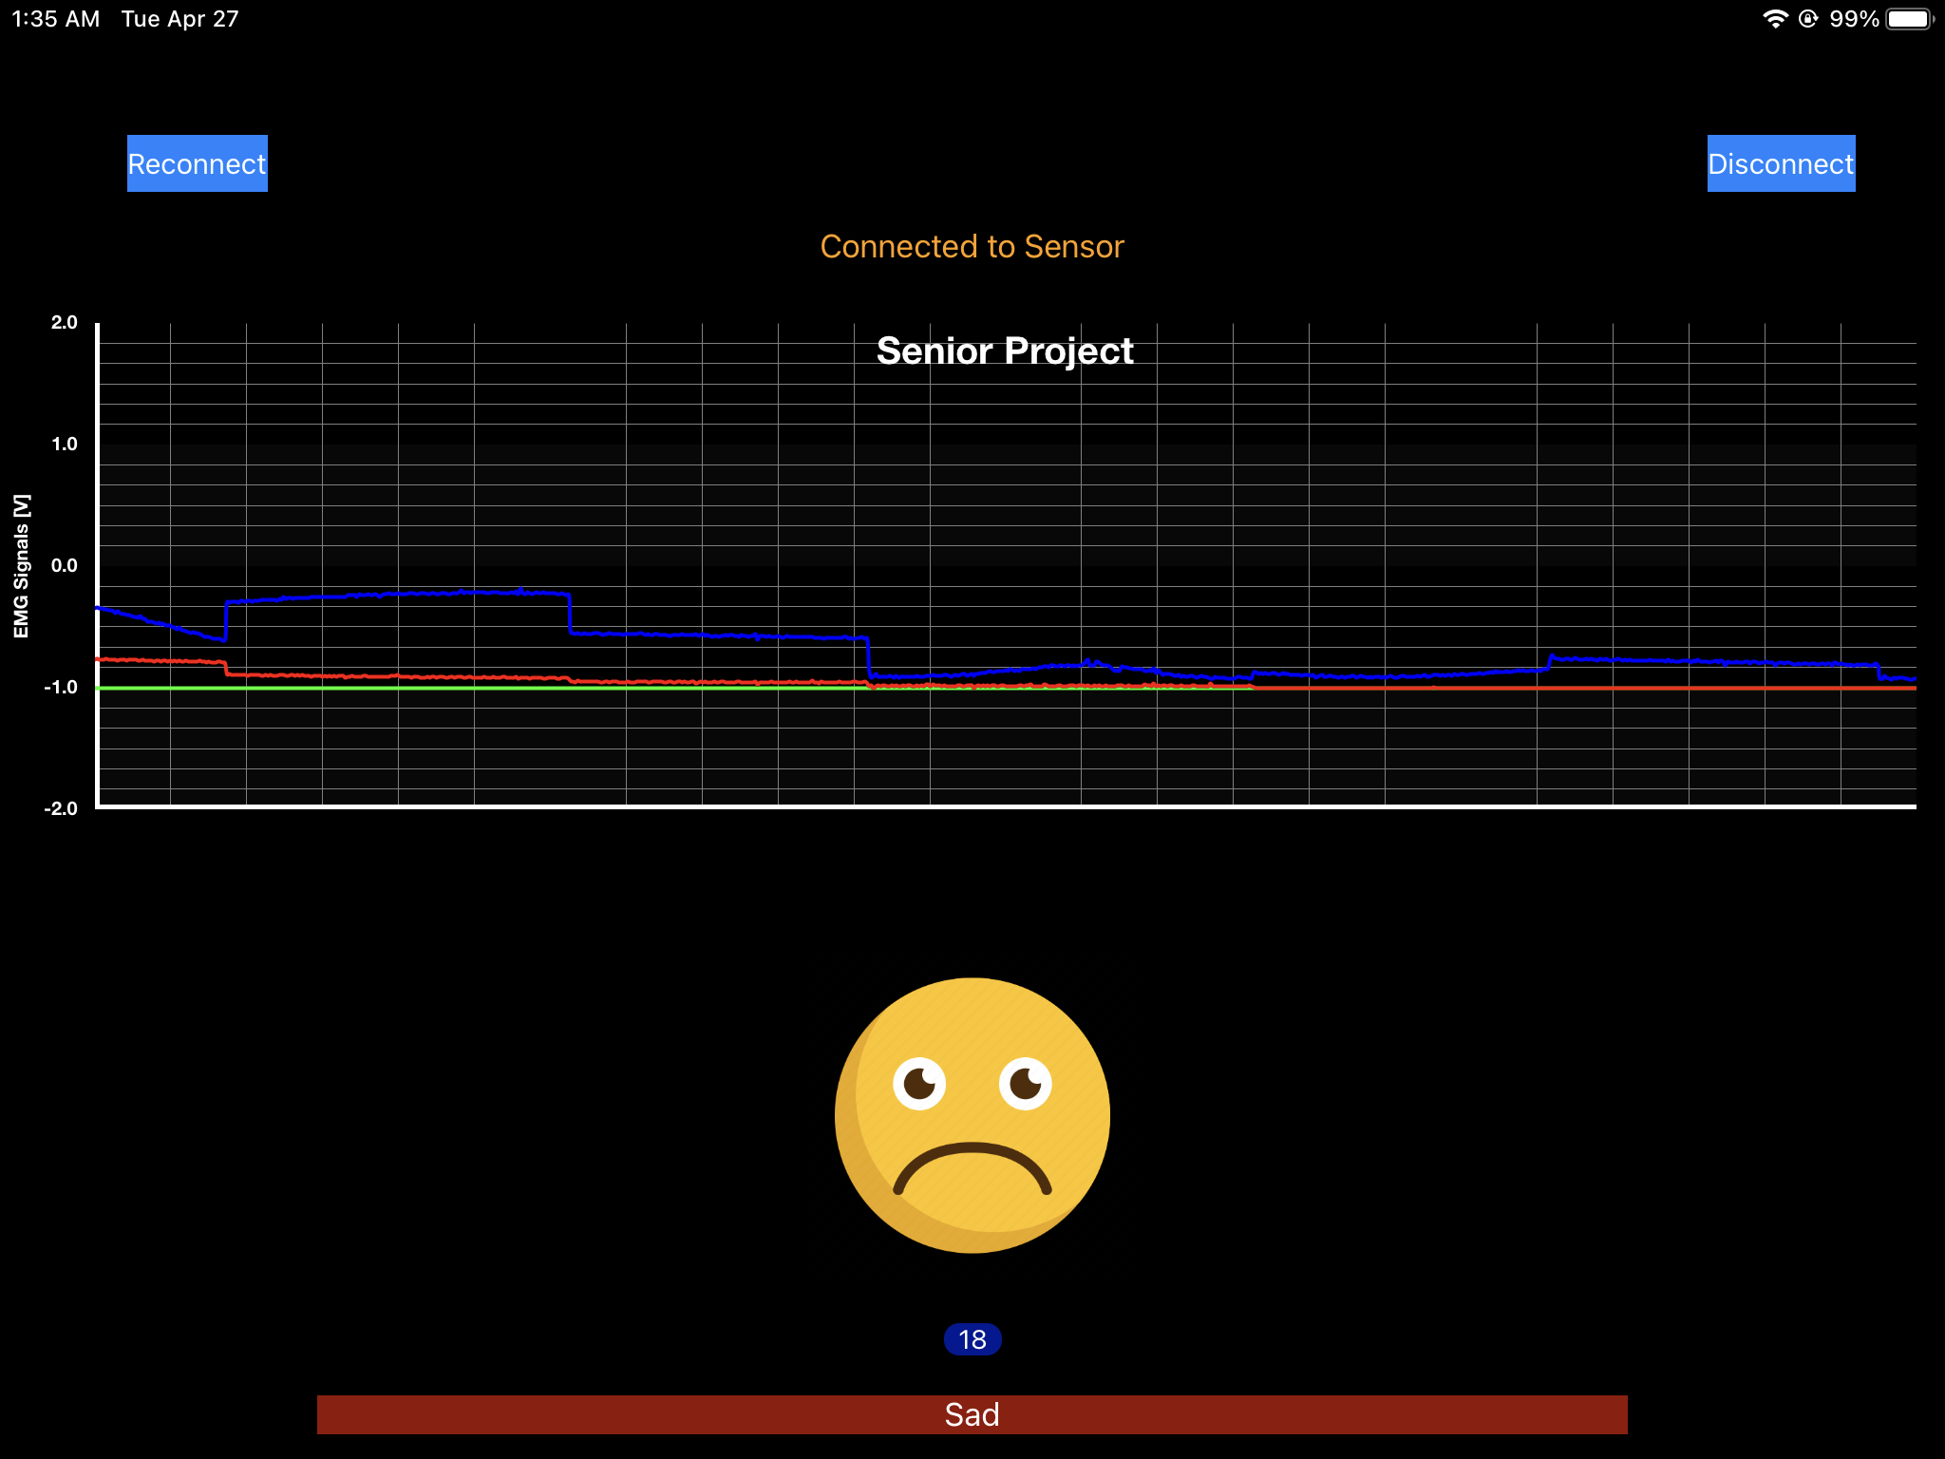
Facial Electromyography Collection Device
Chuong Nguyen, Toan Vu, Johnathan Nguyen
Cullen College of Engineering at University of Houston
Sponsor: Dr. Rose T. Faghih
Project Manager: Dr. Steven Pei
Computational
Medicine
Lab
U N I V E R S I T Y of
Houston
Cullen College of Engineering
Overview
70% of adults experience at least one traumatic event[1]
90% suicide cases related to psychiatric disorders [2]
Psychotherapy success rate: 50% [3]
Better medical data measurements and accurate diagnosis
Facial Electromyography (EMG) signals collection and analysis
Discussion
User-friendly mobile application can collect and display EMG data from ESP32S in real-time
Emotion prediction using facial EMG was successful with ~89% accuracy during the development
Emotions can be predicted using a machine learning model deployed on the app, but the deployment needs to be calibrated for higher accuracy
This prediction is only for three emotions (happy, sad, angry) and is done on only one subject.
Emotion prediction successful but more data needed to make the device viable.
Results
Functionalities:
Real-time EMG Signal Collection and Visualization
Neural Network Machine Learning model deployed on an iOS Mobile Application
Recorded data are saved locally on the user’s phone
Users can manually control the collecting process using the reconnect/disconnect buttons
Machine Learning Model Performance:
Machine learning model accuracy is 90% on train dataset, 86% on validation dataset, and 89% on test
Figure 4: Accuracy of Machine Learning Model
Figure 5: Loss Approximation of the Machine Learning Model
Figure 6: Predicted emotion compared to true emotion on 7316 samples
Live demonstration of the project is provided
Materials and Methods
Data collection
Collect EMG signals with 3 Myoware muscle sensors
Electrodes are attached at the Corrugator supercilii, orbicularis oculi, and levator labii superioris alaeque nasi muscles
Signals are sampled at 1 [KHz] on ESP32S microcontroller
Data is sent to user’s smartphone via Bluetooth Low Energy
Figure 1: EMG Data Collection Process
Conclusions
Implications:
This device predicts a person’s emotion using EMG signals in order to monitor their mental health.
With this device, psychiatrist can collect data on a patient’s mental health, and hopefully give a more accurate diagnosis with a better treatment plan for the patient.
Further work:
An unobtrusive wearable should be made to house the components and to make the devices portable
A larger dataset with more emotions and subjects should be worked on so the device will be able to be used on multiple people and predict more emotions.
Use more sensors to increase the accuracy of the machine learning model when the scope of the project gets bigger.
Connect app to a cloud database so that medical professionals can monitor a patient’s mental health anywhere
Machine Learning Model
Dataset of 2,033,500 data points
Sample size: 512 data points
Overlap: 462 data points
Neural Network: Recurrent Neural Network with Long-Short Term Memory Layers
Figure 2: Machine Learning Model Structure
References
[1] Hull, M., 2020. PTSD Statistics. [online] The Recovery Village. Available at: <https://www.therecoveryvillage.com/mental-health/ptsd/related/ptsd-statistics/> [Accessed 16 September 2020]
[2] Depression and Bipolar Support Alliance. 2020. Depression Statistics - Depression And Bipolar Support Alliance. [online] Available at: <https://www.dbsalliance.org/education/depression/statistics/> [Accessed 16 September 2020].
[3] Miller, S., 2015. The Failure Rate of Psychotherapy: What it is and what we can do?. [online] Scottdmiller.com. Available at: <https://www.scottdmiller.com/the-failure-rate-of-psychotherapy-what-it-is-and-what-we-can-do/> [Accessed 16 September 2020].
Smartphone Application
Save data to a .csv file
Machine Learning model deployment
Real-time EMG signals data visualization using CorePlot
Predicted emotions are displayed using emoticons and preset labels
Buttons to connect to and disconnect from the
microcontroller
Acknowledgement
Our team would like to acknowledge the Computational Medicine Laboratory, our project manager, Dr. Steven Pei, and our mentor, Md. Rafiul Amin.
Figure 3: User Interface of the mobile application

