Slide 1

MemXLife: MLSYSreport
2026/06/16
王丰淼
From GPU Profiling to Runtime
Specialization: An Agentic Systems
Optimization Journey
————————————————————————

Slide 2

One Project, Three Increasingly Realistic Questions

Slide 3
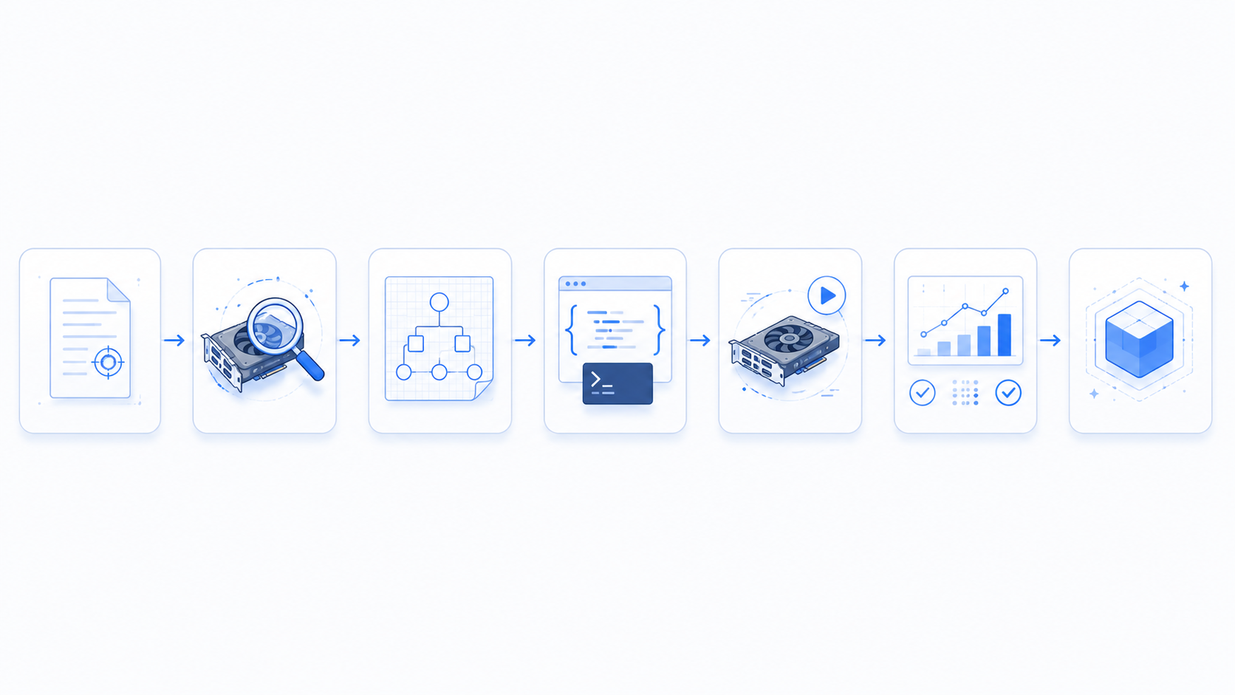
Phase 1: When Hardware APIs Cannot Be Trusted
spec.json
Scout
Planner
Codegen
Runner
Analyzer
results.json

Slide 4
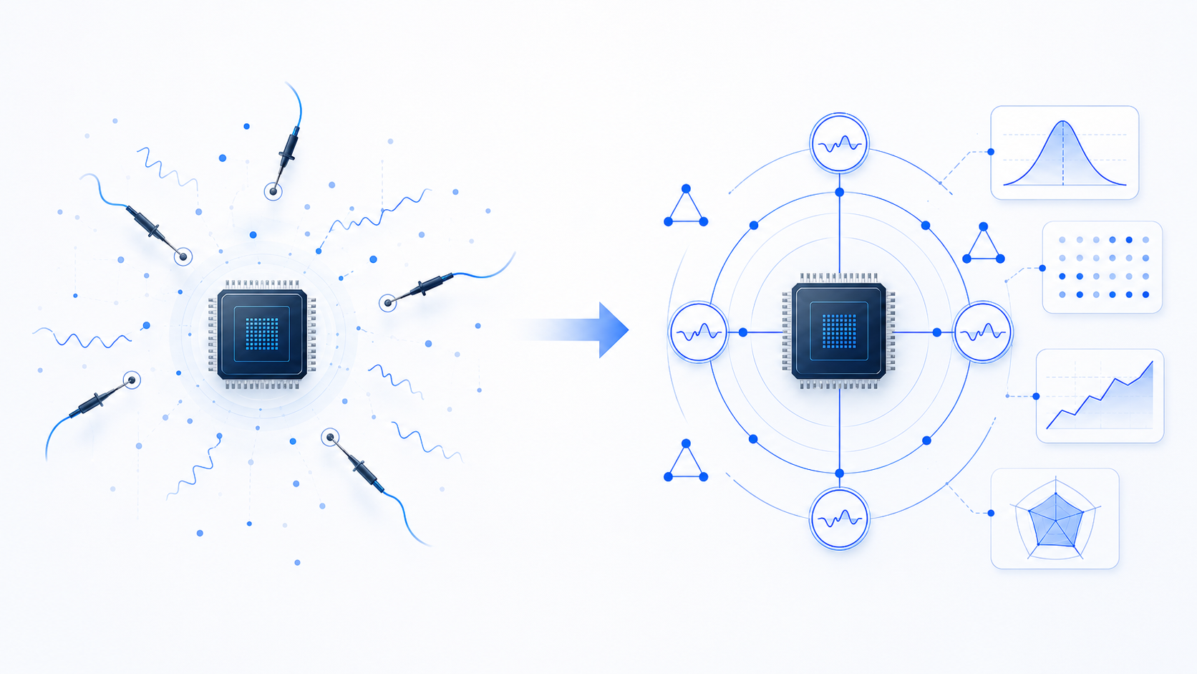
Phase 1 Turning Point: From Reading Numbers To Trusting Evidence

Slide 5
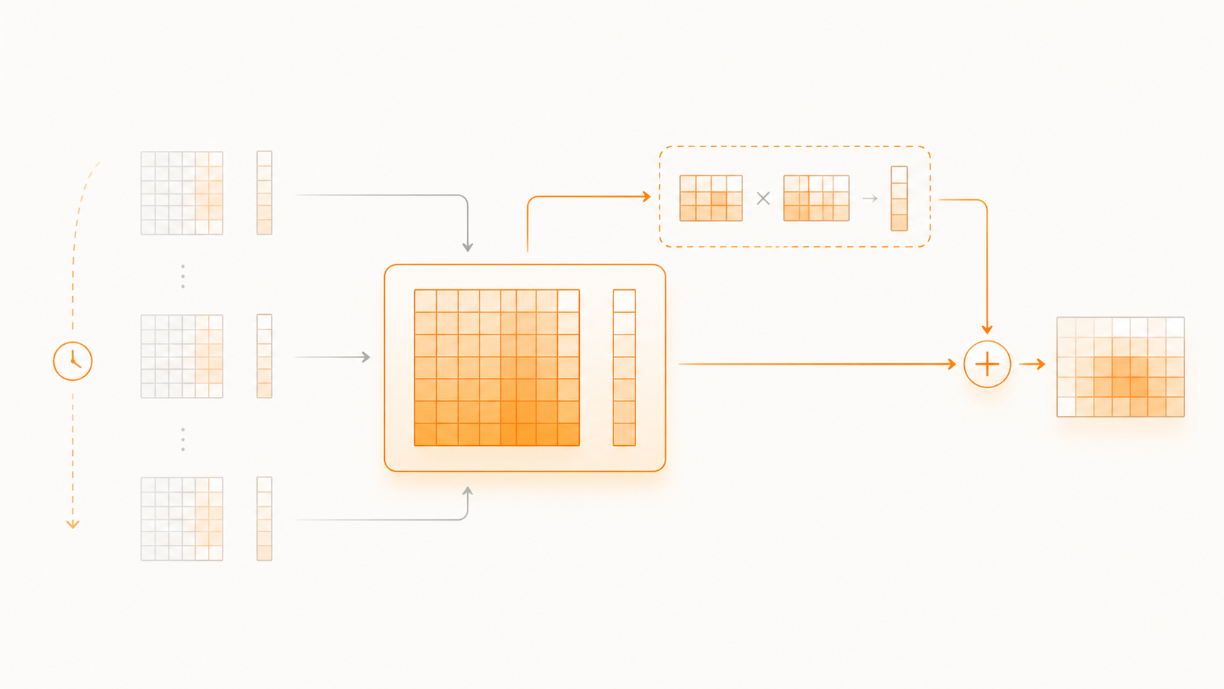
Phase 2: LoRA Operator Optimization Agent

Slide 6
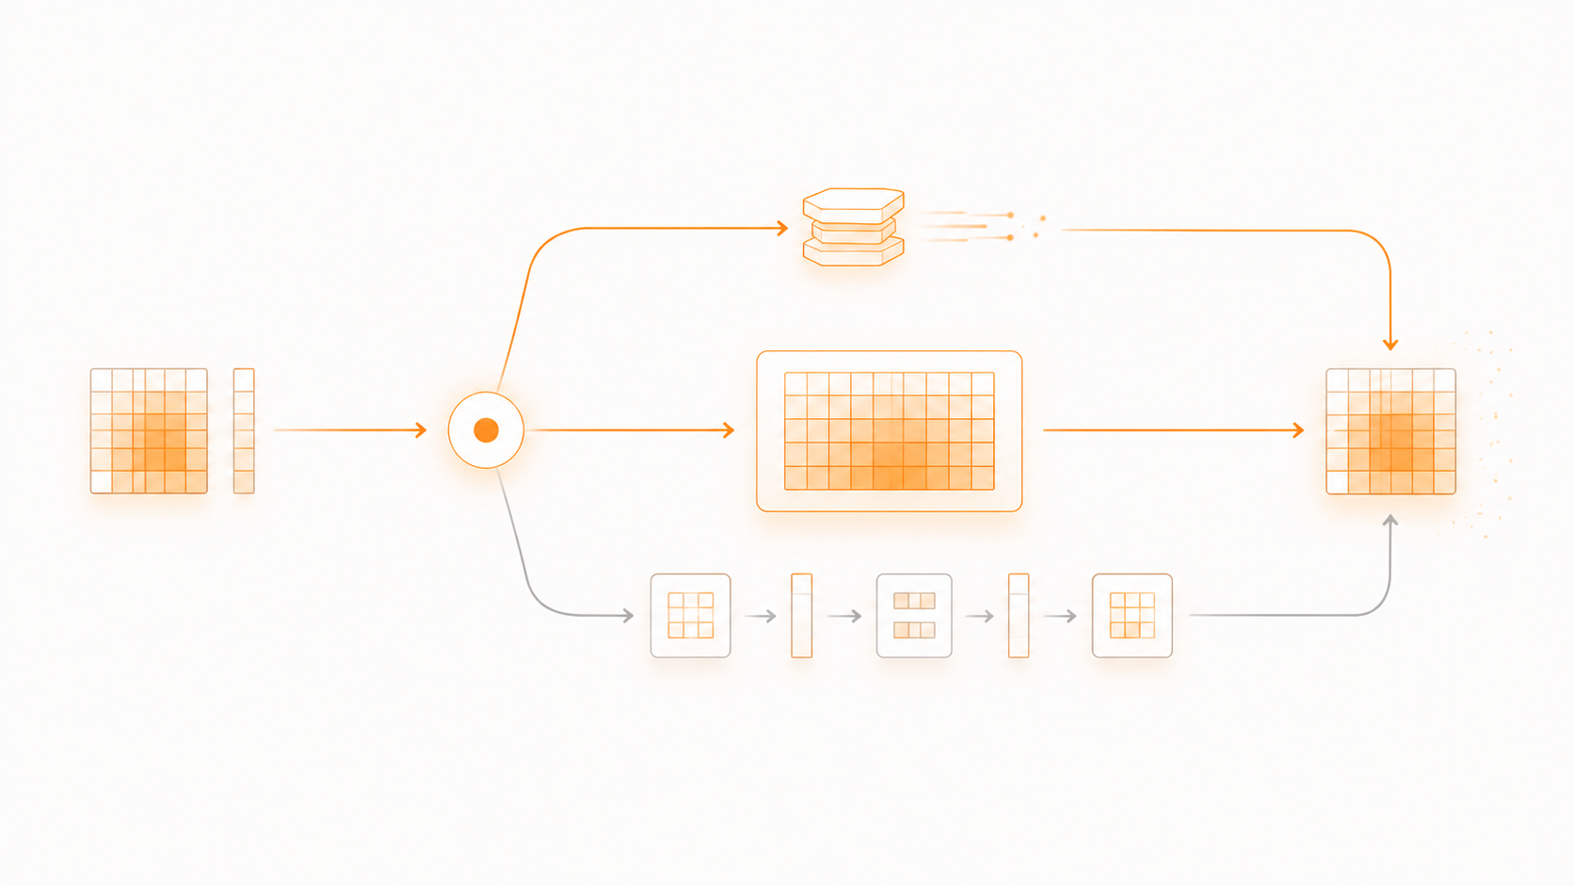
Phase 2 Turning Point: W_eff And Reuse Modeling

Slide 7

Phase 2 Debug And Engineering Reality

Slide 8
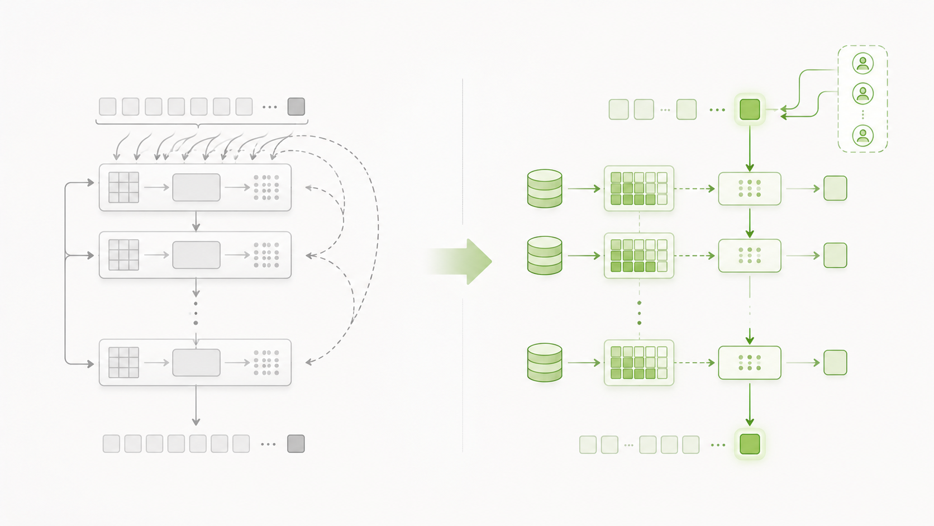
Phase 3: Serving Runtime Optimization

Slide 9
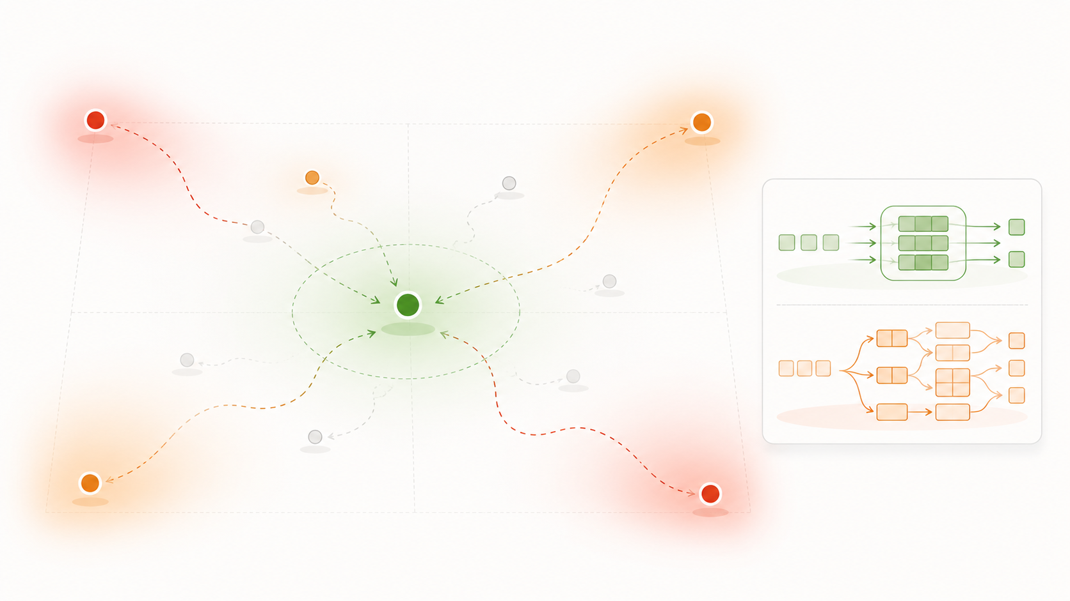
Phase 3 Experiment Logic: Why We Kept The Conservative Version

Slide 10

Final Takeaways

