Slide 1
AZ-104 Administer Azure Virtual Machines

Slide 2
AZ-104 Course Outline
01: Administer Identity
02: Administer Governance and Compliance
03: Administer Azure Resources
04: Administer Virtual Networking
05: Administer Intersite Connectivity
06: Administer Network Traffic Management
07: Administer Azure Storage
08: Administer Azure Virtual Machines
09: Administer PaaS Compute Options
10: Administer Data Protection
11: Administer Monitoring

Slide 3
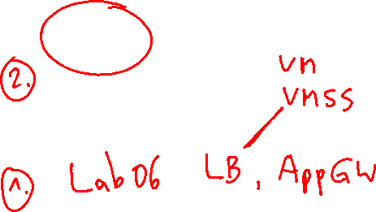
Learning Objectives - Administer Azure Virtual Machines
Configure Virtual Machines
Configure Virtual Machine Availability
Lab 08 – Manage Virtual Machines
Notes:
These Learn modules are part of the AZ-104: Deploy and manage Azure compute resources (https://docs.microsoft.com/learn/paths/az-104-manage-compute-resources/) learning path.

Slide 4
Administer Virtual Machines whiteboard
Azure virtual machines
Storage
Name
Responsibilities
Image
Ubuntu
Windows
Red hat
SUSE
…..
Custom
Access
Bastion
RDP/SSH
Sizing/cost
General purpose
Compute optimized
Memory optimized
Storage optimized
GPU
HPC
Availability options
Availability zones
Availability sets
VM scale sets
Notes:
Optional whiteboard slide to introduce the module or review the content. Use the whiteboard diagram directly or recreate the image during the class. Focus this whiteboard on creating virtual machines.

Slide 5
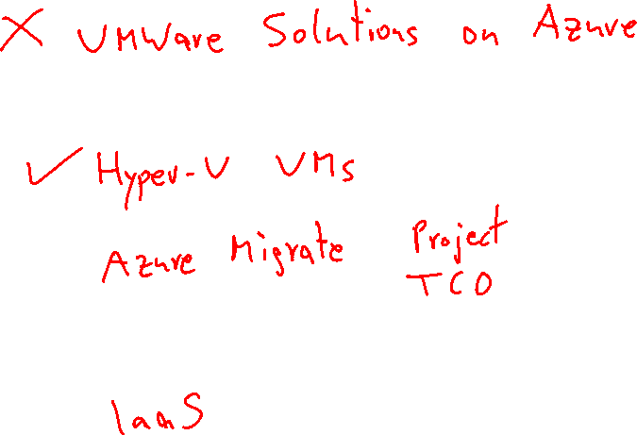
Configure Virtual Machines

Slide 6
Learning Objectives - Configure Virtual Machines
Review Cloud Services Responsibilities
Plan Virtual Machines
Determine Virtual Machine Sizing
Determine Virtual Machine Storage
Demonstration - Creating a VM in the Portal
Connect to Virtual Machines
Connect to Windows Virtual Machines
Connect to Linux Virtual Machines
Learning Recap
Implement and manage Azure compute resources (20-25%): Create and configure virtual machines
Create a VM
Manage images with the Compute Gallery
Configure Azure Disk Encryption
Move VMs
Manage VM sizes
Add data disks
Configure VM network settings
Configure secure access to virtual networks
Implement Azure Bastion

Slide 7
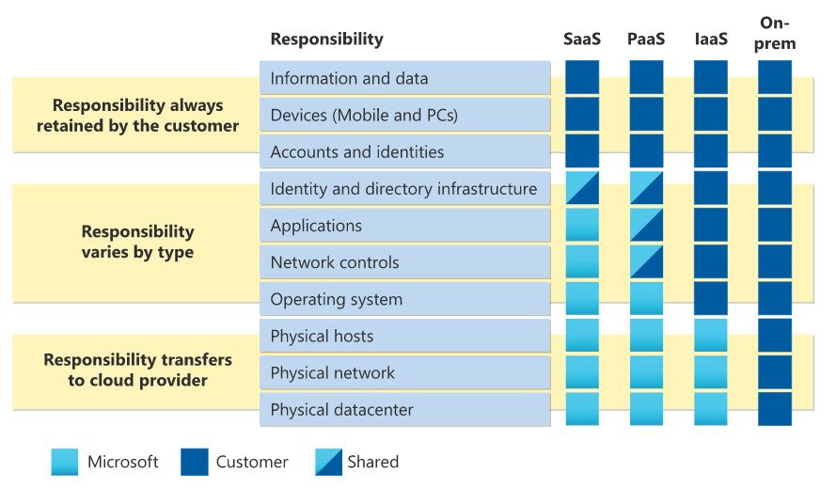
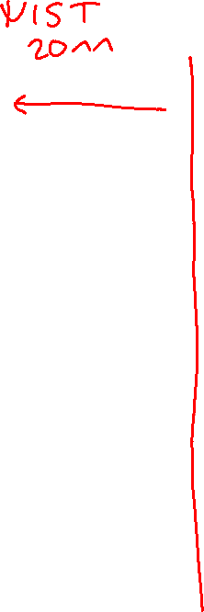
Review Cloud Services Responsibilities
Notes:
Test and development, website hosting, storage, backup, recovery, high-performance computing, big data analysis, and extended data center.
Graphic from: https://learn.microsoft.com/azure/security/fundamentals/shared-responsibility

Slide 8
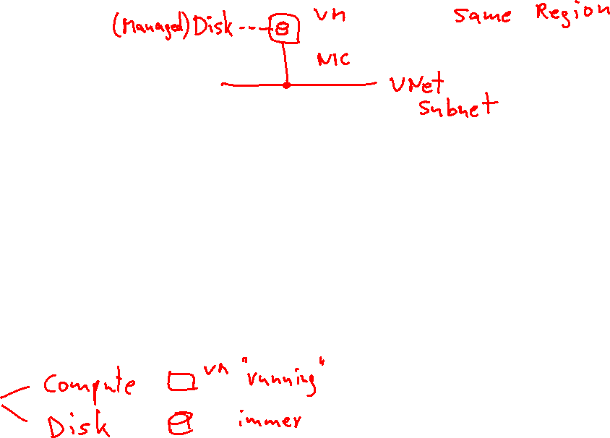
Plan Virtual Machines
Start with the network
Name the virtual machine
Choose a location
Each region has different hardware and service capabilities
Locate Virtual Machines as close as possible to your users and to ensure compliance and legal obligations
Consider pricing
70+ Azure regions
Available in 140 countries
Notes:
Data residency - https://azure.microsoft.com/explore/global-infrastructure/data-residency/#select-geography

Slide 9

Determine Virtual Machine Sizing
Type | Description
General purpose | Balanced CPU-to-memory ratio.
Compute optimized | High CPU-to-memory ratio.
Memory optimized | High memory-to-CPU ratio.
Storage optimized | High disk throughput and I/O.
GPU | Specialized virtual machines targeted for heavy graphic rendering and video editing.
High performance compute | Our fastest and most powerful CPU virtual machines

Slide 10



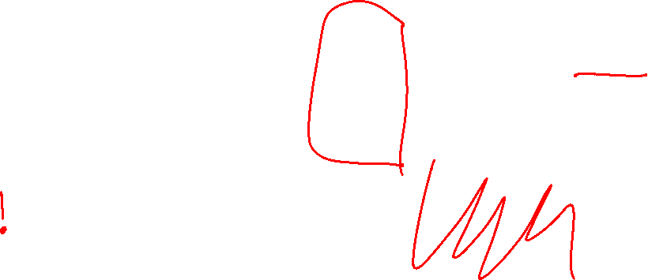
Determine Virtual Machine Storage
Each Azure VM has two or more disks:
OS disk
Temporary disk (not all SKUs have one, content can be lost)
Data disks (optional)
Azure VM (Windows)
C:\
OS disk
D:\
Temporary disk
F:\
Data disk
OS and data disks reside in Azure Storage accounts:
Azure-based storage service
Standard (HDD, SSD) or Premium (SSD), or Ultra (SSD)
Azure VMs use managed disks
Azure blob
Notes:
Azure VM sizes with no temporary disks - https://learn.microsoft.com/azure/virtual-machines/azure-vms-no-temp-disk

Slide 11
Demonstration – Creating a VM in the Portal
Create a virtual machine
Connect to the virtual machine – Bastion, RDP, or SSH
Notes:
Demonstration Creating a VM in the portal - https://microsoftlearning.github.io/AZ-104-MicrosoftAzureAdministrator/Instructions/Demos/08%20-%20Administer%20Azure%20Virtual%20Machines.html#demonstration--create-virtual-machines-in-the-portal

Slide 12
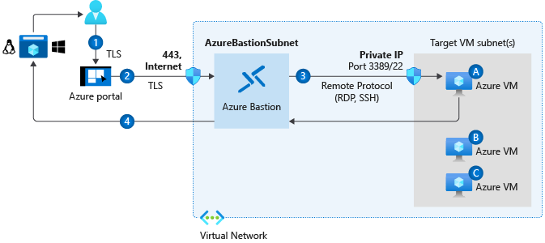
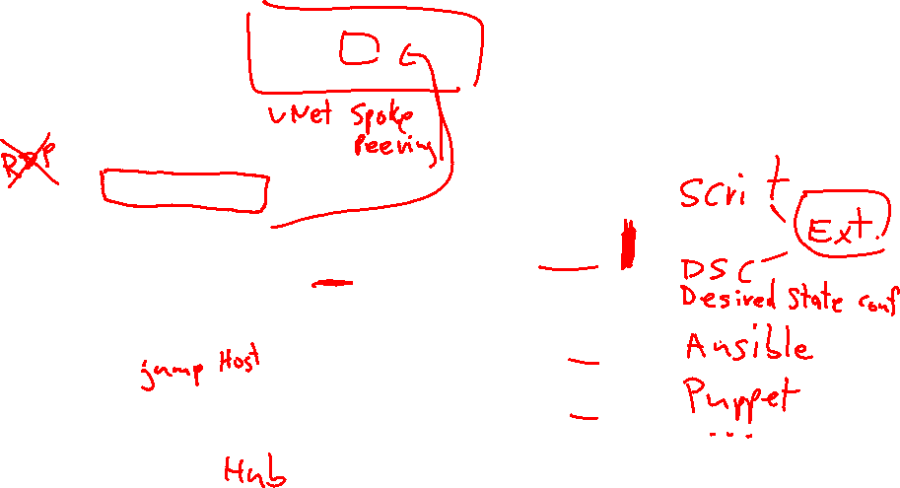
Connect to Virtual Machines
Bastion Subnet for RDP/SSH through the Portal over SSL
Remote Desktop Protocol for Windows-based Virtual Machines
Secure Shell Protocol for Linux based Virtual Machines

Slide 13
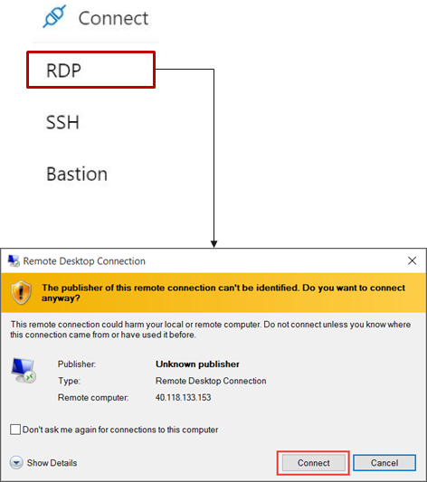
Connect to Windows Virtual Machines
Remote Desktop Protocol (RDP) creates a GUI session and accepts inbound traffic on TCP port 3389
WinRM creates a command-line session so you can run scripts

Slide 14
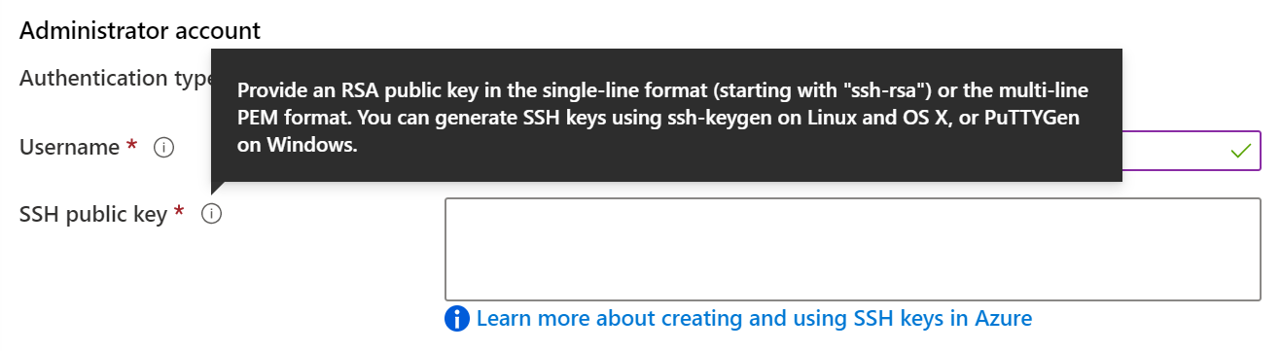
Connect to Linux Virtual Machines
Authenticate with a SSH public key or password
SSH is an encrypted connection protocol that allows secure logins over unsecured connections
There are public and private keys

Slide 15
Learning Recap - Configure Virtual Machines
Introduction to Azure virtual machines
Choose the right disk storage for your virtual machine workload
Create a Linux virtual machine in Azure
Create a Windows virtual machine in Azure
Connect to virtual machines through the Azure portal by using Azure Bastion
Notes:
Additional questions are available in Office Forms - https://forms.office.com/Pages/ShareFormPage.aspx?id=v4j5cvGGr0GRqy180BHbR5NEFZBpuAZBgxPOGXi_gX5UQ0dVV1Y1VzFZTzlMMUNXQlRaSUJWQTQxNC4u&sharetoken=Z37GWdASd35HecCvHOwD&wdLOR=c234DDA58-3B69-40A4-93DA-A87792A49363
Describe at least three things you would need to consider before creating an Azure virtual machine.
Answer: Locating the virtual machine in a region that is close to your users. Selecting the best virtual machine size for your application. Determining how cost will be determined and estimating the monthly cost. Deciding on disk storage including standard, premium, or ultra. Selecting an operating system and version. How you will monitor and update the virtual machine. If any additional scripts, configuration, or agents are required.
Describe ways connect and sign-in to a virtual machine.
Answer: Bastion is the recommended way to connect to a virtual machine. For example, to install required software. Bastion lets you access the virtual machine through the Azure portal over SSL. You can also directly connect to a Windows server with the Remoted Desktop Protocol. For Linux machines you can use Secure Shell Protocol (SSH).

Slide 16
Configure Virtual Machine Availability

Slide 17
Configure Azure Virtual Machine Availability Introduction
Plan for Maintenance and Downtime
Setup Availability Sets
Review Update and Fault Domains
Review Availability Zones
Compare Vertical to Horizontal Scaling
Create Scale Sets (2 student topics)
Configure Autoscale (2 student topics)
Demonstration – Virtual Machine Scaling
Learning Recap
Implement and manage Azure compute resources (20-25%): Create and configure virtual machines
Configure VM availability options
Deploy and configure VM scale sets

Slide 18
Plan for Maintenance and Downtime
Unplanned Hardware Maintenance
Unexpected Downtime
Planned Maintenance
When the platform predicts a failure, it will issue an unplanned hardware maintenance event
Action: Live migration
Unexpected Downtime is when a virtual machine fails unexpectedly
Action: Automatically migrate (heal)
Planned Maintenance events are periodic updates made to the Azure platform
Action: No action

Slide 19
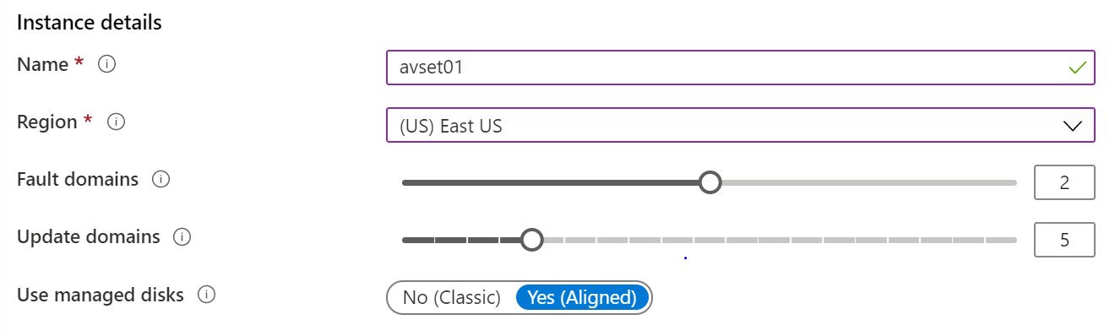
Setup Availability Sets
Two or more instances in Availability Sets = 99.95% SLA
Configure multiple Virtual Machines in an Availability Set
Configure each application tier into separate Availability Sets
Combine a Load Balancer with Availability Sets
Use managed disks with the Virtual Machines
Notes:
Availability set overview - https://learn.microsoft.com/azure/virtual-machines/availability-set-overview

Slide 20
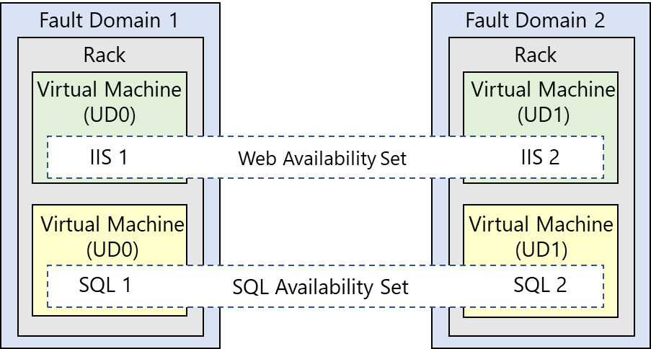
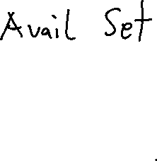
Review Update and Fault Domains
Update domains allows Azure to perform incremental or rolling upgrades across a deployment. During planned maintenance, only one update domain is rebooted at a time
Fault Domains are a group of Virtual Machines that share a common set of hardware, switches, that share a single point of failure. VMs in an availability set are placed in at least two fault domains
Notes:
Fault domain
Prevent Hardware failures like limit the impact of potential physical hardware failures, network outages, or power interruptions
1 Rack that share common power source and network switch.
Max- 3 FD per availability set, Default value=2
Update domain
Max= 20 UD, Default=5
Update domains indicate groups of virtual machines and underlying physical hardware that can be rebooted at the same time
The order of update domains being rebooted may not proceed sequentially during planned maintenance, but only one update domain is rebooted at a time. A rebooted update domain is given 30 minutes to recover before maintenance is initiated on a different update domain.

Slide 21
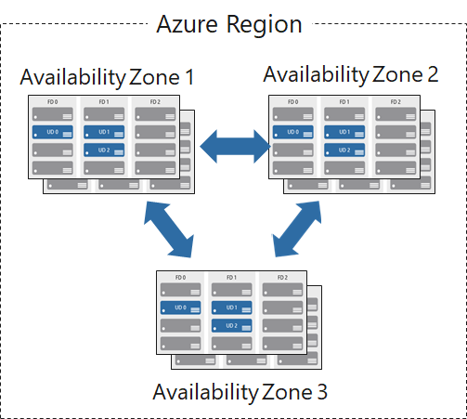
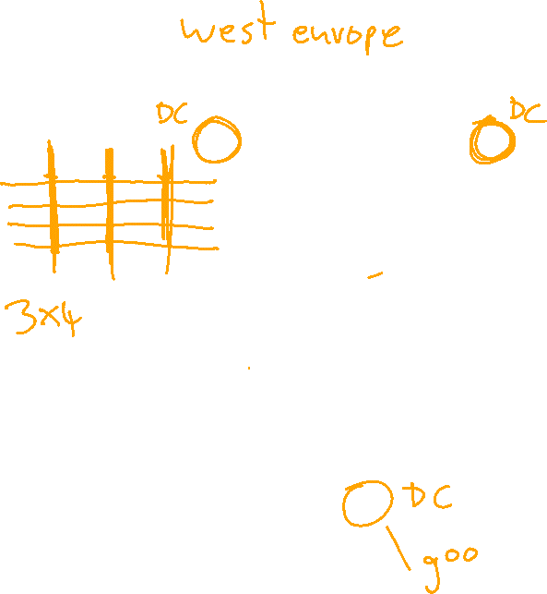
Review Availability Zones
Unique physical locations in a region
Includes datacenters with independent power, cooling, and networking
Protects from datacenter failures
Combines update and fault domains
Provides 99.99% SLA​

Slide 22
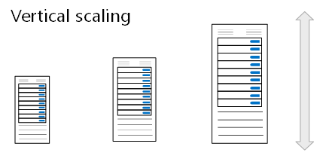
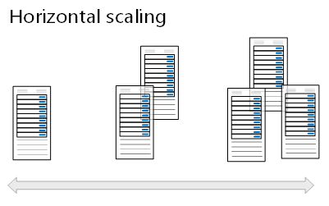
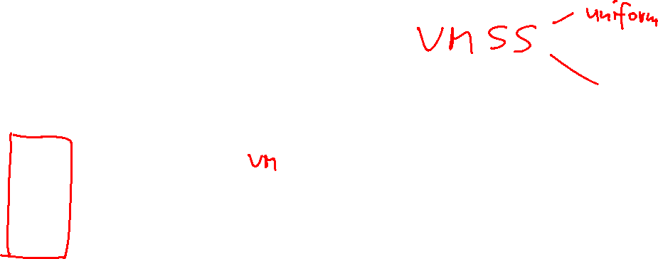
Compare Vertical to Horizontal Scaling
Vertical scaling (scale up and scale down) is the process of increasing or decreasing power to a single instance of a workload; usually manual​
Horizontal scaling (scale out and scale in) is the process of increasing or decreasing the number of instances of a workload; frequently automated

Slide 23
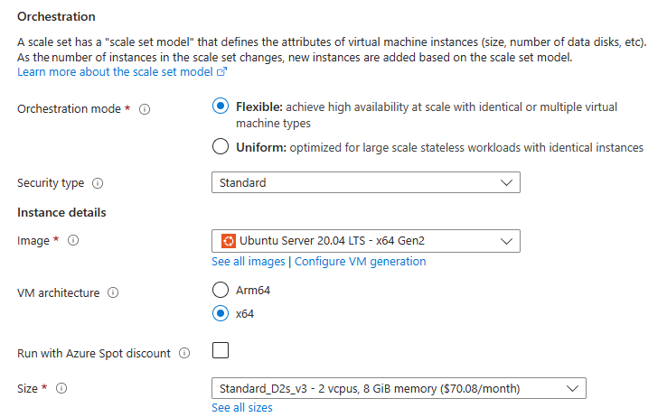
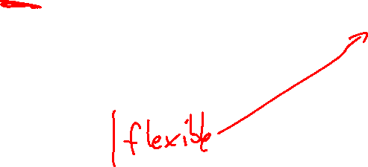
Create Scale Sets
Instance count. Number of VMs in the scale set (0 to 1000)
Instance size. The size of each virtual machine in the scale set
Azure Spot Instance. Unused capacity at a discounted rate
Use managed disks
Enable scaling beyond 100 instances
Notes:
What are virtual machine scale sets - https://learn.microsoft.com/azure/virtual-machine-scale-sets/overview
VMSS are all about performance.

Slide 24
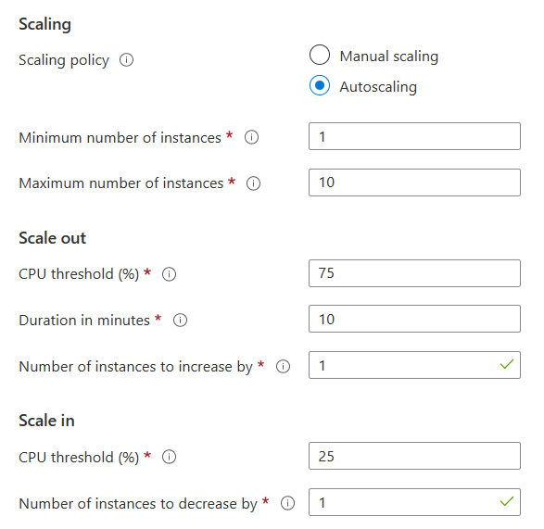
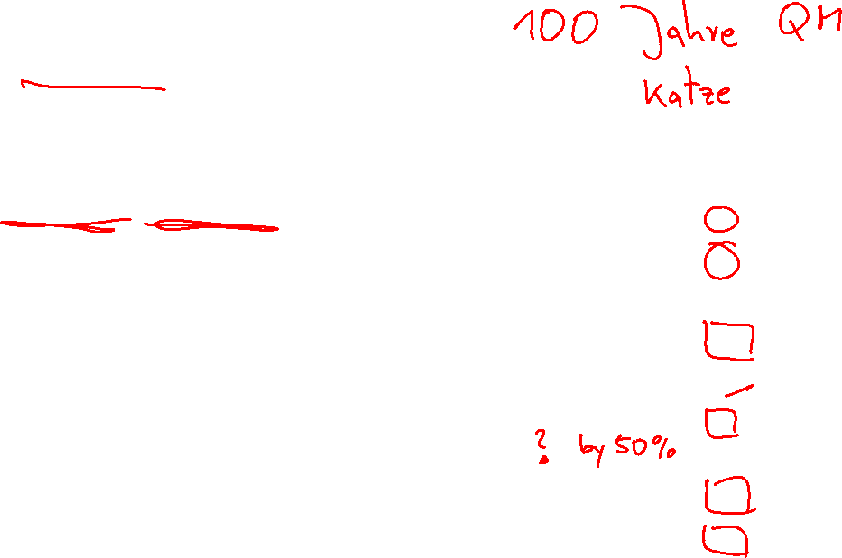
Configure Autoscale
Define a minimum, maximum, and default number of VM instances
Create more advanced scale sets with scale out and scale in parameters
Notes:
Autoscale - https://learn.microsoft.com/azure/virtual-machine-scale-sets/virtual-machine-scale-sets-autoscale-overview

Slide 25
Demonstration – Virtual Machine Scaling
Configure Virtual Machine Scale Sets
Review manual scaling, scale-in policies, and custom scaling options
Notes:
Demonstration virtual machine scaling - https://microsoftlearning.github.io/AZ-104-MicrosoftAzureAdministrator/Instructions/Demos/08%20-%20Administer%20Azure%20Virtual%20Machines.html#configure-virtual-machine-availability

Slide 26
Learning Recap – Configure Virtual Machine Availability
Build a scalable application with virtual machine scale sets
Implement scale and high availability with Windows Server VM
Notes:
Additional questions are available in Office Forms – https://forms.office.com/Pages/ShareFormPage.aspx?id=v4j5cvGGr0GRqy180BHbR5NEFZBpuAZBgxPOGXi_gX5UQ0dVV1Y1VzFZTzlMMUNXQlRaSUJWQTQxNC4u&sharetoken=Z37GWdASd35HecCvHOwD&wdLOR=cAC8A4812-2784-4689-9FB0-FE089C91A0FB
What is the difference between virtual and horizontal scaling?
Answer: Vertical scaling (scale up and scale down) is the process of increasing or decreasing power to a single instance of a workload. For example, selecting a virtual machine with more memory or faster CPU performance. Horizontal scaling (scale out and scale in) is the process of increasing or decreasing the number of instances of a workload. For example, adding additional virtual machines as the workload increases. Vertical scaling is usually a manual process. Horizontal scaling is usually automated.
What is a virtual machine scale set and when would you want to deploy them?
Answer: Azure virtual machine scale sets let you create and manage a group of load-balanced VMs. Scale sets provide redundancy and improved performance, applications are typically distributed across multiple instances. Each instance is identical, no pre-provisioning is required. As demand goes up more VMs are added. As demand goes down instances are removed. Scaling can be manual, automated, or a combination of both. To control costs, you control the instance count.

Slide 27
Lab – Manage Virtual Machines

Slide 28
Lab 08 – Manage Virtual Machines
Job Skills
Task 1: Deploy zone-resilient Azure virtual machines by using the Azure portal.
Task 2: Manage compute and storage scaling for virtual machines.
Task 3: Create and configure Azure Virtual Machine Scale Sets.
Task 4: Scale Azure Virtual Machine Scale Sets.
Task 5: Create a virtual machine using Azure PowerShell (option 1).
Task 6: Create a virtual machine using the CLI (option 2).
In this lab, you compare manual scaling of virtual machines to automatic scaling of virtual machines.
You learn how to configure and resize a single virtual machine.
You learn how create a virtual machine scale set and configure autoscaling.
Optionally, you learn to use scripting to deploy a virtual machine.
Next slide for an architecture diagram
Notes:
Students can do either the PowerShell or the CLI deployment, if they like scripting.
Lab 08 - https://microsoftlearning.github.io/AZ-104-MicrosoftAzureAdministrator/Instructions/Labs/LAB_08-Manage_Virtual_Machines.html

Slide 29



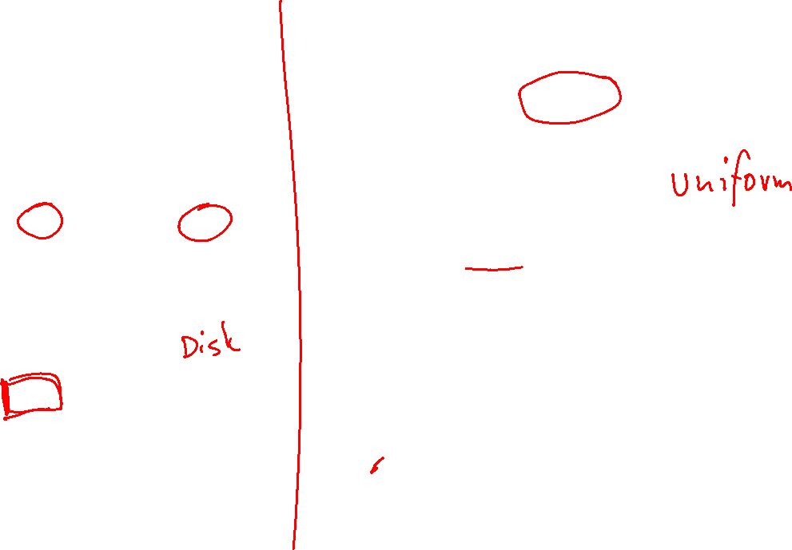
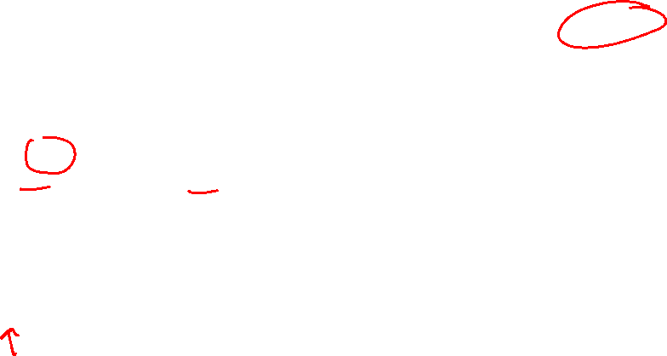
Lab 08 – Architecture diagram
Azure Virtual Machines
Virtual Machine Scale Sets
Task 1
Task 3
az104-vm1
az104-vm2
Zone1
Zone2
vmss1
Zone 1, 2, 3
Task 2
Task 4
resize and update
custom auto scale rules
Task 5: Create a virtual machine using Azure PowerShell (option 1)
Task 6: Create a virtual machine using the CLI (option 2)

Slide 30








Lab 08 – Architecture diagram (interactive lab simulation)
Task 1
Task 2
Task 3, Task 4, Task 5, Task 6, Task 7
az104-08-rg01
az104-08-rg02
az104-06-vnet01 10.80.0.0/20
az104-08-rg02-vnet 10.82.0.0/20
Subnet0 10.80.0.0/24
Subnet0 10.82.0.0/24
az10408rg01diag938
az104-08-vm0
10.80.0.4
az104-08-vm1
10.80.0.5
az10408vmss0
az10408vmss0-lb
Zone1
Zone2
scripts
az10408vmss0-nsg
az10408vmss0-ip
az104-08-install_IIS.ps1
Notes:
This is the architecture diagram for the interactive lab simulation (previous lab), if you want to review that.

Slide 31
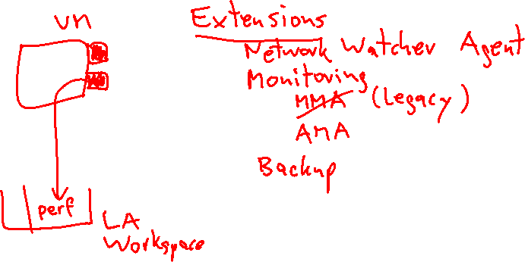
End of presentation

