Slide 1


MA615 Final Project
Zillow Home Value Analysis
Author: Chaoqun Yin
Date: 12/12/2018
Notes:
chronic comic
25 pages

Slide 2
Contents
01
Introduction
04
EDA
02
Objectives
05
Shiny App
03
06
Data Overview
Prediction

Slide 3

Introduction: Zillow
Zillow Group is an online real estate database company that was founded in 2006.
Zillow has data on 110 million homes across the United States, not just those homes currently for sale.
Zillow offers several features including value changes of each home in a given time frame (such as one, five, or 10 years), aerial views of homes, and prices of comparable homes in the area.

Slide 4

Objectives
Dig into the prices of ZHVI(Zillow Home Value Index) in different states and analysis the trend of the prices.
Visualize the outcomes of the analysis of the price.
Make Prediction for housing prices.

Slide 5
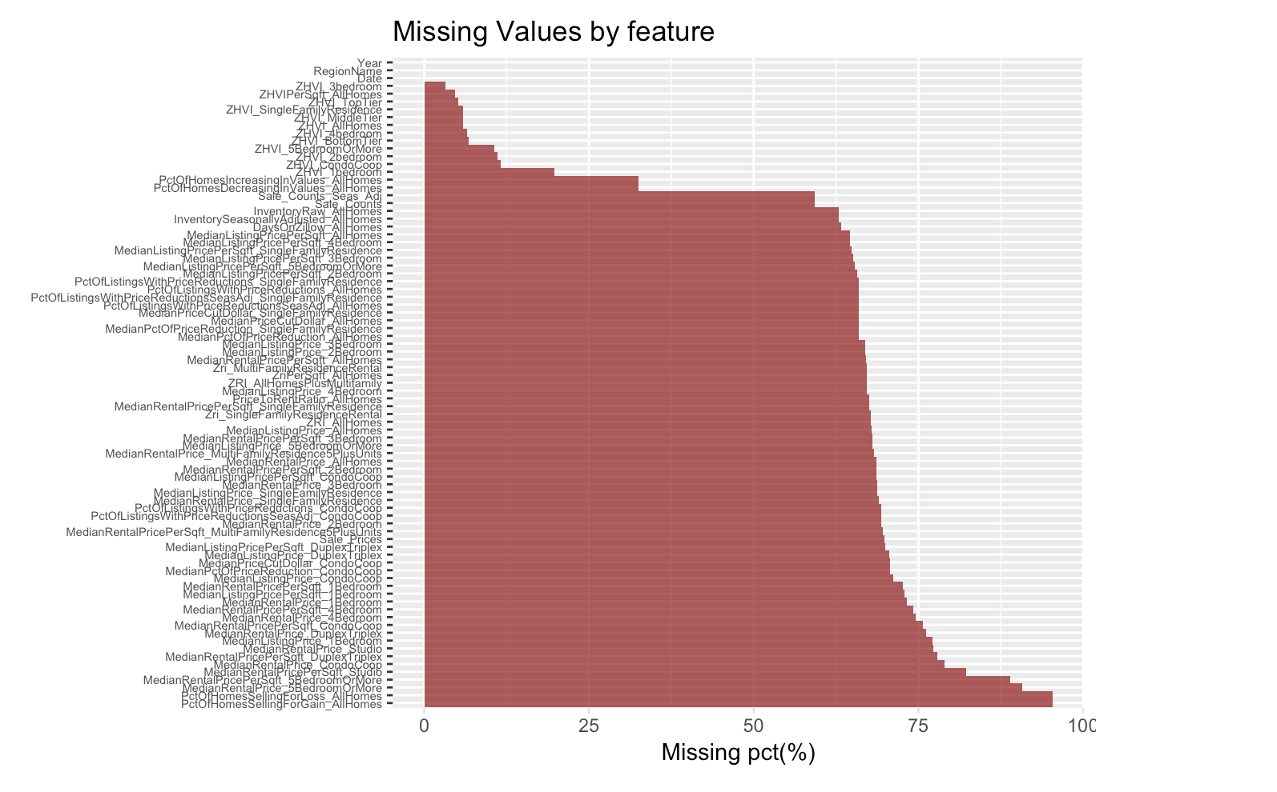
Data Overview

Slide 6
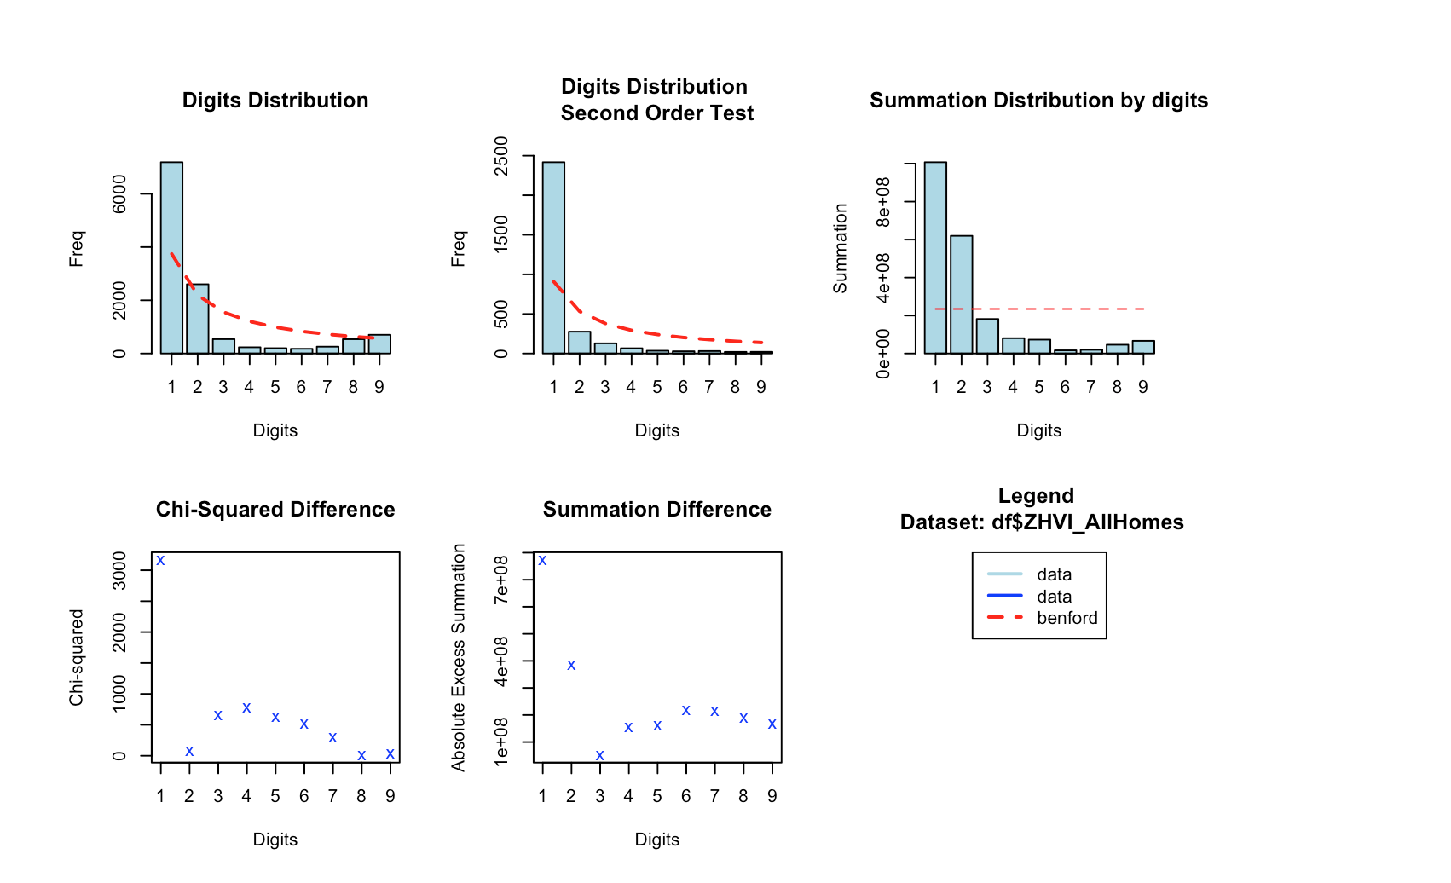
Data Overview: Benford’s Law

Slide 7
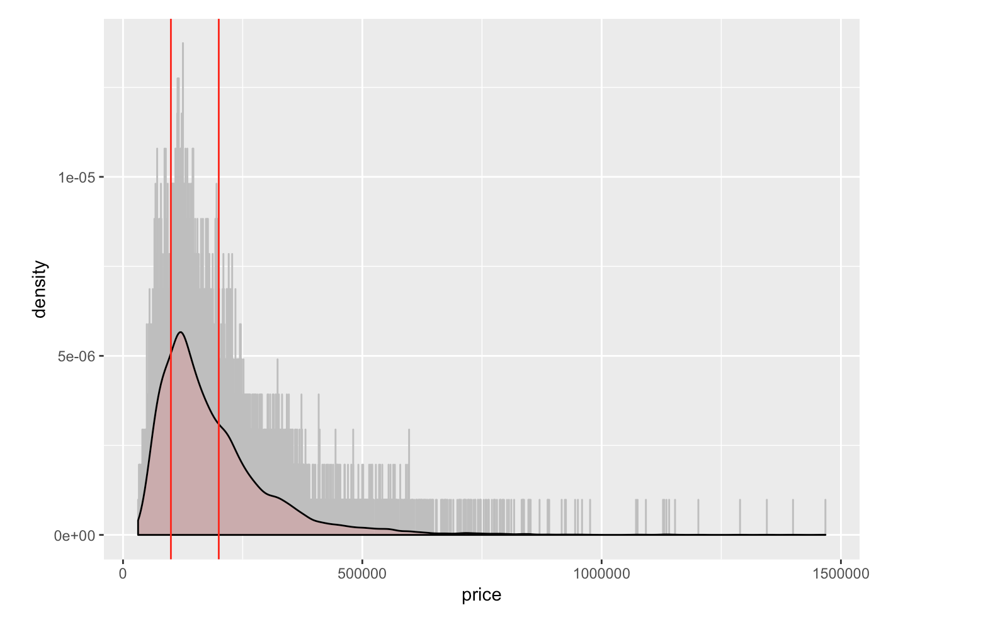
Data Overview: Distribution of Prices

Slide 8
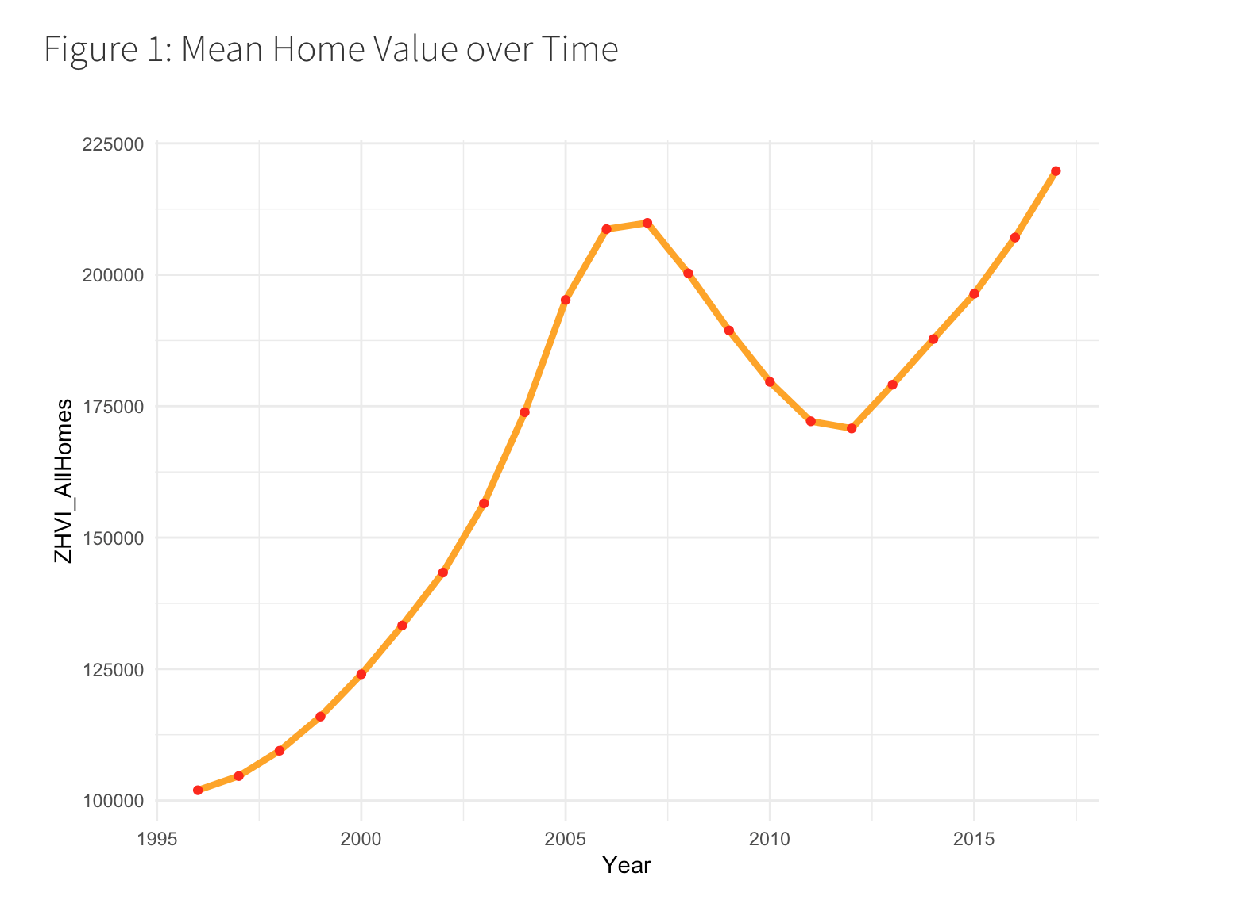
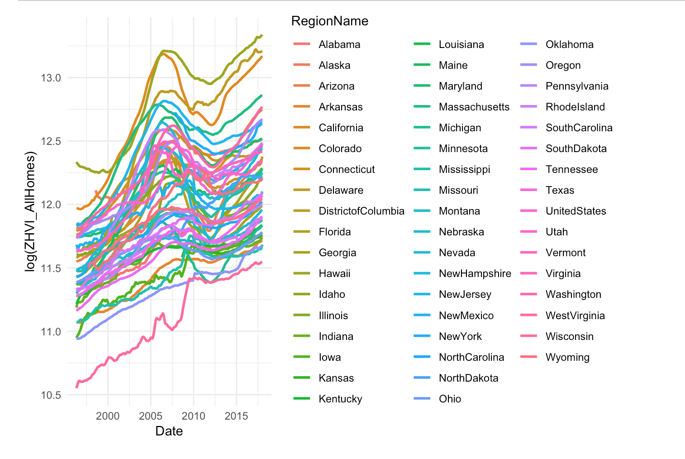
EDA

Slide 9
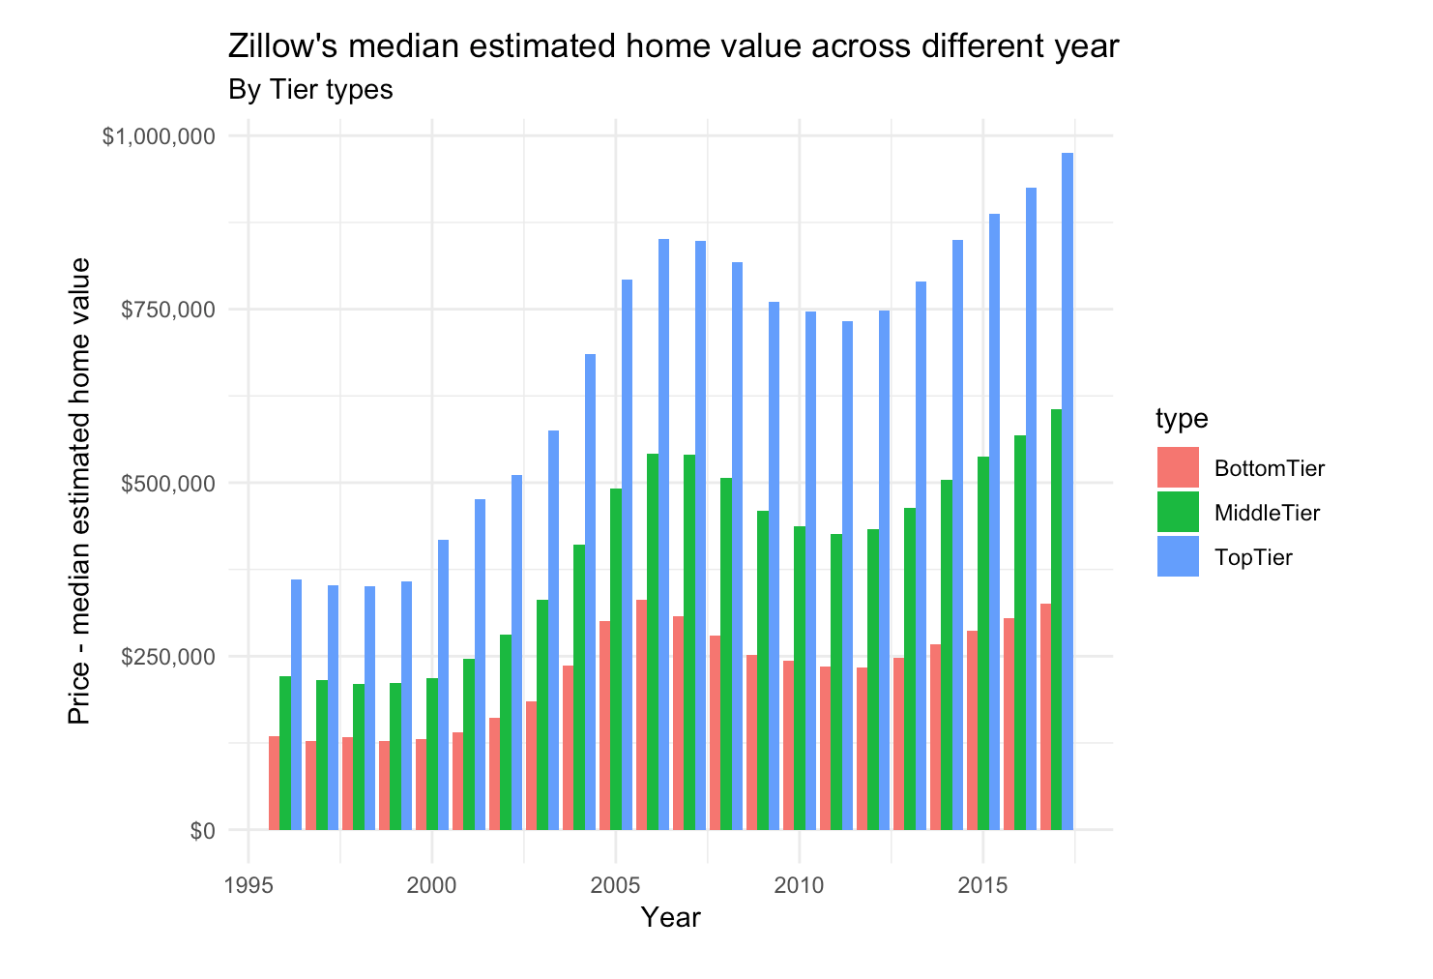
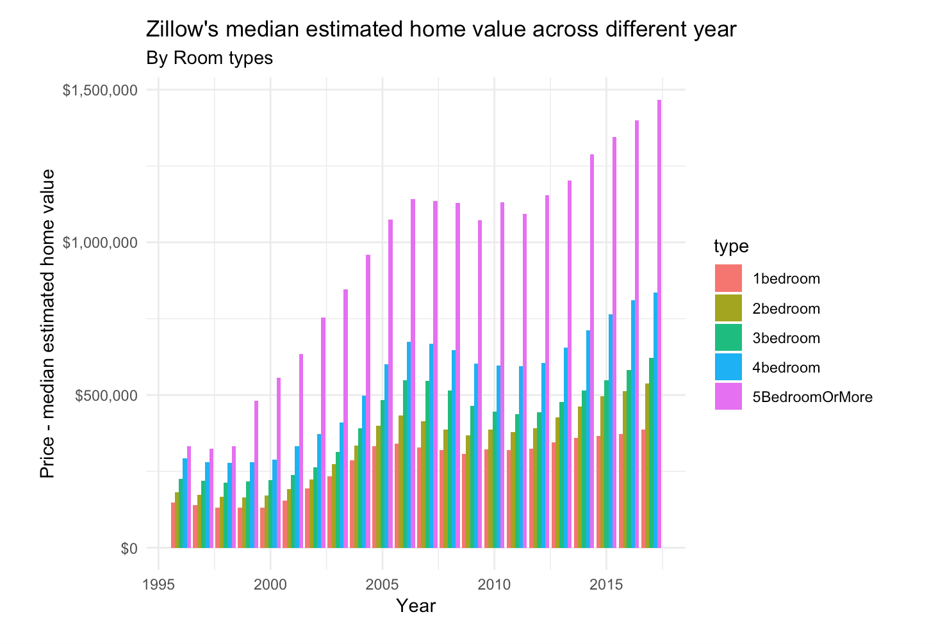
EDA

Slide 10
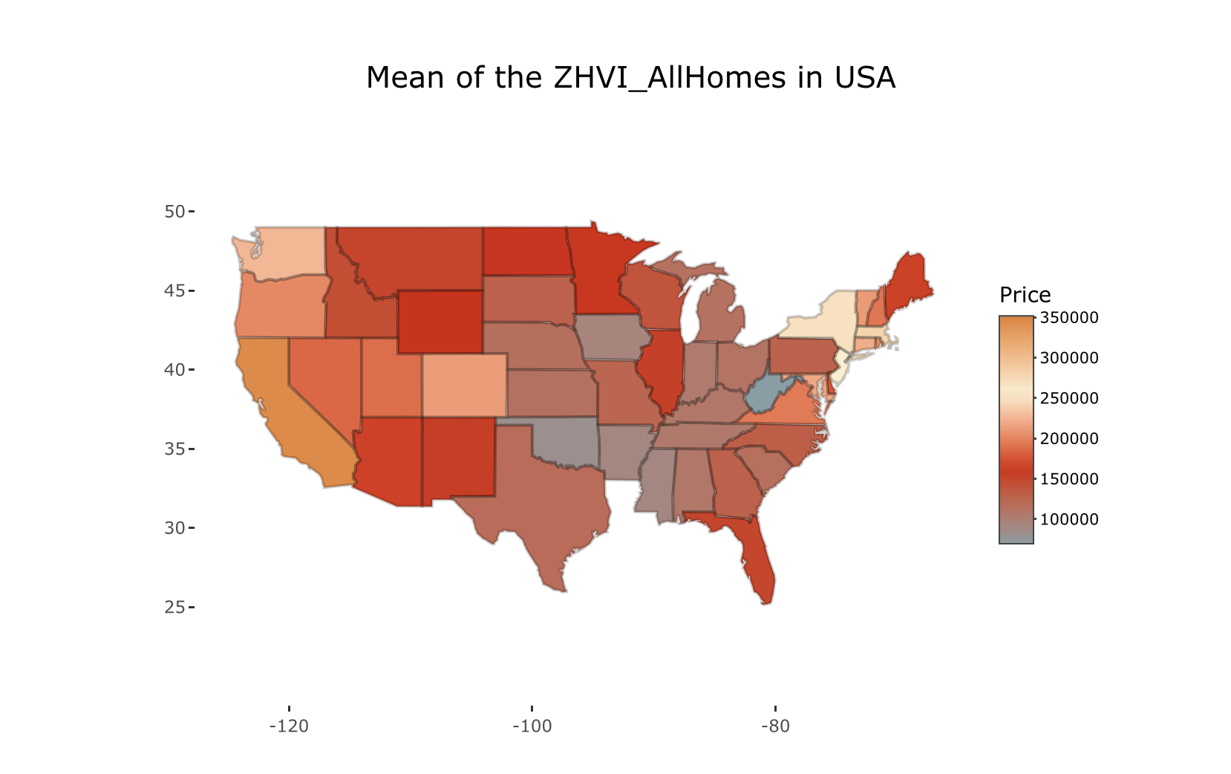
EDA

Slide 11
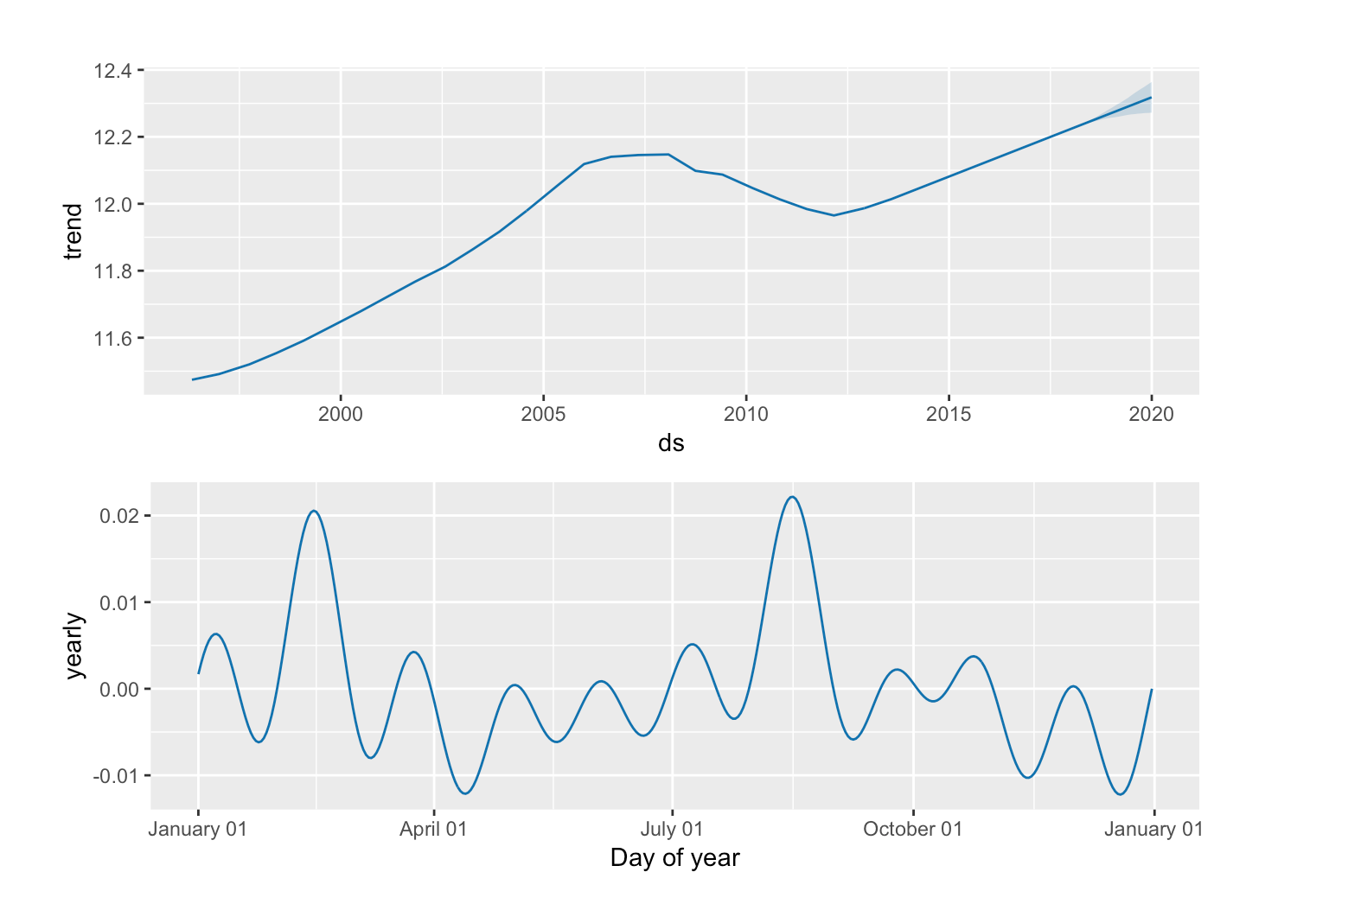
Prediction: Prophet

Slide 12
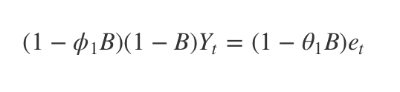
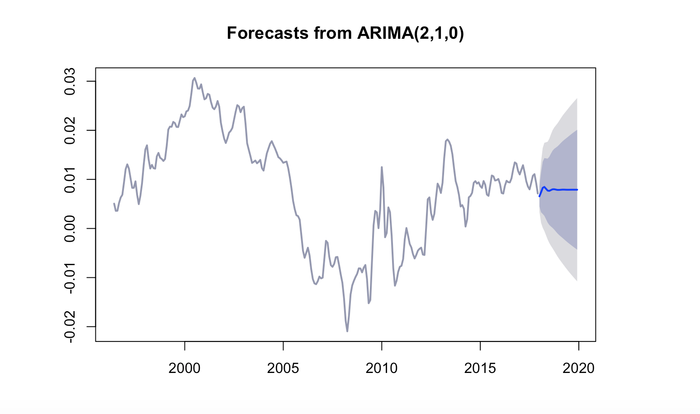
Prediction: ARIMA

