Slide 1
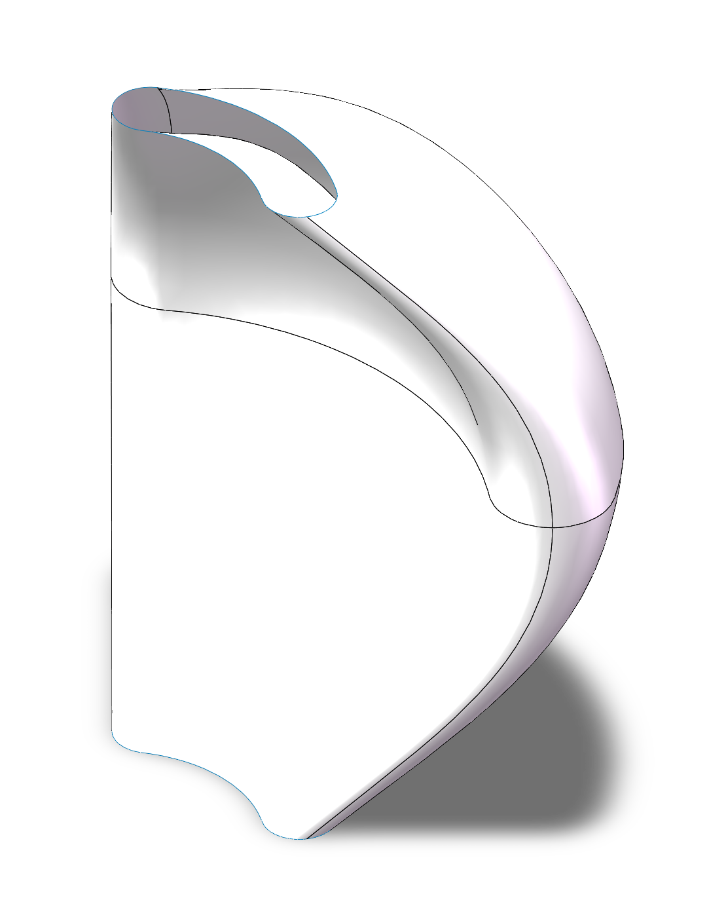
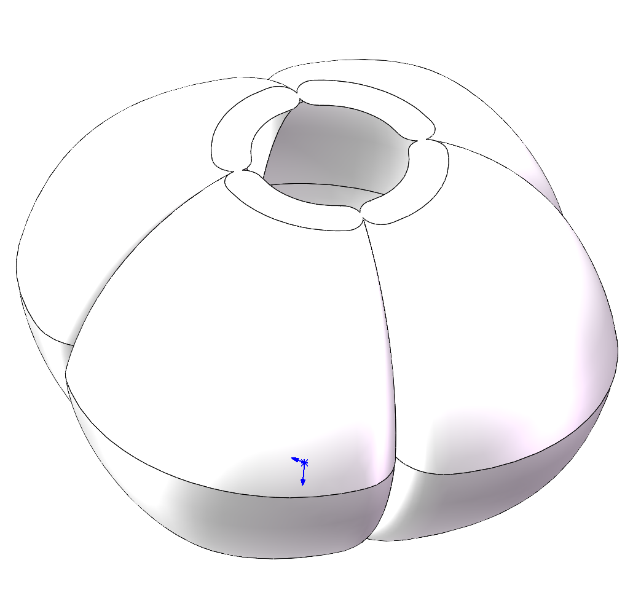

Slide 2
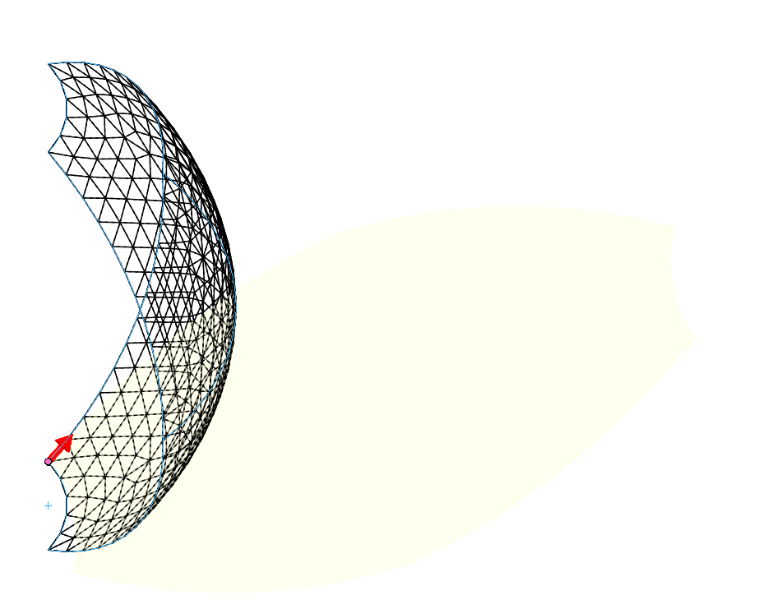
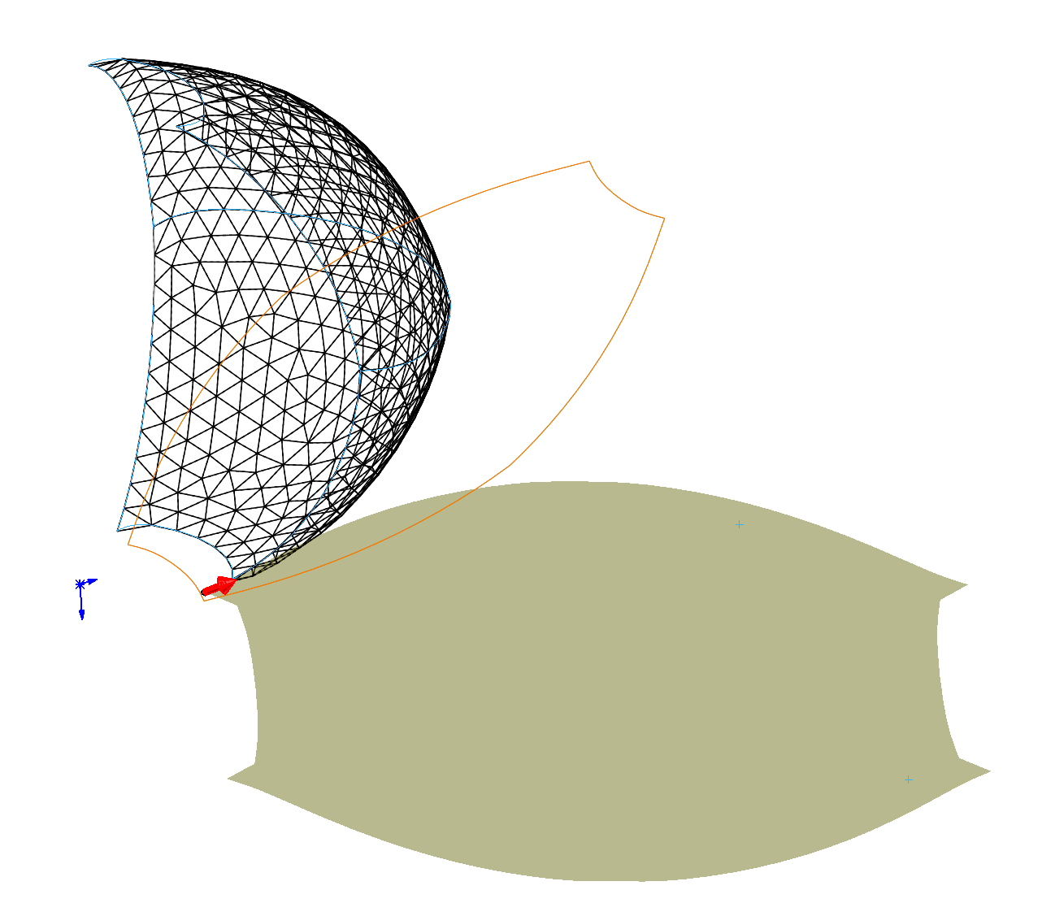
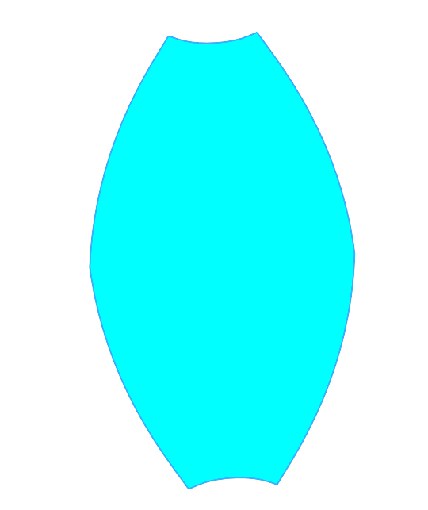
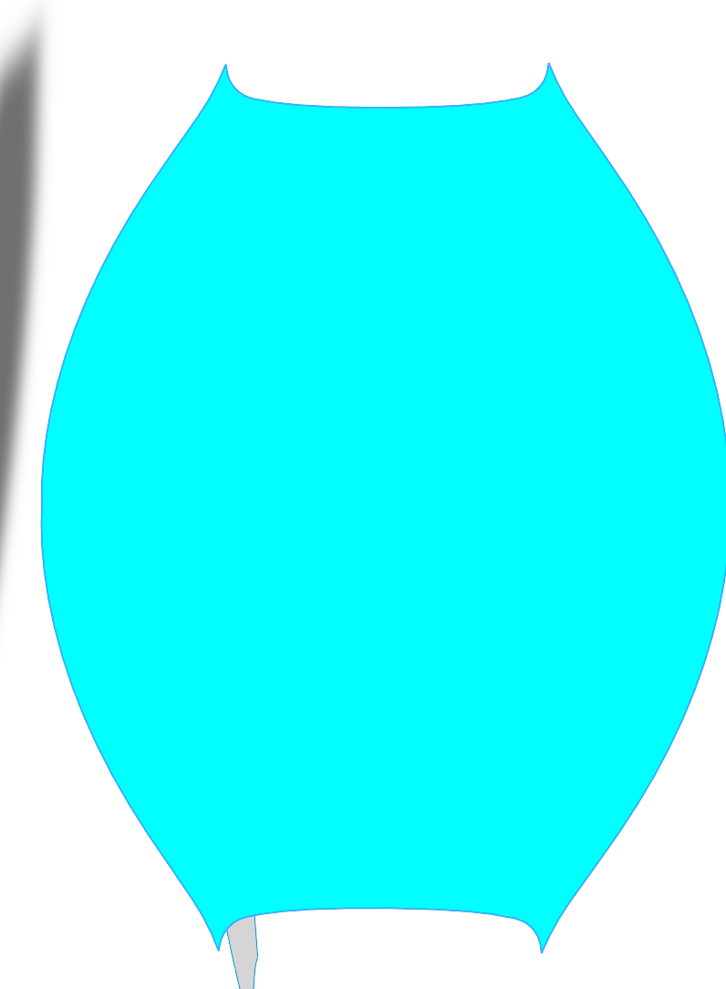
1. Fabrication
Input Airflow
Expansion Direction (Mostly)
Stiff
Soft
Expansion Direction (unwanted)
Restriction fiber to prevent expansion from inside

Slide 3
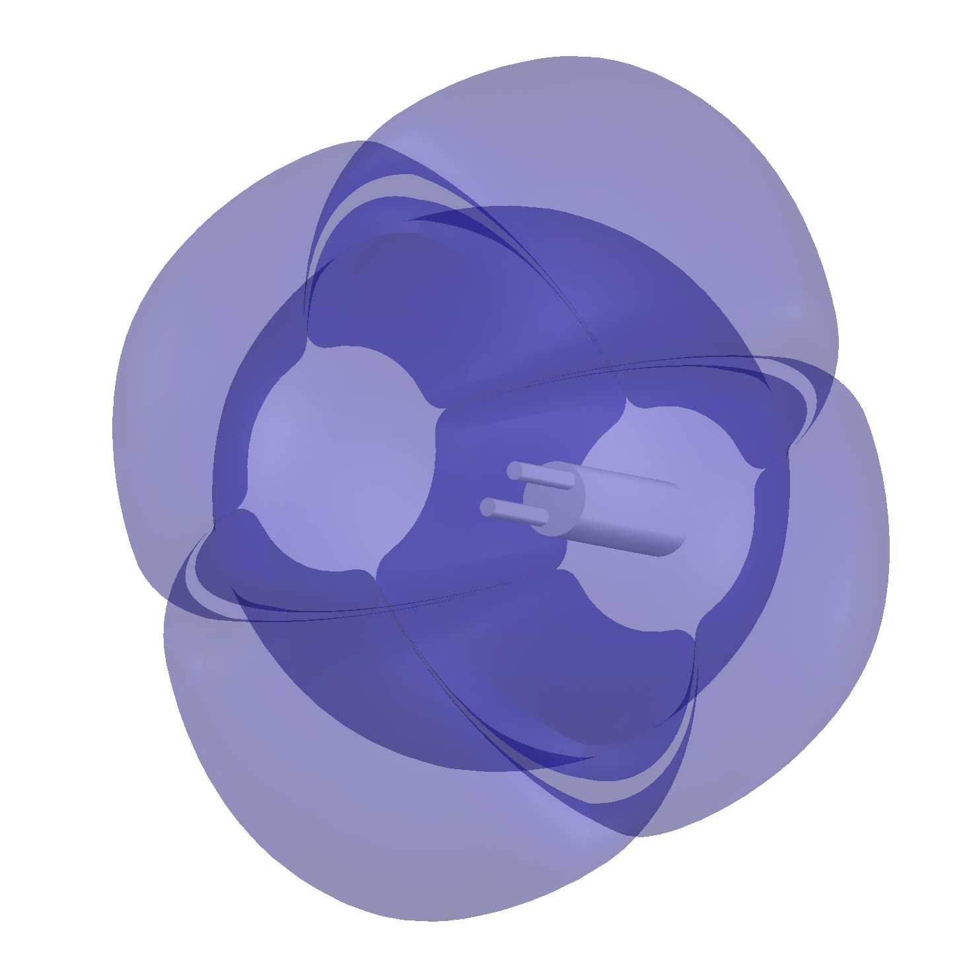
2. Steering
Yaw axis
Pitch axis
Roll axis
Steering mechanism 1
Steering mechanism 2

Slide 4
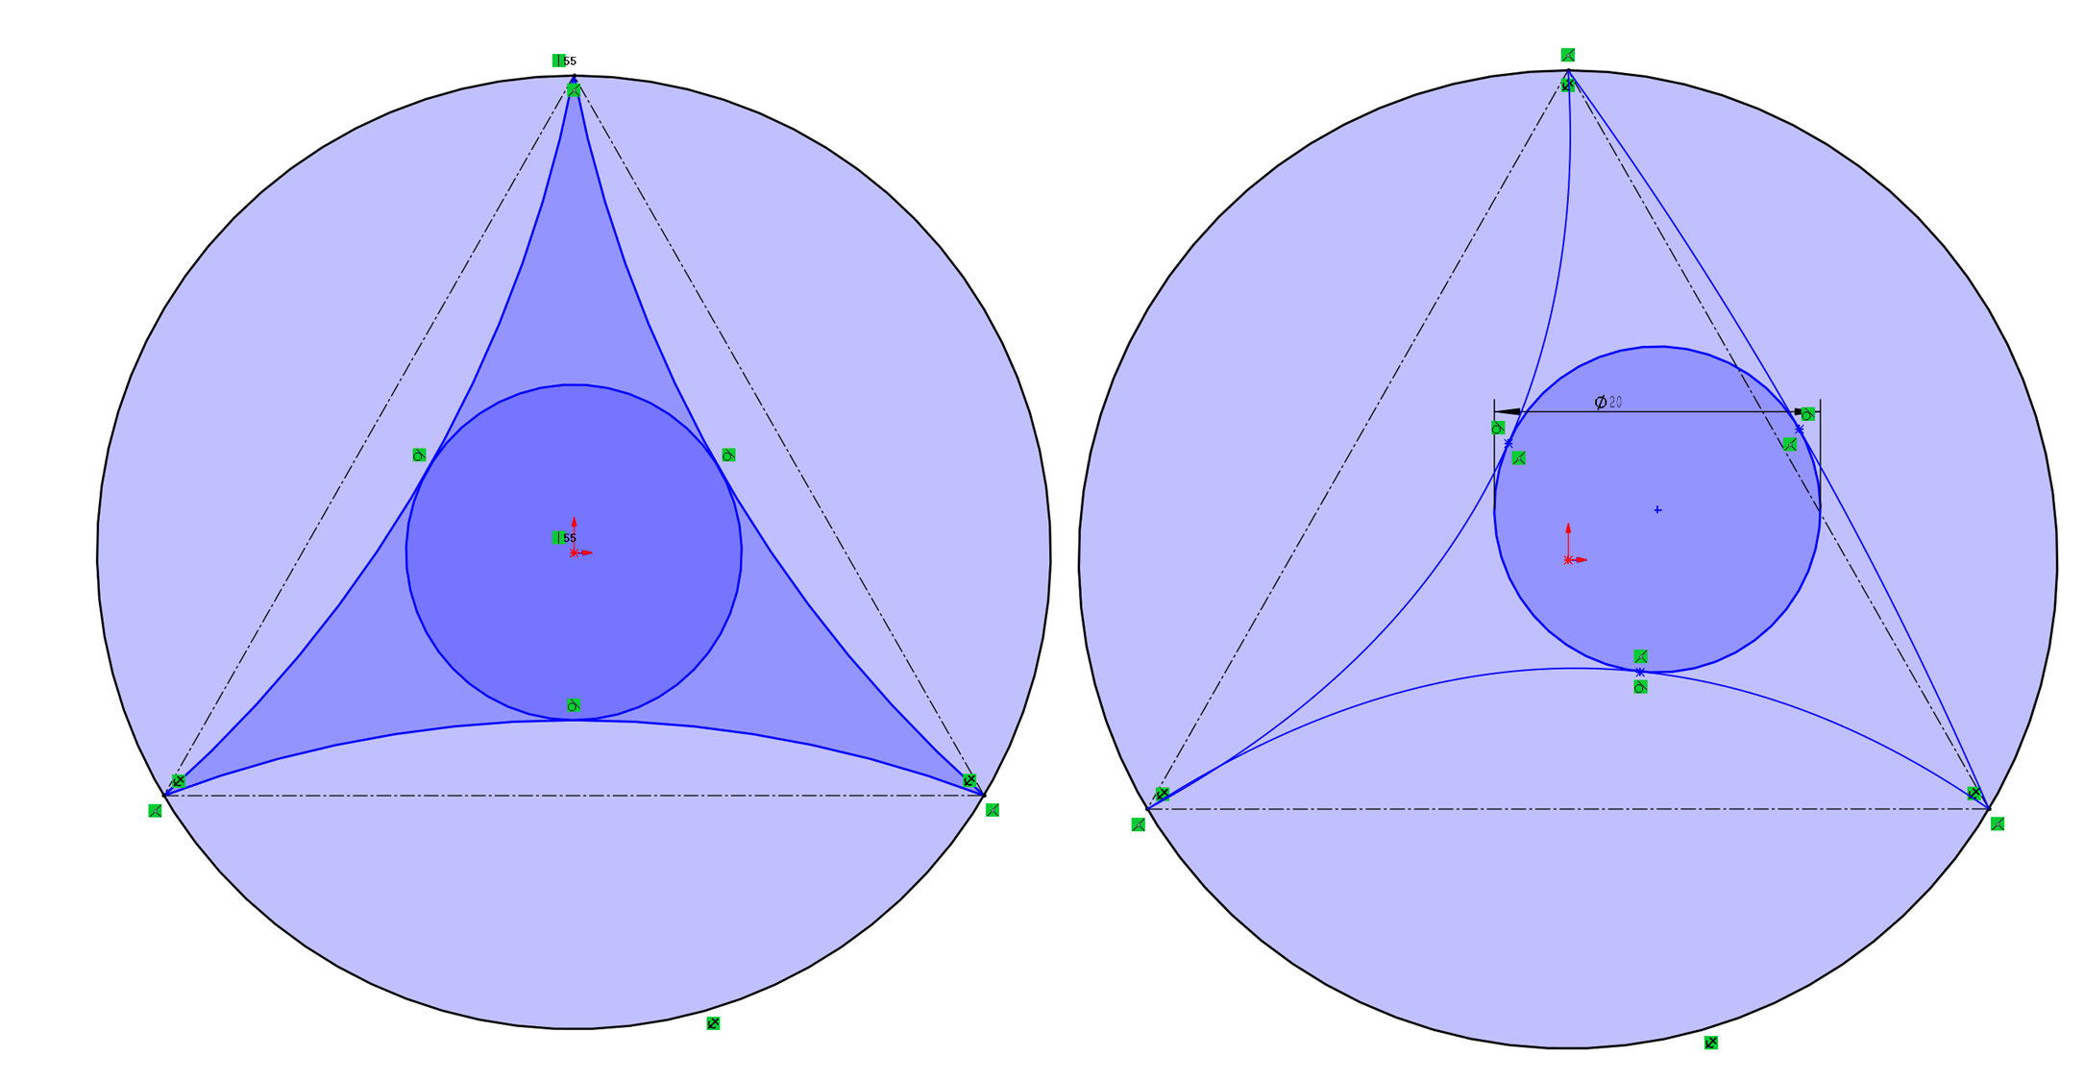
Area 1
Inflated
Area 2
deflated
Area 1
Area 2
Area 3
Area 3

Slide 5
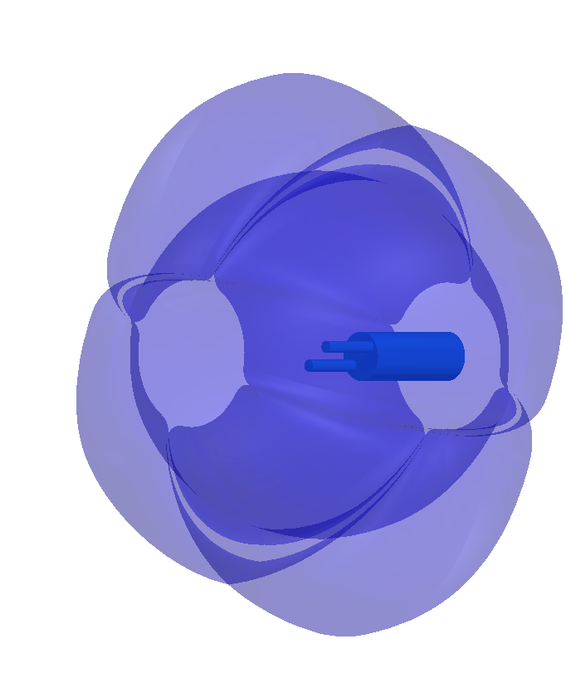
YAW
ROLL
ROLL
PITCH

Slide 6


Slide 7
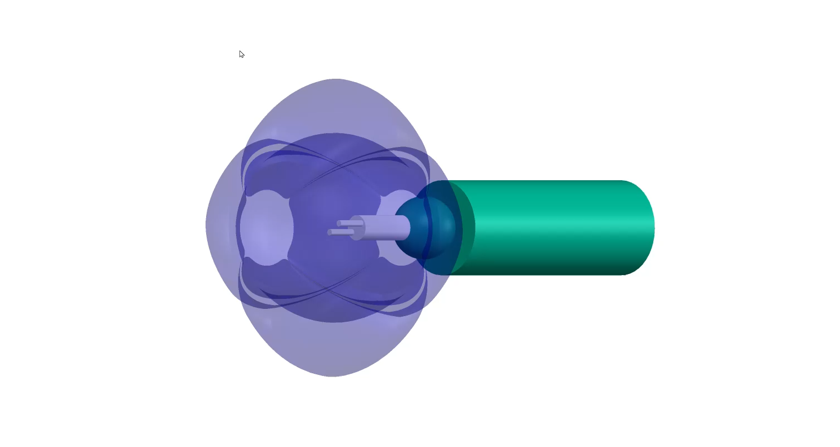

Slide 8
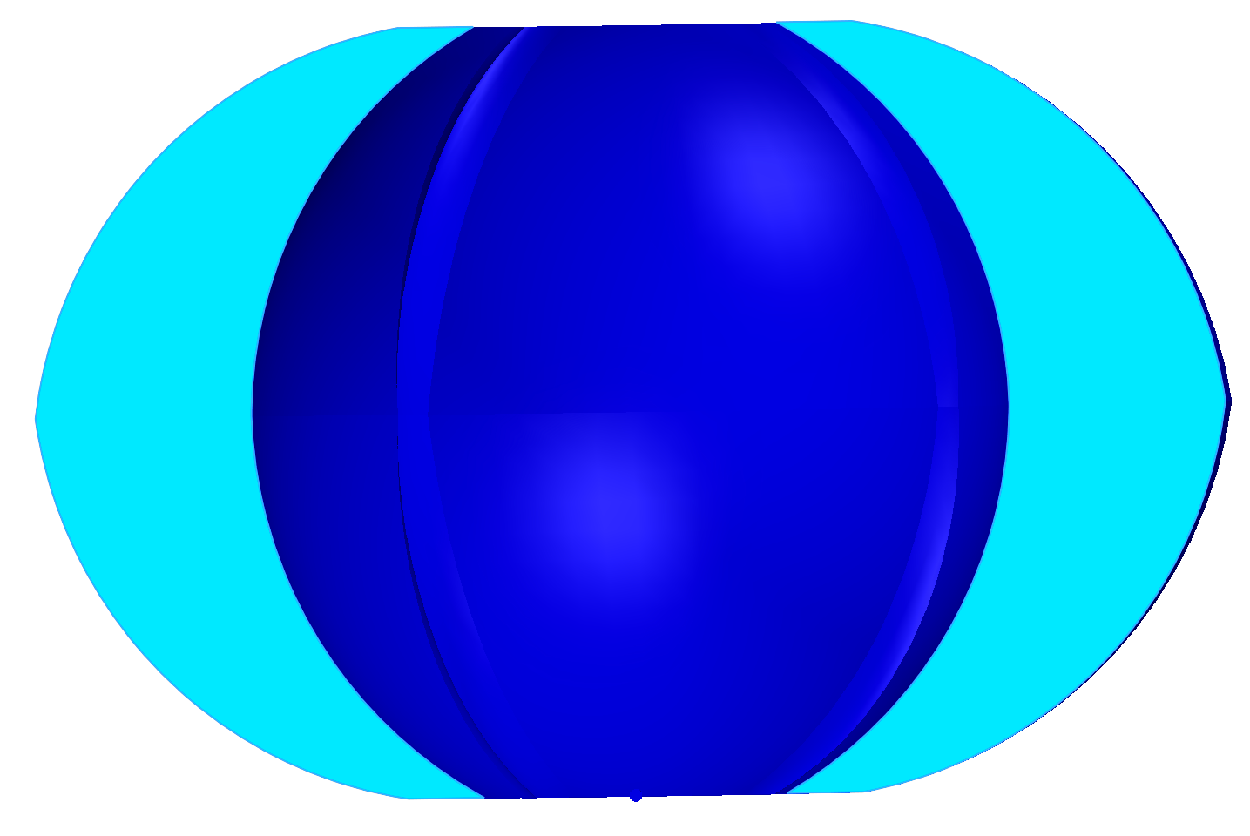
3. Retraction
Spring like tendon

Slide 9
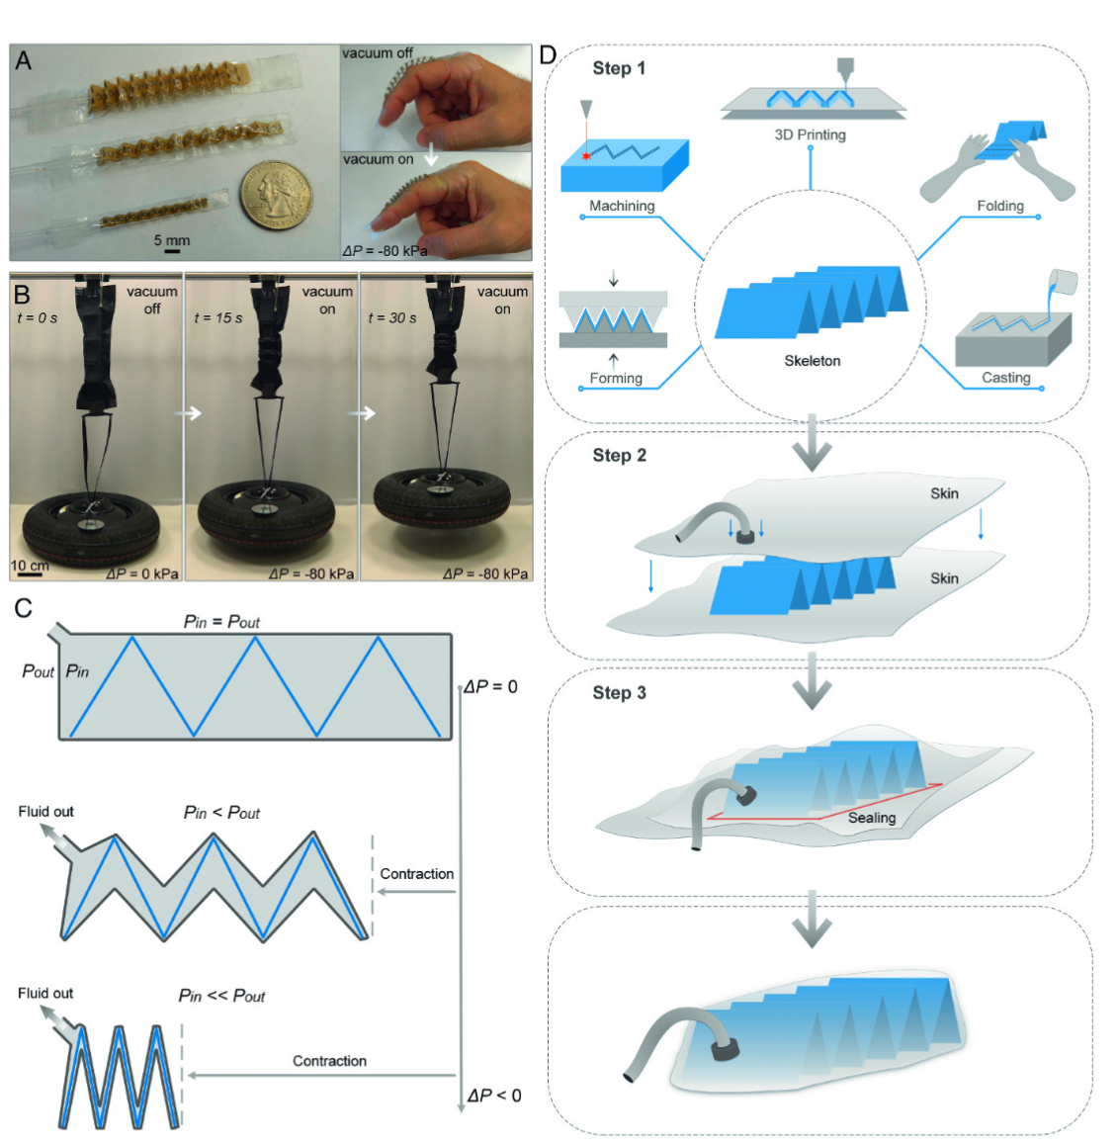
Miniature Actuators (Small-scale prototypes)PEEK zigzag origami as skeleton PVC film as skin Biocompatible → suitable for medical/wearable use Vacuum actuation (ΔP ≈ −80 kPa) produces clear contraction Very small form factor (≈5 mm scale)
Large-scale High-Power Actuator Demonstration Skeleton: nylon plate zigzag structure (fold width 10 cm)Skin: TPU-coated nylon fabric .Negative-pressure actuation (ΔP ≈ −80 kPa)Lifts a 22 kg car wheel Height: 20 cm Time: 30 s Demonstrates scalability from miniature to large loads
Fabrication Process
Step 1 — Skeleton Construction Multiple methods supported:3D printing Machining Forming Folding Casting Any structure with compressible or hinged voids can be used
Step 2 — Skin Preparation Flexible film arranged around the skeleton Skin material chosen based on rigidity, sealing, and fluid compatibility
Step 3 — Sealing and Assembly Seal skin to form fluid-tight enclosure Vacuum port added for pressure control Ready for actuation under negative pressure

Slide 10
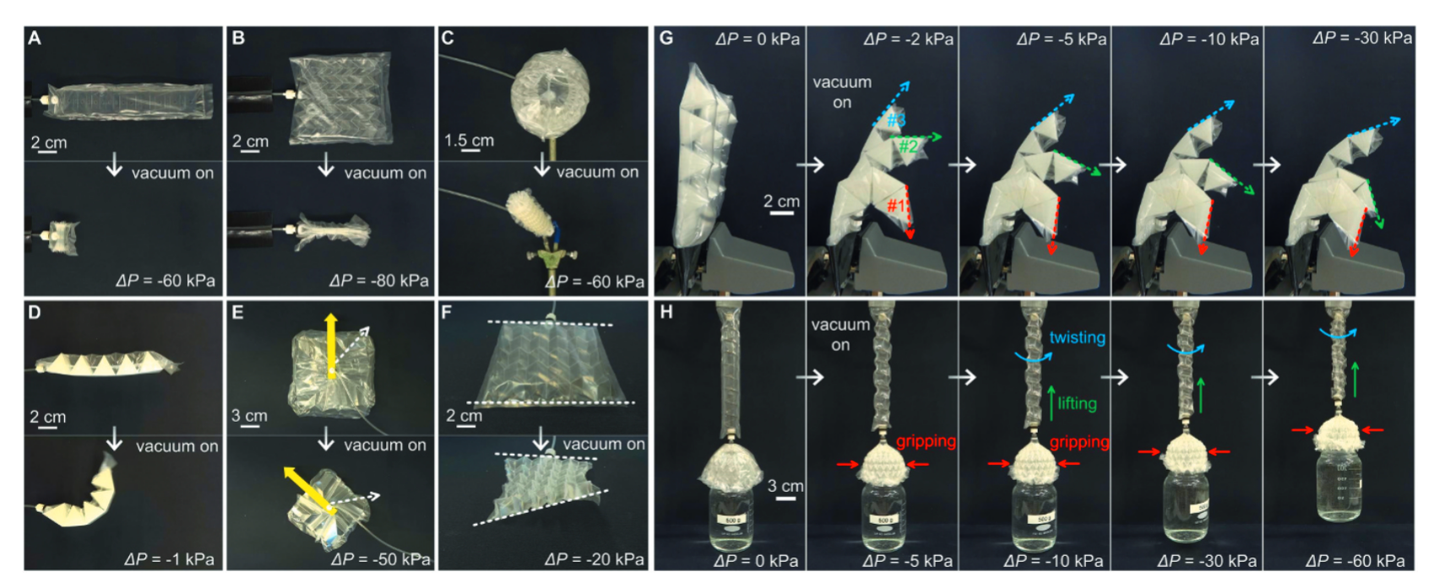
C) A 3D “magicball” origami using the water-bomb pattern (radius: 3.5 cm) contracts to a compacted cylindrical structure (radius: 0.9 cm; height: 6.5 cm). The 3D volume decreases 91% after this contraction

Slide 11
