Slide 1
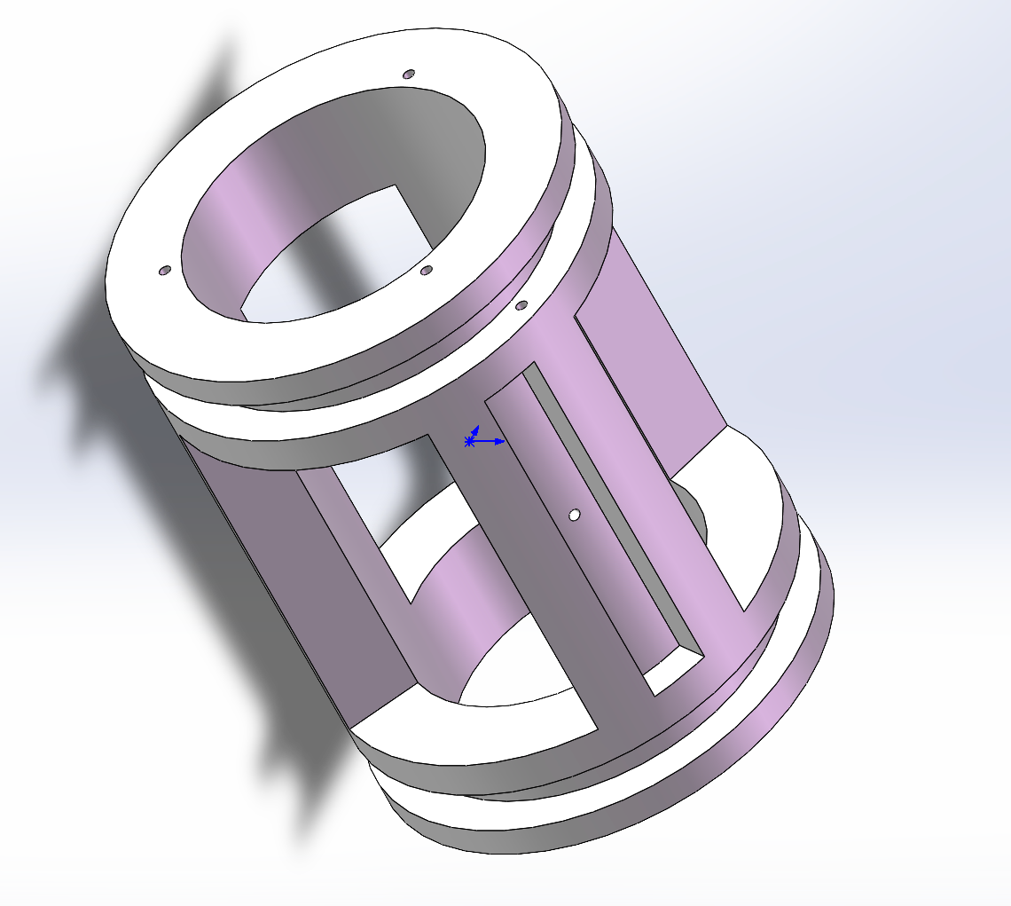
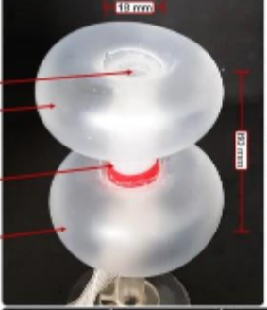
Lock in axial direction

Slide 2
Lock in torsional direction

Slide 3
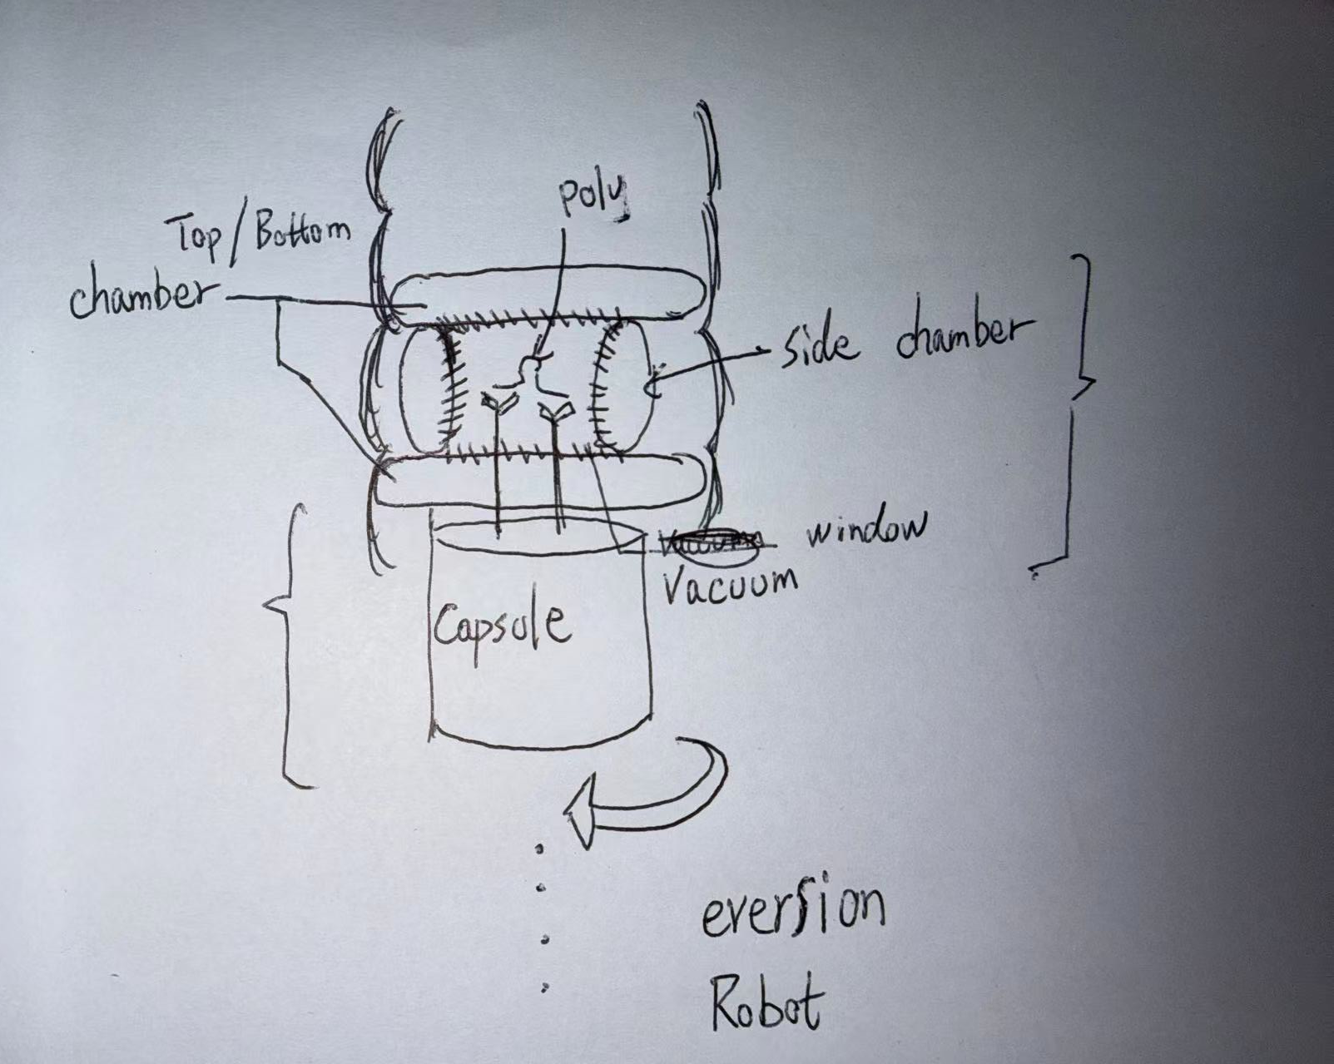
Capsule
Vacuum Chamber

Slide 4
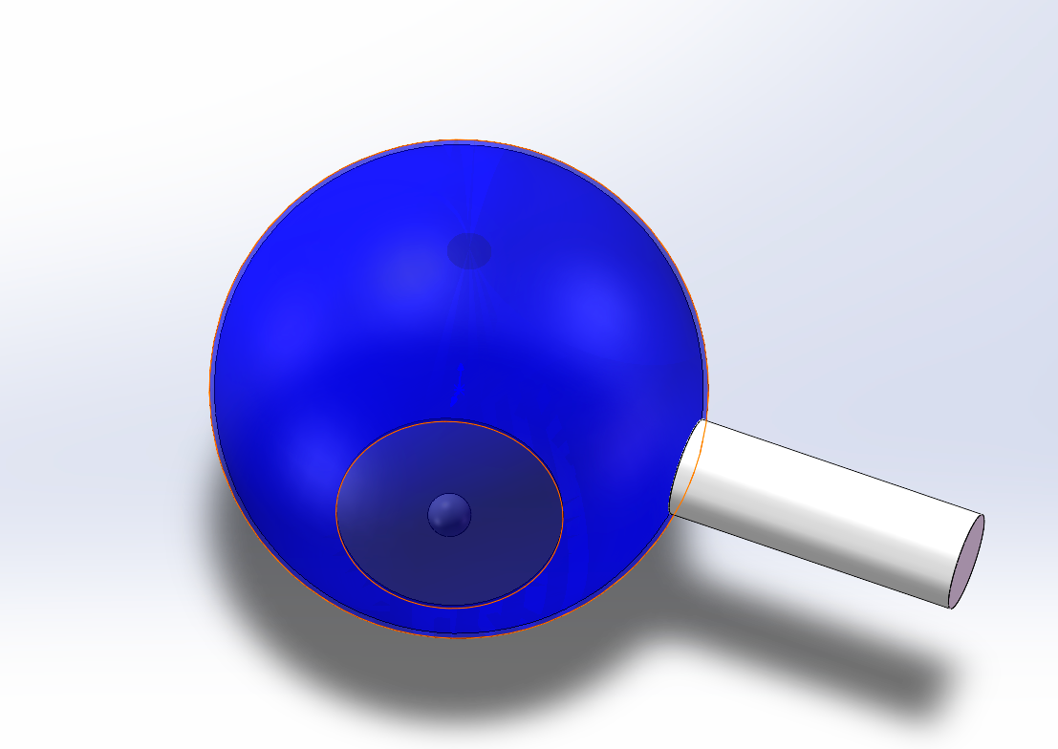
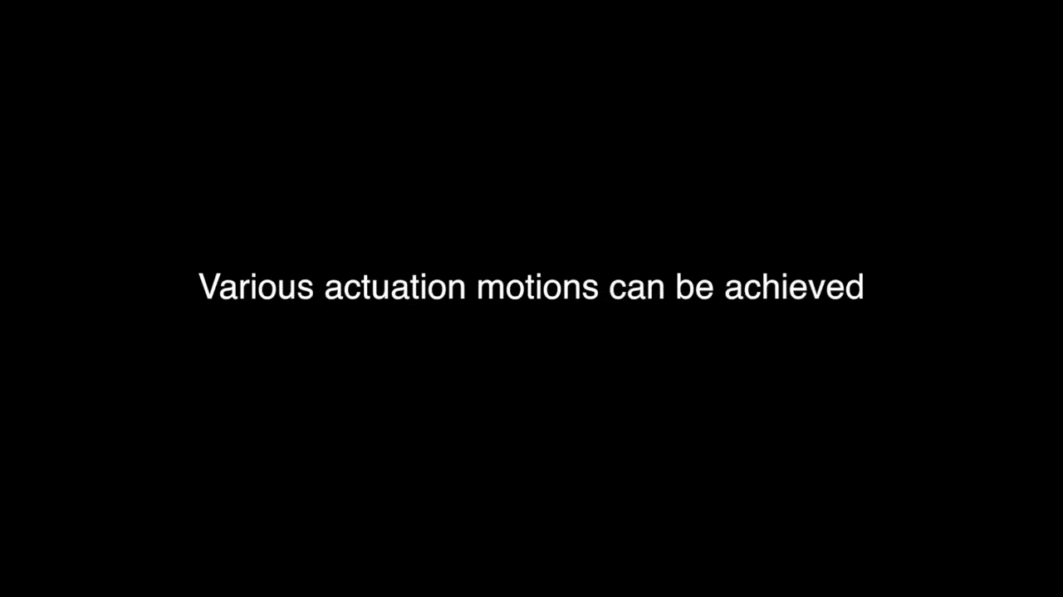
Membrane Design
Requirement
Ability to rotate and align with the polyp location
Coaxial layout when deflated
（circumferential folding ribs?）
Membrane
capsule
Polyp
Fluid-driven origami-inspired artificial muscles
https://www.pnas.org/doi/10.1073/pnas.1713450114

Slide 5
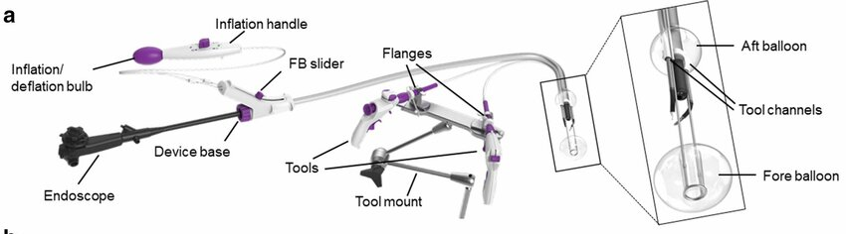
Use of an endoscopic flexible grasper as a traction tool for excision of polyps: preclinical trial
https://www.nature.com/articles/s41598-021-98162-x
Requirement
Ability to extend and retreat the ballon from capsule
Current dual-balloon platforms rely on rigid links and reinforced overtubes, which limit flexibility and occupy significant lumen space.
Rigid structures cannot safely navigate tight bends, variable lumen diameters, or tortuous segments of the colon.
Existing systems are not compatible with capsule/ eversion robot, because structural components permanently block the central lumen.
.

Slide 6
Three-chamber pneumatic architecture
Stage 1 deflation
Stage 2 Inflation
front balloon
back balloon
Capsule
flexible support for extension
1. Minimal Profile When Not in Use
2. No Rigid Mechanical Connections → Safer Interaction
3. Length Freedom & Angular Freedom
The central flexible segment is supported by three parallel pneumatic lines, giving natural multi-DOF bending.
The system adapts to arbitrary colon curvature, unlike rigid dual-balloon frames.
Extension length can be freely adjusted by controlling the pneumatic pressure distribution.
4. Fully Soft, Conformal Anchoring
Balloons expand into smooth, large-area contact surfaces that distribute pressure safely.
Anchoring is created through compliant radial expansion, not rigid wedging.
Suitable for repeated deployment at multiple sites.
5. Repeated Deploy / Retract Capability
6. Geometry-Adaptive and Self-Aligning

