Slide 1
Reactive channels in mineral-filled fracture networks
What 456 BiGraFV simulations at kilometre scale taught us, and where we are
Forsmark FFM01 networks · gypsum and coupled gypsum–calcite · PFLOTRAN on a fracture graph · 9 November 2026
Notes:
Title. This is the Forsmark reactive-channel study: 456 reactive simulations on 117 fracture networks built from SKB Forsmark FFM01 statistics, 1 to 2 km long, 1,587 to 14,658 fractures each. The model is BiGraFV: PFLOTRAN reactive transport on a graph where one control volume is one whole fracture. The deck is laid out as what I am confident of, what changed my mind, and where we are.

Slide 2
The short version
1
One sequence, four stages
open space decouples from flow, recouples, focuses and breaks through, relaxes (87 of 90 runs)
2
A focus that travels and relaxes
each 100 m stretch focuses as the front passes, then returns to within 2 % of its start: the fill runs out
3
Depth set by the attainable gain C
how far flow concentrates: 0.78 of its start at ×5.5 to 0.15 at ×1000; both chemistries on one curve (within ~0.02)
?
Changed my mind
early tracer arrival ranks breakthrough only roughly (blind test failed); the right clock is gypsum dissolved, not time
→
Where we are
story stable; DFN check on the 500 m network running since this morning, verdict ~Wednesday
2
Notes:
The short version. Three things I am confident of: one sequence of four stages; a focus that travels with the dissolution front and relaxes behind it because the soluble fill runs out (the part we have not found published; Hyman 2026 Fig. 11 has the moving front, with wall rock that keeps dissolving, and focusing persists behind it); and a channel depth set by the attainable permeability gain C, the same curve for both chemistries. One thing that changed my mind: the early-arrival predictor only ranks breakthrough roughly, it failed its blind test. Where we are: the story is stable, the DFN check on a 500 m network started this morning and is the one thing that could change it.

Slide 3
Where this sits relative to Hyman et al. 2026
Hyman et al. 2026 (JGR)
This study
graph model of 3D DFNs, ~25 m, ~526 fractures
the wall rock dissolves: apertures keep growing
regimes mapped in Da and G; wormholing at high Da
a focusing front moves downstream (Fig. 11); behind it focusing persists
time: τ = ΔV/V0, dissolved volume over initial void volume
BiGraFV: one PFLOTRAN control volume per fracture, 1–2 km, 1,587–14,658 fractures
a finite vein fill dissolves (gypsum, 90 % of each fracture); walls never do
real gypsum and calcite kinetics, mineral volume, porosity–permeability feedback
456 runs: chemistry, permeability law, rate, length, density, transmissivity spread
flow re-solved on the frozen state at every saved step
3
Notes:
Where this sits. Hyman, Szawełło, Kang and Szymczak (2026, JGR) run a graph model of 3D DFNs, up to 25 m and about 526 fractures, where the wall rock itself dissolves and apertures keep growing (no exhaustion of the soluble rock is modelled); they map regimes in Da and G. Meshed DFN studies stop around 10 m. Our system is different in two ways that matter: the soluble material is a finite vein fill (gypsum filling 90 % of each fracture), and the networks are a kilometre long with thousands of fractures. One BiGraFV cell per fracture is what makes 456 runs of that size possible.

Slide 4
Set-up
The model, what we ran, and the three normalized times
Notes:
Set-up: what one cell is, what we ran, and the clocks, defined the way Hyman defines his.

Slide 5
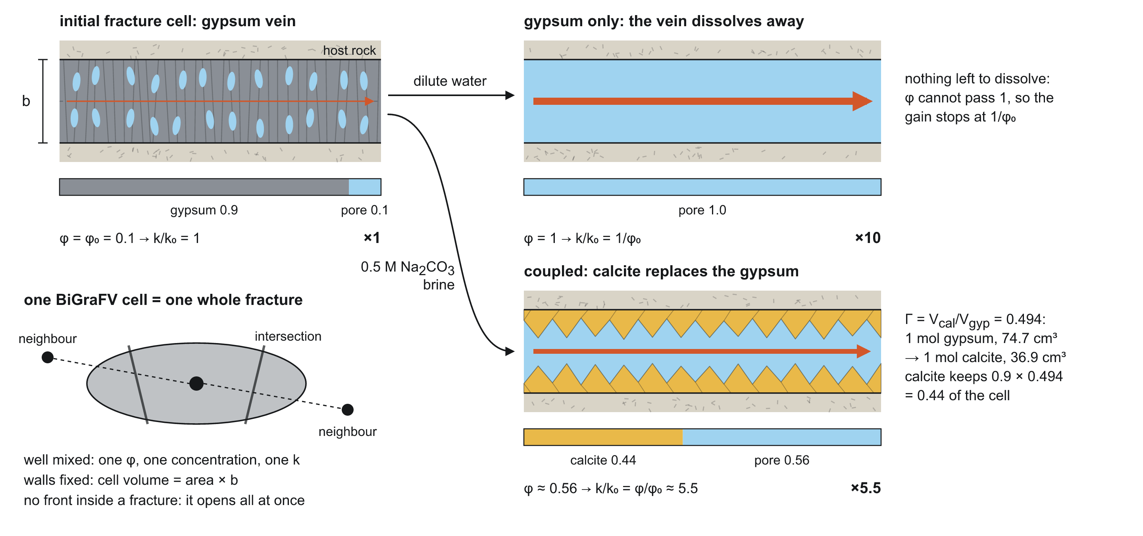
One cell = one fracture, filled with a gypsum vein
5
Notes:
One cell is one whole fracture, well mixed: one porosity, one concentration, one permeability. Each fracture starts as a vein: 90 % gypsum, 10 % open. Two chemistries. Gypsum-only: dilute water dissolves the vein away; porosity can only reach 1, so with k proportional to porosity the permeability can only rise ×10. Coupled: a 0.5 M carbonate brine; calcite replaces gypsum and keeps 0.494 of its volume, so the cell ends 44.5 % calcite, porosity 0.555, ×5.55. Neighbours connect through intersections. No fronts inside a fracture: it opens all at once. That is the main limitation and why the DFN check matters.

Slide 6
What we ran
456
117
1,587–14,658
reactive runs
networks, 1–2 km
fractures per network
Networks: SKB Forsmark FFM01 fracture statistics; P32 ×4, ×6, ×8, ×16; transmissivity spread σ 0 / 0.5 / 1; 5 seeds
Flow: fixed rate of one network pore volume per year
Chemistry: gypsum-only (dilute water) and coupled gypsum–calcite (0.5 M carbonate brine)
Permeability: k = k0 (φ/φ0)ⁿ, φ0 = 0.1; n = 1 main runs, n = 0.5–8 in the law tests
Measures: flow re-solved on every saved state; per-fracture throughflow, porosity, gypsum
6
Notes:
What we ran. Networks from SKB Forsmark FFM01 statistics, 1000 × 250 × 250 m (and 2000 × 500 × 250 m), intensity P32 scaled ×4 to ×16 so they percolate over a kilometre, transmissivity spread σ 0, 0.5 and 1, 5 seeds. Flow: one network pore volume per year at a fixed rate (Hyman's convention). Permeability k = k0 (φ/φ0)^n; n = 1 in the main runs, n = 0.5 to 8 in the law tests. Each saved state the flow is re-solved on the frozen permeability to get per-fracture throughflow. 456 reactive runs in all.

Slide 7
Everything we ran
Campaign | What it varies | Runs | Gypsum-only | Coupled | Networks
Base sweep | P32 ×4–×16, σ 0/0.5/1, 5 seeds; n = 1, φ0 0.1, 1 PV/yr | 120 | 60 | 60 | 60
2 km scale test | P32 ×4/×6/×8, σ 0/0.5/1, 5 seeds | 90 | 45 | 45 | 45
Blind predictor networks (run B) | 12 new 1 km networks, P32 ×4/×8, σ 1 | 24 | 12 | 12 | 12
Starting porosity | φ0 0.05; φ0 0.182 (gain ×5.5 / ×3.3) | 42 | 21 | 21 | 12
Low carbonate | coupled at 2 mM carbonate | 12 | 0 | 12 | 12
Injection rate | 0.1 PV/yr; 10 PV/yr | 12 | 6 | 6 | 3
Ceiling sweep (+ run C at σ 0) | n = 1.48 (×30); n = 2 (×100); n = 3 (×1000); n = 3 on the example network | 108 | 54 | 54 | 18
Law shape at fixed ×10 | n = 0.5; n = 2; n = 8 | 3 | 3 | 0 | 1
Late time (run A) | n = 2 to capacity time 8; n = 3 to capacity time 8 | 36 | 18 | 18 | 9
Late time (run A2) | n = 3 to capacity time 20 | 9 | 9 | 0 | 9
Total, Forsmark networks |  | 456 | 228 | 228 | 117 distinct
DFN validation, graph side | gate checks on 3 test networks, exact-network check, the 500 m pair | 10 | 5 | 5 | 5
DFN validation, meshed DFN | 2 smoke tests (stopped at 40 steps by design); 500 m pair running now | 4 | 2 | 2 | 2
7
Notes:
Everything that was run, counted from the run folders (run_inventory.csv, make_inventory_figures.py). 456 reactive BiGraFV runs on the Forsmark networks, plus one outflow-face check run not counted; 117 distinct networks: 60 at 1 km (P32 ×4, ×6, ×8, ×16; σ 0, 0.5, 1; 5 seeds), 45 at 2 km (P32 ×4, ×6, ×8; σ 0, 0.5, 1; 5 seeds) and 12 new 1 km networks for the blind test. Every run exists in both chemistries except where the question is chemistry-specific. The base sweep is the backbone: n = 1, starting porosity 0.1, one pore volume per year, to capacity time 5 at 1 km and 2 at 2 km. The other campaigns change one thing at a time: starting porosity, carbonate, rate, the permeability law (ceiling sweep, and run C repeats it without transmissivity spread), the law's shape at a fixed gain, late time at high gain, and the blind predictor networks. Run counts in the ceiling sweep include run C's σ 0 runs; the networks column counts distinct networks per campaign. The DFN rows are the validation work on small test networks.

Slide 8
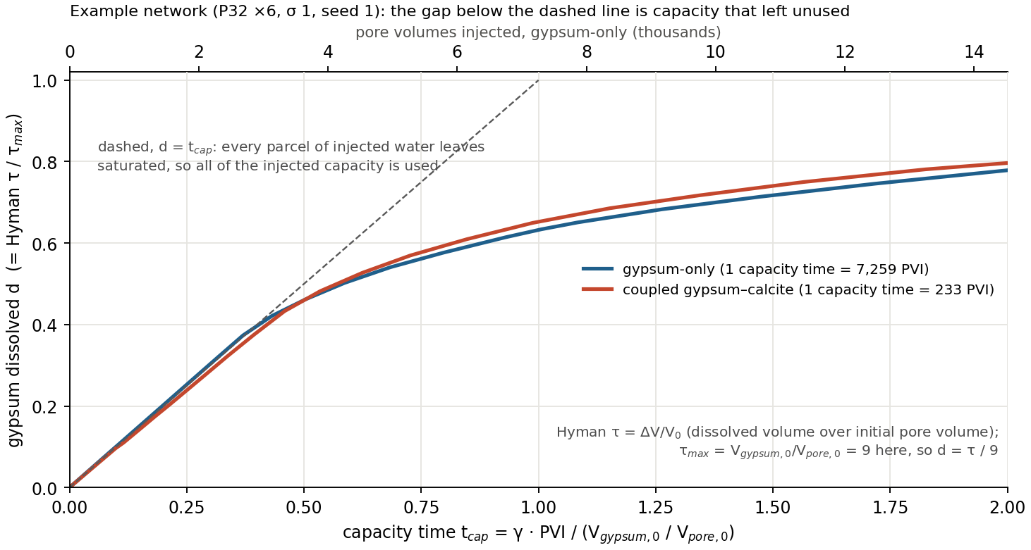
Normalized times, in Hyman's notation
PVI pore volumes injected = Q t / V_{pore,0}
γ acid capacity (Hyman): c₀ / (ν c_{sol}) = volume of mineral one volume of fluid removes
gypsum: c0 = 16.6 mol/m³ (saturation of dilute water), c_sol = 13,400 mol/m³ → γ = 1.24 × 10⁻³
t_{cap} capacity time = γ · PVI / τ_{max}; 1 = enough water in to remove the whole inventory if it all left saturated
gypsum-only: 1 t_cap = 7,259 PVI · coupled: 1 t_cap = 233 PVI
d gypsum dissolved = Hyman τ / τ_{max}, τ = ΔV/V₀, τ_{max} = 9; d ≤ t_{cap} always
Every stage event is timed on d.
8
Notes:
Normalized times. Three clocks. PVI, pore volumes injected, is Q t over the initial pore volume. Gypsum dissolved d is the fraction of the network's gypsum gone; it is Hyman's tau = ΔV/V0 divided by its maximum, tau_max = V_gypsum,0 / V_pore,0 = 9 here, because each fracture is 90 % gypsum. Capacity time uses Hyman's acid capacity number gamma = c0/(ν c_sol): the volume of mineral one volume of injected fluid can remove. For gypsum the 'reactant' is undersaturation: dilute water can carry 16.6 mol/m3 before it is saturated, and solid gypsum is 13,400 mol/m3, so gamma = 1.24e-3. Capacity time is gamma × PVI divided by tau_max: t_cap = 1 means enough water has gone in to remove the whole inventory if every parcel left saturated. That is 7,259 PVI for gypsum-only; for the coupled brine each carbonate also takes one Ca out as calcite, gamma = 0.039 and t_cap = 1 is 233 PVI. The figure is one network. Up to d about 0.4 the curve sits on the dashed line: every parcel of water leaves saturated. After breakthrough water exits through the opened channel undersaturated, and d falls below t_cap.

Slide 9
The raw ensembles: how to read the next four slides
What is plotted
How
What to look for
PR_V: share of fracture volume carrying the flow
d_Q/P32 (Hyman): share of fracture area carrying the flow, %
each against PVI (log), gypsum dissolved d and capacity time
base runs: n = 1, φ0 0.1, 1 PV/yr; gypsum-only here, coupled in backup
1 km blue solid, 2 km rust dashed, darker = larger σ
line = mean of 5 seeds, band = seed range
denser networks spread flow more (PR_V 0.31–0.39 at ×4 → 0.58–0.60 at ×16)
2 km uses less of its area (11–16 % against 16–22 %)
every group dips, then recovers
9
Notes:
How the next four slides are built. For each density (P32 ×4, ×6, ×8 and ×16) the base runs are shown as raw ensembles, before any derived result: participation ratio PR_V and Hyman's active surface d_Q/P32, each against the three normalized times. 1 km and 2 km are on the same axes (×16 was run at 1 km only); σ is a separate line; the line is the mean of 5 seeds and the band the seed range. The general pattern: denser networks spread flow over more of their volume (PR_V starts higher: about 0.31–0.39 at ×4, 0.40–0.47 at ×6, 0.50–0.55 at ×8, 0.58–0.60 at ×16), longer networks carry flow over a smaller share of their fracture area (active surface about 11–16 % at 2 km against 16–22 % at 1 km for ×4–×8), more transmissivity spread lowers PR_V a little, and every group dips and recovers. Coupled versions are in the backup.

Slide 10
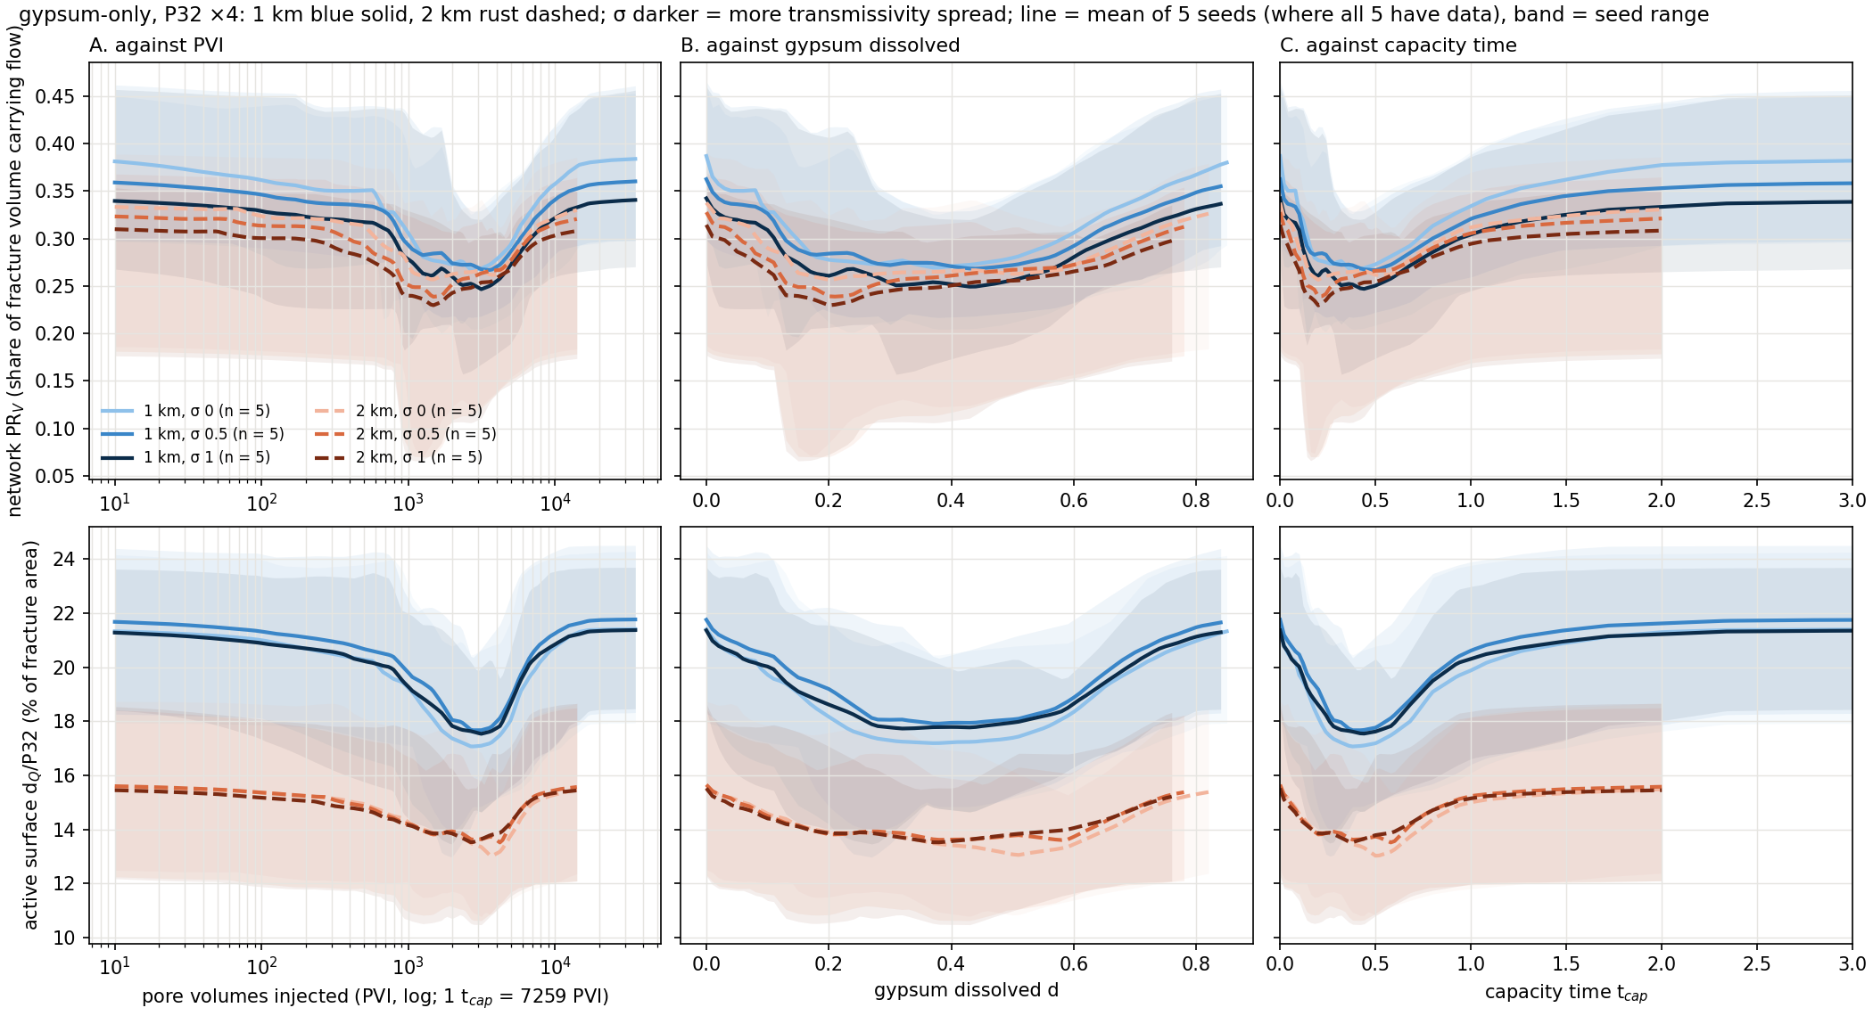
Gypsum-only ensembles, P32 ×4
10
Notes:
Ensemble overview, gypsum-only, P32 ×4, base runs (n = 1, φ0 0.1, 1 PV/yr). Top row: network PR_V, the share of fracture volume that effectively carries the flow. Bottom row: Hyman's active surface d_Q/P32, the share of fracture area that effectively carries the flow (in %). Left to right the same runs against PVI (log), gypsum dissolved and capacity time; within a chemistry PVI and capacity time are the same clock up to a constant, the log axis just shows the early part. Lines are the mean of 5 seeds where all 5 have data, bands the seed range; blue solid 1 km, rust dashed 2 km, darker = larger σ. 1 km: PR_V starts at 0.39 / 0.36 / 0.34 (σ 0 / 0.5 / 1) and dips to 0.25 at σ 1 near d 0.43; active surface starts at 21.4 % and dips to 17.7 % (σ 1); 2 km: PR_V starts at 0.34 / 0.33 / 0.31 (σ 0 / 0.5 / 1) and dips to 0.23 at σ 1 near d 0.20; active surface starts at 15.5 % and dips to 13.5 % (σ 1). Every group dips and recovers on every axis; this is the raw behaviour before any of the results.

Slide 11
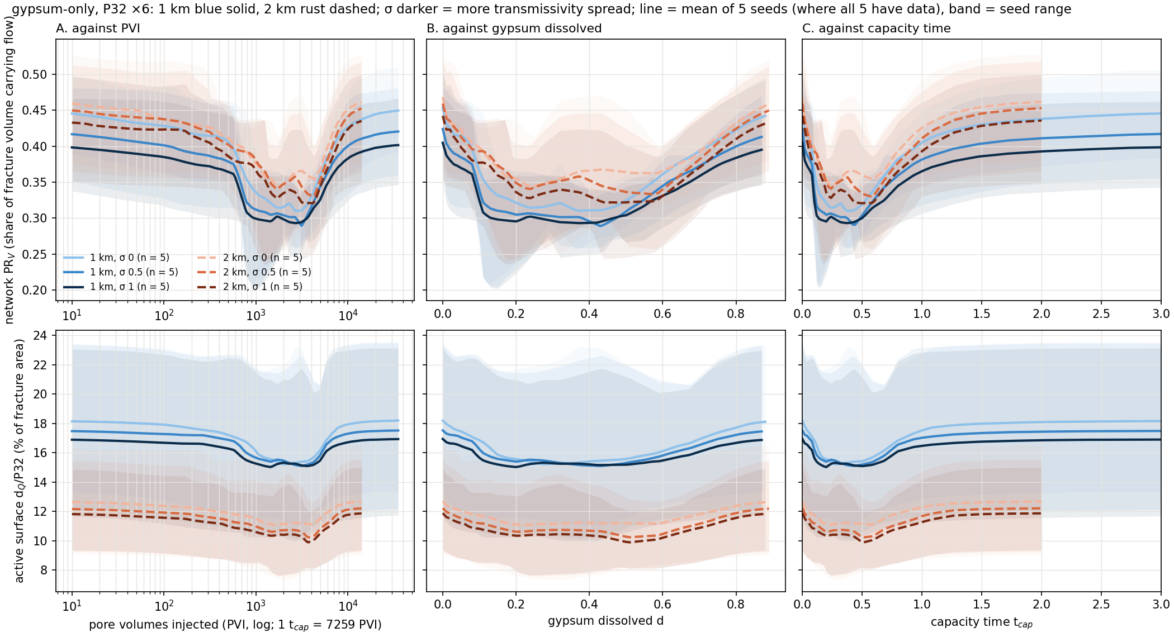
Gypsum-only ensembles, P32 ×6
11
Notes:
Ensemble overview, gypsum-only, P32 ×6, base runs (n = 1, φ0 0.1, 1 PV/yr). Top row: network PR_V, the share of fracture volume that effectively carries the flow. Bottom row: Hyman's active surface d_Q/P32, the share of fracture area that effectively carries the flow (in %). Left to right the same runs against PVI (log), gypsum dissolved and capacity time; within a chemistry PVI and capacity time are the same clock up to a constant, the log axis just shows the early part. Lines are the mean of 5 seeds where all 5 have data, bands the seed range; blue solid 1 km, rust dashed 2 km, darker = larger σ. 1 km: PR_V starts at 0.45 / 0.42 / 0.40 (σ 0 / 0.5 / 1) and dips to 0.29 at σ 1 near d 0.37; active surface starts at 16.9 % and dips to 15.0 % (σ 1); 2 km: PR_V starts at 0.47 / 0.46 / 0.44 (σ 0 / 0.5 / 1) and dips to 0.32 at σ 1 near d 0.49; active surface starts at 11.9 % and dips to 9.9 % (σ 1). Every group dips and recovers on every axis; this is the raw behaviour before any of the results.

Slide 12
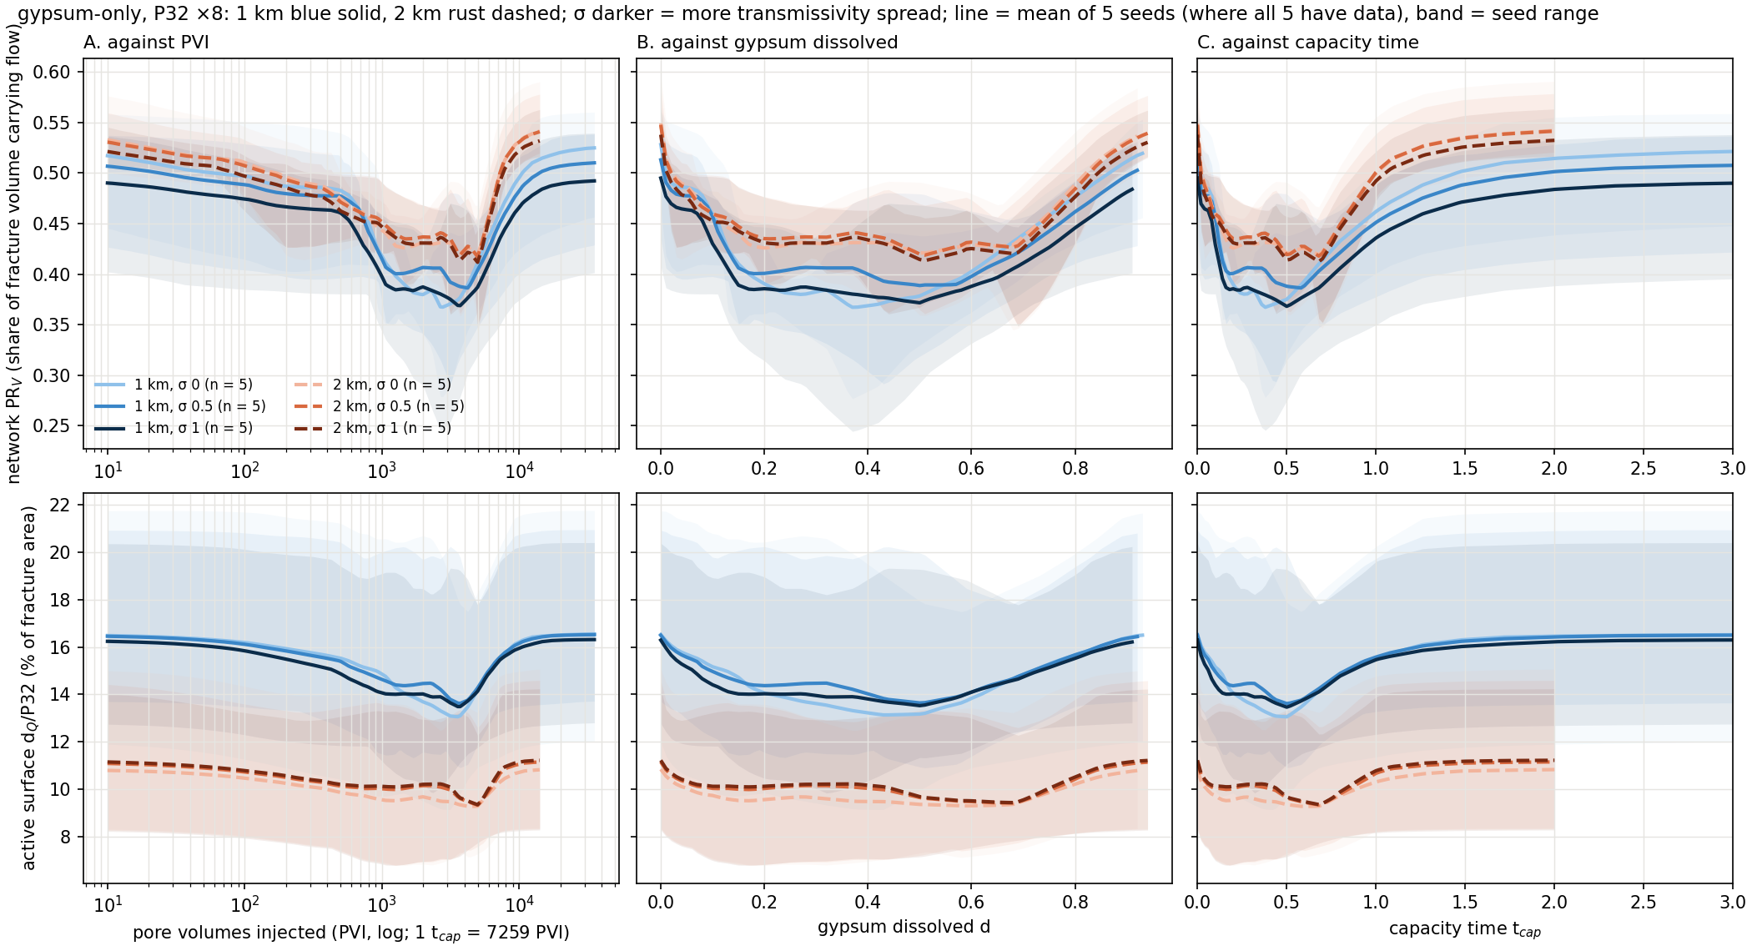
Gypsum-only ensembles, P32 ×8
12
Notes:
Ensemble overview, gypsum-only, P32 ×8, base runs (n = 1, φ0 0.1, 1 PV/yr). Top row: network PR_V, the share of fracture volume that effectively carries the flow. Bottom row: Hyman's active surface d_Q/P32, the share of fracture area that effectively carries the flow (in %). Left to right the same runs against PVI (log), gypsum dissolved and capacity time; within a chemistry PVI and capacity time are the same clock up to a constant, the log axis just shows the early part. Lines are the mean of 5 seeds where all 5 have data, bands the seed range; blue solid 1 km, rust dashed 2 km, darker = larger σ. 1 km: PR_V starts at 0.53 / 0.51 / 0.49 (σ 0 / 0.5 / 1) and dips to 0.37 at σ 1 near d 0.50; active surface starts at 16.3 % and dips to 13.5 % (σ 1); 2 km: PR_V starts at 0.55 / 0.55 / 0.54 (σ 0 / 0.5 / 1) and dips to 0.41 at σ 1 near d 0.51; active surface starts at 11.2 % and dips to 9.4 % (σ 1). Every group dips and recovers on every axis; this is the raw behaviour before any of the results.

Slide 13
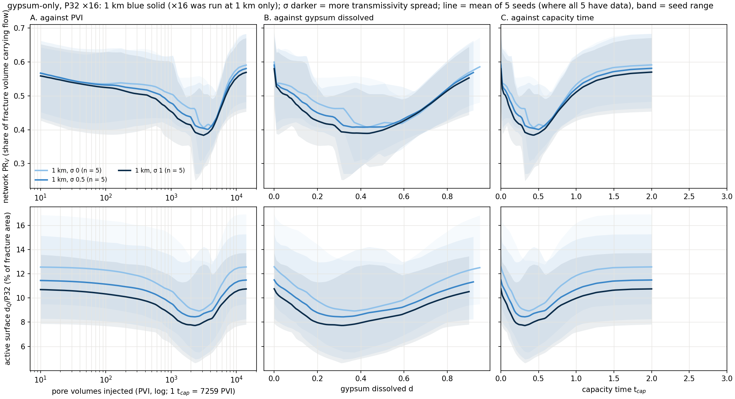
Gypsum-only ensembles, P32 ×16 (1 km only)
13
Notes:
Ensemble overview, gypsum-only, P32 ×16, base runs (n = 1, φ0 0.1, 1 PV/yr). Top row: network PR_V, the share of fracture volume that effectively carries the flow. Bottom row: Hyman's active surface d_Q/P32, the share of fracture area that effectively carries the flow (in %). Left to right the same runs against PVI (log), gypsum dissolved and capacity time; within a chemistry PVI and capacity time are the same clock up to a constant, the log axis just shows the early part. Lines are the mean of 5 seeds where all 5 have data, bands the seed range; blue solid 1 km, rust dashed 2 km, darker = larger σ. 1 km: PR_V starts at 0.60 / 0.59 / 0.58 (σ 0 / 0.5 / 1) and dips to 0.39 at σ 1 near d 0.43; active surface starts at 10.8 % and dips to 7.7 % (σ 1). Every group dips and recovers on every axis; this is the raw behaviour before any of the results.

Slide 14
What I'm confident of · 1
One sequence: four stages in the same order
Notes:
First of three results I am confident of.

Slide 15
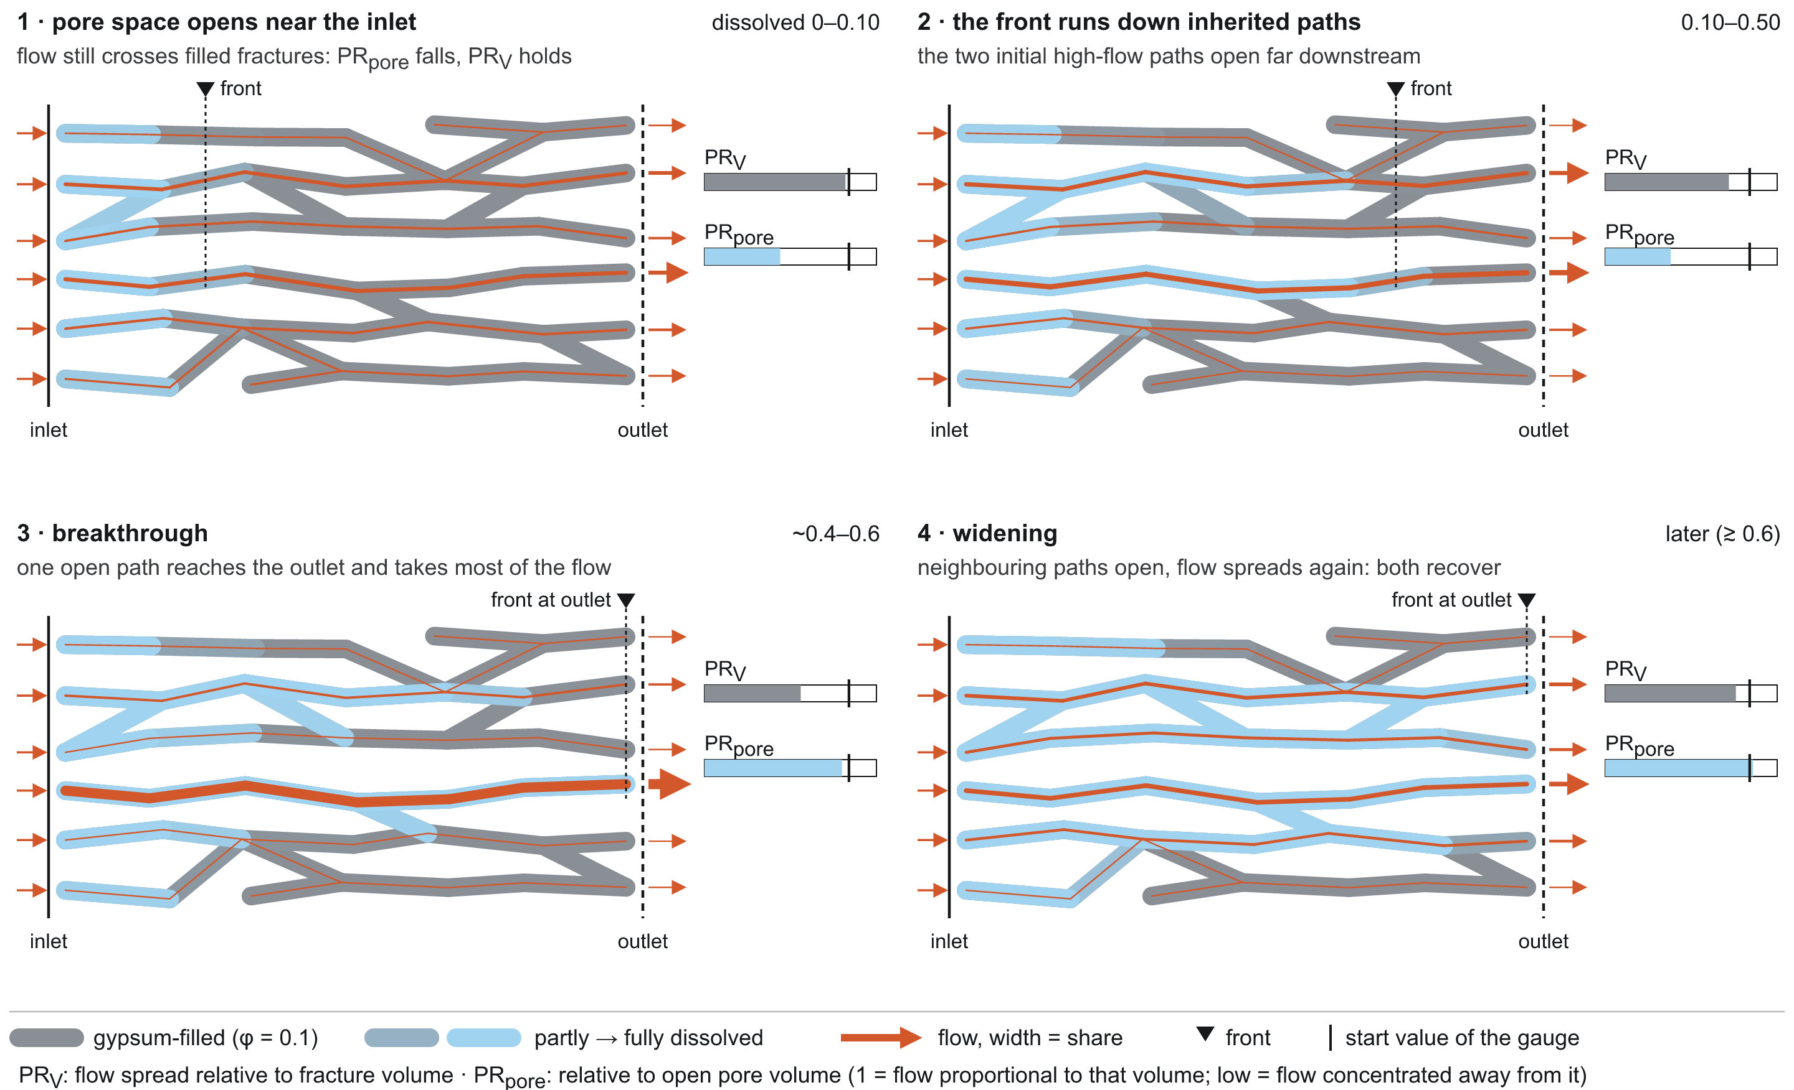
Four stages, one order
15
Notes:
The four stages as a cartoon. Stage 1: gypsum near the inlet dissolves, but the water still has to squeeze through filled fractures further on, so the opened space does not yet change where water goes: open space and flow decouple. Stage 2: the front runs down the paths that already carried the flow. Stage 3: flow crowds into those opened paths, most strongly just before the front reaches the outlet, and breaks through. Stage 4: once the gypsum along those paths is gone, neighbouring paths catch up and flow spreads out again.

Slide 16
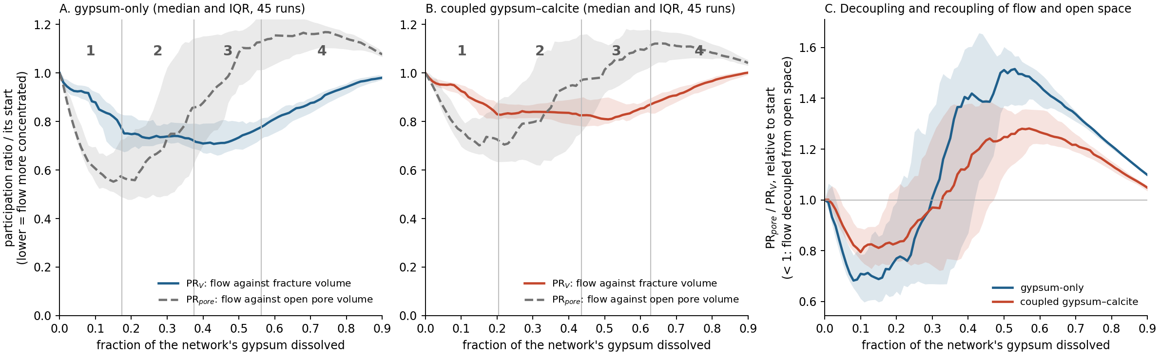
The same order in 87 of 90 runs
87 / 90
0.17 · 0.37 · 0.56
0.995
runs with pore-volume minimum ≤ PR_V minimum ≤ breakthrough (83 / 90 at 2 km)
gypsum dissolved at the three events (gypsum-only medians)
network PR_V at the end relative to its start: it relaxes
16
Notes:
The data behind the cartoon, median and IQR of 45 runs per chemistry. PR_V is the participation ratio of flow against fracture volume: 1 when flow is proportional to volume, smaller when flow is concentrated. PR_pore is the same against open pore volume. Event medians on d: pore-volume minimum 0.17 (gypsum-only) / 0.20 (coupled); PR_V minimum 0.37 / 0.44; breakthrough 0.56 / 0.63. The order pore-volume minimum ≤ PR_V minimum ≤ breakthrough holds in 87 of 90 runs at 1 km and 83 of 90 at 2 km. Decoupling: PR_pore/PR_V falls below its start in all 45 runs per chemistry (to 0.68 / 0.80 at d ≈ 0.1), crosses 1 at d ≈ 0.3 and peaks at 1.52 / 1.28 near d = 0.5. At the end PR_V is 0.995 / 1.01 of its start.

Slide 17
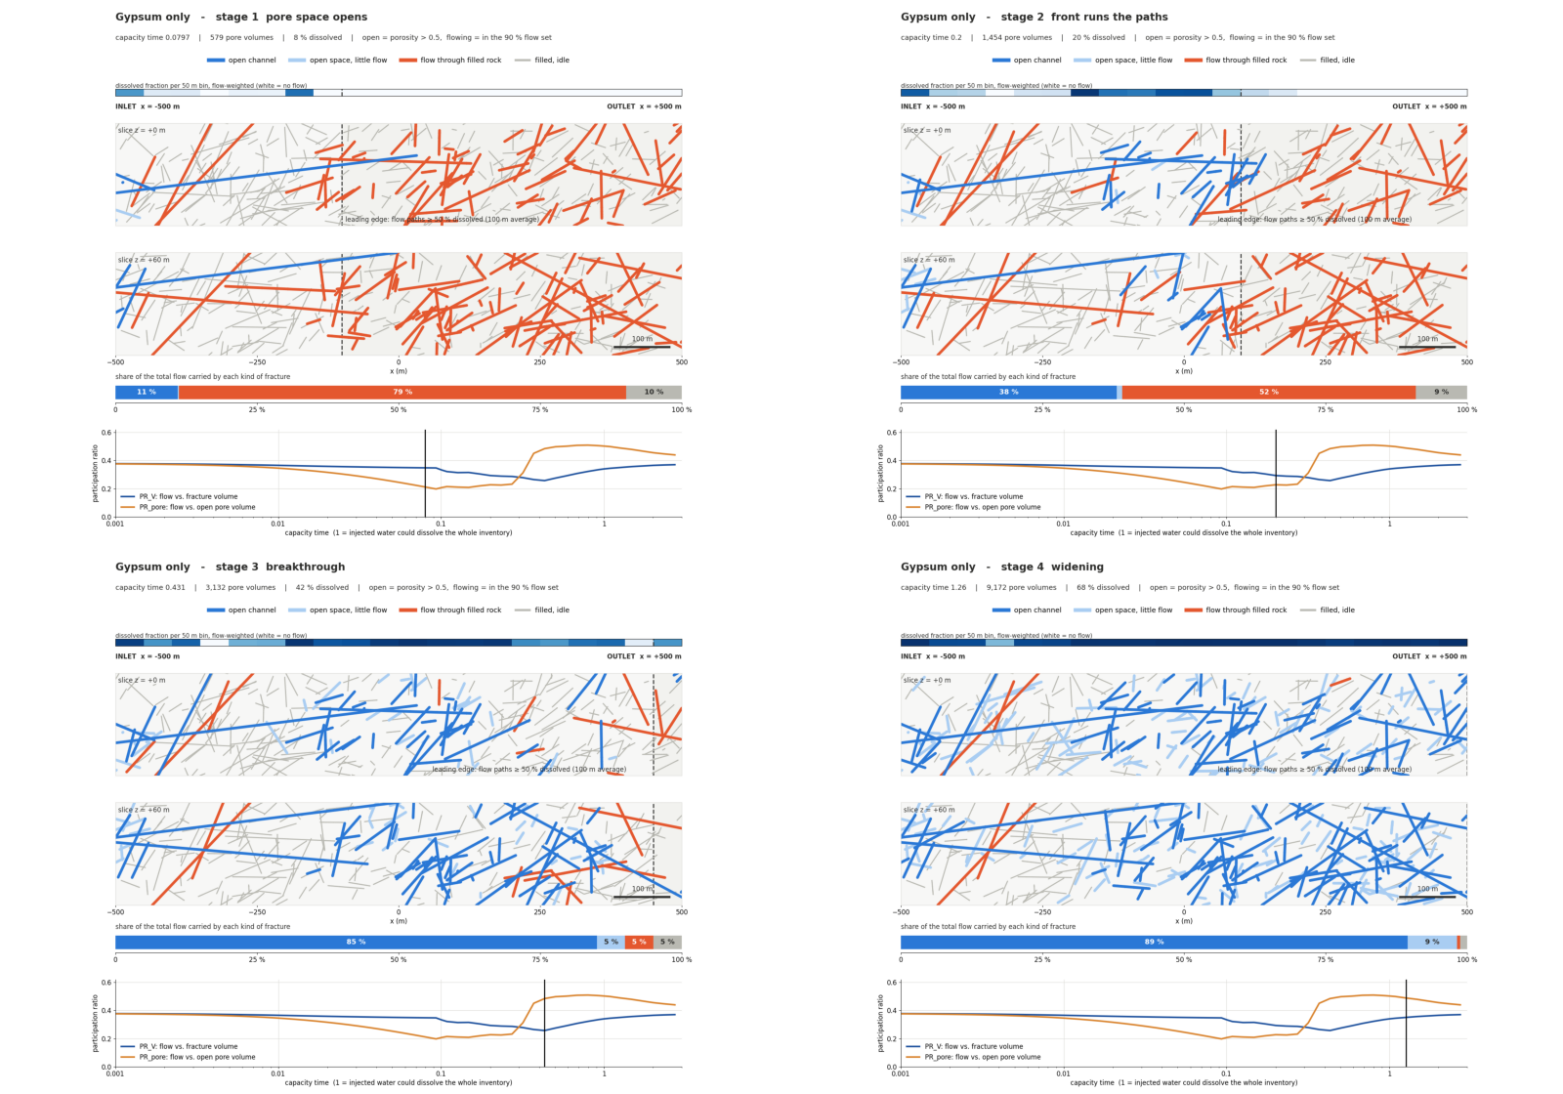
Watch it in one network
17
Notes:
The four stages in a real network: two slices through the example network (P32 ×6, σ 1, seed 1, gypsum-only). Blue is open and flowing, light blue open with little flow, orange flow through still-filled rock. Play it: the inlet opens without taking the flow, then the flow finds the opened paths, the focus runs to the outlet, and the network spreads out again.

Slide 18
What I'm confident of · 2
The focus travels with the front and relaxes behind it
Notes:
Second result, the one we have not found published.

Slide 19
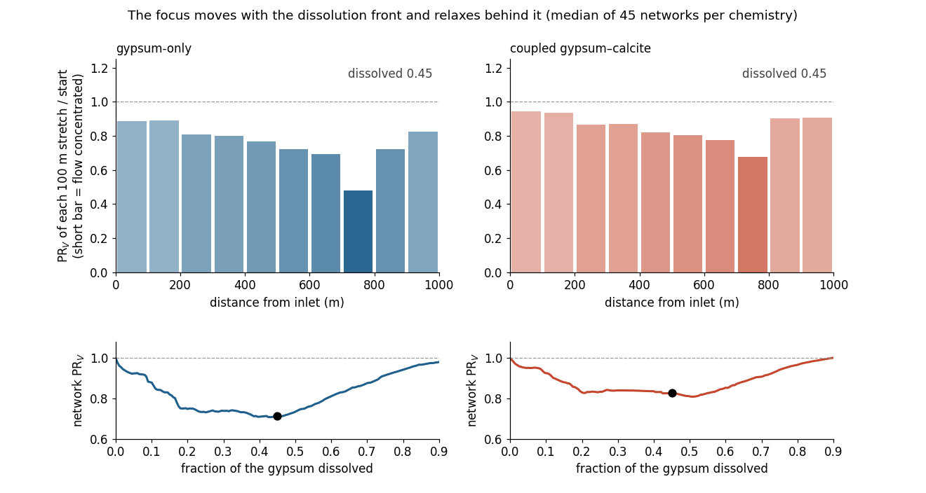
The focus is a travelling wave
19
Notes:
Cut each network into ten 100 m stretches along the flow and compute PR_V per stretch relative to its start. Short bar = flow concentrated. Median of 45 networks per chemistry. Watch the short bar travel from inlet to outlet while the stretches behind it grow back to 1. It is a travelling wave of focusing, not a permanent channel.

Slide 20
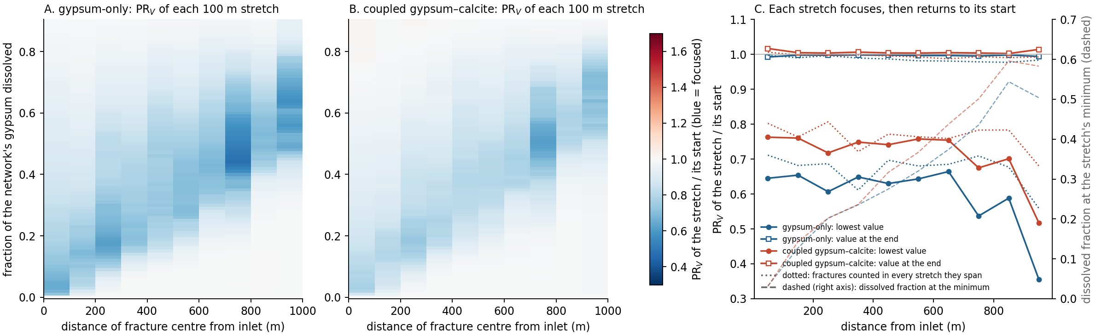
Each stretch focuses once, then returns to its start
0.03 → 0.50
0.36
< 2 %
gypsum dissolved at each stretch's minimum, inlet → outlet
outlet stretch at its minimum: the strongest local focusing
every stretch ends this close to its start
20
Notes:
Numbers. The gypsum dissolved at each stretch's minimum rises from 0.03 at the inlet to 0.50 (gypsum-only) and 0.58 (coupled) at the outlet. The outlet stretch focuses most: 0.36 / 0.52 of its start, against 0.54–0.66 / 0.67–0.76 upstream, because it is the last place where the opened channel still pushes through filled rock. Every stretch ends within 0.8 % (gypsum-only) and 1.7 % (coupled) of its start. It holds when fractures are counted in every stretch they span.

Slide 21
What is new: relaxation behind the front
Dissolving wall rock (Hyman et al. 2026)
Finite soluble fill (this study)
a focusing front moves downstream (Fig. 11)
behind it, focusing persists near its maximum
apertures keep growing; the channel stays
the same moving front
behind it, each stretch returns to its start
the fill runs out, so the channel's advantage ends
Not the explanation: the width of the focused zone does not set when the whole network is most focused (pre-set test failed, ρ 0.27–0.50).
21
Notes:
Why this is new relative to Hyman 2026 Fig. 11. There, a focusing front moves downstream too, but the soluble material is the wall rock itself, which keeps dissolving, so behind the front focusing persists near its maximum (our reading of their snapshots, which stop at tau = 1). Here the soluble material is a finite fill. Once a stretch's gypsum is gone, the opened paths stop gaining on their neighbours, the neighbours catch up, and the stretch relaxes. We tested and rejected one explanation: the width of the focused zone does not set when the whole network is most focused (pre-set test failed, rank correlation 0.27–0.50).

Slide 22
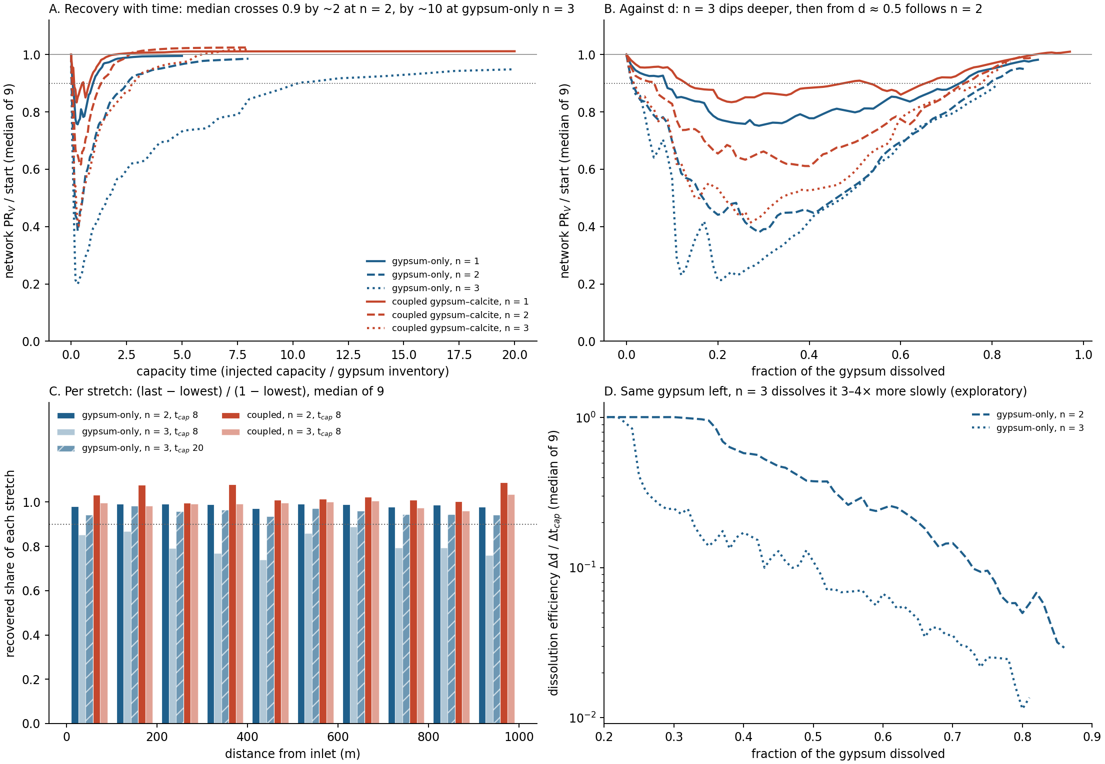
At high gain it still relaxes, it just needs more water
0.95
median network PR_V / start at ×1000, capacity time 20 (×100: 0.99 by 8); 8 of 9 networks ≥ 0.9
≤ 0.03
gap between ×100 and ×1000 at the same gypsum dissolved, d 0.5–0.81 (pre-set)
3–4×
slower dissolution at ×1000 with the same gypsum left, consistent with bypass (exploratory)
22
Notes:
Does it still relax when a cleared fracture gains far more permeability? Run A took n = 2 (×100) and n = 3 (×1000) to capacity time 8, run A2 took gypsum-only ×1000 to 20. ×100 completes by capacity time 8 (network 0.99 of its start). ×1000 completes in the median: network PR_V 0.95, every stretch median at least 0.935 recovered, the median curve crosses 0.9 at capacity time 10.3 against about 2.5 at ×100. Per network it is less uniform: 8 of 9 reach 0.9, only 3 of 9 recover every stretch, and one network (p4 seed 2) is not done. Panel B: below d 0.5 ×1000 dips much deeper at the same d (the depth law, next section); from d 0.5 to 0.81 ×100 and ×1000 sit within 0.028 (pre-set rule, thin margin). Panel D, exploratory: with the same gypsum left, ×1000 dissolves it 3–4× more slowly (all-network medians, panel D; 3.4–7.7× on matched networks) and its flow sees 5–8× less of it, consistent with the channel bypassing the gypsum left. It needs about four times the water to get to the same place (capacity time 10.3 against 2.5 to reach PR_V 0.9; 8.5 against 2.1 to reach d 0.8). The pre-set bypass test compared at matched capacity time and failed, because ×1000 holds more gypsum at any given time.

Slide 23
What it does to transport
Breakthrough curves, read the way Hyman reads them
Notes:
Transport. At each saved state we freeze the reacted network, re-solve flow, and push a tracer pulse through it.

Slide 24
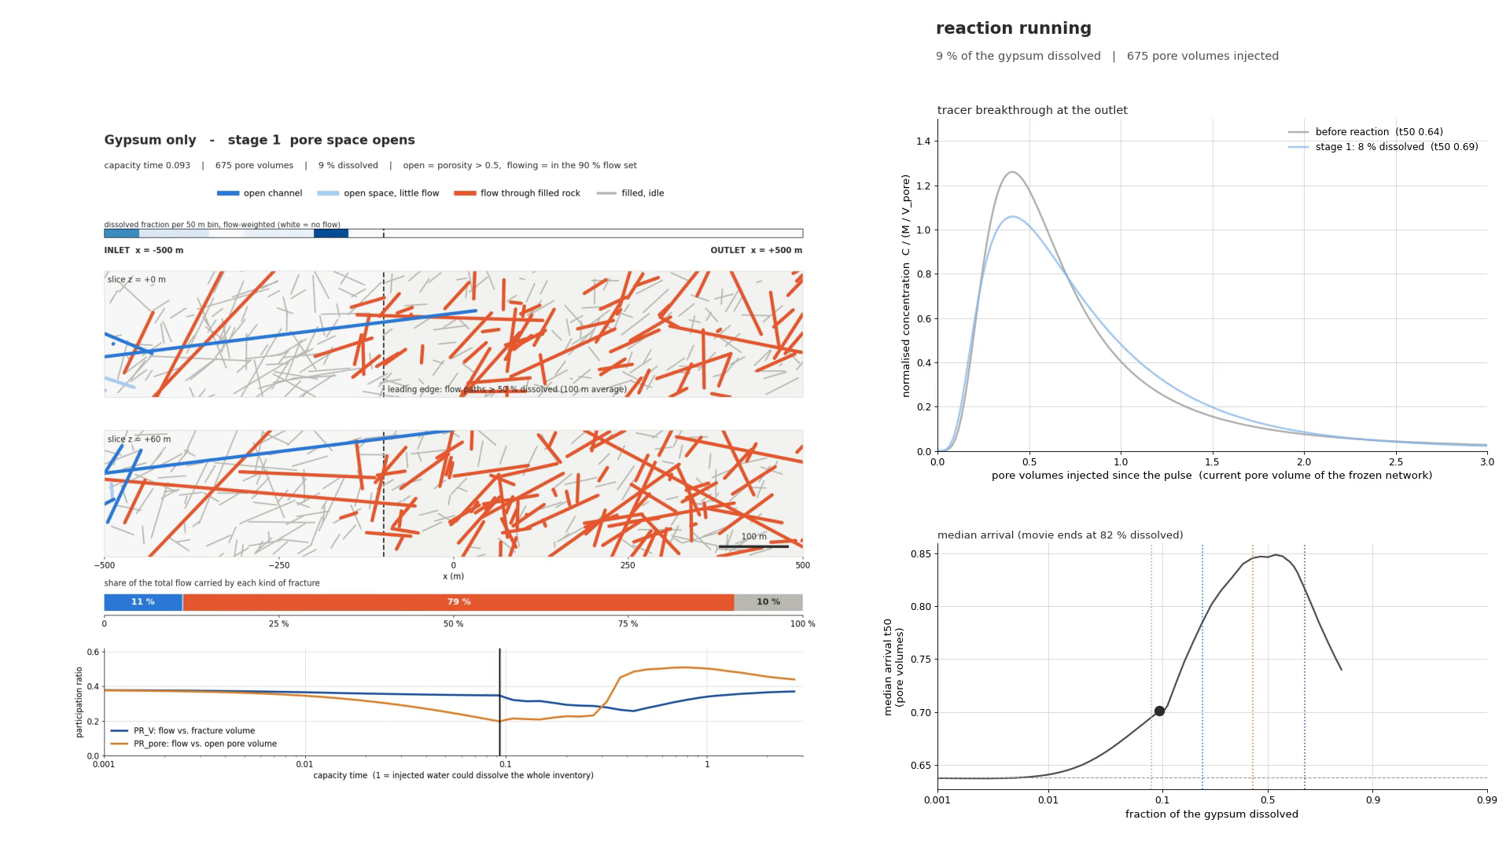
A tracer pulse through the frozen network at each stage
24
Notes:
The reaction is paused at each stage, flow is re-solved on the frozen network, and a tracer pulse of 0.1 residence times runs through. The left panel is the network, the right the outlet breakthrough curve building up. This is an Eulerian pulse with numerical dispersion, not particle tracking, so compare states with each other rather than with Hyman's particle curves in absolute terms.

Slide 25
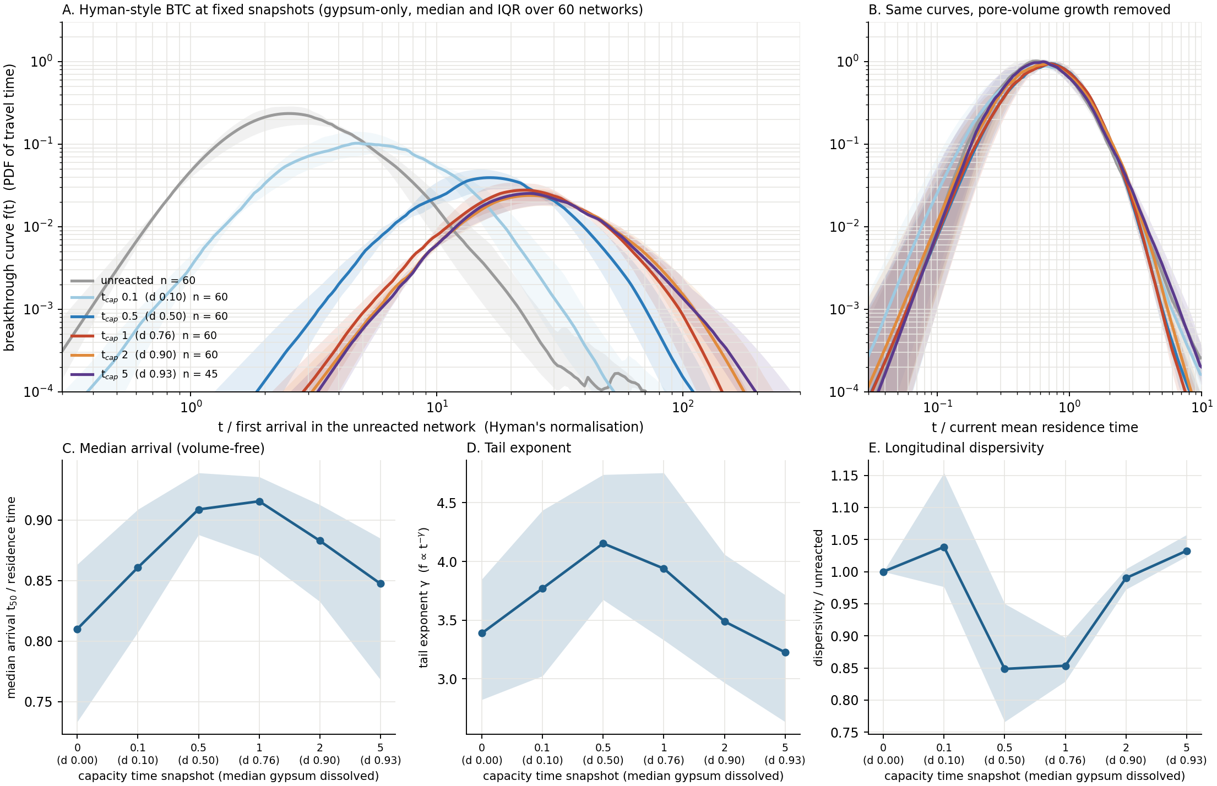
Breakthrough curves, Hyman-style
How to read it
A: the whole curve moves ~10× later: pore volume grows ×10 at fixed Q (Hyman's uniform-regime shift), not the channel
B: scaled by current residence time, the shape barely changes
C–E: while the channel exists the curve narrows (arrival 0.81 → 0.92, tail γ 3.4 → 4.2, dispersivity −15 %), then relaxes back
No dual scaling: unlike a wormhole, there is no fast primary and slow secondary branch
25
Notes:
Breakthrough curves in Hyman's style: the PDF of travel time on log-log axes, time normalized by the first arrival in the unreacted network, median and IQR over 60 gypsum-only networks (45 at capacity time 5), at fixed snapshots in capacity time (his snapshots are in tau; ours are capacity time 0, 0.1, 0.5, 1, 2, 5, median gypsum dissolved 0, 0.10, 0.50, 0.76, 0.90, 0.93). Panel A: the whole curve moves about ten times later. That is the pore volume growing ×10 at a fixed flow rate, exactly the effect Hyman reports in his uniform regime (peak arrival almost doubles as the void volume doubles at tau = 1, Da 2e-4, G 0.1). It is not the channel. Panel B removes it by scaling with the current residence time: the shape changes little, and what changes, C to E, follows the stages. Median arrival rises from 0.81 to 0.92 residence times at capacity time 1 and falls back to 0.85; the tail exponent rises from 3.4 to 4.2 and returns to 3.2; dispersivity drops to 0.85 of the unreacted value and returns to 1.03.

Slide 26
What the curves say
Stage 1–2: little change
Stage 3: narrower, steeper tail
Stage 4: back again
opened space sits near the inlet; flow has not moved
the pulse samples the network much as before
median arrival 0.81 → 0.86 residence times
flow and opened space coincide (PR_pore/PR_V peaks at 1.5)
water spends its time in space that exists: arrival → 1 residence time
tail γ 3.4 → 4.2; dispersivity −15 %
the fill runs out everywhere; side paths catch up
arrival back to 0.85, tail γ 3.2, dispersivity ×1.03
Hyman's wormhole regime goes the other way: earlier first arrival and dual scaling
26
Notes:
What is happening physically. Early on (stage 1), the opened space is near the inlet but the flow is not there yet, so the tracer samples the network much as before. In the channel stages, open space and flow coincide: the paths that carry the flow are the paths whose pore space has opened (PR_pore/PR_V peaks at 1.5 near d 0.5). Water then spends its time in the pore volume that actually exists, so the median arrival moves towards one residence time, the curve narrows and the tail steepens: fewer slow, side paths. This is the opposite sign to Hyman's wormhole regime, where first arrivals get earlier and the curve shows dual scaling, because there the wormhole takes almost all the flow while the rest stagnates. Here the fill runs out everywhere, so the side paths catch up and the curve relaxes back, the transport signature of the relaxation.

Slide 27
What I'm confident of · 3
How deep the channel gets is set by the attainable permeability gain
Notes:
Third result, and the hardest one to explain. Four slides: what depth means, what the law does, the collapse, and what does and does not change.

Slide 28
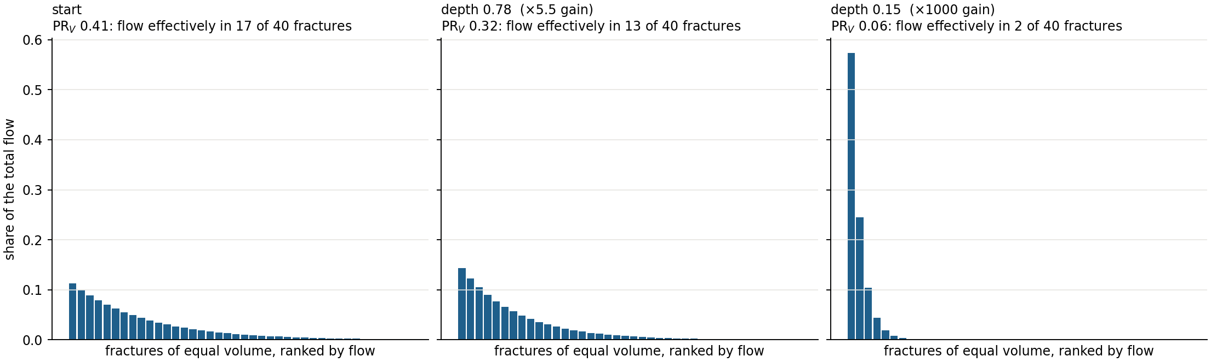
What 'depth 0.78' and 'depth 0.15' mean
PR_{V}: the share of fracture volume that effectively carries the flow (1 = flow in proportion to volume). A typical network starts at 0.41.
Depth = lowest PR_{V} / PR_{V} at the start. Lower = flow squeezed into less of the network.
0.78: flow uses 78 % of the volume it used at the start (mild). 0.15: 15 %, the same water in about a seventh of the volume.
28
Notes:
What the depth numbers mean. PR_V is a participation ratio: (sum of Q)^2 over the sum of Q^2 / w, with w each fracture's share of the volume. It is 1 when flow is spread in proportion to volume, and it reads as the share of the network's fracture volume that effectively carries the flow. At the start a typical network is about 0.41 (9 networks, 0.30–0.54): flow effectively uses about 40 % of the volume. Depth is the lowest PR_V reached over its start value. Depth 0.78 (at ×5.5 gain) means at its most focused the flow uses 78 % of the volume it used at the start: a mild crowding. Depth 0.15 (at ×1000) means it uses 15 % of it: the same water squeezed into about a seventh of the volume. The bars are a cartoon with 40 equal fractures, tuned to those numbers.

Slide 29
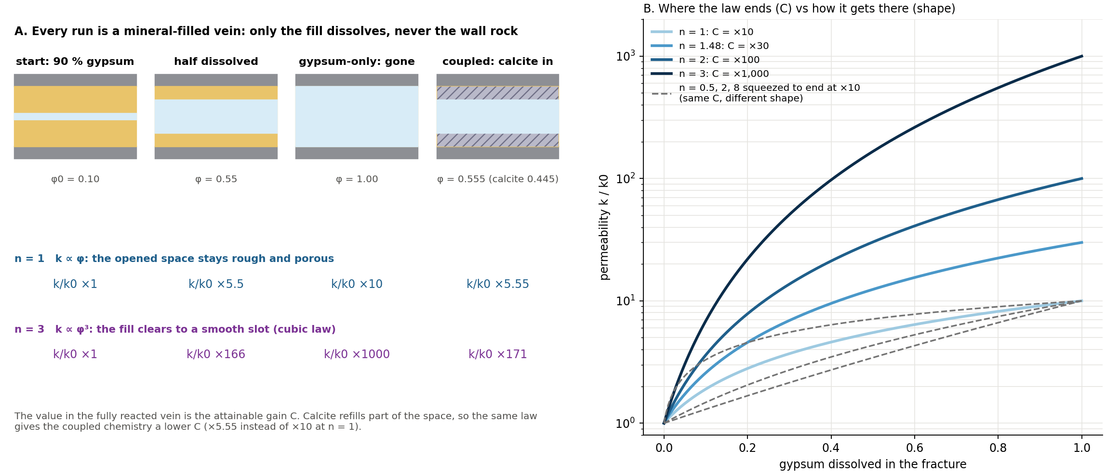
The permeability law: how much a cleared vein gains
29
Notes:
The permeability law, plainly. Every run is a filled vein; only the fill dissolves, never the wall rock, and every run eventually runs out of fill. The law k = k0 (φ/φ0)^n says how much more permeable the vein gets as it clears. n = 1: permeability in proportion to open space, as if the cleared space stays rough and porous; fully cleared it is ×10. n = 3: permeability goes as porosity cubed, which is exactly the cubic law for a vein whose fill clears to leave a smooth parallel-plate slot: ×1000. So n sets the end value, the attainable gain C. Calcite refills part of the space, so the same law gives the coupled chemistry a lower C (×5.55 instead of ×10 at n = 1). Right panel: two separate questions. Solid lines change where the law ends (C = ×10 to ×1000). Dashed lines all end at ×10 but take different paths (n = 0.5, 2, 8 with a critical porosity chosen so the end is ×10).

Slide 30
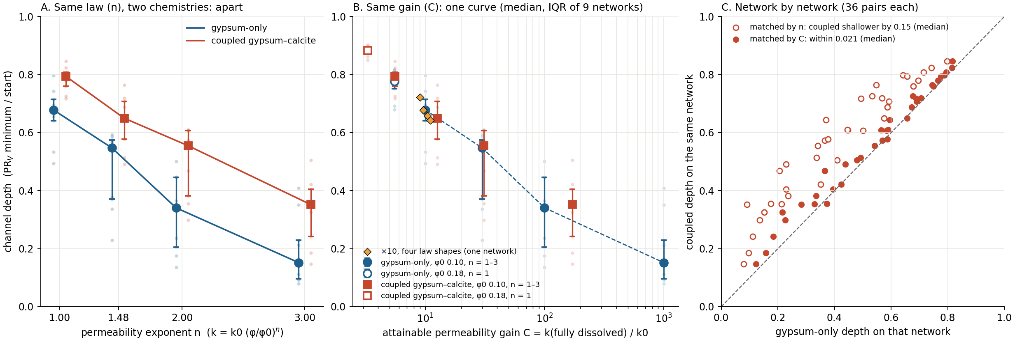
Plot against C, and the chemistries collapse
0.15
0.021
0.78 → 0.15
coupled minus gypsum-only depth at the same n (same network, median)
the same at the same C: one curve (36 pairs; σ 0: 0.029)
median depth from ×5.5 to ×1000 (gypsum-only, 9 networks)
30
Notes:
The collapse. Panel A: plotted against n, the two chemistries sit apart: at the same n, coupled is shallower by 0.15 (median, same network). That is because calcite lowers C. Panel B: plotted against C, both chemistries, both starting porosities (φ0 0.10 and 0.18) and the four law shapes at ×10 fall on one curve (median and IQR of 9 networks; the spread is network to network). Panel C is the cleanest test: network by network, coupled depth against gypsum-only depth on the same network. Matched by n (open circles) they are off the diagonal. Matched by C (filled, gypsum-only interpolated to the coupled C) they sit on it, within 0.021 (median of 36 pairs; pre-set σ 1 rule R2 passed at 0.05; at σ 0, 0.029 against the run C rule of 0.03). The coupled runs sit slightly shallower, consistently, by about 0.02.

Slide 31
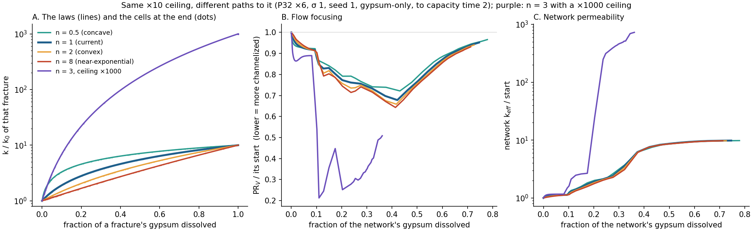
'±0.04': same end value, four shapes
0.72 · 0.68 · 0.66 · 0.64
0.21
The shape of the law is a small correction; where it ends (C) is the lever.
depth for n = 0.5, 1, 2, 8, all ending at ×10 (one network): a spread of 0.08, ±0.04
depth on the same network at ×1000: a change of 0.47
31
Notes:
What '±0.04' means. On one network (P32 ×6, σ 1, seed 1) we held the end value at ×10 and changed only the shape of the law: n = 0.5, 1, 2, 8. Depth was 0.72, 0.68, 0.66, 0.64: a spread of 0.08, ±0.04 around the n = 1 value. Going from ×10 to ×1000 on the same network moved depth to 0.21, a change of 0.47. So the shape is a small correction and the end value is the big lever. The apertures show why the law matters physically: with any ×10 law the hydraulic aperture can grow at most ×2.15, the cube root of 10 (median 75 to 106–122 µm); with n = 3, 13 % of fractures open fully and the top 5 % reach 0.93 mm. Caveat: one network.

Slide 32
So what does the law change, and what does it not?
Changes with C
Does not change
Not 'fill vs wall rock'
how deep: depth 0.78 → 0.15 (×5.5 → ×1000)
how early: breakthrough at 0.65 → 0.27 of the gypsum dissolved
how much water to relax: about 4× more at ×1000
four stages in the same order
the focus travels and relaxes behind the front
the channel forms inside the initial fast paths (91–100 %)
both chemistries on one curve (within ~0.02)
no run dissolves wall rock; every run runs out of fill
low C: the cleared vein stays rough (k ∝ φ)
high C: it clears to a smooth slot (cubic law, k ∝ φ³)
high C looks like Hyman's case for longer, then still relaxes
In one line: the law changes the channel (how deep, how early, how much water), not the story.
32
Notes:
Answering the obvious question directly. Does changing the law change the model's outcome? It changes the channel: how deep (0.78 to 0.15), how early (breakthrough at 0.65 to 0.27 of the gypsum dissolved), and how much water the relaxation needs (about four times more at ×1000). It does not change the story: the four stages in order, the moving focus that relaxes behind the front, the channel forming inside the paths that already carried the flow (91–100 % of the high-gain channel lies inside the n = 1 channel), and the two chemistries on one curve. Two refinements. First, it is C, not n: the same C reached by different n or by different chemistry gives the same depth. Second, low and high n are not 'runs out of fill' versus 'dissolves wall rock': no run ever dissolves wall rock, and every run runs out of fill. Low C is a cleared vein that stays rough; high C is a cleared vein that becomes a smooth open slot. High C behaves more like Hyman's unlimited case for longer (deeper, earlier, slower to relax) but still relaxes, because the fill runs out.

Slide 33
What changed my mind
A predictor that only ranks, and the right clock
Notes:
Two things I believed a week ago that I no longer do, at least not as strongly.

Slide 34
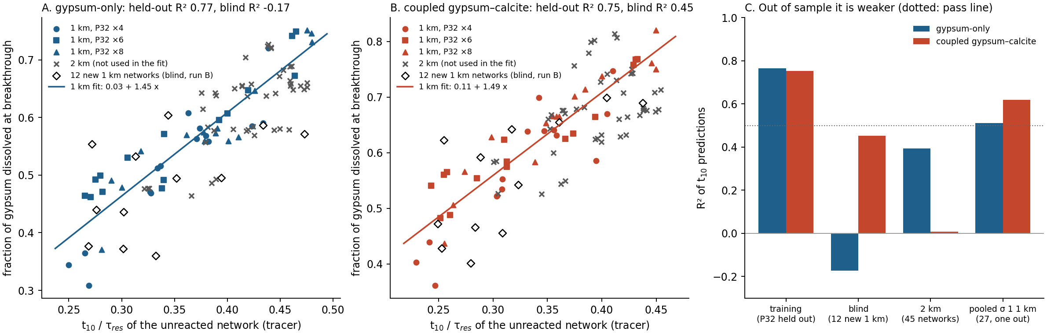
Early tracer arrival ranks breakthrough, roughly
0.77
−0.17 / 0.45
0.51 / 0.62
R² with each P32 level held out (gypsum-only, training set)
R² on 12 blind networks (gypsum-only / coupled): failed
honest estimate, 27 networks one left out (ρ 0.76 / 0.83)
34
Notes:
The predictor. Before any reaction, push a tracer pulse through the network and time how fast the first 10 % comes out, in mean residence times: t10. Fitted on 45 networks per chemistry, it predicted the gypsum dissolved at breakthrough with R² 0.77 / 0.75 (each P32 level held out). Grey crosses: 45 new 2 km networks, where it ranks only weakly (R² 0.39 / 0.01). Open diamonds: 12 new 1 km networks run after the line was frozen. The pre-set blind test failed: R² −0.17 / 0.45, rank correlation 0.51 / 0.72. The honest estimate, all 27 σ 1 networks with one left out at a time: R² 0.51 / 0.62, rank correlation 0.76 / 0.83. It ranks breakthrough; it does not pin it down.

Slide 35
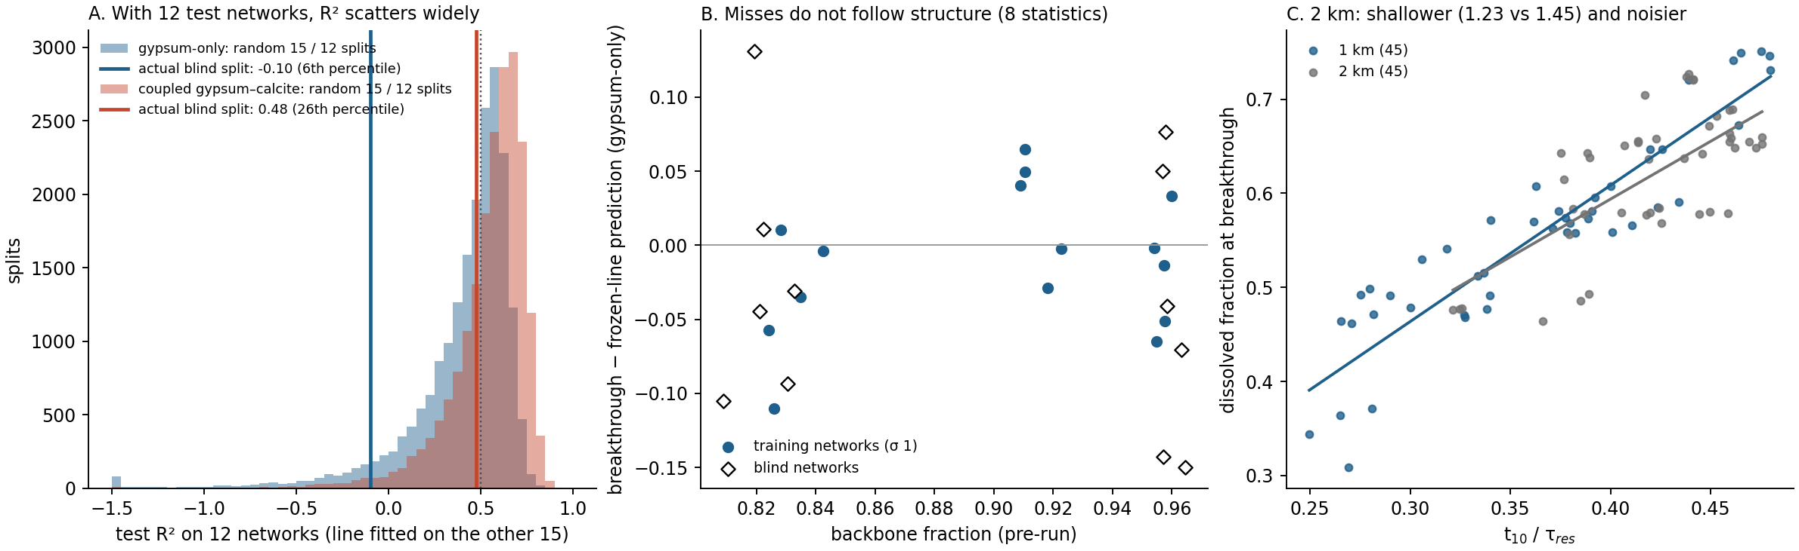
Why the blind test missed
Not the measurement, the probe or the network structure (8 pre-run statistics, |ρ| ≤ 0.16)
Random 15 / 12 splits: the test R² falls below 0.5 in 52 % (gypsum-only); the real split sat at the 6th percentile
At 2 km the relation is shallower and noisier (slope 1.23 against 1.45): early arrival says less over a longer path
35
Notes:
Why it missed. Not the measurement: saved states are 0.059–0.065 of the gypsum apart in every set (medians), and interpolating breakthrough does not help. Not the probe: recovery 0.998–0.999 and the same t10 spread. Not network structure: none of 8 pre-run statistics correlates with the residual (|ρ| ≤ 0.16) and the blind and training networks are indistinguishable. Panel A is the answer: across 20,000 random 15 / 12 splits of the 27 σ 1 networks, the test R² has median 0.49 / 0.60 and falls below 0.5 in 52 % / 30 % of splits; the actual blind split sits at the 6th / 26th percentile. With 12 test networks, passing at 0.5 was close to a coin flip, and the training 0.77 was a lucky draw. At 2 km the relation itself is weaker: slope 1.23 / 0.90 against 1.45 / 1.49, and noisier. Why is still open. The lesson for the papers: this is a supporting result, and any stronger claim needs many more networks and a new blind set.

Slide 36
The right clock is gypsum dissolved, not time
Compared at the same capacity time, ×1000 and ×100 differ, but mostly because ×1000 holds more gypsum (d 0.52 against 0.74 at capacity time 2): the pre-set bypass test was confounded
Compared at the same gypsum dissolved, they relax together from d 0.5 (within 0.028)
So: d for 'how far along', capacity time for 'how much water'. Every event here is timed on d.
36
Notes:
The second thing: the clock. A week ago I compared runs at the same time. The ×1000 runs looked slow, and the pre-set test of why compared them with ×100 at the same capacity time; it failed, because at any given time ×1000 still holds much more gypsum (d 0.52 against 0.74 at capacity time 2). Compared at the same gypsum dissolved, the two relax together from d 0.5, and ×1000's slowness shows up as lower dissolution efficiency: the water passes the gypsum that is left. Every event in this deck is timed on d for that reason. Capacity time is still the right axis for 'how much water', d for 'how far along'.

Slide 37
Where we are
What holds up, what could still change it, and what runs now
Notes:
Robustness, limits, the DFN check that is running, and next steps.

Slide 38
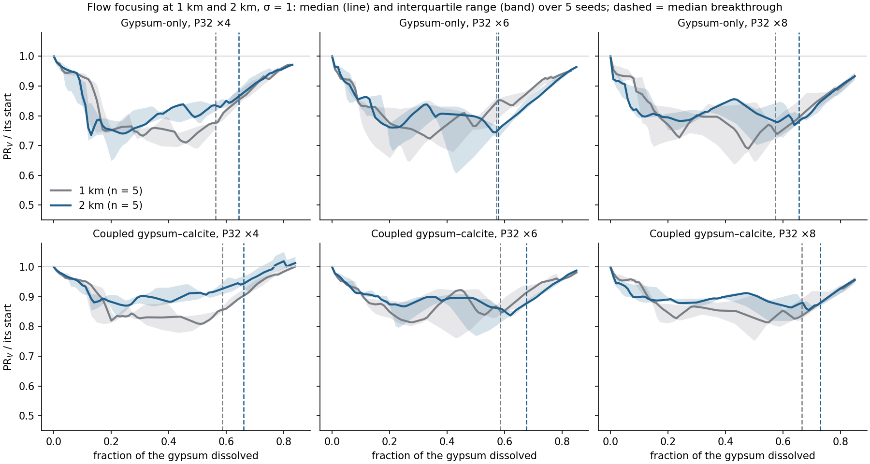
What we tried to break
2 km (90 runs): same dip and recovery; inheritance 0.96–1.00; breakthrough 0.56 → 0.64
Rate ×100 (0.1–10 PV/yr): depth ≤ 0.02; event timing mostly ≤ 0.04 in d
Density P32 ×16: same order in 27 of 30
σ 0: depth law and chemistry match hold (9 of 9; 0.029)
Dropped: an early network peak on sparse 2 km networks (gone at σ 0)
38
Notes:
What we tried to break. 2 km networks (45 networks, 90 runs): the same dip and recovery, inheritance 0.96–1.00, breakthrough needs a little more gypsum dissolved (0.56 to 0.64). Rate 0.1 to 10 pore volumes per year (3 networks per chemistry): gypsum-only depth and PR_V minimum move by at most 0.001 in d, breakthrough and outlet events by up to 0.046 (one network); coupled depth by at most 0.019, coupled events up to 0.04 and its weakly defined pore-volume minimum by 0.094 on one network. Density P32 ×16: same order in 27 of 30. σ 0: the depth law and the chemistry match hold. Binning: the moving focus holds when fractures count in every stretch they span. What did not survive: an apparent early network peak on sparse 2 km networks vanished at σ 0 on the same geometries.

Slide 39
Limits
1
One cell per fracture
no fronts inside a fracture, no intersection throats; the DFN check tests this
2
Permeability law
unknown for these veins; part 3 turns it into a parameter (C)
3
Inputs
FFM01 geometry with P32 scaled ×4–×16 to percolate over 1 km
4
Statistics
σ variants share geometry: 15 independent networks per scale
5
Chemistry match
coupled sits ~0.02 shallower than gypsum-only, at the edge of 0.03
39
Notes:
Limits, in the order a reviewer will raise them. One cell per fracture: no fronts or wormholes inside a fracture, no intersection throats; the literature says that biases channels shallower and later, so depths here are conservative, but earlier validation showed the simple graph misses channel timing at high gain. That is why the DFN check matters. The permeability law is unknown for these veins; the depth law turns it into a parameter. Inputs: FFM01 200–400 m geometry with the 0–200 m transmissivity law and P32 scaled up to percolate over 1 km. Statistics: σ variants share geometry, so there are 15 independent networks per scale. Tracer: Eulerian pulses with numerical dispersion. And the coupled chemistry sits consistently about 0.02 shallower than gypsum-only, right at the edge of the 0.03 tolerance.

Slide 40
Running now: the DFN check on a 500 m network
Set-up
Pass criteria (fixed 6 Nov, before any DFN state)
500 × 125 × 125 m, P32 ×6, σ 1, 381 fractures
meshed DFN 196,864 cells; graph from the same dfnGen output
both chemistries, to capacity time 2; gypsum-only primary
launched Mon 9 Nov 11:08
coupled: ~6–7 h (Monday evening)
gypsum-only: ~25,500 steps × 6–8 s → 40–60 h (Wednesday)
C1 stage order kept
C2 event timing within 0.10 of d
C3 depth within 0.10
C4 inheritance ≥ 0.8, channel-set overlap ≥ 0.5
C5 front moves inlet → outlet
C6 every bin relaxes to ≥ 0.9
C7 per-fracture dissolved fraction ρ ≥ 0.6
Verdict: agrees / agrees on mechanism, differs in magnitude / differs
40
Notes:
The DFN check, launched this morning (Mon 9 Nov 11:08). Network: 500 × 125 × 125 m trial network, P32 ×6, σ 1, 381 fractures, meshed DFN of 196,864 cells; BiGraFV graph and DFN built from the same dfnGen output, so the fractures and apertures are identical. Same deck, both chemistries, to capacity time 2. Pass criteria were fixed on 6 Nov before any DFN state existed: C1 stage order; C2 event timing within 0.10 of d; C3 depth within 0.10; C4 inheritance ≥ 0.8 and channel-set overlap ≥ 0.5; C5 front moves inlet to outlet; C6 every 50 m bin relaxes to ≥ 0.9; C7 per-fracture dissolved fraction rank correlation ≥ 0.6. Verdict: agrees, agrees on mechanism but differs in magnitude, or differs. Gypsum-only is primary; the coupled graph run itself fails C1 (a known near-tie), so coupled is descriptive. Timing, measured over the first 30 minutes on a shared, heavily loaded machine: coupled about 1 simulated year per 50 s with 467 years to go, so about 6–7 h (Monday evening); gypsum-only about 25,500 steps at 6–8 s each on 6 ranks, 40–60 h, so Wednesday, with breakthrough about a third of the way through (Tuesday). The steady-flow difference is 1.69 (DFN carries 1.69× the graph's flow at the same pressure drop), reported, not tested.

Slide 41
Next
This week
Papers
Open, not needed for the papers
read the DFN verdict (coupled this evening, gypsum-only ~Wed)
final literature check of the 'not found reported' claims
start drafting paper 1
1 · transient channels in finite-fill networks: stages, travelling focus, transport
2 · channel depth set by the attainable gain C
3 · BiGraFV at kilometre scale, with the DFN comparison
why some networks relax much more slowly at ×1000
why early arrival says less at 2 km
a better pre-run predictor (needs a new blind set)
41
Notes:
Next. Read the DFN verdict when it lands (coupled this evening, gypsum-only Wednesday). A final literature check of the 'not found reported' claims, especially relaxation behind the front. Then draft paper 1: transient reactive channels in finite-fill fracture networks (stages, moving focus and relaxation, transport). Paper 2: channel depth set by the attainable permeability gain. Paper 3 later: BiGraFV at kilometre scale as a method, with the DFN comparison. Open questions that the papers do not need: why some networks relax much more slowly at ×1000, and why early arrival says less at 2 km.

Slide 42
Take-home
4 stages
travels
C
one order in 87 of 90 runs: decouple, recouple, focus and break through, relax
the focus moves with the front and relaxes behind it, because the soluble fill runs out
how deep the channel gets: one curve for both chemistries (within ~0.02); the law's shape barely matters
Changed my mind: early arrival ranks breakthrough, it does not predict it. Running: DFN check, verdict ~Wednesday.
Notes:
Take-home. One order of stages. The focus travels with the front and relaxes behind it, because the soluble fill runs out; that relaxation is what we did not find published. How deep the channel gets is set by the attainable permeability gain C, one curve for both chemistries; the shape of the law barely matters. The early-arrival predictor ranks, it does not predict. The DFN check is running.

Slide 43
Backup: definitions
PVI
Q t / V_pore,0, pore volumes injected (one per year here)
γ
Hyman's acid capacity c0/(ν c_sol): 1.24 × 10⁻³ gypsum-only, 0.039 coupled
τ (Hyman)
ΔV/V0, dissolved volume over initial pore volume; τ_max = 9 here
d
fraction of the network's fracture gypsum dissolved = τ/τ_max (gypsum-only)
t_cap
γ · PVI / τ_max; 1 = enough water to remove the inventory if it all left saturated
PR_V
(Σ Q)² / Σ(Q²/w), w = fracture volume share; 1 when flow ∝ volume
PR_pore
the same with w = open pore volume share
depth
min PR_V / PR_V at the start
breakthrough
first state with flow-weighted d of fractures in the last 100 m ≥ 0.5
C
k of a fully reacted fracture / k0 = (φ_end/φ0)ⁿ; φ_end = 1 gypsum-only, 0.555 coupled
t10/τ_res
time for 10 % of a tracer pulse to leave the unreacted network / mean residence time
43
Notes:
Definitions, for reference.

Slide 44
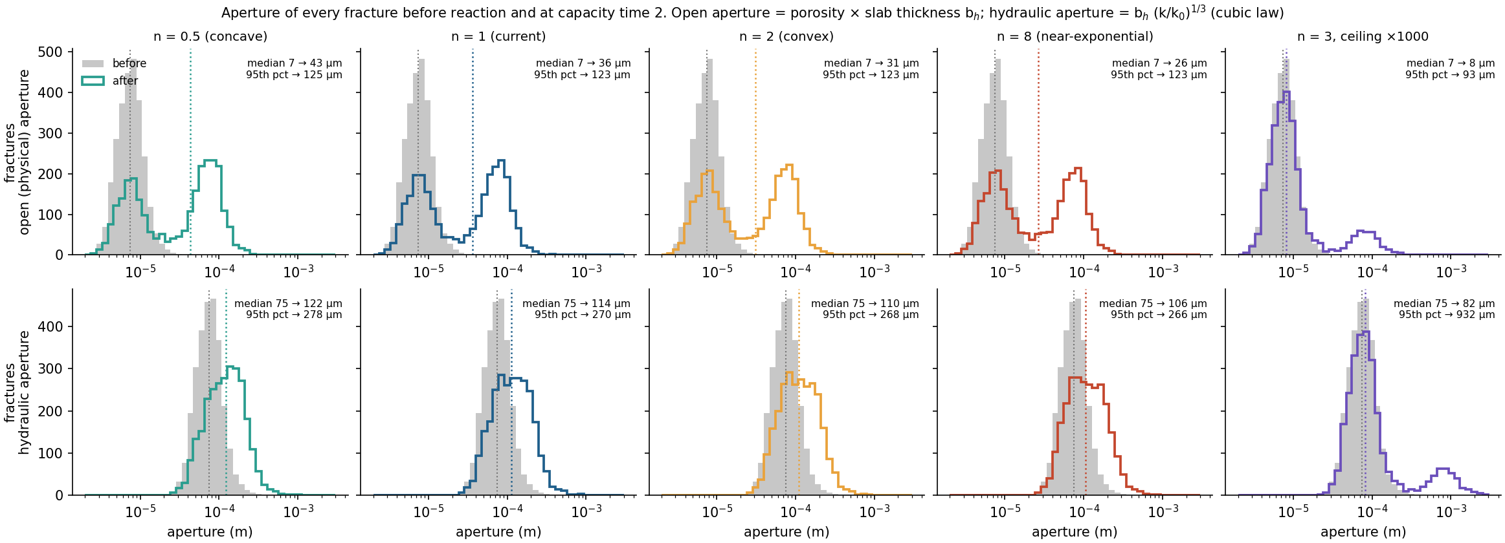
Backup: apertures before and after
44
Notes:
Backup: apertures. The physical side of the law. With any ×10 law the hydraulic aperture can grow at most ×2.15 (median 75 to 106–122 µm); with n = 3, 13 % of fractures open fully and the top 5 % reach 0.93 mm.

Slide 45
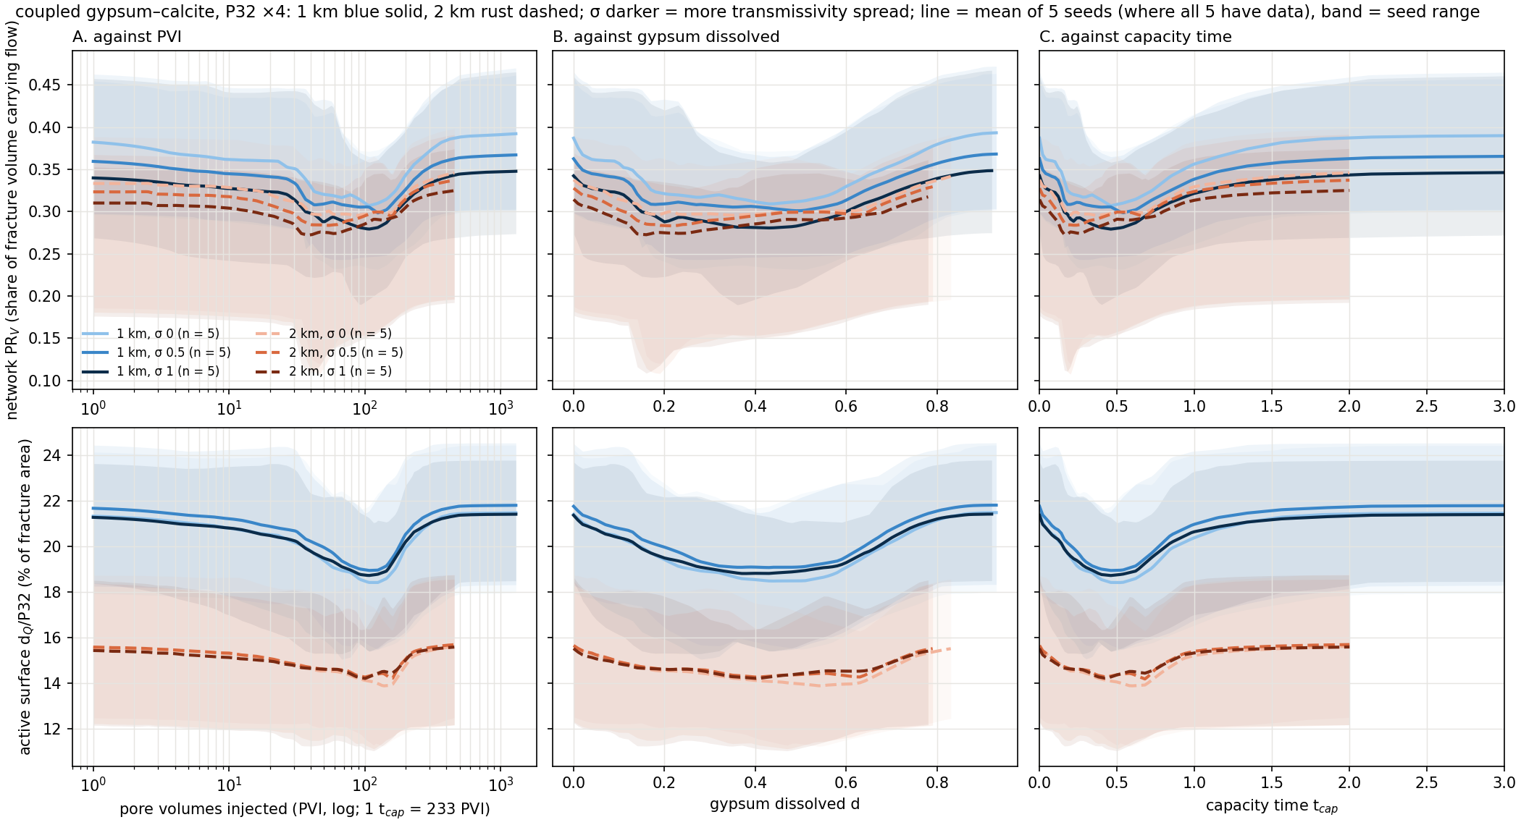
Backup: coupled ensembles, P32 ×4
45
Notes:
Ensemble overview, coupled, P32 ×4, base runs (n = 1, φ0 0.1, 1 PV/yr). Top row: network PR_V, the share of fracture volume that effectively carries the flow. Bottom row: Hyman's active surface d_Q/P32, the share of fracture area that effectively carries the flow (in %). Left to right the same runs against PVI (log), gypsum dissolved and capacity time; within a chemistry PVI and capacity time are the same clock up to a constant, the log axis just shows the early part. Lines are the mean of 5 seeds where all 5 have data, bands the seed range; blue solid 1 km, rust dashed 2 km, darker = larger σ. 1 km: PR_V starts at 0.39 / 0.36 / 0.34 (σ 0 / 0.5 / 1) and dips to 0.28 at σ 1 near d 0.43; active surface starts at 21.4 % and dips to 18.8 % (σ 1); 2 km: PR_V starts at 0.34 / 0.33 / 0.31 (σ 0 / 0.5 / 1) and dips to 0.27 at σ 1 near d 0.16; active surface starts at 15.5 % and dips to 14.2 % (σ 1). Every group dips and recovers on every axis; this is the raw behaviour before any of the results.

Slide 46
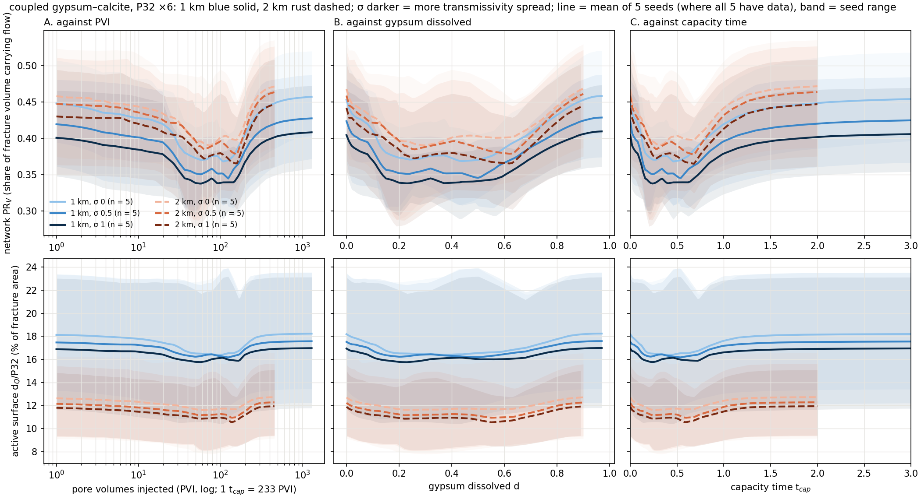
Backup: coupled ensembles, P32 ×6
46
Notes:
Ensemble overview, coupled, P32 ×6, base runs (n = 1, φ0 0.1, 1 PV/yr). Top row: network PR_V, the share of fracture volume that effectively carries the flow. Bottom row: Hyman's active surface d_Q/P32, the share of fracture area that effectively carries the flow (in %). Left to right the same runs against PVI (log), gypsum dissolved and capacity time; within a chemistry PVI and capacity time are the same clock up to a constant, the log axis just shows the early part. Lines are the mean of 5 seeds where all 5 have data, bands the seed range; blue solid 1 km, rust dashed 2 km, darker = larger σ. 1 km: PR_V starts at 0.45 / 0.42 / 0.40 (σ 0 / 0.5 / 1) and dips to 0.34 at σ 1 near d 0.23; active surface starts at 16.9 % and dips to 15.8 % (σ 1); 2 km: PR_V starts at 0.47 / 0.46 / 0.44 (σ 0 / 0.5 / 1) and dips to 0.37 at σ 1 near d 0.62; active surface starts at 11.9 % and dips to 10.5 % (σ 1). Every group dips and recovers on every axis; this is the raw behaviour before any of the results.

Slide 47
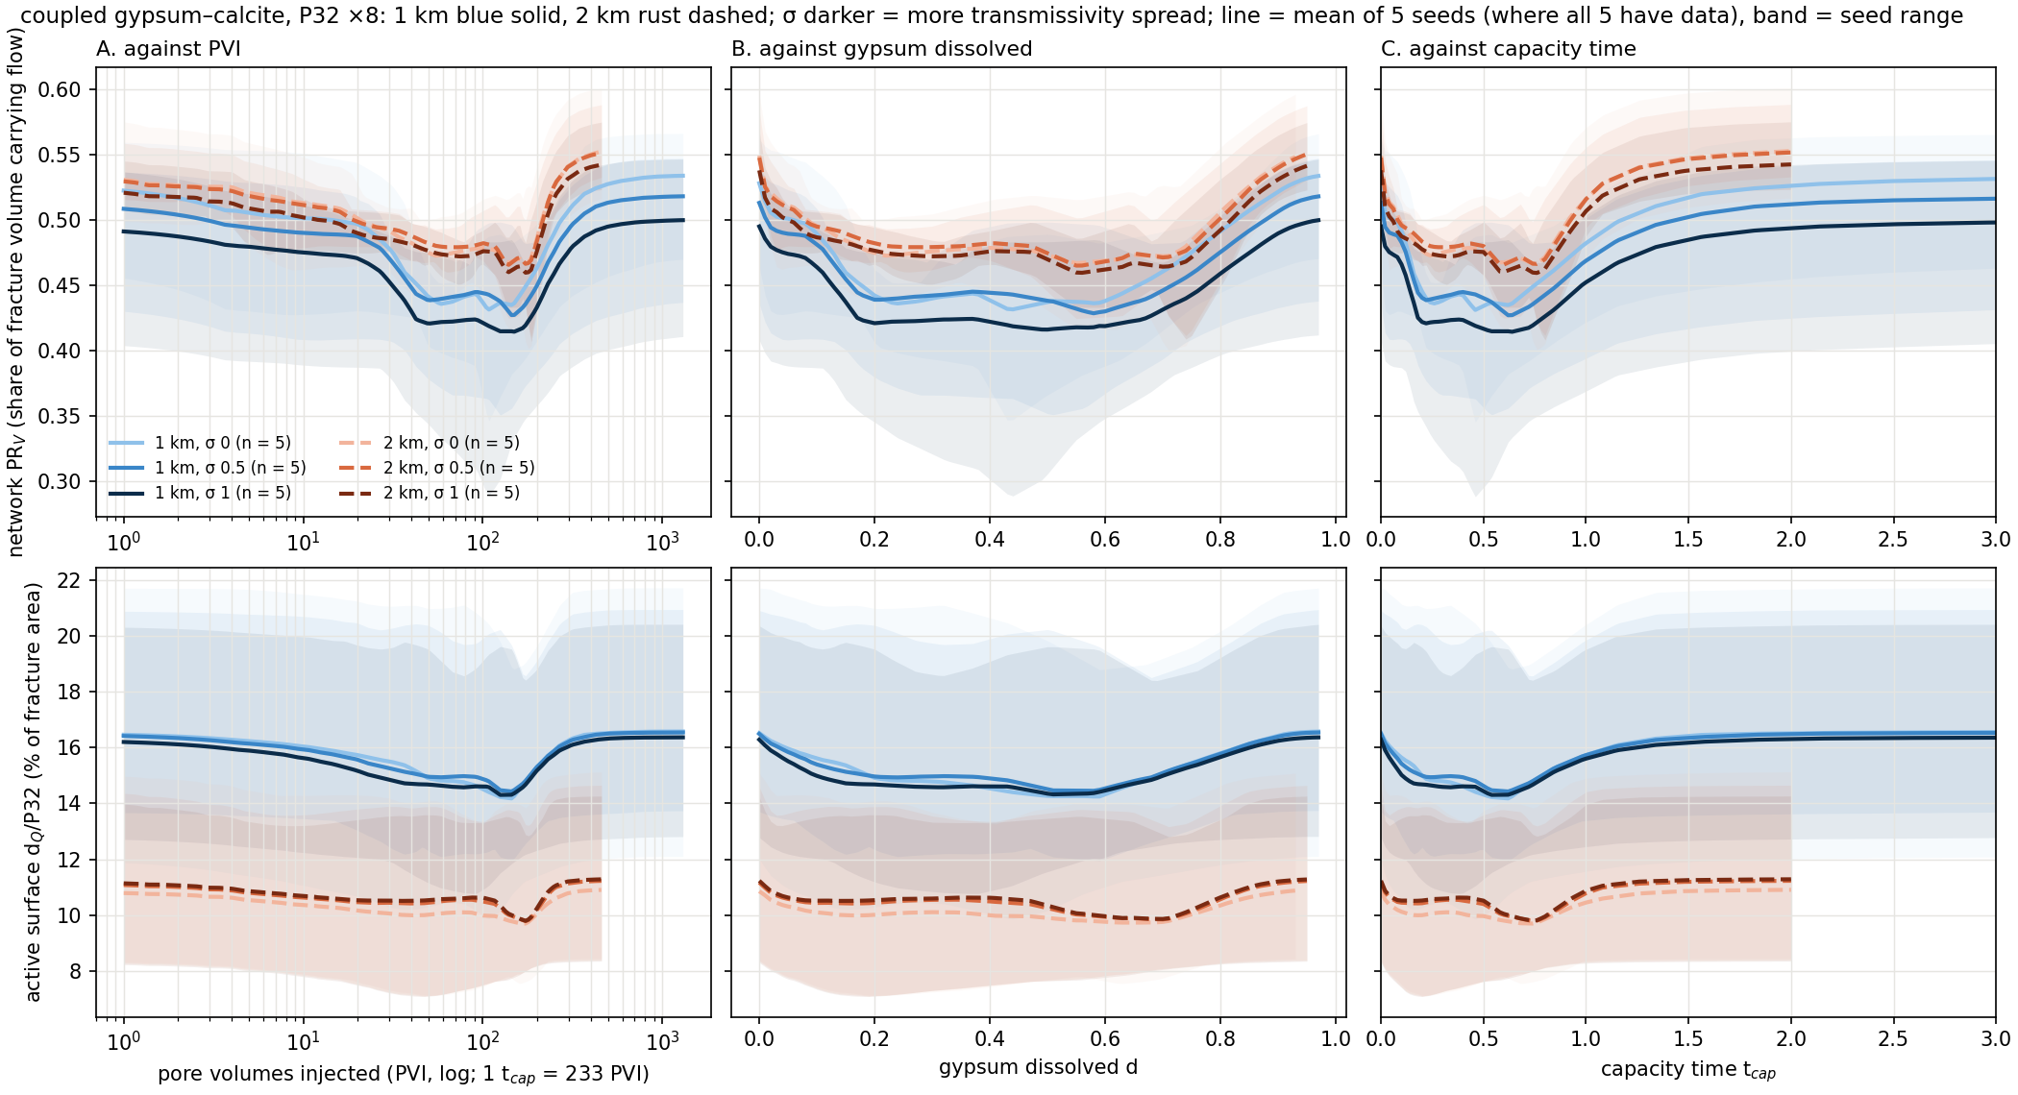
Backup: coupled ensembles, P32 ×8
47
Notes:
Ensemble overview, coupled, P32 ×8, base runs (n = 1, φ0 0.1, 1 PV/yr). Top row: network PR_V, the share of fracture volume that effectively carries the flow. Bottom row: Hyman's active surface d_Q/P32, the share of fracture area that effectively carries the flow (in %). Left to right the same runs against PVI (log), gypsum dissolved and capacity time; within a chemistry PVI and capacity time are the same clock up to a constant, the log axis just shows the early part. Lines are the mean of 5 seeds where all 5 have data, bands the seed range; blue solid 1 km, rust dashed 2 km, darker = larger σ. 1 km: PR_V starts at 0.53 / 0.51 / 0.49 (σ 0 / 0.5 / 1) and dips to 0.42 at σ 1 near d 0.50; active surface starts at 16.3 % and dips to 14.3 % (σ 1); 2 km: PR_V starts at 0.55 / 0.55 / 0.54 (σ 0 / 0.5 / 1) and dips to 0.46 at σ 1 near d 0.56; active surface starts at 11.2 % and dips to 9.9 % (σ 1). Every group dips and recovers on every axis; this is the raw behaviour before any of the results.

Slide 48
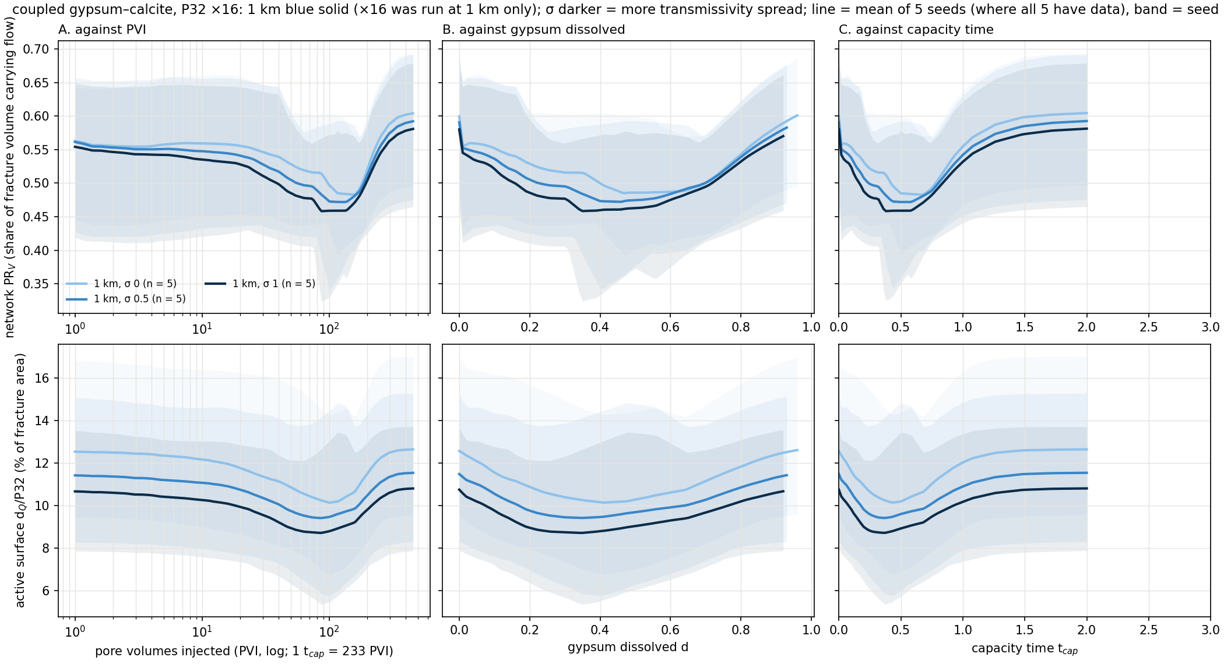
Backup: coupled ensembles, P32 ×16 (1 km only)
48
Notes:
Ensemble overview, coupled, P32 ×16, base runs (n = 1, φ0 0.1, 1 PV/yr). Top row: network PR_V, the share of fracture volume that effectively carries the flow. Bottom row: Hyman's active surface d_Q/P32, the share of fracture area that effectively carries the flow (in %). Left to right the same runs against PVI (log), gypsum dissolved and capacity time; within a chemistry PVI and capacity time are the same clock up to a constant, the log axis just shows the early part. Lines are the mean of 5 seeds where all 5 have data, bands the seed range; blue solid 1 km, rust dashed 2 km, darker = larger σ. 1 km: PR_V starts at 0.60 / 0.59 / 0.58 (σ 0 / 0.5 / 1) and dips to 0.46 at σ 1 near d 0.35; active surface starts at 10.8 % and dips to 8.7 % (σ 1). Every group dips and recovers on every axis; this is the raw behaviour before any of the results.

