Slide 1
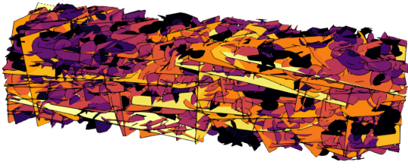
Dissolution channels follow paths the network already has
Reactive flow in kilometre-scale Forsmark fracture networks
90 Phase 1 runs on 45 networks · early Phase 2 · BiGraFV + PFLOTRAN
share of injected flow per fracture, P32 ×6, σ = 1
Status 04 November 2026
Notes:
Opening. The question of the talk: when water dissolves minerals in a fractured rock mass, do the channels that form invent new paths or follow ones the network already had? We answer it for kilometre-scale networks built from the Forsmark site statistics, with gypsum dissolution alone and coupled to calcite precipitation.

Slide 2
Three questions about reacting fracture networks
1
2
3
Emergent or inherited?
Does precipitation re-route?
What sets channel depth?
Do dissolution channels open new paths, or deepen the ones that already carry the flow?
Calcite forms where gypsum dissolves. Can it block a path and push the flow elsewhere?
How strongly does flow focus, and does that depend on the chemistry or on something simpler?
2
Notes:
Why this matters: in fractured crystalline rock a handful of fractures carry most of the flow. If reaction re-routes that flow, transport and storage security change. Three questions frame the talk.

Slide 3
What we know, and where the gap is
Single fractures
Small networks
Coupled precipitation
Wormholes emerge from an instability; the initial aperture field is largely forgotten.
Dissolution follows the flow backbone that topology sets before any reaction.
Calcite replacing gypsum limits how much permeability a fracture can gain.
Szymczak & Ladd 2009, 2012; Upadhyay et al. 2015
Hyman et al. 2024, 2026
Szawełło et al. 2026; Budek et al. 2026
Gap. None of this has been tested on kilometre-scale networks of mineral-filled fractures built from site data, with precipitation coupled in.
3
Notes:
What is known. Single fractures: wormholes emerge from instability and forget the initial aperture field (Szymczak & Ladd; Upadhyay et al. 2015). Networks: dissolution follows the topological backbone (Hyman et al. 2024, 2026). Coupled precipitation: calcite replacing gypsum limits the permeability gain (Szawełło et al. 2026; Budek et al. 2026). The gap: kilometre scale, mineral-filled fractures, site statistics.

Slide 4
Approach
Forsmark networks, one control volume per fracture, two chemistries, one shared clock
Notes:
Section divider: how we set the problem up.

Slide 5
45 networks built from Forsmark fracture statistics
1,587–4,070
fractures per network (P32 ×4 to ×8)
1 km
inlet to outlet, 1000 × 250 × 250 m, SKB FFM01 families
P32 ×4, ×6, ×8 (×16 running: 7,849–8,229 fractures)
transmissivity spread σ = 0, 0.5, 1; 5 seeds each
fixed rate: one network pore volume per year (Hyman)
Transmissivity: SKB 0–200 m law used at 200–400 m (kept and labelled).
5
Notes:
The networks: SKB FFM01 fracture families (NS, NE, NW, EW, HZ), 1000 × 250 × 250 m, layer 2, minimum radius 15 m. Real FFM01 intensity does not percolate across a kilometre, so we scale P32 by 4, 6 and 8 (and 16, running). Transmissivity heterogeneity sigma 0, 0.5, 1; five seeds each. Water is injected at one network pore volume per year. The transmissivity law is the 0-200 m SKB law applied at 200-400 m depth; we kept and labelled it.

Slide 6
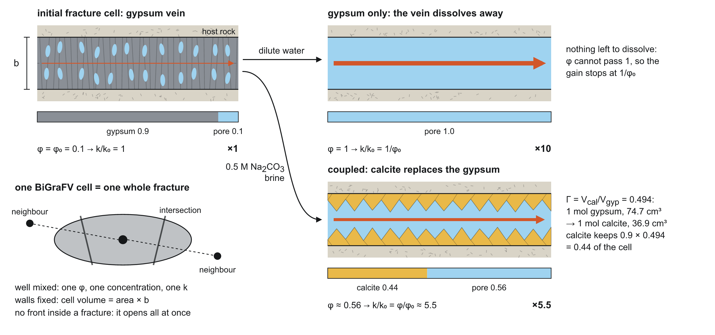
One well-mixed cell per fracture
Fast: a 1 km network in hours on a laptop
Captures: which fractures carry the flow, and how that changes
Misses: fronts and wormholes inside a fracture; intersection throats
6
Notes:
BiGraFV: each fracture is one well-mixed control volume, connected through its intersections; PFLOTRAN solves flow and reactive transport on that graph. It is fast enough for 1 km networks, but by construction it cannot form a front inside a fracture or resolve an intersection throat. Keep that in mind for the candidate findings.

Slide 7
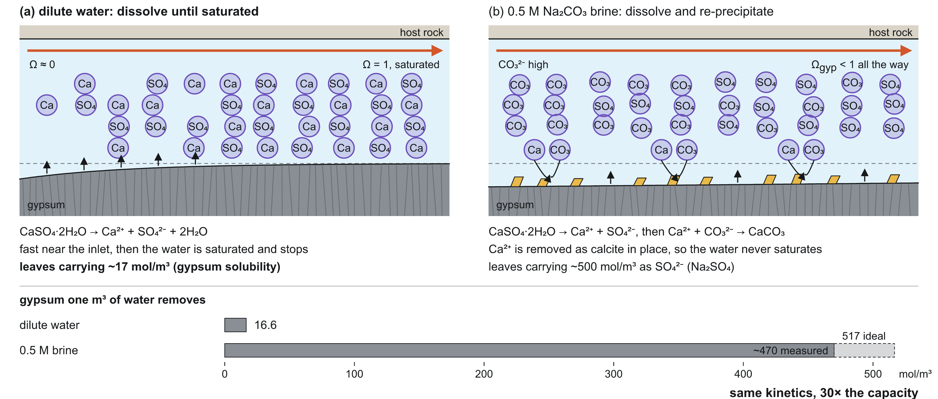
Two chemistries: same kinetics, 30× the capacity
Permeability ceiling (n = 1): ×10 gypsum-only, ×5.5 coupled, because calcite takes back about half the volume.
7
Notes:
Two chemistries with the same gypsum kinetics. Dilute water leaves carrying about 17 mol/m3 of gypsum. In 0.5 M sodium carbonate brine the calcium precipitates as calcite where it is released, so the water never saturates and removes about 30 times more gypsum per pore volume. Calcite occupies about half the volume of the gypsum it replaces (Gamma = 0.49), which caps the permeability gain: x10 for gypsum-only, x5.5 coupled (k-phi with n = 1).

Slide 8
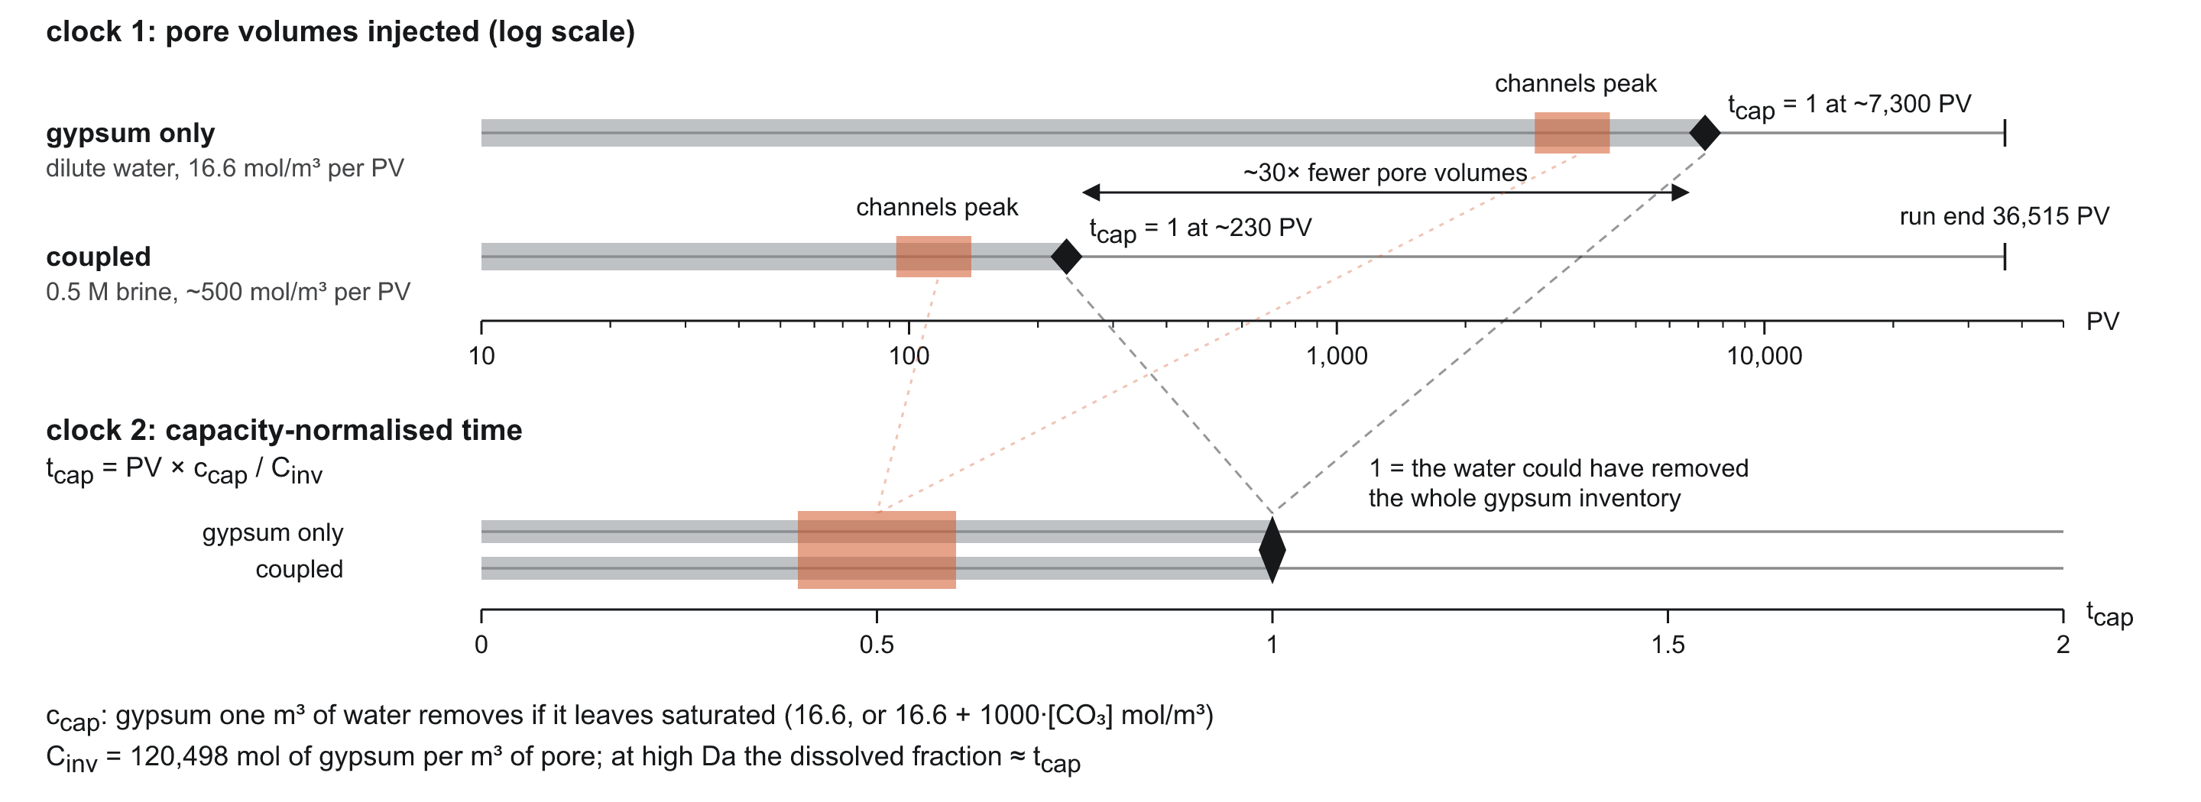
One clock for both chemistries: the fraction dissolved
+0.066
coupled minus gypsum-only at breakthrough, same network (45 pairs), on the dissolved fraction; +0.12 on capacity time
×3.5
spread of breakthrough across chemistries and porosities on Hyman's τ, against ×1.2 on the dissolved fraction
Capacity time stays as the prediction made before a run; τ = ΔV/V₀ is read as the mean permeability gain.
8
Notes:
Pore volumes put the two chemistries 30 times apart. We time everything by the fraction of the gypsum dissolved, a measured quantity. Capacity time (pore volumes times what each pore volume can remove, over the inventory) is the prediction of that fraction; it holds until breakthrough and drifts after it. On the dissolved fraction the coupled run still comes a little later than gypsum-only on the same network, but the gap is a third to a half of that on capacity time. Hyman's tau (open volume gained over the initial) does not line the stages up across chemistries: here it is the mean permeability gain instead.

Slide 9
What happens
Four stages, one inherited channel
Notes:
Section divider: the Phase 1 results.

Slide 10
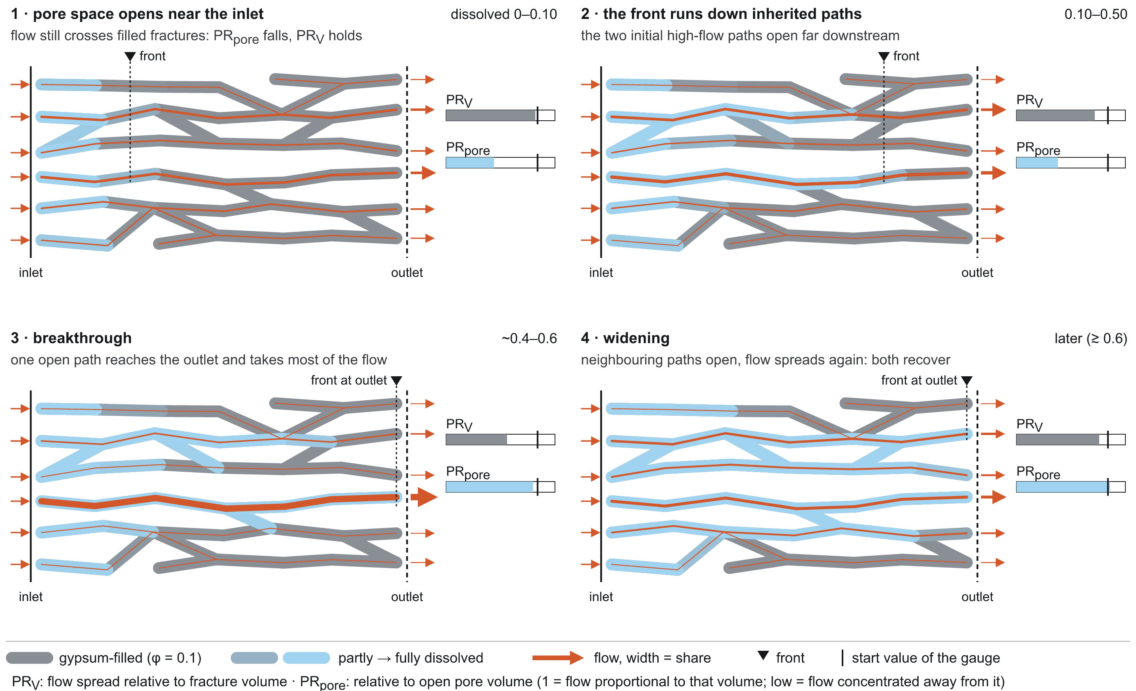
Every run passes through the same four stages
10
Notes:
The sequence every run follows. Stage 1, up to about 10 % dissolved: pore space opens near the inlet while the flow is still set by filled fractures downstream. Stage 2: the front runs down the paths that already carried the most flow. Stage 3: flow focusing is strongest (PR_V minimum at 37 % dissolved gypsum-only, 44 % coupled) and the outlet breaks through (56 % and 63 %). Stage 4: neighbouring paths open and the flow spreads again. Phase 1 medians, 45 runs per chemistry.

Slide 11
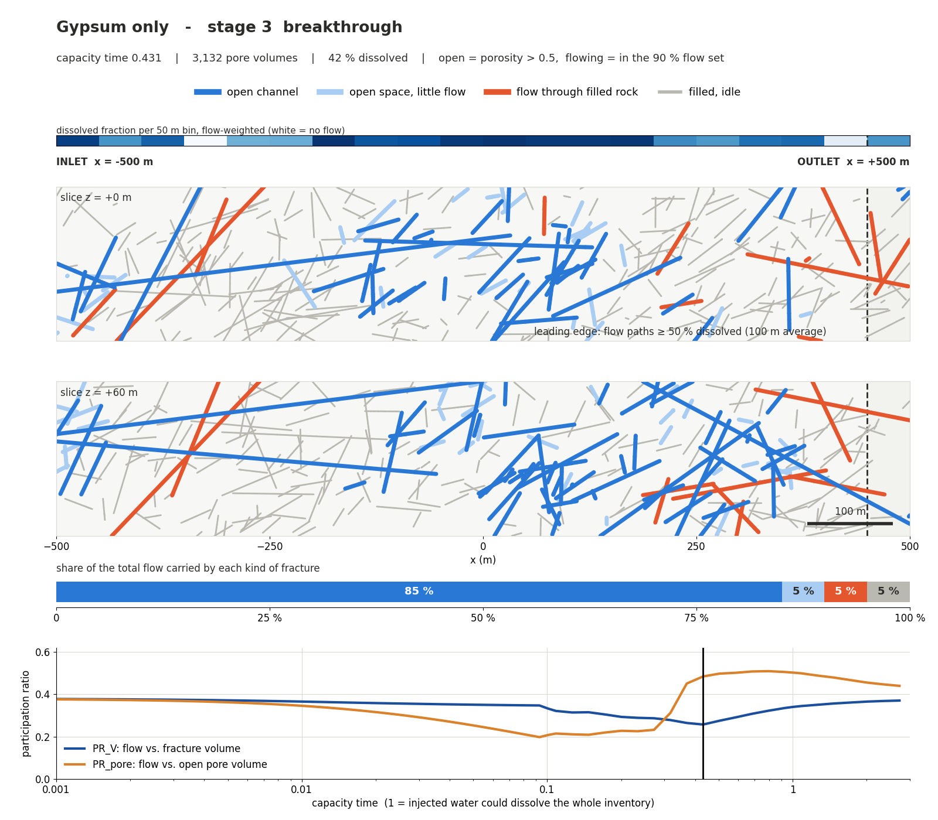
Stage 3 in a real network: open channels carry the flow
56 %
of the gypsum dissolved when the outlet breaks through (gypsum-only, Phase 1 median)
63 %
for the coupled brine on the same networks
Example network: P32 ×6, σ = 1, seed 1. Movies of all stages are in the report.
11
Notes:
The same stages in a real network: two horizontal slices through P32 x6, sigma 1, seed 1, gypsum-only, at breakthrough. Blue is open and flowing, light blue open but nearly idle, orange flow through still-filled rock, grey filled and idle. The bar shows that open channels already carry most of the flow.

Slide 12
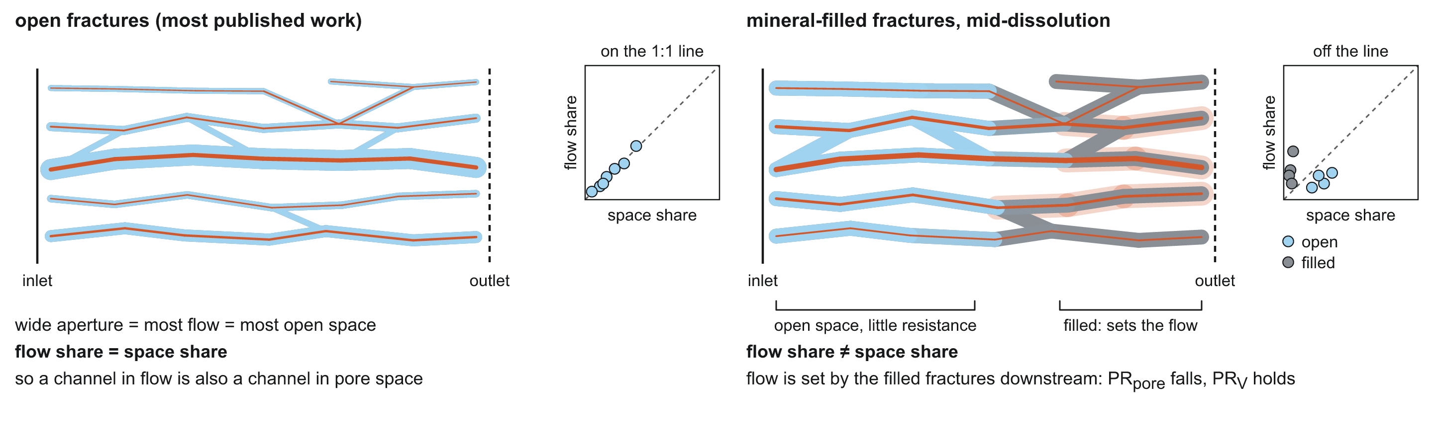
Pore space opens before the flow moves
17 %
37 %
90
dissolved when flow and open space are most mismatched (PR_pore minimum, gypsum-only)
dissolved when flow is most focused (PR_V minimum, gypsum-only)
runs, both chemistries, same order every time
12
Notes:
Stage 1 decoupling. PR_pore compares flow with where the open space is; it bottoms out first, at 17 % dissolved gypsum-only and 20 % coupled, while PR_V, flow against fracture volume, has barely moved. The pore space opens near the inlet but the flow is still controlled by filled fractures downstream. The two realign later: PR_V reaches its minimum at 37 % and 44 %.

Slide 13
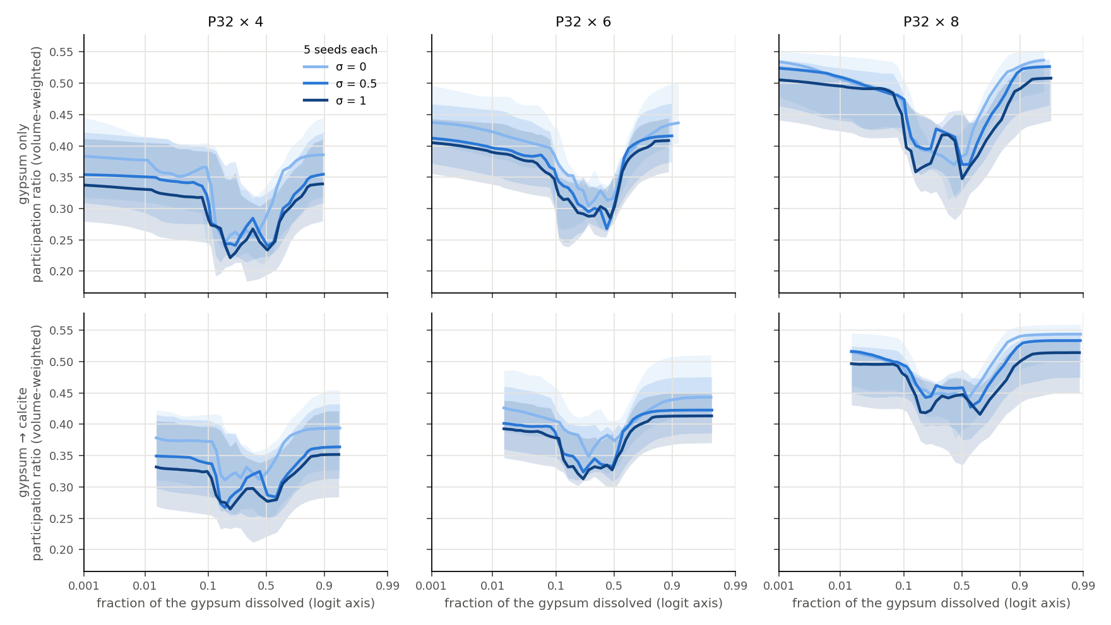
Channels deepen, then the flow spreads again
0.65
PR_V minimum over its start, gypsum-only (median of 45)
0.78
same for the coupled brine: a shallower channel
PR_V = (ΣQ)² / Σ(Q²/w), w = fracture volume share. Rows: chemistries; columns: P32 ×4, ×6, ×8.
13
Notes:
Channel depth through time, PR_V: 1 if flow were spread in proportion to fracture volume, lower when it concentrates. Every panel dips while the channel forms and recovers after breakthrough. The dip is deeper for gypsum-only: the minimum is 0.65 of the start (median) against 0.78 coupled. Lines are sigma ensembles, medians of 5 seeds with 10-90 % bands.

Slide 14
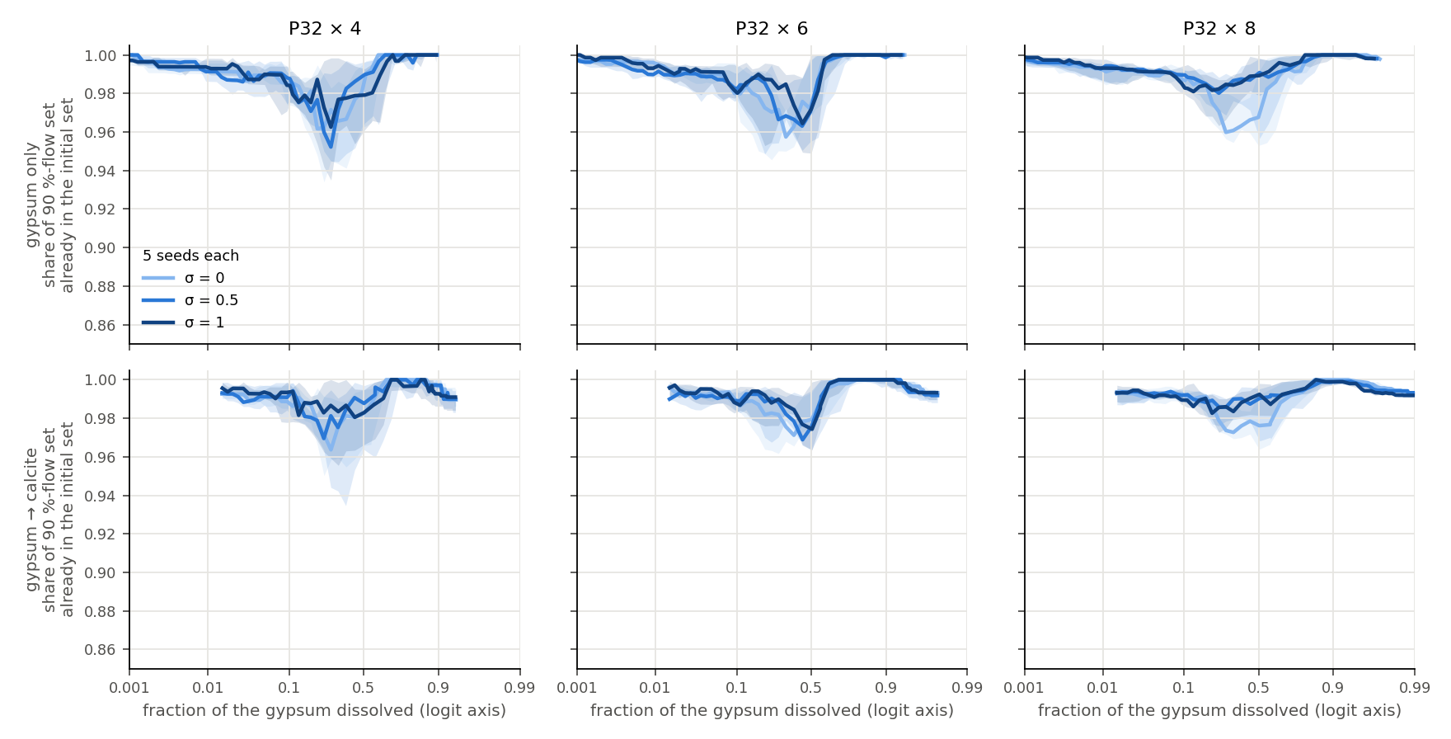
The channel is inherited
98 %
of the peak channel was already in the initial 90 %-flow set (median, gypsum-only)
92 %
lowest of 90 runs
Inheritance: share of the 90 %-flow set at its smallest that was in the initial set (n90 minimum). Phase 1, 45 runs per chemistry.
14
Notes:
Inheritance: of the fractures carrying 90 % of the flow when the channel is strongest, a median 98 % (gypsum-only) and 98 % (coupled) were already in the initial 90 % set; the lowest of 90 runs is 92 %. The channel is chosen by the network before any reaction. This answers question 1, for this model.

Slide 15
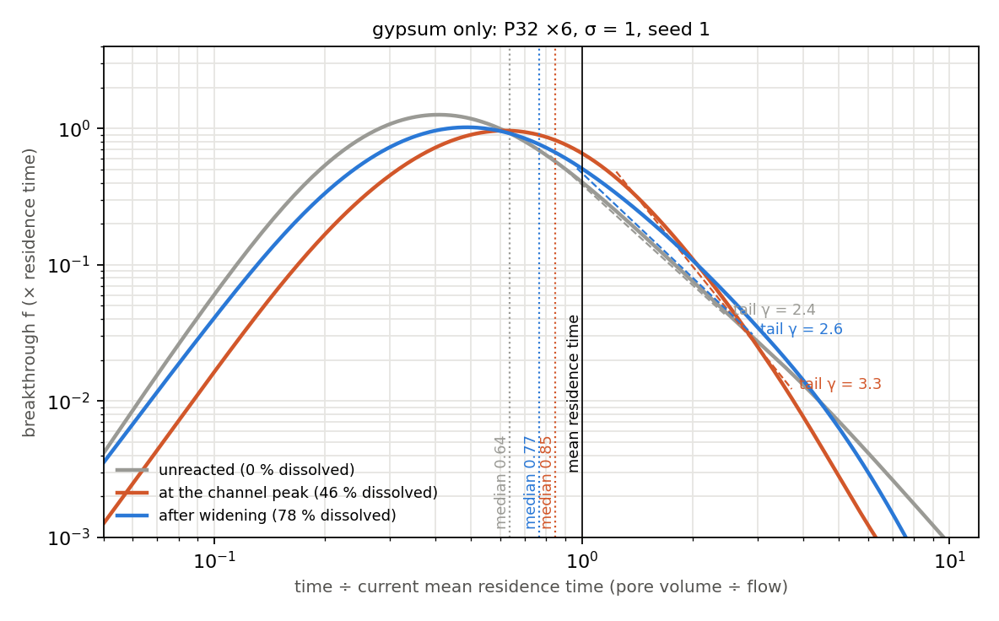
Transport narrows while the channel forms
gypsum-only, medians of 45 networks
median arrival / τ_res
0.79 → 0.90 → 0.85
tail exponent γ
3.3 → 4.1 → 3.2
dispersivity α_L (m)
168 → 144 → 174
start → channel peak (50 % dissolved) → end (93 %)
Coupled runs move the same way: arrival 0.73 → 0.86 → 0.80; γ 3.4 → 3.9 → 3.3.
15
Notes:
Transport, from tracer pulses through frozen snapshots of the reacted network (fine probes, all 45 networks per chemistry). While the channel forms the median arrival moves towards the mean residence time (0.79 to 0.90 for gypsum-only), the tail steepens (gamma 3.3 to 4.1) and dispersivity falls (168 to 144 m). Gamma and dispersivity recover after breakthrough; arrival only partly.

Slide 16
Twice the fractures, the same story
fraction of the gypsum dissolved (gypsum-only)
97 %
P32 ×4–×8
P32 ×16
PR_pore minimum
17 %
25 %
inheritance at ×16 (gypsum-only, median of 15)
PR_V minimum
37 %
43 %
+0.13
breakthrough
56 %
58 %
coupled minus gypsum-only depth, same network: all 15 positive
Order unchanged; the mismatch between flow and open space peaks later.
Phase 1 at P32 ×16, 15 networks per chemistry, run to capacity time 2. Phase 2 at ×16 (3 networks per case) gives the same depth law.
16
Notes:
P32 x16 doubles the fracture count (7,849-8,229). The stages keep their order, inheritance stays at 97 % (lowest 94 %), and the coupled run is shallower on the same network by +0.135 (all 15 pairs). What shifts: the flow/open-space mismatch peaks later, at 25 % dissolved gypsum-only and 35 % coupled, against 17 % and 20 % at x4-x8.

Slide 17
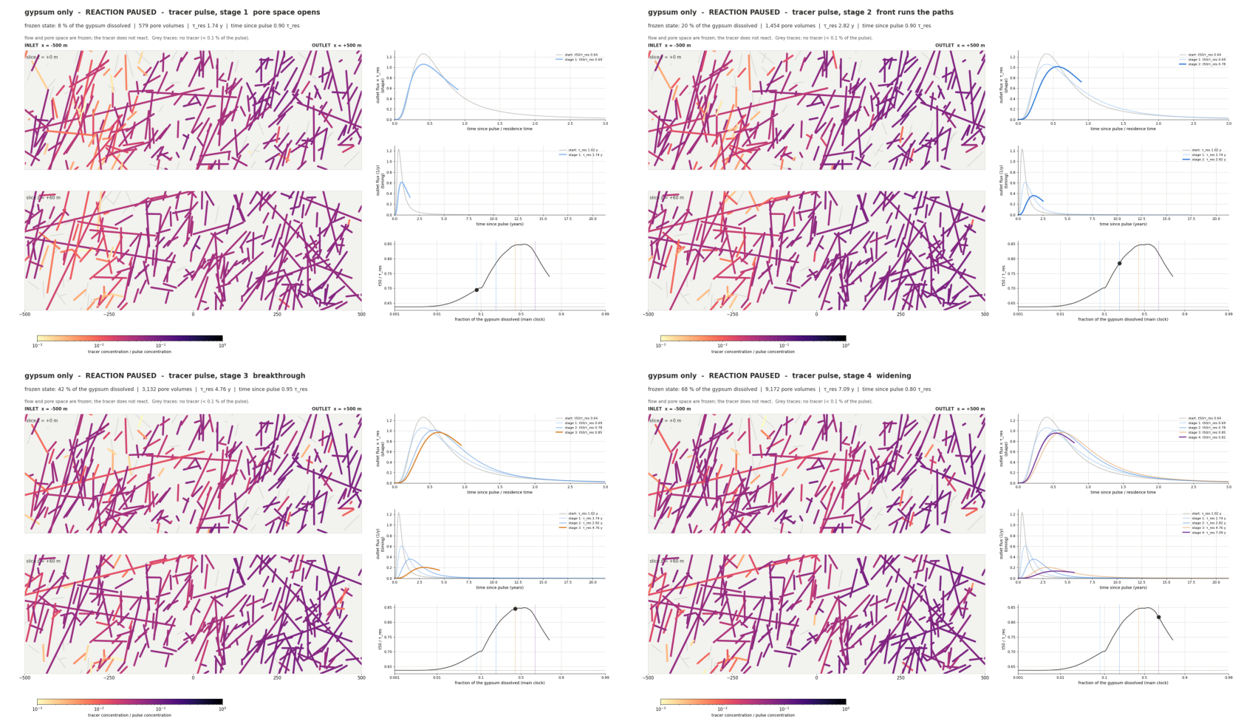
Pause the reaction, pulse a tracer
gypsum-only, example network
residence time τ_res (yr)
1.0 1.7 2.8 4.8 7.1
t50 / τ_res
0.64 0.69 0.78 0.85 0.82
start · pause 1 · 2 · 3 · 4
Across 720 probed states the change in tail exponent tracks PR_V: ρ -0.80.
17
Notes:
The paused-pulse movie: the reaction freezes at each stage and a conservative tracer pulse runs through the frozen network. In stage 1 the residence time grows from 1.02 to 1.74 years while t50/tau_res moves only from 0.64 to 0.69: pore volume is added before the flow paths change. By stage 3 the shape changes: t50/tau_res 0.85. One network only (P32 x6, sigma 1, seed 1). The movies are in the report.

Slide 18
Candidate findings
What might be new, and what could make it wrong
Notes:
Section divider: candidate findings.

Slide 19
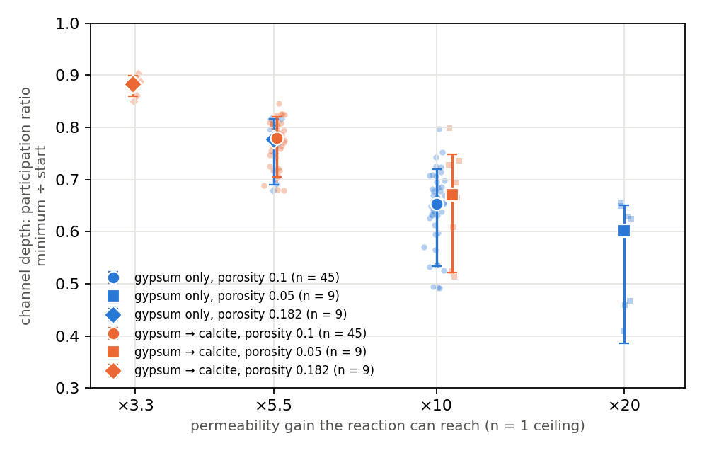
Depth is set by the permeability ceiling, not chemistry
0.009
median |difference|, equal ceilings ×10.6 vs ×10 (9 pairs)
+0.13
×5.5 minus ×10: shallower in all 45 pairs
-0.07 to -0.20
×20 minus ×10: deeper in all 9 pairs
Depth = PR_V minimum over start, paired on the same network (σ = 1, seeds 1–3). Phase 3: gypsum-only at ×5.5 vs coupled ×5.5: -0.012 (n 9).
19
Notes:
Channel depth law. Paired on the same network, chemistries with the same permeability ceiling give the same depth: x10.6 coupled at porosity 0.05 against x10 gypsum-only differ by a median 0.009 (max 0.032, 9 pairs). A lower ceiling is shallower (x5.5 minus x10: +0.126, all 45 pairs positive); a higher one deeper (x20 minus x10: -0.07 to -0.20, all 9 negative). Caveat: x5.5 and x20 change chemistry or porosity together with the ceiling; three seeds per case.

Slide 20
Same ceiling, same depth; any rate, same stages
0.012
depth difference at equal ×5.5 ceiling, two chemistries and porosities (median, 9 networks)
+0.08
depth change from ×10 to ×5.5 with the same chemistry
< 0.003
largest shift in the PR_V minimum, outlet and breakthrough between 0.1 and 10 pore volumes per year (3 networks per chemistry)
20
Notes:
Two robustness tests from Phase 3. Ceiling: gypsum-only at porosity 0.182 has the same x5.5 ceiling as the coupled runs at 0.1; on the same 9 networks the depths match within a median 0.012 (gypsum-only slightly deeper in all 9), against +0.08 when the same chemistry goes from x10 to x5.5. The depth law now spans x3.3 to x20. Rate: 100-fold range, 0.1 to 10 pore volumes per year, three networks per chemistry: stage timing on the dissolved fraction changes by at most 0.0002 (gypsum-only) and 0.0024 (coupled), depth by at most 0.014. Local equilibrium.

Slide 21
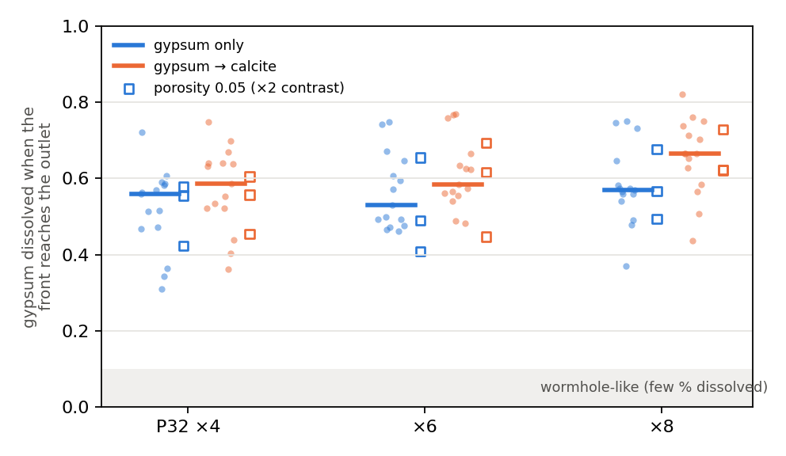
Breakthrough needs more than half the gypsum
53–57 %
of the gypsum dissolved at breakthrough, gypsum-only (per-P32 medians)
58–67 %
coupled brine
Model-dependent. One cell per fracture cannot form an in-fracture wormhole; a bound is being computed.
21
Notes:
Breakthrough is expensive: when the outlet passes 50 % dissolved, the network has used 53 %-57 % of its gypsum (gypsum-only, per-P32 medians) and 58 %-67 % coupled; single runs 31 %-82 %. That is a compact front, not a wormhole. But the one-cell model cannot form a wormhole inside a fracture, so this is model-dependent. The wormhole checks queued tonight bound how much in-fracture wormholes could move breakthrough.

Slide 22
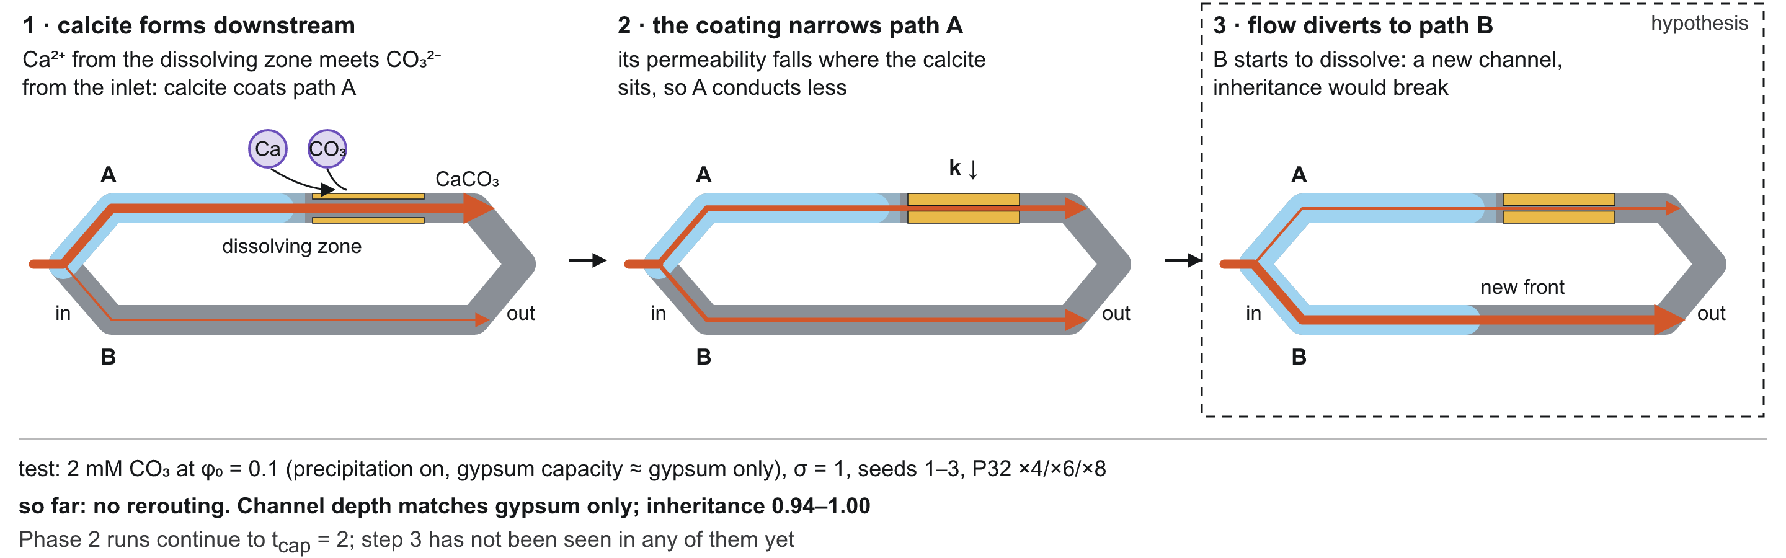
No rerouting at low carbonate, and we can see why
94–100 %
Why: calcite (36.9 cm³/mol) replaces gypsum (74.7 cm³/mol) where it dissolves, so every well-mixed cell gains porosity. Clogging needs a reaction that adds solid volume.
inheritance at 2 mM carbonate (9 networks)
22
Notes:
Question 2, precipitation rerouting. At 2 mM carbonate (capacity matched to gypsum-only) the channel depth matches gypsum-only (median |difference| 0.009, 9 networks) and inheritance at the channel peak stays 94 %-100 %: no rerouting. In a well-mixed cell calcite only forms where gypsum dissolves and takes half its volume, so a cell can only open. The olivine-carbonation run tests a chemistry that adds solid volume.

Slide 23
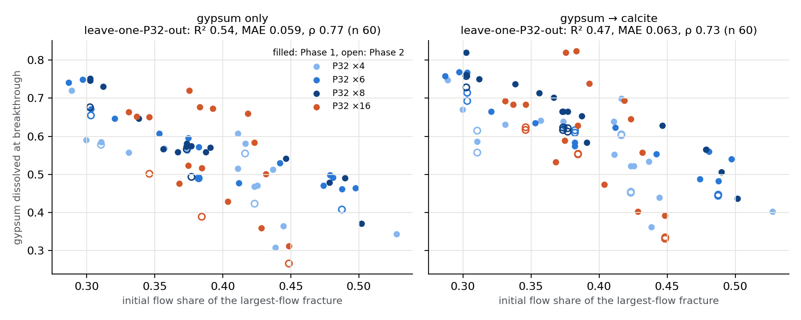
One fracture's flow share predicts breakthrough
R² 0.54
held-out P32 level, gypsum-only (coupled 0.47)
ρ 0.90
rank agreement on Phase 2 runs (same networks, new ceiling and porosity; not independent)
The channel-volume share, the obvious mass-balance guess, predicts poorly (R² 0.12).
23
Notes:
Breakthrough can be predicted from the initial flow field. The single best predictor, held out one P32 level at a time, is the initial flow share of the largest-flow fracture: R2 0.54 (gypsum-only) and 0.47 (coupled), Spearman 0.77; on the Phase 2 runs (same 12 networks, new ceiling and porosity, so not independent) R2 0.37 and Spearman 0.90. The more one fracture dominates at the start, the less gypsum has to dissolve before the outlet breaks through.

Slide 24
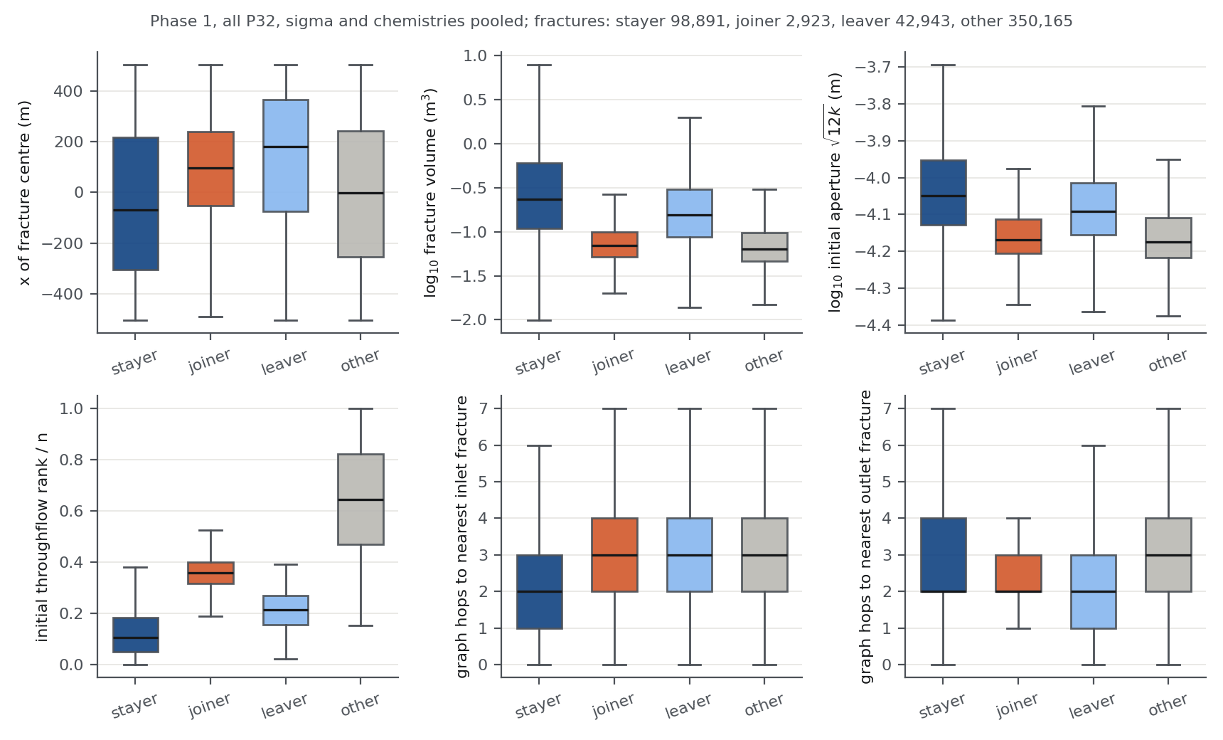
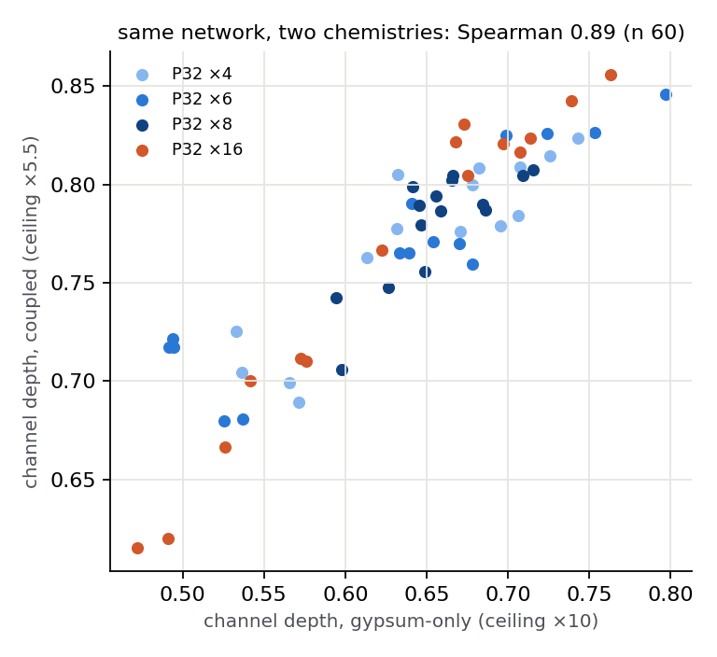
The channel narrows; depth belongs to the network
Depth rank kept across chemistry: ρ 0.89 (n 60)
32 % of the initial channel drops out (median); 2 % of the peak channel is new.
24
Notes:
Turnover: inheritance says the peak channel is built from the initial one, but about 32 % of the initial 90 %-flow set drops out (median over 120 runs), mostly small, narrow fractures downstream where the flow converges. Only 2 % of the peak set is new, all of them side branches touching the channel. And the depth of focusing is a stable property of each network: the gypsum-only and coupled depths on the same network have Spearman 0.89, although none of 19 initial-state features predicts it out of sample.

Slide 25
A DFN check is feasible for one 1 km network
1 km, P32 ×4, h = 1 m
0.78 M cells
coupled 9–17 core-h · gypsum-only 240–470
recommended
1 km, P32 ×8, h = 2 m
1.5 M cells
coupled 17–38 core-h
coupled only
1 km, ×8 at 1 m; ×16
2.9 M; 11 M
16–110 GB memory
not on this laptop
250 m block, ×4
0.19 M cells
cannot test 1 km depth or breakthrough
partial
Needs a regenerated network: the Phase 1 networks were built with dfnWorks' feasibility checks off and cannot be meshed.
Estimates from four Forsmark mesh tests and the earlier TPL DFN runs (forsmark_reactive/DFN_VALIDATION_SCOPE.md).
25
Notes:
Validation scope. The Phase 1 networks were generated with dfnWorks' feasibility checks off, so they cannot be meshed; a validation needs a regenerated network. With relaxed checks (rFram) the P32 x4 network keeps 1,605 fractures and 9 inlet-outlet paths (Phase 1: 1,608 and 11). At h = 1 m that is about 0.78 M DFN cells: the coupled chemistry to capacity time 2 is about 9-17 core-h, gypsum-only to capacity time 1 about 120-240 core-h. x8 at 1 m and x16 do not fit in 24 GB. All estimates; a 10-step smoke test would replace them.

Slide 26
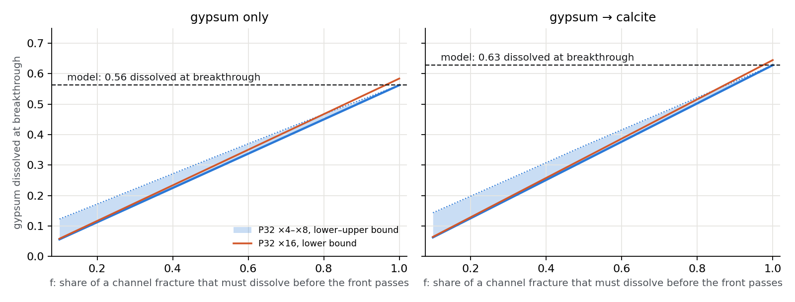
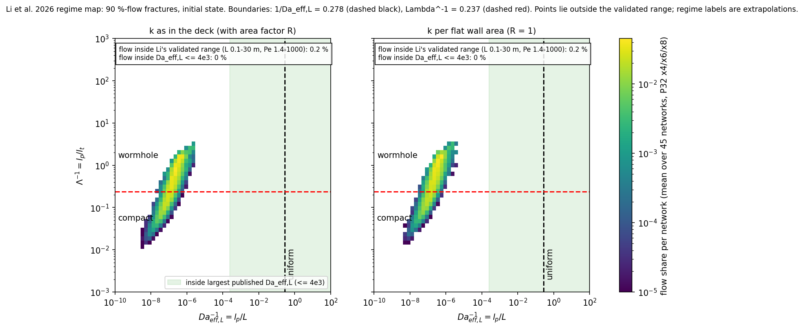
Wormholes could move breakthrough, not the channel
28–32 %
dissolved at breakthrough if fronts cross a fracture at half dissolution (gypsum-only; model 56 %)
×10⁶
margin by which uniform in-fracture dissolution is excluded
Compact vs wormhole is an extrapolation: 0.2 % of the flow lies inside the published tested range.
26
Notes:
Would in-fracture wormholes change this? The dissolved budget, stage 1 and inheritance do not depend on the in-fracture pattern. On the published single-fracture diagram (Li et al. 2026) uniform dissolution is excluded by about 1e6; the compact/wormhole split is an extrapolation (only 0.2 % of the flow at x6 is inside the tested range). The channel fractures hold 86 % of the gypsum dissolved by breakthrough, so if a wormhole crossed a fracture after dissolving half of it, breakthrough would need 28 %-32 % of the gypsum (gypsum-only) instead of more than half.

Slide 27
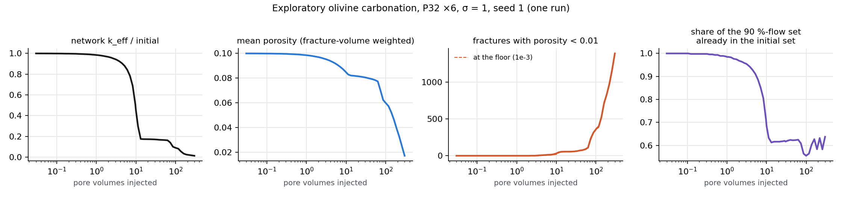
A reaction that adds volume does re-route the flow
0.55–0.64
458 → 675
Exploratory. One olivine run at 185 °C on one network; not part of the Forsmark result.
inheritance after clogging starts (gypsum runs: never below 0.92)
fractures in the 90 %-flow set: the flow spreads
27
Notes:
Exploratory, one run: olivine carbonation adds solid volume (+80 % with chalcedony, from the PFLOTRAN database), so a well-mixed cell can clog. The inlet fractures seal first; around 10 pore volumes k_eff drops to about a fifth and the 90 %-flow set turns over to 0.55-0.64 inherited while n90 grows from 458 to about 675. By 300 pore volumes 1374 fractures are at the porosity floor and k_eff is 0.013 of the start. Caveats: one run, no pressure, no CO2 phase, surface area sets the rate, the floor keeps 1 % of k.

Slide 28
What is new, and what is not
Known, now shown at 1 km
Candidate findings
channels follow the initial structure (Hyman et al. 2026)
replacement by calcite limits the permeability gain (Szawełło et al. 2026; Budek et al. 2026)
transport narrows while a channel forms
flow and open pore space decouple in stage 1, then realign
channel depth set by the permeability ceiling, not the chemistry
a compact front: breakthrough after more than half the inventory (model-dependent)
stages timed by the fraction dissolved, not by open-volume gain
28
Notes:
What is new and what is not. Channels following the initial structure, and calcite replacement limiting the permeability gain, are known from smaller systems; we show them at 1 km on site statistics. The candidates that may be new: the stage-1 decoupling of flow and open space, the depth law, and the compact front.

Slide 29
Limits and next steps
What the model cannot see, and what is running
Notes:
Section divider.

Slide 30
Limits we know about
1
Model. One cell per fracture: no in-fracture fronts, wormholes or intersection throats.
2
Inputs. SKB 0–200 m transmissivity law used at 200–400 m; kept and labelled.
3
Clock. Capacity time assumes saturated outflow; it drifts after breakthrough, so we time stages by the fraction dissolved.
4
Statistics. Phase 2: 3 seeds per case (9 networks per group).
5
Measure. Published active surface area ≈ its value for size-proportional flow (17 vs 18 % at ×6): it mostly tracks fracture-size spread.
30
Notes:
Limits. The one-cell model misses in-fracture fronts, wormholes and intersection throats. The transmissivity law is the shallow SKB law used deeper. Capacity time assumes saturated outflow, which fails after breakthrough. Phase 2 has three seeds per case. And the published active surface area mostly reflects fracture-size spread here: with flow exactly proportional to volume it would already be 22, 17 and 20 % at P32 x4, x6, x8, close to the measured 22, 18, 15 %.

Slide 31
Proposed next steps
1
2
3
4
Test
Test
Test
Write
Resolve in-fracture fronts on a few channel fractures (DFN or multi-cell) to pin down f in the wormhole bound
Why the flow/open-space mismatch peaks later at ×16
Olivine: more networks, surface-area range, pressure-dependent CO₂
Draft the paper around inheritance, the depth law and the clock
31
Notes:
Next steps proposed, not yet started: resolve in-fracture fronts on a few channel fractures to pin down how much of a fracture a real front dissolves (the f of the wormhole bound); understand why the stage-1 mismatch peaks later at x16; extend the olivine exploration; and draft the paper.

Slide 32
Take-home
98 %
4
×10 = ×10.6
of the peak channel was there before any reaction: channels are inherited
stages in every run, timed by the fraction of gypsum dissolved
equal permeability ceilings give equal channel depth, whatever the chemistry
Full report, numbers and sources: Forsmark Reactive Channels (claude.ai artifact)
Notes:
Closing: three take-home messages, one per question.

Slide 33
Backup
Measures and clocks
Notes:
Backup slides.

Slide 34
Three channel measures
Active surface area
Participation ratio PR_V
n90
d_Q / P32 = (Σ S Q)² / (Σ S · Σ S Q²)
(Σ Q)² / Σ (Q² / w), w = volume share
fractures to 90 % of summed throughflow
100 % only if every fracture carries the same flow. Maillot et al. 2016; Hyman.
1 if flow is proportional to volume. Ours.
A set: used for inheritance. Counts each fracture once.
Size-proportional baseline of d_Q/P32: 21.6 / 16.5 / 19.7 % against measured 22.5 / 17.5 / 15.0 % at P32 ×4 / ×6 / ×8 (medians of 15).
34
Notes:
How the channel measures differ. All three fall when flow concentrates. Active surface area has 'equal flow in every fracture' as its reference, so in power-law networks it is low even without channelling. PR_V has 'flow in proportion to volume' as its reference. n90 counts fractures to 90 % of summed throughflow and defines the channel set used for inheritance.

