Slide 1
Reactive Channels at Kilometre Scale
A focus that moves and relaxes, and a depth law, from 456 BiGraFV simulations of mineral-filled fracture networks
BiGraFV · Forsmark FFM01 · draft 8 November 2026
Notes:
Title. 456 BiGraFV reactive runs on 117 Forsmark FFM01 networks of 1,587 to 14,658 fractures.

Slide 2
Four findings
1 · Stages
2 · Moving focus
3 · Depth law
4 · Early arrival
87 / 90
0.03 → 0.50
0.78 → 0.15
ρ 0.76
runs follow one order: open space decouples from flow, recouples, focuses and breaks through, relaxes
dissolved fraction when each 100 m stretch focuses, inlet → outlet; each then returns to its start, at ×100 too
channel depth from ×5.5 to ×1000 attainable gain; coupled on the same curve; holds at σ 0
ranks the gypsum dissolved at breakthrough; out of sample R² 0.5–0.6, blind test failed
2
Notes:
The four findings in one slide. 1: the order holds in 87 of 90 runs at 1 km. 2: each 100 m stretch focuses as the front passes (dissolved fraction 0.03 at the inlet to 0.50 at the outlet, gypsum-only) and returns to within 0.8-1.7 % of its start. 3: depth 0.78 at x5.5 to 0.15 at x1000 attainable gain, 9 networks; coupled within a median 0.021 at the same gain; holds at sigma 0 (run C). 4: early tracer arrival ranks the dissolved fraction at breakthrough (pooled rank correlation 0.76 / 0.83) but explains only half the variation out of sample (R2 0.51 / 0.62); the pre-set blind test failed, so it is a supporting result.

Slide 3
What BiGraFV makes possible
25 m · 526
14,658
456
largest published reactive network study found: domain size and fractures (Hyman et al. 2026)
this study: fractures in the largest network; domains 1–2 km long
reactive runs, flow re-solved at every saved state
How. Each fracture is one control volume and each intersection a connection; PFLOTRAN solves gypsum and calcite kinetics, mineral volume and the porosity–permeability feedback on that graph.
Why it matters. We can run the same network with different chemistries, permeability laws, rates, lengths and densities, and compare BiGraFV with BiGraFV, one change at a time.
3
Notes:
Why this needs BiGraFV. Published reactive network studies stop at 10 m (meshed DFN) to 25 m and about 526 fractures (graph, Hyman et al. 2026). One control volume per fracture lets PFLOTRAN run full reactive transport with mineral volume and permeability feedback on 1,587-14,658 fractures in hours, so the same network can be run hundreds of ways (456 runs). Every comparison here is BiGraFV against BiGraFV.

Slide 4
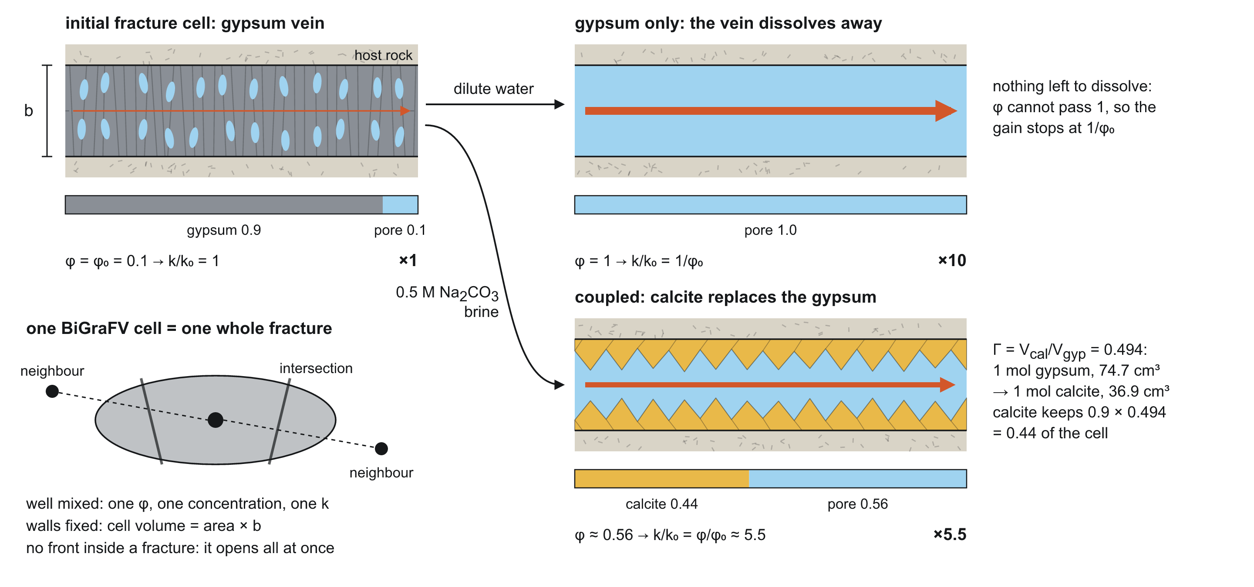
What we ran
Forsmark FFM01 networks, 1 km and 2 km; P32 ×4–×16; σ 0/0.5/1; 5 seeds
one network pore volume per year, fixed rate
fractures start 90 % gypsum; gypsum-only or coupled gypsum–calcite
k = k₀(φ/φ₀)ⁿ: n = 1 main runs, 0.5–8 in the law tests
clock: fraction of the gypsum dissolved; depth: PR_V minimum / start
4
Notes:
Setup. Forsmark FFM01 statistics, 1000 x 250 x 250 m and 2000 x 500 x 250 m, P32 x4-x16, sigma 0/0.5/1, 5 seeds. One pore volume per year. Fractures start 90 % gypsum. Gypsum-only and coupled gypsum-calcite (calcite takes 49.4 % of the gypsum volume). k = k0 (phi/phi0)^n. The clock is the fraction of the gypsum dissolved.

Slide 5
1 · The front moves through four stages
Open space decouples from flow, recouples, breaks through, relaxes

Slide 6
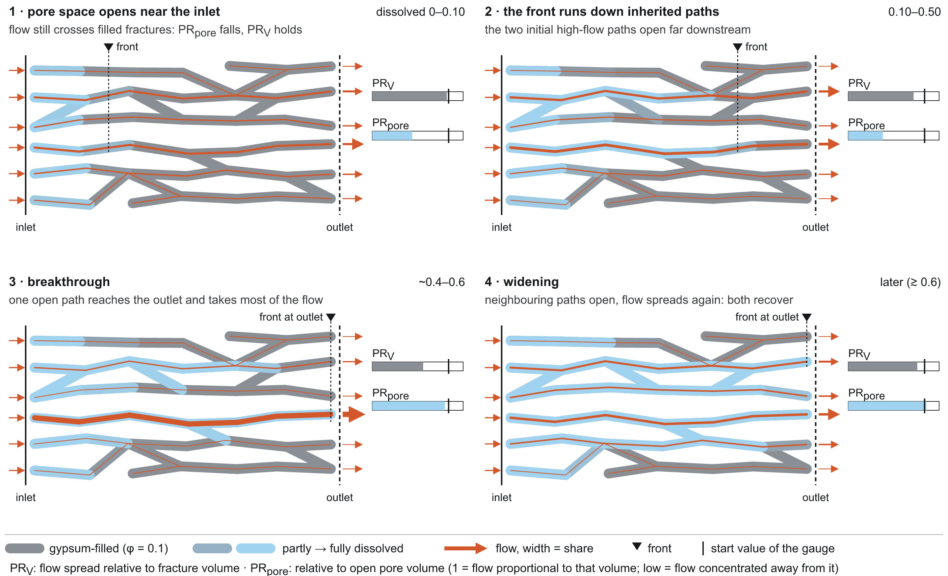
Four stages, one order
6
Notes:
The four stages as a cartoon: (1) pore space opens near the inlet while flow is set downstream; (2) flow moves into the opened fractures; (3) focusing peaks, then the front breaks through; (4) neighbouring paths open, flow spreads.

Slide 7
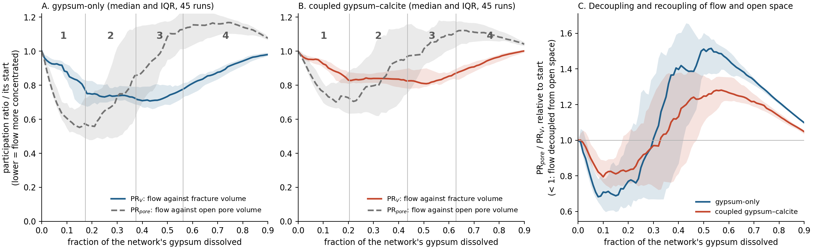
Decoupling, recoupling, peak, relaxation
87 / 90
45 / 45
0.995
runs with the full order at 1 km (83 / 90 at 2 km)
runs per chemistry where flow decouples from open space first
PR_V at the end relative to start (gypsum-only): the network relaxes
7
Notes:
Figure 1. Event medians (dissolved fraction): pore-volume minimum 0.17 / 0.20, PR_V minimum 0.37 / 0.44, breakthrough 0.56 / 0.63 (gypsum-only / coupled, 45 runs each). Full order in 87 of 90 runs at 1 km, 83 of 90 at 2 km. PR_pore/PR_V falls below its start in every run (median curve 0.68 / 0.80 at d about 0.1), recrosses 1 near d = 0.3 and peaks at 1.52 / 1.28 near d = 0.5. Last state: PR_V 0.995 / 1.01 of its start.

Slide 8
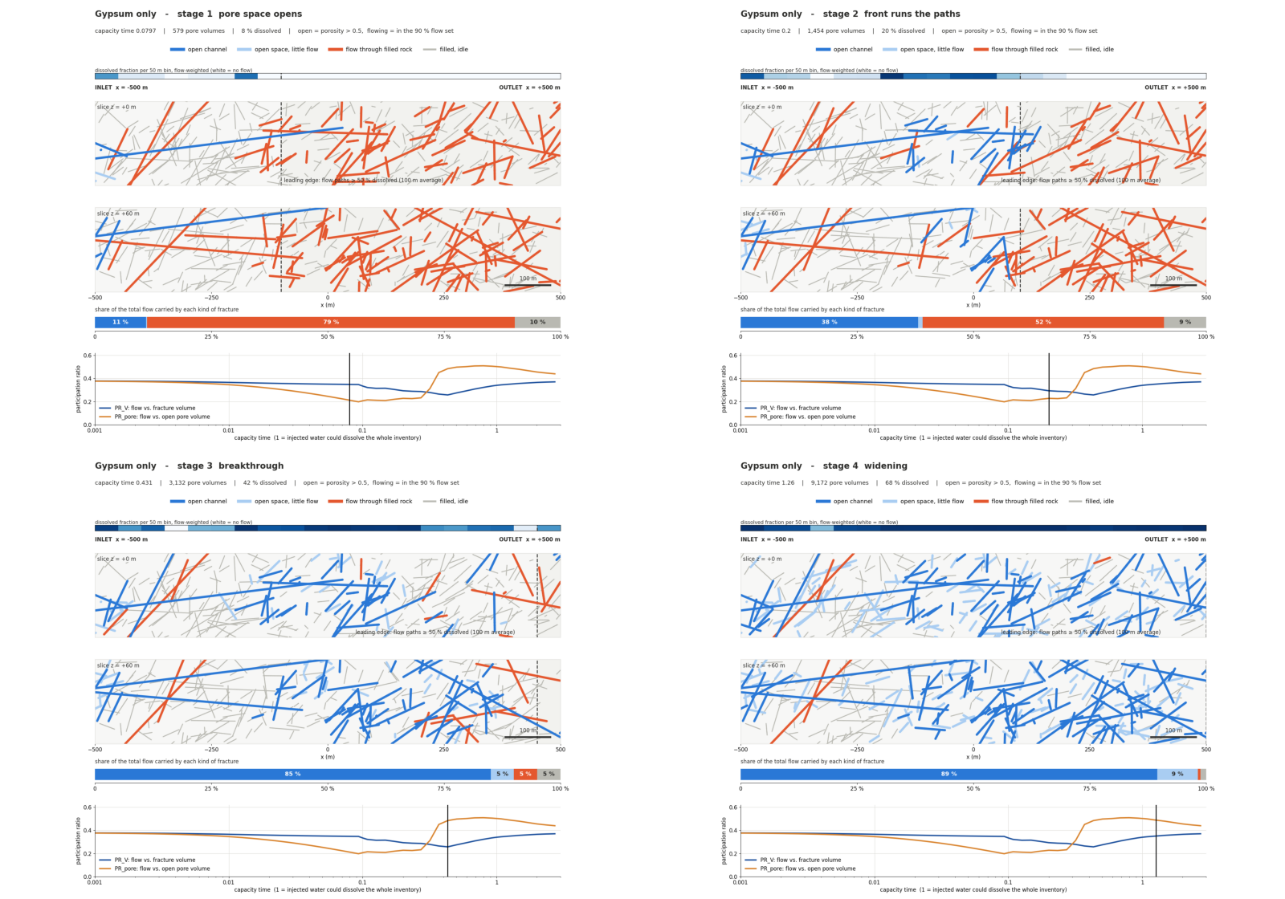
The stages in a real network
8
Notes:
Movie: two slices through the example network (P32 x6, sigma 1, seed 1, gypsum-only) through the four stages.

Slide 9
2 · A focus that moves and relaxes
Each stretch focuses as the front passes, then returns to its start

Slide 10
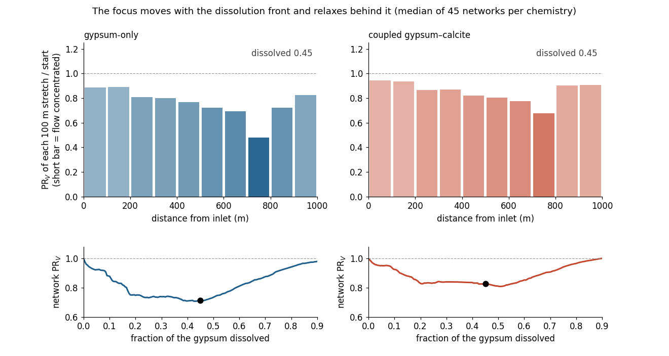
Watch the focus travel
10
Notes:
Animation: median of 45 networks per chemistry. Bars: PR_V of each 100 m stretch over its start. Watch the short bar travel from inlet to outlet while the stretches behind it grow back to 1.

Slide 11
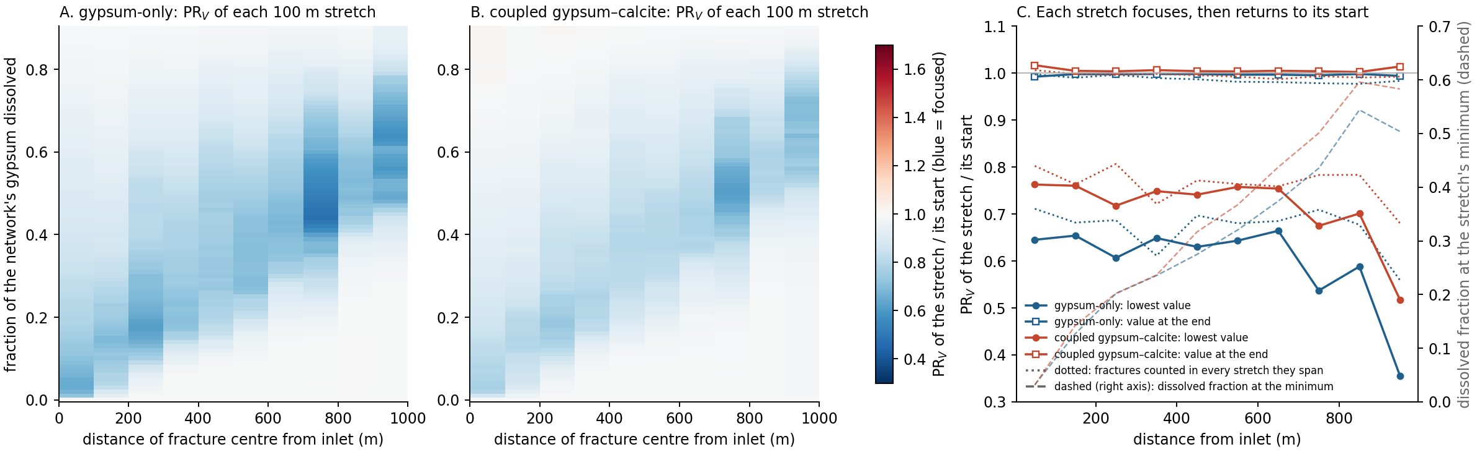
Focus moves inlet → outlet, then relaxes
0.03 → 0.50
0.36
< 2 %
dissolved fraction at each stretch's minimum, inlet → outlet
outlet stretch at its minimum: the strongest local focusing
every stretch ends this close to its start
11
Notes:
Figure 2. The dissolved fraction at each stretch's minimum rises from 0.03 at the inlet to 0.50 (gypsum-only) and 0.58 (coupled). Outlet stretch minimum 0.36 / 0.52 against 0.54-0.66 and 0.67-0.76 upstream. Every stretch ends within 0.8 % / 1.7 % of its start; with fractures counted in every stretch they span, within 2.3 % / 1.3 %. At high gain the front still moves; run A follows those runs to capacity time 8 (next slide).

Slide 12
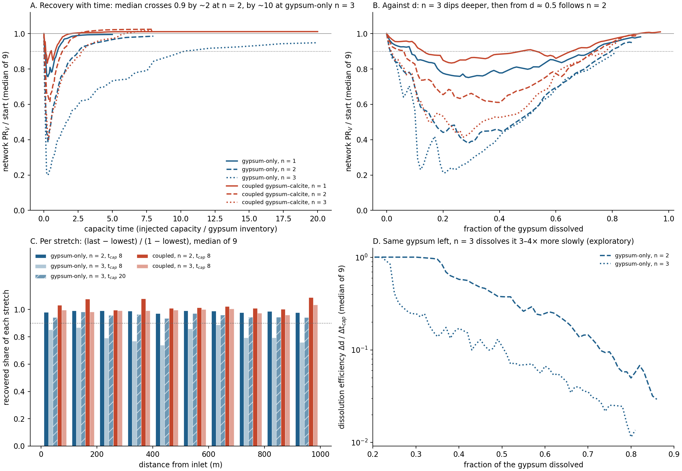
High-gain relaxation: paced by the gypsum left
0.95
median network PR_V / start at ×1000, capacity time 20 (×100: 0.99 by 8); 8 of 9 networks ≥ 0.9
≤ 0.03
gap between ×100 and ×1000 at the same dissolved fraction, d 0.5–0.81 (pre-set); deeper dip at ×1000 before
3–4×
slower dissolution at ×1000 with the same gypsum left, consistent with bypass (exploratory)
12
Notes:
Figure 5, runs A and A2. Run A continued n = 2 and 3 on the 9 sweep networks to capacity time 8: n = 2 (x100) completes, every stretch 97-99 % recovered, network PR_V 0.99 of its start; n = 3 (x1000) was at 0.84 and rising. Run A2 took gypsum-only n = 3 on to capacity time 20: in the median relaxation completes (every stretch median at least 0.935 recovered, network 0.95, 85 % of the gypsum gone; 8 of 9 networks at or above 0.9 but only 3 of 9 with every stretch, p4 seed 2 clearly not done); the median curve crosses 0.9 at capacity time 10.3, about four times later than n = 2 (2.5). n = 3 dips deeper at the same d below d 0.5 (the depth law); pre-set A2 rule 2: from d 0.5 to 0.81 n = 2 and n = 3 stay within 0.028 (thin margin), so from there recovery is paced by the gypsum left. Why x1000 needs more water: the locked bypass test at matched capacity time failed (confounded by the larger gypsum left); at matched dissolved fraction (exploratory, panel D) x1000 dissolves its remaining gypsum 3-4x more slowly (matched networks 3.4x at d 0.5 to 7.7x at d 0.8, coarse states) and its flow sees 5-8x less of it, on every network that reaches each d: consistent with bypass, correlational. Coupled runs relax fully at both n by capacity time 8.

Slide 13
What is new: relaxation behind the front
Dissolving wall rock (Hyman et al. 2026)
Finite soluble fill (this study)
a focusing front moves downstream
behind it, focusing persists
after breakthrough, channelization stops changing
the same moving front
behind it, each stretch returns to its start
after breakthrough, the network relaxes
Not the explanation: the width of the focused zone does not set when the whole network is most focused (pre-set test, ρ 0.27–0.50).
13
Notes:
What is new here. Hyman et al. (2026, Fig. 11) show a focusing front moving downstream in 3D DFN graphs, but there focusing behind the front persists because the soluble material is the wall rock itself, which keeps dissolving. Here the soluble fill runs out, so each stretch relaxes behind the front. The width of the focused zone does not predict when the whole network is most focused (pre-set test failed).

Slide 14
3 · Depth follows the attainable gain
The chemistry acts through how much more permeable a fracture can become

Slide 15
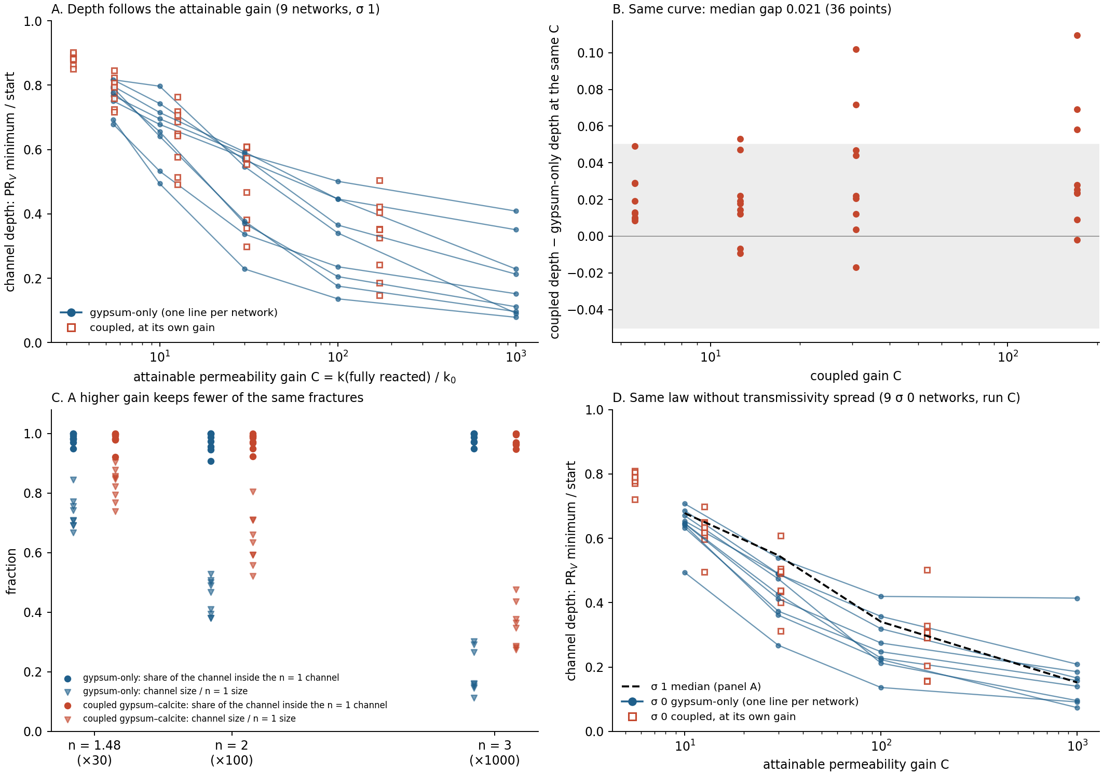
One depth law for both chemistries, at σ 1 and σ 0
0.78 → 0.15
median depth, ×5.5 → ×1000; falls on 9 of 9 networks at σ 1 and at σ 0
0.021
median gap, coupled vs gypsum-only at the same gain (σ 1, 36 points; σ 0: 0.029)
91–100 %
of the high-gain channel inside the n = 1 channel
15
Notes:
Figure 3. Depth falls with the attainable gain C on 9 of 9 networks: median 0.78 at x5.5, 0.68 at x10, 0.55 at x30, 0.34 at x100, 0.15 at x1000 (gypsum-only); about 0.25 per decade, flattening at high C. Coupled at its own C (x3.3 to x171) sits a median 0.021 from the gypsum-only curve at the same C (36 points; 6 beyond 0.05, all positive). Matched points compare different n at the same C and agree. 91-100 % of the high-n channel lies inside the n = 1 channel, which shrinks to 0.71 / 0.47 / 0.16 of its size at n = 1.48 / 2 / 3. Panel D, run C: the same 9 geometries without transmissivity spread (sigma 0). Depth falls with C on 9 of 9; coupled within a median 0.029 (27 points, median +0.027, passes the pre-set 0.03 narrowly; sigma 1 on the same laws 0.022); median depth 0.65 / 0.43 / 0.25 / 0.16 at x10 / x30 / x100 / x1000.

Slide 16
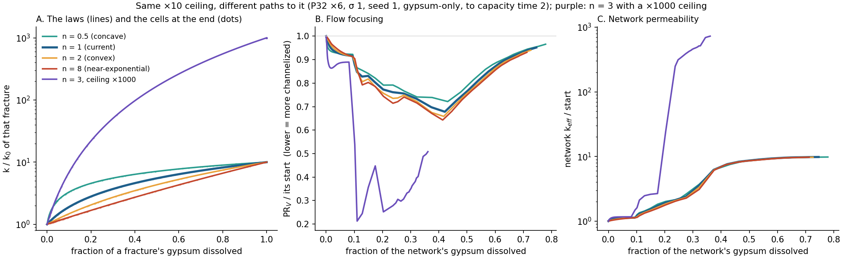
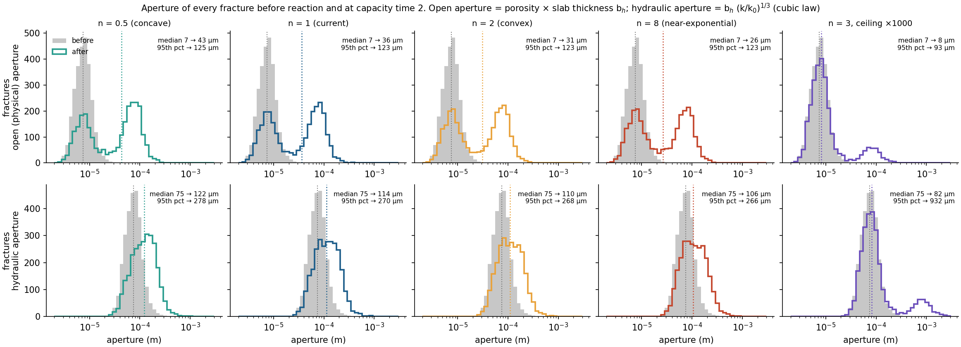
The gain matters, the shape barely
±0.04
depth spread from four law shapes at the same ×10 gain (one network)
0.47
depth change from ×10 to ×1000 on the same network
A higher gain also makes everything earlier: breakthrough at 0.65 → 0.27 of the gypsum dissolved (×5.5 → ×1000).
16
Notes:
Separating the gain from the shape. At a fixed x10 gain, four law shapes (n = 0.5, 1, 2, 8) give depth 0.72, 0.68, 0.66, 0.64 on one network; going to x1000 gives 0.21 on that network. Hydraulic aperture can grow at most x2.15 under any x10 law (median 75 to 106-122 um); with n = 3, 13 % of fractures open fully, top 5 % at 0.93 mm. The gain also moves events earlier: breakthrough 0.65 to 0.27 from x5.5 to x1000.

Slide 17
4 · Early arrival ranks breakthrough, roughly
Early tracer arrival through the unreacted network: a supporting result

Slide 18
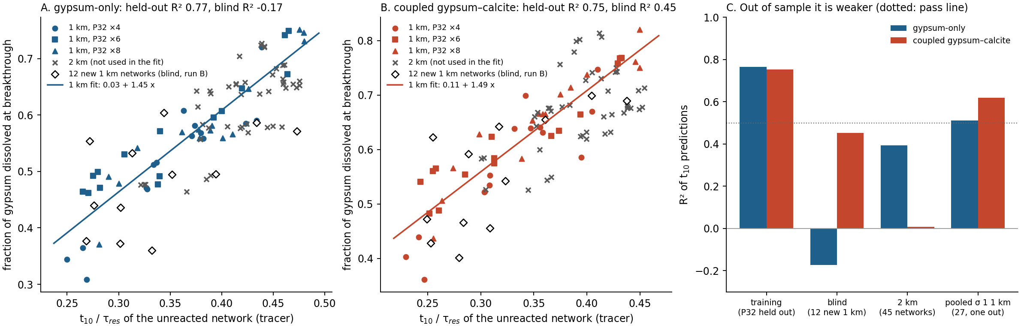
Early arrival ranks breakthrough; the blind test failed
ρ 0.76
R² 0.51
R² −0.17
rank correlation, all 27 σ 1 1 km networks (coupled 0.83)
one network left out at a time (coupled 0.62); training said 0.77
blind, 12 new networks, gypsum-only (coupled 0.45); pass was 0.5
18
Notes:
Figure 4. d_bt = 0.03 + 1.45 t10/tau (gypsum-only), 0.11 + 1.49 t10/tau (coupled). Held-out R2 0.77 / 0.75 with each P32 level left out, against 0.62 / 0.55 for the largest fracture's flow share (training). On 45 new 2 km networks it ranks weakly (rho 0.60 / 0.43). Run B, blind, 12 new 1 km networks against the frozen line: R2 -0.17 / 0.45, rho 0.51 / 0.72, bias -0.043 / -0.034, so the pre-set test failed for both chemistries. Not the sigma mix (sigma-1 in-sample R2 0.80 / 0.76); likely an optimistic training fit. All 27 sigma-1 1 km networks with one left out: R2 0.51 / 0.62, rho 0.76 / 0.83. Diagnosis (next slide): sampling luck around a moderate relation, not measurement, probe or structure; at 2 km the relation is shallower.

Slide 19
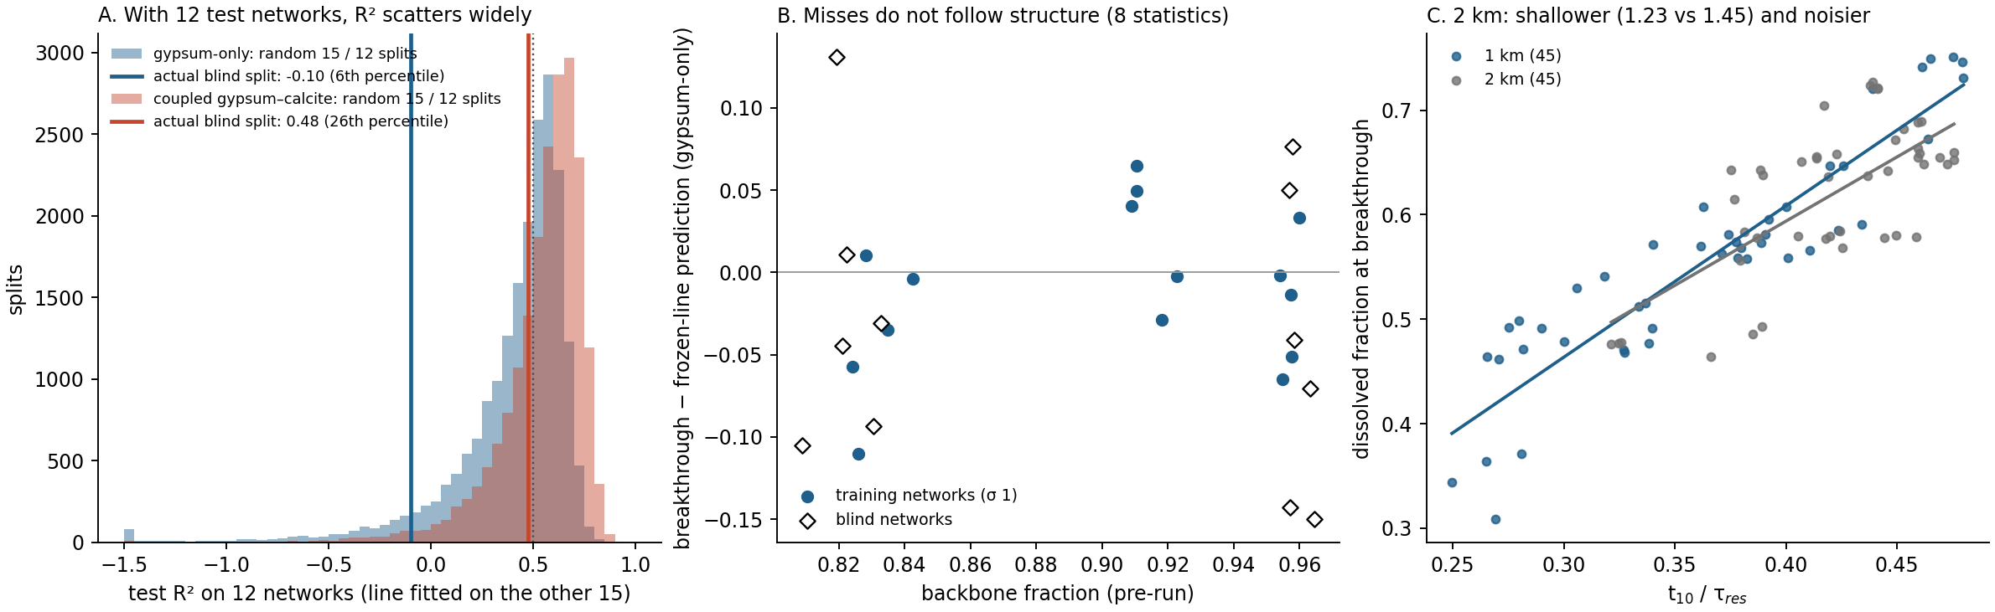
Why it missed: luck around a moderate relation
0.49
6th
|ρ| ≤ 0.16
median test R² over 20,000 random 15 / 12 splits (gypsum-only; coupled 0.60)
percentile of the actual blind split (coupled 26th)
misses against 8 pre-run network statistics: no structural cause
19
Notes:
Why the blind test missed (diagnosis after the result). Not the measurement: saved states 0.05-0.06 of the gypsum apart at breakthrough in every set, and interpolating breakthrough does not help (blind R2 0.04 / 0.45). Not the probe: recovery 0.998-0.999, same t10 spread. Not structure: 8 pre-run statistics, none correlates with the miss (|rho| <= 0.16). Random 15 / 12 splits of the 27 sigma-1 networks: median test R2 0.49 / 0.60, below 0.5 in 52 % / 30 % of splits; the actual split is at the 6th / 26th percentile. At 2 km the relation is shallower (slope 1.23 / 0.90 against 1.45 / 1.49) and noisier, which a narrower spread alone does not explain (expected R2 0.65).

Slide 20
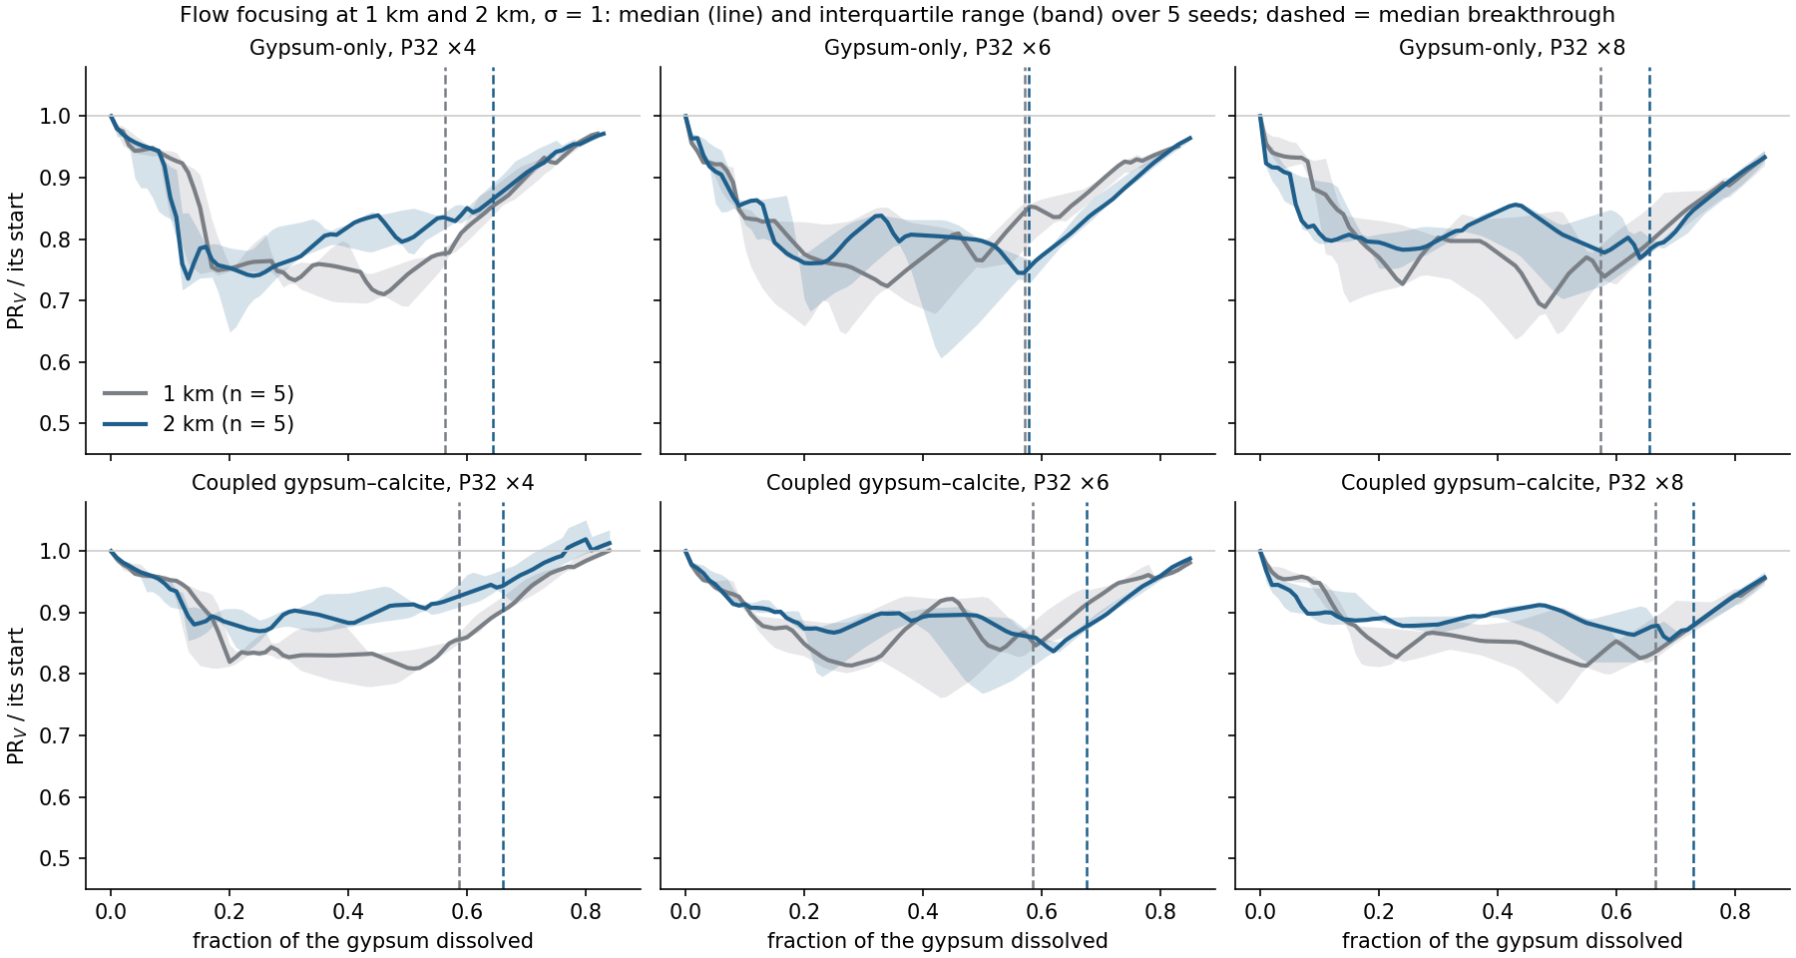
What holds, and what we dropped
2 km: same stages, inheritance 0.96–1.00
rate ×100 range: timing ≤ 0.003, depth ≤ 0.014
P32 ×16: same order in 27 of 30
spanning bins: focus still moves and relaxes
σ 0: depth law and chemistry match hold (run C)
dropped: the sparse 2 km early peak (gone at σ 0)
20
Notes:
Robustness. 2 km (90 runs): same dip and recovery, inheritance 0.96-1.00, breakthrough needs more gypsum dissolved (0.56 to 0.64). Rate 0.1-10 pore volumes per year: gypsum-only depth moves at most 0.001, event timing up to 0.046; coupled depth at most 0.019. P32 x16: same order in 27 of 30. Binning: the moving focus holds with spanning bins. Sigma 0: the depth law holds (run C). Dropped: an apparent early peak on sparse 2 km networks vanished at sigma 0.

Slide 21
New or known
Known, now at 1–2 km
Not found reported
channels follow the initial flow paths (Hyman et al. 2026)
a focusing front moves downstream (Hyman et al. 2026, Fig. 11)
calcite replacement limits the gain (Budek et al. 2026)
focus relaxes behind the front (finite fill)
four-stage sequence with flow–open-space decoupling in 3D networks
one depth law for both chemistries; narrowing inside the initial channel
early tracer arrival ranks breakthrough inventory (moderately)
reactive network runs at km scale with thousands of fractures
21
Notes:
What is known and what we did not find reported. A final literature check before submission is still to do.

Slide 22
Limits
1
Model. One cell per fracture: no in-fracture fronts, wormholes or throats; channels are, if anything, too shallow.
2
Law. The permeability law is unknown; part 3 turns it into the parameter C.
3
Inputs. FFM01 200–400 m geometry with the 0–200 m transmissivity law; P32 scaled to percolate across 1 km.
4
Statistics. σ variants share geometry: 15 independent networks per scale.
5
Tracer. Eulerian pulses with numerical dispersion: compare states, not with particle tracking.
22
Notes:
Limits: one cell per fracture (no in-fracture fronts, wormholes or throats; biases channels shallower); permeability law unknown (part 3 makes it a parameter); FFM01 inputs with the shallow transmissivity law; sigma variants share geometry.

Slide 23
Toward manuscripts
Paper 1
Paper 2
Paper 3
Transient reactive channels in finite-fill fracture networks
Channel depth is set by the attainable permeability gain
BiGraFV at kilometre scale
stages · moving focus and relaxation · depth law · late-time relaxation
optional, now supported: σ 0 and late-time runs extend Figure 3
later: the method, its checks and the parked DFN comparison
23
Notes:
Manuscripts. Paper 1: the dynamics, four figures plus late-time relaxation; early arrival as a supporting result. Paper 2 (optional): the depth law, now extended by runs A and C. Paper 3 (later): BiGraFV at kilometre scale, the method and its checks.

Slide 24
Gap-filling runs: what passed and what did not
A
Does relaxation complete at high gain?
×100: complete (0.99). ×1000: 0.84 by 8; A2 to 20: complete in the median (0.95), paced from d 0.5
n = 2, 3 · 9 networks · to capacity time 8 (A2: n = 3 to 20) · 45 runs
B
Does the predictor hold on unseen networks?
failed: R² −0.17 / 0.45, ρ 0.51 / 0.72 (pass 0.5 / 0.7)
12 new 1 km networks · start-of-run tracer · 24 runs
C
Is the depth law specific to σ 1?
passed: falls on 9 of 9; chemistry gap 0.029
n = 1.48, 2, 3 · 9 σ-0 networks · 54 runs
24
Notes:
Gap-filling runs, 123 runs (A-C 7 Nov 11:18-22:39; A2 8 Nov 09:30-19:14), rules fixed before the runs (gapfill/GAPFILL.md). A: n = 2 met, n = 3 not met by capacity time 8. A2: n = 3 completes by 20 and is paced by the gypsum left (both passed); the locked bypass test was not supported (confounded), supported at matched d (exploratory). B: failed for both chemistries. C: passed (0.029).

Slide 25
Take-home
4 stages
travels
0.78 → 0.15
one order in 87 of 90 runs: decouple, recouple, focus and break through, relax
the focus moves with the front and relaxes behind it, because the soluble fill runs out
channel depth set by the attainable permeability gain, one curve for both chemistries and both σ
Report: Reactive Channels at Kilometre Scale (claude.ai artifact) · code and data: github.com/cr-sutton/BiGraFV_reactive_channelization
Notes:
Take-home: one order of stages; the focus travels and relaxes because the fill runs out, at a pace set by the gypsum left; depth is set by the attainable gain. Early tracer arrival only ranks breakthrough roughly (blind test failed).

