Slide 1

APANPS 5210 Python for Data Analysis
Presentation Assignment
Aadhar Kaul (ak4937)
Catalina Riquelme (cr3298)
Pablo Vargas (pm3179)
Rishika Todi (rt2866)
Rohit Shivthare (rs4369)

Slide 2

Data Analysis
Content
Problem approach
Matching Algorithm
Analysis of the results
Summary

Slide 3
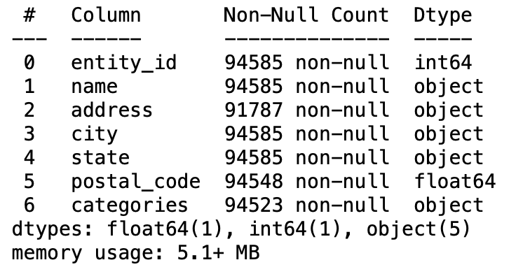
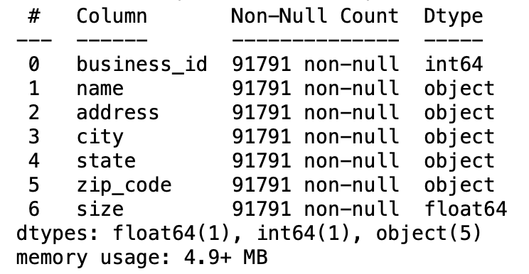
Basic
information
Data Analysis
Left dataset
Right dataset
Problem Approach
The Research Question
Matching
Algorithm
Analysis of the Results
Summary

Slide 4
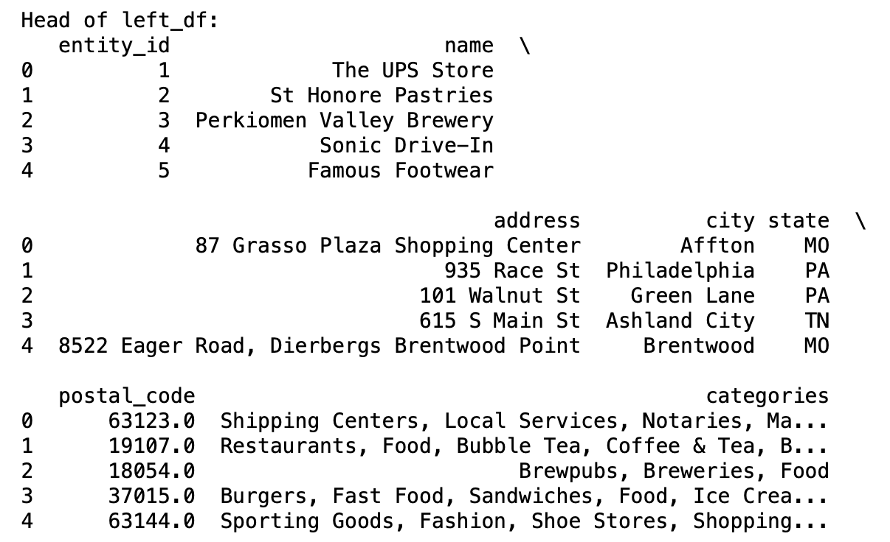
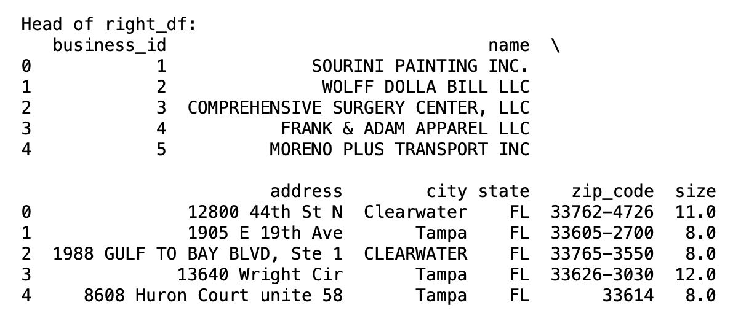
Basic
information
Data Analysis
Left dataset
Right dataset
Problem Approach
The Research Question
Matching
Algorithm
Analysis of the Results
Summary

Slide 5
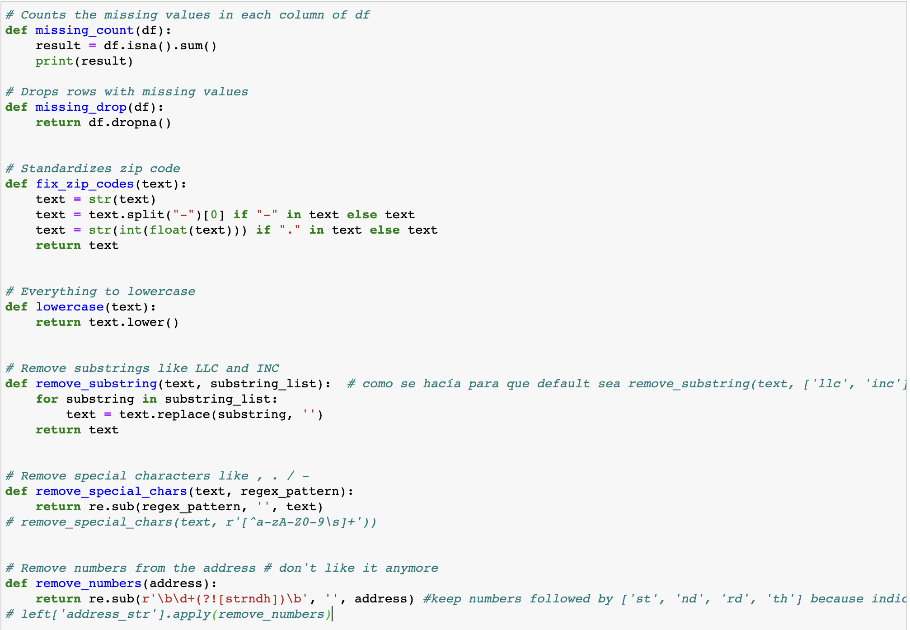
Basic
information
Data Analysis
Data Pre-processing
Checking the missing value count and then dropping.
Replacing NAN values with “ ”
Standardizing the Zip Code
Removing any special character
Converting all values to lowercase
Problem Approach
The Research Question
Matching
Algorithm
Analysis of the Results
Summary

Slide 6
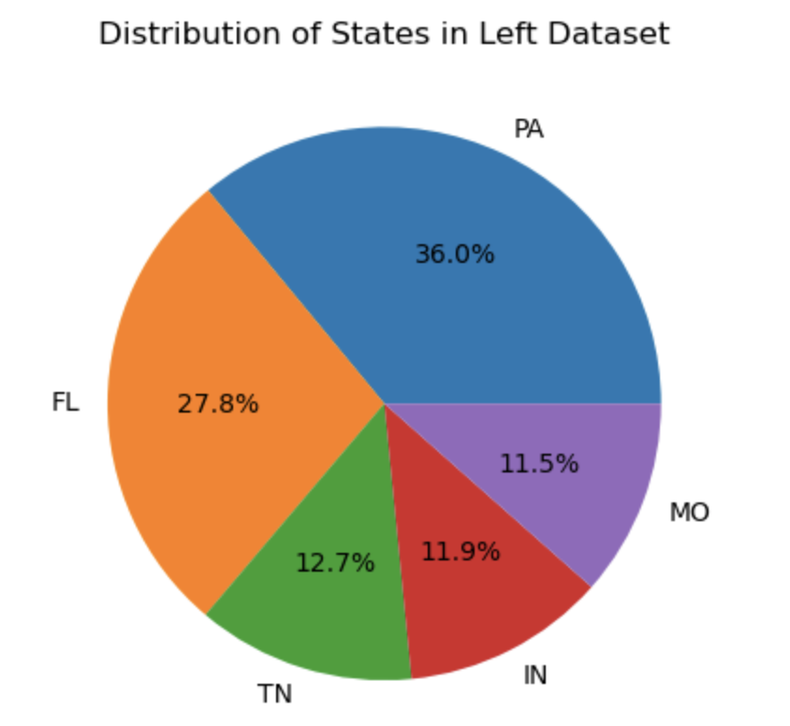
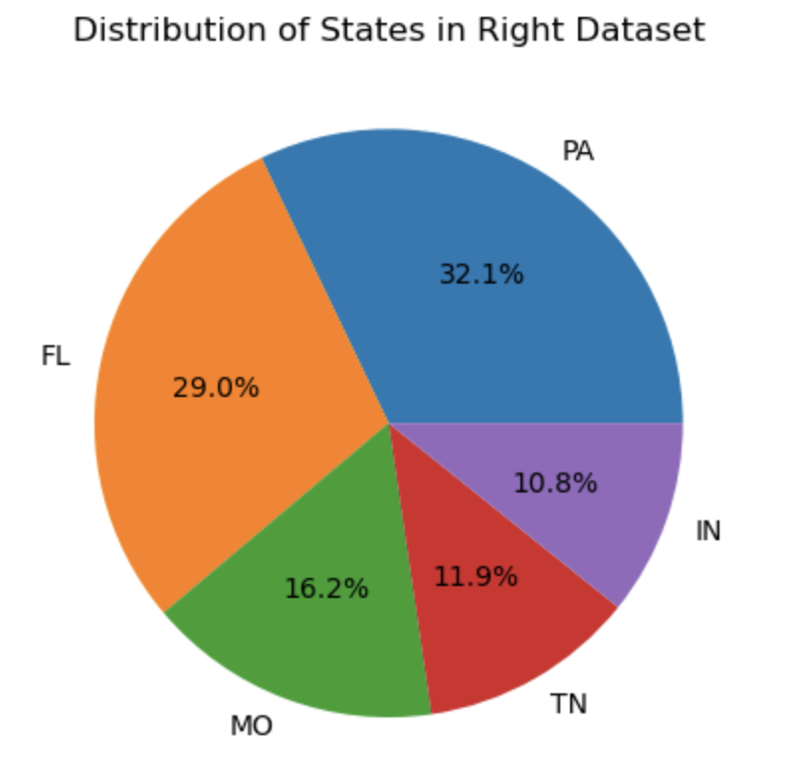
Data
Visualization
Data Analysis
Left dataset
Right dataset
Problem Approach
The Research Question
Matching
Algorithm
Analysis of the Results
Summary

Slide 7
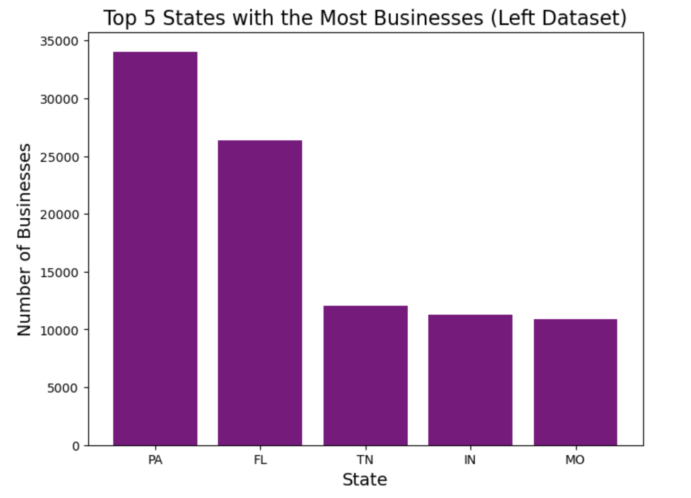
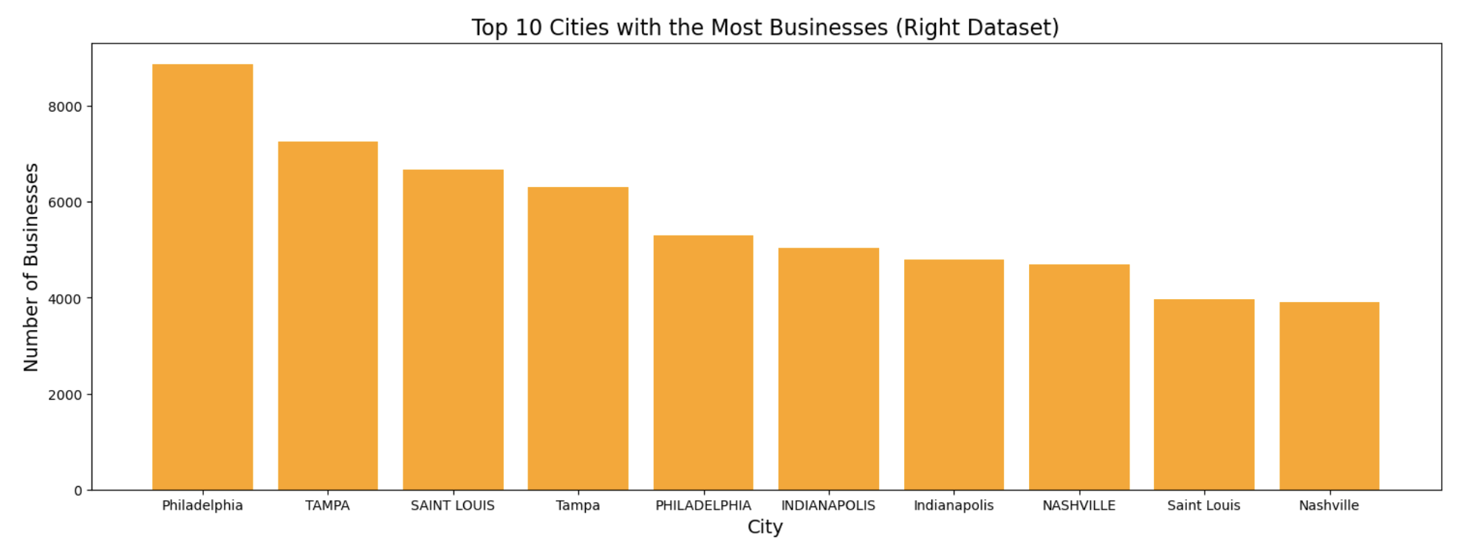
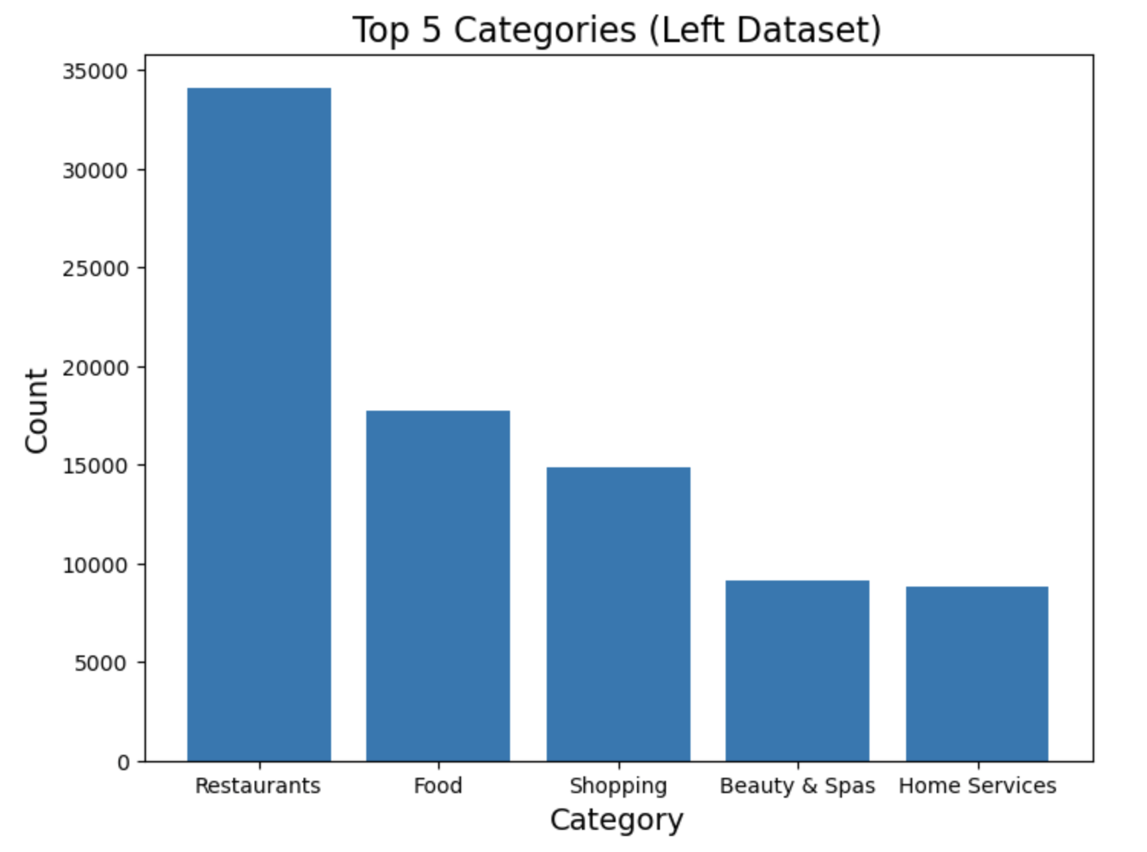
Data
Visualization
Data Analysis
Left dataset
Right dataset
Problem Approach
The Research Question
Matching
Algorithm
Analysis of the Results
Summary

Slide 8
Data Analysis
Content
Problem approach
Matching Algorithm
Analysis of the results
Summary

Slide 9
Main
Problems
Data Analysis
"Fuzzywuzzy” library
process.extractOne()
This Python library provides a simple and easy-to-use set of functions for fuzzy string matching.
It uses Levenshtein distance algorithm to calculate the similarity between two strings.
Time : 12 hours (But still didn’t iterate through all the records, and hence we tried a different matching Algorithm)
Problem Approach
Matching
Algorithm
Analysis of the Results
Summary

Slide 10
Data Analysis
Content
Problem approach
Matching Algorithm
Analysis of the results
Summary

Slide 11
JACCARD ALGORITHM
Data Analysis
Data Pre-Process before running algorithm:
Formatted the business name column in the right dataset using title function
(to make the first letter of every word uppercase and rest lowercase to match with the name
in left dataset).
Create a new column in Dataset B called 'new_key_attr', and assign a range of integers
from 0 to the length of B to this column which creates a unique identifier in dataset B during the
join operation
Libraries used:
py_stringsimjoin
py_stringmatching
sklearn
Function:
jaccard_join()
Problem Approach
Matching
Algorithm
Analysis of the Results
Summary

Slide 12
JACCARD ALGORITHM
Data Analysis
Jaccard similarity is a measure of similarity between two sets. It is defined as the size of the
intersection divided by the size of the union of two sets. In Python, Jaccard similarity can be
calculated using the "jaccard_similarity_score" function in the "sklearn" library.
Time : 12 seconds
Problem Approach
The Jaccard similarity threshold is set to 0.8.
Name Matches : 1914
Address Matches: 14147
Total number of matched records for both address and name : 16061
Matching
Algorithm
Analysis of the Results
Summary

Slide 13
Data Analysis
Content
Problem approach
Matching Algorithm
Analysis of the results
Summary

Slide 14
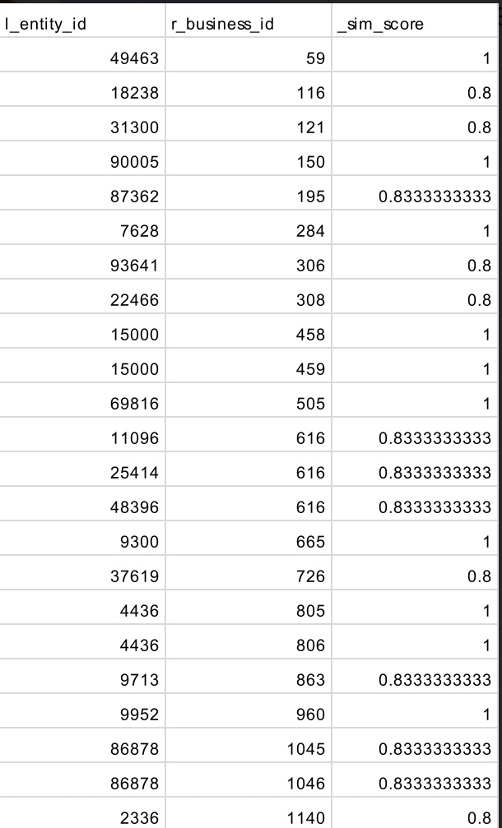
Similarity
Score
Data Analysis
The Jaccard similarity threshold refers to the minimum value or level of similarity that two sets must have in order to be considered similar or related, based on the Jaccard similarity score.
The resulting score is a value between 0 and 1, where 0 means the sets have no common elements, and 1 means the sets are identical.
Problem Approach
Matching
Algorithm
In our dataset, the majority of the data is greater than the set similarity score of 0.8
Analysis of the Results
Summary

Slide 15
Data Analysis
Content
Problem approach
Matching Algorithm
Analysis of the results
Summary

Slide 16
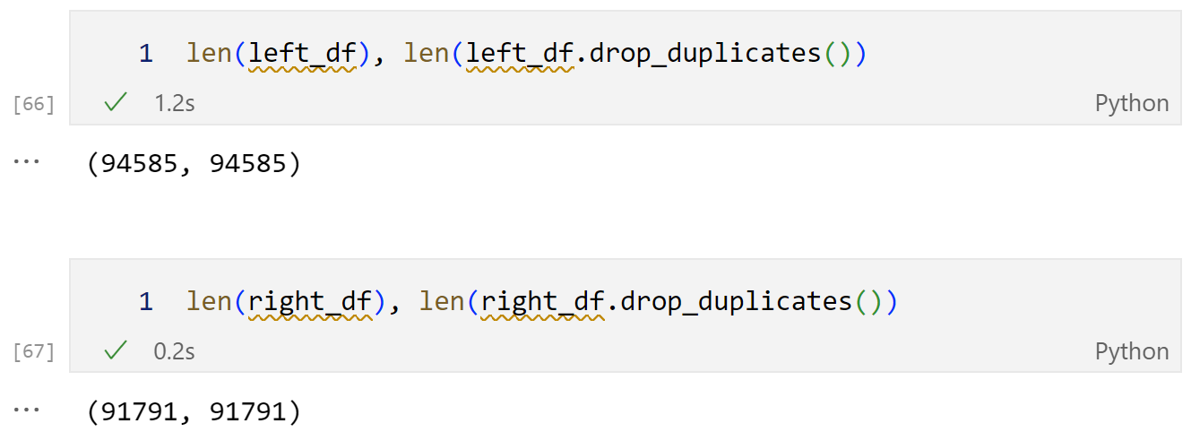
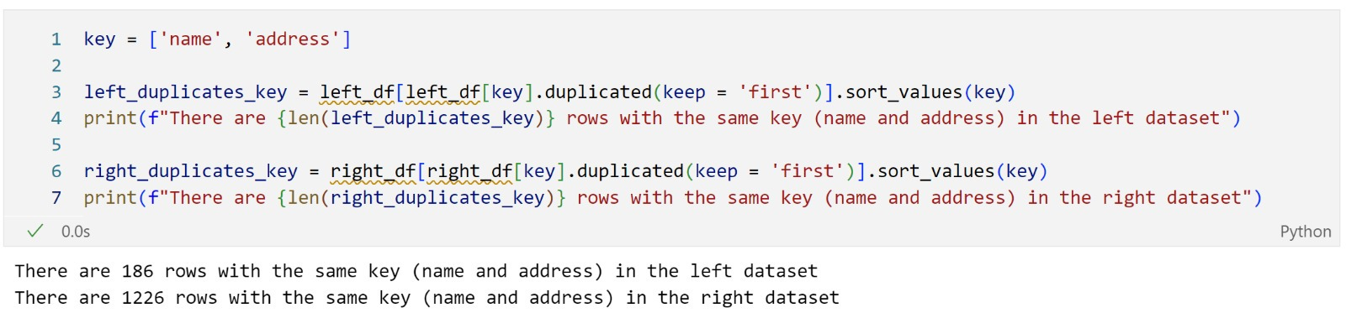
Important
Lessons
Data Analysis
We may have overestimated the number of matches
Because of duplicates in the key
Although there are no row duplicates
Later on, we realized that the keys we used to merge left and right datasets were duplicated
Additional data preparation is required to avoid matching
n rows in the left with n rows in the right dataset
Problem Approach
Matching
Algorithm
Analysis of the Results
Summary

Slide 17
GitHub URLs
https://github.com/cr3298
https://github.com/R-Todi/Python-Final-Project
https://github.com/Pablofmv/Columbia2023
https://github.com/aadharkaul/columbia2023.git
https://github.com/RohitDS1/Python-for-Data-Analysis-Project

