Slide 2
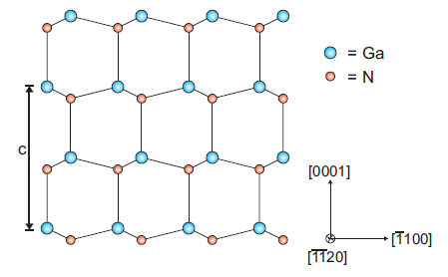

Slide 3
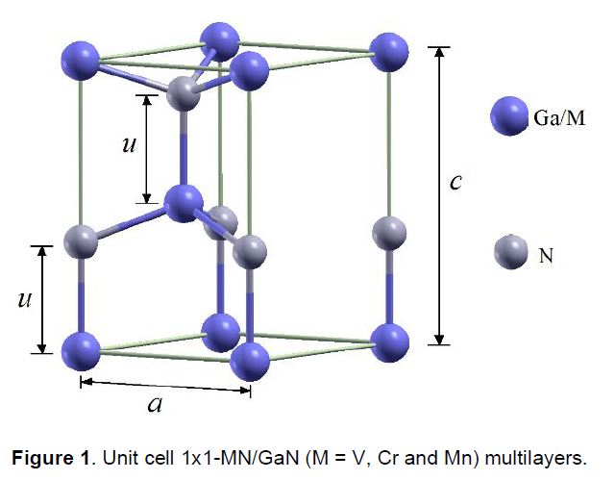
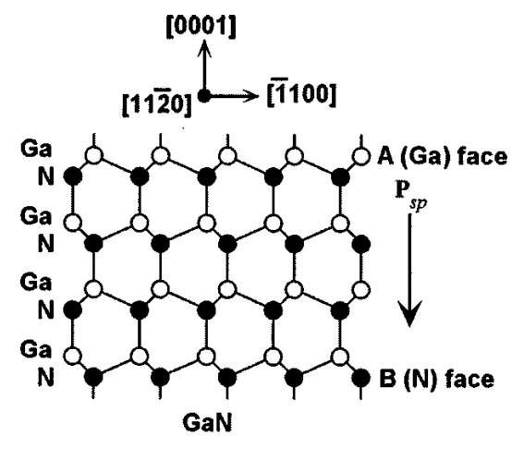
c₀
a₀

Slide 4
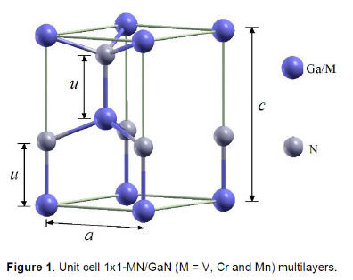

Slide 6
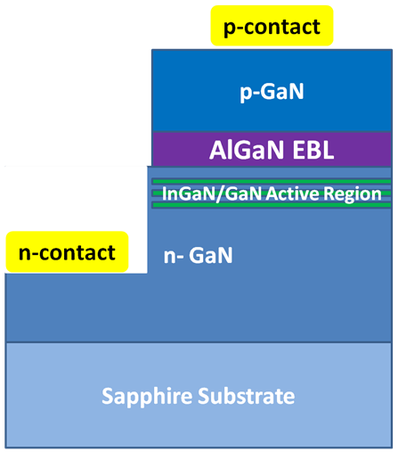

Slide 7
Intensity
FSR
δν₀
ν₀
Frequency ν

Slide 10
R_{min}
R
θ_{c}

Slide 11
Four Quadrant Photodetector
Laser
Cantilever
Sample

Slide 12
Optic Axis
C1 lens (spot size)
C2 lens (intensity) + aperture
Specimen

Slide 13
Incident Beam
Backscattered Electrons
Thin Sample
High-angle (Rutherford) scattering
Bragg-scattering
Direct Beam

Slide 14
Incident Beam
Cathodoluminescence
Secondary Electrons
Electron-hole pairs
Phonons + Plasmons
Characteristic X-rays
Brehmsstrahlung X-rays
Inelastic scattering

Slide 15
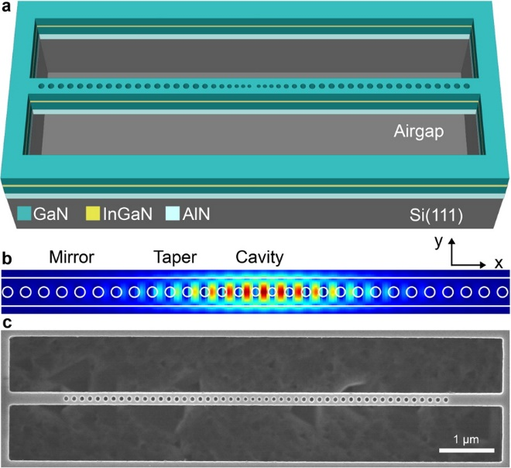

Slide 16
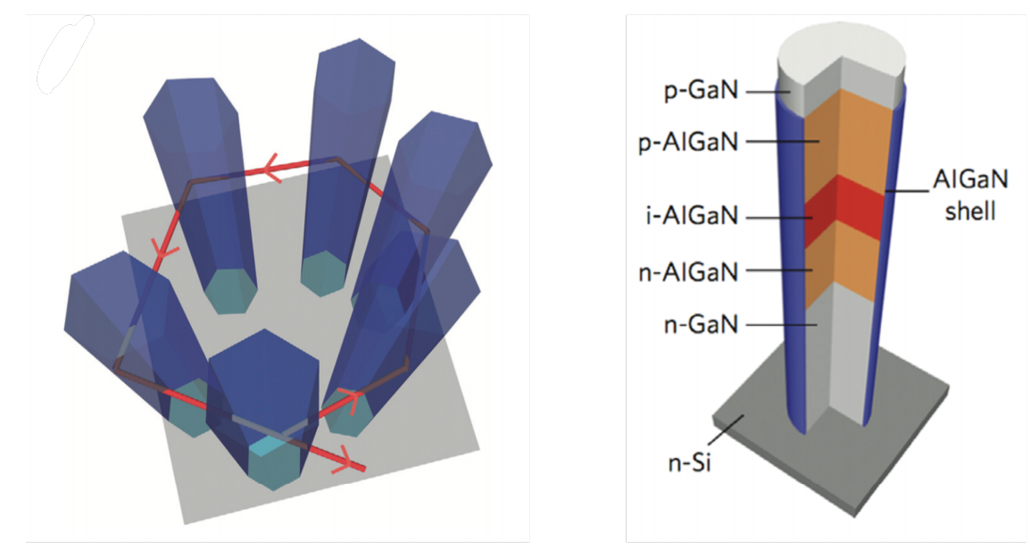
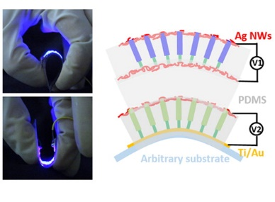

Slide 17
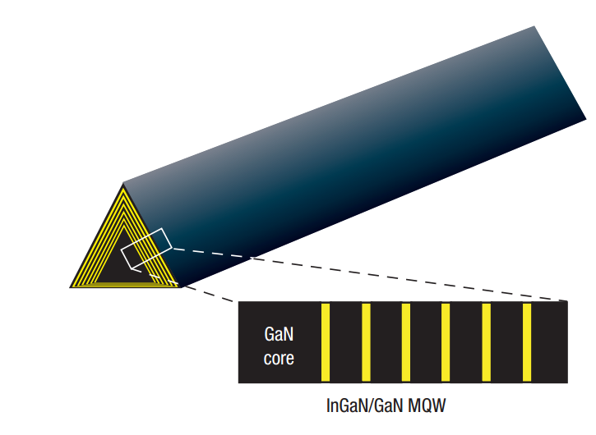

Slide 18
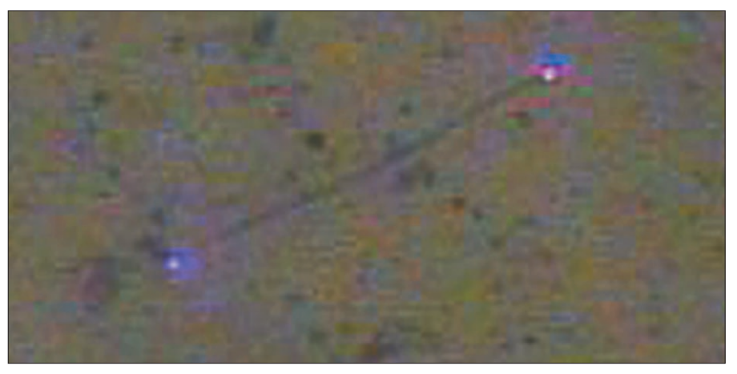

Slide 19
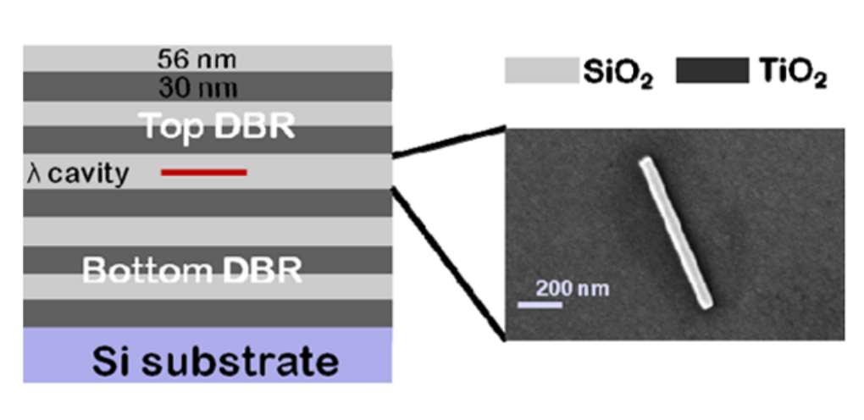

Slide 20
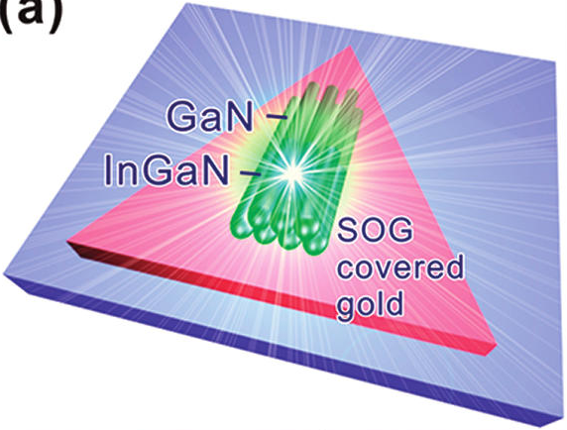
a)
b)
c)
d)

Slide 21
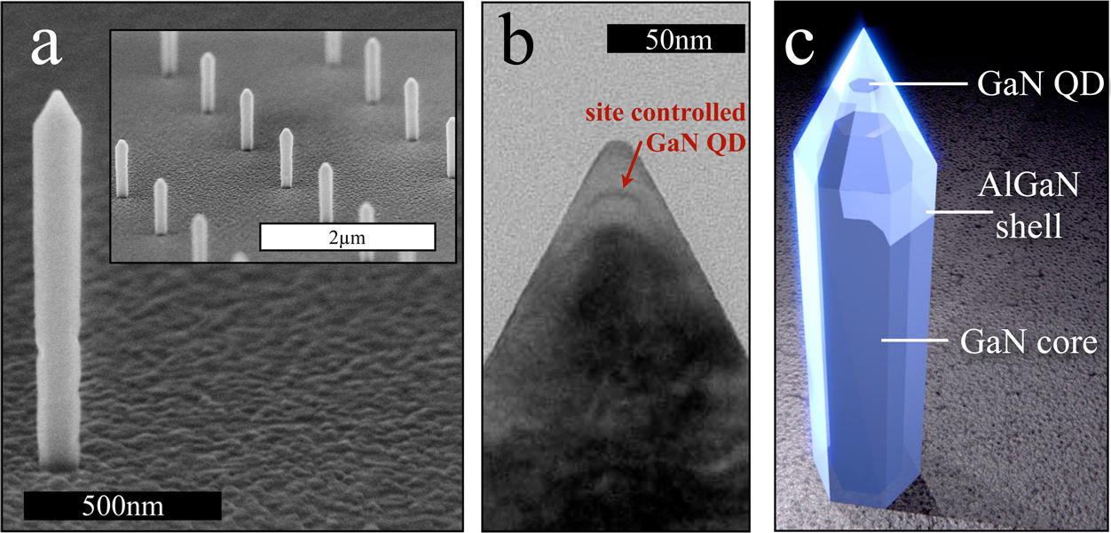

Slide 22
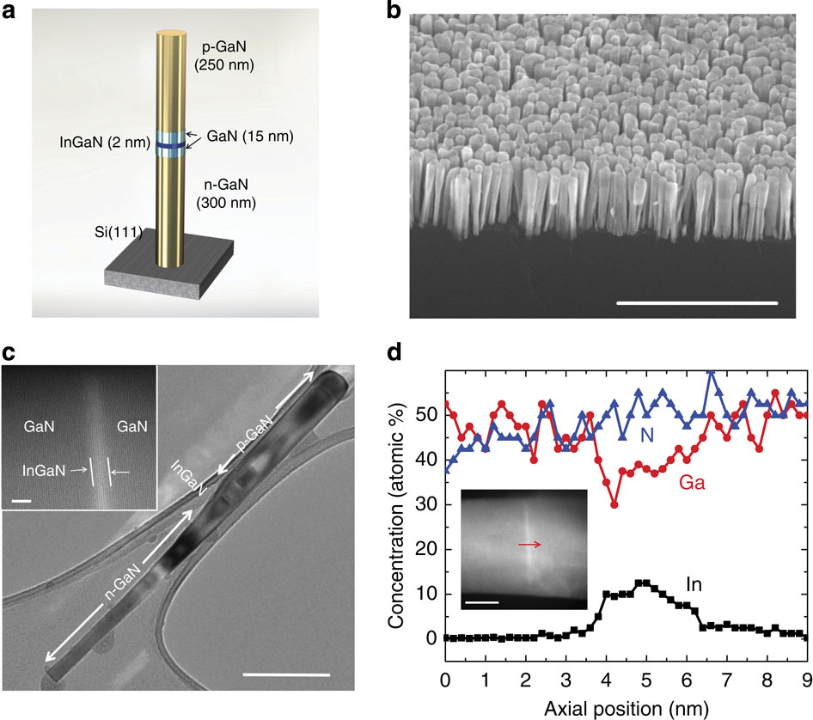

Slide 23
InGaN Growth
GaN Growth
Temperature
Time

Slide 24

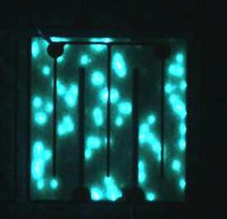
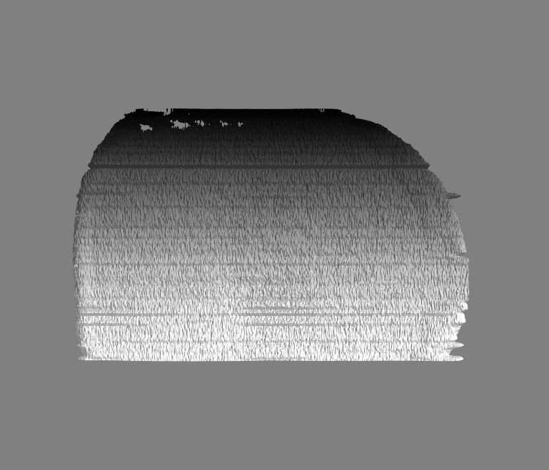
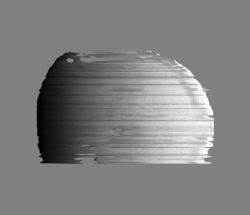

Slide 25
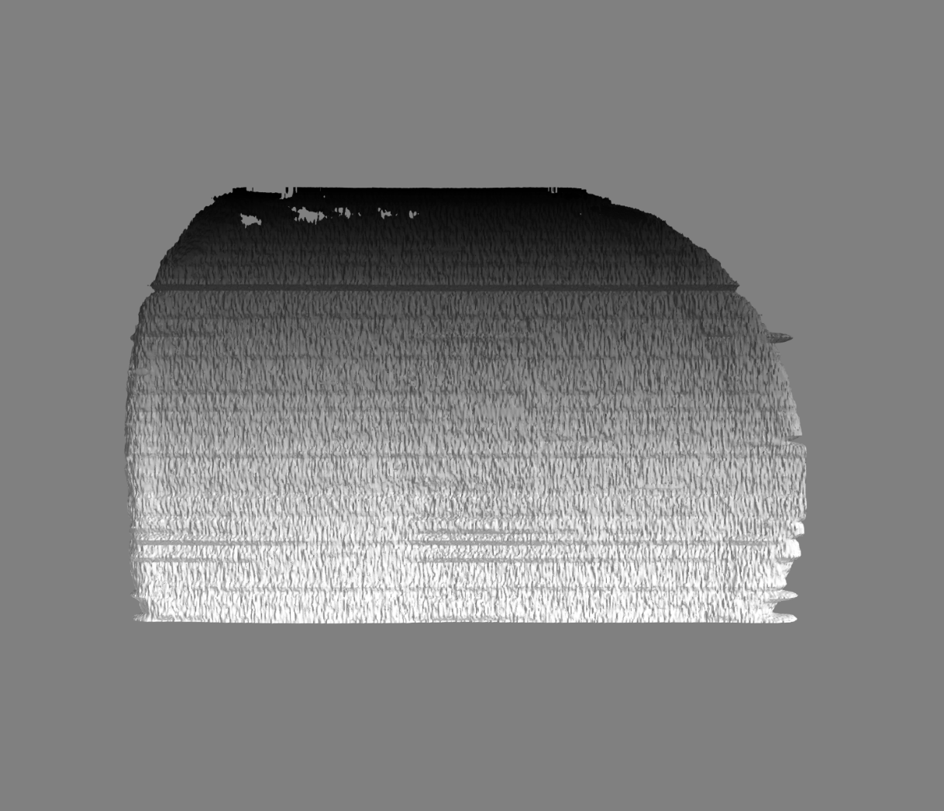

Slide 26
‘Flat’ area vector (F)
Mesh triangle area vector (N)
φ
Flat Surface

Slide 27
N
(x₁,y₁,z₁)
B
A
(x₃,y₃,z₃)
(x₂,y₂,z₂)

Slide 28
GaN
Dry etch
PEC etch
SSL
SSL
GaN
GaN
GaN

