Slide 2




40 nm
60 nm
80 nm
100 nm

Slide 3



1 µm
0 degrees
40 degrees
80 degrees

Slide 4

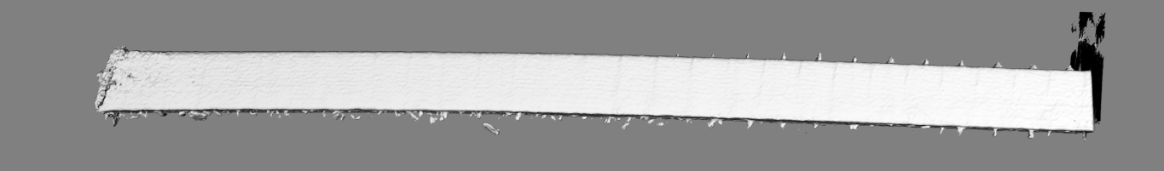
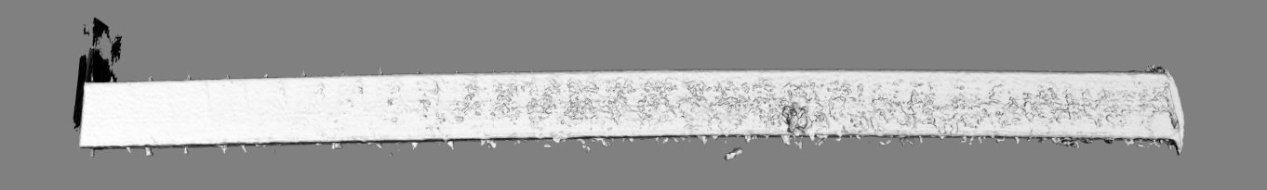
a)
b)

Slide 5
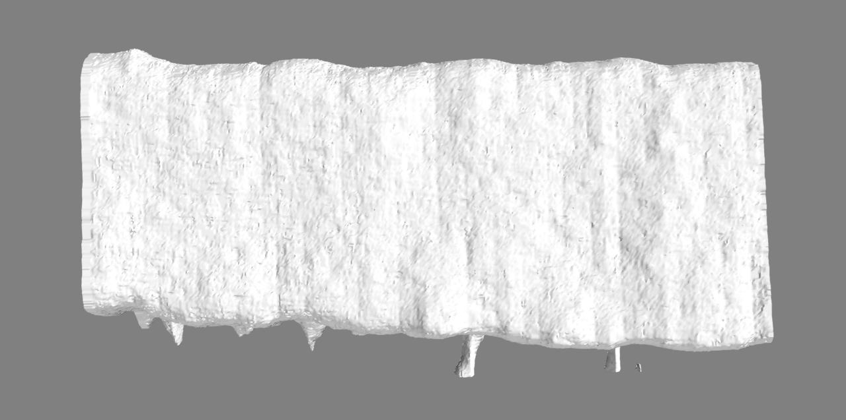
Corrugation
Stacking shift

Slide 6
Corrugation
Stacking shift

Slide 7
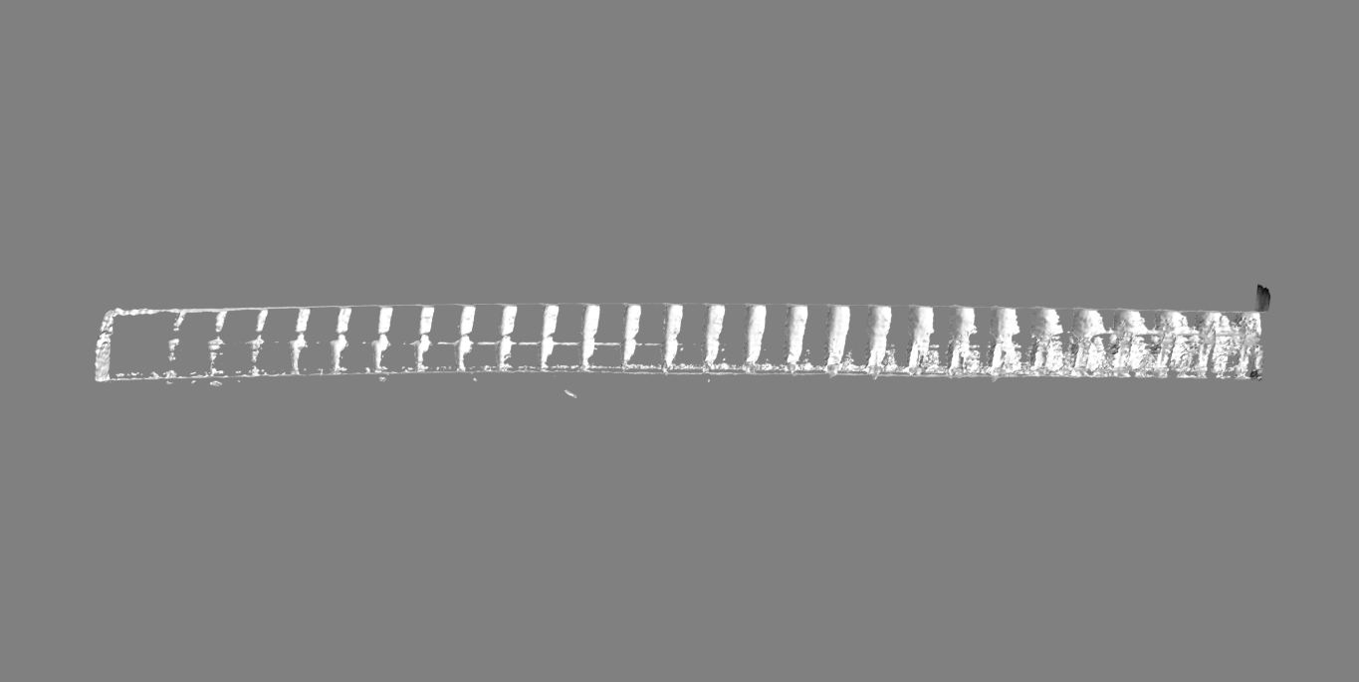

Slide 8
