Slide 2
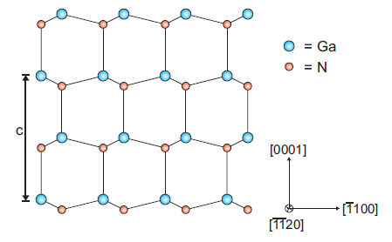

Slide 3
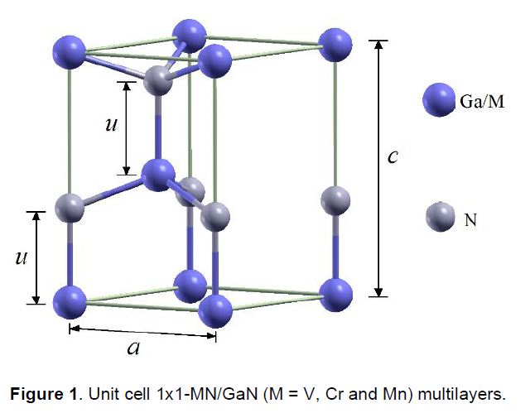
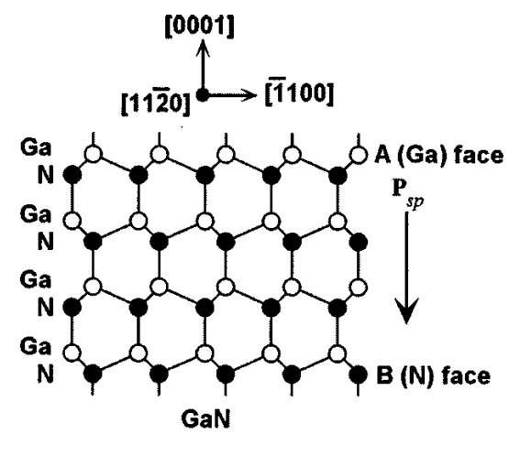
c₀
a₀

Slide 4
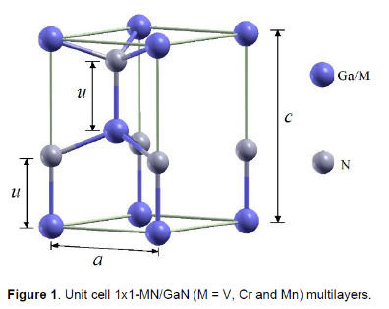

Slide 6
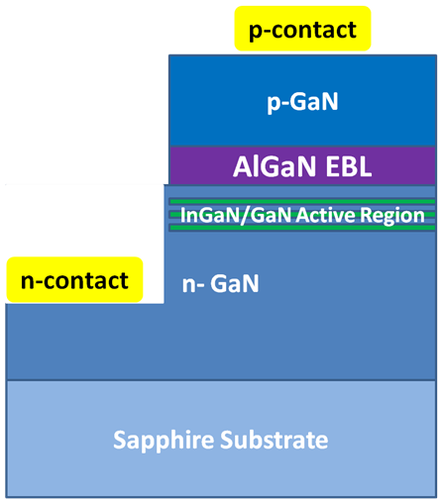

Slide 7
Intensity
FSR
δν₀
ν₀
Frequency ν

Slide 10
R_{min}
R
θ_{c}

Slide 11
Four Quadrant Photodetector
Laser
Cantilever
Sample

Slide 12
Optic Axis
C1 lens (spot size)
C2 lens (intensity) + aperture
Specimen

Slide 13
Incident Beam
Backscattered Electrons
Thin Sample
High-angle (Rutherford) scattering
Bragg-scattering
Direct Beam

Slide 14
Incident Beam
Cathodoluminescence
Secondary Electrons
Electron-hole pairs
Phonons + Plasmons
Characteristic X-rays
Brehmsstrahlung X-rays

Slide 15
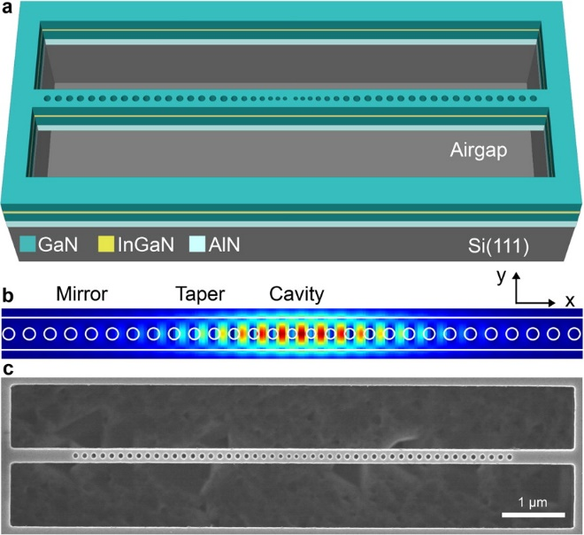

Slide 16
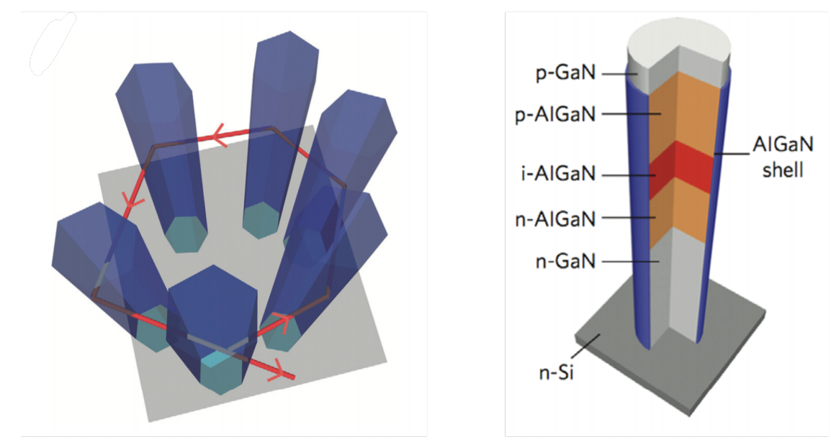
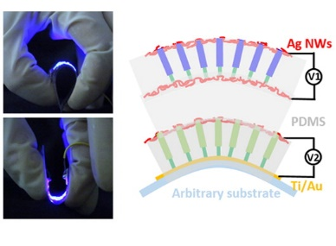

Slide 17
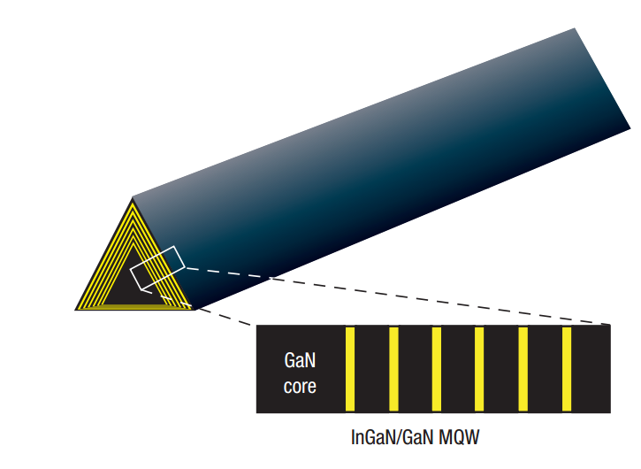

Slide 18
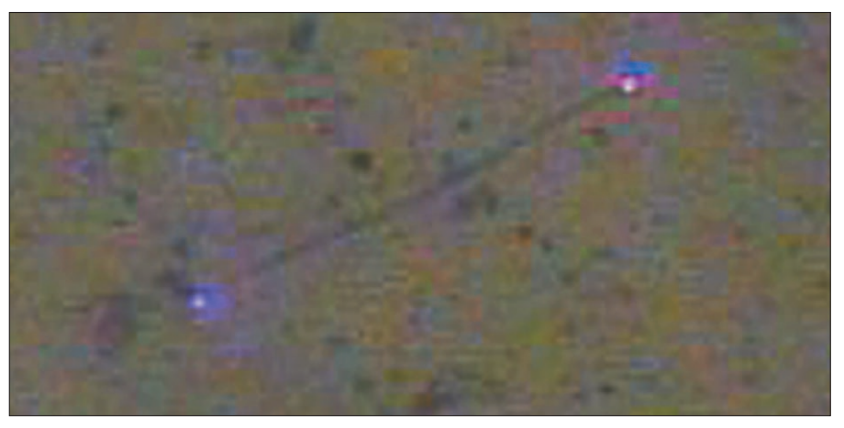

Slide 19
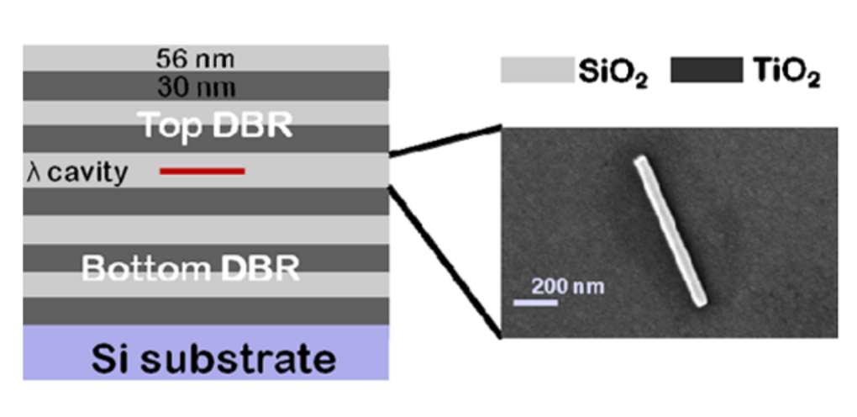

Slide 20
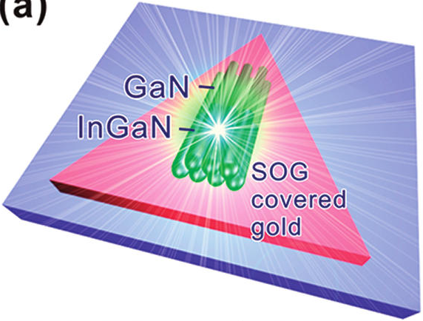
a)
b)
c)
d)

Slide 21
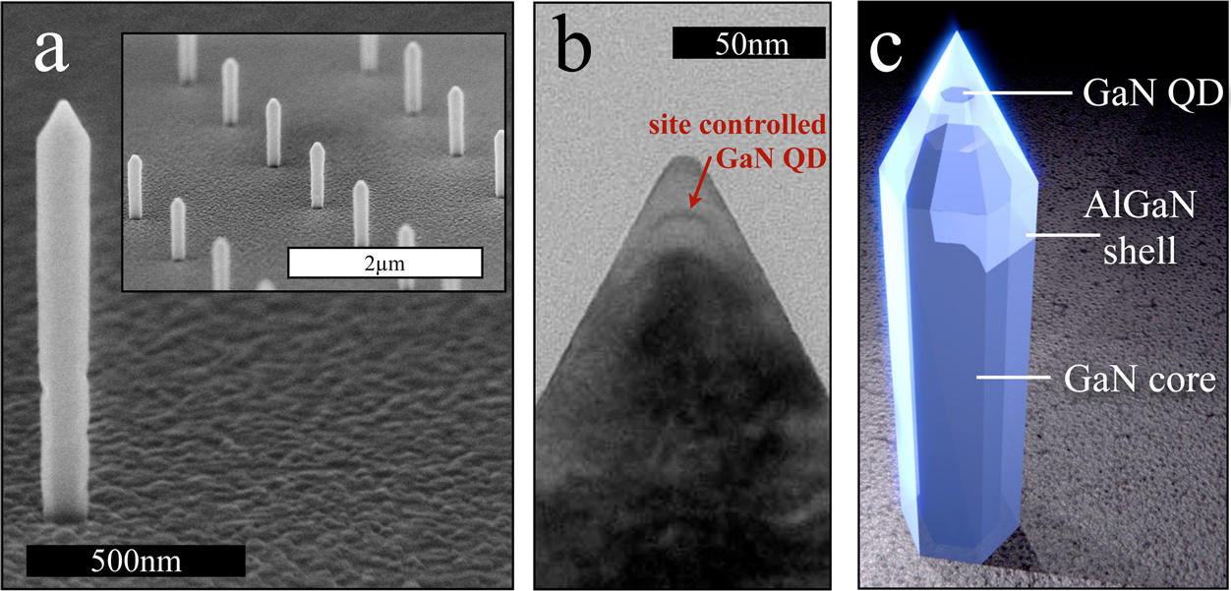

Slide 22
