Slide 2
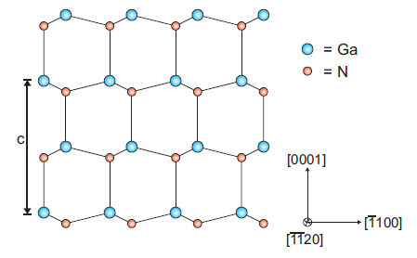

Slide 3
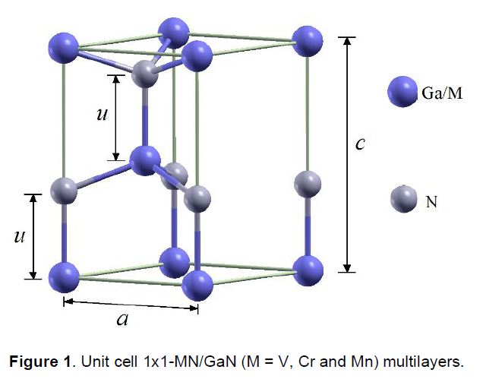
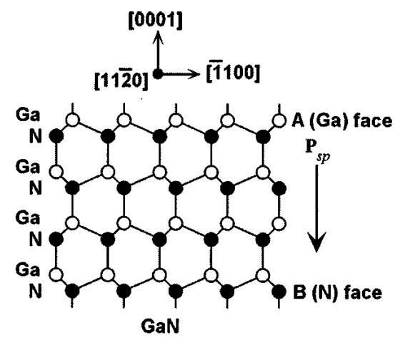
c₀
a₀

Slide 4
p-GaN (117 nm)
AlGaN EBL (20 nm)
InGaN QWs
n-GaN (3 μm)
UiD GaN (2 μm)
Sapphire Substrate

