Slide 1
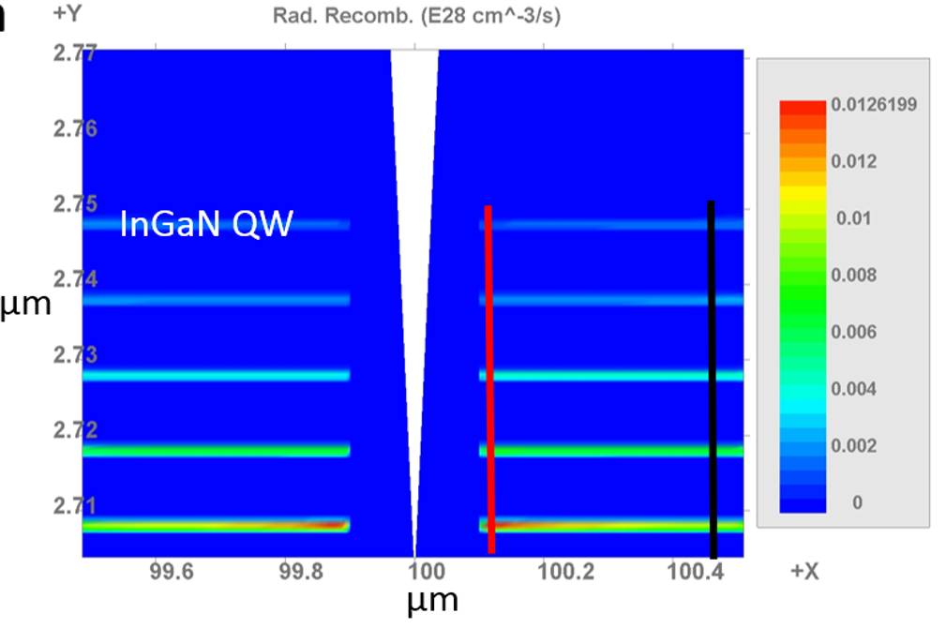

Slide 3
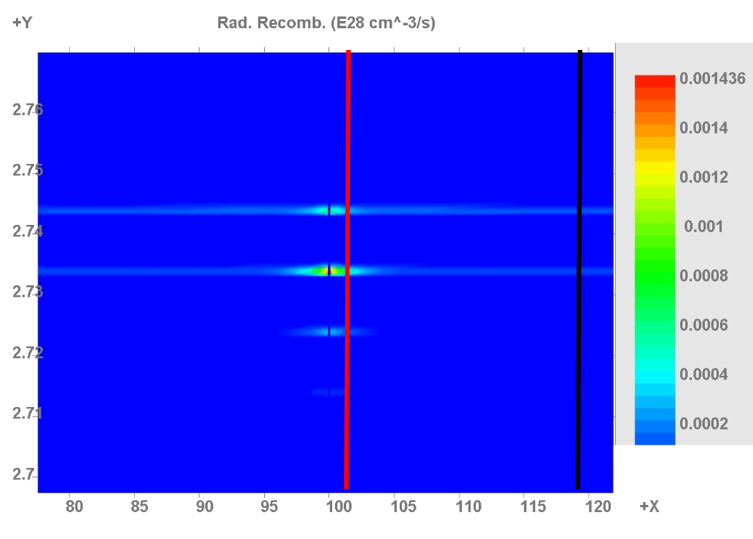
(×10²⁸ cm⁻³ s⁻¹)
Radiative Recombination Events
2.76
2.75
2.74
2.73
2.72
2.71
2.70
Shallow AlGaN inclusion
Profile taken ‘close’ to inclusion
QW1
QW2
Y (µm)
QW3
Profile taken ‘far’ from inclusion
QW4
QW5
80 85 90 95 100 105 110 115 120
X (µm)

Slide 4
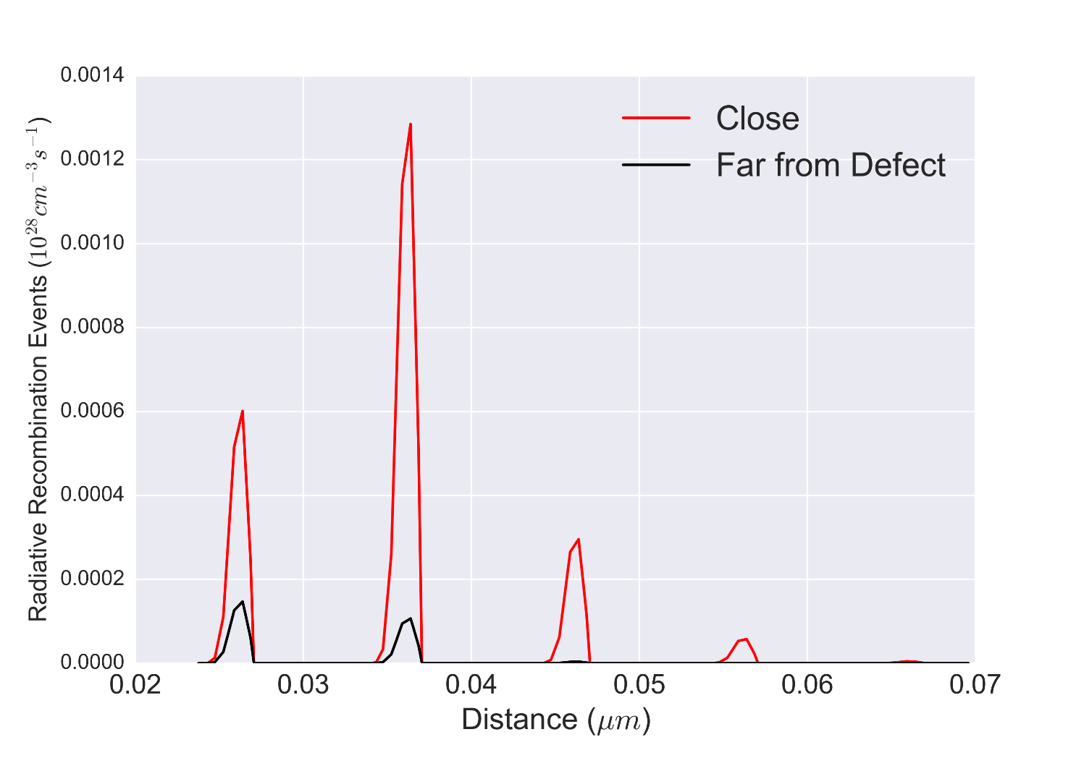
QW2
QW1
QW3
QW4
QW5

Slide 5
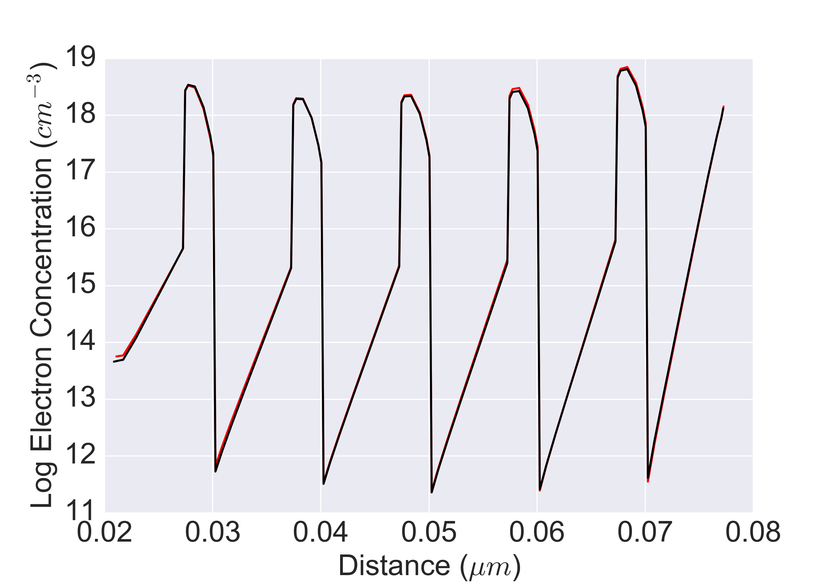
QW1
QW2
QW3
QW4
QW5

Slide 6
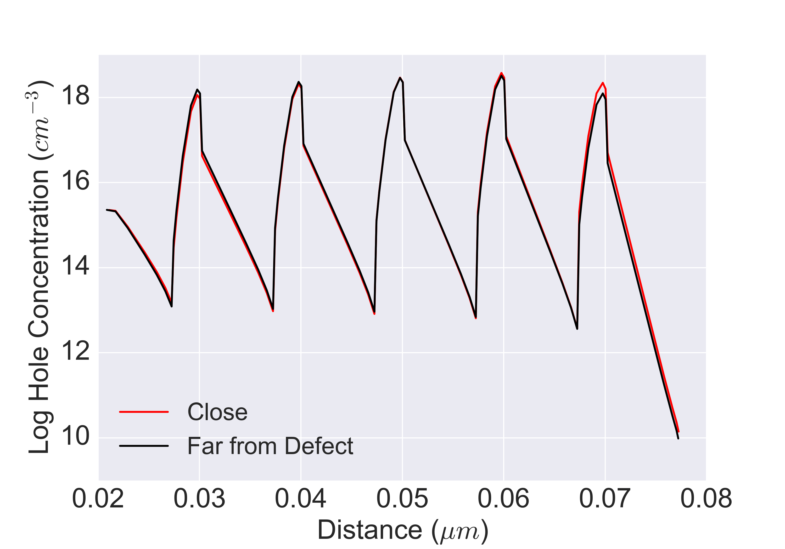
QW1
QW2
QW3
QW4
QW5

Slide 7
(×10²⁸ cm⁻³ s⁻¹)
Radiative Recombination Events
2.76
2.75
2.74
2.73
2.72
2.71
2.70
Profile taken ‘far’ from inclusion
Profile taken ‘close’ to inclusion
Hexagonal pit
1
Y (µm)
QW2
QW3
QW4
QW5
99.6 99.8 100 100.2 100.4
X (µm)

Slide 8
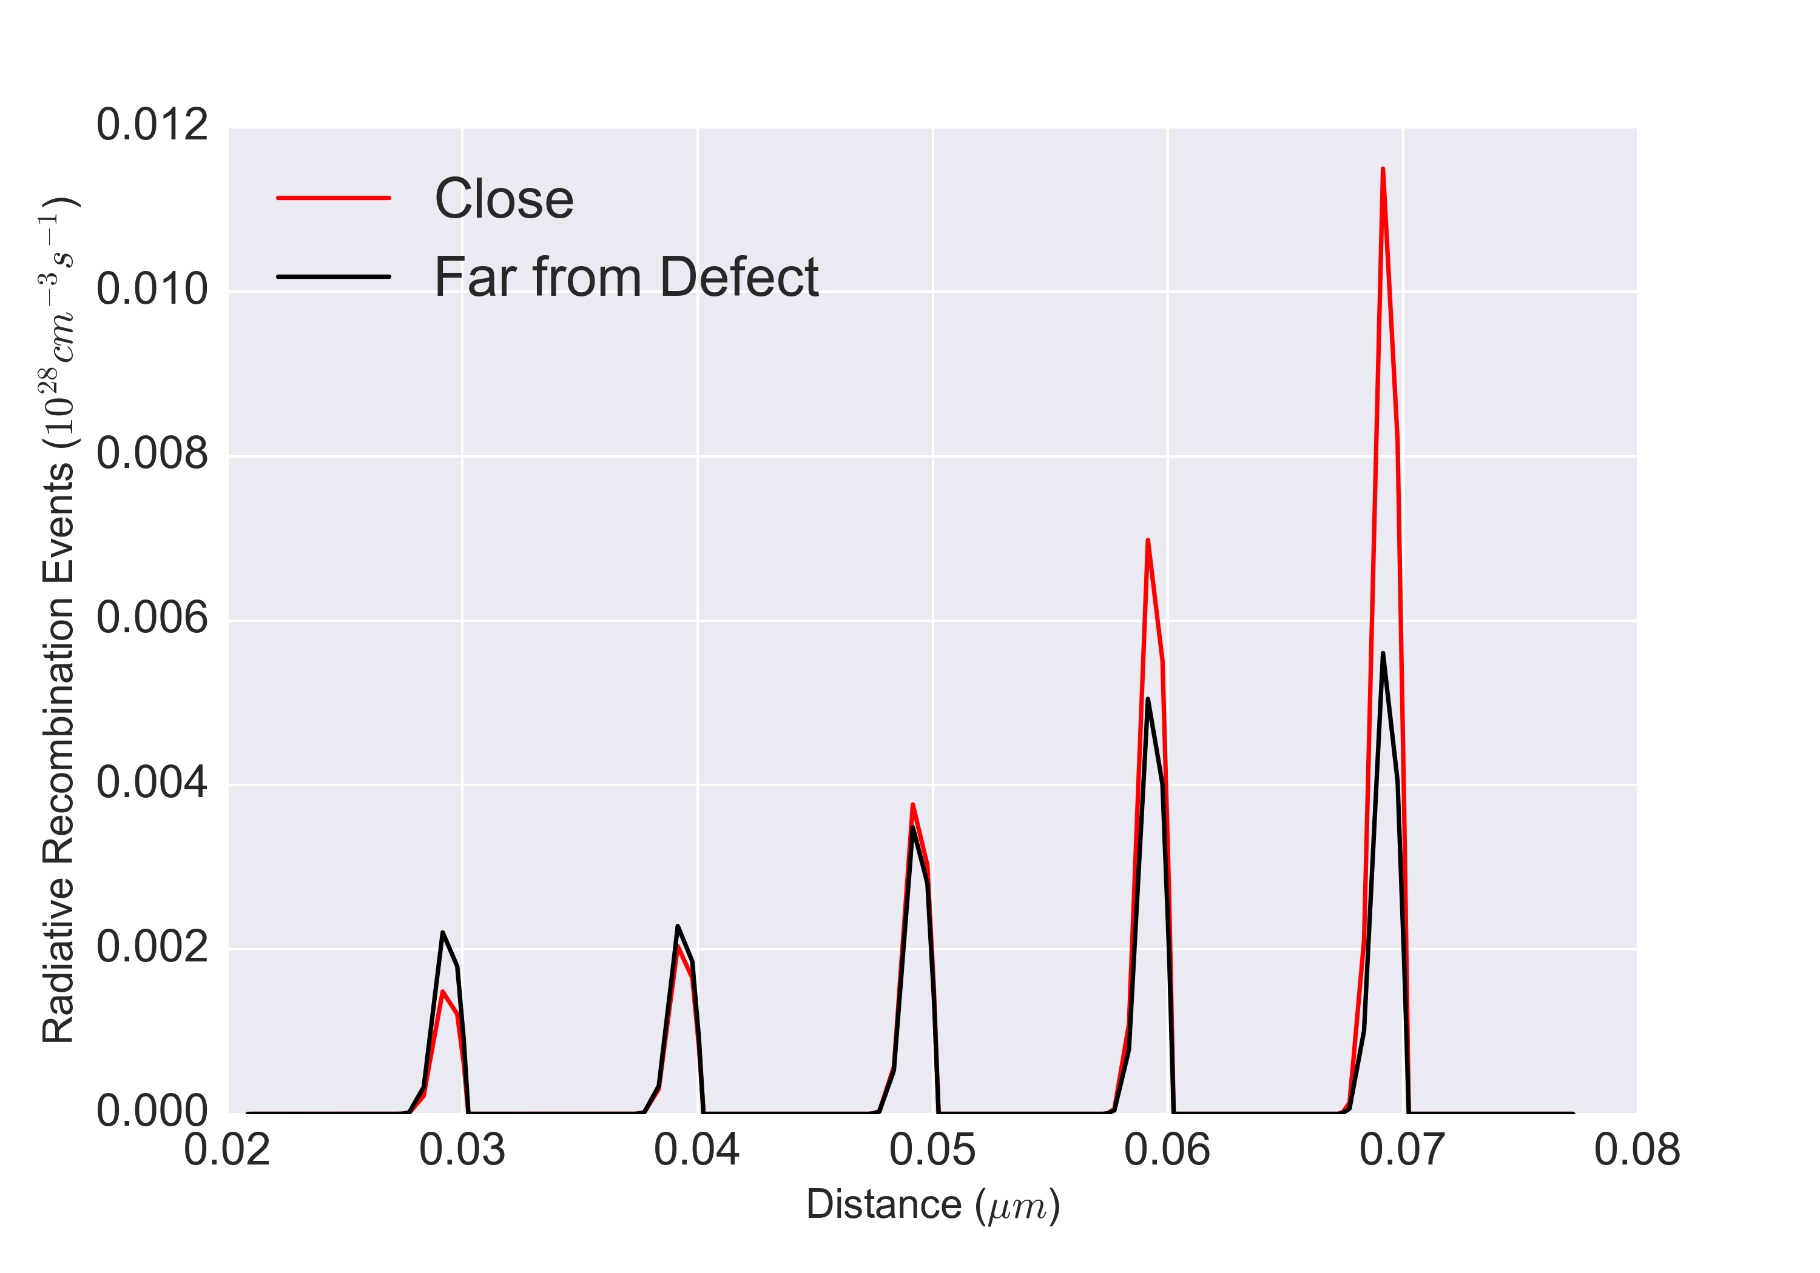
QW5
QW4
QW3
QW1
QW2

Slide 9
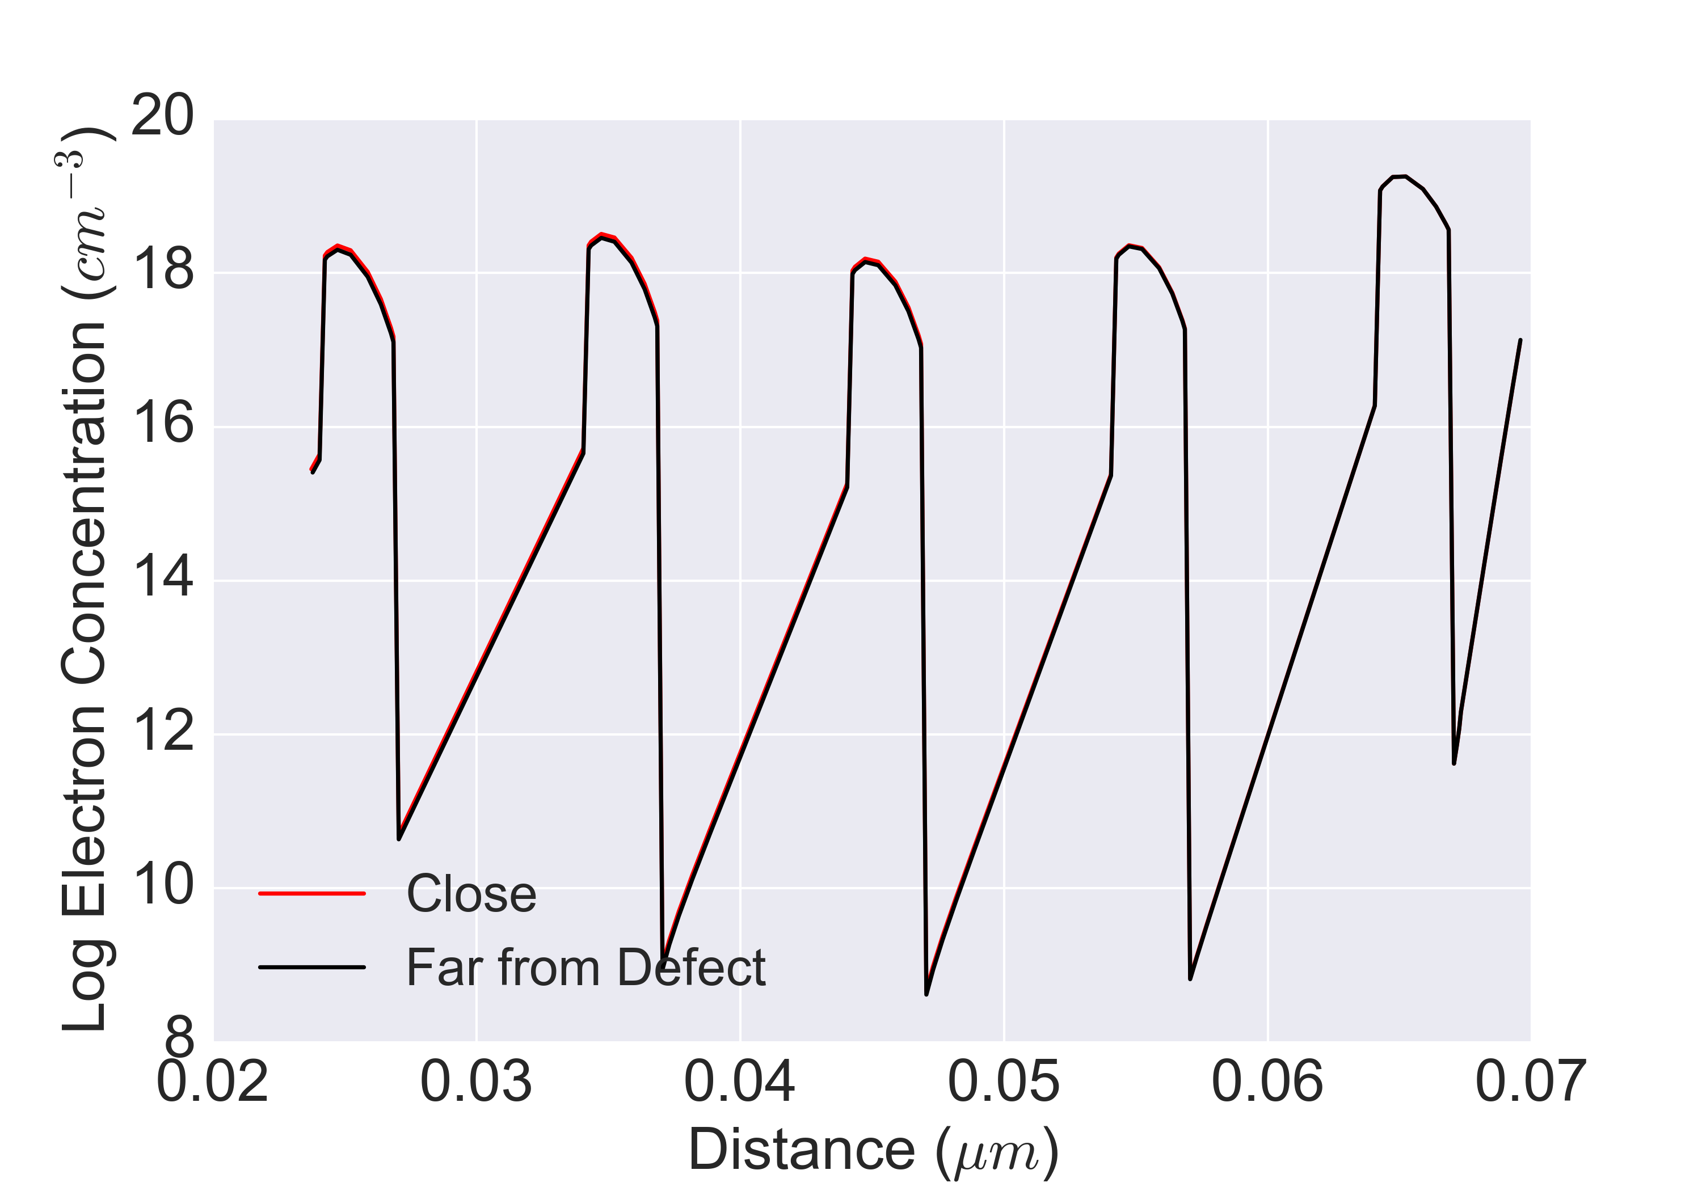
QW1
QW2
QW3
QW4
QW5

Slide 10
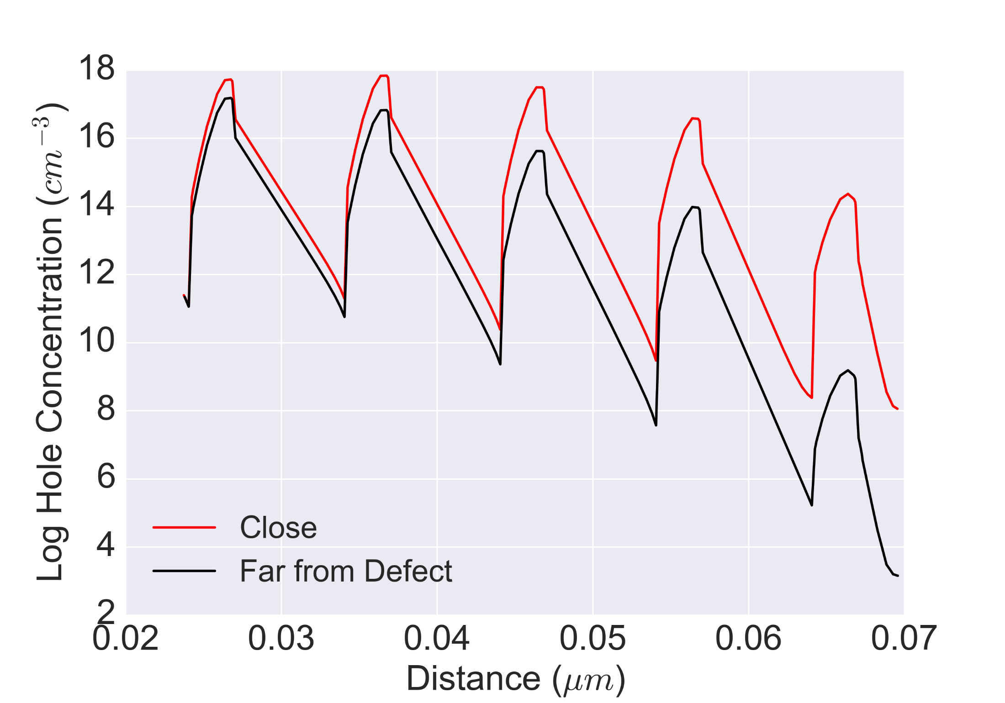
QW1
QW2
QW3
QW4
QW5

Slide 11
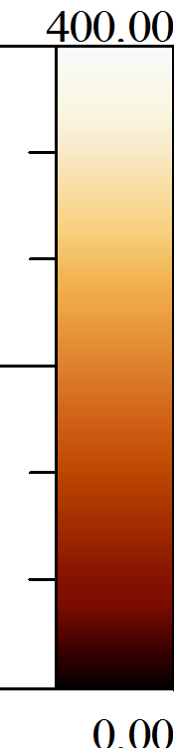
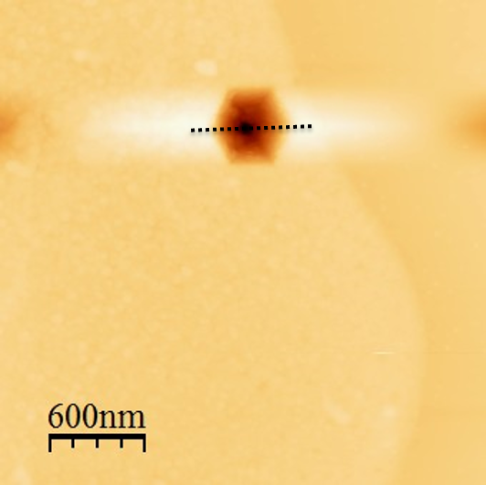
nm
nm

Slide 12
Au-Ni contact

Slide 13
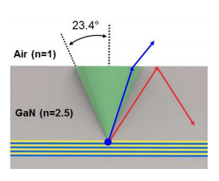
Θ =
Light escape cone for a single point

Slide 14
Enhanced radiative recombination
Top-view of emission
Hexagonal defect boundary
Individual light escape cones

