Slide 2
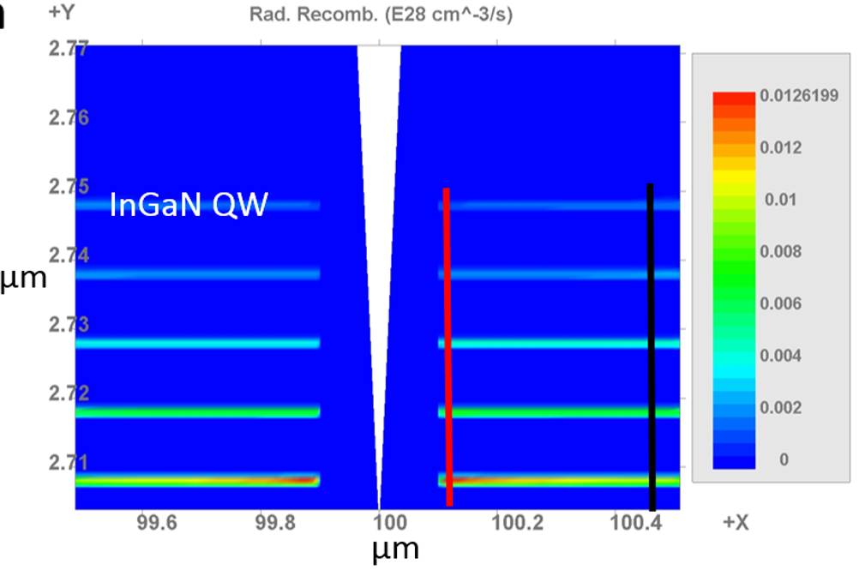

Slide 3
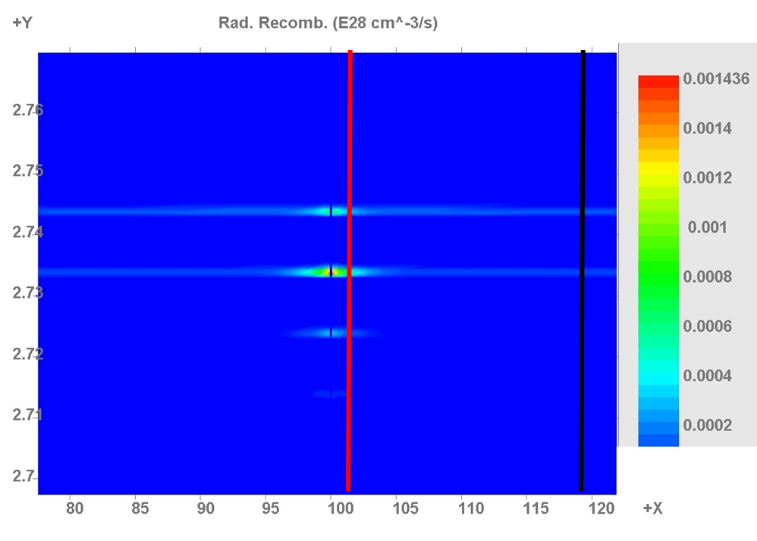
(×10²⁸ cm⁻³ s⁻¹)
Radiative Recombination Events
2.76
2.75
2.74
2.73
2.72
2.71
2.70
AlGaN inclusion
Profile taken ‘close’ to inclusion
Y (µm)
Profile taken ‘far’ from inclusion
80 85 90 95 100 105 110 115 120
X (µm)

