Slide 2
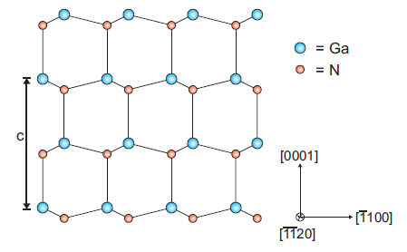

Slide 3
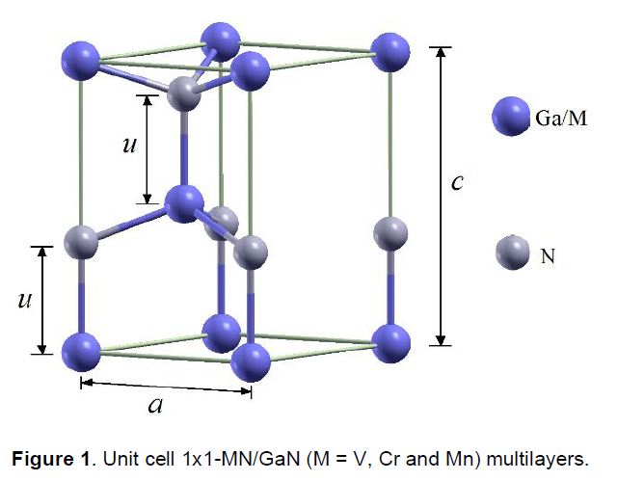
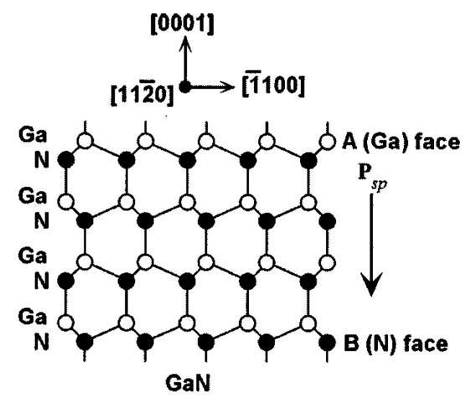
c₀
a₀

Slide 4
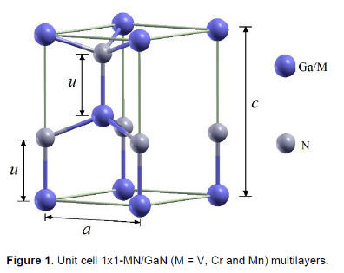

Slide 6
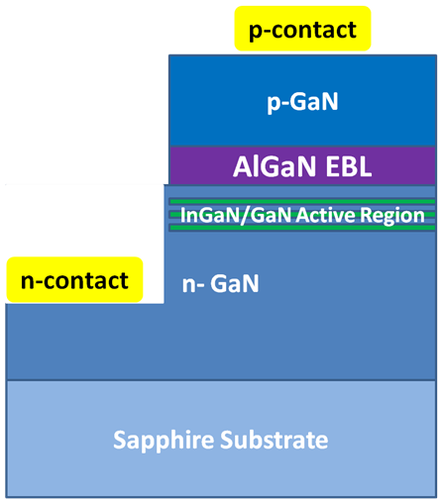

Slide 7
Intensity
FSR
δν₀
ν₀
Frequency ν

Slide 10
R_{min}
R
θ_{c}

Slide 11
Four Quadrant Photodetector
Laser
Cantilever
Sample

