Slide 2
Envoy Gateway
Project Update
Daneyon Hansen, Tetrate
Alice Wasko, Ambassador Labs

Slide 3
History
Envoy released fall of 2016
Envoy started as an edge proxy
The Envoy Gateway project was born out of the belief that bringing Envoy “to the masses” requires:
Simplified deployment and API.
Consolidate existing Envoy-based projects into a common core.
Envoy Gateway born spring of 2022

Slide 4
Introduction
Why should I care about Envoy Gateway?
Provides a “batteries included” Envoy Proxy experience
Supports multiple user personas
Extensibility
Built with community horsepower
Think of Envoy Gateway as as a “wrapper” around the Envoy Proxy core
Notes:
Let’s face it… xds is not easy for a new user to immediately pickup and start using. EG abstracts these details away while still fully supporting xds (future).
You can start using Envoy in 2 super simple steps.

Slide 5
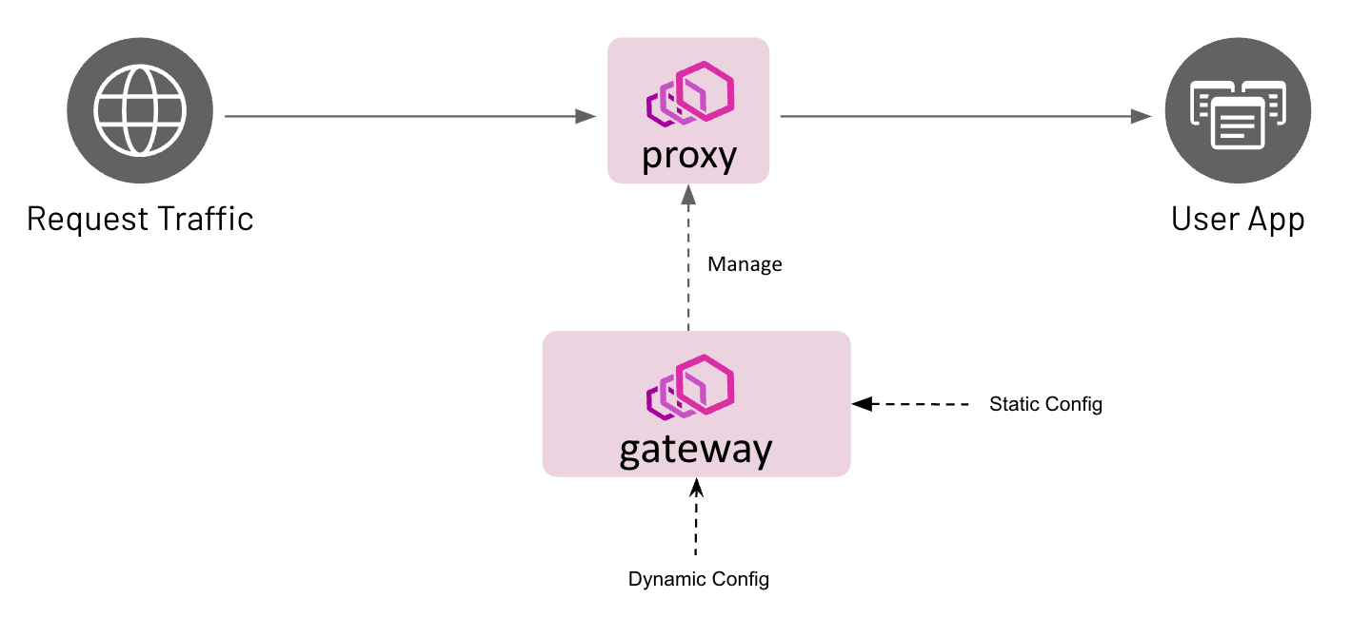
Introduction

Slide 6
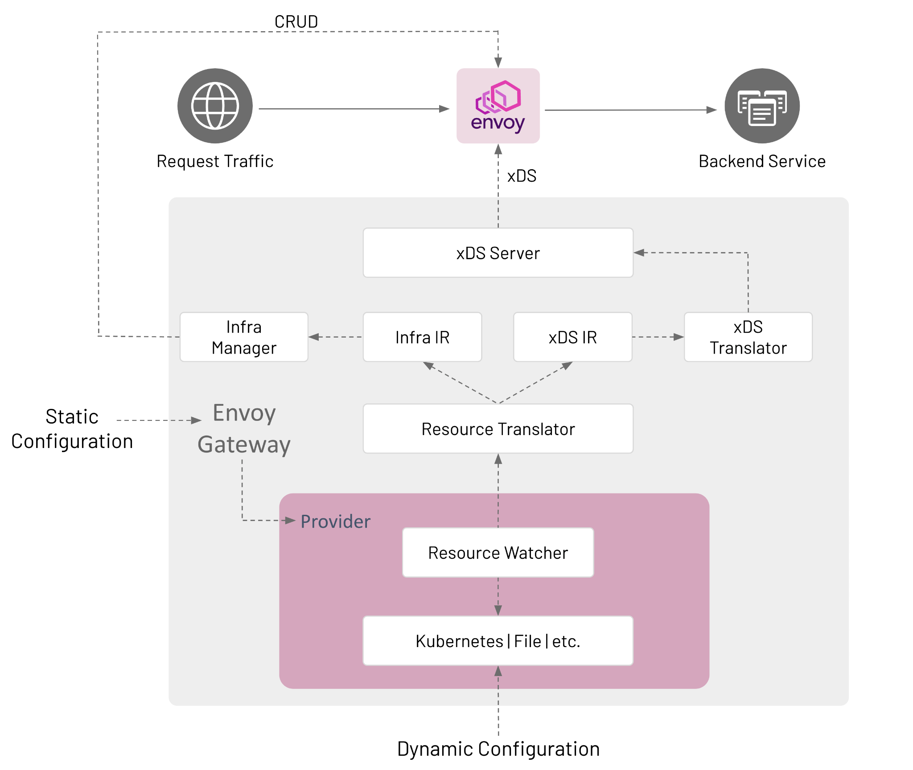
Architecture

Slide 7
Configuring Envoy Gateway
Envoy Gateway supports Gateway API resources for managing a fleet of Envoy proxies.
Support for all core fields in:
GatewayClass
Gateway
HTTPRoute
TLSRoute
kind: GatewayClass
metadata:
name: eg
spec:
controllerName: gateway.envoyproxy.io/gate..
Notes:
Highlight user personas- cluster admin creates gc/gw and dev’s only interact with routes.

Slide 8
Configuring Envoy Gateway
Envoy Gateway supports Gateway API resources for managing a fleet of Envoy proxies.
Support for all core fields in:
GatewayClass
Gateway
HTTPRoute
TLSRoute
kind: GatewayClass
metadata:
name: eg
spec:
controllerName: gateway.envoyproxy.io/gate..
kind: Gateway
metadata:
name: eg
spec:
gatewayClassName: eg
listeners:
- name: http
protocol: HTTP
Port: 8080

Slide 9
Configuring Envoy Gateway
Envoy Gateway supports Gateway API resources for managing a fleet of Envoy proxies.
Support for all core fields in:
GatewayClass
Gateway
HTTPRoute
TLSRoute
kind: GatewayClass
metadata:
name: eg
spec:
controllerName: gateway.envoyproxy.io/gate..
kind: Gateway
metadata:
name: eg
spec:
gatewayClassName: eg
listeners:
- name: http
protocol: HTTP
Port: 8080
kind: HTTPRoute
metadata:
name: backend
spec:
parentRefs:
- name: eg
hostnames:
- www.example.com
rules:
- backendRefs:
- name: backend
Port: 3000

Slide 10
Demo
Follow along with the Envoy Gateway Quickstart

Slide 11

Demo

Slide 12

Who is Envoy Gateway?

Slide 13

Envoy Gateway Maintainers

Slide 14
Release v0.2 Highlights
First functional release
Gateway API core conformance
Kubernetes support

Slide 15
Roadmap
Leverage extensions for advanced functionality.
Additional providers
Multi-cluster
Native xDS Mode
Checkout the roadmap for additional details
Help us prioritize roadmap features
Notes:
We use GH milestones to manage roadmap details.
The roadmap is a “reference” and not set in stone. If you need a feature, get involved.

Slide 16
Q&A
Time for Questions

Slide 17
References
Envoy Gateway: https://gateway.envoyproxy.io/
Envoy: https://www.envoyproxy.io/
Gateway API: https://gateway-api.sigs.k8s.io/
xDS: https://github.com/cncf/xds
go-control-plane: https://github.com/envoyproxy/go-control-plane

