Slide 1
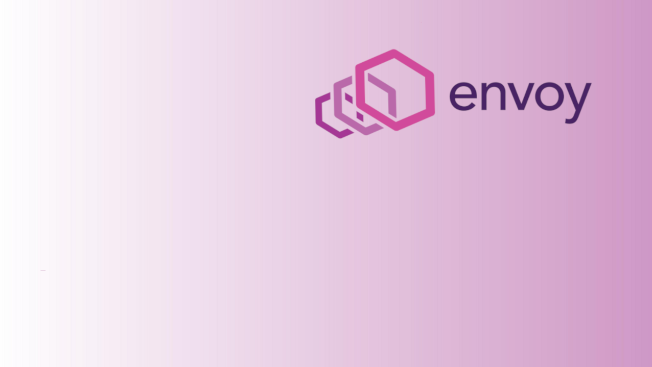
Envoy Gateway
Project Update
Alice Wasko, Ambassador Labs
Arko Dasgupta, Tetrate

Slide 2

Introduction
Why should I care about Envoy Gateway?
Why should I care about Envoy Gateway?
Provides a “batteries included” Envoy Proxy experience
Based on Gateway API that supports multiple user personas
Extensibility
Built with community horsepower
Think of Envoy Gateway as as a “wrapper” around the Envoy Proxy core
Notes:
Alice

Slide 3
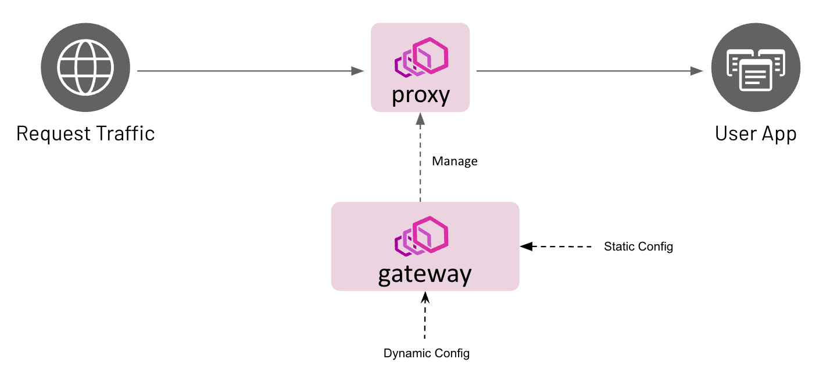
Introduction
Notes:
Alice

Slide 4
Resource Translation
ENVOY PROXY
K8s Service
K8s Pod
xDS Listener
xDS Route
xDS Cluster
EnvoyGateway
ENVOY GATEWAY
GatewayClass
EnvoyProxy
Gateway
HTTPRoute
Notes:
Arko Thanks for that introduction Alice. This slide is similar to the previous one and highlights the various API resources consumed by the Envoy Gateway controller and the resulting translations. Going from left to the right, the first config processed is the EnvoyGateway resource which is read during process startup and defines the state of the controller. It is an optional resource that may be configured by the infrastructure admin that can be used to define fields like the name of the Envoy Gateway controller. Once the controller is ready, the infrastructure admin can configure the GatewayClass which represents a class of Gateways that can be instantiated. An optional resource, called EnvoyProxy may be linked to the GatewayClass using the parametersRef field to customize the data plane infrastructure. Examples for such configuration are number of envoy proxy replicas and custom envoy proxy service annotions. The admin can now create a Gateway which defines the the protocol listener settings. Once Envoy Gateway detects this, it instantiates a new fleet of Envoyproxy in the environment based on the infrastructure settings defined in the GatewayClass. In Kubernetes this results in the creation of a EnvoyProxy Kubernetes service and a EnvoyProxy Kubernetes deployment. The networking intent in EnvoyProxy such as the xDS Listener configuration can be programmatically applied from Envoy Gateway via xDS protocol over gRPC. Finally the application developer can configure the HTTPRoute. Envoy Gateway reads this resource and translates it into xDS Route resource and pushes this over xDS. The BackendRef field within the HTTPRoute which points to a Service, is translated into a xDS Cluster and also pushed over xDS.

Slide 5
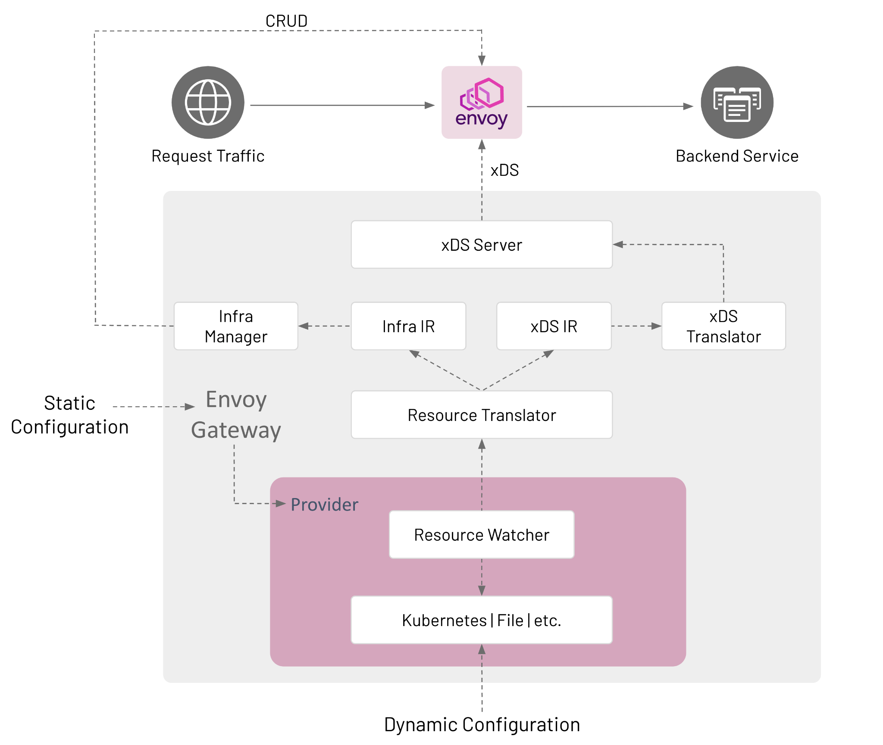
Architecture Overview
Notes:
Arko This is a deep dive view of the components within Envoy Gateway. As I mentioned in the last slide, that the configuration within the static EnvoyGateway resource is used to decide the state of the components within the Envoy Gateway process. Going bottom up, The provider is the component responsible for watching and ingesting relevant Gateway API resources. These resources are published to the next component, the Resource Translator over a pub-sub open source messaging component called watchable. The resource translator subscribes to these messages, and on receiving it, translates it into 2 intermediate data types - the Infra IR and the xDS IR. These data types help decouple the front end user facing API and the backend APIs. The Infra manager subscribes to the Infra IR messages and on receiving them translates into infrastructure resources such as the EnvoyProxy Kubernetes Deployment and Services and applies it to the API server. The xds Translator subscribes to the xDS IR messages and on receiving these, translates it to xds. These xds resources are now published and consumed by the xds Server which pushes these to the managed Envoy Proxy instance via xds.

Slide 6
0.3.0 Release (Feb 2023) Recap
Support for Experimental APIs:
GRPC Routing
kind: GRPCRoute
metadata:
name: example-grpc
spec:
parentRefs:
- name: example-gateway
hostnames:
- “grpc-example.com”
rules:
- backendRefs:
- name: example
port: 9000
TCP Routing
UDP Routing
Request Mirror Filter
Response Header Modifier Filter
Notes:
Alice

Slide 7
0.3.0 Release (Feb 2023) Recap
Support for Advanced APIs:
Rate Limiting
kind: RateLimitFilter
metadata:
name: example-ratelimit
spec:
type: Global
global:
rules:
- clientSelectors:
- headers:
- name: x-user-id
value: foo
limit:
requests: 3
unit: hour
kind: AuthenticationFilter
metadata:
name: jwt-example
spec:
type: JWT
jwtProviders:
- name: example
issuer: https://example.com
remoteJWKS:
uri: https://foo.com/jwks.json
audiences:
- foo.com
Authentication
JWT
Notes:
Alice

Slide 8
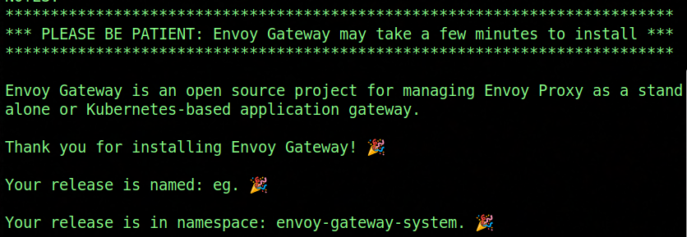
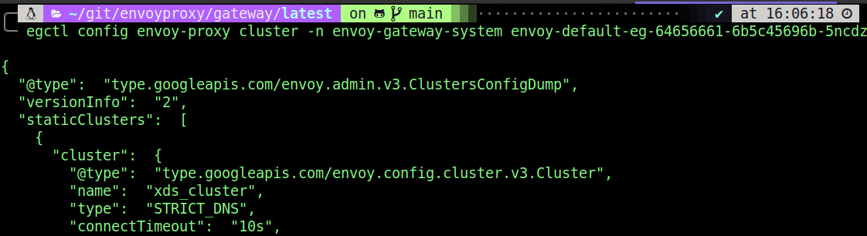
0.4.0 Release (April 2023) - UX
Improving User Experience:
Helm Support
egctl CLI tool
Config
Translate (Dry run) (Add Diagram)
Notes:
Arko Lets talk about our forthcoming 0.4.0 release. The rc was released on April 13th and we plan on releasing v0.4.0 on April 21st. The community has been working hard on this release since February 2023, and the focus on been on two areas - improving user experience and providing more ways to customize envoy gateway to accommodate user needs, To improve user experience, we have introduced installation via helm, which is widely adopted in the cloud native community . We have also introduced a CLI tool called egctl, that can be used to retrieve xds configuration from the running envoyproxies in the environment. Another cool feature added to this CLI is the translate subcommand that allows the user to translate the Gateway API resources directly into xds. This allows users to understand the final xds configuration within EnvoyProxy without running envoy gateway. This subcommand also can output the Status associated with the Gateway API resources, so users can know beforehand whether their Gateway API config will be accepted or rejected even before applying it to the Kubernetes API server.

Slide 9
0.4.0 Release - Customization
Extending Gateway Functionality:
Custom Bootstrap Config
Custom Kubernetes Settings
Control Plane Extensions
Notes:
Arko To accommodate more use cases we focused on customizations in this release. This includes allowing the user to bring their own envoy bootstrap configuration. The egctl tool can be used to generate a default one that can be further customized and applied. Users can now customize the generated EnvoyProxy kubernetes resources such can the replica count, pod annotations which are needed to join a mesh such as Istio or Linkerd, service annotations which are used to configure external controllers such AWS NLB and many more fields. One of the goals of the Envoy Gateway was to provide a common foundation for vendors to build value added products on top without having to fork and re-engineer Envoy Gateway. In this release we will introduce the ability to extend Envoy Gateway so an auxiliary control plane can add functionality to Envoy Gateway using gRPC hooks at various stages of the resource translation pipeline.

Slide 10
Roadmap
0.5.0 Release:
Observability
Access Logs
Metrics
Tracing
Performance & Scalability
Future Wishlist:
xDS Patch API
Notes:
Alice

Slide 11

Thanks To All The Contributors!
Notes:
Alice

Slide 12
Get Involved!
Docs: gateway.envoyproxy.io
Project: github.com/envoyproxy/gateway
Notes:
Alice

Slide 13
References
Envoy Gateway Source: https://github.com/envoyproxy/gateway
Envoy Gateway User Docs: https://gateway.envoyproxy.io/
Envoy: https://www.envoyproxy.io/
Gateway API: https://gateway-api.sigs.k8s.io/
xDS: https://github.com/cncf/xds
go-control-plane: https://github.com/envoyproxy/go-control-plane

