Slide 1
Hackers Anonymous
Sprint 2 Review

Slide 2
Sprint Retrospective
What went well during this sprint?
Working better as a team, discussed weaknesses from sprint 1 with the product owner and used feedback to improve.
Plans for improvement?
Work together more and try to all work together every week. Have a set meeting time to all meet up and work on the project every week.

Slide 3
Design Artifacts
CRC cards
Class diagram

Slide 4
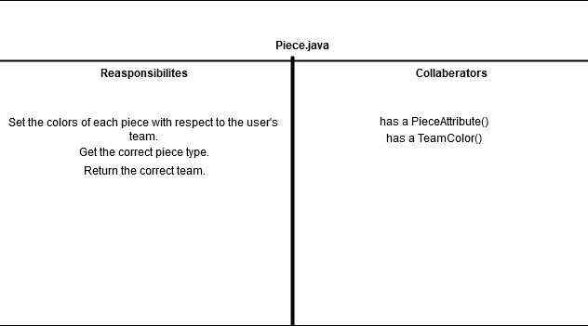
CRC Cards

Slide 5
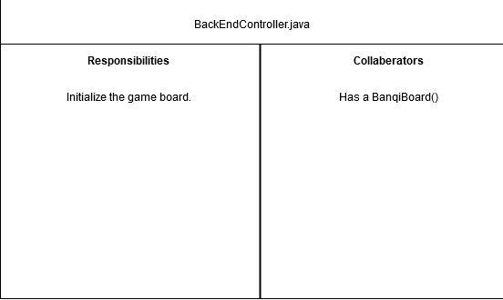

Slide 6
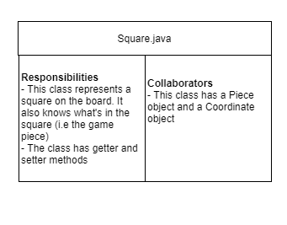

Slide 7
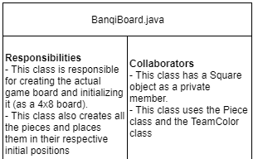

Slide 8
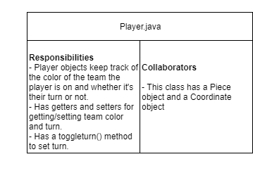

Slide 9
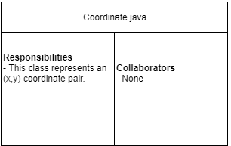

Slide 10
Class Diagrams

Slide 11
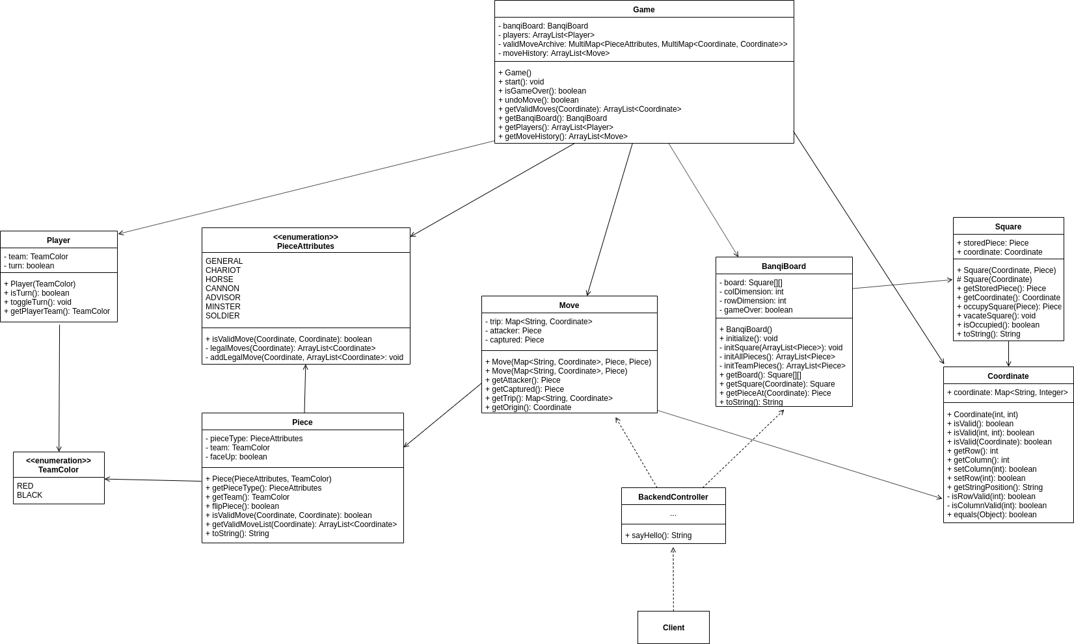

Slide 12
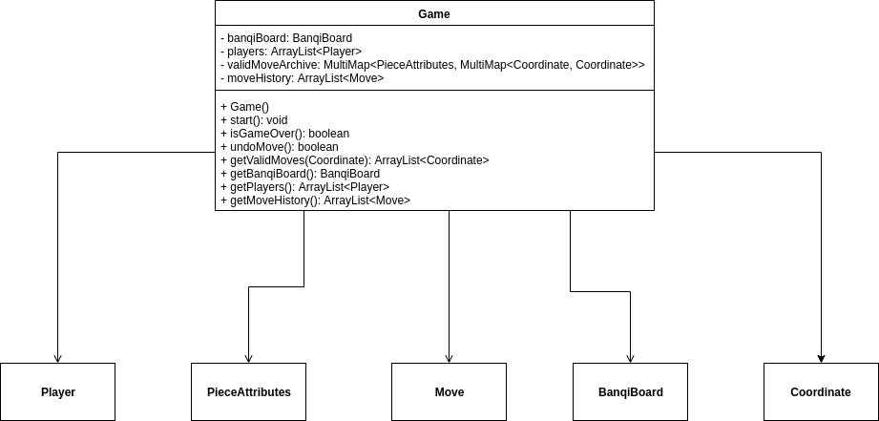

Slide 13
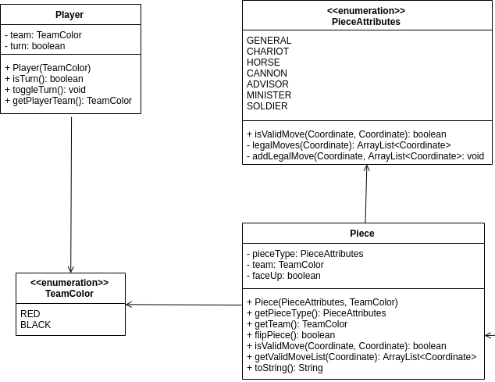

Slide 14
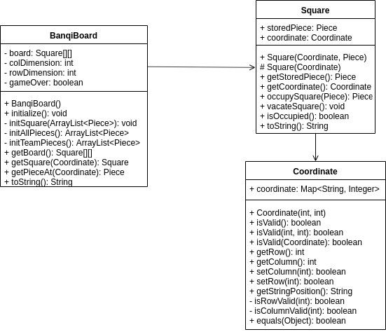

Slide 15
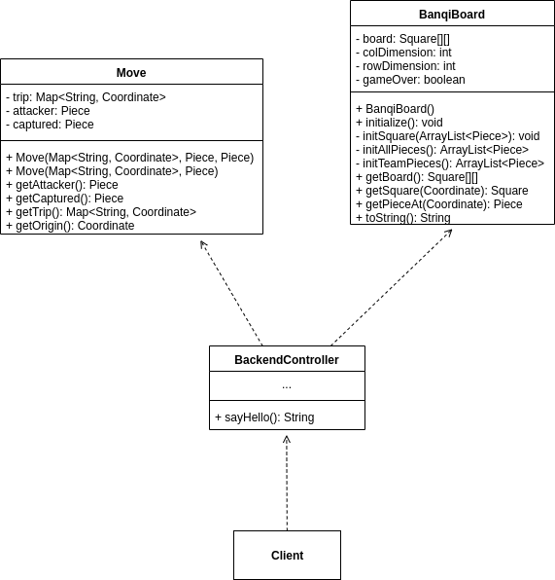

Slide 16
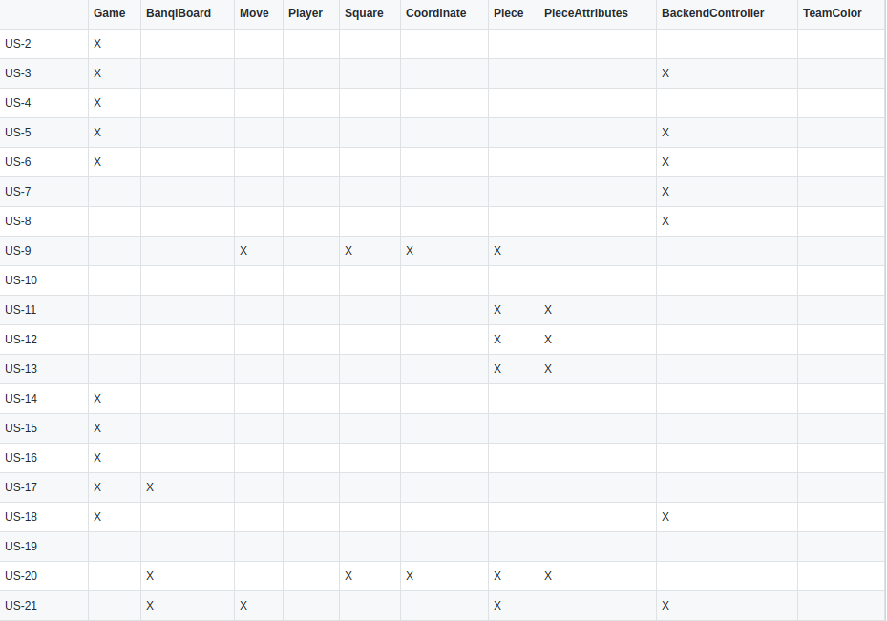
Traceability Link Matrix

Slide 17
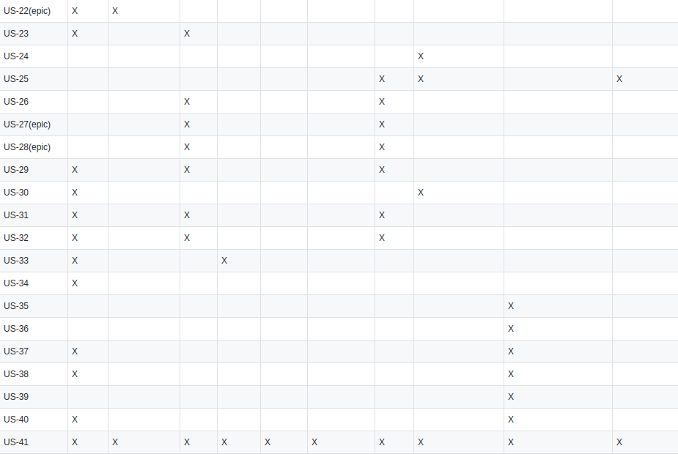

Slide 18
Scrum Meetings
Delegate, create, and assign tasks.
Meet weekly for discussing current progress.
Plan when everyone could also meet up next.
Work on the project.

Slide 19
Plans for Sprint 3
Develop out frontend using communication with server
Associated Scrum Board Epics
User: I would like to play the game on a board with 8x4 squares.
Dev: Connect frontend and backend
Notes:
Now that the logic has been created on the server side controller, it is time to make it pretty for the user on the client side

