Slide 1



A Buisiness Plan for Nite Bargain
Team Name: Orange
Team Members: R. Li; K. Liu; S.Wang; R. Yang; Y. Yao; X. Zhao; X. Wang; Y. Zhang; Q. Xie; S. Wang

Slide 2
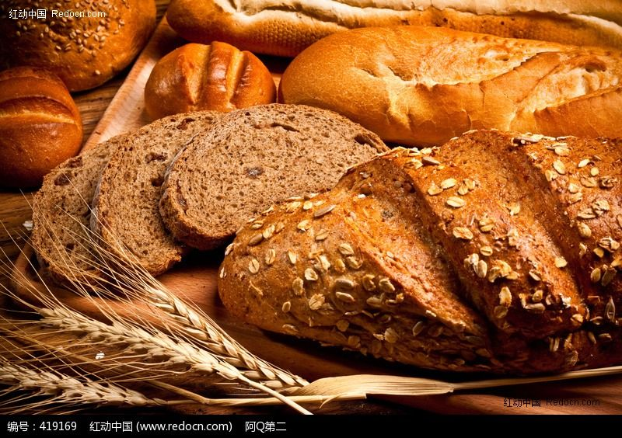



Throwing away?

Slide 3
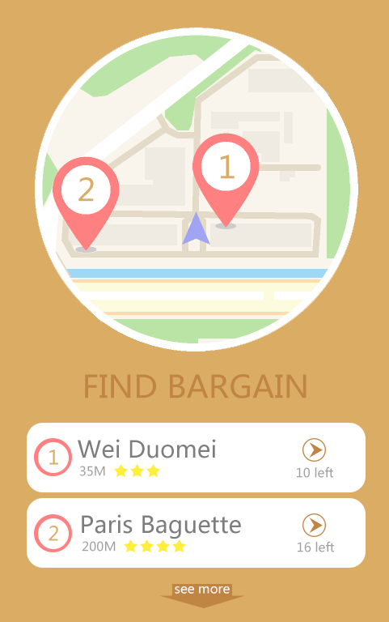
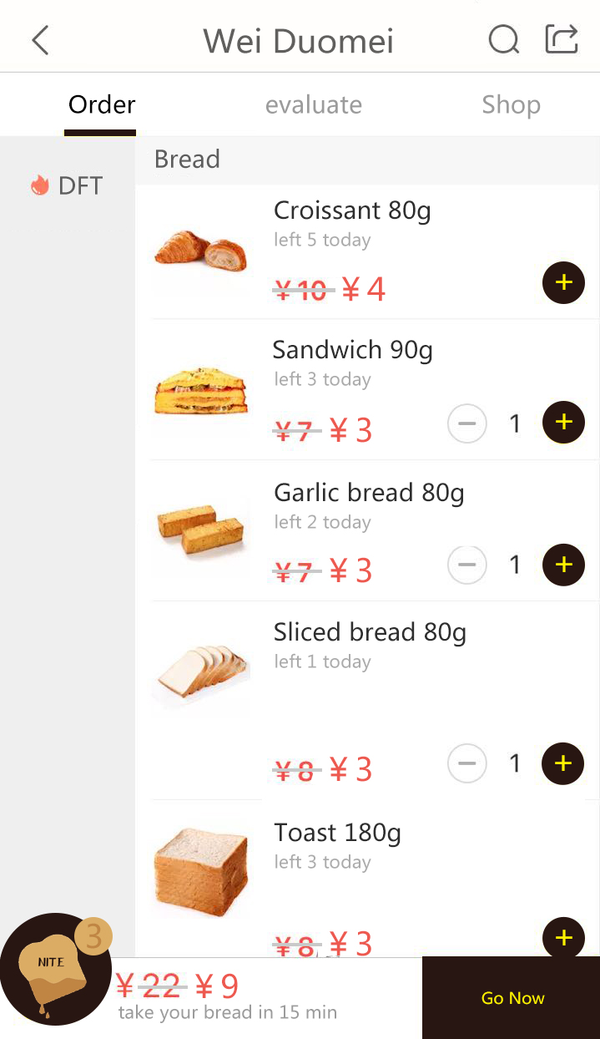
How does Nite Bargain work?

Slide 4
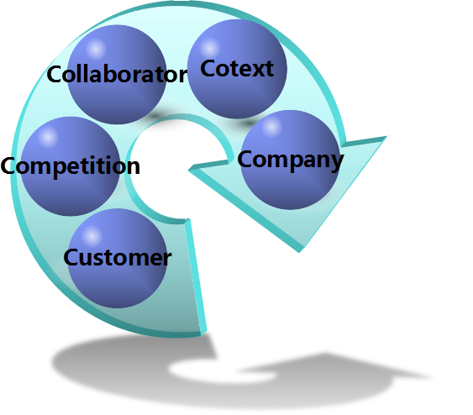
The “5C” Analysis
Food companies
Alipay company
Much more willing for Chinese to accept this kind of products to save
External
Internal
Future competitions from similar companie
Occupying the market share as soon as possible
Demographics
Geographic
Behavioral
Psychographic

Slide 5




The “4P” in Marketing
Charging 20% of the profit from the businesses.
placing advertisement of the joining shops
Price
Product
Consumers
Shopkeepers
Marketing
Place
Promotion
First-tier cities:
Beijing, Shanghai, Guangzhou
Focus on advanced measures

Slide 6








The Milestone of the Project
Contact over 100 shops & Begin profit gain
App users over 20k & Contact over 1000 shops
Retained profits larger than 0
Accomplishing Design of the App
Contact over 300 shops
Quarter sale break even
Retained profits reach 1million

Slide 7
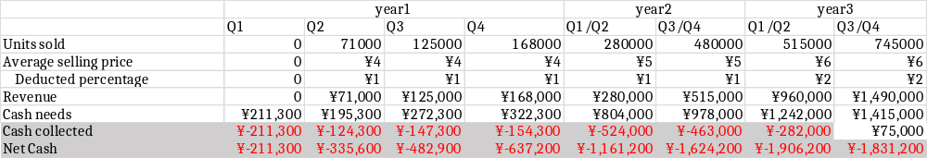
The Cash Flow Plan

Slide 8
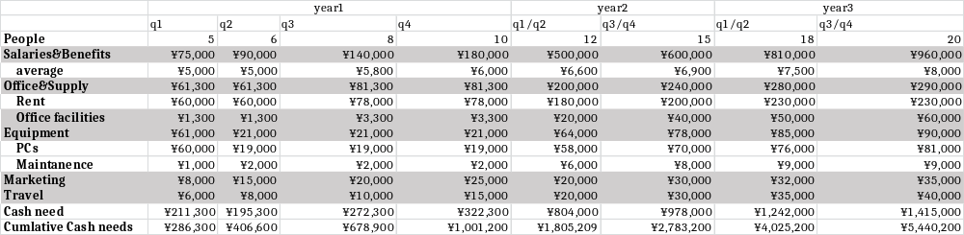
The Financial Plan

Slide 9
IDEA
COMPETENCE
PASSION
TEAM

Slide 10


