Slide 1
Capstone 2 Presentation
Colton Crabtree

Slide 2
Project Goals
Create model(s) for new drug (Drug Y) for the “Drug” company
Define graphs that help support model data
Determine which model is best and determine primary consumer of Drug Y

Slide 3
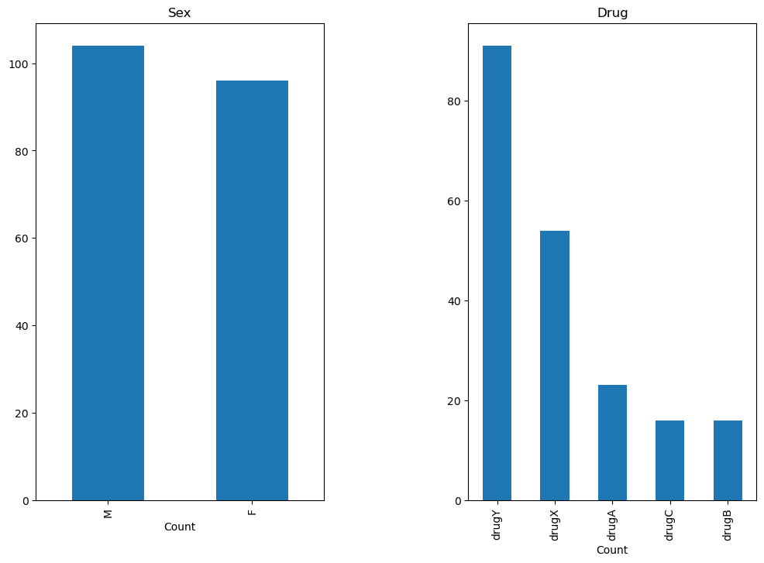
Company Drug as a Whole
Left: Pretty equal distribution Male (M) and Female (F)
Right: Drug Y is the most common being distributed almost 50% more often than Drug X

Slide 4
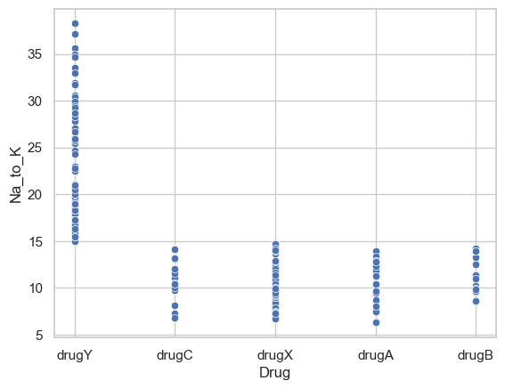
Sodium Potassium Relation to Drug Selection
Shown: Drug Y is only used for Sodium Potassium levels above 15.
Equal distribution amongst 4 competitors with Sodium Potassium below 15

Slide 5
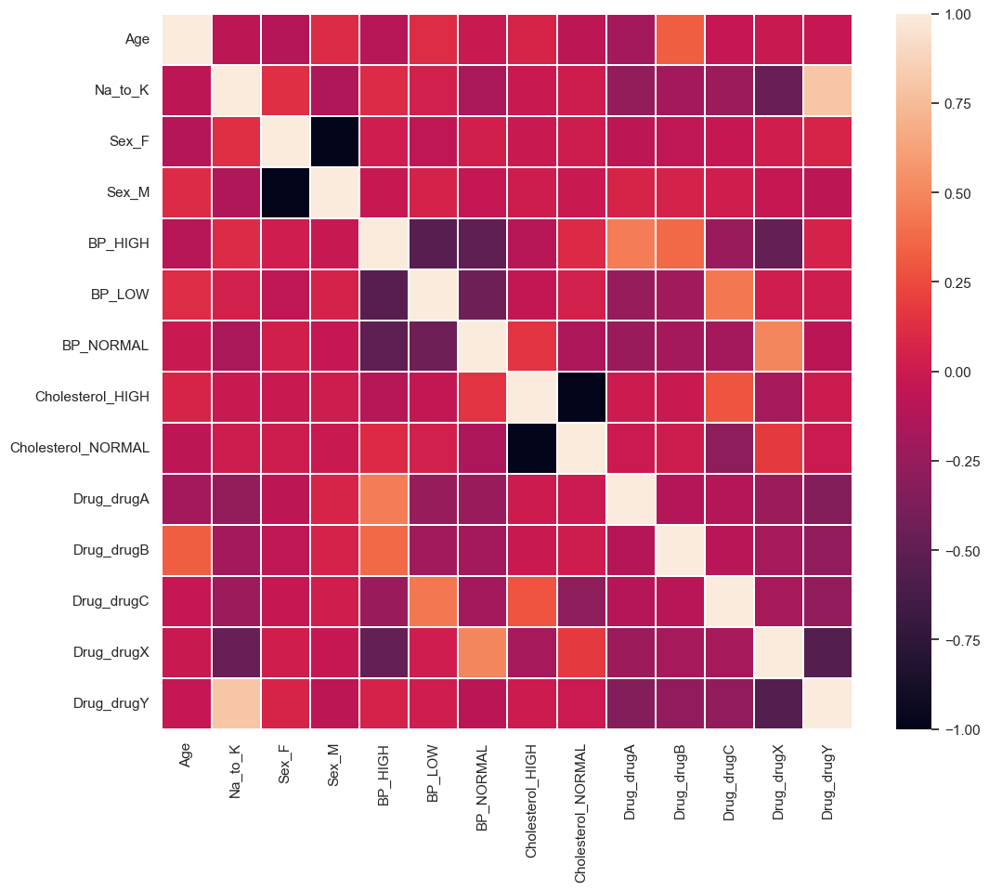
Correlation
Strongest correlation is with Sodium Potassium and Drug Y

Slide 6
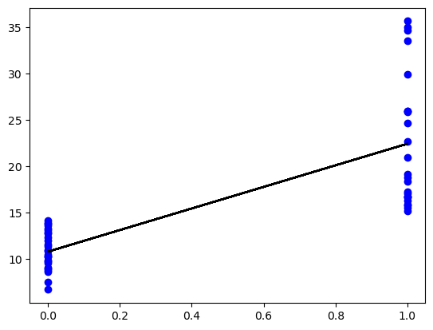
Linear Regression Model
Clear regression when Sodium Potassium drops below 15. This signals Drug Y is best used with levels above 15.

Slide 7
Recommendations
Drug Y is best with Sodium Potassium levels above 15
Sex has no effect on drug selection
Linear model shows regression between Drug Y and Sodium Potassium levels
All other drugs to be used with Sodium Potassium levels below 15.

