Slide 1
Capstone 3 Presentation
Colton Crabtree

Slide 2
Goals
Create model of primary applicants that would be beneficial to the “Bank”
Determine criteria for acceptance
Create plots showing distribution of applicant base

Slide 3
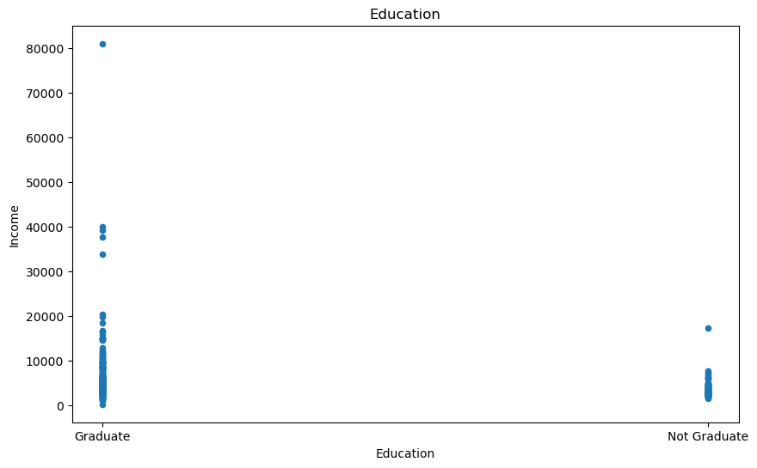
Education of Applicants
Majority of applicants are college educated

Slide 4
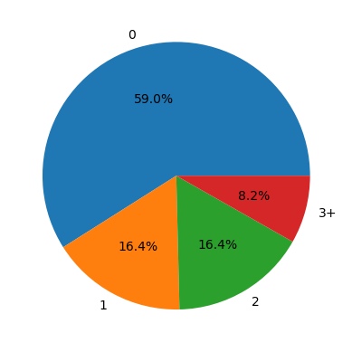
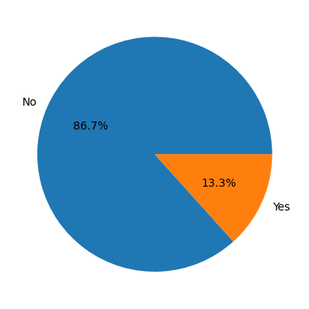
Income Source from Applicants
Left: 59% of Applicants have 0 dependents, 8.2% have 3 or more
86% of applicants have employers, the others are self employed

Slide 5
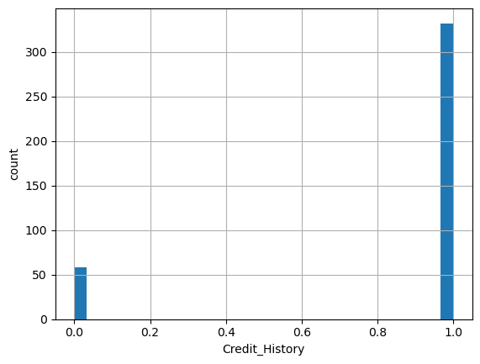
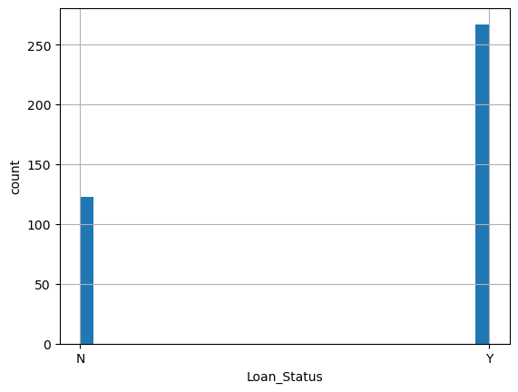
Credit History
Direct Correlation between loan acceptance and credit history

Slide 6
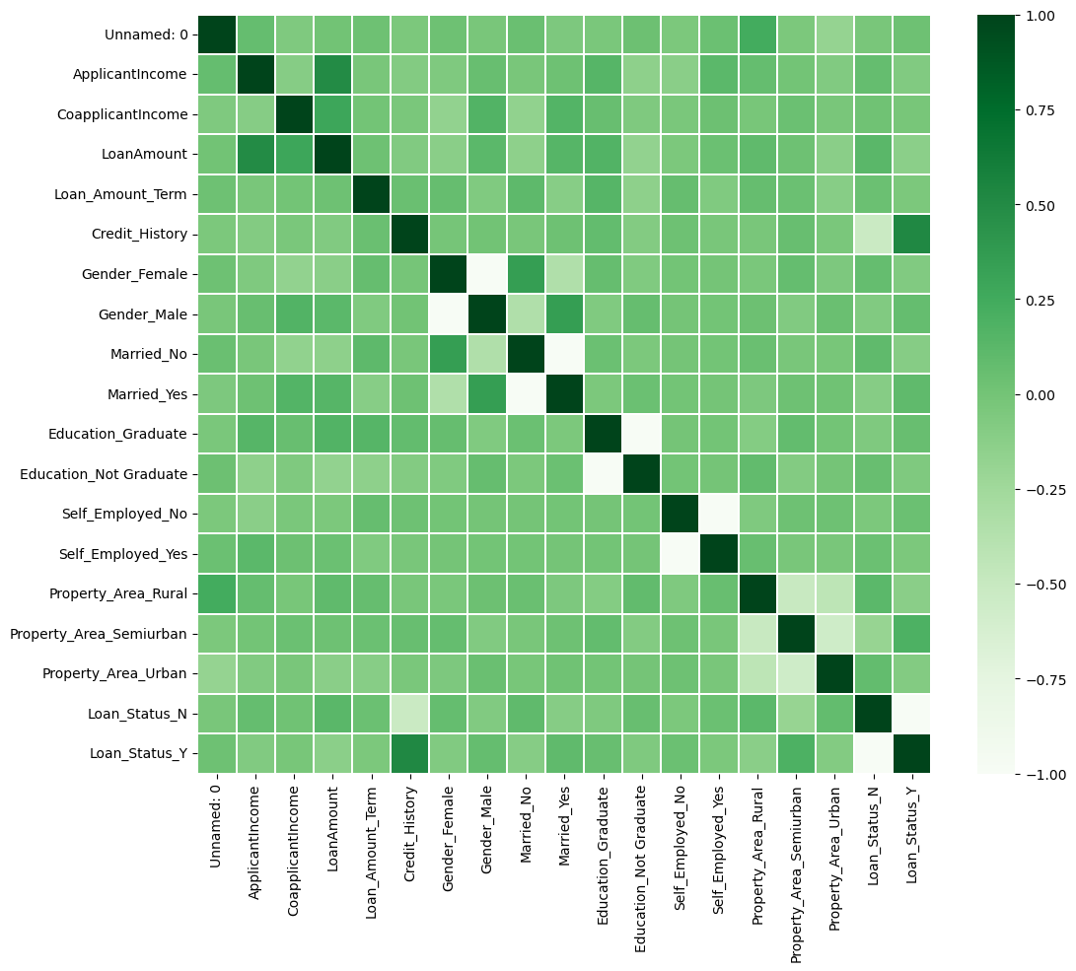
Correlation
As predicted, strongest correlations with loan acceptance are credit history, income, and the amount of loan requested.

Slide 7
Recommendations
Credit History is a must have for acceptance
Income is not a big factor w/co-applicant, otherwise income needs to be accounted for
Consider loan amount with credit history for best result when accepting or denying applicant

