Slide 1
Big Mountain Solution
Colton Crabtree

Slide 2
Identification
Big Mountain Resort (Montana), 350,000 annual visitors.
Recently added new chair lift due to increase of visitor base.
New chair lift adds an additional 1.54 Million in maintenance cost.
Executives asking my team to study whether raising ticket prices or other solutions is right idea.

Slide 3
Identification Recommendation
Team recommendation is raise the ticket price $1.31.
Also, add to our amenities to justify for rise in cost. (Increase snow making).
Adding amenities can bring in more visitors adding more to revenue.

Slide 4
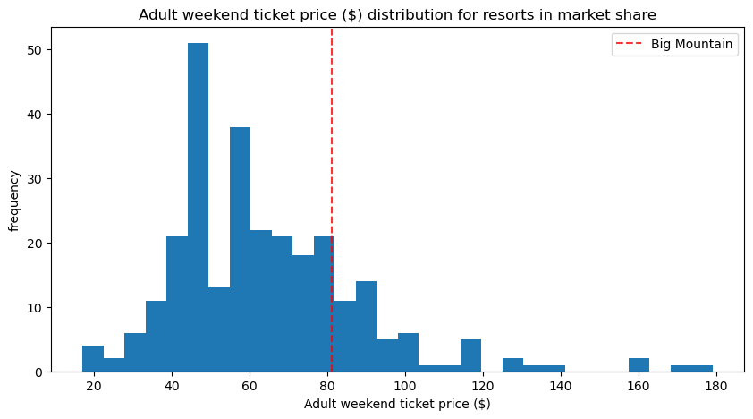
Current Standing
$81 a ticket is slightly above
average Nationally.

Slide 5
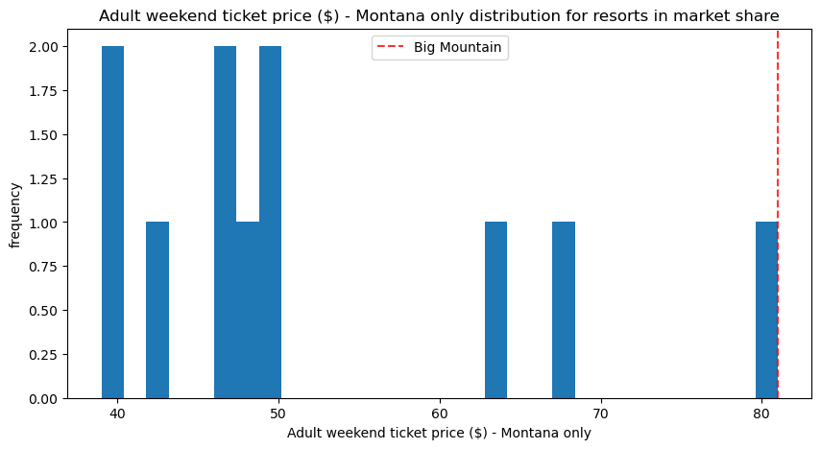
Current Standing (State)
At $81, we lead the state in
price for an Adult weekend
ticket.
Weekend is most visited
day.

Slide 6
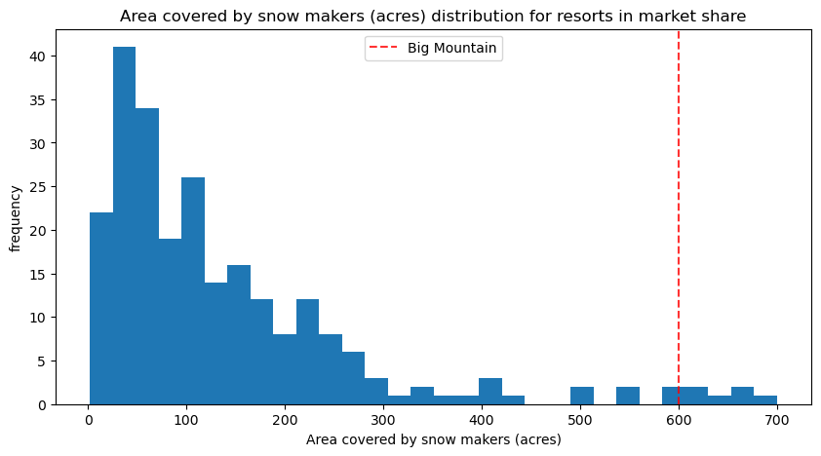
Current Standing (Snow Making)
Big Mountain already covers
600 acres of Snow making
Increasing by another 2 acres
offers more snow resulting in more
customers.

Slide 7
Predictions
Increasing snow making by 2 acres can help bring in an additional $2,300,926 annually.
To support this prediction a $1.31 ticket price increase in needed.
Increasing vertical drop by 150 ft and adding one more chair lift would result in same revenue increase.
Also needs $1.31 ticket price increase.

Slide 8
Conclusion
I recommend raising ticket price by $1.31, to $82.31 (1.7%).
To justify ticket price increase, I also recommend increasing snow making by 2 acres. (More amenities for no additional maintenance cost).
Raising ticket price and increase in snow making will bring additional $2,300,926
$1,540,000 need to cover maintenance cost shortfall.
$760,926 in additional revenue can be used to invest more in property.

