Slide 1
Dangerous Road Event Detection
Jacob crabtree
Allie jett

Slide 2
Dataset
Publically available courtesy of Mivia Lab^{[1]}
200 clips of car crashes and car skidding
Approximately 45 minutes of background noise
Audio sampled at 32 kHz and saved as .wav files
Notes:
[1] http://mivia.unisa.it/datasets/audio-analysis/mivia-road-audio-events-data-set/

Slide 3

Feature Extraction
Loading and cutting wavs
Example Audio clip
XML description of clips provided
WAVs loaded and cut into clips labeled with class ID
Audio features are extracted from these clips

Slide 4
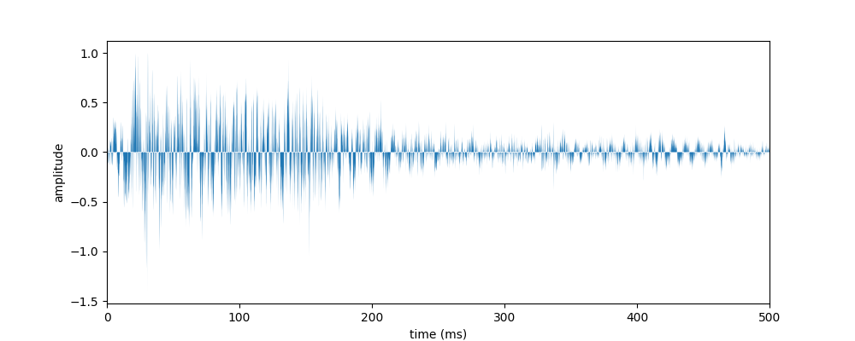
Feature Extraction
Extracting mfccs
Graph of crash audio
Cut each clip into frames
Example clip of crash on the right
Tested frame sizes of 50ms, 100ms, and 300ms with 50% overlap
Extracted the 13 lowest Mel-Frequency Cepstral Coefficients for each frame
FFT -> Filter into Frequency Ranges -> Log -> DCT
Get frequencies -> Get ranges of frequencies -> non-linear scaling to match human hearing -> simplify features

Slide 5
Audio “Word” Generation
Treated each frame as being a particular “word”
Used KMeans with various cluster sizes (64, 128, 256, 512, 1024)
K = number of audio “words” in dictionary
Used KMeans to identify each frame as a word
Frames with similar MFCCs became essentially equivalent frames

Slide 6
Bag-of-Words Representation
Used KMeans to effectively generate a dictionary of “words”.
Created a histogram for each clip
Count of “words”
Low level feature vector of MFCCs became audio words became a histogram
Each audio clip is now treated as a bag of audio words and classified

Slide 7
Classification
Sk-learn SVC used to classify histograms created from Kmeans
Used K-folds cross-validation using a GridSearchCV to tune kernel, C, and Gamma
Kernel = ‘rbf’ always outperformed linear
C trades off correct classification against maximization of the decision function‘s margin
Low C makes decision surface smooth
High C wants to classify all training examples correctly
Gamma defines how much influence a single training sample has.
The larger the gamma, the closer other examples must be to be affected
We tuned our classification per Kmeans cluster (64, 128 … 1024).

Slide 8
C-VALUES & GAMMA FOR EACH CLUSTER
C-values
Gamma

Slide 9
Results
After running our test set, we plotted the results of 50ms, 100ms, and 300ms chunked clips together.
The 50ms set did the best, followed by 100ms and then 300ms.
These results were to be expected:
Smaller chunked segments give a more accurate reading of clustering of “words”.
Ex: 100 “words” of a “skid” mean less when the words are 300ms segments as opposed to 50ms segments.

Slide 10
 | Classification Report for 50ms Frames
 | KNN Cluster Size |  | 64 |  |  | 128
 |  |  | Precision | Recall | F1-Score | Precision | Recall | F1-Score
Clip Type | Background Noise |  | 0.90 | 1.00 | 0.95 | 0.96 | 0.97 | 0.97
 | Car Crash |  | 1.00 | 0.84 | 0.91 | 1.00 | 0.78 | 0.88
 | Skid |  | 0.83 | 0.78 | 0.80 | 0.77 | 0.92 | 0.84
 | KNN Cluster Size |  | 256 |  |  | 512
 |  |  | Precision | Recall | F1-Score | Precision | Recall | F1-Score
Clip Type | Background Noise |  | 1.00 | 0.95 | 0.97 | 0.99 | 0.96 | 0.97
 | Car Crash |  | 1.00 | 0.82 | 0.90 | 1.00 | 0.82 | 0.90
 | Skid |  | 0.78 | 1.00 | 0.88 | 0.79 | 0.98 | 0.87
 | KNN Cluster Size |  | 1024
 |  |  | Precision | Recall | F1-Score
Clip Type | Background Noise |  | 1.00 | 0.95 | 0.97
 | Car Crash |  | 1.00 | 0.98 | 0.99
 | Skid |  | 0.89 | 1.00 | 0.94

Slide 11
 | Classification Report for 100ms Frames
 | KNN Cluster Size |  | 64 |  |  | 128
 |  |  | Precision | Recall | F1-Score | Precision | Recall | F1-Score
Clip Type | Background Noise |  | 0.88 | 1.00 | 0.93 | 0.96 | 0.96 | 0.96
 | Car Crash |  | 1.00 | 0.86 | 0.92 | 1.00 | 0.78 | 0.88
 | Skid |  | 0.84 | 0.72 | 0.77 | 0.75 | 0.92 | 0.83
 | KNN Cluster Size |  | 256 |  |  | 512
 |  |  | Precision | Recall | F1-Score | Precision | Recall | F1-Score
Clip Type | Background Noise |  | 0.98 | 0.93 | 0.95 | 0.99 | 0.91 | 0.95
 | Car Crash |  | 1.00 | 0.76 | 0.86 | 1.00 | 0.98 | 0.99
 | Skid |  | 0.72 | 0.96 | 0.82 | 0.83 | 0.98 | 0.90
 | KNN Cluster Size |  | 1024
 |  |  | Precision | Recall | F1-Score
Clip Type | Background Noise |  | 1.00 | 0.87 | 0.93
 | Car Crash |  | 0.91 | 0.98 | 0.94
 | Skid |  | 0.85 | 1.00 | 0.92

Slide 12
 | Classification Report for 300ms Frames
 | KNN Cluster Size |  | 64 |  |  | 128
 |  |  | Precision | Recall | F1-Score | Precision | Recall | F1-Score
Clip Type | Background Noise |  | 0.90 | 0.99 | 0.94 | 0.98 | 0.96 | 0.97
 | Car Crash |  | 1.00 | 0.80 | 0.89 | 1.00 | 0.76 | 0.86
 | Skid |  | 0.78 | 0.78 | 0.78 | 0.75 | 0.96 | 0.84
 | KNN Cluster Size |  | 256 |  |  | 512
 |  |  | Precision | Recall | F1-Score | Precision | Recall | F1-Score
Clip Type | Background Noise |  | 0.98 | 0.90 | 0.94 | 0.98 | 0.88 | 0.93
 | Car Crash |  | 0.91 | 0.86 | 0.89 | 0.87 | 0.96 | 0.91
 | Skid |  | 0.79 | 0.96 | 0.86 | 0.87 | 0.96 | 0.91
 | KNN Cluster Size |  | 1024
 |  |  | Precision | Recall | F1-Score
Clip Type | Background Noise |  | 1.00 | 0.83 | 0.91
 | Car Crash |  | 0.79 | 0.98 | 0.87
 | Skid |  | 0.91 | 1.00 | 0.95

Slide 13
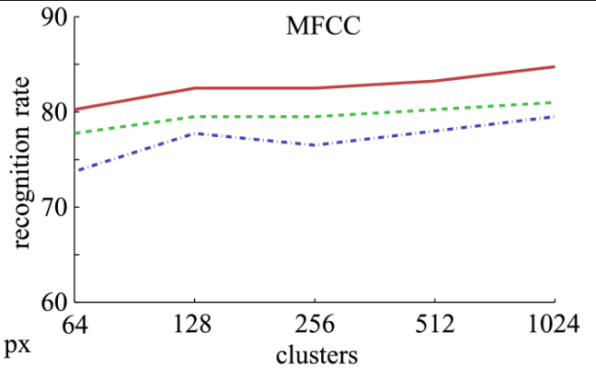
Comparison to Existing Work
Our work was mostly an experiment to replicate an already existing study [1].
Existing work focused more on the implications of a real world set up
Reducing the decibels of the .wav file to make it harder to recognize
Analyzing microphone placement
Our SVM actually outperformed theirs, even with their 0dB loss classification.
We possibly did better parameter tuning.
They used n = 4 folds for cross-validation
We used n = 10 folds
[1]: Recognition rate vs kmeans clusters in the source paper. The red line is 0dB loss.

Slide 14
Future Work
Timing the various methods to see if the accuracy tradeoff is worth having to process less audio
Use of other audio features (such as Bark Sub-bands)
Attempt to classify audio via visual classifications on spectrograms.
Extending this framework to other noises/events (explosion, gunshot, “crime” sounds).

Slide 15
Replicated Article Reference
[1]: http://mivia.unisa.it/datasets/audio-analysis/mivia-road-audio-events-data-set/ (Data sets)
[2]: Foggia, P., Saggese, A., Strisciuglio, N., Vento, M., Petkov, N., & Strisciuglio, N. (January 01, 2016). Audio surveillance of roads: A system for detecting anomalous sounds. Ieee Transactions on Intelligent Transportation Systems, 17, 1, 279-288.

