Slide 1
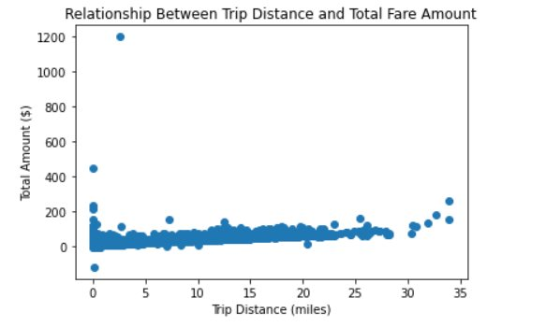
NYC TLC — Dataset Inspection Summary
Automatidata | Course 1 Executive Summary | 2017 Yellow Taxi Trip Data
OVERVIEW
OBJECTIVE
Automatidata is consulting for the NYC Taxi & Limousine Commission (TLC) to build a fare prediction model. As the newest team member, my task was to inspect the TLC dataset, identify key variables, flag data quality issues, and prepare initial findings ahead of exploratory data analysis.
Inspect and prepare the TLC dataset to identify key variables, assess data quality, and lay the groundwork for future exploratory data analysis and fare prediction modeling.
Dataset: 22,699 rows × 18 columns covering NYC taxi trips (2017).
RESULTS
VISUAL EVIDENCE
Key variables for fare prediction: trip distance, pickup/dropoff location, and datetime columns (time of day, day of week).
Median fare of $9.50 and median trip distance of 1.61 miles — typical for NYC city travel. Mean fare of $13.03 skewed upward by outliers.
Credit card dominates at 67% of trips. Cash tips not recorded — average tip of $1.84 underestimates actual tipping behavior.
Data quality issues to clean: negative fare amounts, zero trip distances, zero passenger counts, invalid RatecodeID of 99, fare cap at $999.99, datetime columns stored as object type.
Trip Distance vs. Total Amount — outliers visible at short distances with high fares
NEXT STEPS
Clean data quality issues before EDA: negative fares, zero trip distances/passenger counts, invalid RatecodeID, system cap values, and convert datetime columns to proper type.
Gather additional data to strengthen the model: recorded cash tips, live traffic data, GPS-level location coordinates, weather data, and multi-year/seasonal trip data for broader pattern recognition.
Automatidata | Confidential | For internal use only

