Slide 1
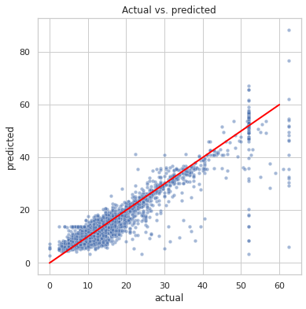
AD
NYC TLC Fare Prediction Model
Course 4 · Regression Analysis
Executive Summary · Automatidata for NYC Taxi & Limousine Commission
PROJECT OVERVIEW
Built a multiple linear regression model to predict NYC taxi fare amounts before the ride begins, using route-level features derived from 2017 Yellow Taxi Trip Data (~408K rides). Purpose: give riders upfront fare transparency and support operational planning at NYC TLC.
KEY RESULTS
Model performance (test set)
R² = 0.87 · MAE = $2.1 · MSE = 14.36 · RMSE = $3.8
87% of variance in fare amount explained. Similar train/test scores indicate no overfitting.
Distance is the strongest predictor: each additional mile adds approximately $2 to the fare.
Predictions cluster tightly along the y = x line, confirming strong model accuracy across the fare range.
Actual vs. Predicted fare
(test set)
METHODOLOGY
RECOMMENDATIONS
CAVEATS & NEXT STEPS
Multiple Linear Regression (OLS)
Predictors: mean route distance, mean route duration, rush-hour flag, vendor ID.
80/20 train-test split; StandardScaler applied only to training data.
Cleaning: negative values imputed to 0; IQR-based winsorization capped extreme outliers.
Deploy as an upfront fare estimator
Show riders an expected fare at booking using pickup/dropoff zones, day, time, and rush-hour status.
Handle JFK trips (RatecodeID = 2) separately: impute the $52 flat rate directly.
Communicate the MAE transparently so riders understand accuracy.
Regression assumptions verified
Linearity, independence, near-normal residuals, and homoscedasticity all met.
Caveats: high correlation (0.87) between mean_distance and mean_duration; cash tips not recorded; some routes under-represented.
Next: retrain periodically; request data for under-represented routes; test Ridge/Lasso.
Prepared for NYC TLC · Automatidata Data Analytics Team
Model: OLS Multiple Linear Regression · R² = 0.87 · MAE = $2.1 · RMSE = $3.8

