Slide 1
Project: Road markings detection and road measurement in aerial imagery
CSE541 – Computer Vision
Group - 4
Instructor: Prof. Mehul Raval

Slide 2
Problem Statement
The road marking extraction problem is centered around the task of detecting and extracting road markings from images captured by Unmanned Aerial Vehicles (UAVs).
Road markings hold significant importance in managing traffic and aiding navigation.

Slide 3
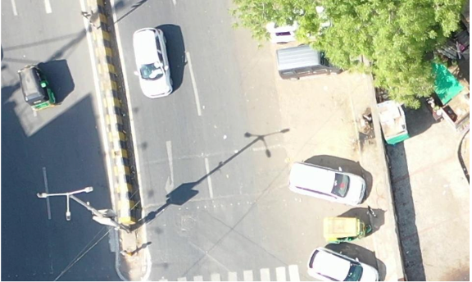
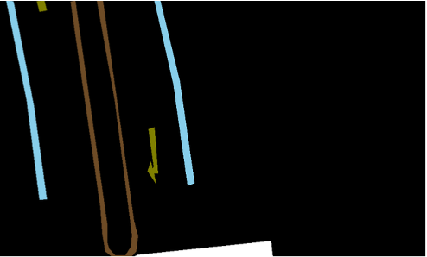
Data
.

Slide 4
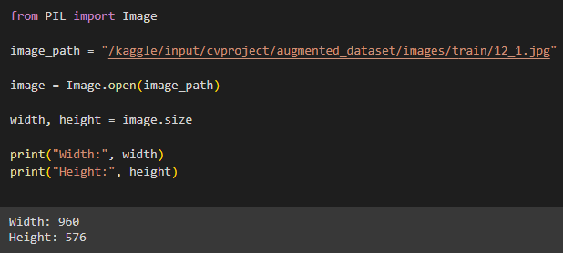
Methodology
1. Data-preprocessing :
Given data is of dimension 960x576, but the input in Unet architecture is 256x256x3

Slide 5

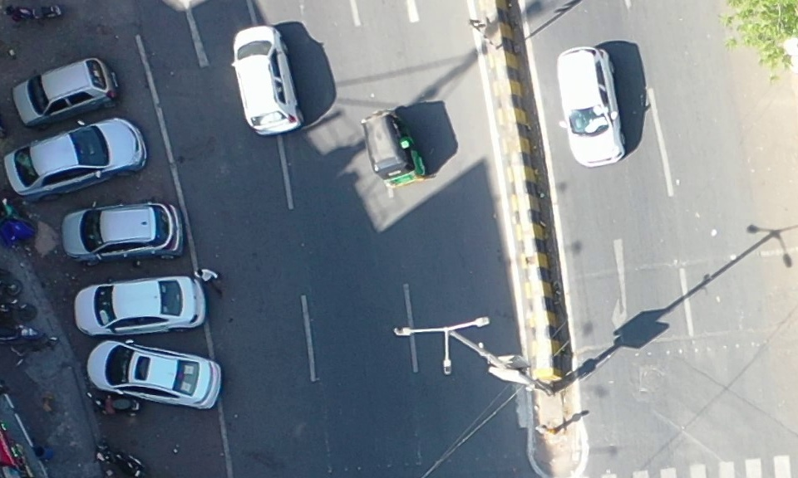
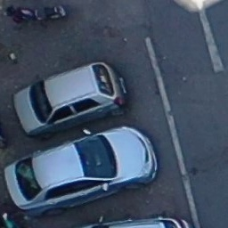
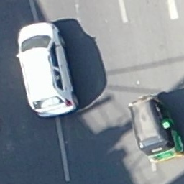
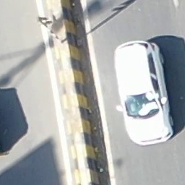
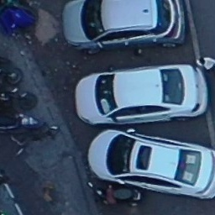
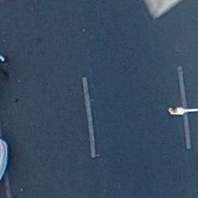
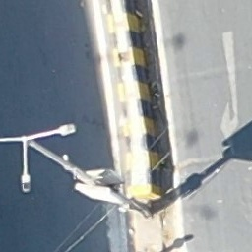
Methodology

Slide 6
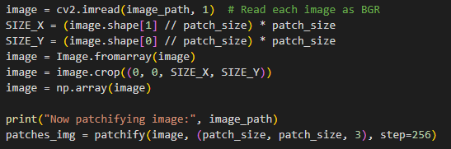
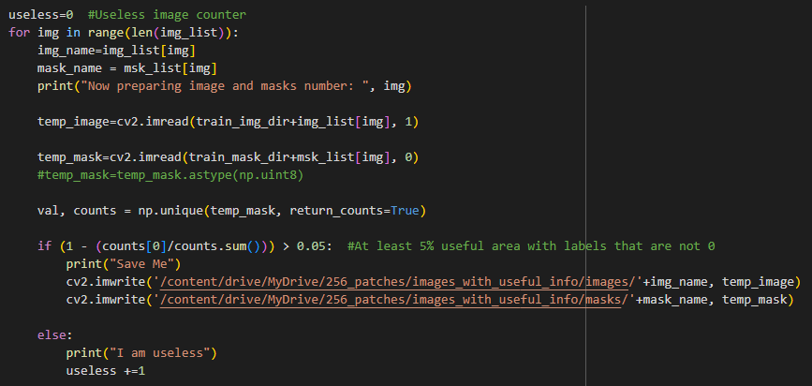
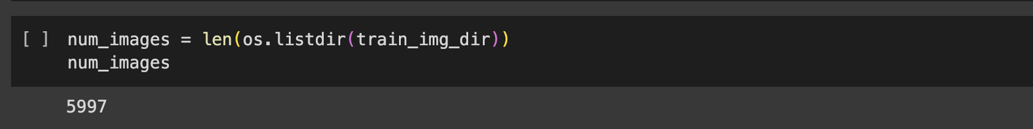
Methodology

Slide 7
Methodology
2. Data Augmentation:
Data augmentation improves model generalization and performance by introducing variations in the training data.
Images and masks with a significant amount of labels (not just background) are identified and saved to a new directory.
Only patches with meaningful information are retained for training.

Slide 8
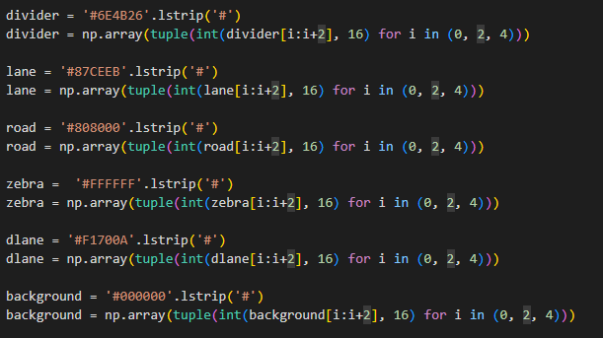
Methodology
Colour encoding :
Assigning HEX colour code and converting them to respective RBG values for all the classes
Then our label masks is given as input in RGB format, then replacing pixel with class labels

Slide 9
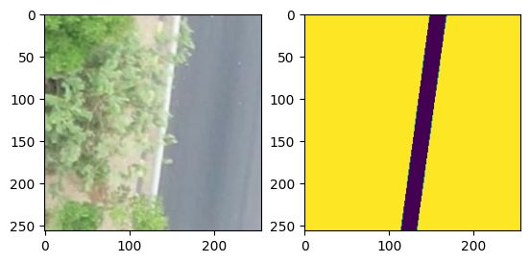
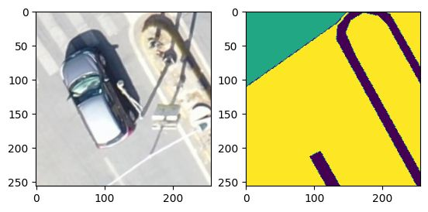
Methodology
After patching and colour encoding, this is the image and mask data that will be used for training

Slide 10
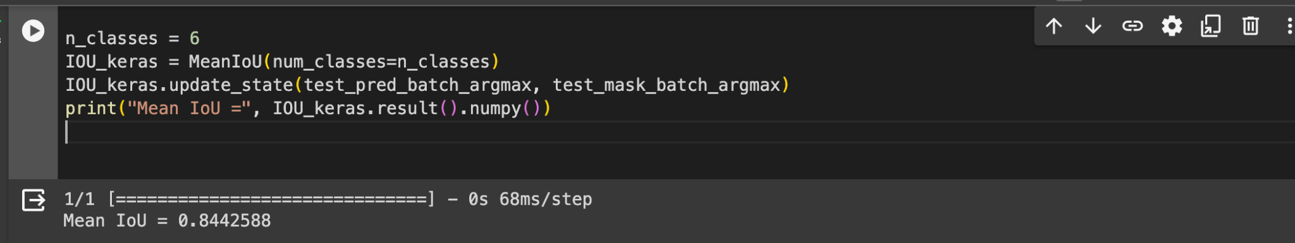
Methodology
3. Model Architecture :
As discussed during the mid-sem presentation we are using U-Net architecture for semantic segmentation by using ResNet-50 as the CNN architecture for the same.
We are using pretrained weights of ImageNet dataset in the U-net model

Slide 11
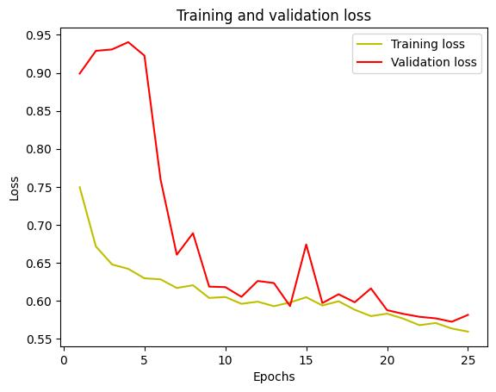
Results

Slide 12
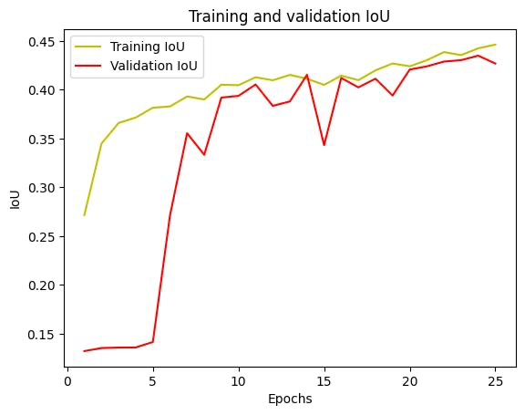
Results

Slide 13
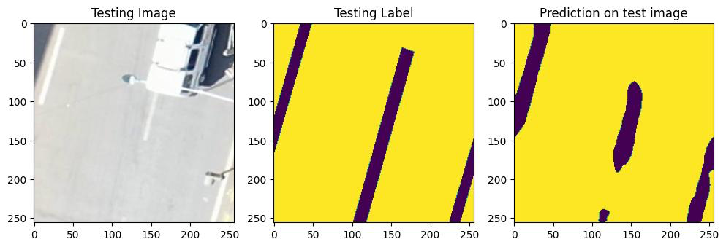
Results

Slide 14
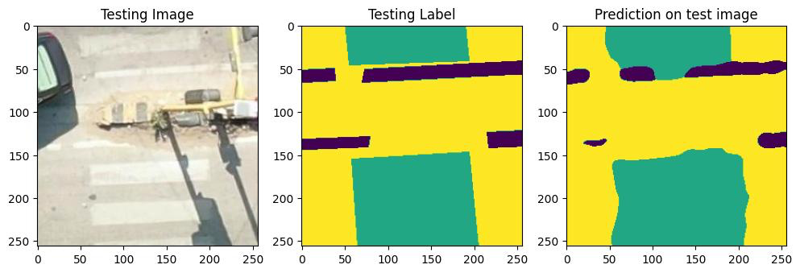
Results

Slide 15
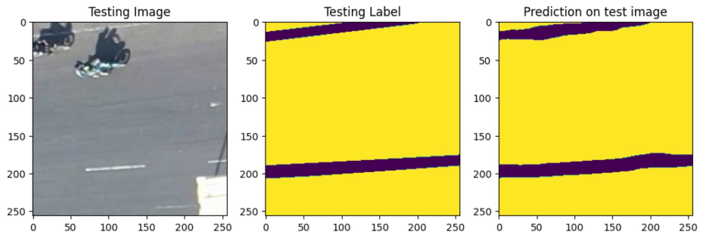
Results

Slide 16
Conclusion
The results are not as expected due to lack of resources, because of which took subset of the training data.
Our model was trained for 25 epochs only, due to which the shape of predicted classes is not accurate.
Mean IOU score: 0.84425
Training | Validation
Loss: 0.5595 | Loss: 0.5725
IOU score: 0.4462 | IOU score: 0.4349

Slide 17
References
[1] S. M. Azimi, P. Fischer, M. Körner, and P. Reinartz, “Aerial LaneNet: Lane marking semantic segmentation in aerial imagery using wavelet-enhanced cost-sensitive symmetric fully convolutional neural networks,” arXiv.org, https://arxiv.org/abs/1803.06904
[1] G. Haiyan, X. Lei, Y. Yu, and H. Zhao, “Road marking extraction in UAV imagery using attentive capsule feature Pyramid Network,” International Journal of Applied Earth Observation and Geoinformation, https://www.sciencedirect.com/science/article/pii/S0303243422000034.
[1] “Image segmentation : Tensorflow Core,” TensorFlow, https://www.tensorflow.org/tutorials/images/segmentation.

Slide 18
Group Members
AU2140164 - Deeprajsinh Gohil AU2140111 - Raiyan Diwan AU2140186 - Vats Patel
AU2140101 - Tejas Pansuriya

Slide 19
Thank You

