Slide 1
Project: Road markings detection and road measurement in aerial imagery
CSE541 – Computer Vision
Instructor: Prof. Mehul Raval

Slide 2
Problem Statement
Road markings play a crucial role in ensuring traffic safety and efficiency. Accurate detection and classification of road markings are essential for autonomous driving systems and intelligent transportation systems.

Slide 3
Approach Explanation
In this report, we propose a deep learning-based approach to address the road marking detection and classification problem. We employ a UNet architecture, a popular choice for semantic segmentation tasks, to segment road images and classify different types of road markings.

Slide 4
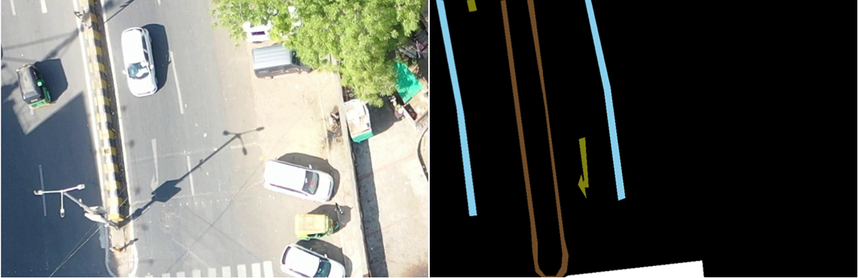
Methodology
1. Data: We have a dataset of road images and corresponding masks, where each color pixel in the mask represents a specific type of road marking and are bifurcated according to the colour as we can see in the image below.
{(104, 76, 44): 0, # dividers
(128, 128, 38):1, # road_sign
(151, 204, 232):2, # lane mark
(221, 255, 255):3, # zebra crossing
(225,119, 48):4} # double line

Slide 5
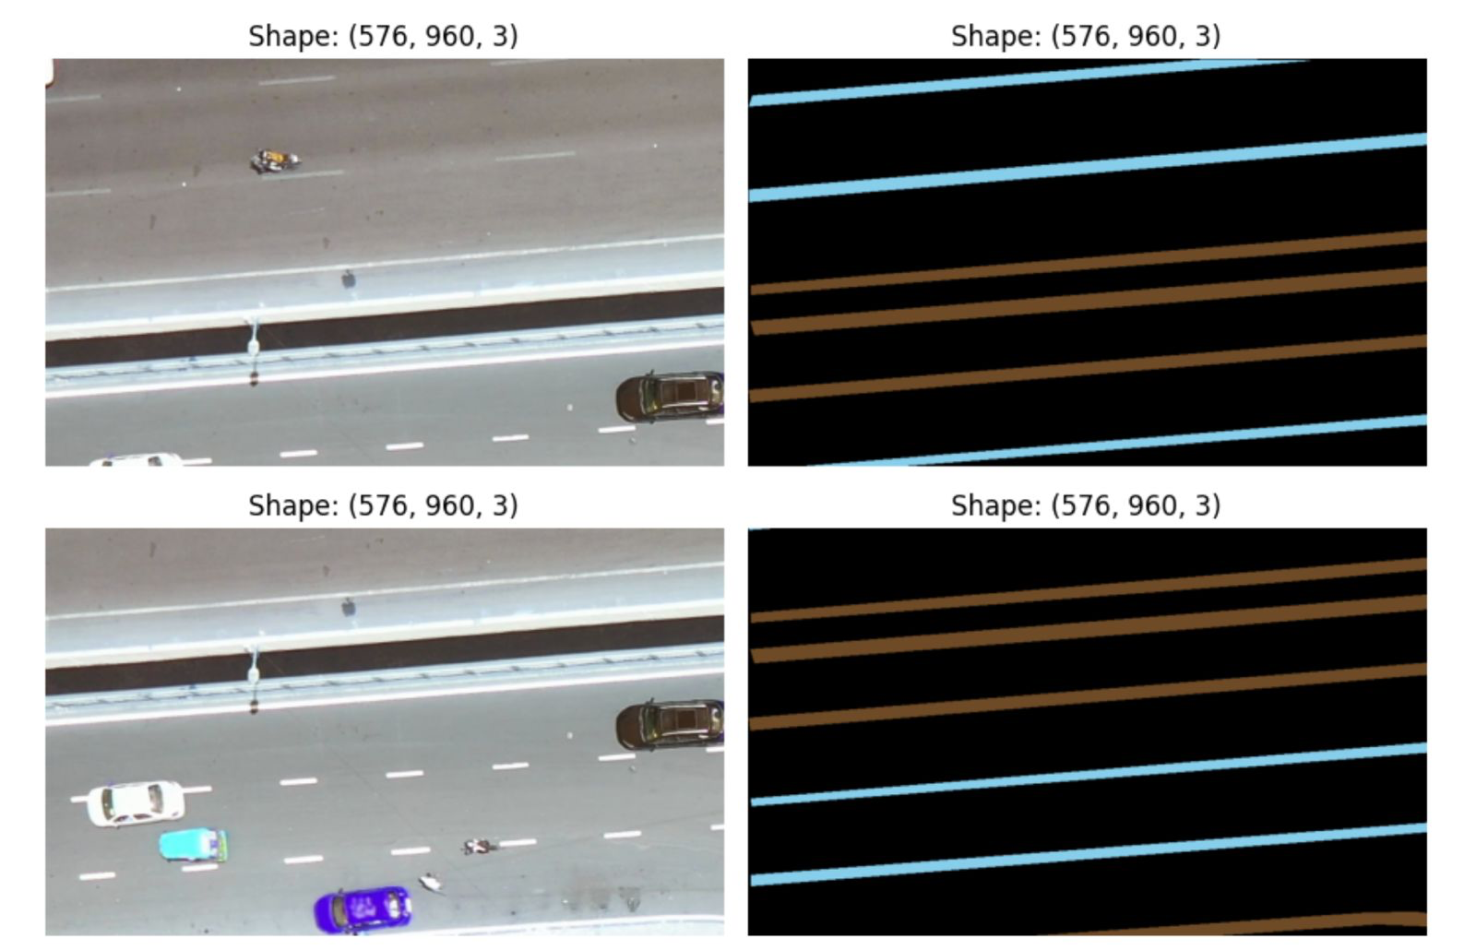
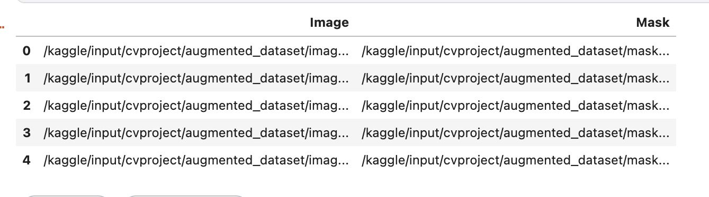

Slide 6
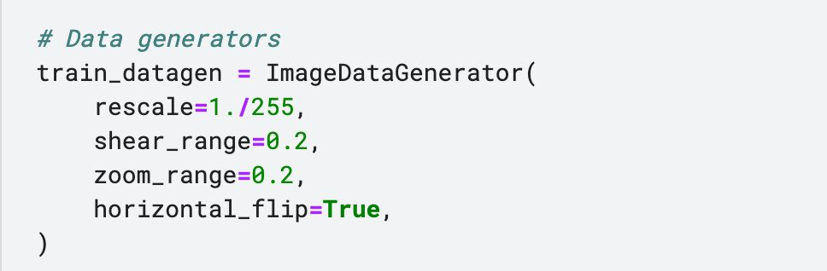
Methodology
2. Data Preprocessing: We preprocess the data by resizing images and masks, and applying transformations such as normalization and augmentation. We are also aligning the masks with its corresponding original images

Slide 7
Methodology
3. Training: In the training phase, we aim to train a deep learning model for road marking detection and classification using a UNet architecture. The model will be trained on a dataset consisting of road images and corresponding masks, where each color pixel in the mask represents a specific type of road marking. The model will be trained using a combination of pixel-wise Dice Loss and Adam optimizer. The training process involves iterating over the dataset and updating the model parameters to minimize the loss function.

Slide 8
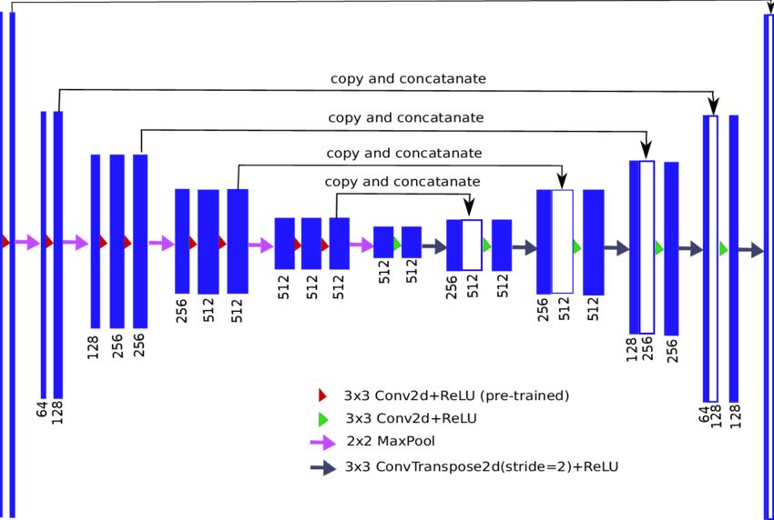
U-net Architecture
Model Architecture: We use a UNet architecture for semantic segmentation, which consists of an encoder-decoder structure with skip connections.

Slide 9
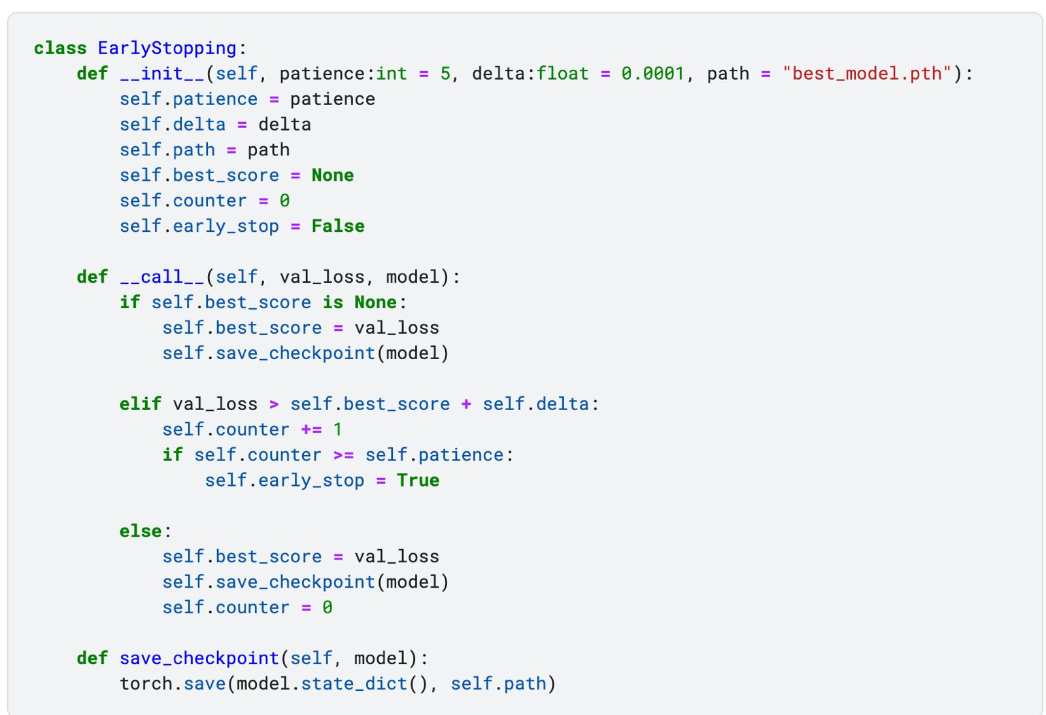

Slide 10
Conclusion
In summary, our current utilization of the UNet architecture has encountered challenges in effectively training the model with the provided dataset. As a result, we have made the strategic decision to explore an alternative approach outlined in the base paper of CapsuleNet.
Looking ahead, our roadmap includes the intention to incorporate both UNet and CapsuleNet architectures into our framework. By doing so, we aim to conduct a analysis to discern the strengths and weaknesses of each approach.

Slide 11
Future Work
In the coming future, we are planning to test our dataset with CapsuleNet which was the approach given to us in our base paper.
The dataset will be same - AU Drone dataset with the ground truth given to us as mask of the image.
We will then compare the results of both UNet and CapsuleNet and compare the accuracy of both the approaches.

Slide 12
Group Members
AU2140164 - Deeprajsinh Gohil AU2140111 - Raiyan Diwan AU2140186 - Vats Patel
AU2140101 - Tejas Pansuriya

Slide 13
References
Encoder-decoder neural network architecture also known as U-Net. . . (n.d.). ResearchGate.
https://www.researchgate.net/figure/Encoder-decoder-neural-network-architecture-also-known-as-U-Net-where-VGG11-neul_fig1_322568421
Guan, H., Lei, X., Yu, Y., Zhao, H., Peng, D., Marcato, J., & Li, J. (2022). Road marking extraction in UAV imagery using attentive capsule feature pyramid network. International Journal of Applied Earth Observation and Geoinformation, 107, 102677. https://doi.org/10.1016/j.jag.2022.102677

Slide 14
Thank You

