Slide 1
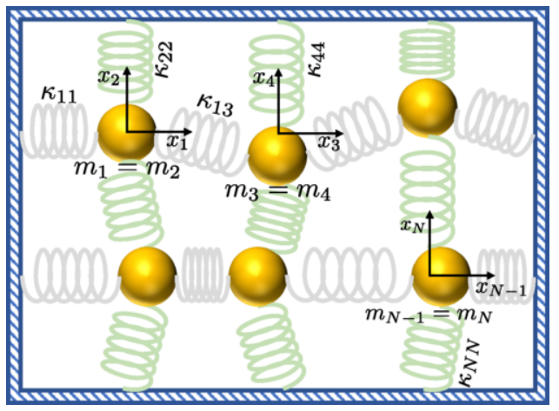

Development of Novel Quantum Algorithms
Exponential quantum speedup in simulating coupled classical oscillators.
Content:
Problem Statement
Solution Description
Achievements
Issues and Future scope
Bibliography and Acknowledgements
Network of classical coupled oscillators (Baboush et al, 2023, https://doi.org/10.1103/PhysRevX.13.041041 , [1])
The Abstract Oscillators Team: Kerem Yurtseven Cristina Radian Viraj Daniel DSouza

Slide 2
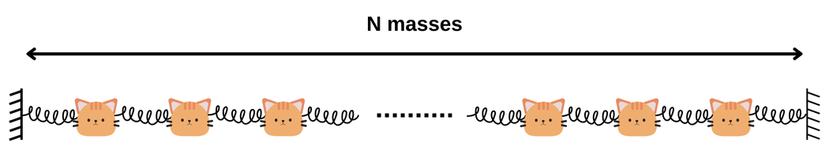
Problem Statement
Building on the theoretical framework from the 2023 study by Babbush et al., our project seeks to translate the exponential quantum speedup in simulating coupled classical oscillators into a practical implementation using Classiq, compatible with current quantum hardware and software.
Project Importance: Achieving this practical quantum advantage would revolutionize fields like material science, climate modeling, and medical technology by enabling unprecedented accuracy and efficiency in complex simulations, driving innovation across multiple disciplines.​

Slide 3
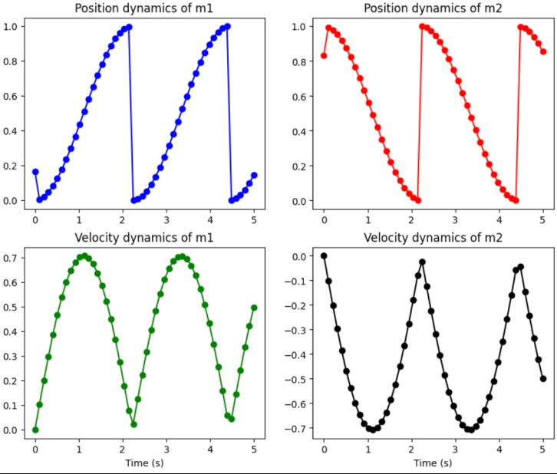
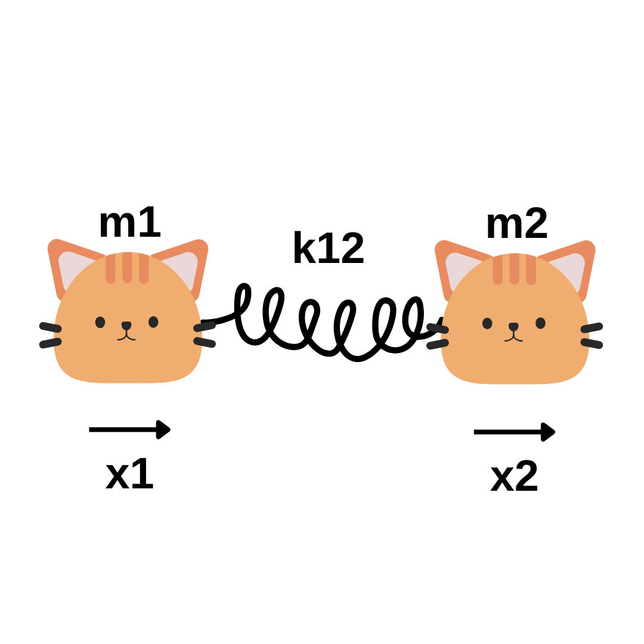
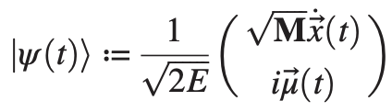
Toy Problem – Task 1
Configuration
Methodology
Results
Pre-Processing
Pauli Decomposition
Post-Processing
Hamiltonian Evolution
N = 2
m1 = m2 = 1
K12 = 1
Product-based
Block Encoding
Errors at t = 0.5
 | Velocities | Positions
Mass 1 | %0.82 | %1.78
Mass 2 | %0.63 | %0.30
Exponentiation
Suzuki Trotter
Qubitization​
QSVT
The final quantum state
!PHASE ERROR!

Slide 4
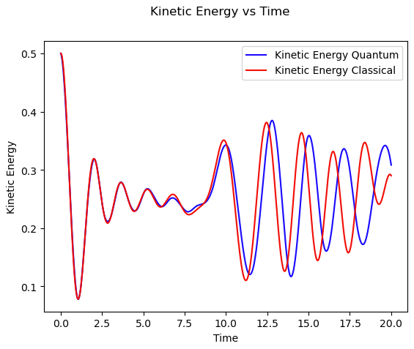
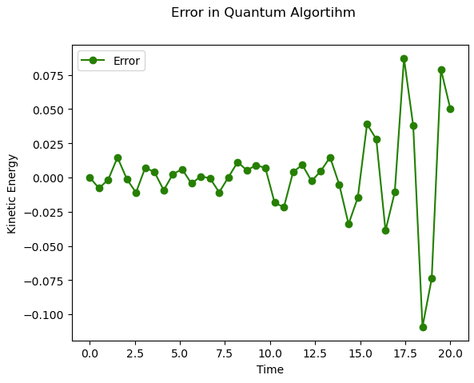
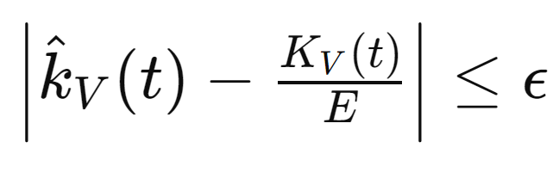
Kinetic Energy Estimation – Task 2
Real Example can be simulated with N = 8 masses to prove the final equation
epsilon = 0.1
epsilon = 0.025
Params: m = 1, k = 1, Suzuki Trotter

Slide 5
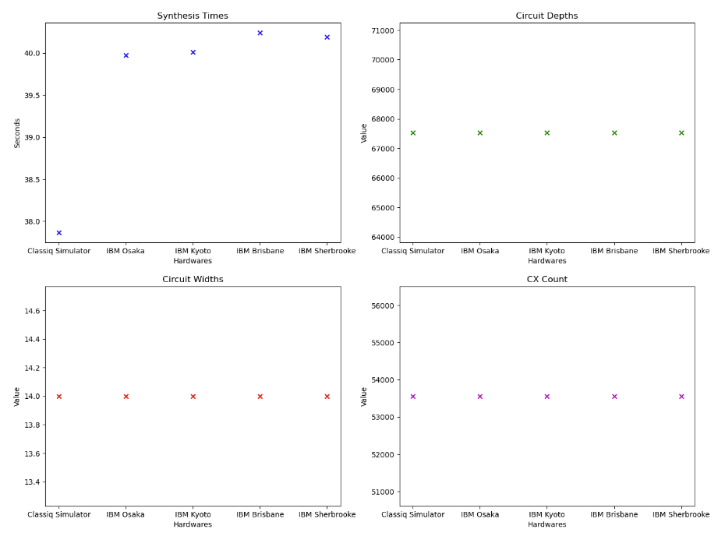
Resource Estimation
Real Quantum Hardwares are critical to understand the importance and reality of quantum algorithms
Compared the following simulator and IBM Quantum Hardware for Kinetic Energy Estimation
Classiq Simulator
IBM Osaka
IBM Kyoto
IBM Sherbrooke
IBM Brisbane
Resource Estimation with Suzuki Trotter

Slide 6
Optimization – Task 3
All of the hardwares give same circuit parameters except synthesis time. So, choose IBM Osaka with lowest time and try to optimize it
IBM Osaka | No Optimization | Depth Optimization | Width Optimization
Synthesis Time | 39.97 s | 66.69 s | 67.00 s
Depth | 67537 | 67537 | 67537
Width | 14 | 14 | 14
CX Gate Number | 53561 | 53561 | 53561
!NO OPTIMIZATION!
CHANGE EVOLUTION METHOD

Slide 7
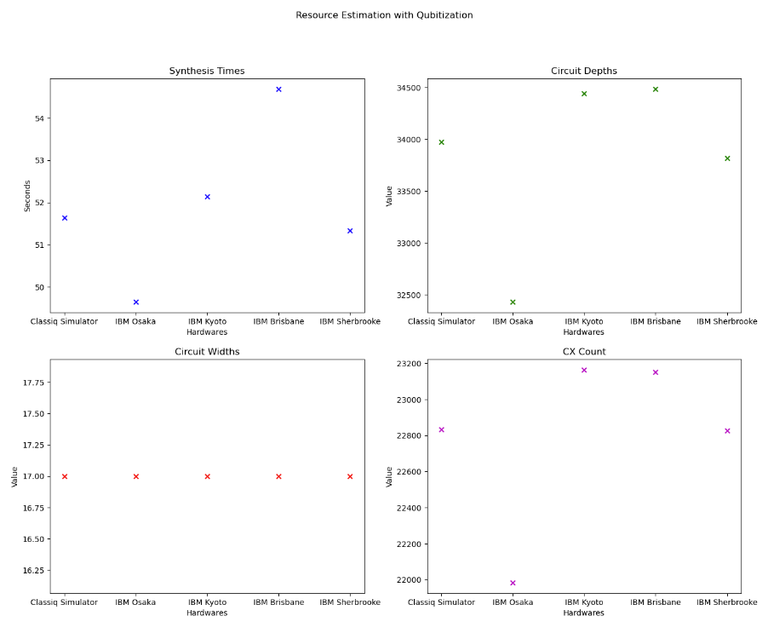
Qubitization
Qubitization for Kinetic Energy Estimation, we set N = 2 due to very long synthesis and execution times
Compared the following simulator and IBM Quantum Hardwares
Classiq Simulator
IBM Osaka
IBM Kyoto
IBM Sherbrooke
IBM Brisbane
Resource Estimation with Qubitization
Hardwares differ a lot in depth and CX gate number and IBM Osaka is the most appropriate amongst them. We chose this for the next step- Optimization

Slide 8
Optimization with Qubitization
IBM Osaka has a maximum of 127 qubits, so we tried to trade-off very large depths for some qubits
IBM Osaka | No Optimization | Depth Optimization | Width Optimization | Depth Opt. 127 Max
Synthesis Time | 49.65 s | 189.37 s | 818.17 s | 2350.92 s
Depth | 32342 | 19767 | 56581 | 19744
Width | 17 | 1273 | 15 | 127
CX Gate Number | 21984 | 14836 | 39098 | 14816
SUCCESSFUL OPTIMIZATION

Slide 9
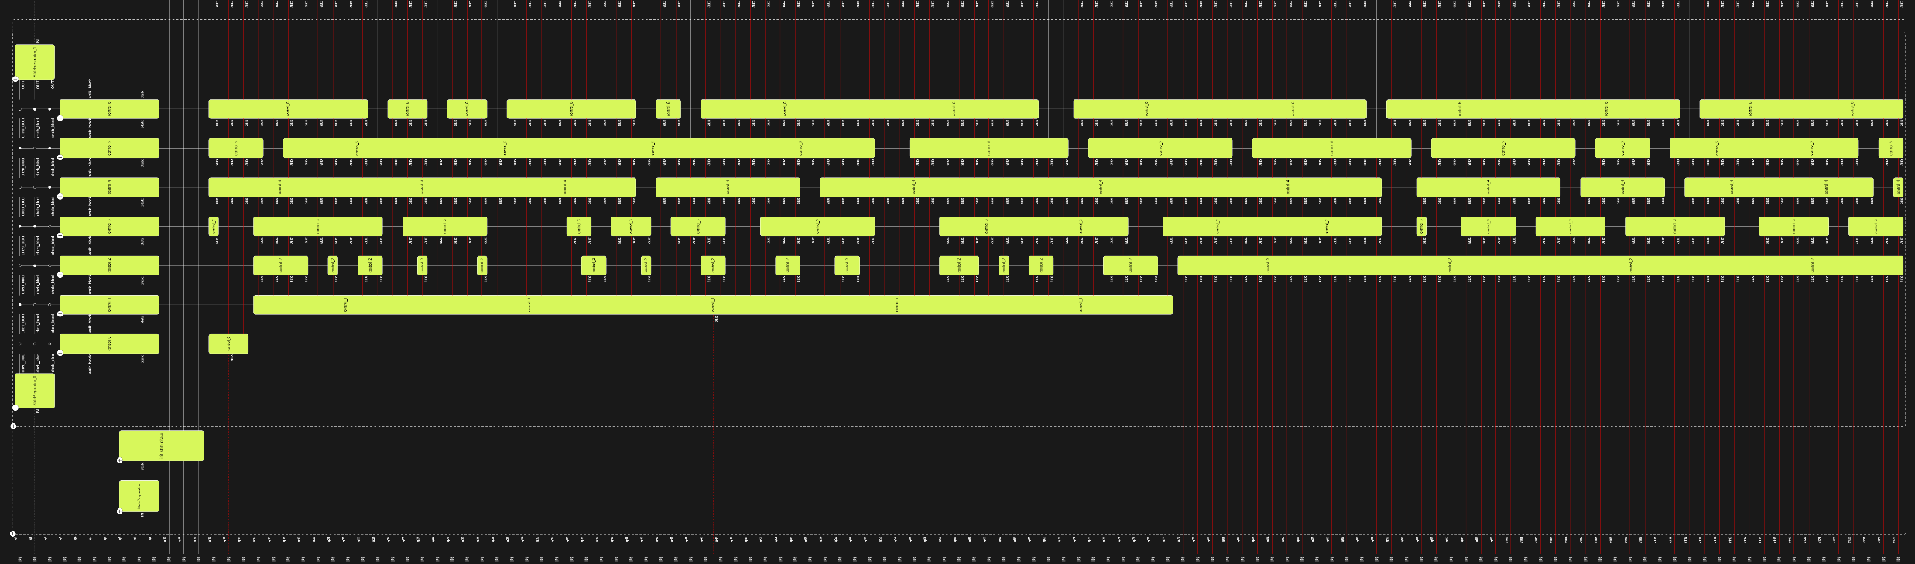
Optimization with Qubitization
127 Qubits

Slide 10
Achievements
Task 1
Toy examples successfully simulated and compared with classical results
Multiple evolution methods implemented with considerable accuracy
Task 2
A real problem from the paper illustrated and theoretical assertions supported with simulations
Resource estimation and hardware comparison for the real problem
Task 3
Most appropriate hardware chosen and tried to get optimized results with different evolution methods
Optimal transpiled circuit created for the implementation of the algorithm on real quantum hardwares

Slide 11
Future Scope and Issues
Issues
Future Scope
Post-processing the global phase
Uncertain positions with singular B matrix
Higher number of masses
Further optimization on real quantum hardware
Real quantum hardware simulations with higher number of masses
Post-processing for the results of real quantum hardware
Generalization for different subjects such as electric circuit simulations, molecular simulations, climate modelling, material science etc.​

Slide 12
Bibliography and Acknowledgements
Bibliography:
R. Babbush, D. W. Berry, R. Kothari, R. D. Somma, and N. Wiebe, Exponential Quantum Speedup in Simulating Coupled Classical Oscillators, Phys. Rev. X 13, 041041 (2023), https://doi.org/10.1103/PhysRevX.13.041041
2. G.H. Low, I.L. Chuang, *Hamiltonian simulation by Qubitization*, published in Quantum, 3 (2019), p. 163, https://doi.org/10.22331/q-2019-07-12-163
András Gilyén, Yuan Su, Guang Hao Low, and Nathan Wiebe. 2019. Quantum singular value transformation and beyond: exponential improvements for quantum matrix arithmetics. In Proceedings of the 51st Annual ACM SIGACT Symposium on Theory of Computing (STOC 2019). Association for Computing Machinery, New York, NY, USA, 193–204. https://doi.org/10.1145/3313276.3316366, link to paper
M. Szegedy, "Quantum speed-up of Markov chain based algorithms," In 45th Annual IEEE symposium on foundations of computer science, pages 32–41, 2004, link to paper
Classiq Github Glued Trees https://github.com/Classiq/classiq-library/blob/9c43f05f3d498c8c72be7dcb3ecdaba85d9abd6e/algorithms/glued_trees/glued_trees.ipynb#L4
Classiq Github Hamiltonian Qubitization https://github.com/Classiq/classiq-library/tree/9c43f05f3d498c8c72be7dcb3ecdaba85d9abd6e/tutorials/hamiltonian_simulation/hamiltonian_simulation_with_block_encoding
Classiq documentation https://docs.classiq.io/latest/
Acknowledgments
A heartfelt gratitude to Womanium Team for designing & organizing this program and offering scholarships.
Special thanks to Eden Shirman, Tomer Goldfriend, and everyone at Classiq.
This project uses Classiq Github by Classiq.

Slide 13

THANKS!

