Slide 1
A guide to time and frequency in the EEG
Matt Craddock
University of Leeds
AQM workshop
University of York
28th May 2015

Slide 2
http://bit.ly/1AuXCqI
Download this ZIP file!
addpath('C:\User Files\matlabeeglab\fieldtrip-20150520')
addpath('C:\User Files\matlabeeglab\Matt\YorkTutorial\')

Slide 3
The temporal domain - ERP

Slide 4
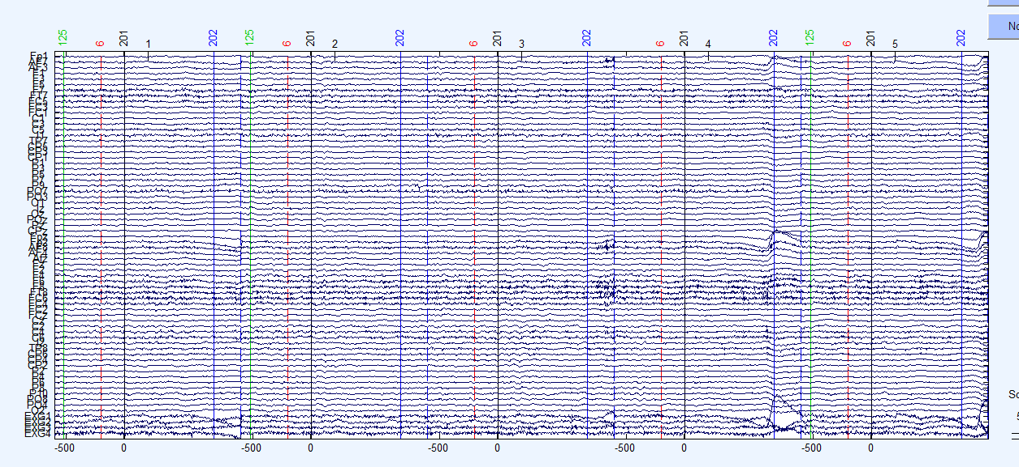
The raw EEG

Slide 5
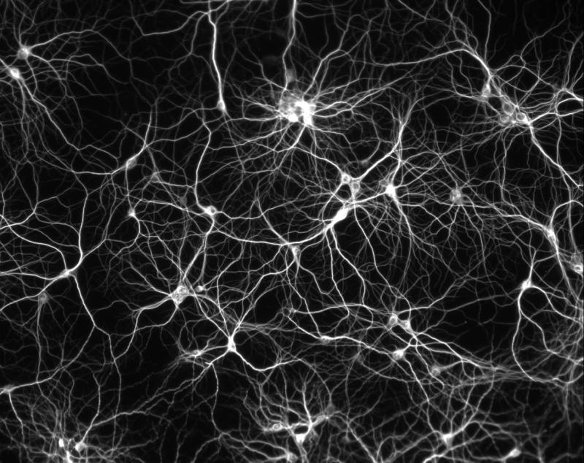

Slide 6
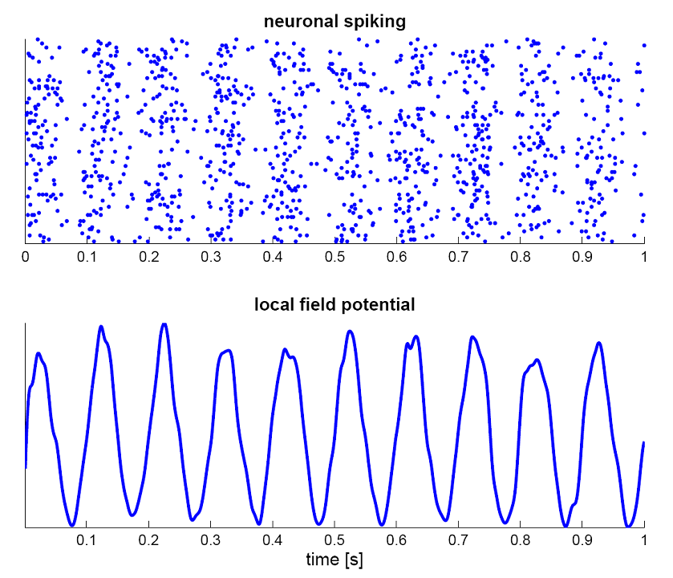

Slide 7
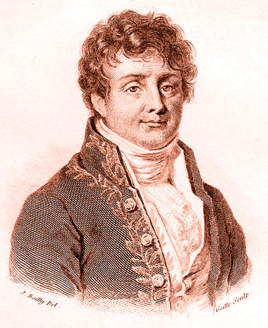
Joseph Fourier
Any function of a variable, whether continuous or discontinuous, can be expanded in a series of sines of multiples of the variable.

Slide 10
I. How to describe and create an oscillatory signal

Slide 11
Asin(2πft+θ)
(Amplitude*sin(2*pi*frequency*time+phase))
Load exampleSignal.m

Slide 12
exampleSignal.m

Slide 13
Amplitude
Amplitude
Time (s)
amplitude = .75;

Slide 14
Frequency
Amplitude
Time (s)
frequency = 5;

Slide 15
Phase
Amplitude
Time (s)
phase = .75;

Slide 16
Play around a bit with amplitude, frequency and phase! Load exampleSignal.m

Slide 17
II. The Fourier Transform and Frequency Analysis

Slide 18
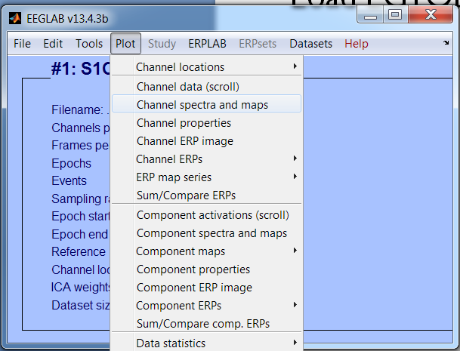
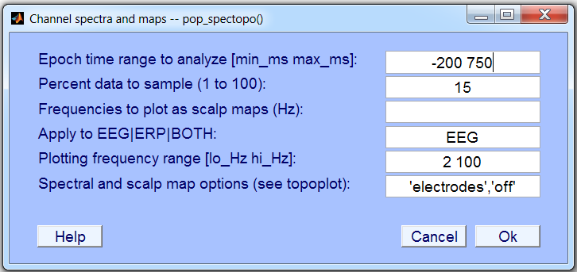
Some real data!
Start EEGLAB
Load EG1ObjOnly
SELECT THIS
SET IT UP LIKE THIS

Slide 20
Power decreases as frequency increases – hence, it follows a 1/f power distribution

Slide 21
compositeSignal.m

Slide 22
compositeSignal.m

Slide 23
The Fast Fourier Transform
doFFT(composite,samplingRate,0,0)

Slide 24
Play around a bit with the signal and the FFT! Edit compositeSignal.m to make a new signal, then run doFFT(composite,samplingRate,0,0)

Slide 25
Dot product
2
Amplitude
0
-2
0
0.2
0.4
0.6
0.8
1
Time (seconds)
2
Amplitude
0
-2
0
0.2
0.4
0.6
0.8
1
Time (seconds)
2
Sum (
Amplitude
) = a + bi
0
-2
0
0.2
0.4
0.6
0.8
1
Time (seconds)

Slide 26
Complex number
B
A+Bi
A = real
Bi = imaginary
A

Slide 27
+

Slide 28
Complex number
+
A = real
Bi = imaginary
A+Bi
Bi
A

Slide 29
Bi
A
A = amplitude/magnitude
Bi = phase

Slide 31
Play around a bit with the signal and the FFT! Edit compositeSignal.m to make a new signal, then run doFFT(composite,samplingRate,0,0)

Slide 32
WHY 125 Hz?
doFFT(composite,samplingRate,0,0)
Notes:
Why 125 Hz, why so many dots? b/c Nyquist and frequency resolution

Slide 33
Nyquist theorem
Max frequency = half sample rate!
10 Hz sampling rate
15 Hz sampling rate
exampleSignal.m

Slide 34
Sampling rate
20 Hz sampling rate
10 Hz signal
0.75 phase
exampleSignal.m

Slide 35
Sampling rate
20 Hz sampling rate
10 Hz signal
0.5 phase
No amplitude???
20 Hz sampling rate
10 Hz signal
0.6 phase
exampleSignal.m

Slide 36
Sampling rate
40 Hz
exampleSignal.m

Slide 37
WHY THIS MANY DOTS, AND HOW FAR APART ARE THEY??
doFFT(composite,samplingRate,0,0)
Notes:
Why 125 Hz, why so many dots? b/c Nyquist and frequency resolution

Slide 38
.25 second signal
4 Hz frequency precision

Slide 39
Frequency precision/resolution
.25 second window
What is the shortest frequency that completes a full cycle?

Slide 40
Frequency precision/resolution

Slide 41
Play around a bit with signal duration and sample rate! compositeSignal.m doFFT(composite,samplingRate,0,0)

Slide 42
WHAT ARE THESE EXTRA FREQUENCIES?

Slide 43
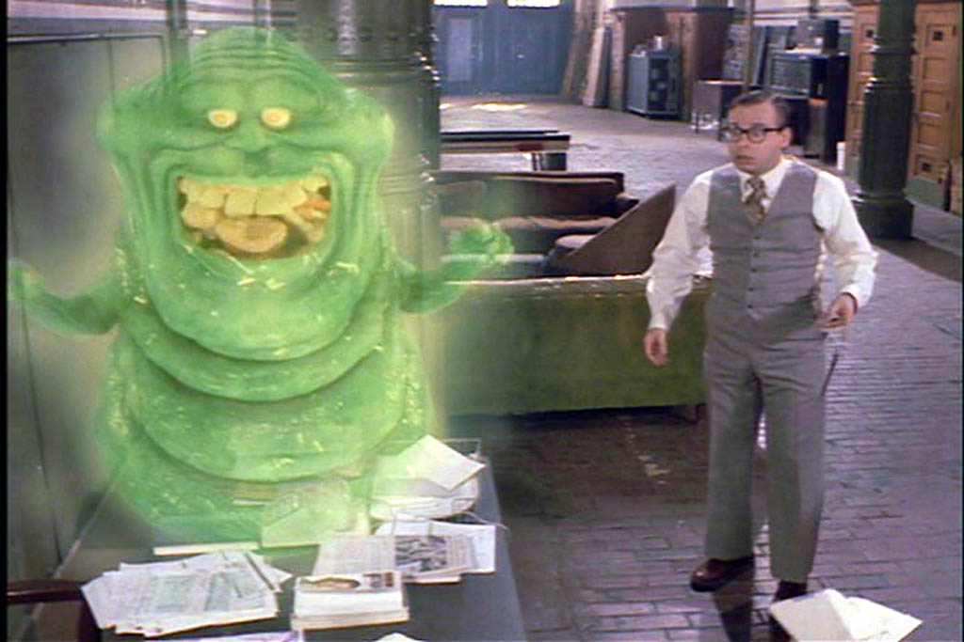
Spectral leakage

Slide 44
Edge artefacts
FFT treats signals as if they were a sample from an *infinite* signal.
Extending a sine infinitely is fine…
…but for a real signal it “wraps around” when it hits the edge

Slide 45
Edge artefacts
Sharp offsets cause artefactual, high frequency artefacts

Slide 46
Aliasing
Sampling rate = 30 Hz
Red line = 50 Hz signal

Slide 47
Windowing
Hann/Hanning Window

Slide 48
Edge artefacts

Slide 49
Still some leakage, but reduced!
doFFT(composite,samplingRate,0,1)

Slide 50
Red = Hann taper
Black = No taper

Slide 51
Note: doFFT(composite,samplingRate,0,1) performs Hann tapering

Slide 52
III. Time-Frequency Analysis

Slide 53
Stationary
Non-stationary
timeVaryingSignal.m

Slide 54
Stationary
Non-stationary
6
6
5
5
4
4
3
3
2
2
1
1
Amplitude
Amplitude
0
0
-1
-1
-2
-2
-3
-3
-4
-4
-5
0
1
2
-5
0
1
2
Time (seconds)
Time (seconds)
timeVaryingSignal.m

Slide 55
6
5
4
3
2
1
Amplitude
0
-1
-2
-3
-4
-5
-0.5
0
0.5
1
1.5
2
2.5
Time (seconds)
doFFT(compositeVarying,samplingRate,0,0)

Slide 56
Bringing time back…
timeVaryingExample.m

Slide 57
Create a signal with timeVaryingSignal.m, then use the first cell of timeVaryExample.m to plot a time-frequency representation

Slide 58
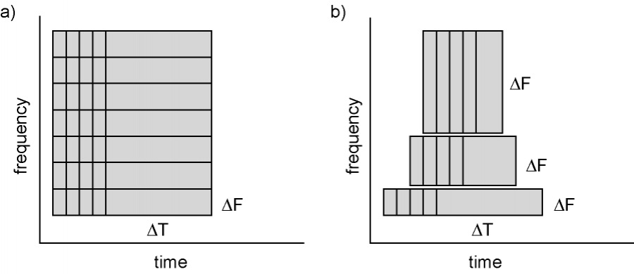
Sliding window FFT
Constant length
Scaling length
http://www.fieldtriptoolbox.org

Slide 59
Convolution
6
5
4
3
2
1
Amplitude
0
-1
-2
-3
-4
-5
-0.5
0
0.5
1
1.5
2
2.5
Time (seconds)

Slide 60
Convolution
6
5
4
3
2
1
Amplitude
0
-1
-2
-3
-4
-5
-0.5
0
0.5
1
1.5
2
2.5
Time (seconds)

Slide 61
Morlet wavelets
10 Hz
7 cycle width

Slide 62
createMorlet.m

Slide 63
createMorlet.m

Slide 64
Convolution
6
5
4
3
2
1
Amplitude
0
-1
-2
-3
-4
-5
-0.5
0
0.5
1
1.5
2
2.5
Time (seconds)

Slide 65
Convolution
6
5
4
3
2
1
Amplitude
0
-1
-2
-3
-4
-5
-0.5
0
0.5
1
1.5
2
2.5
Time (seconds)

Slide 66
Convolution
6
5
4
3
2
1
Amplitude
0
-1
-2
-3
-4
-5
-0.5
0
0.5
1
1.5
2
2.5
Time (seconds)

Slide 67
timeVaryExample.m

Slide 68
timeVaryExample.m

Slide 69
timeVaryExample.m

Slide 70
timeVaryExample.m

Slide 71
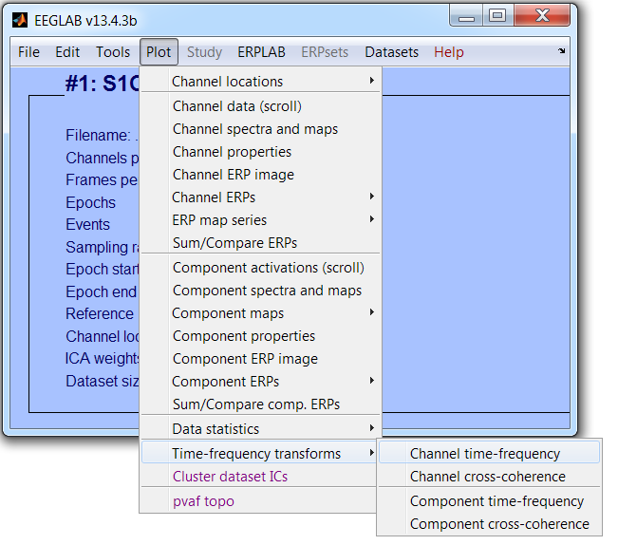
Open EEGLAB
Load EG1ObjOnly

Slide 72
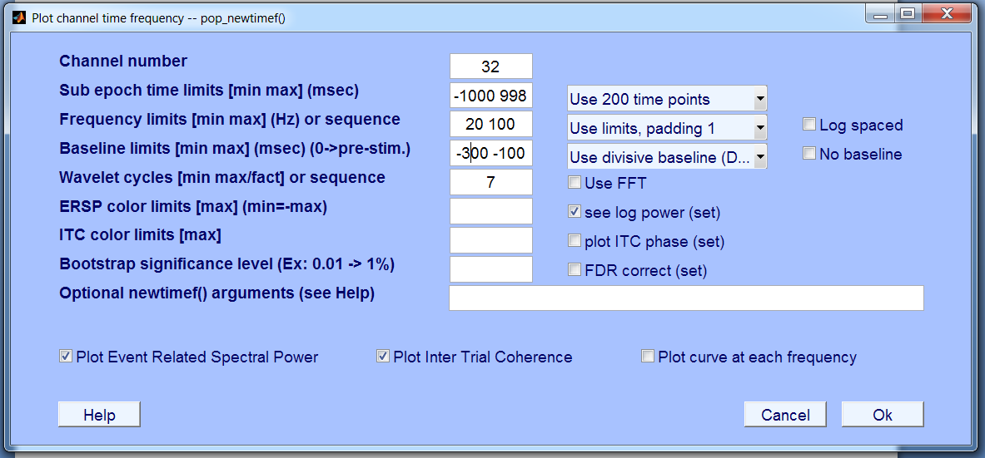

Slide 74
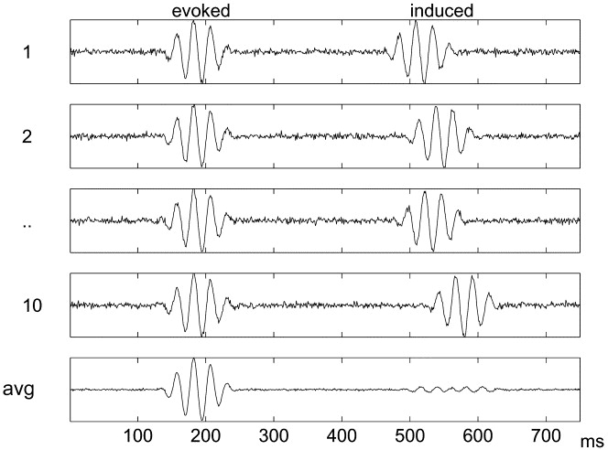
Evoked versus induced activity

Slide 75
Intertrial coherence/phase-locking index

Slide 76
Intertrial coherence/phase-locking index

Slide 77
Intertrial coherence/phase-locking index

Slide 78
Fieldtrip toolbox
www.fieldtriptoolbox.org
Specialized toolbox for time-frequency analysis
Scripting only!
More powerful!
More flexible!

Slide 79
How to get your data into Fieldtrip
Make sure you have eeglab open and EG1ObjOnly loaded
Type data = eeglab2fieldtrip(EEG,’preprocessing’)
Load fieldtripSingleTaper.m

Slide 81
Baseline corrected

Slide 82
Different baselines
Absolute
Same as typical ERP
Relative change
Controls for 1/f power spectrum, amp. At diff sites
None!
Sometimes not considered necessary
Offset from 0 is baseline and included in all conditions by default

Slide 83
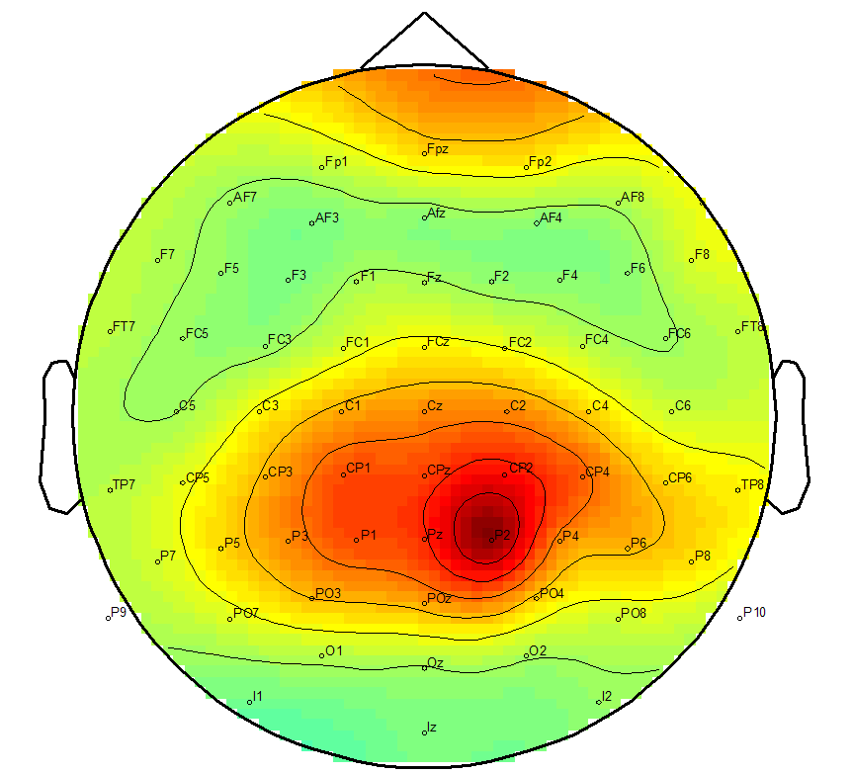
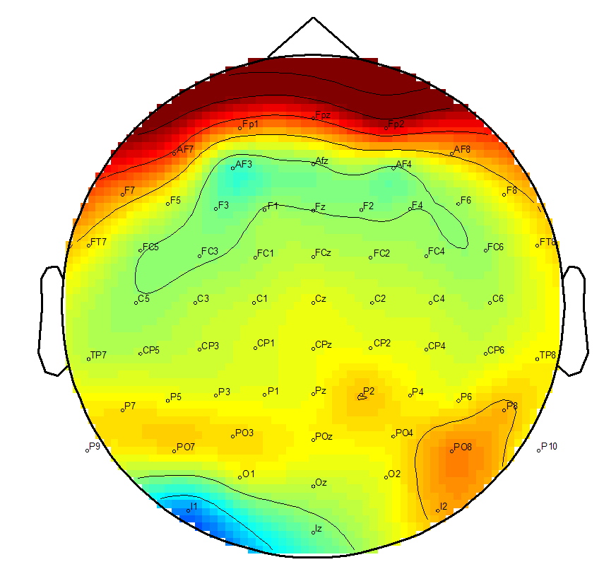
Baseline correction
Relative change
Absolute change

Slide 84
No baseline
Relative change baseline

Slide 85
Low frequency activity at CPz

Slide 86
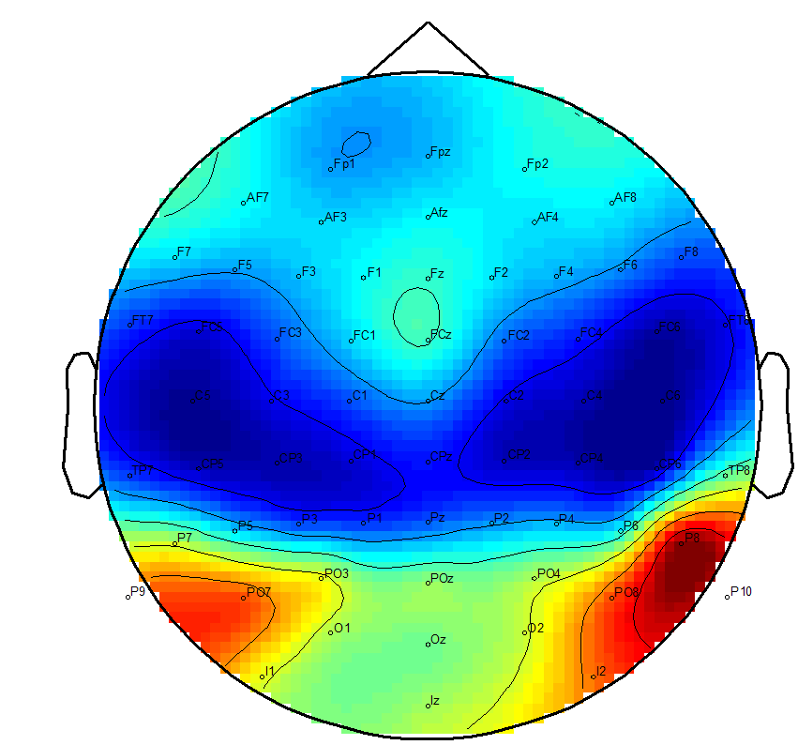
Power at 6-10 Hz, 100-300 ms after stimulus onset

Slide 87
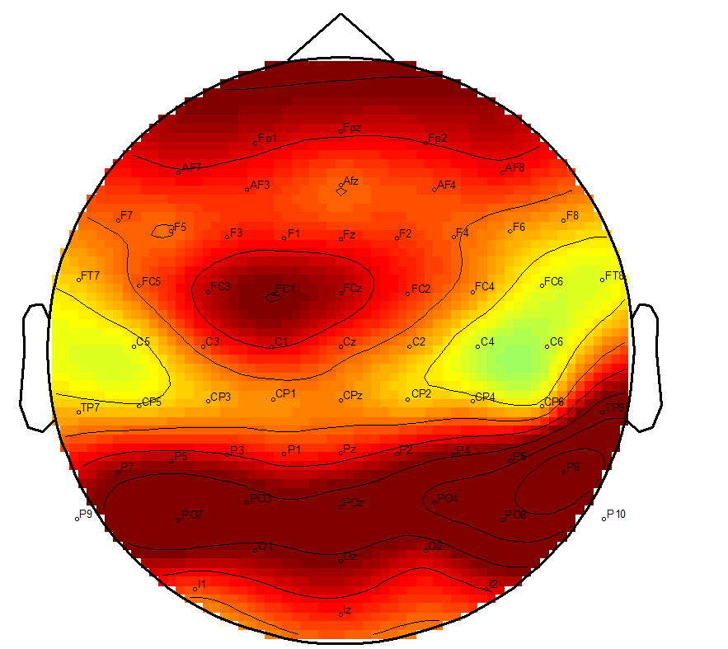
Power at 6-10 Hz, 100-300 ms after stimulus onset

Slide 88
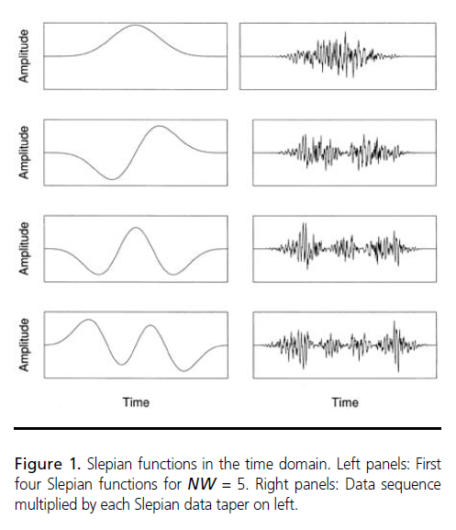
Multitapers
The estimates from all the tapers are averaged together to provide a single estimate
Good control over spectral leakage, frequency smoothing, and temporal smoothing.
For me, more intuitive to design than wavelets.
Load fieldtripMultiTaper.m
Pesaran (2008)

Slide 89
High-frequency activity

Slide 90
Baseline corrected

Slide 91
Refs/Acknowledgements
Dorothy Bishop’s frequency analysis tutorial
http://bishoptechbits.blogspot.co.uk
FieldTrip – a Matlab toolbox for time-frequency analysis
http://www.fieldtriptoolbox.org
Tutorial from Steve Luck’s lab
http://erpinfo.org/Members/ldtien/bootcamp-lecture-pptx/13-%20Time-Frequency%20Analysis.pptx/at_download/file

Slide 92
