Slide 1

ASP.NET Core & Docker From Zero to Azure in 60 (+ ☺) minutes
Marco De Sanctis
Visual Studio and Development Technologies MVP
info@marcodesanctis.it | @crad77

Slide 2
Agenda
What’s Docker and why should I care
ASP.NET Core & Docker
Let’s port a non-trivial project to Docker and AKS

Slide 3
Disclaimer
We are going to use some command line, but cmon, it’s not that scary, is it? ☺
Anyway, don’t worry: it’s just a few commands, and I’ll provide you a reference of everything we are going to use

Slide 4
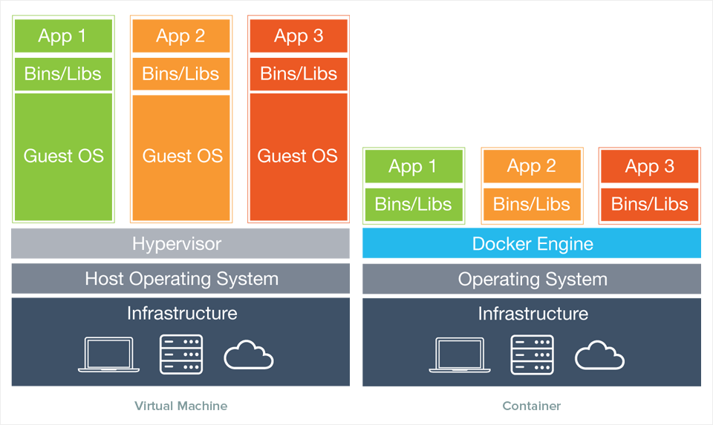
How did we get here
Service density++ ☺

Slide 5
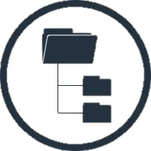

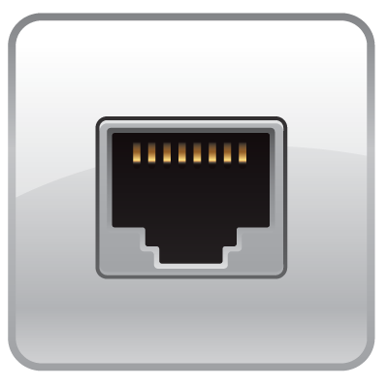
Containers == Virtualized Operating System
Kernel namespaces (Linux e Windows)
Virtual File System
Virtual Process Tree
Virtual Network

Slide 6
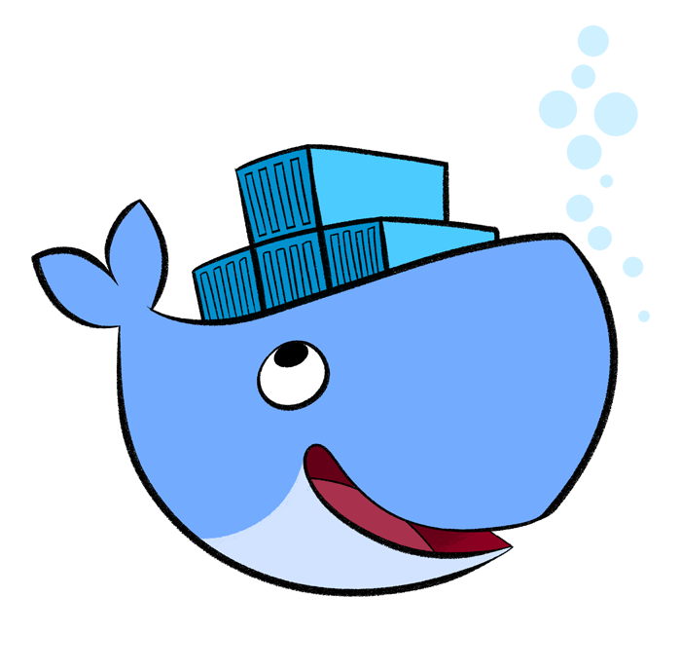
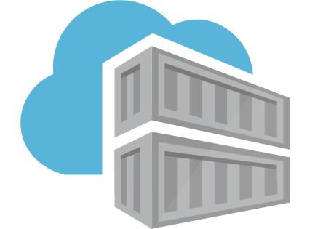
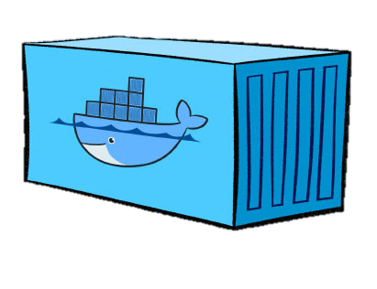
Docker is a (the) container engine
Image
Engine
Container
Docker (aka Moby project) is free and open source, no limitations
There’s an enterprise edition (hosting, support, certification...)
It’s the de-facto standard for container-based applications

Slide 7
Let’s get started!! ☺
Demo

Slide 8

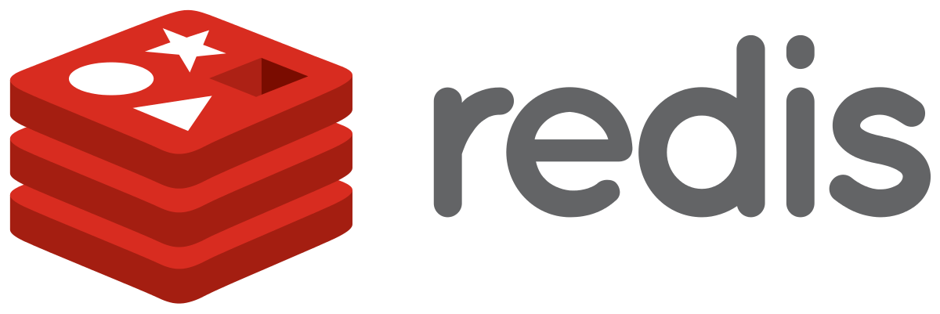


What we are going to build
Front end
ASP.NET Core MVC
Back end
ASP.NET Core MVC

Slide 9
Dockerfile explained
Host machine
base
dotnet:2.1-aspnetcore-runtime
80
/app
FROM microsoft/dotnet:2.1-aspnetcore-runtime AS base
WORKDIR /app
EXPOSE 80
FROM microsoft/dotnet:2.1-sdk AS build
WORKDIR /src
COPY Backend/Backend.csproj Backend/
COPY Entities/Entities.csproj Entities/
RUN dotnet restore Backend/Backend.csproj
COPY . .
WORKDIR /src/backend
RUN dotnet build -c Release -o /app
FROM build AS publish
RUN dotnet publish -c Release -o /app
FROM base AS final
WORKDIR /app
COPY --from=publish /app .
ENTRYPOINT ["dotnet", "backend.dll"]
build
dotnet:2.1-sdk
/src
Backend.csproj
Entities.csproj
Backend.csproj
Entities.csproj
Packages
program.cs
start.cs, …
program.cs
start.cs, …
/app
backend.dll
publish
dotnet:2.1-sdk
/src
*.csproj, *.cs
Pkgs
/app
.dll
Pkgs
/views
final
dotnet:2.1-aspnetcore-runtime
/app
/app
.dll
Pkgs
/views
80
$: dotnet backend.dll

Slide 10

Dockerfile explained
Host machine
base
dotnet:2.1-aspnetcore-runtime
80
/app
FROM microsoft/dotnet:2.1-aspnetcore-runtime AS base
WORKDIR /app
EXPOSE 80
FROM microsoft/dotnet:2.1-sdk AS build
WORKDIR /src
COPY Backend/Backend.csproj Backend/
COPY Entities/Entities.csproj Entities/
RUN dotnet restore Backend/Backend.csproj
COPY . .
WORKDIR /src/backend
RUN dotnet build -c Release -o /app
FROM build AS publish
RUN dotnet publish -c Release -o /app
FROM base AS final
WORKDIR /app
COPY --from=publish /app .
ENTRYPOINT ["dotnet", "backend.dll"]
build
dotnet:2.1-sdk
/src
Backend.csproj
Entities.csproj
Backend.csproj
Entities.csproj
Packages
program.cs
start.cs, …
program.cs
start.cs, …
/app
backend.dll
publish
dotnet:2.1-sdk
/src
*.csproj, *.cs
Pkgs
/app
.dll
Pkgs
/views
final
dotnet:2.1-aspnetcore-runtime
/app
/app
.dll
Pkgs
/views
80
$: dotnet backend.dll

Slide 11
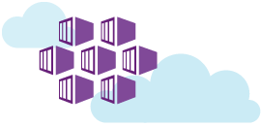
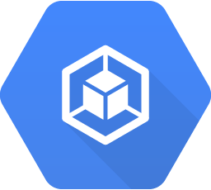
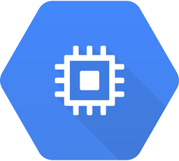
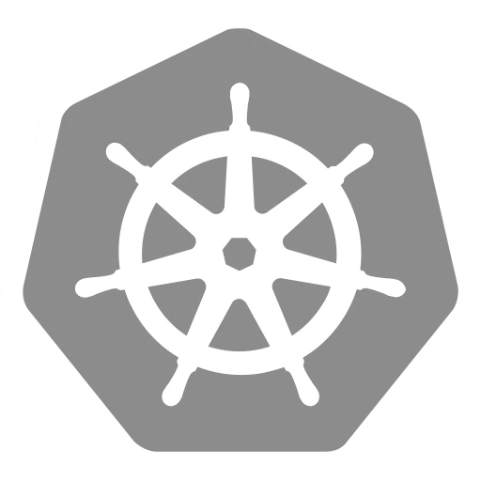
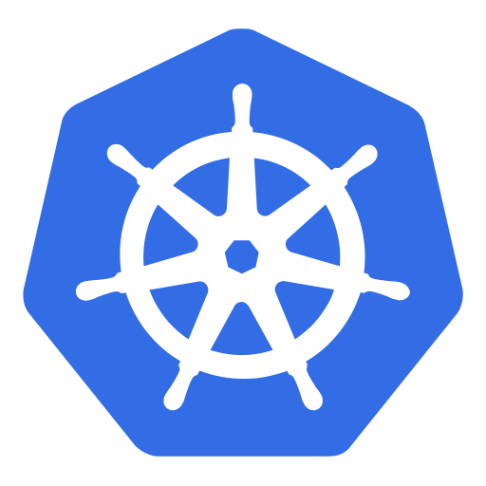
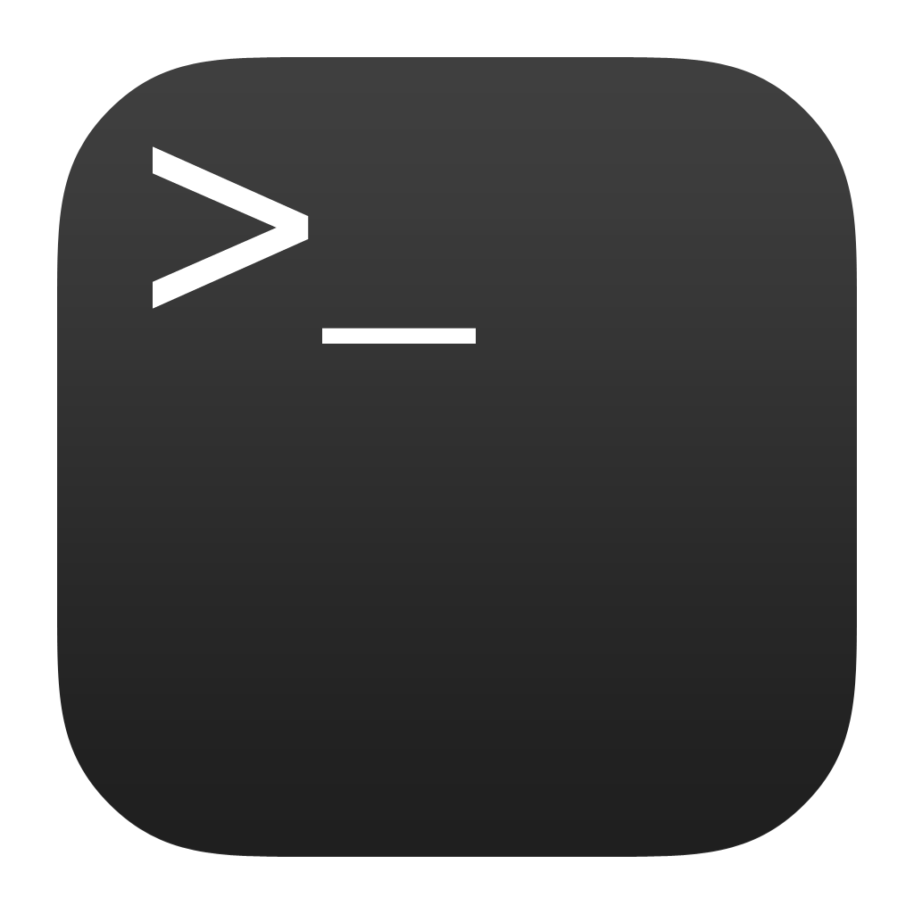
We need an orchestrator: enter Kubernetes and AKS
Running Pods
(~containers)
Agent
nodes
Master
nodes
Kubectl
CLI

Slide 12
Our application...
Front end
ASP.NET Core MVC
Back end
ASP.NET Core MVC

Slide 13
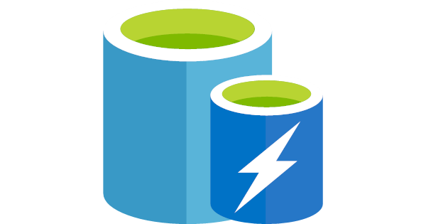
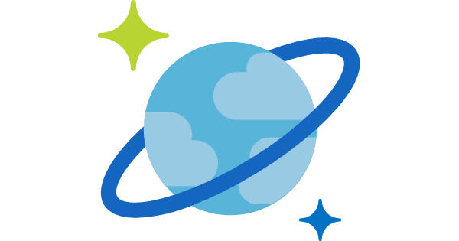
Let’s leverage Azure PaaS
Front end
ASP.NET Core MVC
Back end
ASP.NET Core MVC
Azure Redis Cache
Azure Cosmos DB

Slide 14
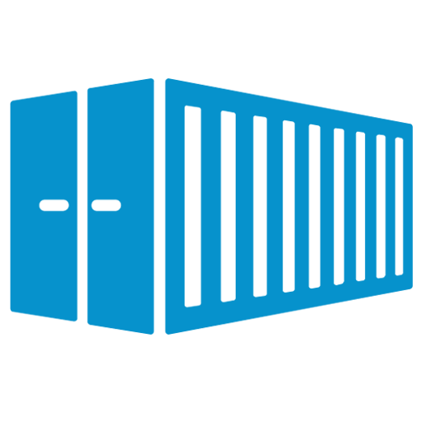
Kubernetes objects are created through its REST API
Service
apiVersion: v1
kind: Service
metadata:
name: frontend-svc
spec:
ports:
- port: 80
selector:
app: frontend
Deployment
HOST: frontend-svc
apiVersion: apps/v1beta1
kind: Deployment
metadata:
name: frontend-dpy
spec:
replicas: 3
template:
metadata:
labels:
app: frontend
spec:
containers:
- name: frontend
image: myreg/frontend:latest
ports:
- containerPort: 80
app: frontend
ReplicaSet
Upgrade policy
Pod
frontend
frontend
frontend
10.1.0.11:80
10.1.0.19:80
10.1.0.47:80
app: frontend
app: frontend
app: frontend

Slide 15
Recap
Run Mongo & Redis as Docker containers
Dockerised frontend and backend
Added nginx
Described the whole system on docker-compose
Run all of it on our laptop
Saved the images on Azure Container Registry
Configured a CI/CD pipeline for them
Deployed on a Kubernetes cluster in Azure Container Service (AKS)
Set up a dashboard and an alert in Log Analytics

Slide 16
Recap - Commands
docker run –p 8080:80 wordpress | Starts a container from an image, exponing it on 8080
docker ps | Lists of all running containers (-a includes stopped ones)
docker start containerName | Starts (and stops) a container
docker rm -f $(docker ps -q) | Removes all running containers
docker images | Lists all images
docker rmi imageName | Removes an image
docker login myregistry.azurecr.io | Logs in Azure Container Registry
docker tag frontend myregistry.azurecr.io/frontend | Tags an image for Azure Container Registry
docker push myregistry.azurecr.io/frontend | Pushes an image to Azure Container Registry
kubectl apply -f filename | Creates the kubectl objects specified in the file
kubectl get deployments/services/pods | Lists all the deployments/services/pods in the cluster
kubectl proxy --address="0.0.0.0" | Tunnels the cluster’s dashboard to localhost

Slide 17
Recap – On Azure
Azure Container Registry
Our private repository where we can store Docker images
docker login myregistry.azurecr.io
Azure Web App for Containers
They can run only one container at a time
Sort of CD supported via Azure Container Registry and web hooks
Azure Container Service (AKS)
Fully managed orchestrator
Based on Kubernetes
https://docs.microsoft.com/en-us/azure/aks/
Container monitoring solution
Based on Azure LogAnalytics
Uses a DaemonSet to track cluster events
https://docs.microsoft.com/en-us/azure/log-analytics/log-analytics-containers

Slide 18
Thank you!
@crad77
info@marcodesanctis.it
Get the code at https://github.com/cradle77/DockerGettingStarted

