Slide 1




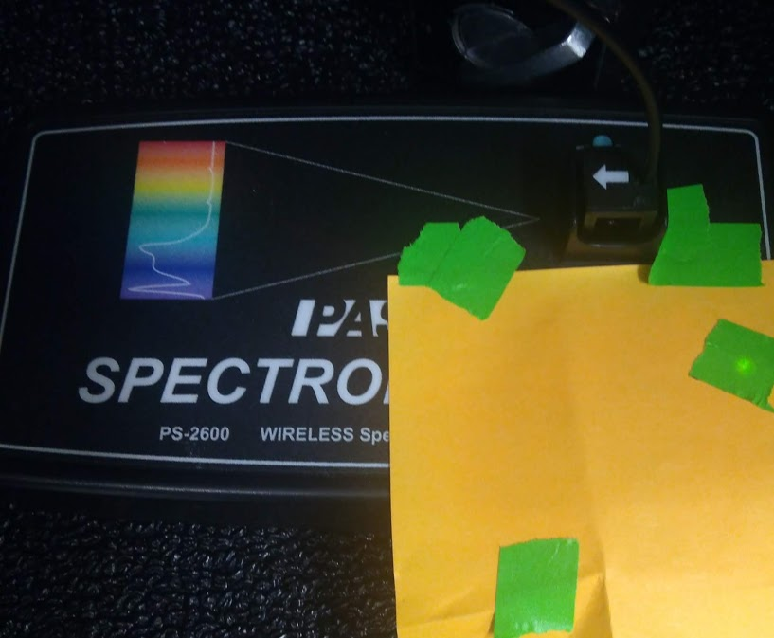
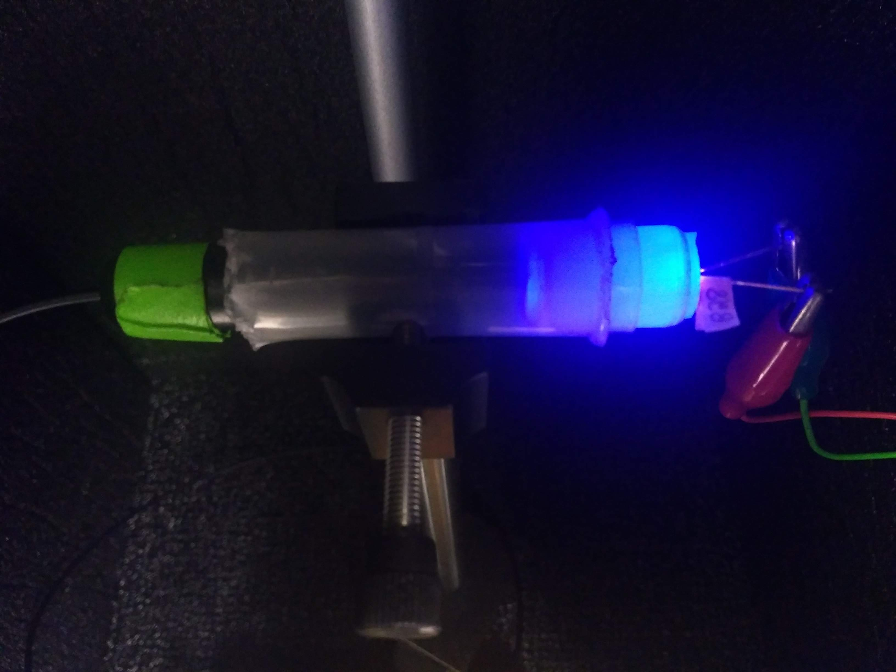
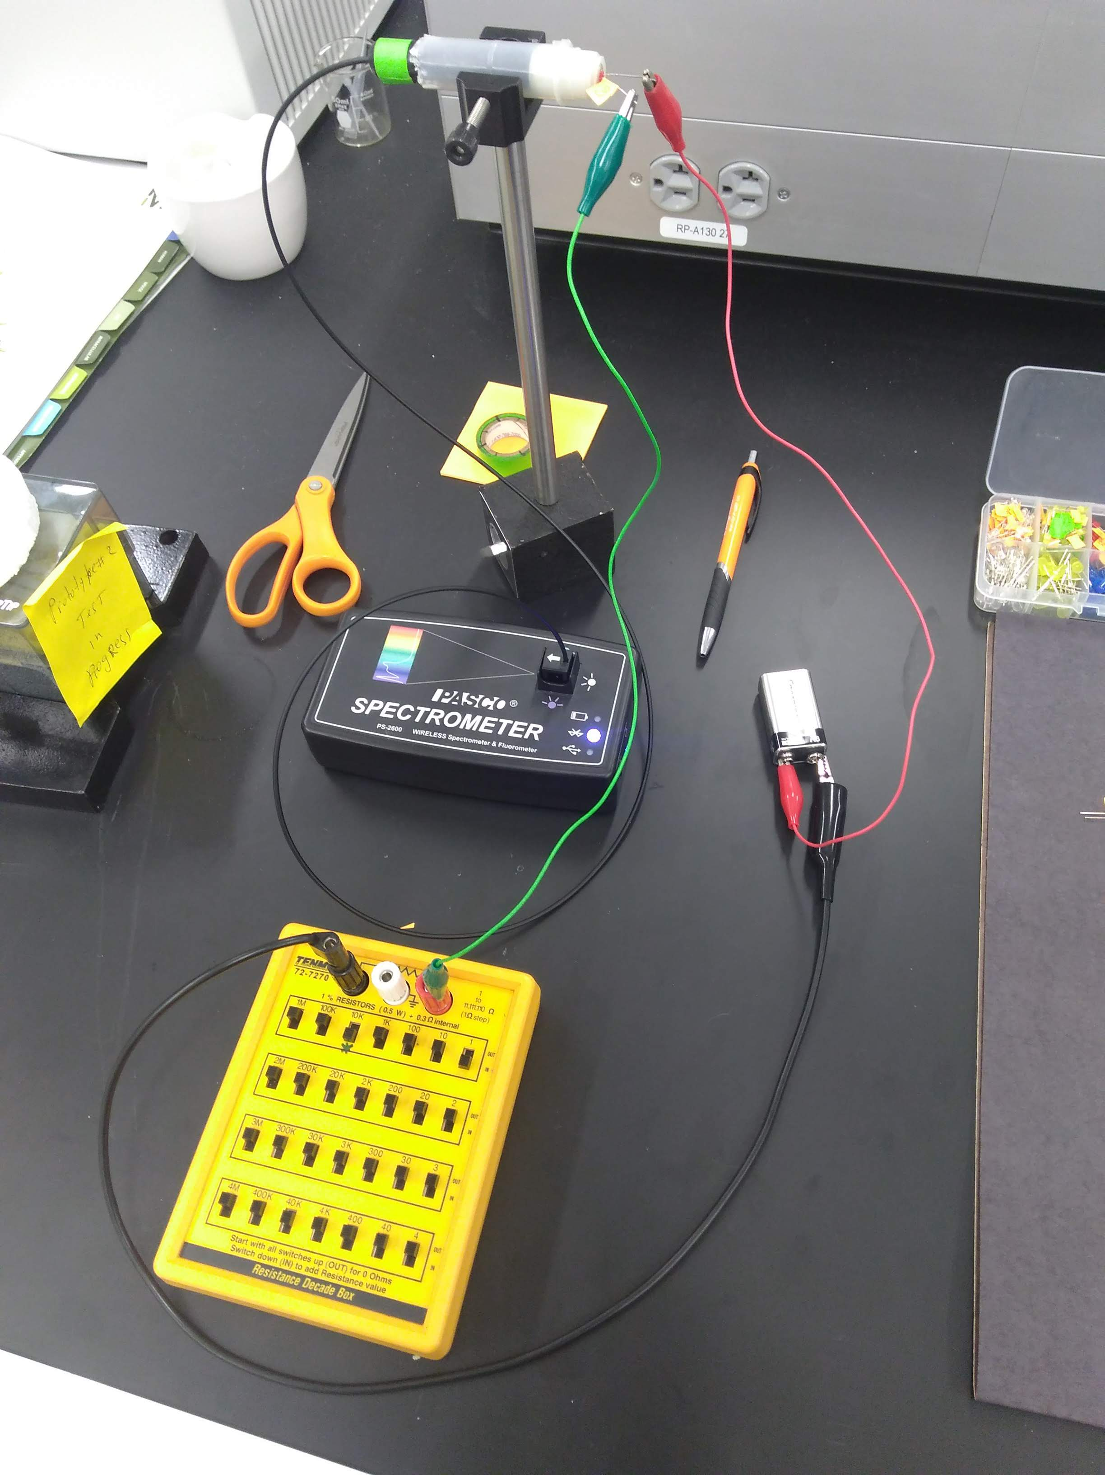
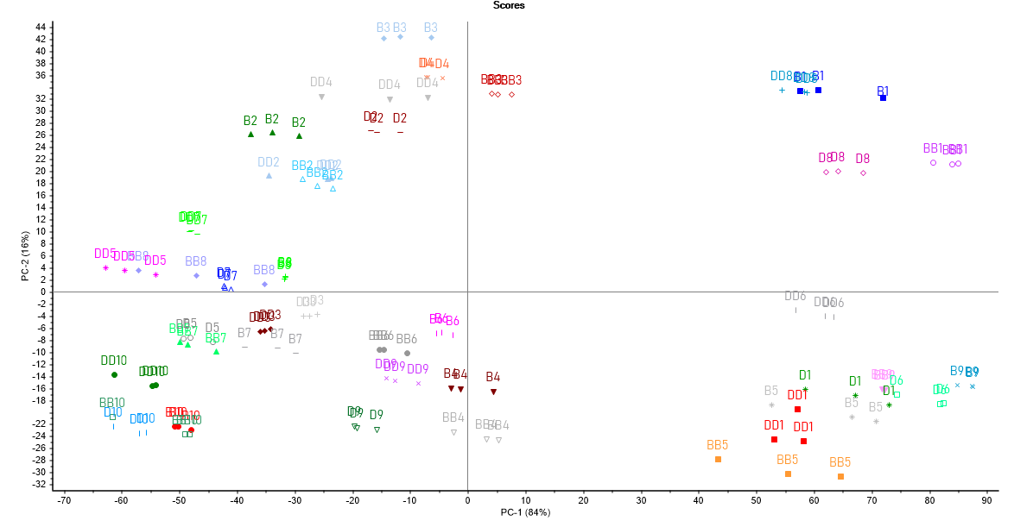
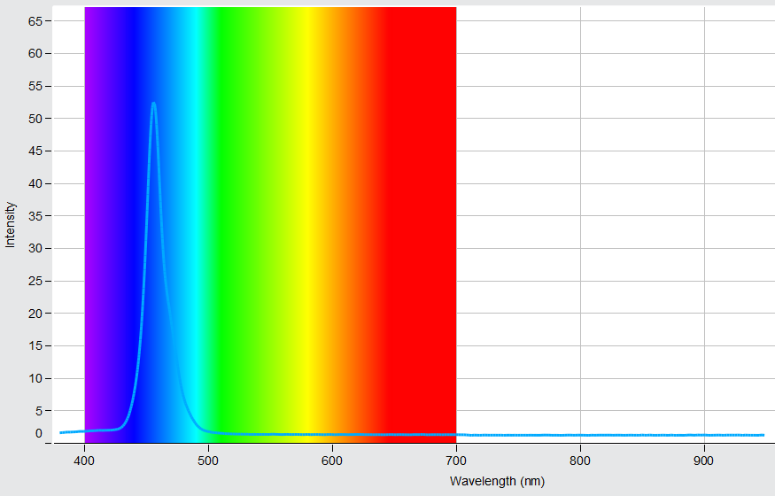
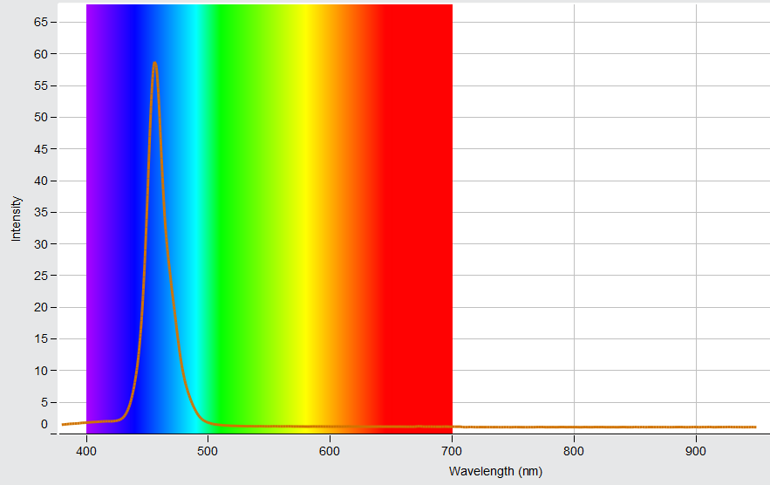
MACHINE LEARNING CLASSIFICATION OF LIGHT-EMITTING DIODES THROUGH SPECTROSCOPY
BRENDAN LEWIS, DR. YURIY MARKUSHIN
Optical Science Center for Applied Research (OSCAR)
Department of Physics and Engineering, Delaware State University, Dover, DE
Motivation
Setup and Data
The Internet of Things (IoT) is a network of devices that work together using the Internet to make your life better. These devices could be anything: smart appliances, smart watches, and healthcare equipment are prime examples. However, many of these devices are insecure, due to having weak passwords, or not receiving critical updates. If one device on a network is hacked, every other device it regularly communicates with is put at risk, potentially compromising private information. This is where Light-Emitting Diodes (LEDs) can help. All LEDs, even of the same color, have slightly differing spectra due to the manufacturing process and small inconsistencies. In our project, we demonstrated the feasibility of a new password method allowing for greater protection of personal information stored on home computers, using the uniqueness of individual LEDs.
Procedures
Fig. 1: The spectrometer used to measure the LEDs.
Fig. 2: An LED in the process of being analyzed.
To begin, we needed to know if LEDs were distinguishable from other LEDs. In preparation, we set up a 9-volt battery with 10,001 ohms of resistance to protect the LED from shorting out, and ran alligator wires from this setup into a lightproof cabinet, so no interference from the lab could affect the results. The status LEDs on the spectrometer, which had to go in the cabinet with the LED, were covered via a combination of a post-it note and tape. We proceeded to analyze 25 LEDs, and used an unsupervised machine learning algorithm known as Principal Component Analysis (PCA) to view the groupings. It soon became clear that a computer could easily tell the difference between different LEDs. Moving on, we chose to perform a blind test on the blue LEDs, which had more pronounced spectra than any other LED color. While gathering data, instead of using the full output from the spectrometer, we chose only the light from the LEDs that was above the 50% strength threshold, to reduce the amount of noise. As evidenced in Fig. 3, there are distinct groupings, that identify the unlabeled LEDs to their label.
Fig. 3: The completed PCA graph of the blue LED blind test.
Fig. 4: The complete setup, except for the cabinet (so all components are visible)
Conclusions
Due to their small size, low price, and long lifespan, LEDs are a practical and secure alternative to regular passwords. However, their potential is far greater than being a simple passkey. Another potential application for this technology is more secure links between medical computers to prevent dosage fraud and cyberattacks, which are significant problems in hospitals and emergency care clinics. Spectrometry has many uses, and it's potential cannot be understated.
References:
Fig. 5: The spectra between LED#10 (old label) and LED#9 (after swap) – it is clear they are not the same LED
Acknowledgments:
Yousuf, Tasneem & Mahmoud, Rwan & Aloul, Fadi & Zualkernan, Imran. (2015). Internet of Things (IoT) Security: Current
    Status, Challenges and Countermeasures. International Journal for Information Security Research. 5. 608-616.
EY. (2015, March). Cybersecurity and the Internet of Things. Retrieved from
    https://www.ey.com/Publication/vwLUAssets/EY-cybersecurity-and-the-internet-of-things/%24FILE/EY-cybersecurity-and-the-internet-of-things.pdf
Eggers, Matthew J. (2017, October). IoT Cybersecurity Policy. Retrieved from
    https://www.nist.gov/sites/default/files/documents/2017/10/23/mattheweggers_slides.pdf
We acknowledge the Optical Science Center for Applied Research (OSCAR),
the financial support of The National Science Foundation (NSF-CREST grant No 1242067,
the Department of Navy (HBCU/MI-MSI STEM Initiative Seed Grant),
the Delaware Bioscience Center for Advanced Technology (CAT grant),
the Delaware Economic Development Office (grant No 25007/6520),
and of the National Aeronautics and Space Administration (NASA URC 5 grant No NNX15AP84A).

