Slide 1
V
Did the new UI
improve client
completion rates?
VANGUARD
A/B TEST ANALYSIS
2017
A data-driven analysis of Vanguard's digital UX experiment
Gabriela Cascione · Hina Haq · Jorge Barrios Hurtado
IronHack · Weeks 5 & 6 · 2026

Slide 2
VANGUARD
Introduction
About Vanguard
The Central Question
Vanguard is one of the world's largest investment management companies, serving over 50 million investors globally.
As part of a digital transformation initiative, the UX team designed a new online process with a refreshed interface and in-context prompts to guide client`s step by step.
The goal: reduce friction and increase the number of clients completing the process.
Did the new UI lead to a statistically significant improvement in client completion rates?
Test period: March 15 – June 20, 2017
Groups: Control (old UI) vs Test (new UI)
Success threshold: ≥5% improvement
2

Slide 3
VANGUARD
Data Overview & Preparation
01
Client Profiles
02
Digital Footprints
03
Experiment Roster
df_final_demo
df_final_web_data (pt_1 + pt_2)
df_final_experiment_clients
Demographics: age, gender, tenure, balance
Step-by-step interactions with timestamps
Client assignment: Control or Test group
Data Cleaning
1 Merge
2 Nulls
3 Types
4 Outliers
5 Features
Combined pt_1 + pt_2, joined with demo and experiment tables
126,662 rows without group assignment identified (demo-only)
date_time → datetime64; process steps mapped to numeric order
Sessions > 30 min filtered out as inactive
Added step_num, time_spent, prev_step_num, is_error
3

Slide 4
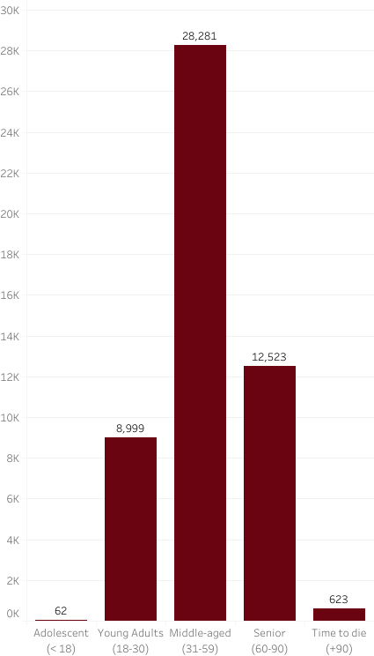
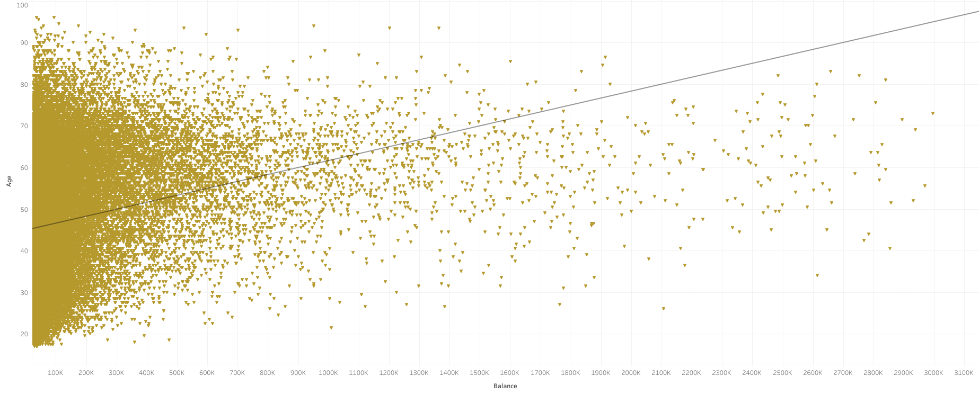
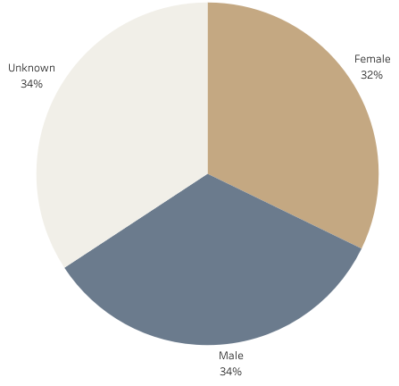
VANGUARD
Who Are Vanguard's Clients?
Gender Distribution
Age Groups
Age vs Balance
Key insight: most clients are middle-aged (31–59), with balance increasing with age. Gender is evenly split across Male, Female and Unknown, which suggests incomplete demographic data.
4

Slide 5
VANGUARD
KPI 1 — Completion Rate
Definition: % of unique visits that reach 'confirm' from 'start' · Success: Test > Control by ≥5%
Control
Test
Difference
51.91%
65.54%
+13.63%
completion rate
completion rate
✅ beats 5% threshold
5

Slide 6
VANGUARD
KPI 2 — Average Time Spent per Step
Definition: Mean duration (seconds) per step per visit · Success: Test < Control (faster = better UX)
Step
Control (sec)
Test (sec)
Faster?
Start
60.91
56.24
✅ Test
Step 1
47.46
58.48
❌ Control
Step 2
90.21
88.13
✅ Test
Step 3
133.30
124.83
✅ Test
Confirm
156.16
221.59
❌ Control
Key insight: test group was significantly faster at Start, Step 2 and Step 3. No significant difference at Step 1. Test users spent considerably more time at Confirm (a negative finding)
6

Slide 7
VANGUARD
KPI 3 — Error Rate
Definition: % of visits where users moved backward from a step · Success: Test < Control (less friction)
Step
Control error %
Test error %
Diff
Result
Start
0.00%
0.00%
0.00%
—
Step 1
9.57%
18.04%
+8.47%
❌ Test worse
Step 2
8.91%
16.17%
+7.26%
❌ Test worse
Step 3
20.94%
19.78%
-1.16%
✅ Test better
Confirm
39.03%
9.61%
-29.42%
✅ Test better
Interesting finding: test group had higher error rates at Steps 1–2, but a dramatically lower rate at Confirm (9.61% vs 39.03%). The new UI did not reduce overall friction
7

Slide 8
VANGUARD
Hypothesis Testing
01
Completion Rate
02
Time Spent per Step
03
Error Rate
H₀
Completion rate (Test) ≤ Completion rate (Control)
H₀
Test group time ≥ Control group time
H₀
Error rate (Test) ≥ Error rate (Control)
H₁
Completion rate (Test) > Completion rate (Control)
H₁
Test group time < Control group time
H₁
Error rate (Test) < Error rate (Control)
✅ Reject H₀
Z = 35.04 · p < 0.000001
Test: 65.54% vs Control: 51.91%
The new design significantly improved process completion
✅ Reject H₀ at Start, Step 2, Step 3
❌ Fail to reject H₀ at Step 1 and Confirm
Start (p=0.0011) · Step 2 (p=0.0101) · Step 3 (p=0.0001): test group significantly faster
Step 1 (p=1.0): no significant difference
Confirm (p=0.9999): test group is actually slower (negative finding)
❌ Fail to Reject H₀
Z = 7.9996 · p = 1.0000
The new UI did not reduce errors: test group showed higher error rate than control
8

Slide 9
VANGUARD
Experiment Evaluation
Design Effectiveness
Well-structured control/test split; unassigned client IDs were dropped to ensure clean group comparison.
Randomisation & Balance
Groups unequal (~3k more in test), assignment method undocumented; bias expected but not seen in visualisations.
Demographic Balance
No meaningful bias detected across age, gender, tenure, balance or account count.
Duration
3-month window (Mar–Jun 2017) was adequate, though seasonal effects cannot be fully ruled out.
Additional Data Needs
Clearer step-flow mapping, app context, and client goals would enable more targeted recommendations.
9

Slide 10
VANGUARD
Tableau Dashboard
Live Dashboard
[ Link ]
10

Slide 11
VANGUARD
Teamwork & Learnings
01
Team Management
02
Challenges & Learnings
Week 1: KPIs and Hypothesis Testing divided individually (one task per person).
Week 2: One big task per team member, with shared ownership of deliverables.
Leadership shifted from Week 1 (assigned lead) to Week 2 (shared knowledge and peer training).
Tools: Trello for task tracking · GitHub for version control · at least 1 commit per project day.
Challenges: Communication: coordinating decisions, naming conventions, code structure and which dataset to use at each stage of the analysis.
Building one beautiful, consistent, streamlined dashboard that works 100%.
Learnings: Regular review is essential to ensure consistency in grouping methodology. Being precise and strict with the questions we ask, and our answers, is key to avoiding misaligned results.
Different datasets do not allow filtering of visualizations built with them.
11

Slide 12
VANGUARD
Strengths, Limitations & Next Steps
01
Strengths
02
Limitations
03
Next Steps
· Large sample size: 317,235 rows, 30k+ unique visits per group
· 126,662 rows had no group assignment and were excluded
· Investigate why users go backwards at the start of the process
· Real user data from a genuine A/B experiment with proper control/test split
· Possible incomplete demographics data
· Re-run analysis with demographic filters to check if specific segments benefit more
· Test period only ~3 months (seasonal effects cannot be ruled out)
· Multiple KPIs analysed across completion, time, errors and funnel drop-off (drop-off was measured but ultimately excluded from the formal analysis)
· Extend or repeat the test across different seasons to confirm results hold
· Assignment method undocumented (minor randomisation risk remains)
· No meaningful demographic bias confirmed through Tableau visualizations
· Step-flow logic unclear: uncertain which steps can lead backwards to which
12

Slide 13
VANGUARD
Conclusion
Final Verdict
The new UI significantly boosted completion rates: up 13.63%, well above the 5% target. Users in the test group dropped off less at the beginning and end of the funnel and progressed further through the process.
Completion rate jumped from 51.91% to 65.54%, meaning the new design works.
Time improvements were significant at Start, Step 2 and Step 3; but test users were actually slower at Confirm.
Error rates were higher in the test group; users navigated backwards more, especially early on.
Recommendation: roll out the new UI, but investigate why users are confused at the start of the process.
13

Slide 14
V
Thank you
VANGUARD
Questions?
Gabriela Cascione
Hina Haq
Jorge Barrios Hurtado
IronHack · Weeks 5 & 6 · 2026

