Slide 1


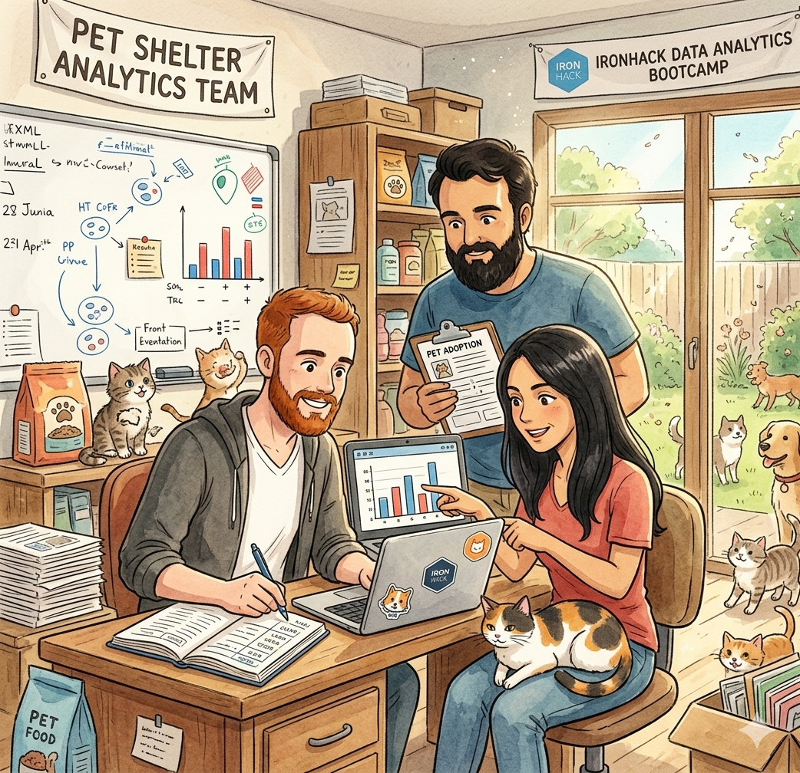
Austin Animal Center
SQL Database Project
Hina Haq · Gabriela Cascione · Husseim Stuck
IronHack Data Analytics Bootcamp · 2026

Slide 2


Project Overview
The Dataset
Business Problem
Austin Animal Center Outcomes
173,775 records from 2013–present
Source: data.austintexas.gov (open data, no login required)
What factors influence animal outcomes at the shelter?
Can we identify patterns to improve adoption rates and reduce time in shelter?
Hypotheses
H1: Dogs and cats have significantly different adoption rates. H2: Younger animals are adopted faster than older animals.

Slide 3
Data Acquisition, Enrichment & Examination
01
Primary Source
02
Challenges
03
Complementary Data
Austin Animal Center Outcomes CSV
Downloaded directly from Austin Open Data Portal
12 columns · 173,775 rows
Mixed date formats and string-encoded ages
Null values in name, outcome_subtype
Breed names inconsistent across animal types
Austin Animal Center Intakes dataset
Allows linking intake date to outcome date
Same animal_id as primary key

Slide 4
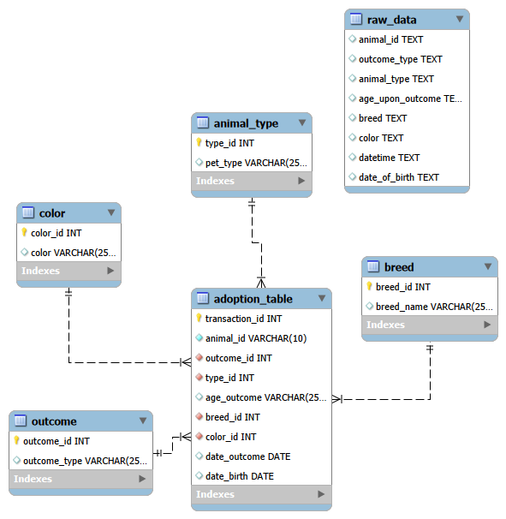
Database Design & Data Transformation
[ Insert ERD Diagram Here ]
Key Challenges
age_upon_outcome stored as string — converted to numeric months
sex_upon_outcome combines status + sex — split into two fields
Breed names vary across animal types — kept at animal level
monthyear column redundant with datetime — dropped
Null names and outcome subtypes — handled with IS NULL checks

Slide 5
Major Obstacle
The Obstacle
What We Learned
The dataset was large, with about 170K data points, which made loading into MySQL slower and more difficult.
Data quality was low, so only about 4K rows could be loaded into SQL successfully.
Pre-cleaning was necessary before import to fix issues like inconsistent formatting, missing values, and invalid records.
The cleaning and preparation were done in Python using Jupyter Notebook before moving the data into SQL.
Main troubleshooting focus was reducing errors during import by improving data quality first, rather than forcing the full raw dataset into the database.
It is important to clean the dataset before importing it
always checl parameters before and after import to see that all cells got transferred

Slide 6
Thank You
Austin Animal Center · SQL Database Project
Hina Haq · Gabriela Cascione · Husseim Stuck
IronHack Data Analytics Bootcamp · 2026
github.com/craftedbygaby/sql-database

Slide 7
SQL Insights & Advanced Analysis
Insight 1
SELECT animal_type, outcome_type,
COUNT(*) AS total,
RANK() OVER (PARTITION BY animal_type
ORDER BY COUNT(*) DESC) AS rnk
FROM adoption_table
JOIN animal_type USING (type_id)
JOIN outcome USING (outcome_id)
GROUP BY animal_type, outcome_type;
Outcome rates by animal type
Replace with your key finding from this query.
Insight 2
SELECT DATE_FORMAT(date_outcome, '%Y-%m') AS month,
COUNT(*) AS adoptions,
SUM(COUNT(*)) OVER (
ORDER BY DATE_FORMAT(date_outcome,'%Y-%m')
) AS running_total
FROM adoption_table
JOIN outcome USING (outcome_id)
WHERE outcome_type = 'Adoption'
GROUP BY month;
Monthly adoption trends (window function)
Replace with your key finding from this query.

Slide 8
Visualisation & Key Insights · 1 of 2
[ Chart 1: e.g. Outcomes by Animal Type ]
Key Insight
Replace this with your main takeaway from the visualisation.
Caption: Describe the insight this chart shows.

Slide 9
Visualisation & Key Insights · 2 of 2
[ Chart 2 placeholder ]
[ Chart 3 placeholder ]
Caption: describe insight here.
Caption: describe insight here.
Overall pattern: Replace with a sentence connecting the two charts above to your hypotheses.

Slide 10
Conclusions & Business Implications
H1 — Black cats are less adopted ? 🐈‍⬛
H2 — Age & adoption speed
Business implications
Did your data support or refute this hypothesis? Describe the outcome in 2–3 sentences.
Did your data support or refute this hypothesis? Describe the outcome in 2–3 sentences.
What should the shelter actually do with these findings? 2–3 concrete recommendations.

