Slide 1
StayInsight
ACCOMMODATION INTELLIGENCE
Paris — Airbnb Analysis 2025
Desmond Ugboaja · Gabriela Cascione · Johannes Vidal
IronHack Data Analytics Bootcamp

Slide 2
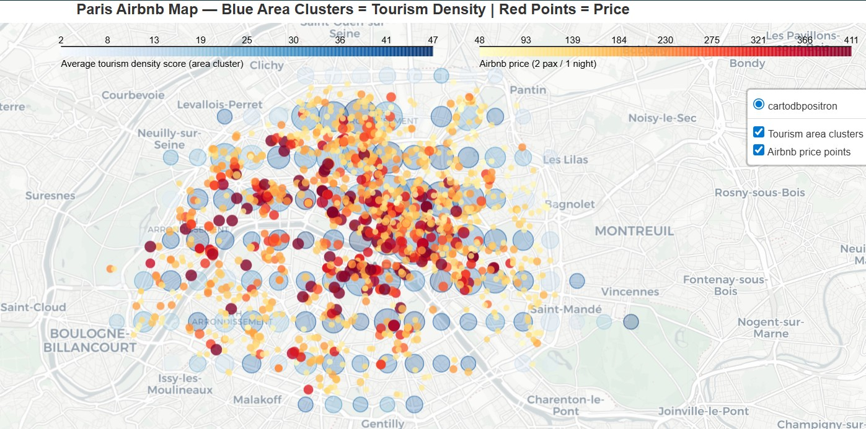
Project Overview
Why this topic?
INSERT CHART OR IMAGE HERE
StayInsight is a travel intelligence startup helping accommodation services make smarter strategic decisions in European cities
Paris chosen as first city — rich data availability across hospitality, especially Airbnb
Goal: understand what drives pricing, satisfaction and location patterns
Datasets
Airbnb Paris weekdays & weekends (Kaggle)
Hotel data via Google Hotel Scraper API (RapidAPI)
POI enrichment via Geoapify Places API
Tourism & Hospitality macro dataset (Kaggle)
StayInsight | Paris Accommodation Analysis 2025
Project Overview

Slide 3
Research Questions & Hypotheses
RQ1 — Weekday vs Weekend
H: Airbnb listings will have lower cleanliness ratings and guest satisfaction scores on weekends due to higher turnover and less time for cleaning between stays.
RQ2 — Superhost Impact
H: Superhost listings will show higher guest satisfaction scores and cleanliness ratings than non-superhost listings, and will command higher prices per night.
RQ3 — Location & Pricing
H: Listings in areas with higher tourism intensity — rich in heritage and major attractions — tend to command higher prices, but do not necessarily achieve higher guest satisfaction.
StayInsight | Paris Accommodation Analysis 2025
Hypotheses

Slide 4
Data Wrangling & Cleaning
Missing data & duplicates
Formatting & standardisation
Nulls handled per column with justified strategy. Duplicates checked after each merge and drop.
All string columns stripped and title-cased. Address lines cleaned of list formatting. City names standardised.
API — Google Hotels
API — Geoapify POI
Rome rows dropped. Hotels beyond 50km from Paris centre removed using Geopy distance calculation on lat/lon.
Extracted POIs within 500m radius. Derived n_geoapify_heritage and geoapify_tourism_density_score.
StayInsight | Paris Accommodation Analysis 2025
Data Wrangling

Slide 5
Exploratory Data Analysis
Univariate analysis — distributions of cleanliness, satisfaction, pricing
Bivariate analysis — weekday vs weekend, superhost vs non-superhost
Geographic analysis — latitude/longitude mapping of listings across Paris
Correlation analysis — tourism density score (POI) vs pricing and satisfaction
INSERT CHART HERE
StayInsight | Paris Accommodation Analysis 2025
EDA

Slide 6
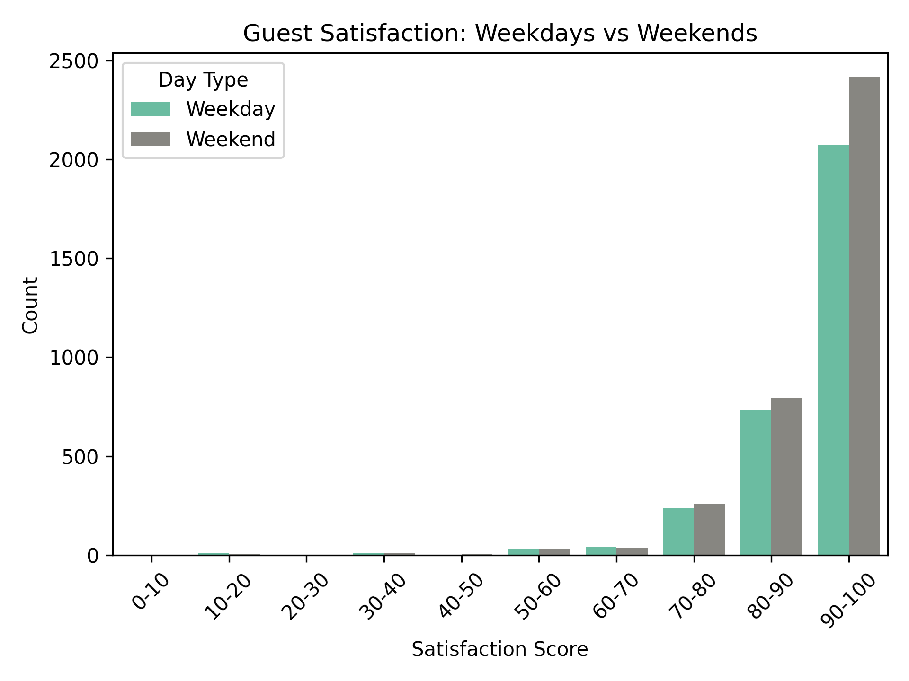
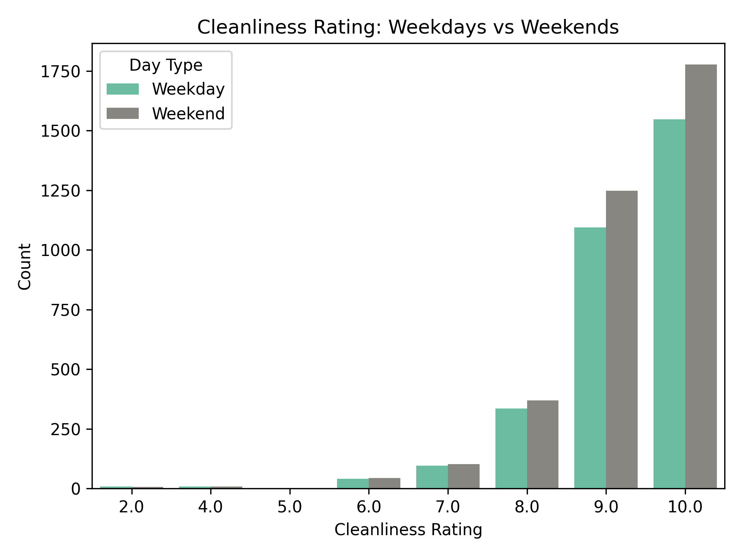
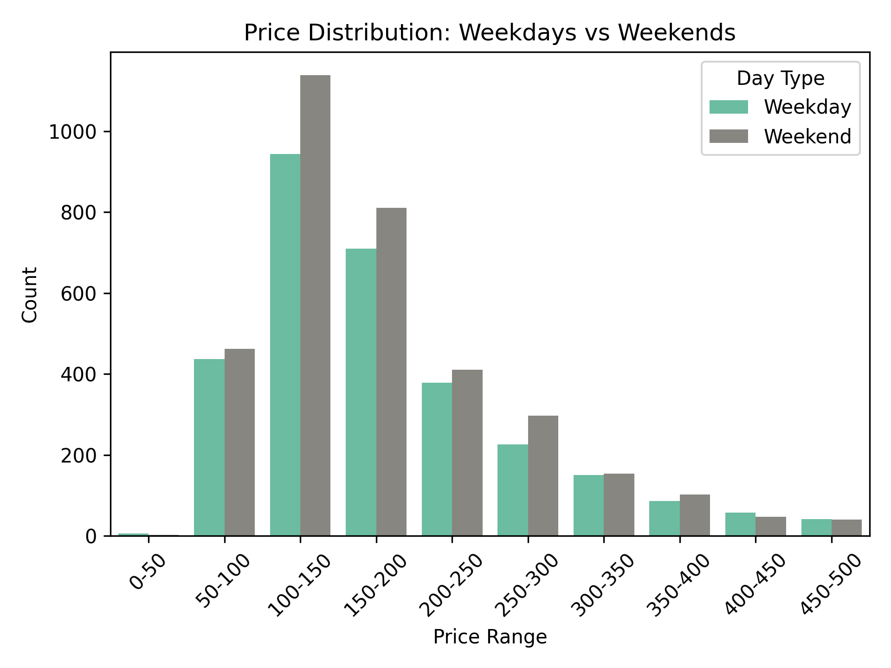
Conclusions & Insights
RQ1 — Weekday vs Weekend
H: Lower cleanliness & satisfaction on weekends due to higher turnover
Conclusion: Weekends actually have slightly better satisfaction, cleanliness, and higher prices
 | Average
Weekday | 91,85
Weekend | 92,20
 | Average
Weekday | 9,25
Weekend | 9,27
 | Average
Weekday | 193,51
Weekend | 199,39
StayInsight | Paris Accommodation Analysis 2025
Conclusions

Slide 7
Conclusions & Insights
RQ2 — Superhost Impact
H: Superhosts show higher satisfaction, cleanliness and prices
Conclusion: PLACEHOLDER — supported / refuted?
StayInsight | Paris Accommodation Analysis 2025
Conclusions

Slide 8
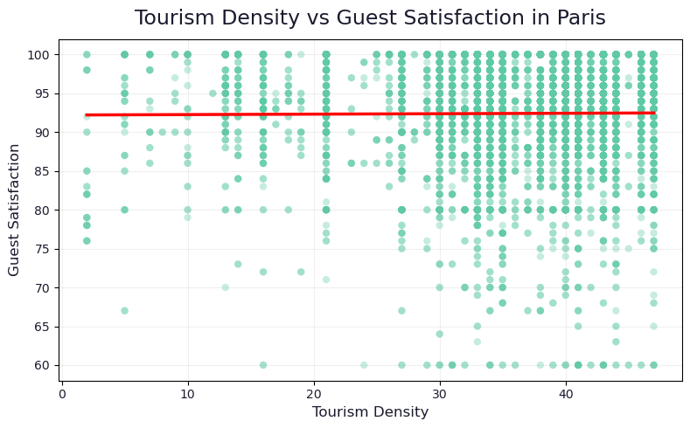
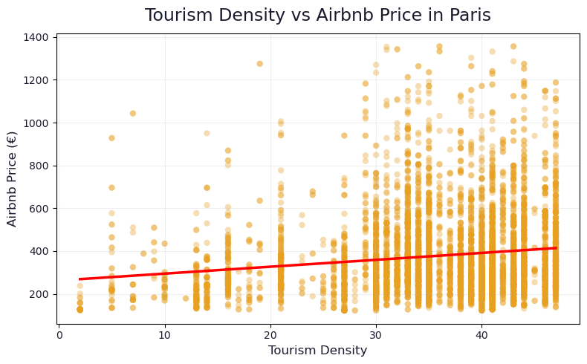
Conclusions & Insights
RQ3 — Location & Pricing
H: Higher tourism intensity = higher prices, higher satisfaction
Conclusion: Location influences prices, but not guest satisfaction
StayInsight | Paris Accommodation Analysis 2025
Conclusions
Notes:
Tourism density shows a moderate positive relationship with price.
Its relationship with satisfaction is weak and nearly negligible.
Location influences pricing, but not guest experience.

Slide 9
Digging deeper: What actually drives guest satisfaction?
Key findings
Correlation with guest satisfaction
Cleanliness is the strongest driver of satisfaction
Facility quality and comfort also play a key role
Tourism-related factors have minimal impact
Cleanliness rating
0.63
Bedrooms
0.18
Dist. Notre-Dame
0.16
Conclusion
Tourism density
0.04
Guest experience depends on internal quality, not location
What drives price ≠ what drives satisfaction
Top POIs (1km)
0.13
0.0
0.2
0.4
0.6
StayInsight | Paris Accommodation Analysis 2025
Follow-up insight

Slide 10
Major Obstacle
The obstacle
What we learned
Finding a suitable dataset was our biggest challenge. Available data didn't align with our initial research questions.
Defining questions and searching for datasets is an iterative process: if no dataset fits, pivot and keep looking until scope and data align.
How it influenced us
What we'd do differently
Gave us practical knowledge on how to handle data gaps in future projects. In the workplace, we'll proactively ask for more data and seek support from others: just as we did with Miguel.
PLACEHOLDER — hindsight improvements
StayInsight | Paris Accommodation Analysis 2025

Slide 11
Teamwork & Project Management
Workflow
What worked well
Used Trello Kanban board to track tasks. Each member owned specific cards with checklists.
Kanban board for task tracking
Regular check-ins every 1h–1h30
Strong team support and collaboration
Clear division of work per question/hypothesis
What to improve
Risk management
Team communication outside of check-ins to ensure everyone stays on the same page
Difficulty finding a suitable dataset
Had to pivot from the original plan
Found an API and alternative dataset, adapted questions to the new scope
StayInsight | Paris Accommodation Analysis 2025
Teamwork

Slide 12
StayInsight
ACCOMMODATION INTELLIGENCE
Thank You!
Paris — Airbnb Analysis 2025
Desmond Ugboaja · Gabriela Cascione · Johannes Vidal
IronHack Data Analytics Bootcamp

