Slide 1

Jan -2024
Project Work Review - 2
Centre for Distance and Online Education
IV Semester
MCA

Slide 2
Project Title : Online Ayurveda Medicine Order App
Name of the Learner : Ramakumar Kasireddy
Register number : 91241160033
Name of the Course : Project Work
Course Code : 223MCA4201
Regulation : 2022
Faculty Advisor : Mr. M. GOVINDARAJ

Slide 3
ABSTRACT
The Online Ayurveda Medicine Order App is a web-based application designed to simplify the procurement and management of Ayurvedic medicines through a digital platform. The system aims to make traditional healthcare more accessible by enabling users to search, select, and purchase medicines online. The application also includes a secure login module to ensure authenticated access. The application is built using a modern full-stack architecture. An Admin interface is incorporated to manage medicine inventory, categories, customers, and orders.
Administrators can update medicine details, monitor stock levels, and oversee customer orders. The cart and order modules streamline the purchasing and checkout process. In Ayurvedic medicine Modules Included, Login Module , Medicine & Category Modules , Customer Module , Cart & Order Modules.

Slide 4
Introduction
Background of the Project
Ayurveda is a traditional system of medicine widely used in India, but access to medicines
is still largely dependent on offline stores.
Need for Digital Transformation
With the growth of e-commerce and digital healthcare, there is a need to bring
Ayurvedic medicine procurement to an online platform.
Project Overview
This project focuses on developing a web-based application for ordering and
managing Ayurvedic medicines efficiently.

Slide 5
Introduction
Scope of the Project
The system supports customers for browsing and purchasing medicines and administrators
for managing inventory, categories, and orders.
Purpose of the Project
The main purpose is to simplify the medicine ordering process, improve accessibility,
and ensure better management of Ayurvedic products.
6. Expected Impact
The application aims to enhance user convenience, reduce manual effort, and provide
a reliable digital solution for traditional healthcare.

Slide 6
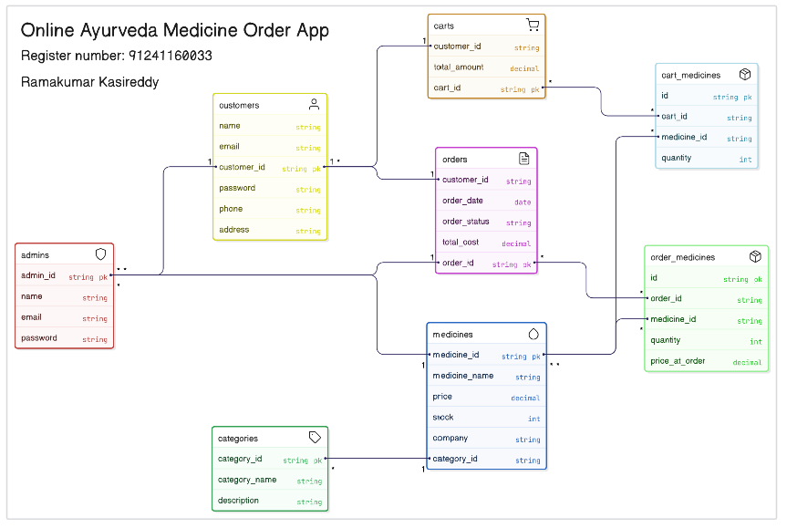
ER (Entity Relationship) Diagram

Slide 7
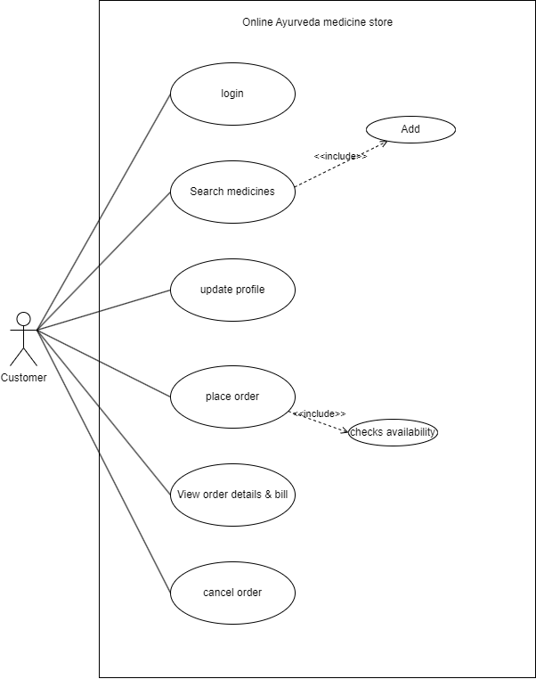
Use-Case Diagram

Slide 8
Hardware and Software Requirements
HARDWARE REQUIREMENTS
    PROCESSOR : Above i3 @2.3 GHz
    RAM : 16 GB min
    LAN : On Board 10/100 Mbps SIS LAN
    HARD DISK : 100 GB min
    DISPLAY : 1024 x 768 VGA
    KEYBOARD : At extended 104 Keyboard
SOFTWARE REQUIREMENTS
    OPERATING SYSTEM : WINDOWS 10/11
    FRONT END : JavaScript, ReactJS
    BACK END : NodeJS , MySQL, MongoDB

Slide 9
Module Name
This is system include five modules,
      Login Module
      Medicine & Category Module
      Customer Module
      Cart & Order Module
      Admin Module

Slide 10
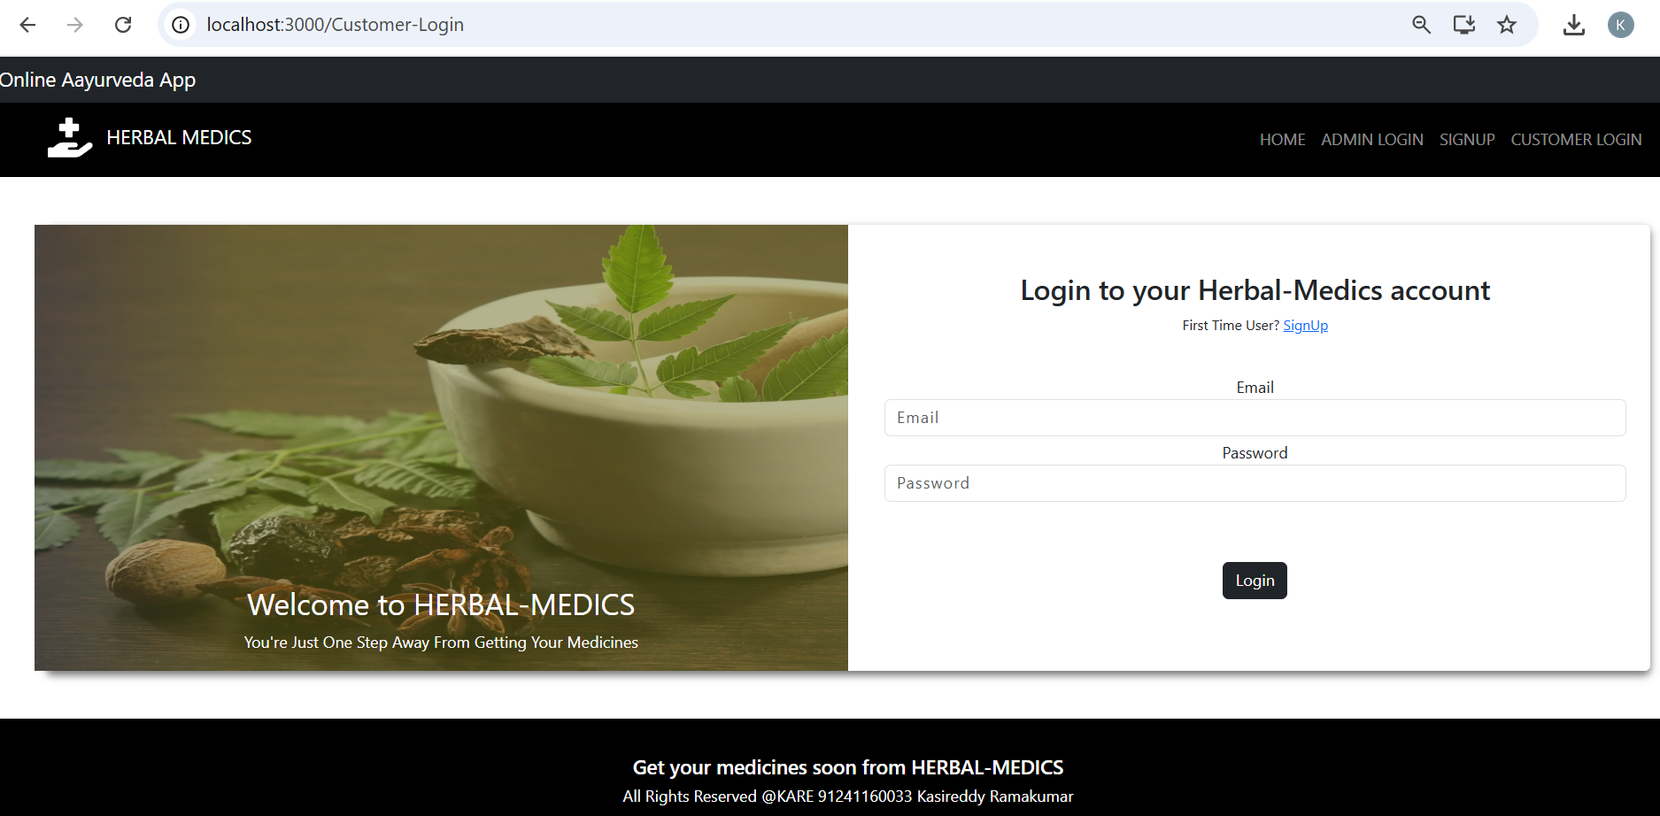
Login Module
Login Module
The Login Module provides secure authentication for both users and administrators by validating login credentials such as username and password. It ensures role-based access control by differentiating between admin and customer privileges. This module prevents unauthorized access and maintains the overall security of the system.

Slide 11
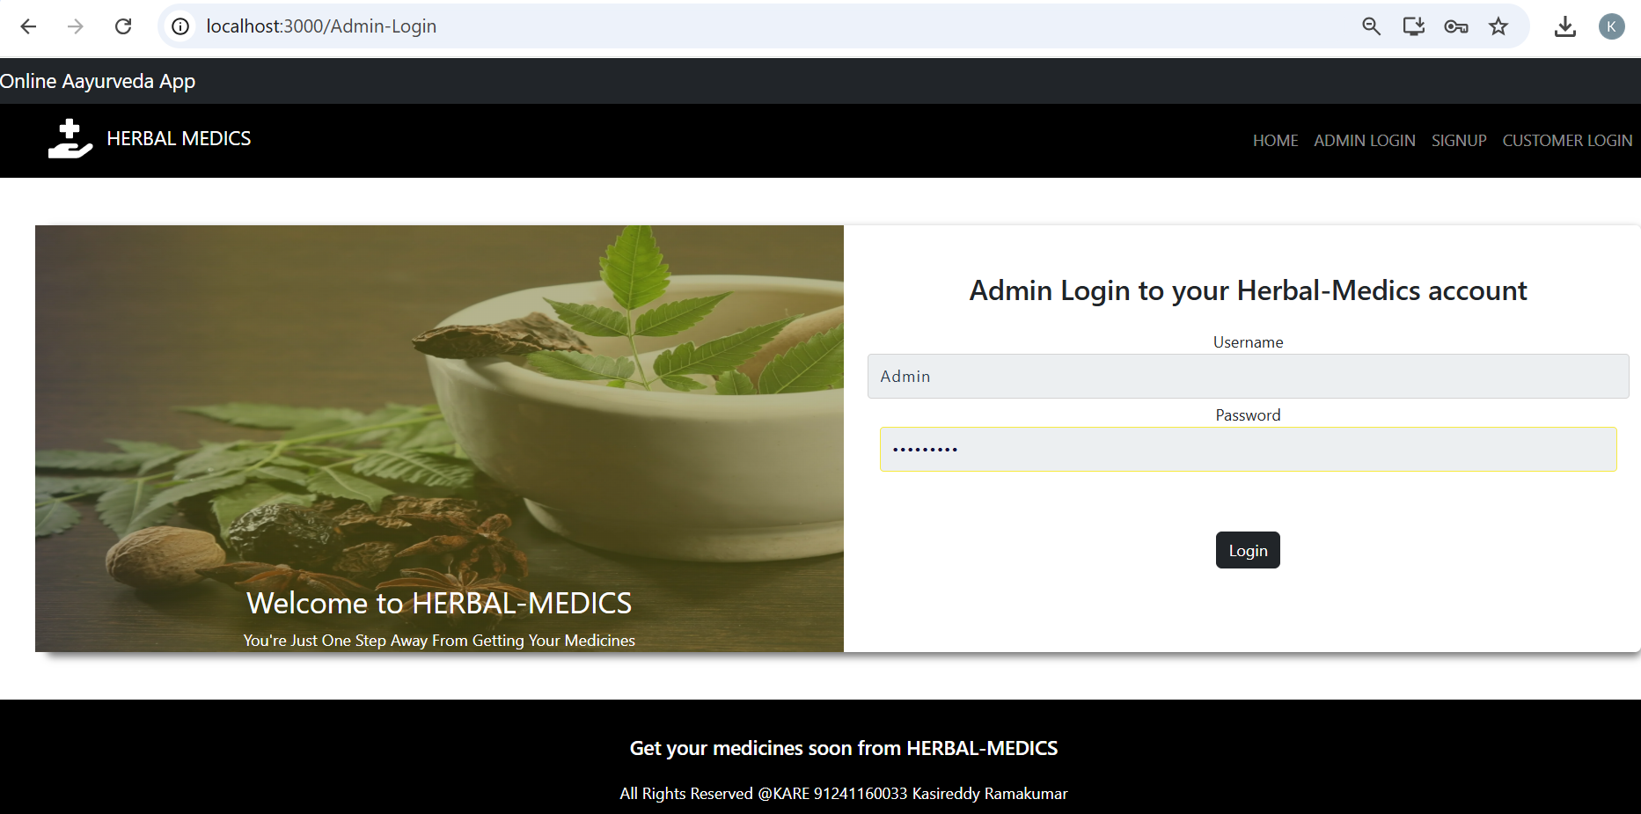
Admin Modules
Admin Module
The Admin Module provides centralized control over the entire system, allowing efficient management of medicines, categories, customers, and orders. It continuously monitors inventory and stock levels to avoid shortages and overstocking. The module also generates reports and ensures smooth and reliable system operation.
.

Slide 12
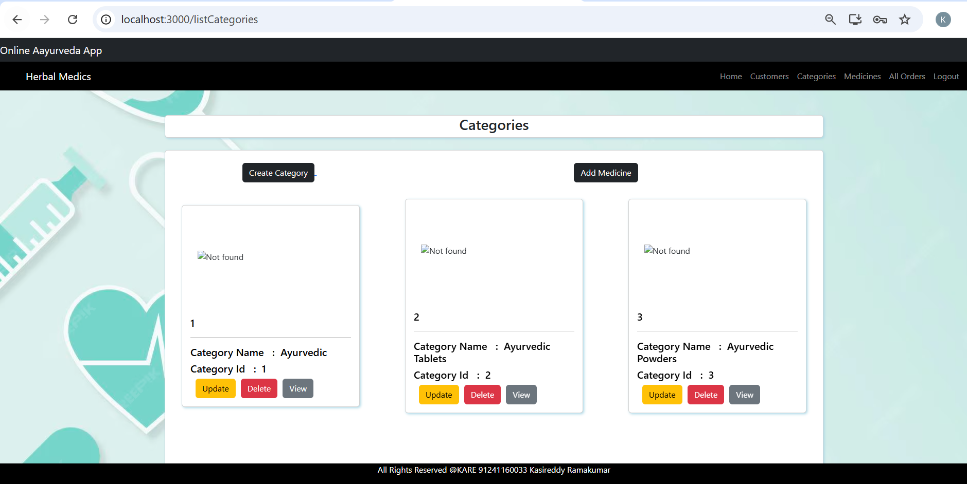
Categories
Herbal Medicines:
This Category includes Ayurvedic tablets, powders, syrups, and capsules prepared from natural herbs. These medicines are formulated using traditional practices to treat common and chronic ailments. They focus on natural healing with minimal
side effects
.

Slide 13
Module Name…
How it works
  Login Module
  Verifies user credentials and grants secure access to the system.
  Medicine & Category Module
  Displays medicines organized by categories for easy search and selection.
  Customer Module
  Manages customer registration, profile details, and order history.
  Cart & Order Module
  Adds selected medicines to cart and processes order placement.
  Admin Module
  Controls medicines, categories, users, inventory, and orders from a central dashboard.

Slide 14
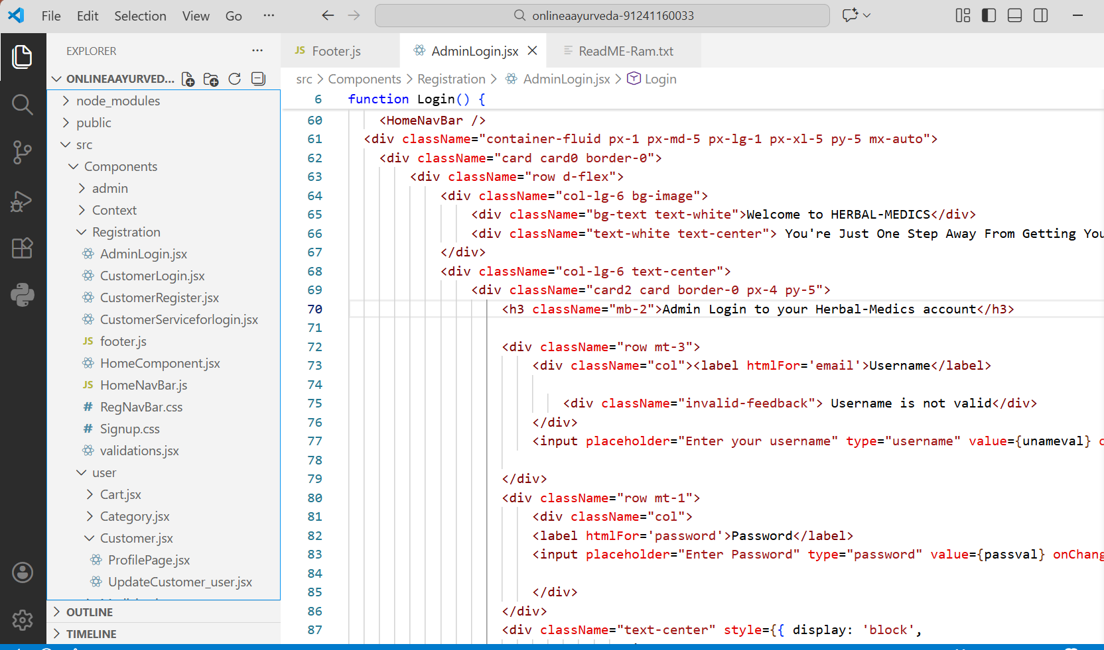
Sample code : UI : ReactJS : AdminLogin

Slide 15
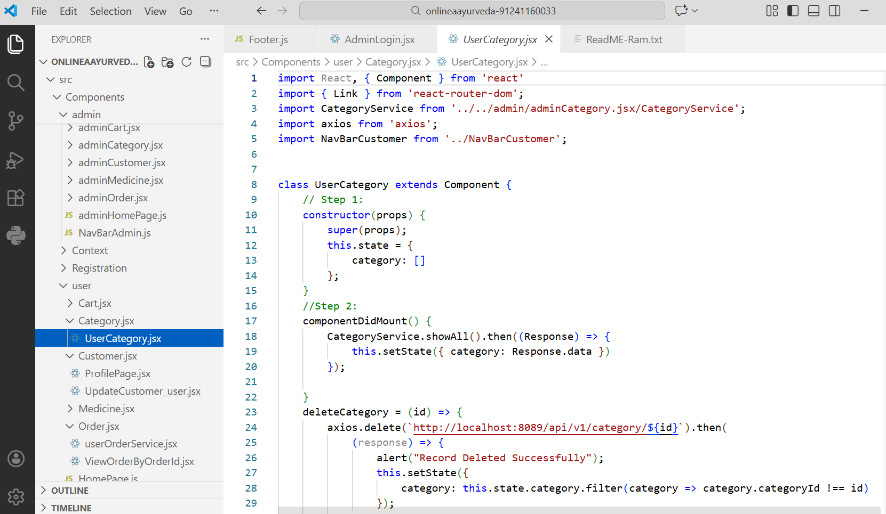
Sample code : UI : ReactJS : Categories

Slide 16
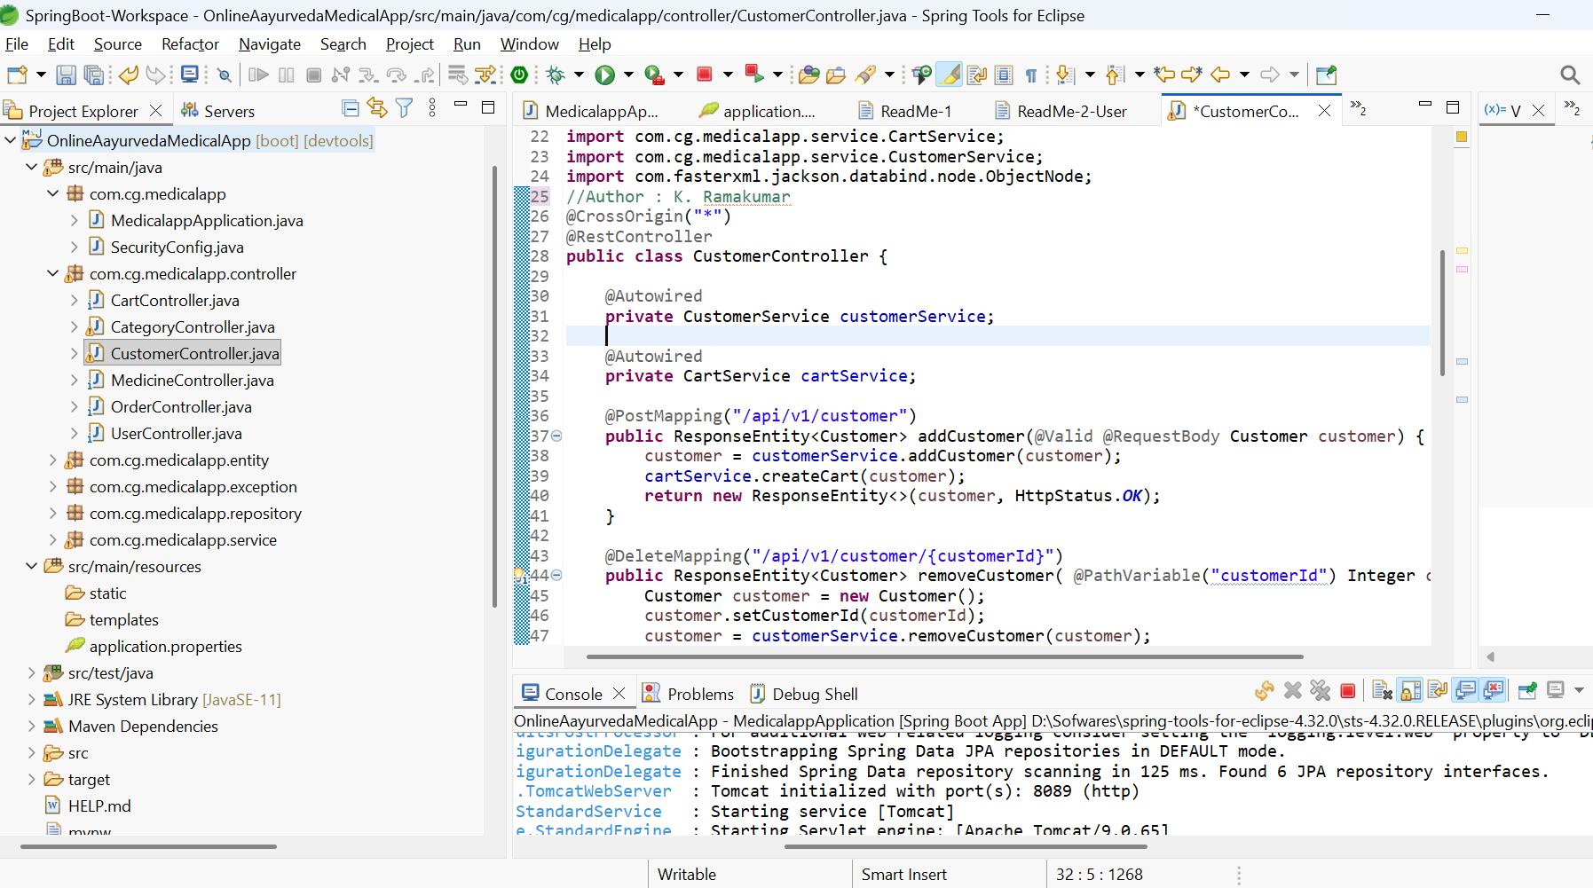
Sample code : Backend : Spring Boot : CustomerController

Slide 17
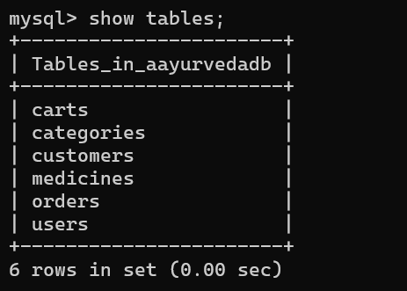
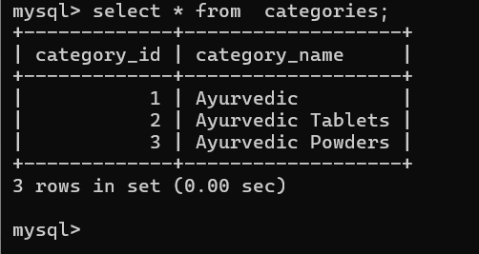
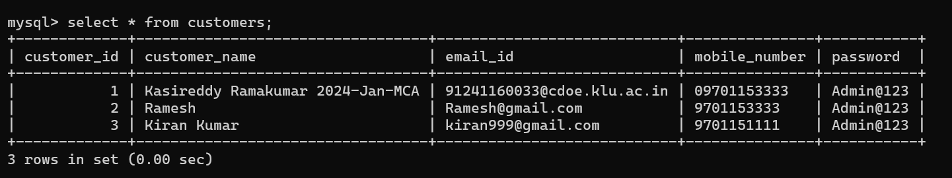
Sample data set : MySQL

Slide 18
Testing Methods : Backend Testing Spring Boot
Backend Testing (Spring Boot)
JUnit → Used for unit testing service and controller methods.
Mockito → Used to mock repositories and dependent services.
Spring Boot Test → Tests integration between controller, service, and repository layers.
API Testing → Validates REST APIs using request and response verification.
Exception Handling Testing → Ensures proper error messages and status codes.
Advantage:
Ensures backend logic is reliable, secure, and error-free.

Slide 19
Testing Methods : Frontend Testing- ReactJS
Frontend Testing (ReactJS)
Karma → Test runner used to execute frontend test cases.
Jasmine → Framework used for writing unit test cases.
Component Testing → Tests React components independently.
UI Behaviour Testing → Validates button clicks, form inputs, and validations.
Integration Testing → Ensures frontend works correctly with backend APIs.
Advantage:
Improves UI reliability and ensures a smooth user experience.

Slide 20
Testing Methods
Black Box Testing (Functional Testing)
  Focuses on the functionality of the software.
  Testers do not need knowledge of internal code.
  Based on inputs and outputs.
  Examples:
    Functional Testing
    Boundary Value Analysis
    Equivalence Partitioning
    Regression Testing
    System Testing
    Advantages:
      Tester does not need programming knowledge.
      Useful for validating business requirements.

Slide 21
Testing Methods
Other Testing Methods
Manual Testing → Human testers execute test cases without automation.
Automation Testing → Tools/scripts (e.g., Selenium, JUnit) execute test cases.
Static Testing → Reviews, walkthroughs, inspections without running the code.
Dynamic Testing → Executing the code and validating output.

Slide 22
Conclusion
The Online Ayurveda Medicine Order App provides an efficient and user-friendly digital platform for purchasing and managing Ayurvedic medicines. The system improves accessibility for customers, simplifies the ordering process, and enables administrators to manage inventory and orders effectively. By reducing manual work and errors, the application enhances overall operational efficiency.
In the future, the system can be extended with features such as online payment integration, mobile application support, prescription uploads, and advanced analytics to further improve functionality and user experience.

Slide 23
Future Enhancements
  Integration of online payment gateways for secure digital transactions.
  Development of a mobile application (Android/iOS) for better accessibility.
  AI-based medicine recommendations based on user history and symptoms.
  Integration with cloud services for scalability and high availability.

Slide 24
Reference Books and Websites
Craig Walls (2021), Spring Boot in Action, 2nd Edition, Manning Publications, USA.
Josh Long (2020), Cloud Native Java: Designing Resilient Systems with Spring Boot, O’Reilly Media.
Cory House & Azat Mardan (2022), React and Modern JavaScript, Packt Publishing.
Jasmine Team (2021), Jasmine JavaScript Testing Framework Documentation, Open Source Community.
John Ferguson Smart (2020), JUnit in Action, 2nd Edition, Manning Publications.
Giuseppe Di Natale and Filippo Ricca (2019), Mockito Essentials, Packt Publishing.
R. S. Sharma (2018), Introduction to Ayurveda and Traditional Medicine,
Indian Council of Medical Research, New Delhi.
MySQL Documentation Team (2023), MySQL 8.0 Reference Manual, Oracle Corporation.

Slide 25
I sincerely thank my project guide :
Mr. M. GOVINDARAJ Sir
Thank You

